Slide 1
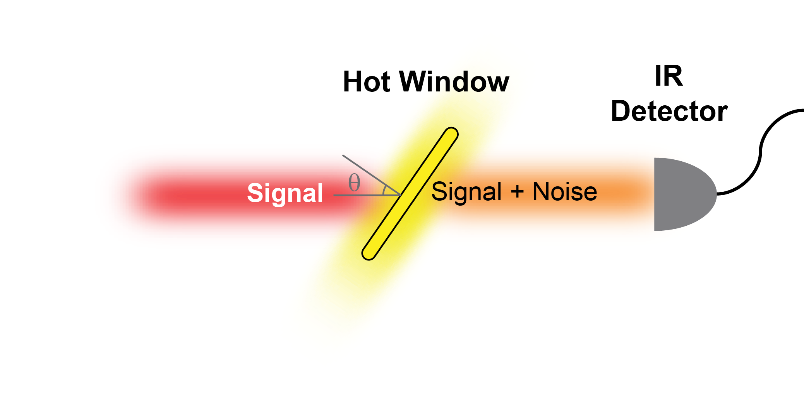
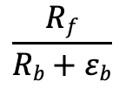
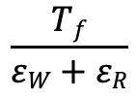
How can a spatial Kramers–Kronig coating help?
1. Coating behind window (e.g. ellipsometry)
window
coating
I₀
T
$$\frac{Rf}{Rb+εb}$$
FOM:
R_{f} (signal)
R_{b} (noise)
ε_{b} (noise)
2. Coating in front of window (e.g. TE detection)
coating
window
I₀
T₀
T_{f}
FOM:
$$\frac{Tf}{εW+εR}$$
ε_{L}
ε_{R} (noise)
ε_{W} (noise)

Slide 2
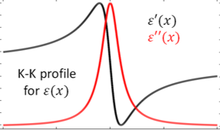
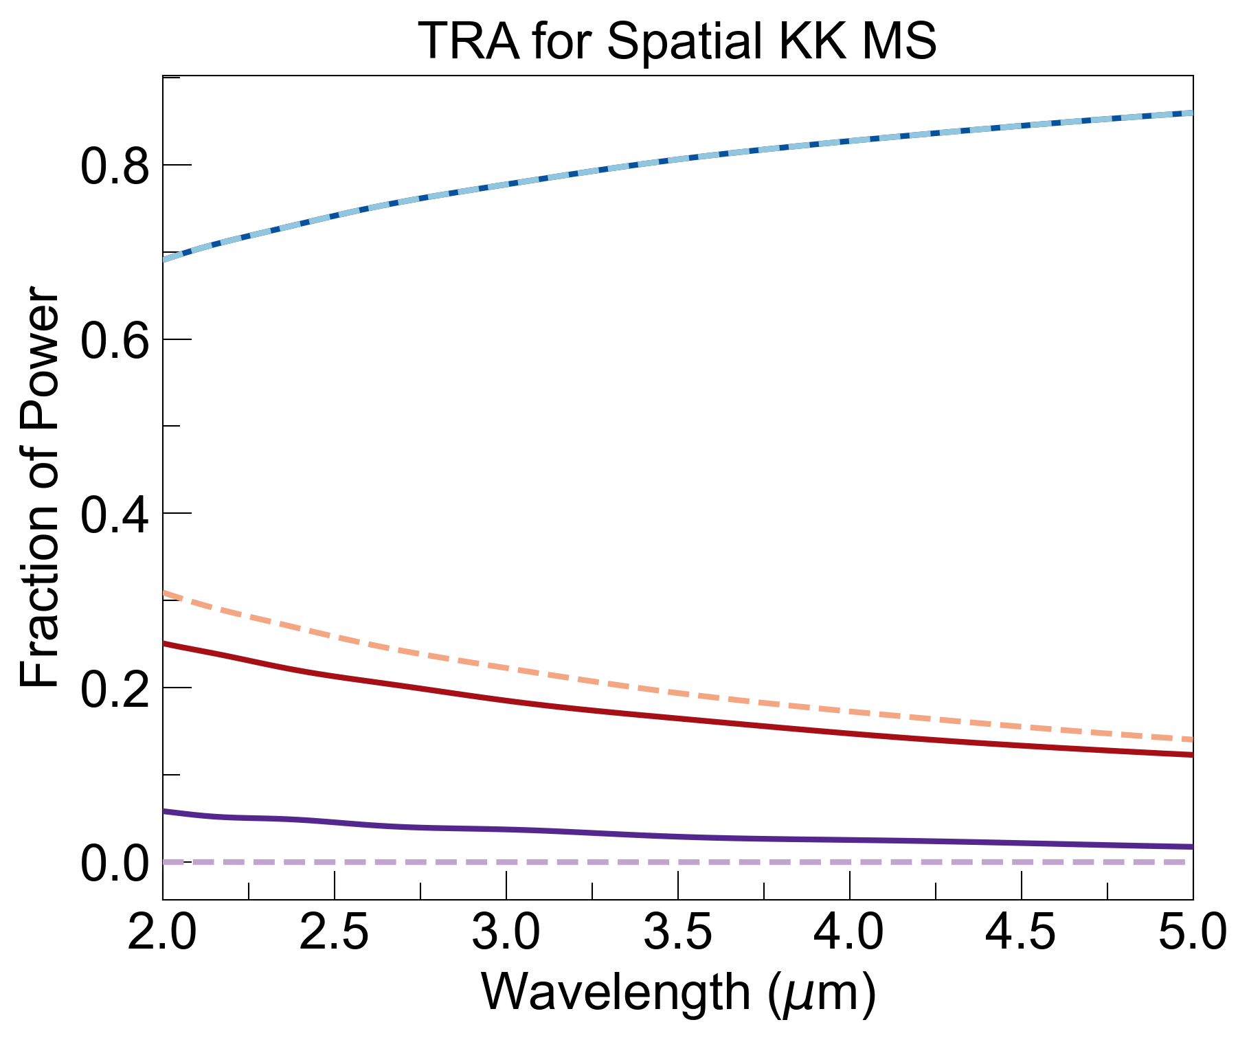
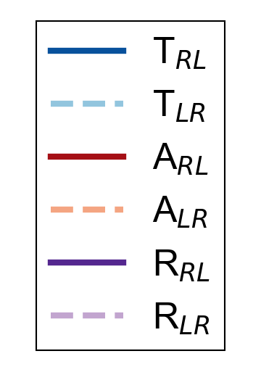
Plan and Intuition
Use different portions of KK profile for coating
Compare FOM of sKK coating and AR coating
Intuition: sKK coating will not help (trading reflection for emission, not transmission)

Slide 3
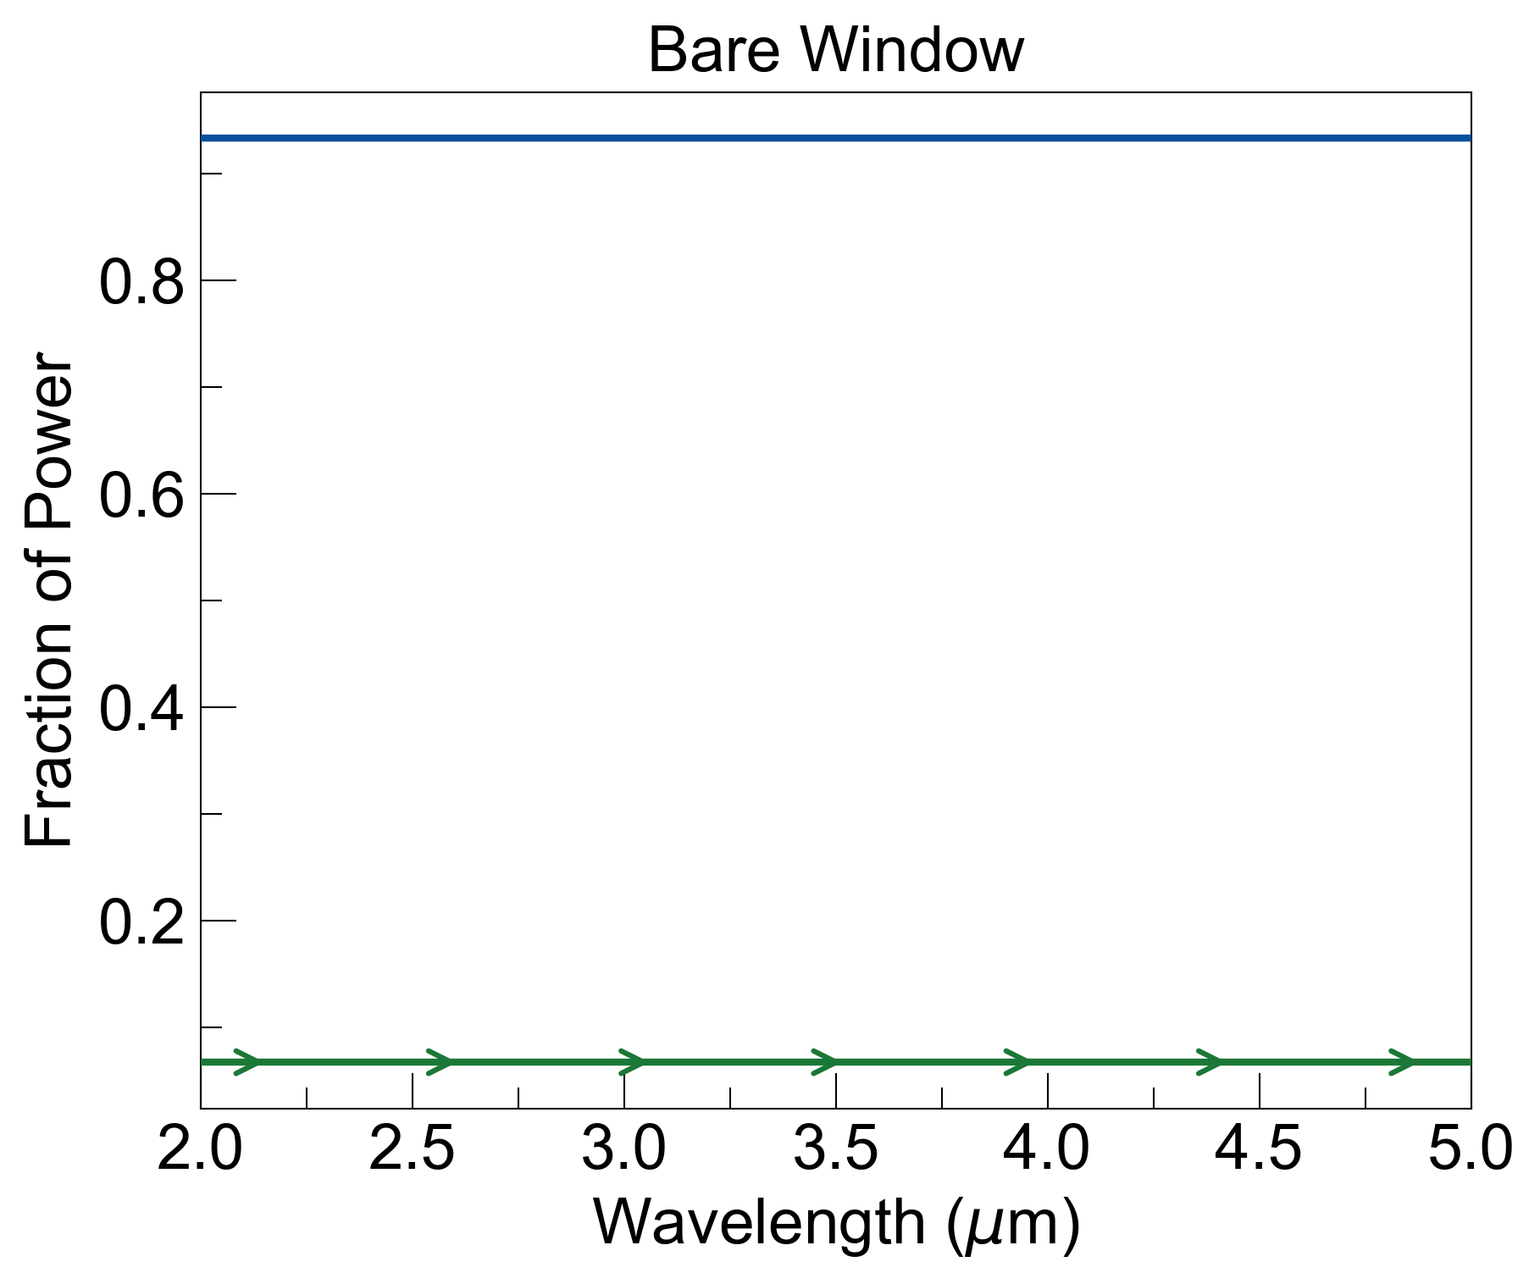
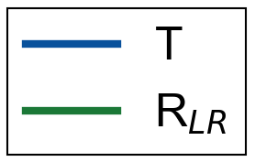
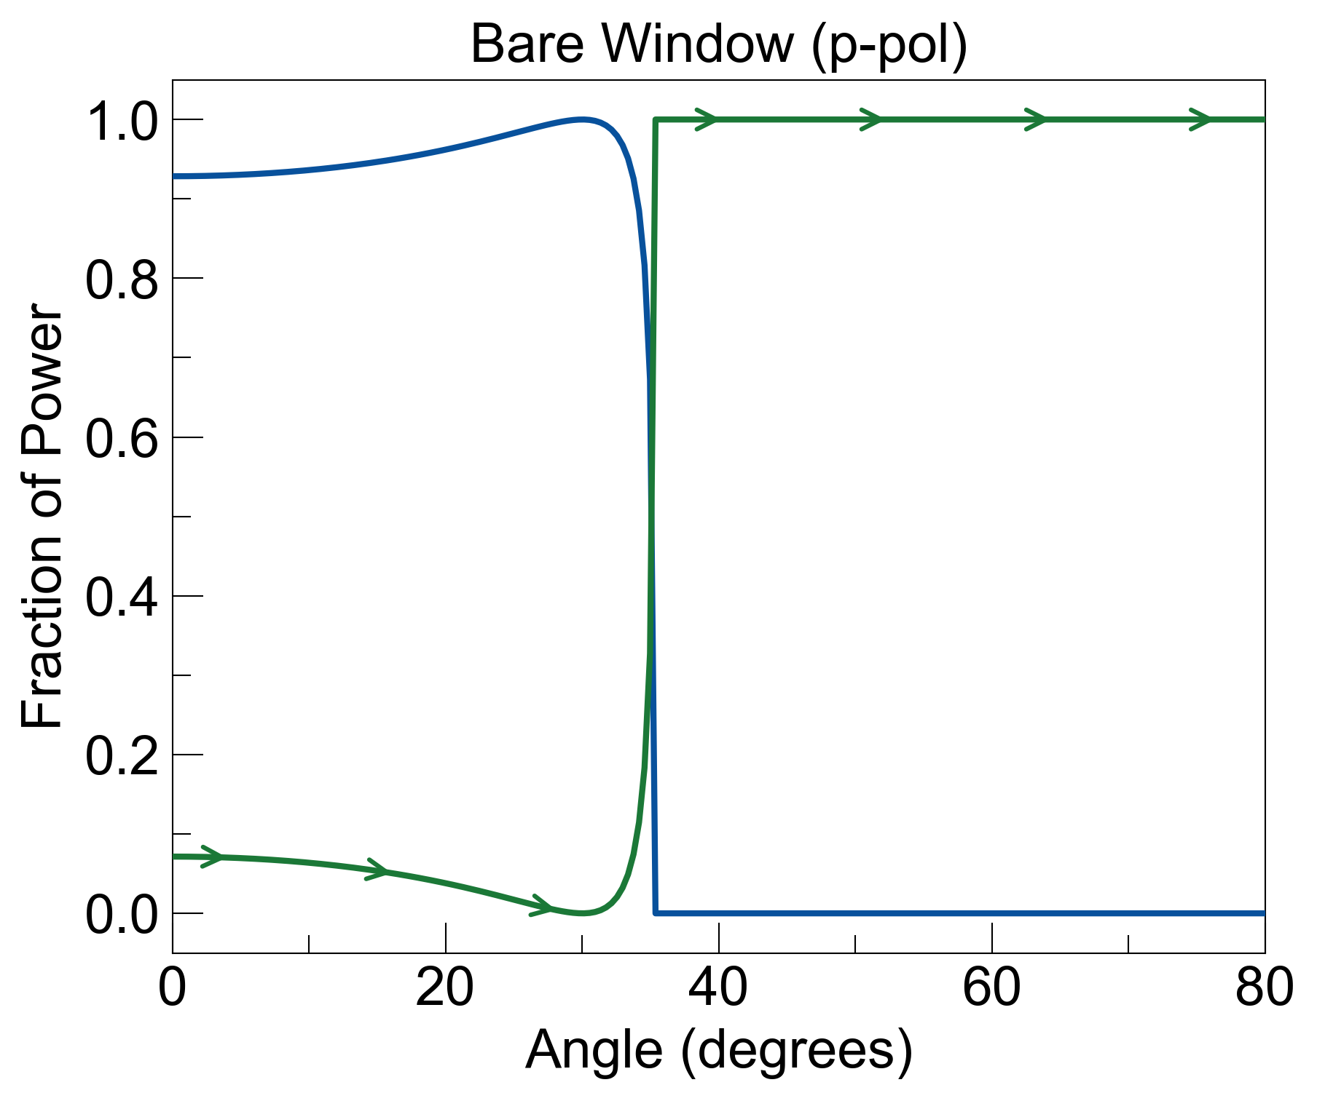
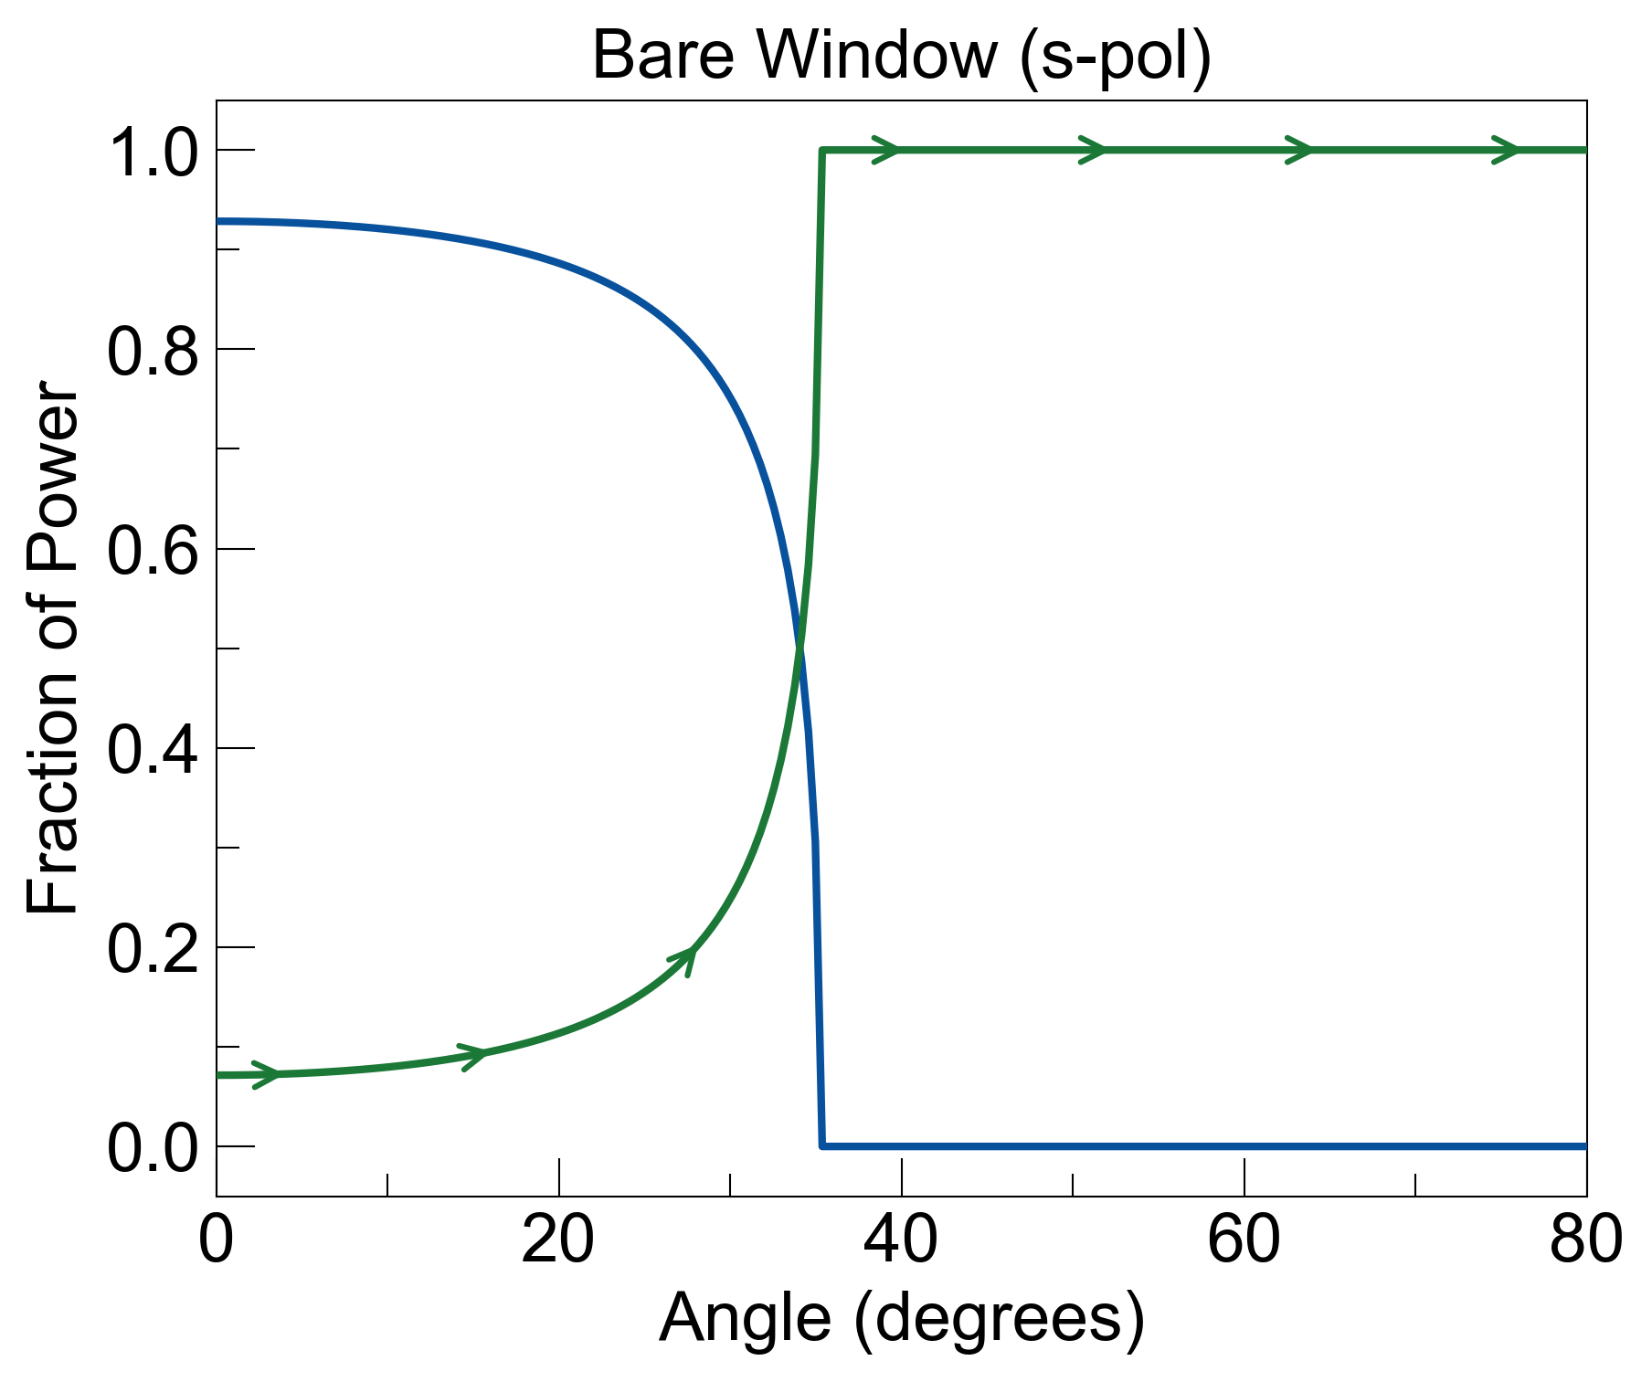
1. Ellipsometry (Bare Window)
I₀
noise = R_{LR}
noise=0.071
noise=0.58
noise=0.63

Slide 4
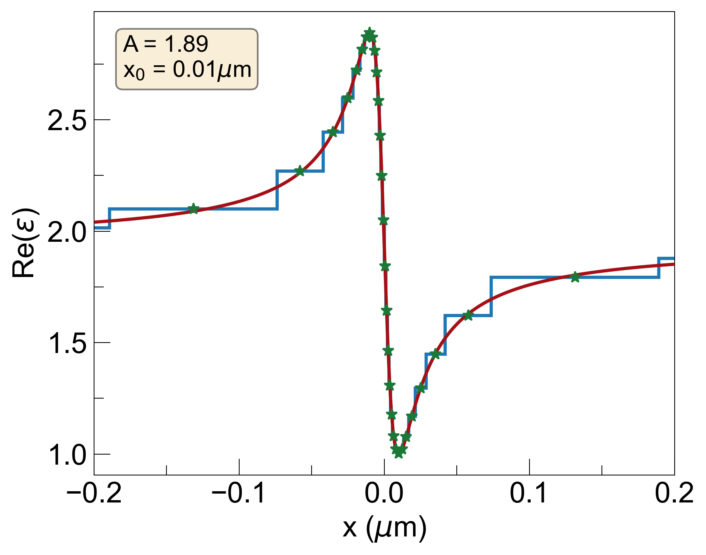
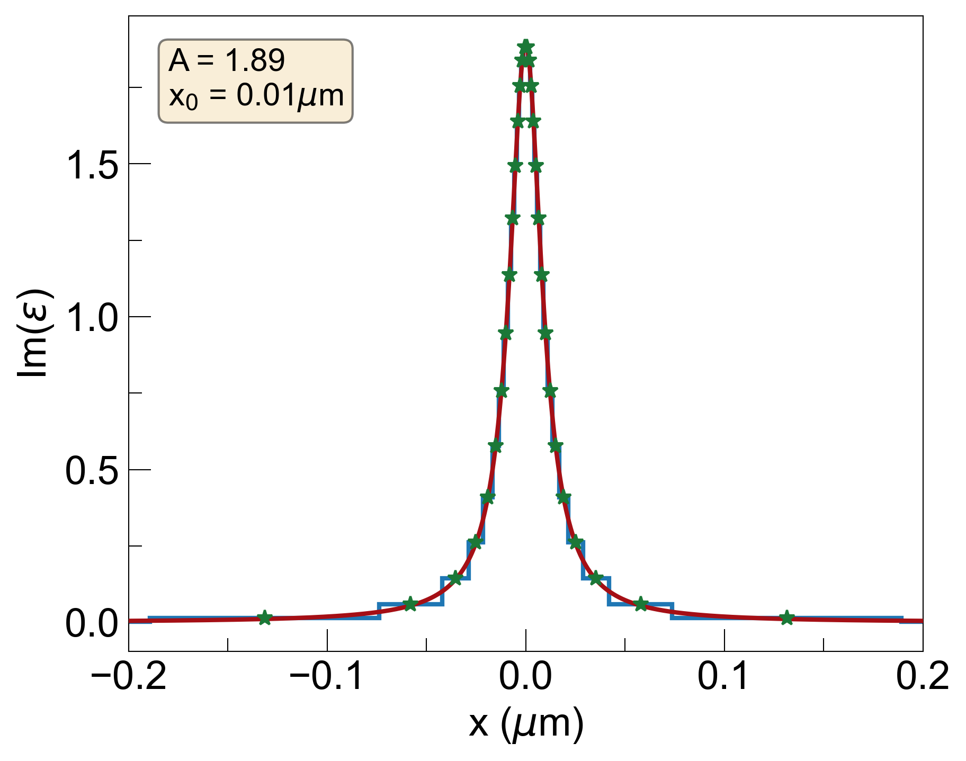
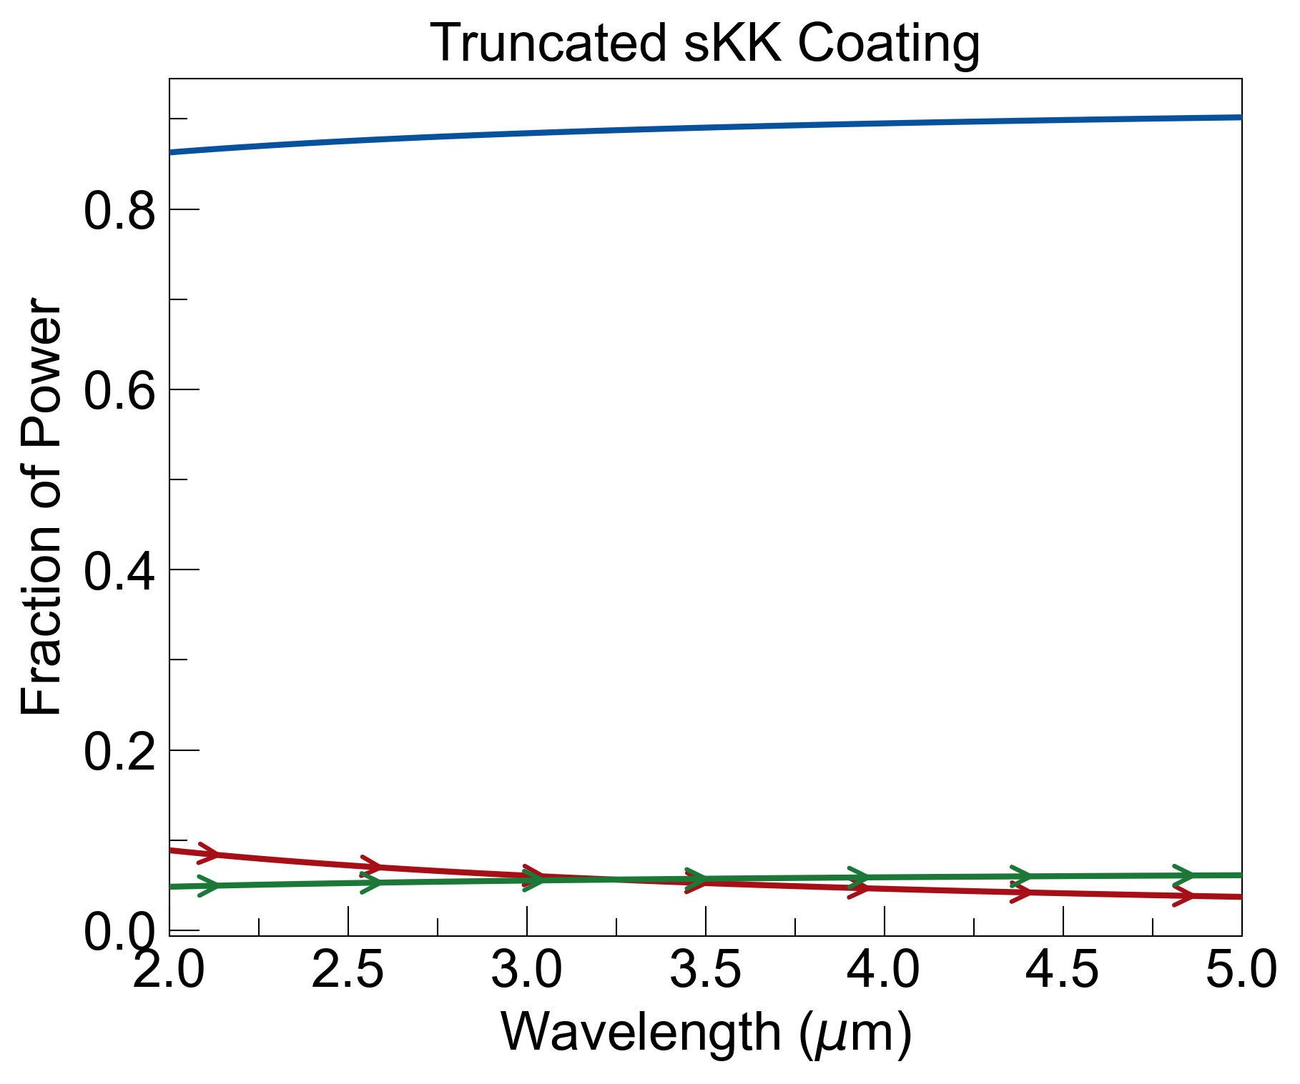
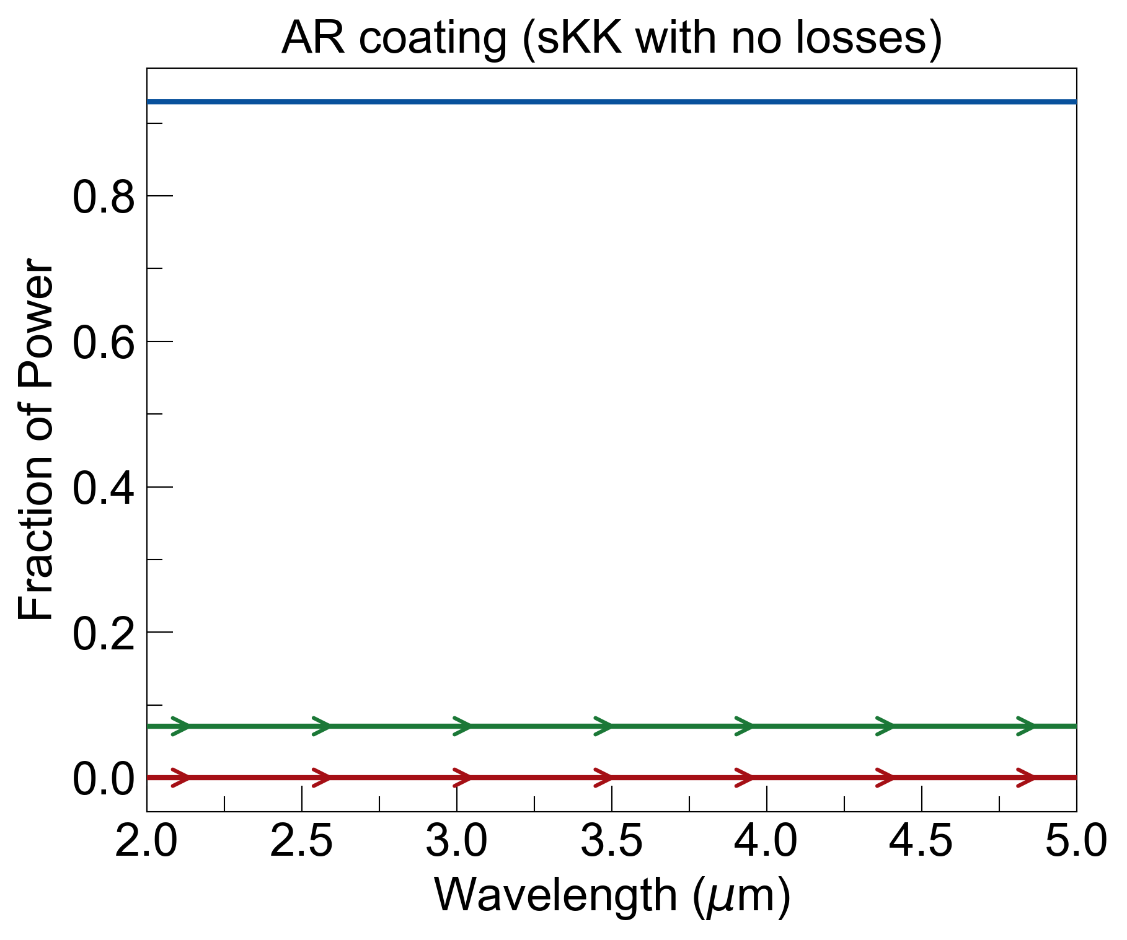
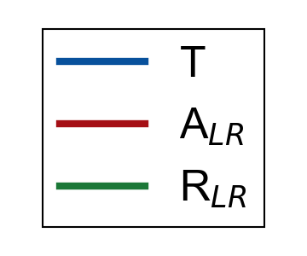
Wavelength dependence
I₀
noise = R_{LR} + E_{L}
E_{L} = A_{LR}
semi-infinite layer on left is the bulk material, which is assumed to be max value of real part of dielectric function.
semi-infinite layer on the right is air.
adding losses lowers reflectance, but adds emission, so more noise overall.
adding dispersion will likely not change results (still trading reflection for emission).
R_{LR}=0.057, A_{LR}=0.056, noise=0.11
R_{LR}=0.071, A_{LR}=0, noise=0.071

Slide 5
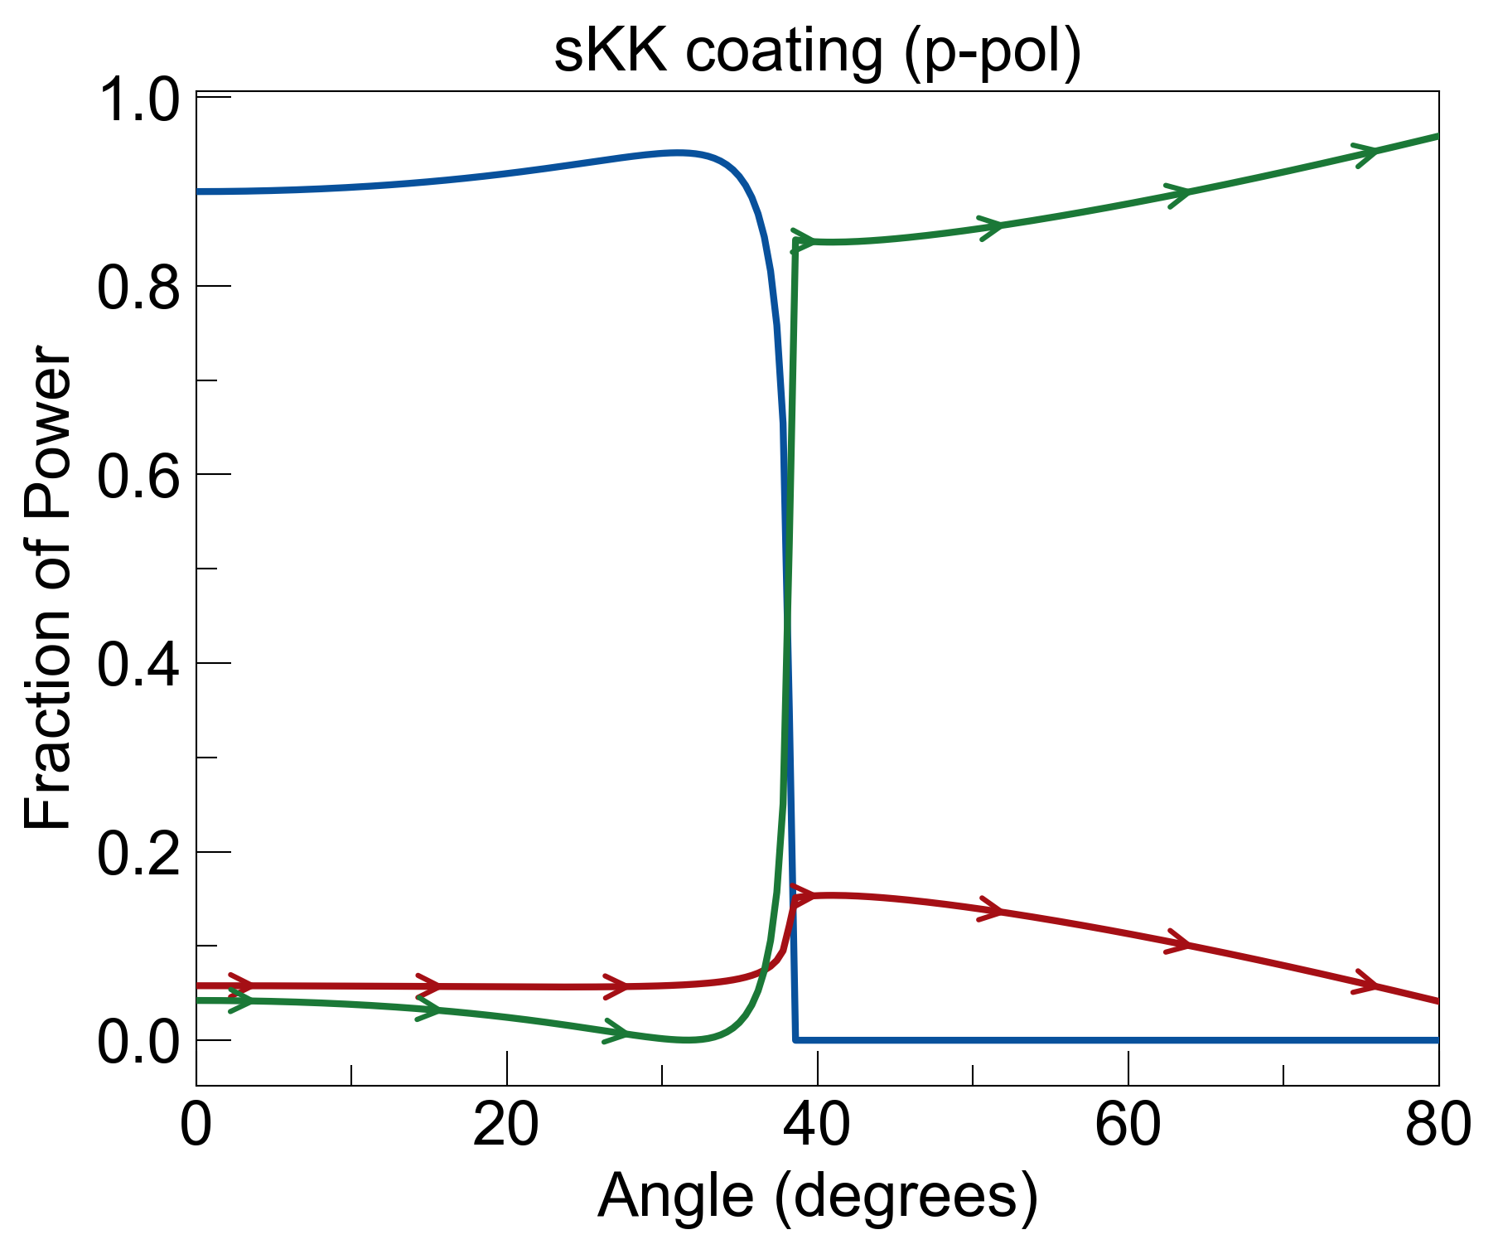
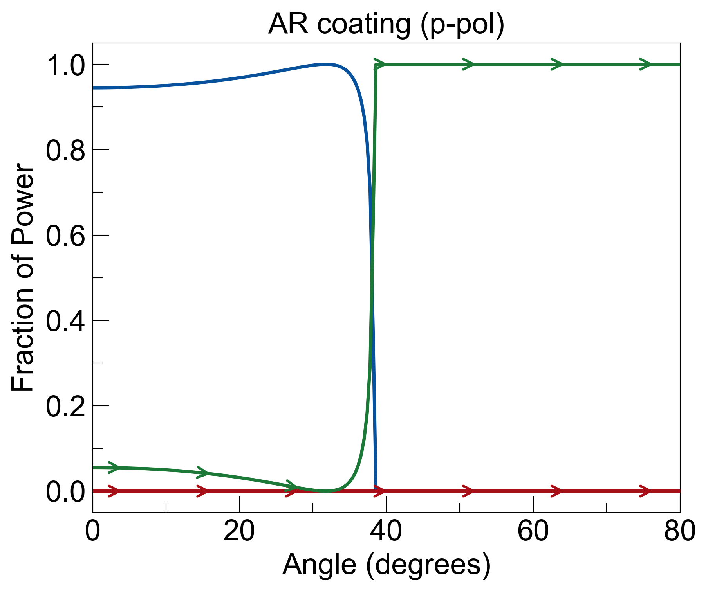
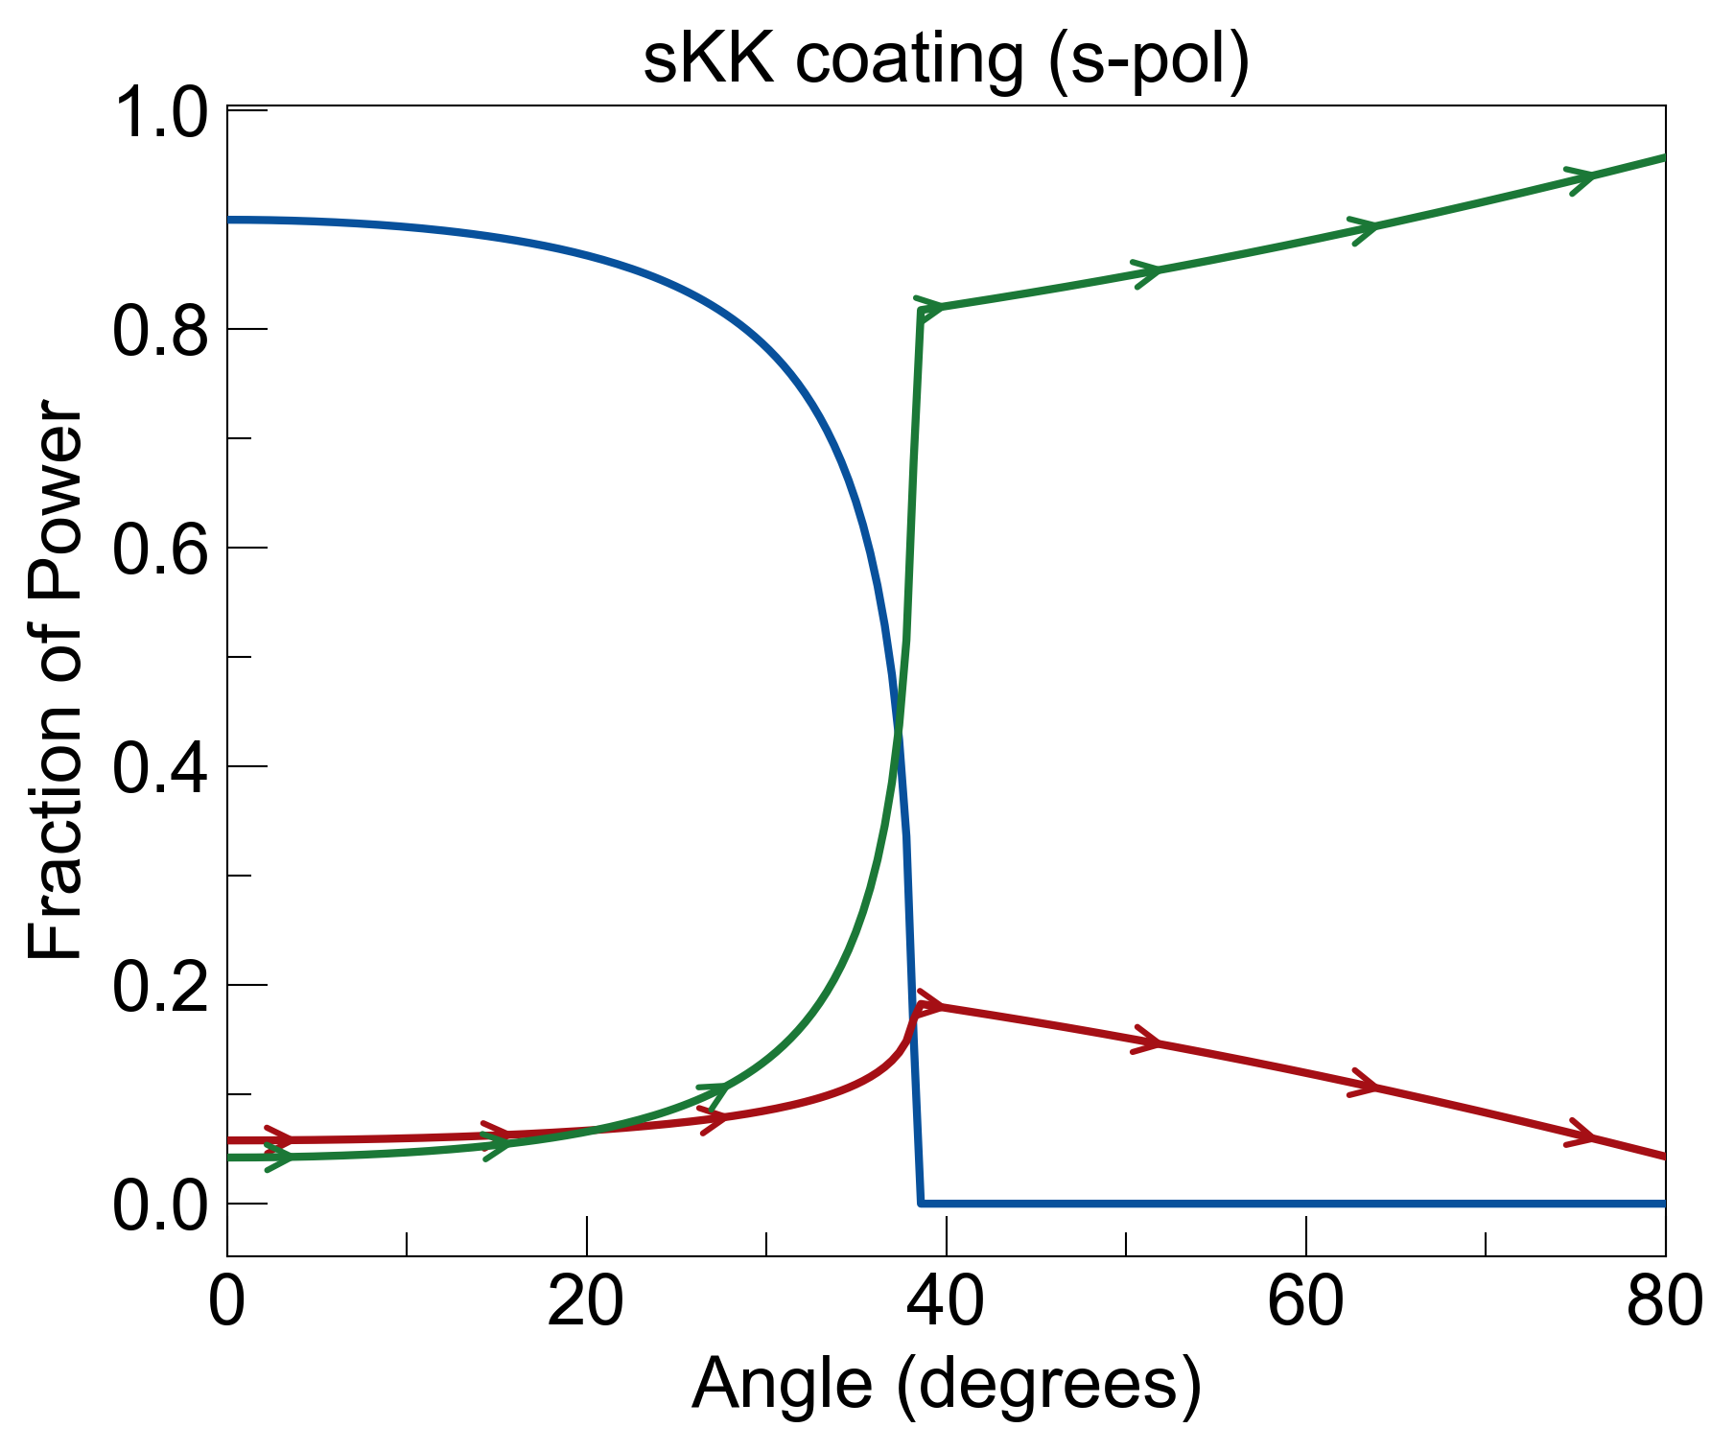
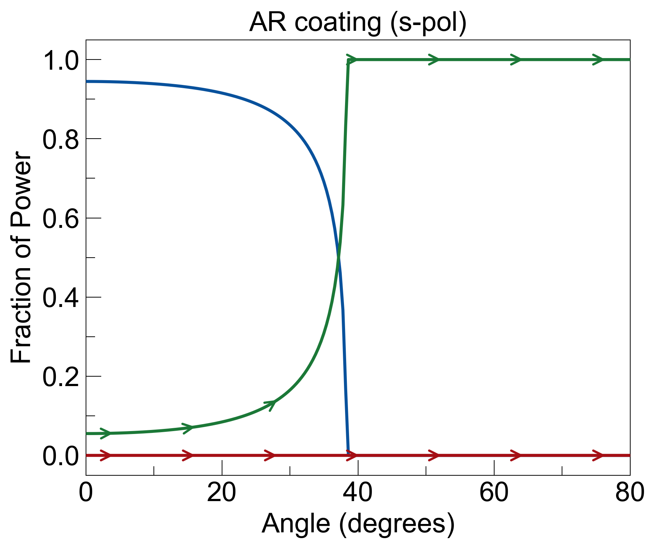
Angle dependence
I₀
noise = R_{LR} + E_{L}
E_{L} = A_{LR}
R_{LR}=0.48, A_{LR}=0.086, noise=0.57
R_{LR}=0.54, A_{LR}=0, noise=0.54
adding losses does not help (trading reflection for emission, which is still noise).
R_{LR}=0.51, A_{LR}=0.1, noise=0.61
R_{LR}=0.59, A_{LR}=0, noise=0.59

Slide 6
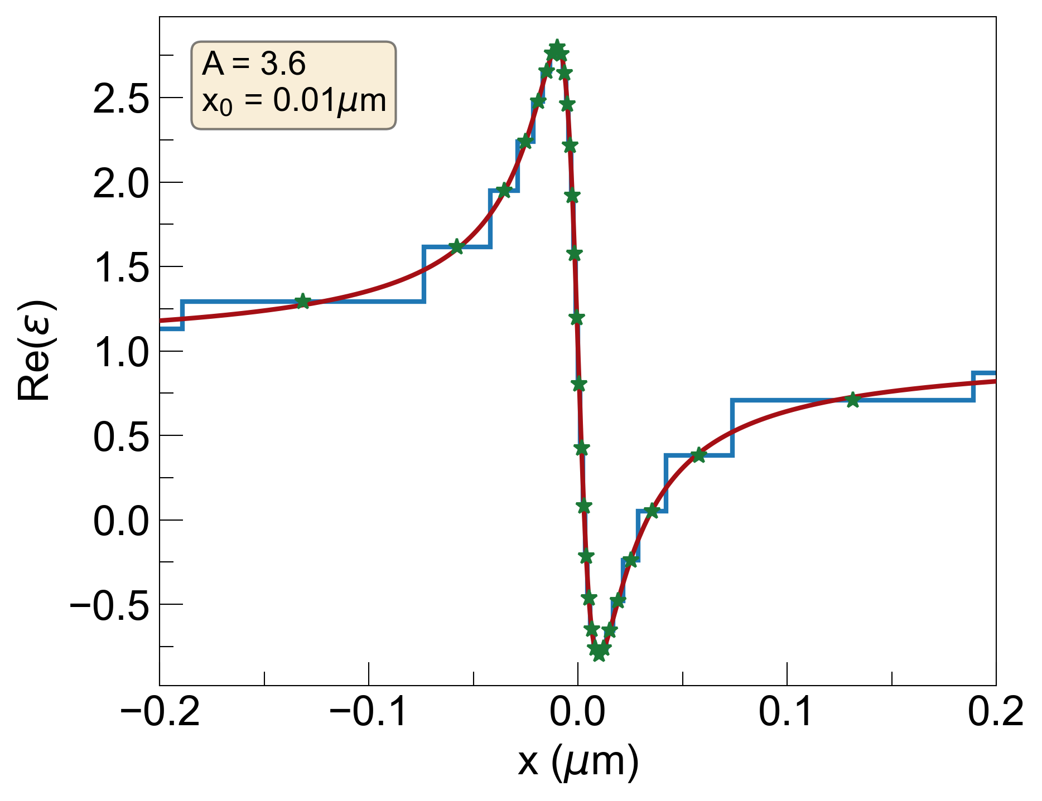
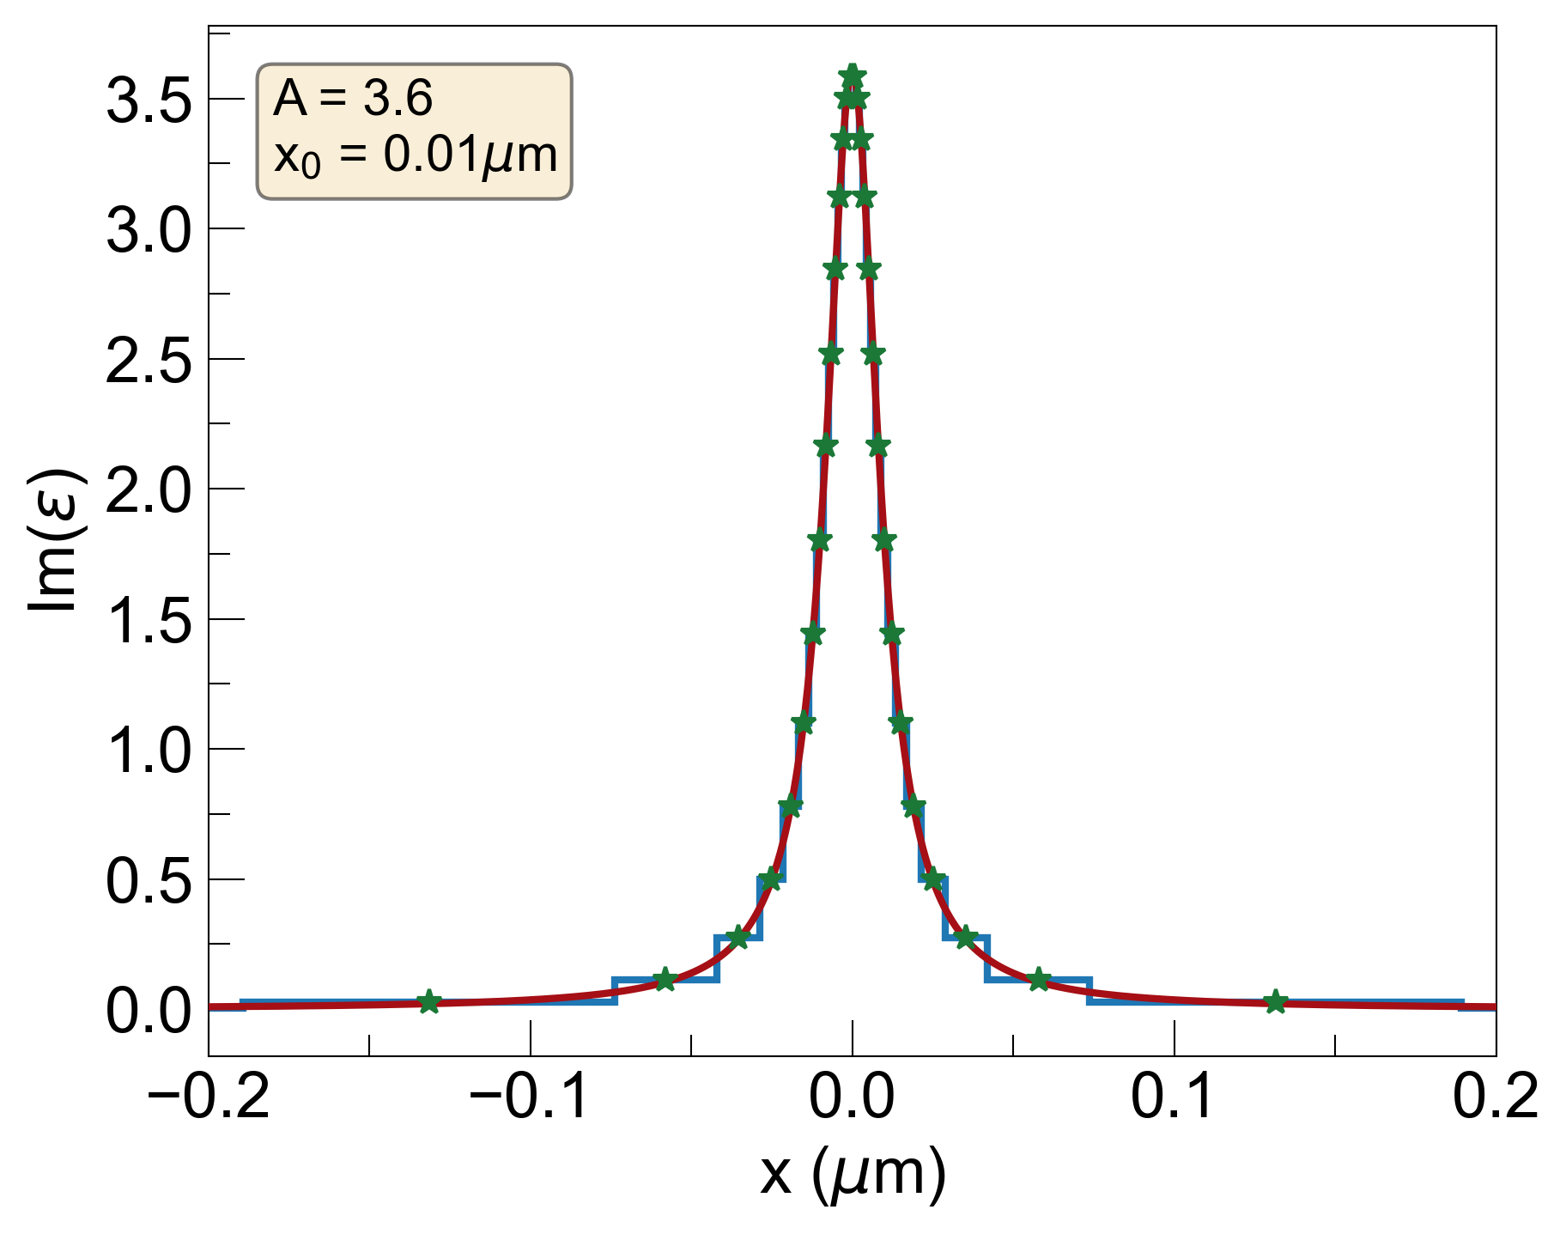
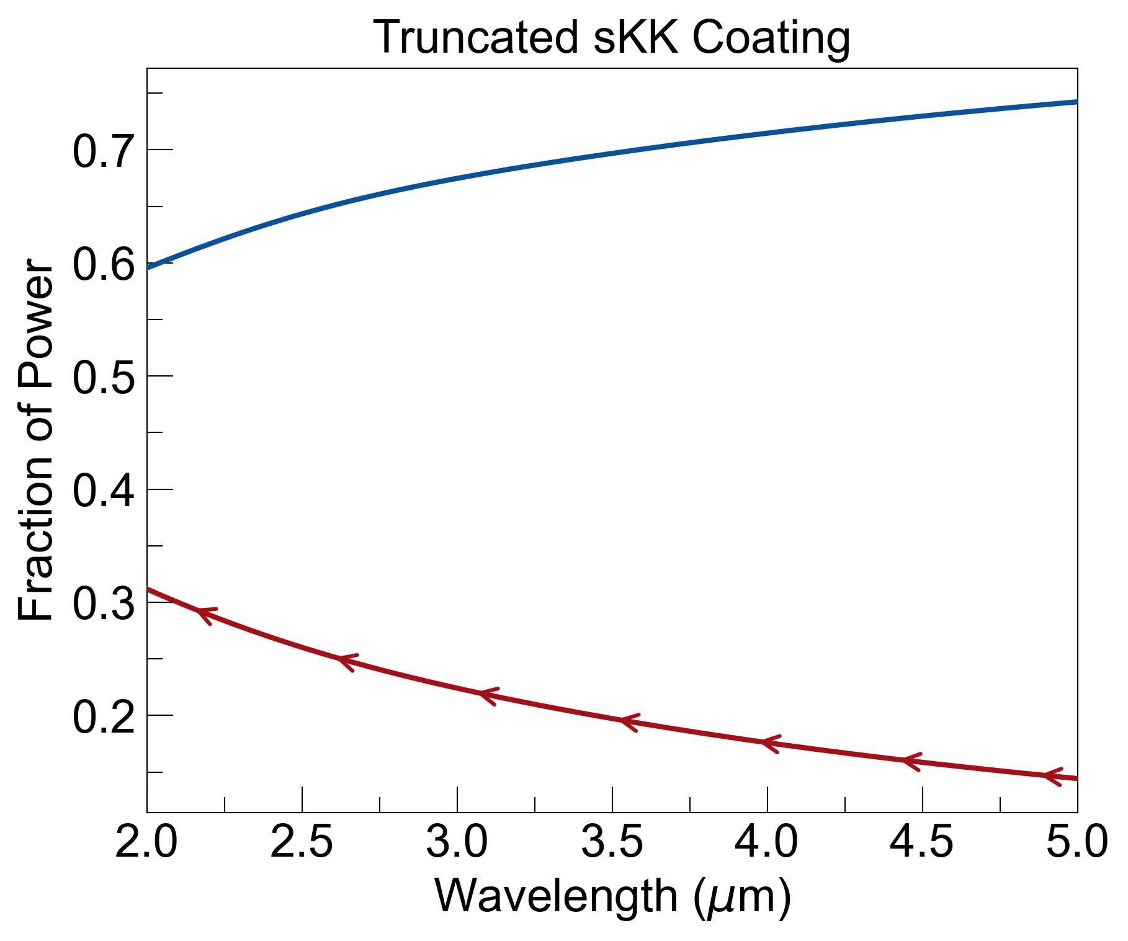
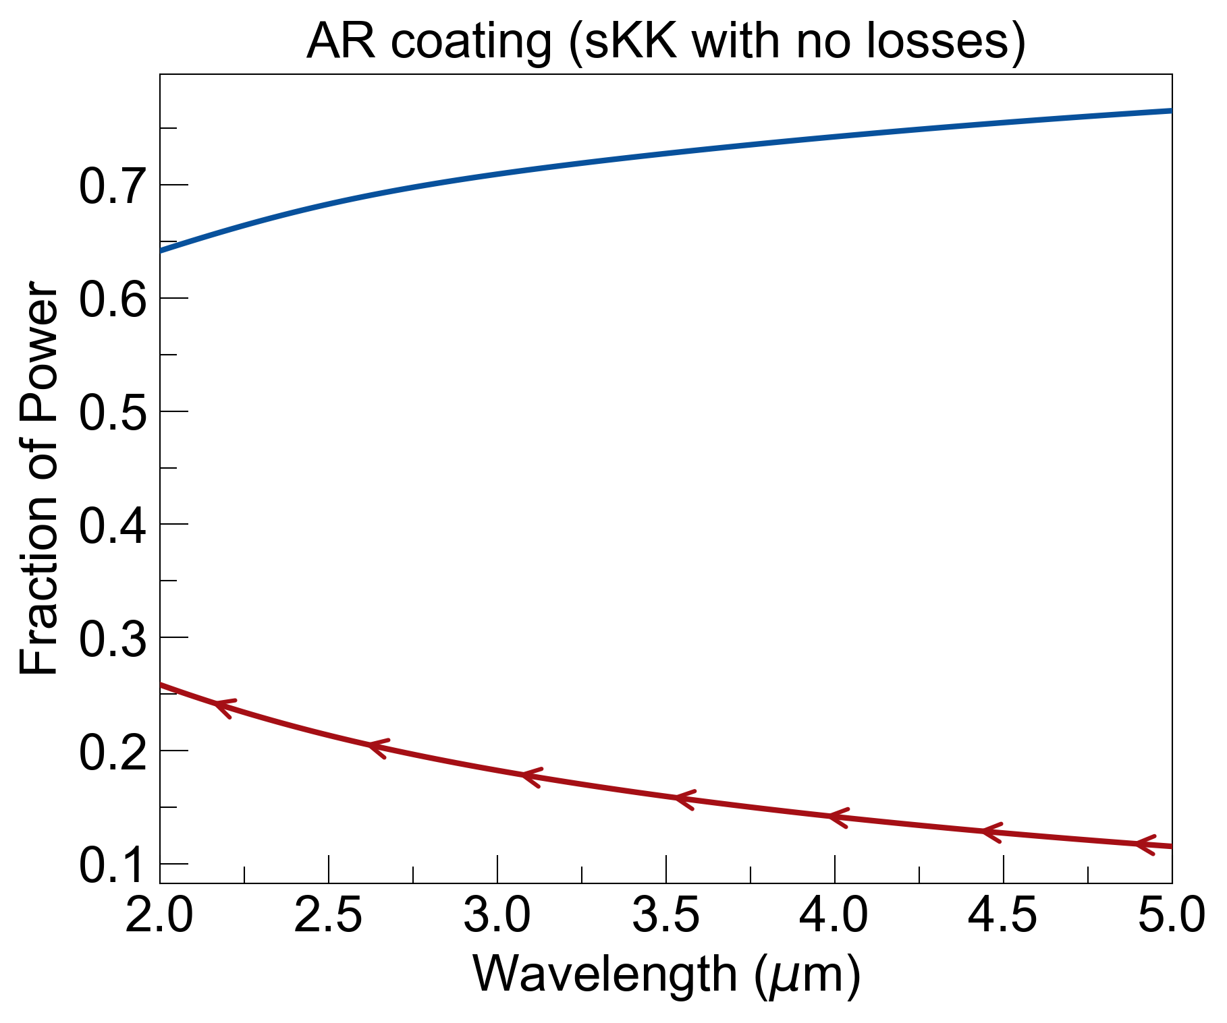
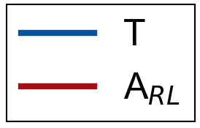
Wavelength dependence
I₀
signal = T
noise = E_{R} = A_{RL}
FOM = signal / noise
window is 5mm sapphire with k = 10⁻⁵
adding losses lowers transmission and increases emission (no benefit)
T=0.69, A_{RL}=0.21, FOM=3.33
T=0.72, A_{RL}=0.17, FOM=4.29

Slide 7
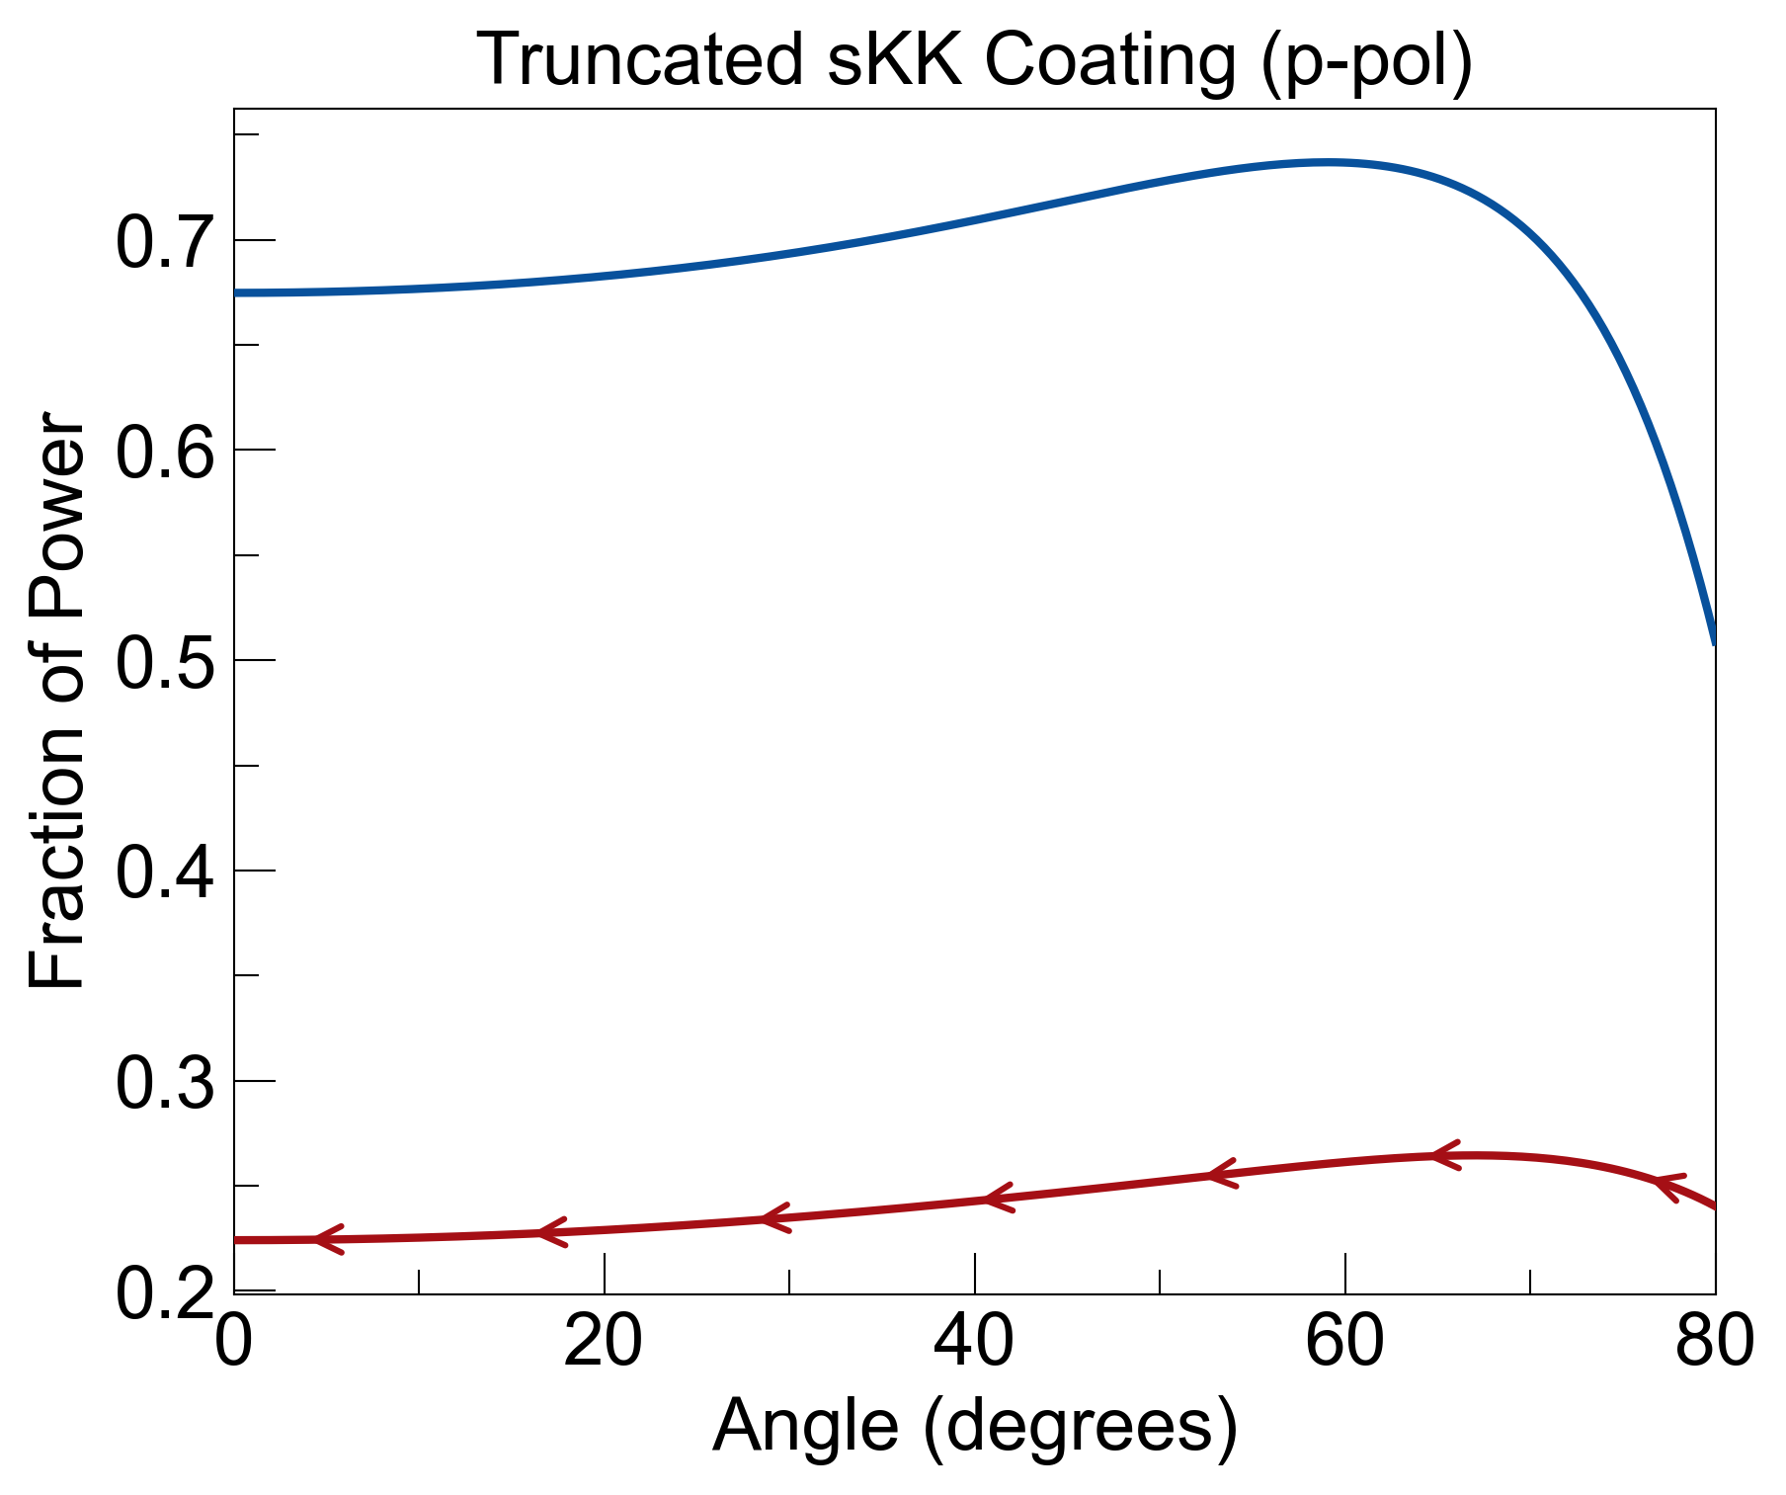
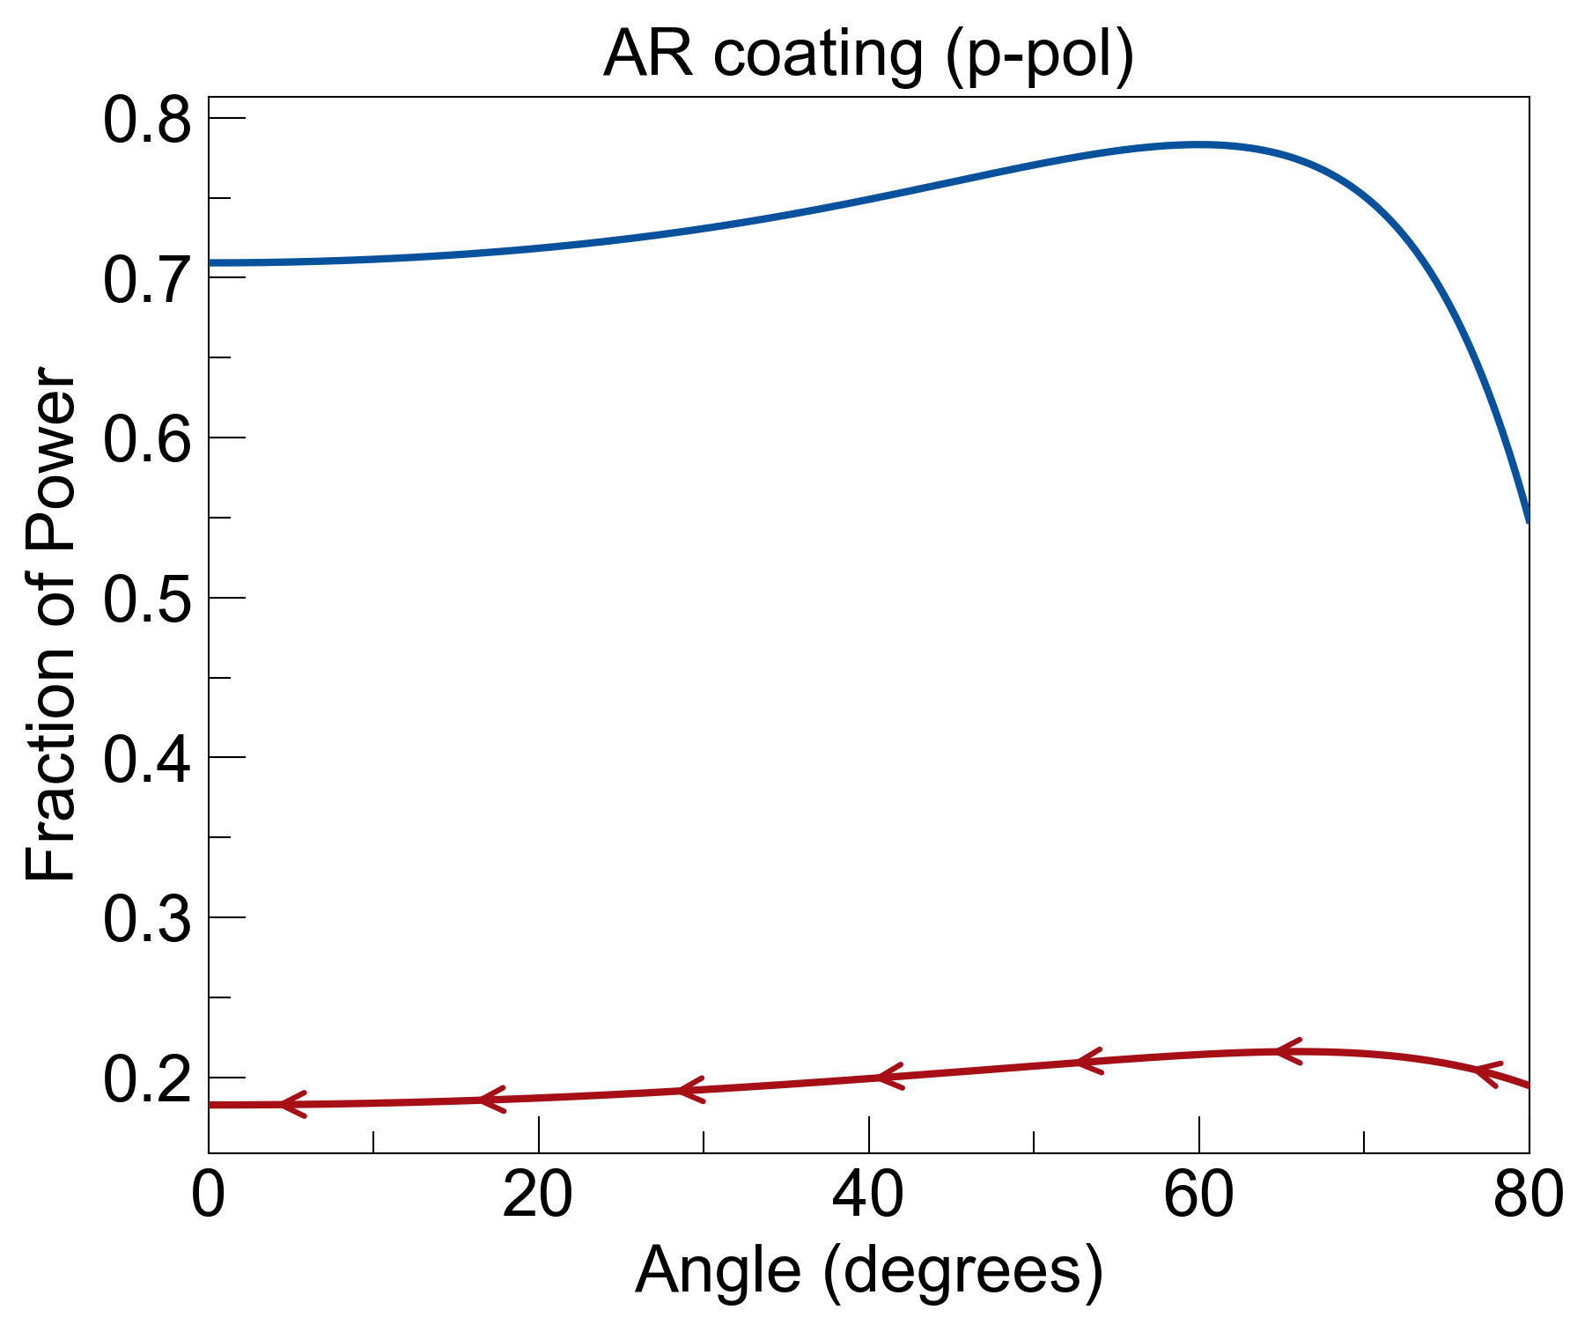
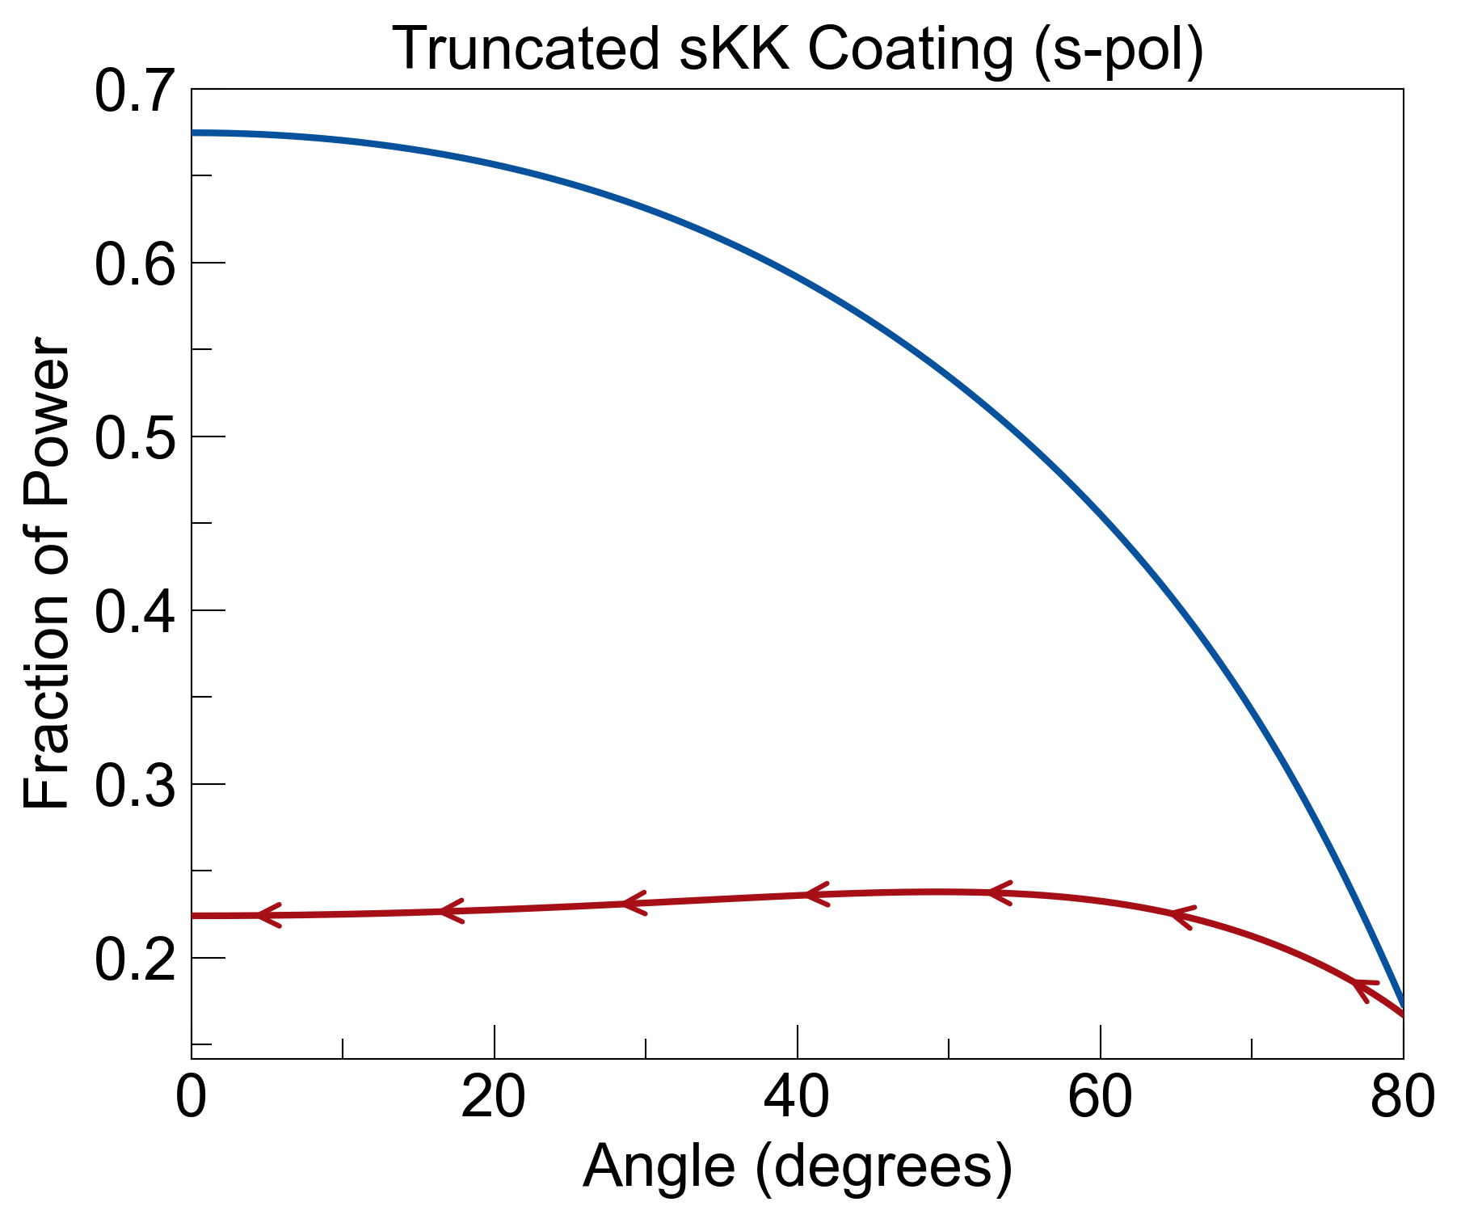
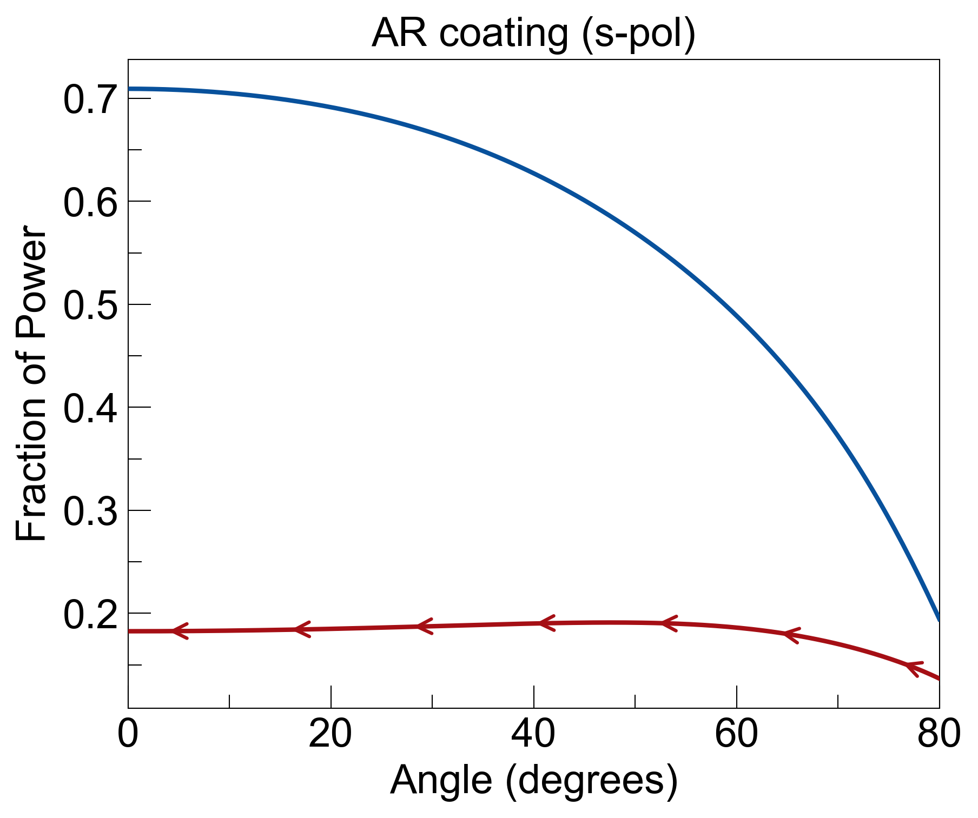
Angle dependence
I₀
signal = T
noise = E_{R} = A_{RL}
FOM = signal / noise
T=0.69, A_{RL}=0.24, FOM=2.85
T=0.73, A_{RL}=0.2, FOM=3.7
Same conclusion for angle dependence: FOM gets worse for sKK coating for both s and p polarizations.
T=0.54, A_{RL}=0.23, FOM=2.4
T=0.57, A_{RL}=0.18, FOM=3.15

Slide 8
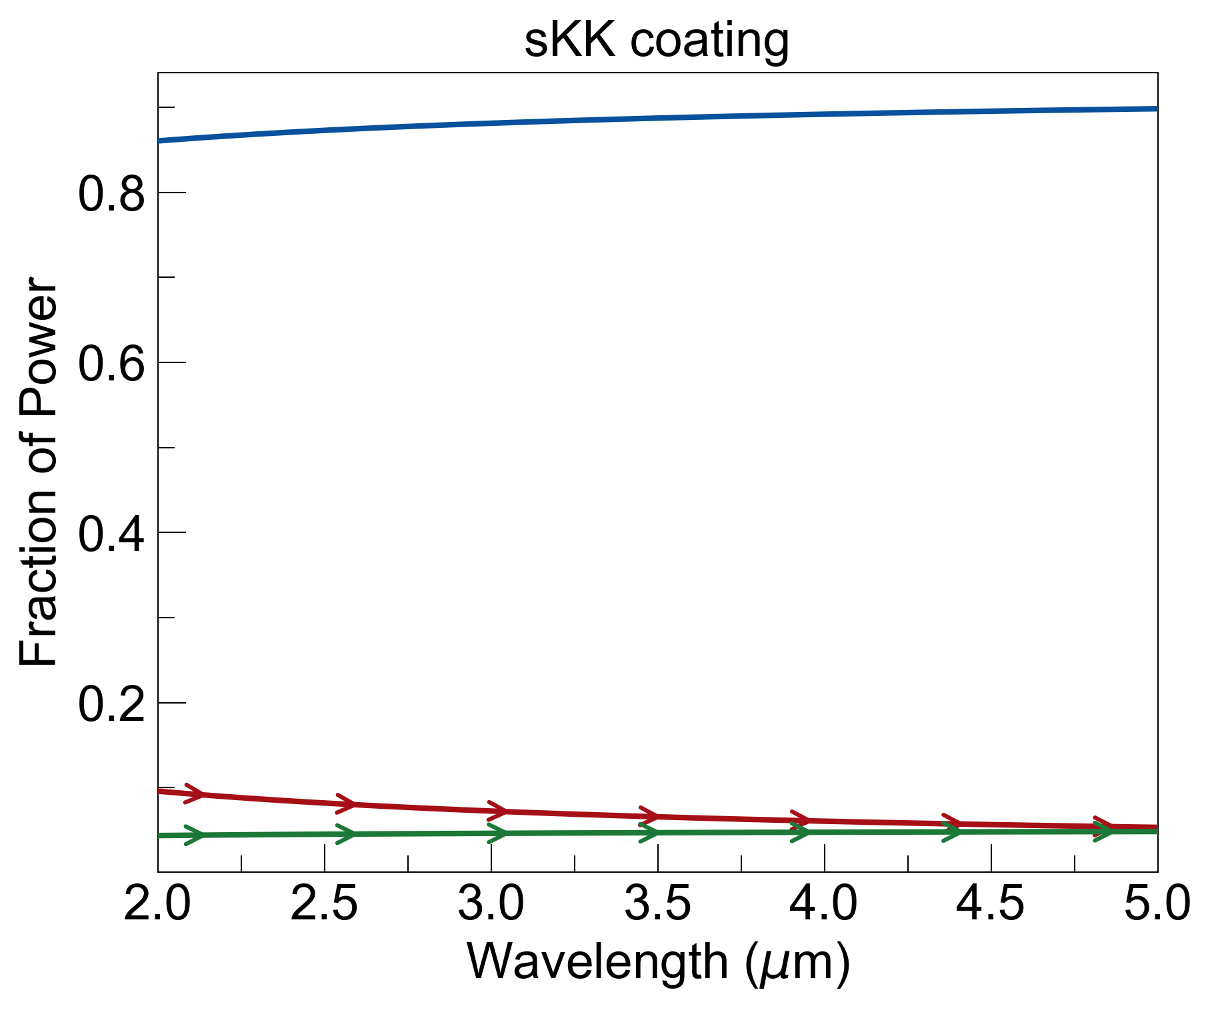
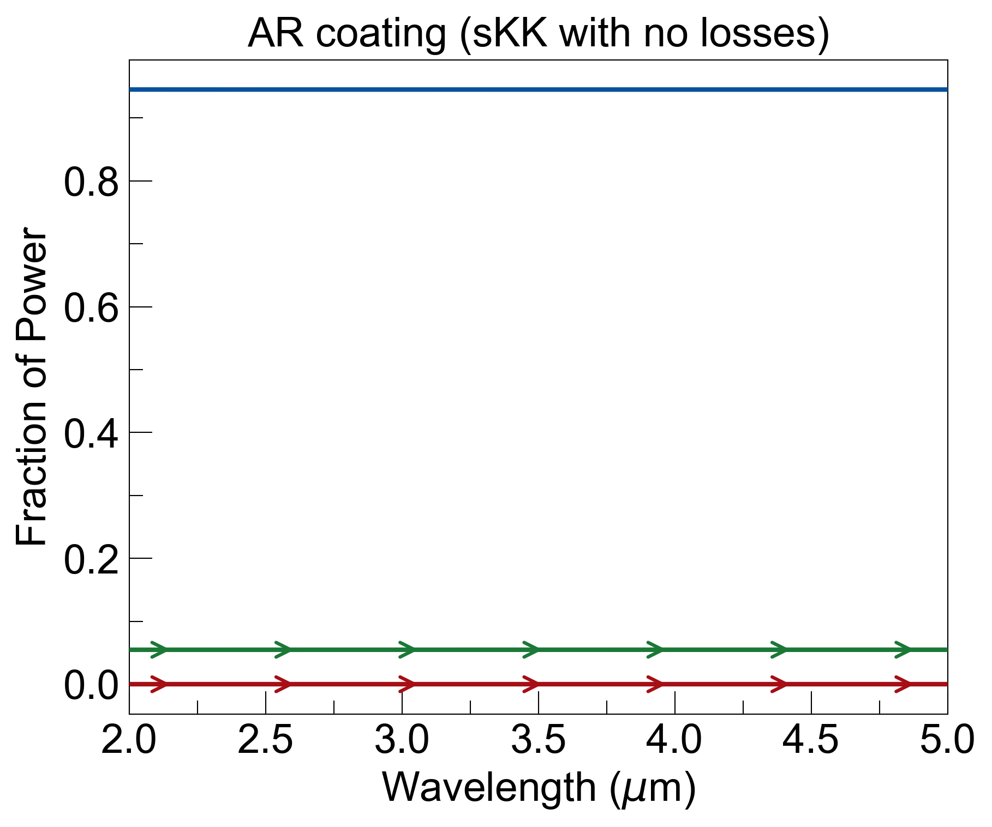
I₀
noise = R_{LR} + A_{LR}
semi-infinite layer on left is window, which is assumed to be max value of real part of dielectric function.
semi-infinite layer on the right is min value of Re(eps).
assumed that materials between n=1 and n=1.4 exist, to show whether adding losses help or not.
noise = 0.115
noise = 0.055

Slide 9
