Slide 1
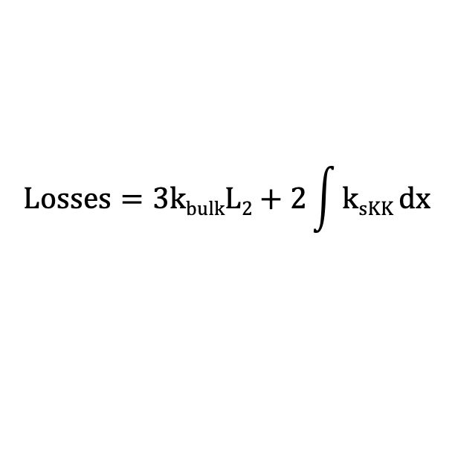

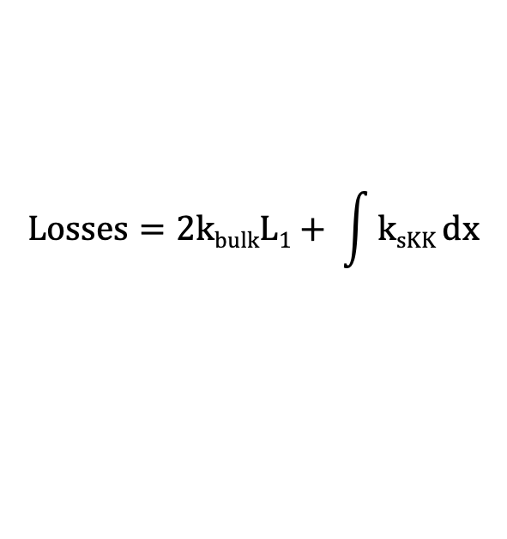
k_{bulk}
$$Losses=kbulkLo$$
L_{o}
$$Losses=2kbulkL1+ \int{ksKK}dx$$
k_{bulk}
s-KK
k_{bulk}
L₁
L₁
$$Losses=3kbulkL2+2\int{ksKK}dx$$
k_{bulk}
s-KK
k_{bulk}
s-KK
k_{bulk}
Determine length of bulk such that losses are constant
L₂
L₂
L₂
…

Slide 2
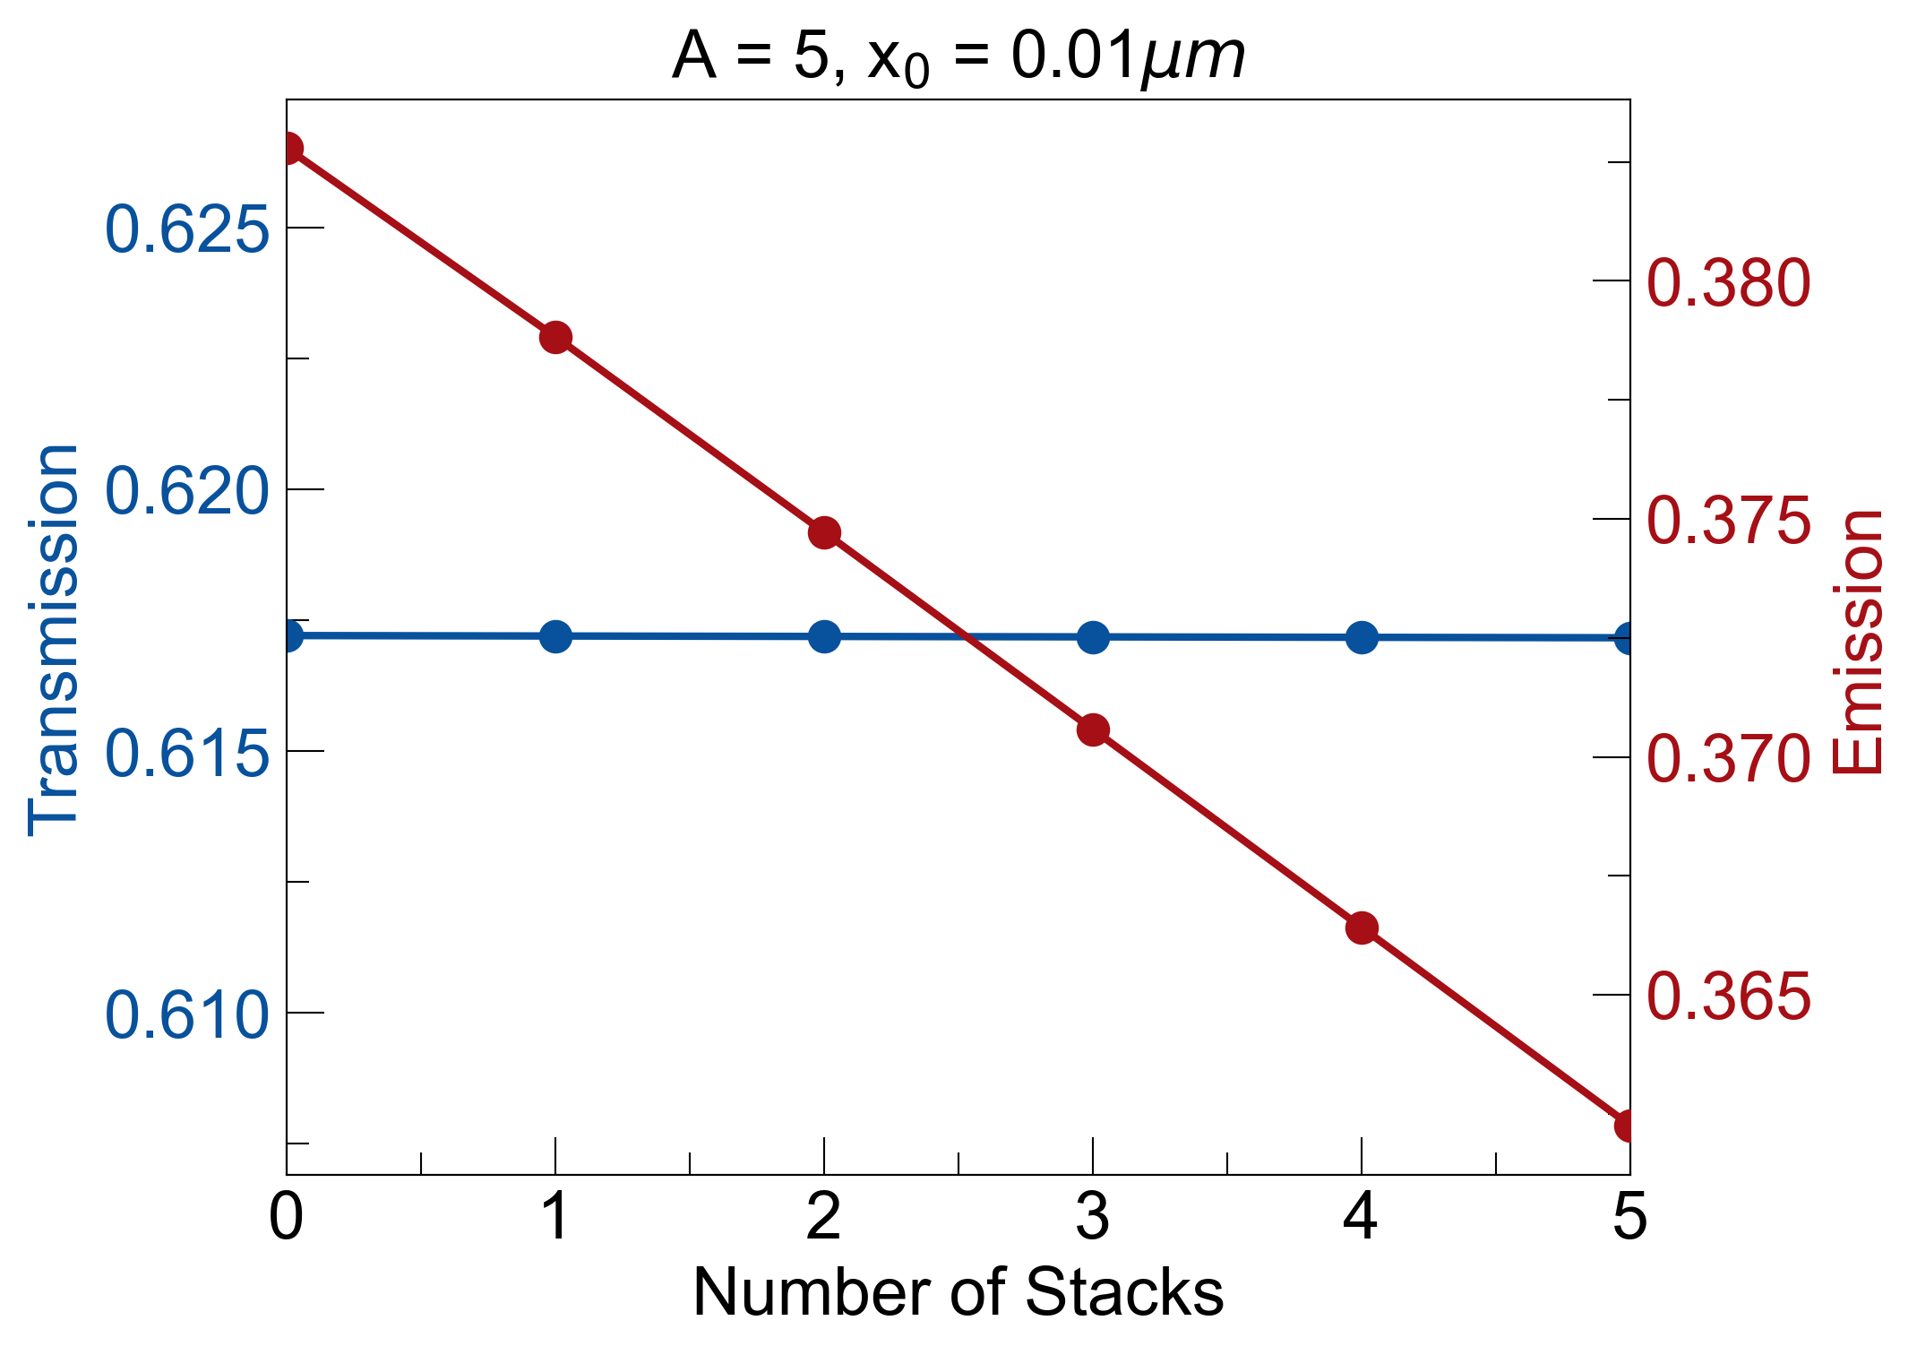
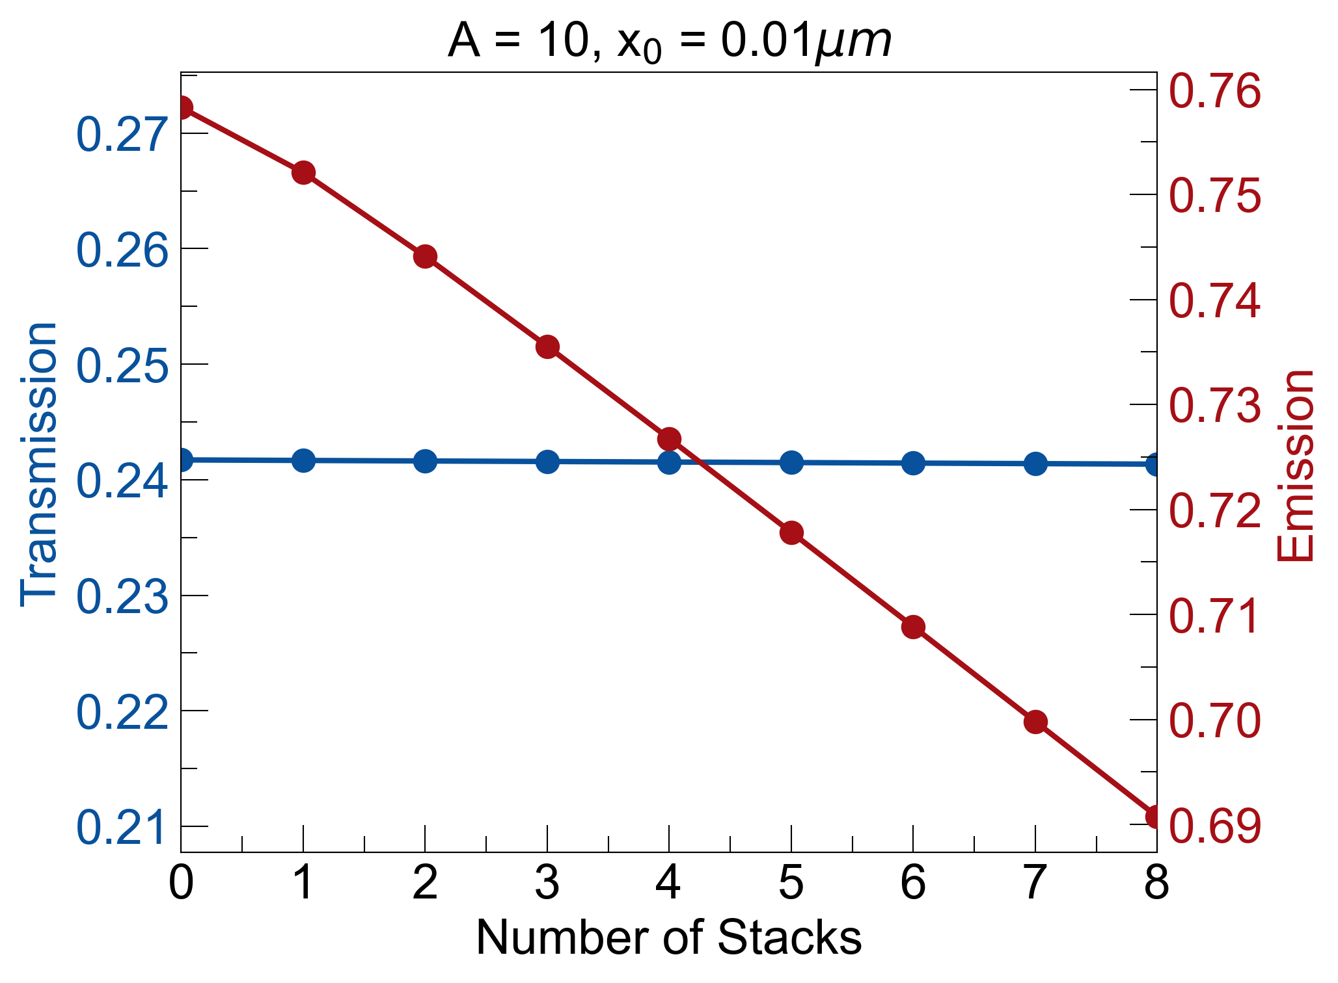
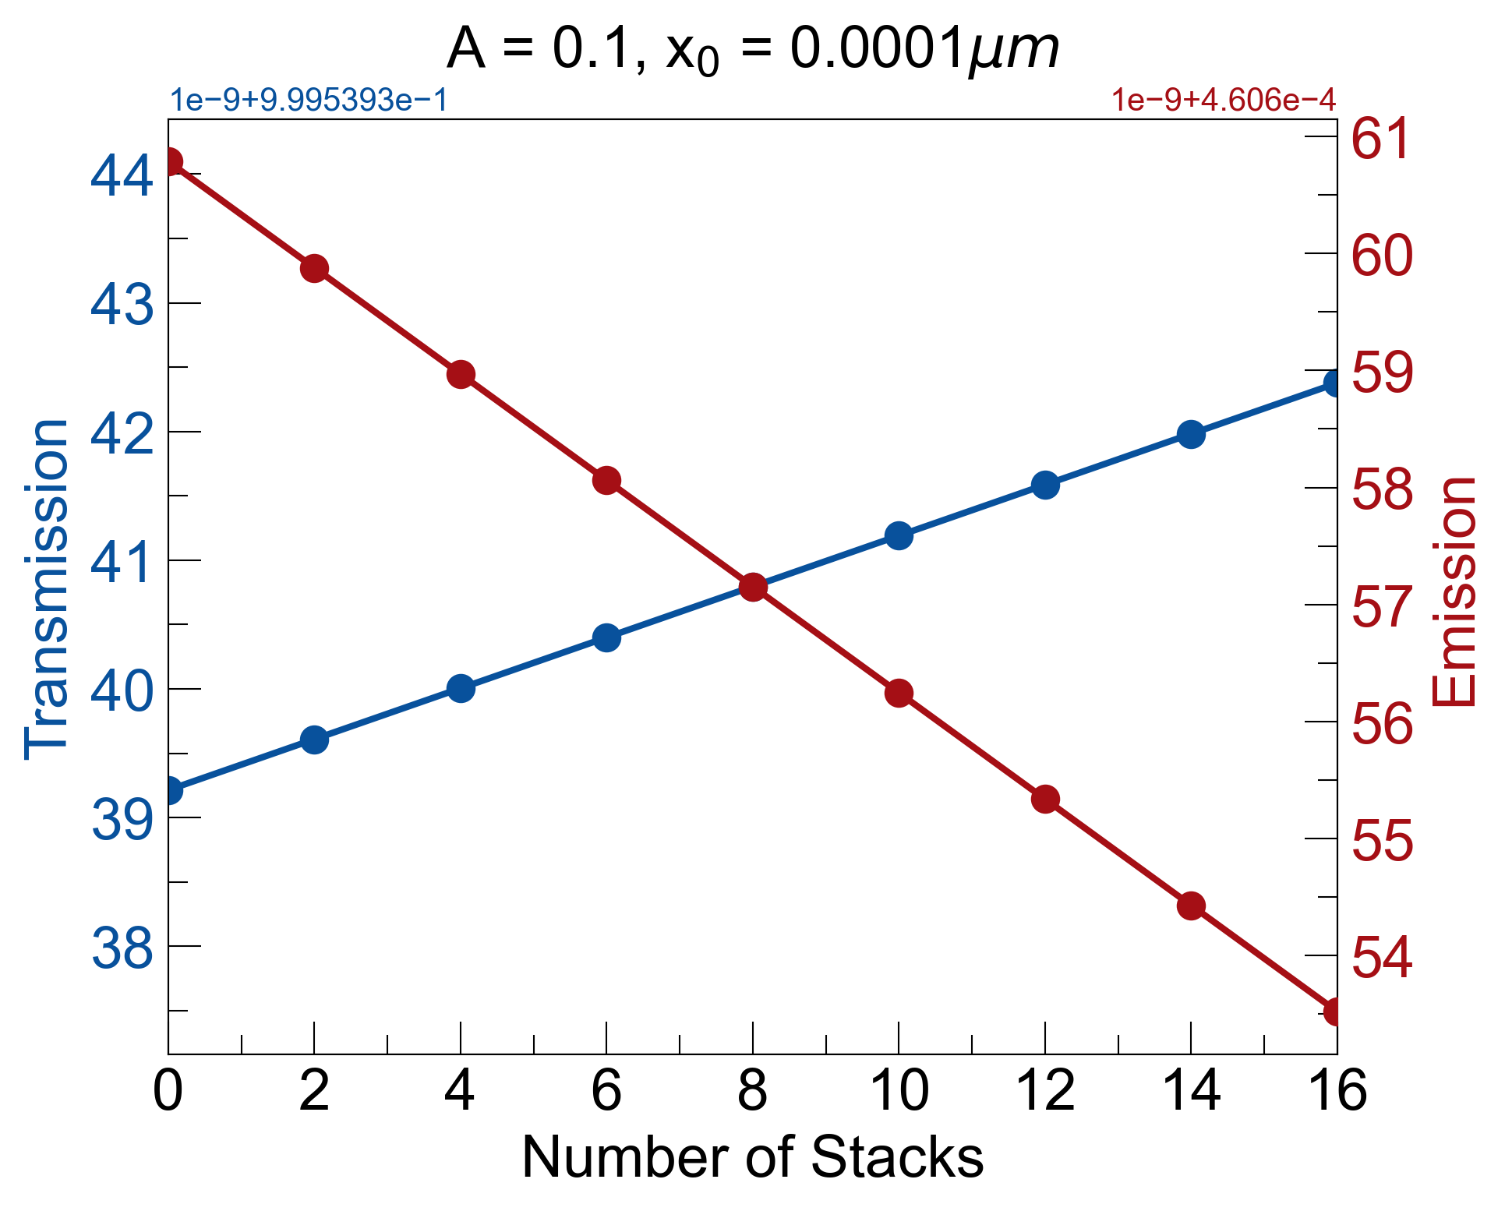
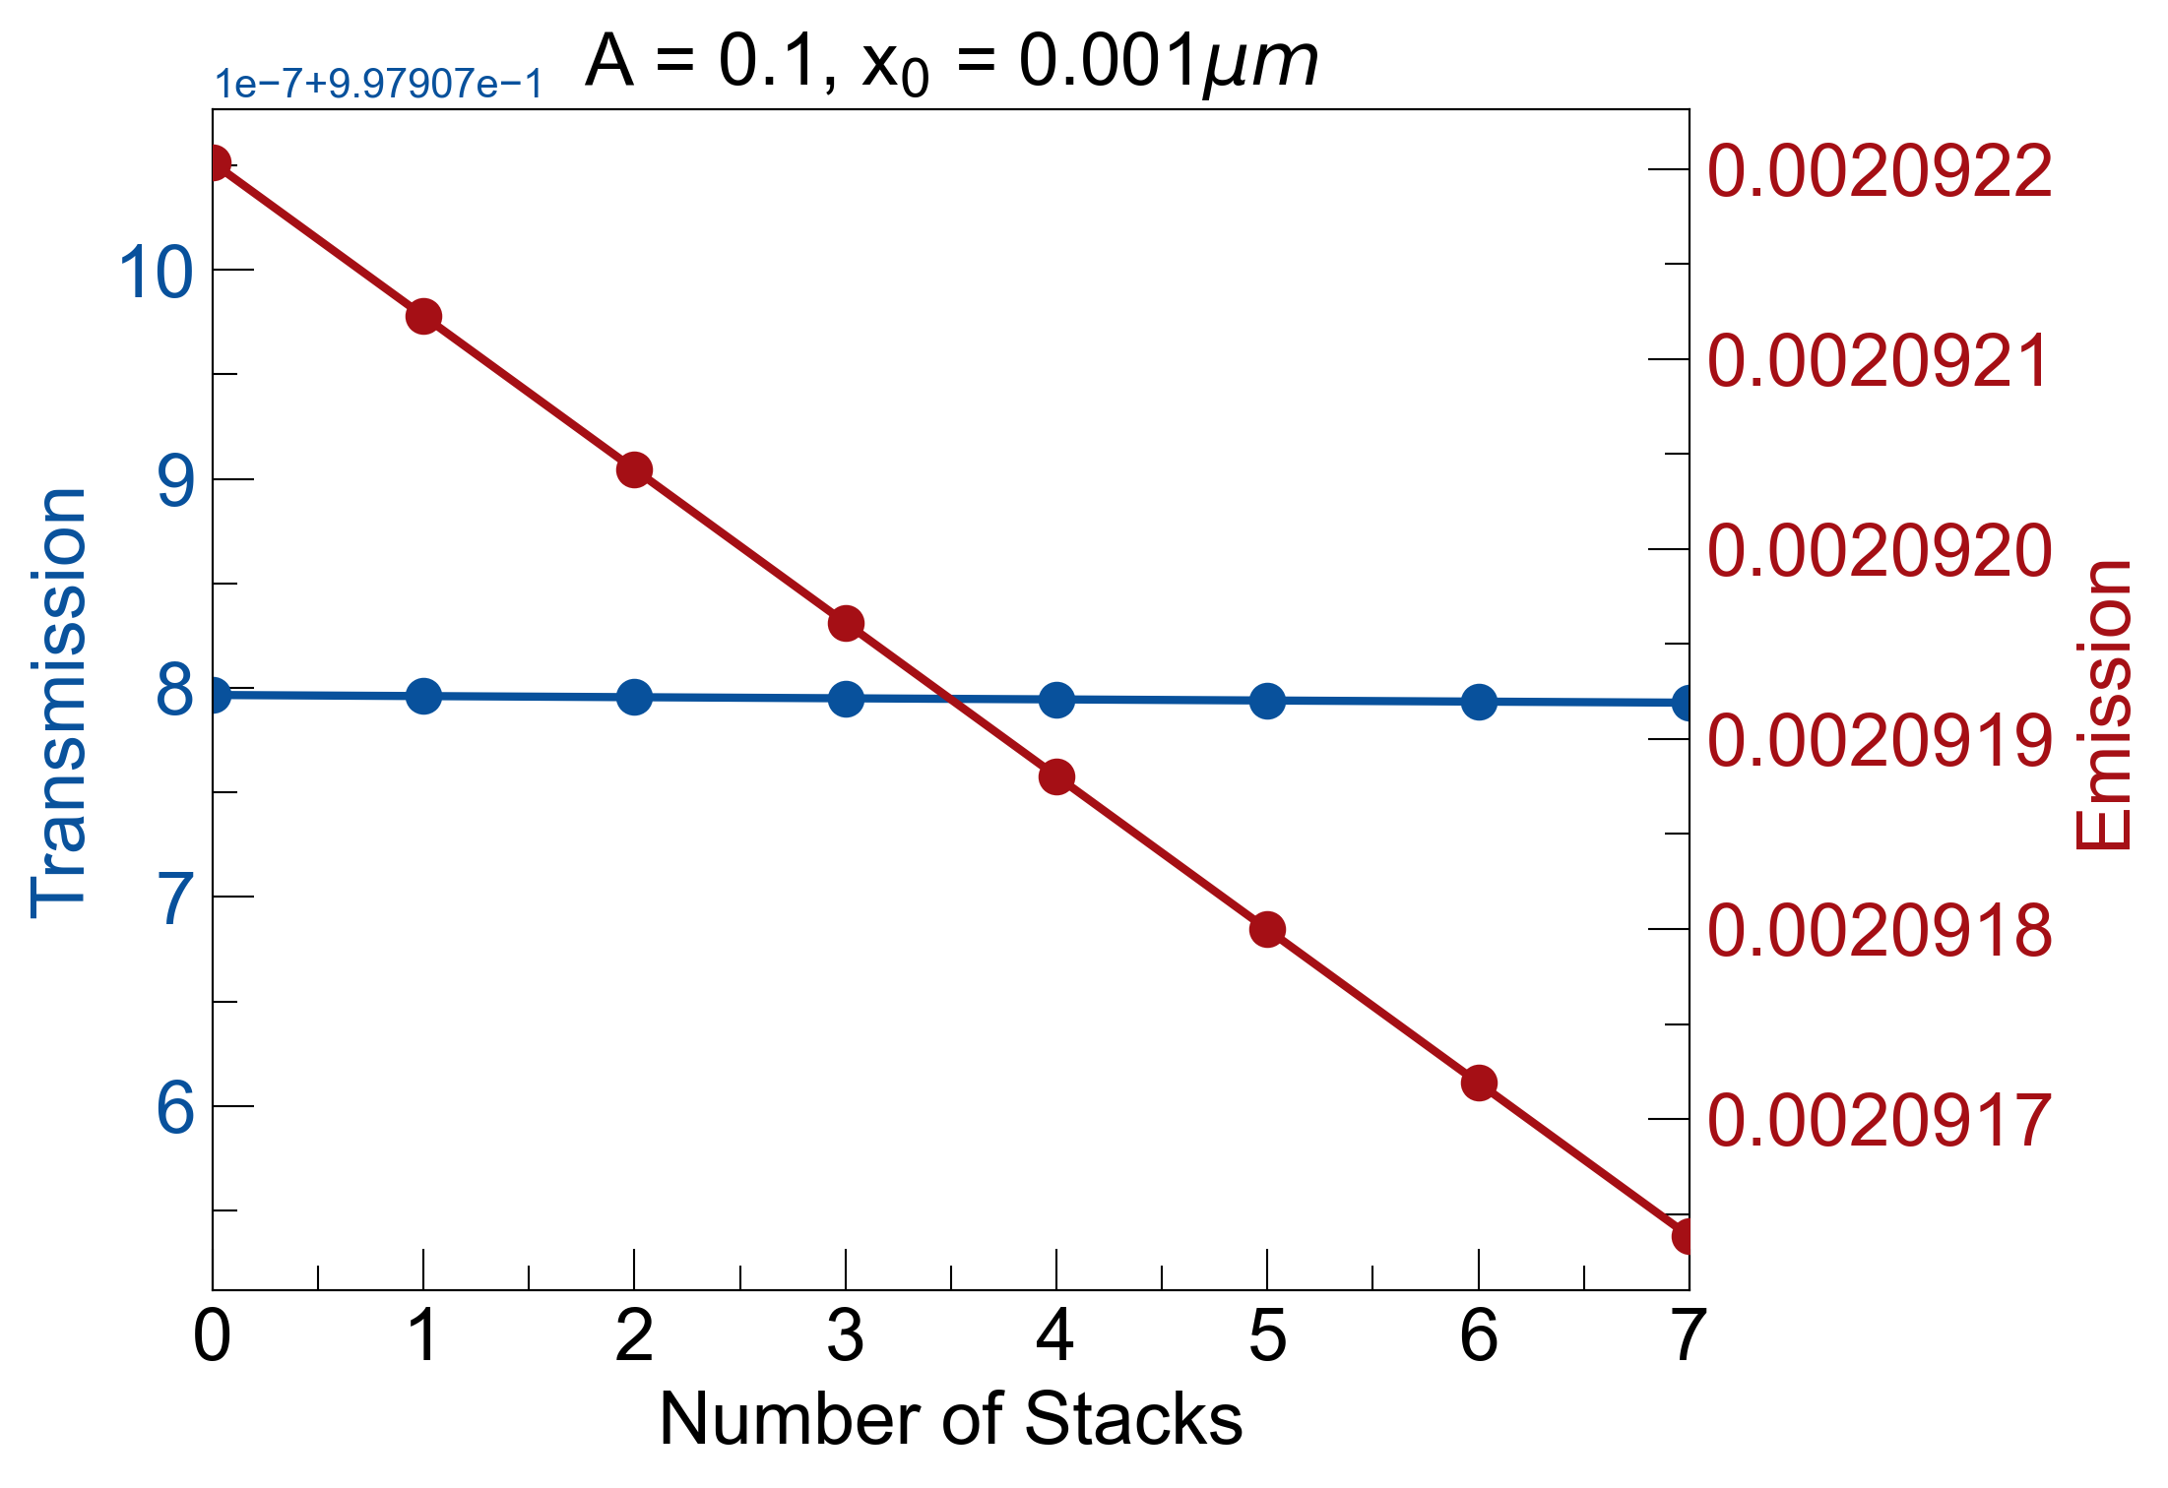
k_{sapphire} (λ = 5µm, T = 300K) = 3.84e-05
k_{sapphire} (λ = 5µm, T = 900K) = 1.13e-04
used temperature dependent data for k-values for sapphire window
more losses = more asymmetry (as expected)
almost 10% asymmetry for λ = 5µm, T = 900K
k_{sapphire} (λ = 3µm, T = 300K) = 2.2e-08
k_{sapphire} (λ = 3µm, T = 900K) = 1.00e-07

Slide 3
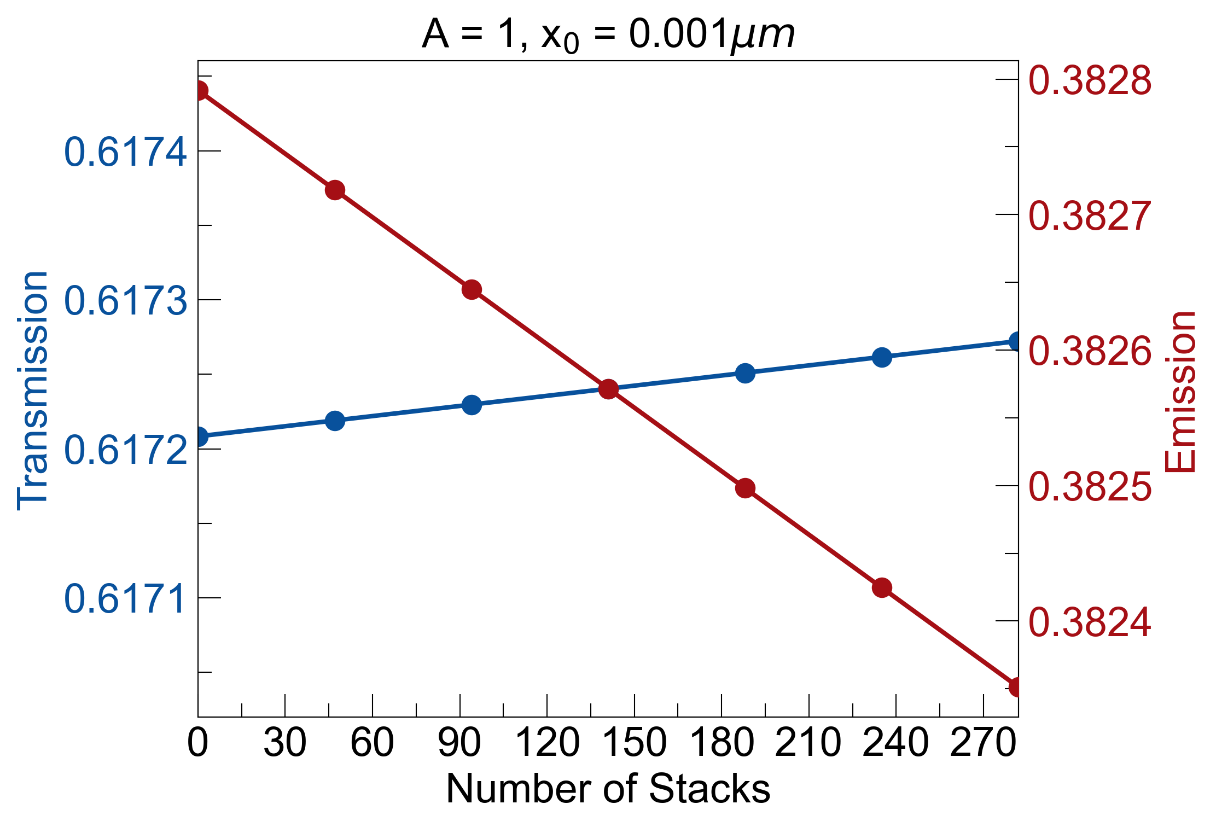
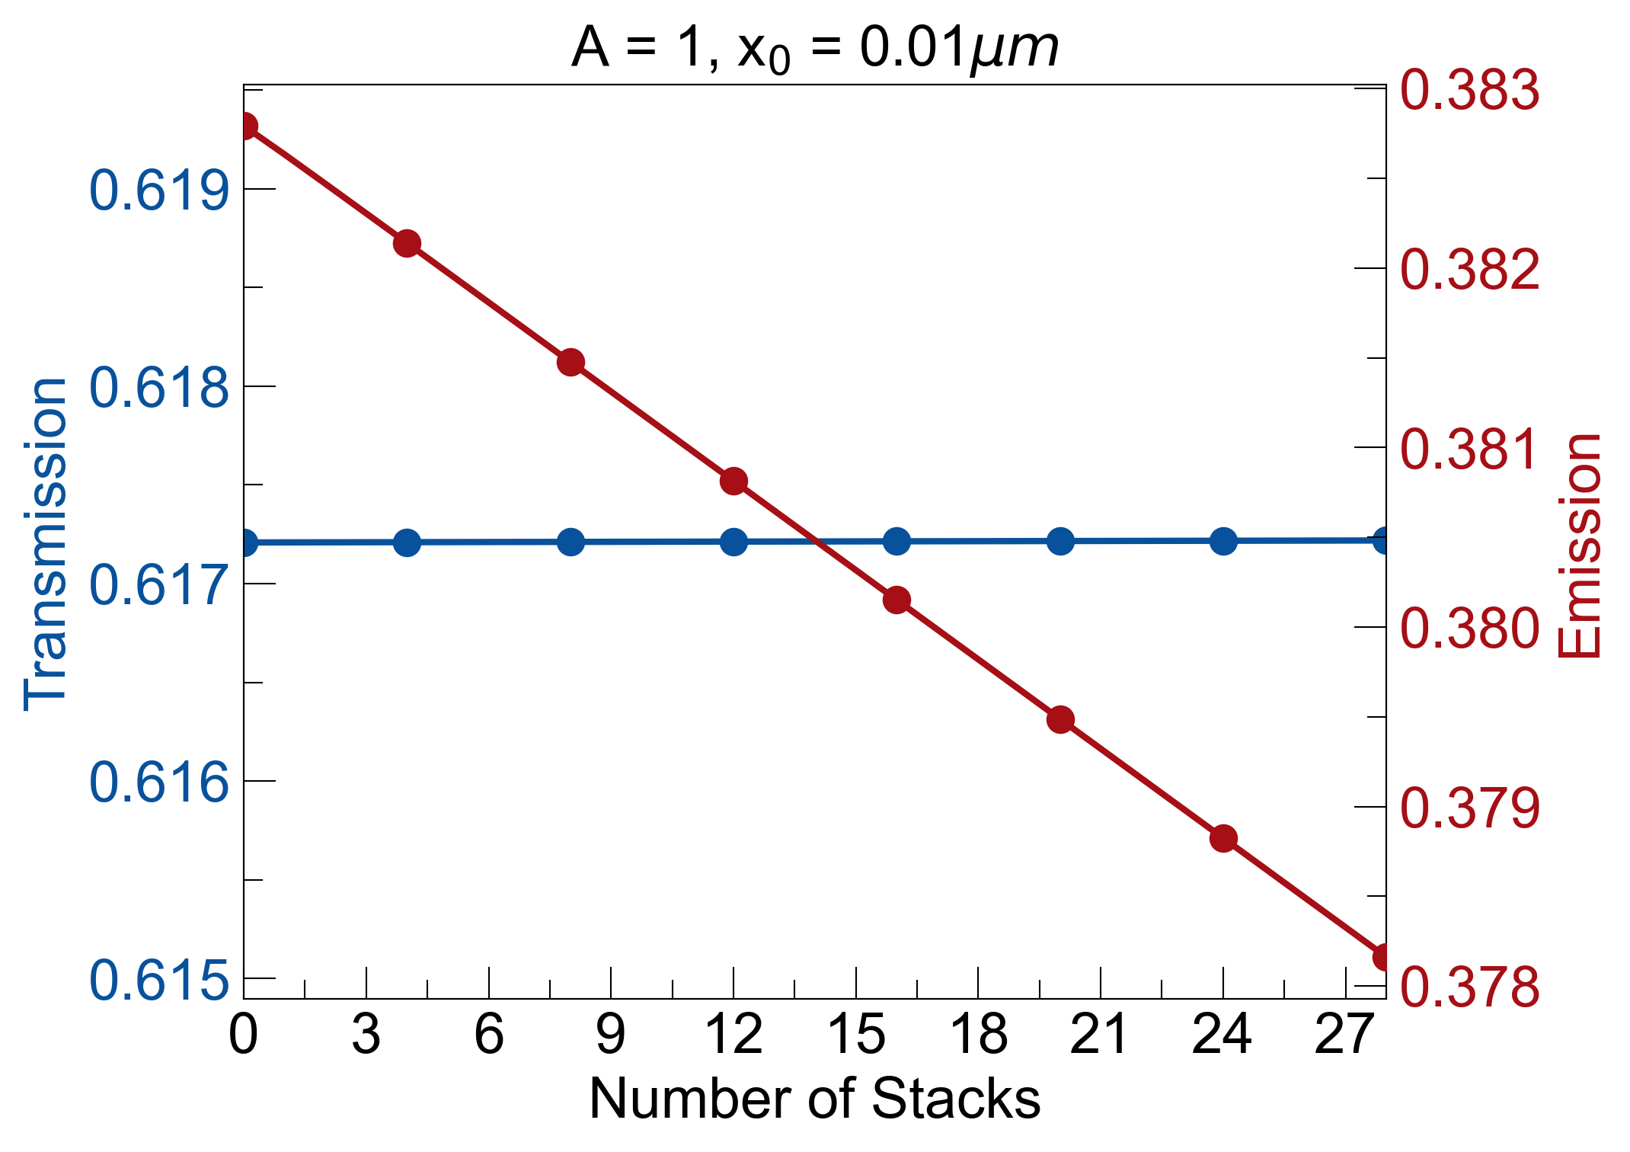
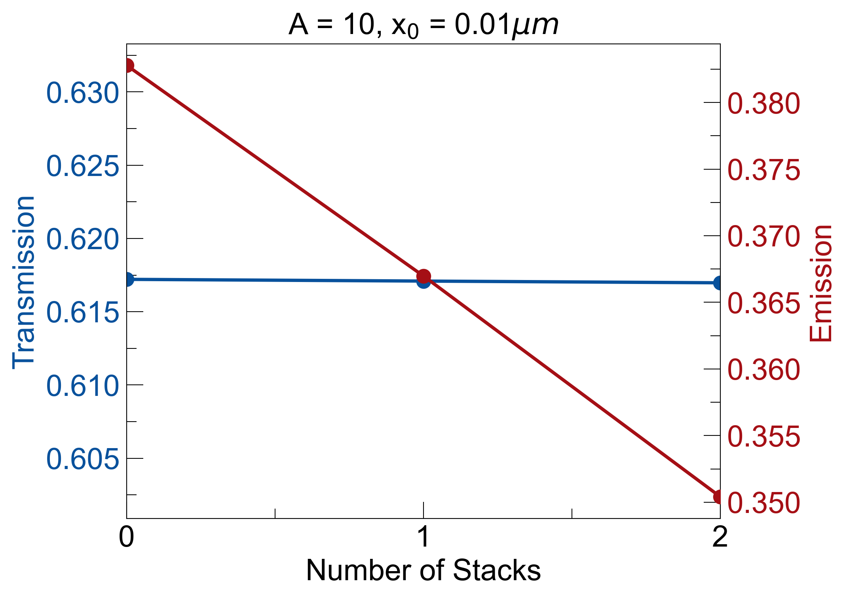
k_{sapphire} (λ = 5µm, T = 300K) = 3.84e-05
many sKK MS with less losses provide less asymmetry compared to fewer sKK MS with higher losses

Slide 4
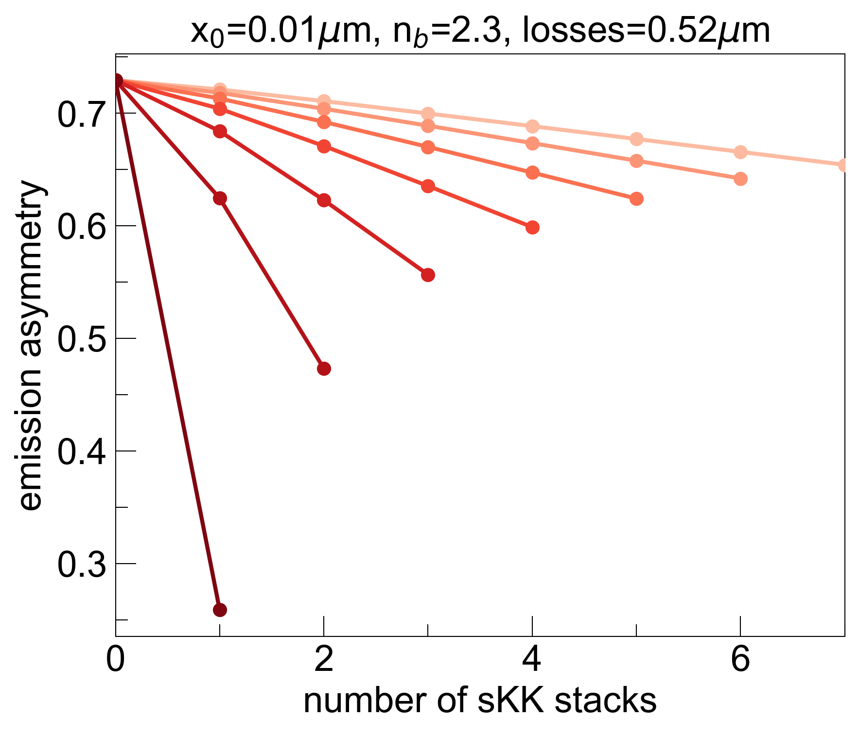
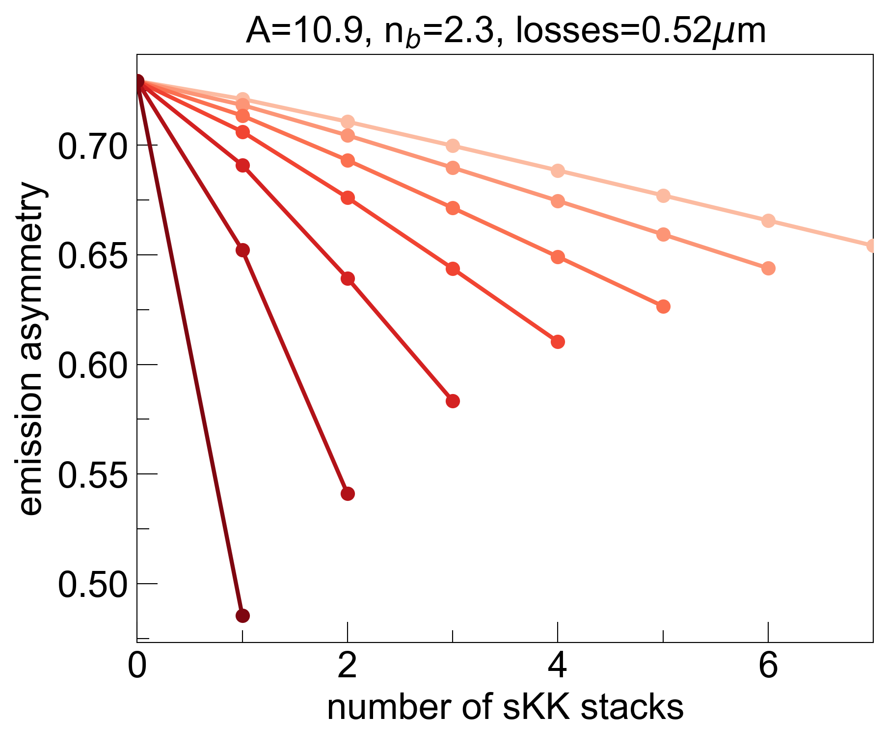
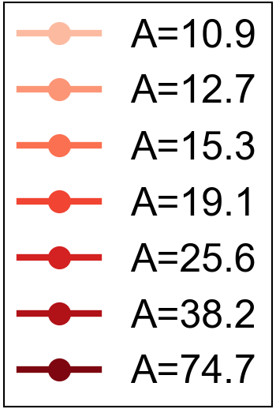
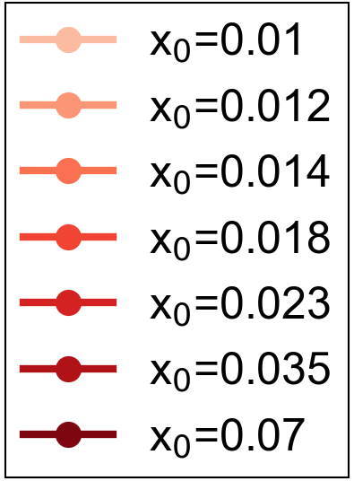
Sweep specific A or x₀ values so that maximum number of sKK stacks addable fully replaces bulk material:
k_{bulk}
s-KK
s-KK
s-KK
s-KK
Both amplitude sweep and width sweep show that maximum asymmetry is achieved when all losses are built into a single KK stack
Focusing losses into a thinner region (large A, small x₀) yields larger asymmetry compared to spreading out losses (small A, large x₀)

Slide 5
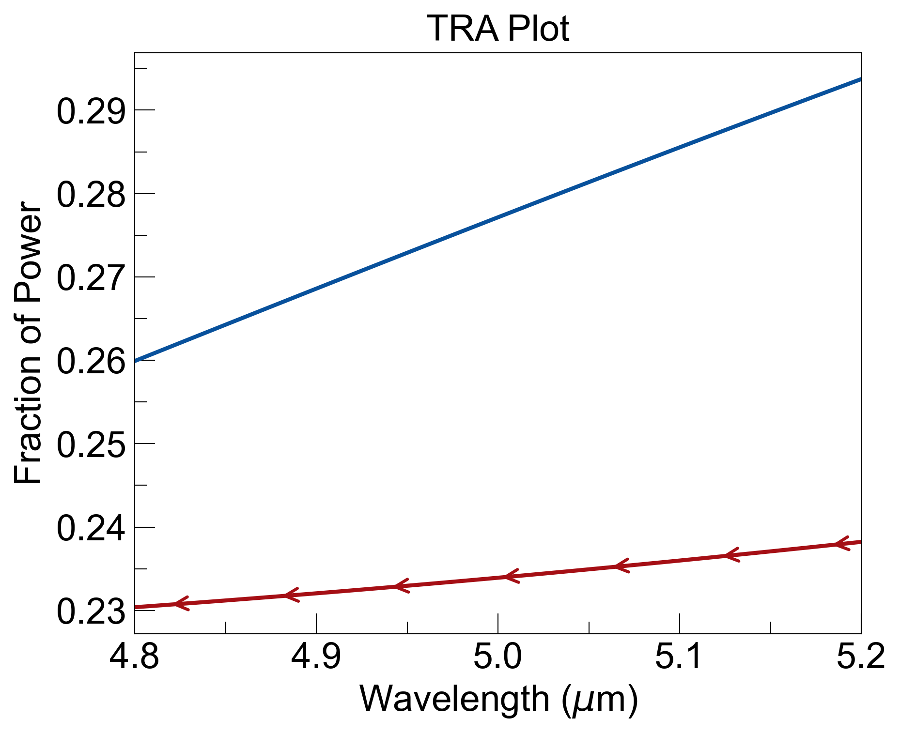
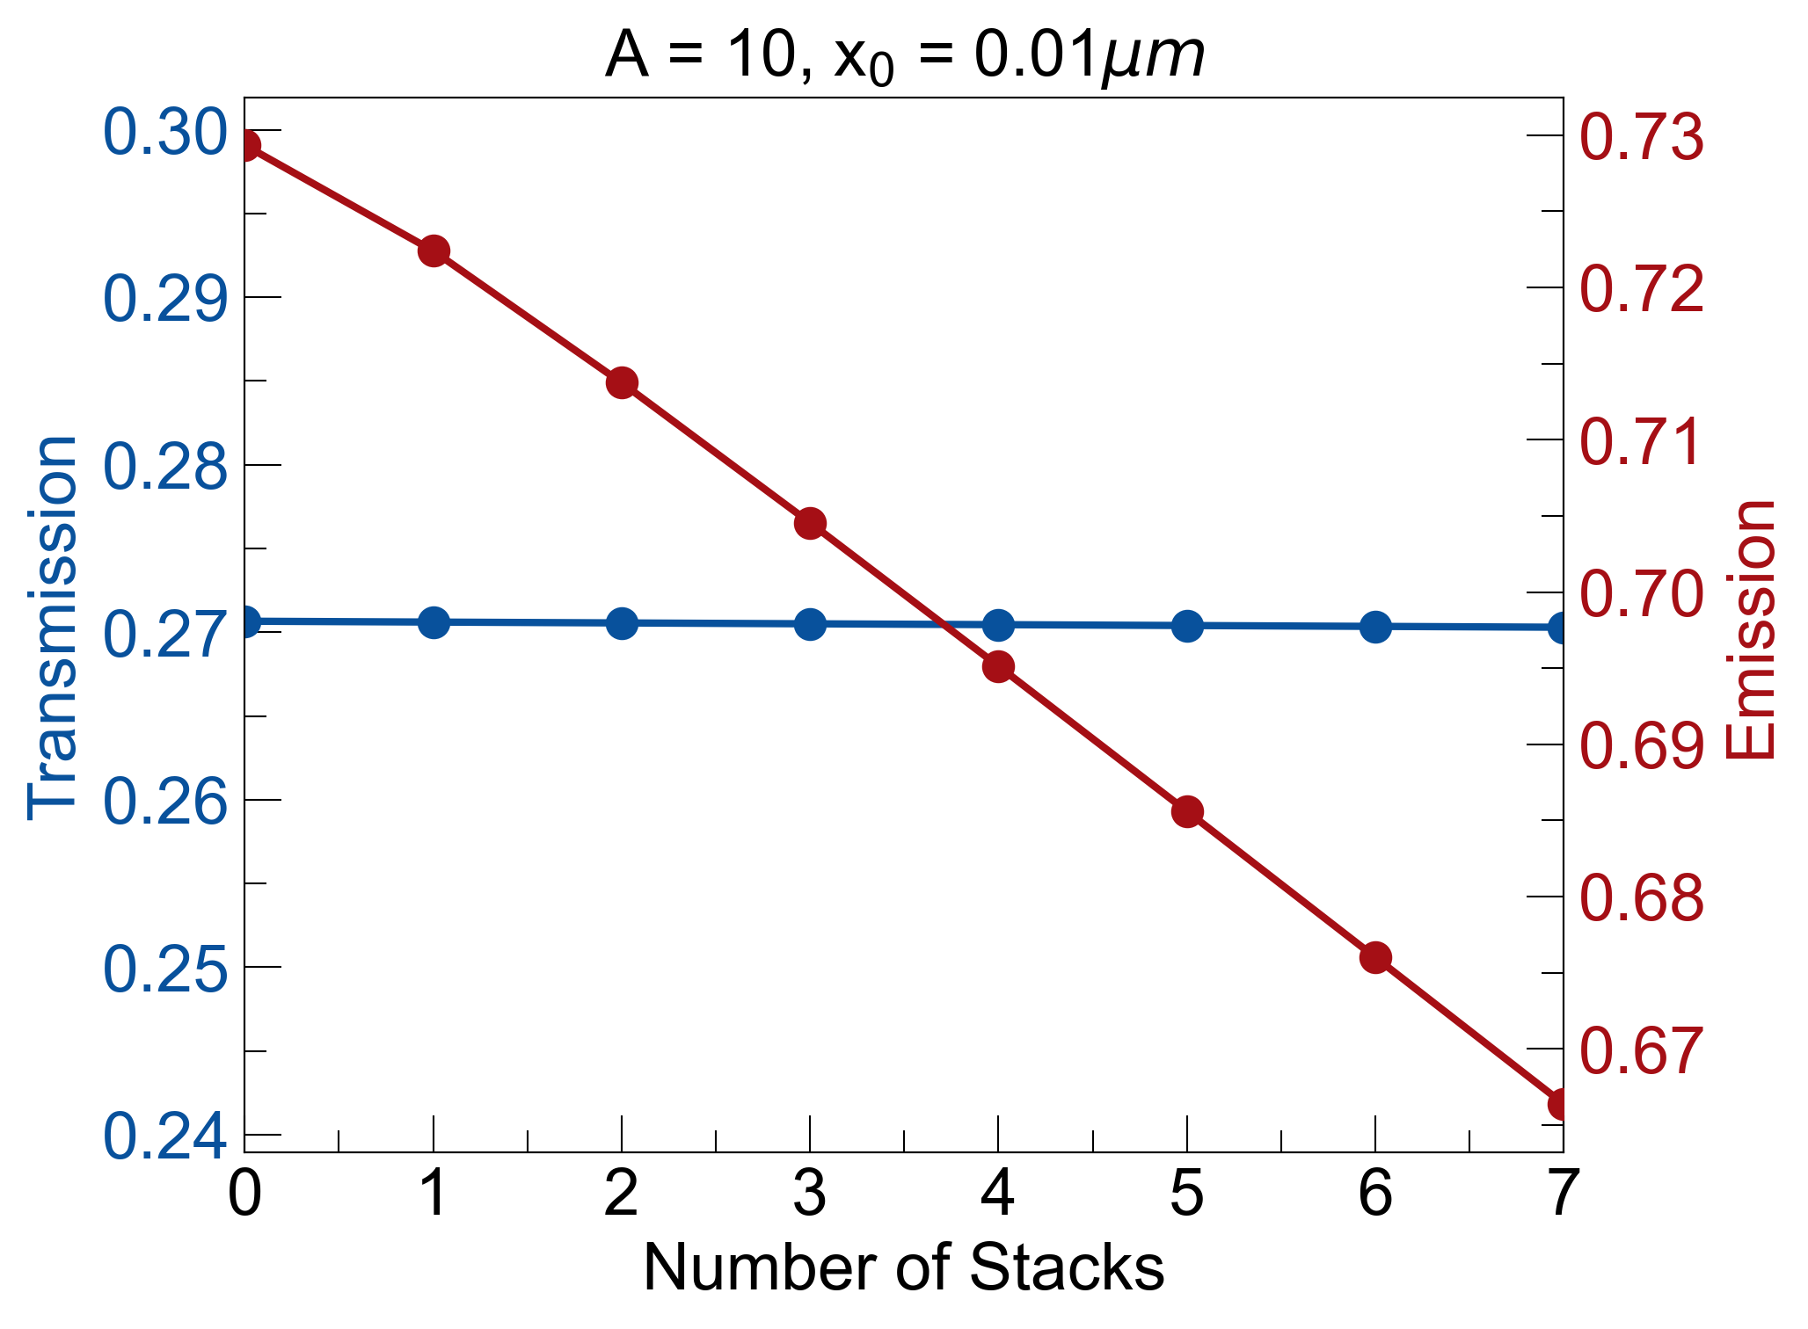

Slide 6
