Slide 1

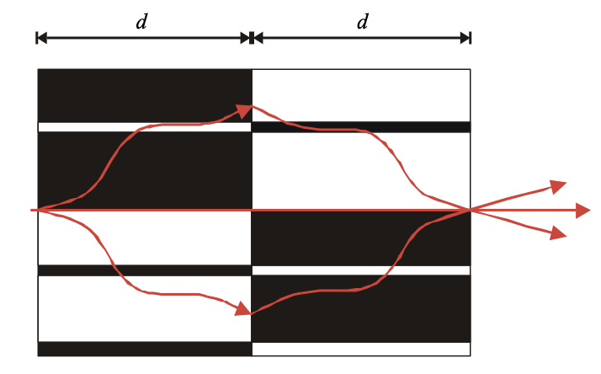
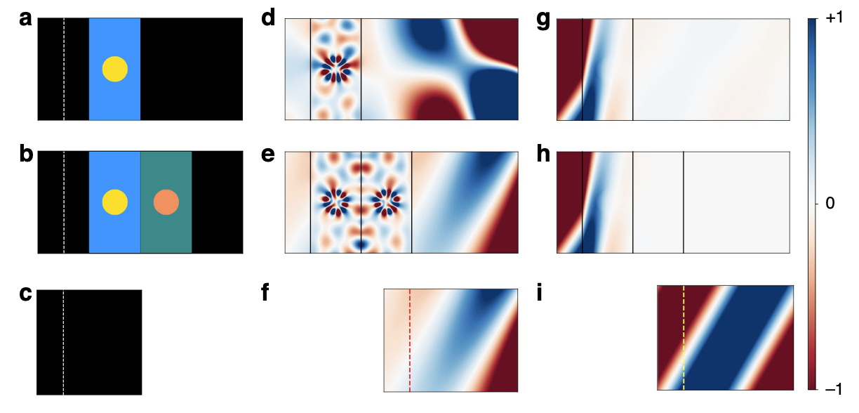


Complex frequency (temporally decaying wave):
$ω$ = $ω′+iω′′$
Allows for lossless propagation in positive-index, dispersive, passive media:
Pendry et al. 2003
complementary media:
idealized to be lossless, which is impractical. due to constraint of positive energy density: negative permittivity -> dispersive -> lossy
“In experiments, the presence of loss has severely limited this demonstration.” Long et al.

Slide 2

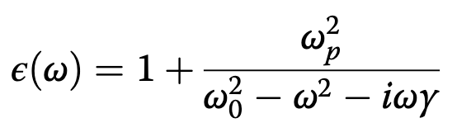
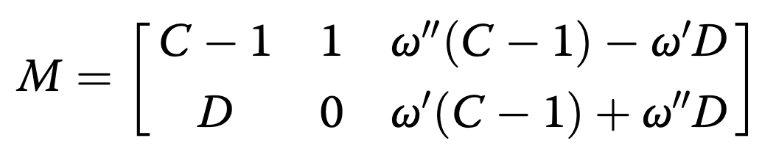
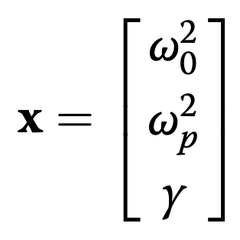

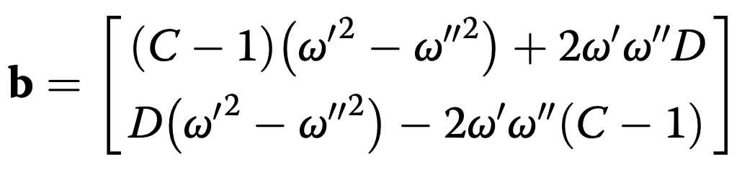



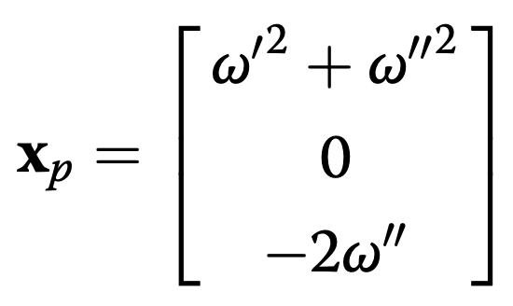
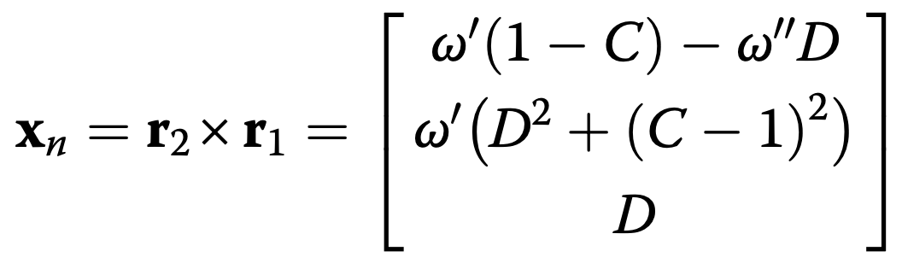
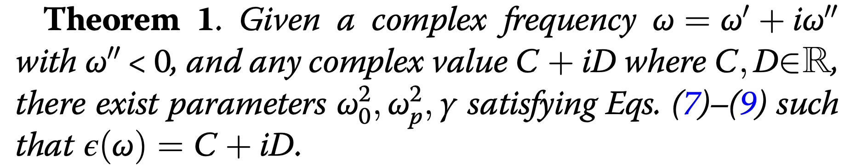
Proof that realizable parameters exist for the setup
Fundamental model for dispersive material (Drude-Lorentz model):
for realizable and non-exotic design of metamaterials, we require
In metamaterials, these can all be controlled
resonance frequency (Eq. 7)
plasma frequency (Eq. 8)
general solution:
damping (Eq. 9)
where ⍺ is a free(ish) variable

Slide 3
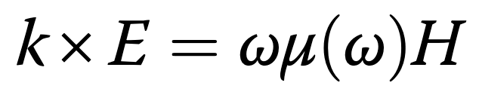
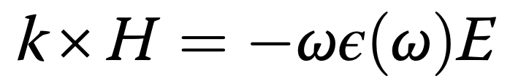
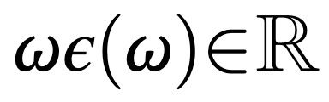
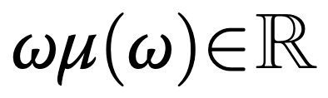
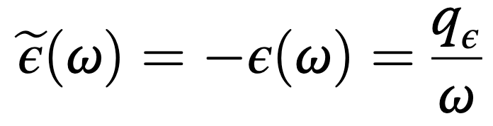
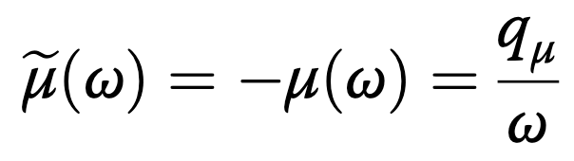

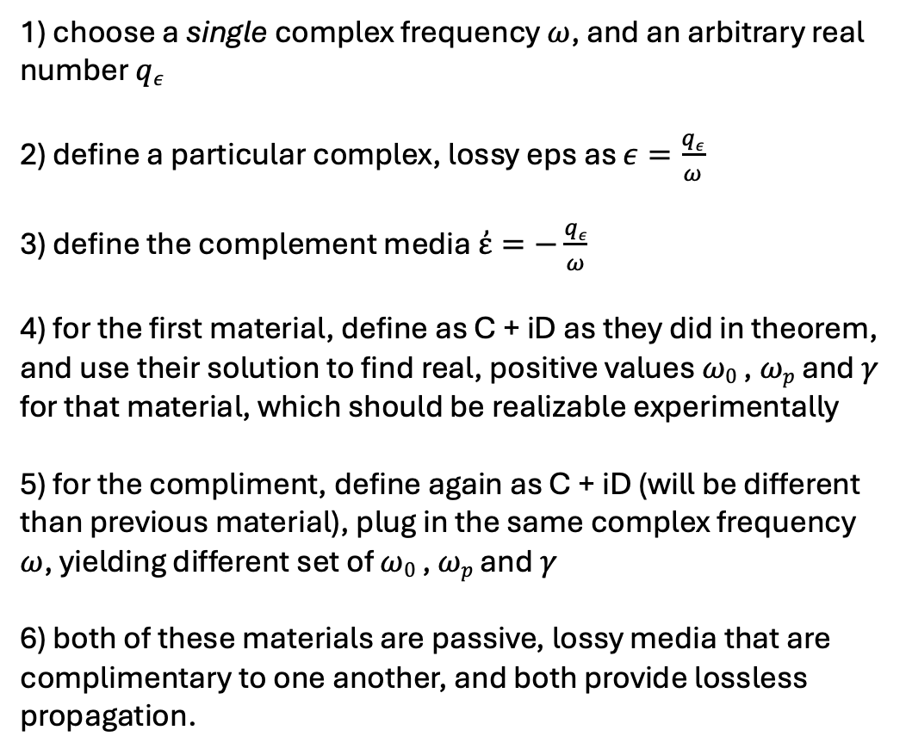
Lossless Propagation in Optical Antimatter using Passive, Lossy Media
Start with Maxwell’s equations:
1) choose a single complex frequency $ω$, and an arbitrary real number $qε$ 2) define a particular complex, lossy eps as $ε=\frac{qε}{ω}$
3) define the complement media $ἐ=−\frac{qε}{ω}$ 4) for the first material, define as C + iD as they did in theorem, and use their solution to find real, positive values $ω0$ , $ωp$ and 𝛾 for that material, which should be realizable experimentally 5) for the compliment, define again as C + iD (will be different than previous material), plug in the same complex frequency $ω$, yielding different set of $ω0$ , $ωp$ and 𝛾 6) both of these materials are passive, lossy media that are complimentary to one another, and both provide lossless propagation.
sub in one for the other, and using vector identities:
$$k2=ω2ε\left(ω\right)μ(ω)$$
so it is sufficient to say for real k:

Slide 4
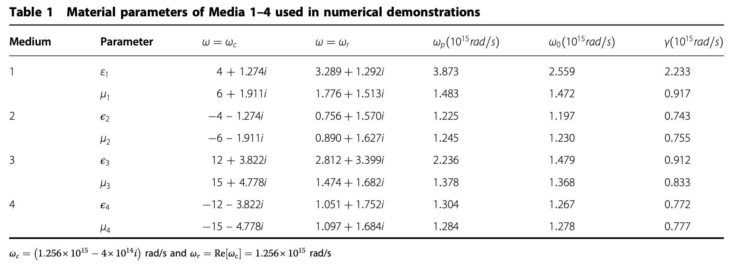
Numerical Demonstration of Optical Antimatter

Slide 5
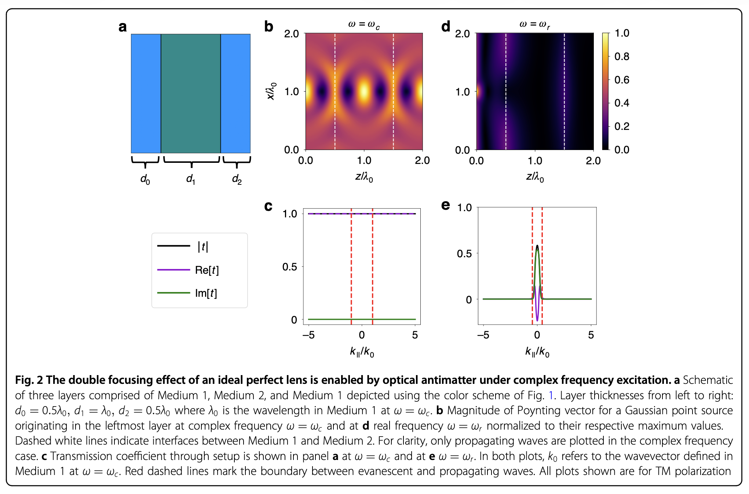
Ideal Perfect Lens using Optical Antimatter

Slide 6
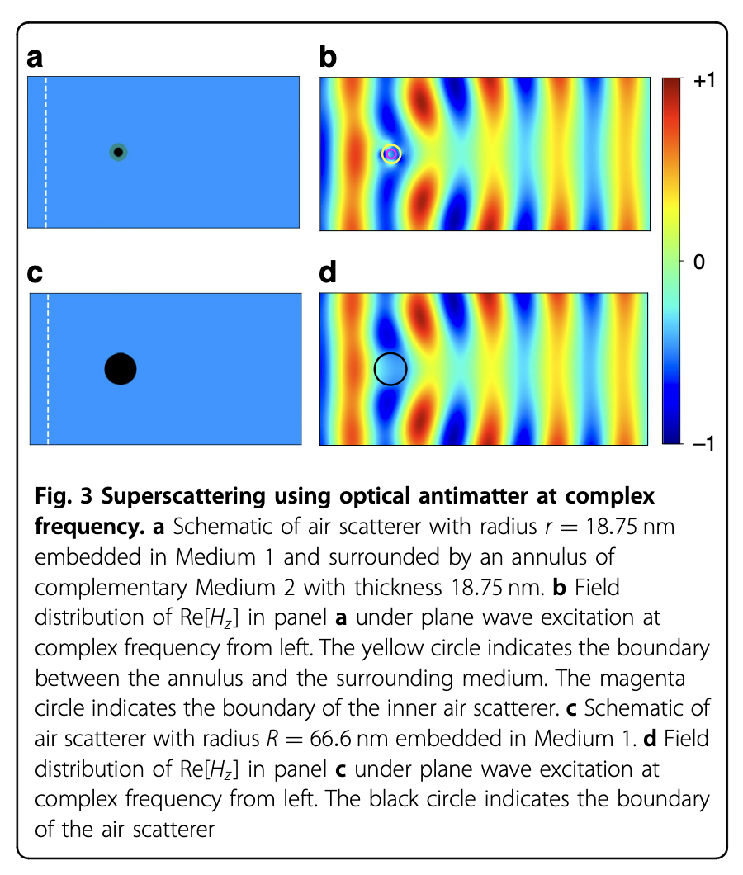
Superscattering using Optical Antimatter

Slide 7
Key Takeaways
Provided an alternative path to achieving complementary media
negative-index materials are hard to fabricate and attenuate the signal due to losses
Use a temporally decaying wave to make positive-index materials behave like negative-index ones, with lossless propagation!
Laid out path for realizable materials for this schema using Drude model parameters
Showed applications of this technique in important fields like lensing, superscattering, etc.

