Slide 1
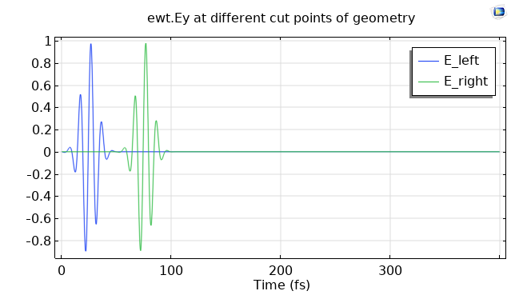

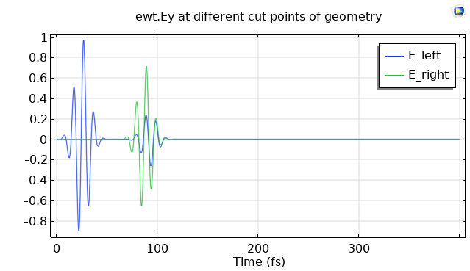
both sides air (𝜀_{r}=1)
.
E_left
E_right
.
left side 𝜀_{r}=1, right side 𝜀_{r}=3

Slide 2
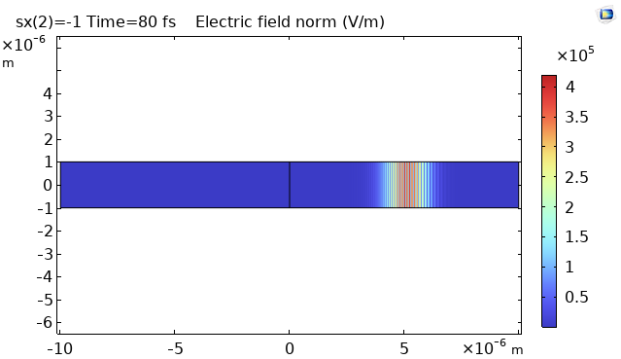
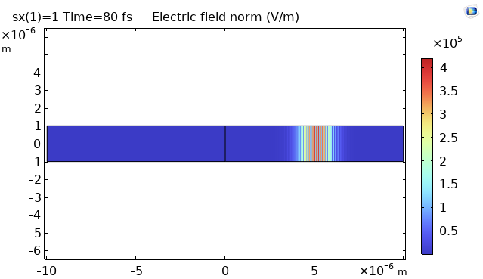
left side 𝜀_{r}=1, right side 𝜀_{r}=3-1i
changing imaginary part from negative to positive did not make a difference.
Comsol is interpreting either sign as gain, or there is another error somewhere.
left side 𝜀_{r}=1, right side 𝜀_{r}=3+1i

