Slide 1
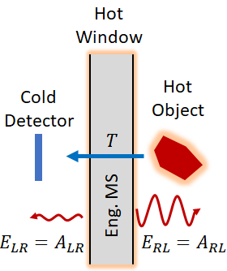
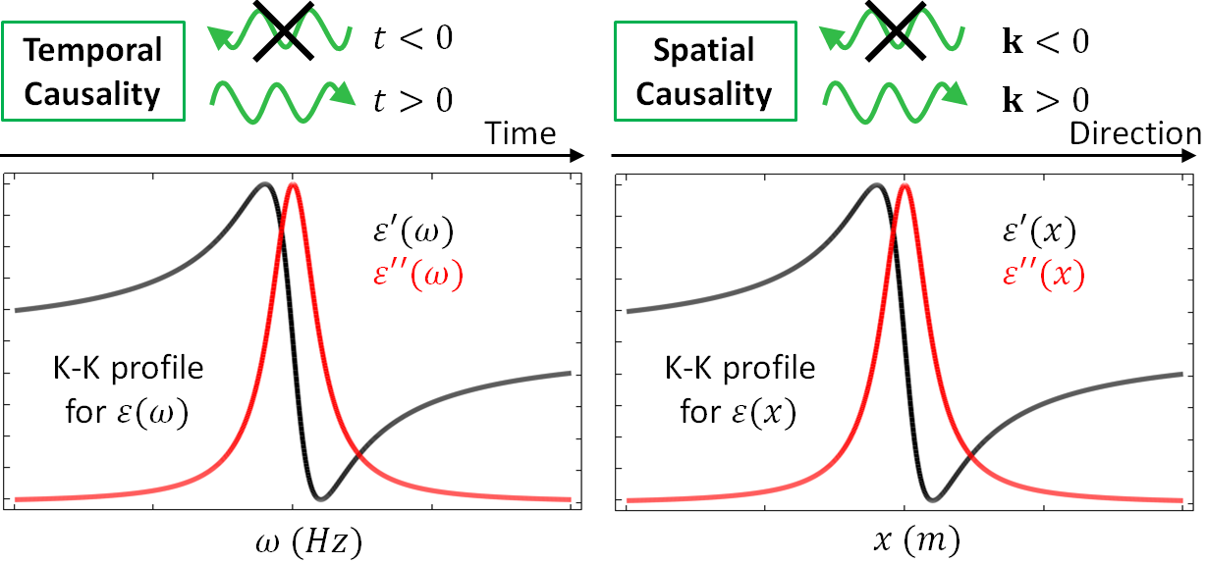
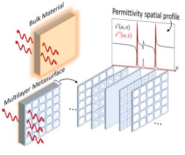
Spatial Kramers-Kronig Metawindow
A spatial Kramers-Kronig (KK) metawindow (MW) is capable of redirecting its own emission
Broadband zero reflectivity for any incident angle
Intuition:
KK in frequency enforces temporal causality (waves only move forward in time)
KK in space enforces momentum causality (waves only move forward in space)

Slide 2
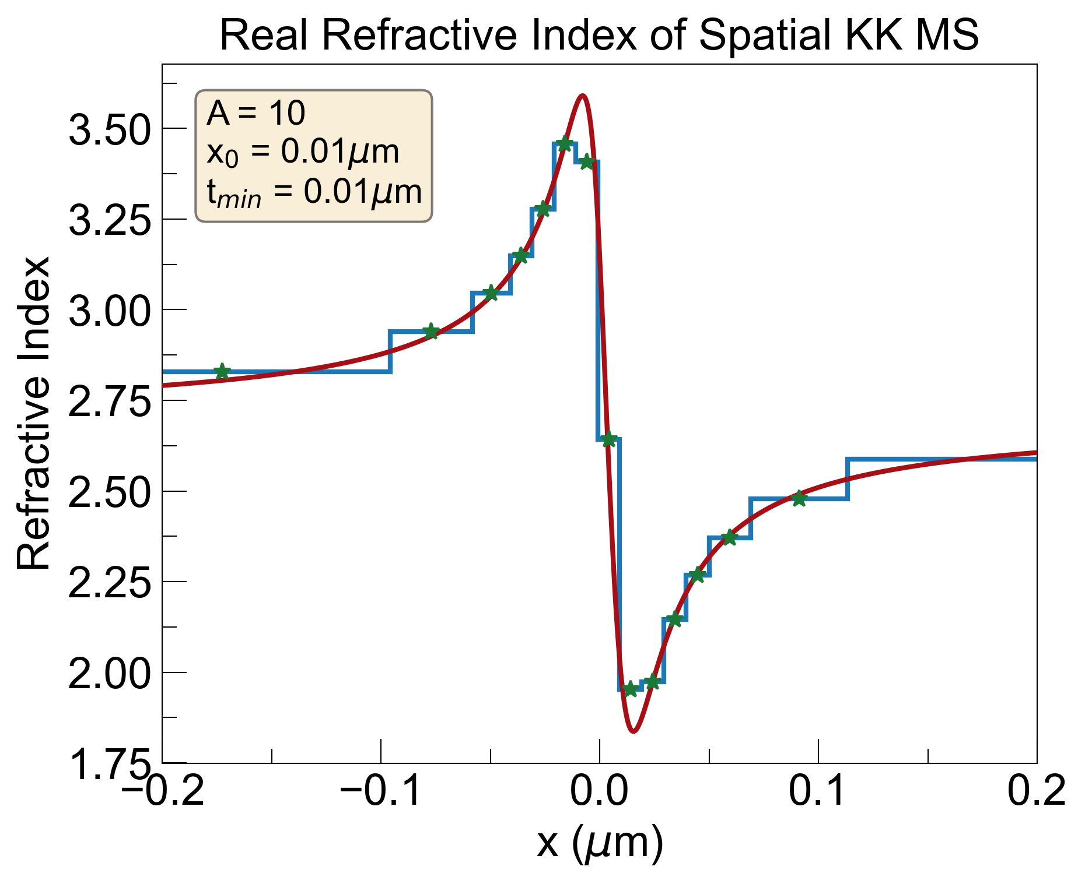
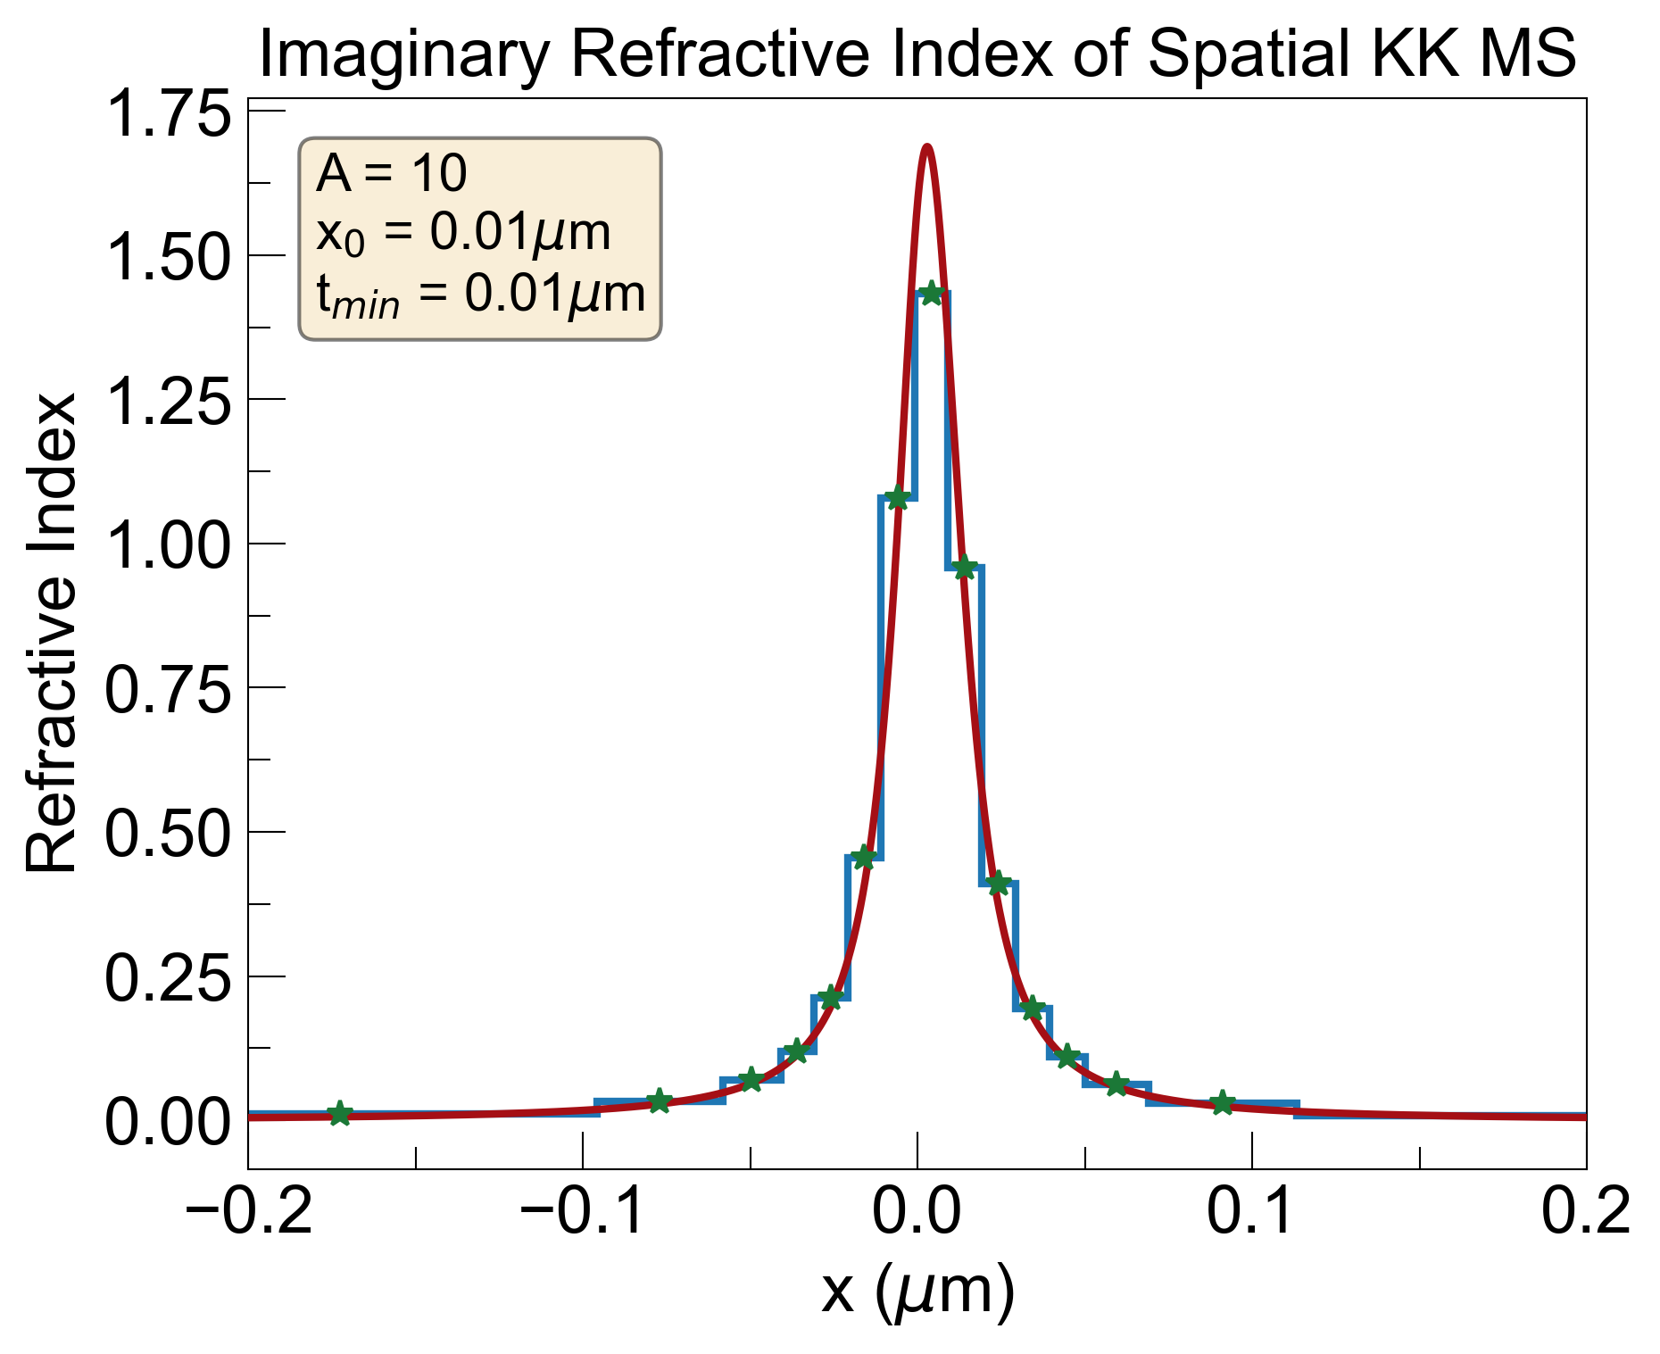
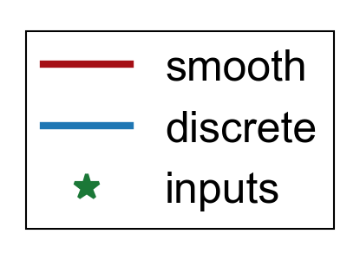
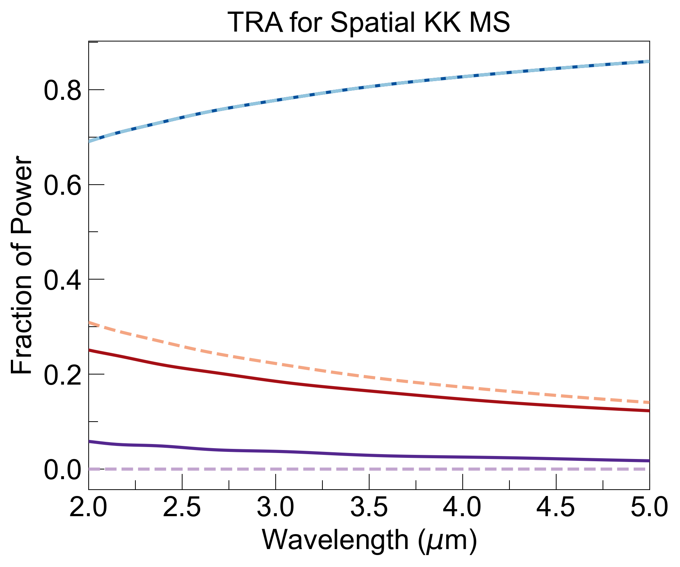
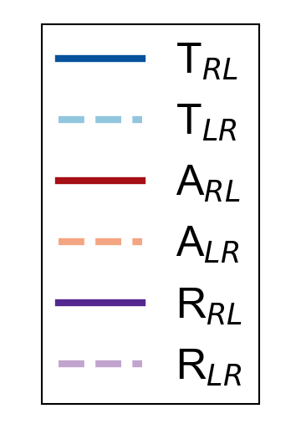
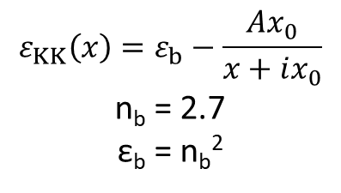
Calculation of Transmittance, Reflectance, Absorbance Using TMM
$$ε_{KK}\left(x\right)=ε_{b}−\frac{Ax_{0}}{x+ix_{0}}$$
n_{b} = 2.7
ε_{b} = n_{b}²

Slide 3
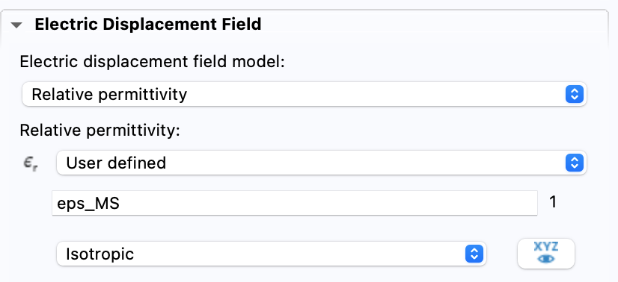
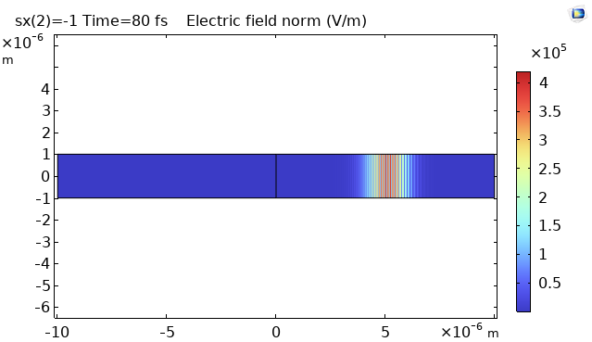
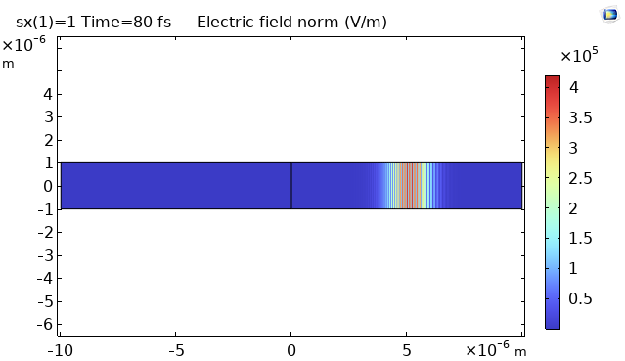
Issues with ‘emt’ Module
directly plugging in sKK permittivity into ‘relative permittivity’ section was making fields diverge
looked at simple system with air on one side and complex permittivity on other, same issue
even changing sign of imaginary part did not help
left side 𝜀_{r}=1, right side 𝜀_{r}=3-1i
left side 𝜀_{r}=1, right side 𝜀_{r}=3+1i

Slide 4
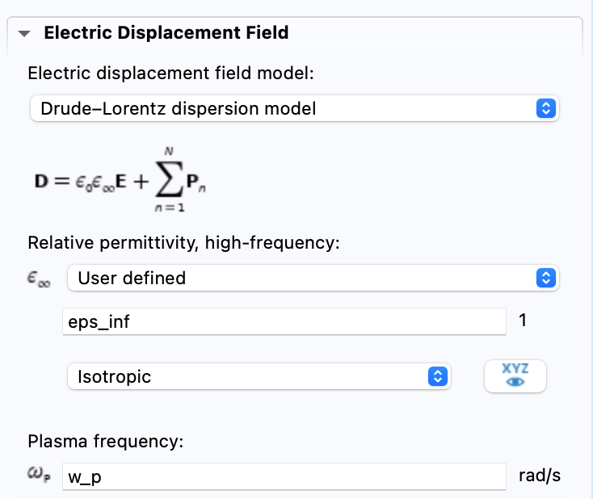
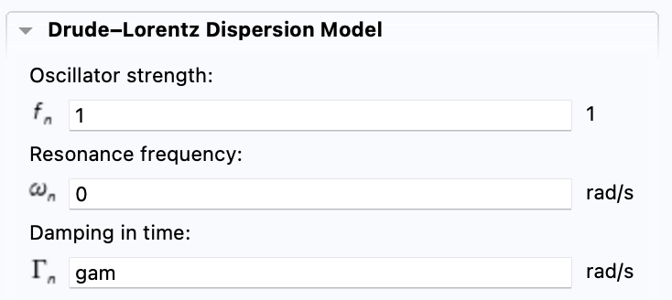
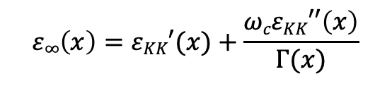
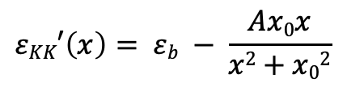
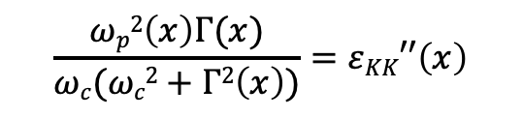
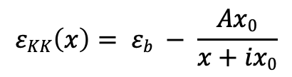
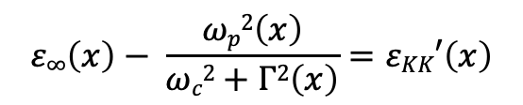
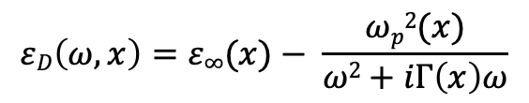
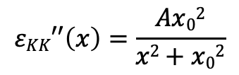

Represent sKK Profile as a Drude Material
$$εD\left(ω,x\right)=ε∞(x)− \frac{ωp2(x)}{ω2+iΓ\left(x\right)ω}$$
$$εKK\left(x\right)= εb − \frac{Ax0}{x+ix0}$$
$$εKK′\left(x\right)= εb − \frac{Ax0x}{x2+x02}$$
$$εKK′′\left(x\right)=\frac{Ax02}{x2+x02}$$
pick a carrier frequency ω_{c} of pulse, set real and imaginary parts equal:
$$ε∞\left(x\right)− \frac{ωp2\left(x\right)}{ωc2+Γ2\left(x\right)}=εKK′\left(x\right)$$
$$\frac{ωp2\left(x\right)Γ(x)}{ωc(ωc2+Γ2\left(x\right))}=εKK′′\left(x\right)$$
write ω_{p} in terms of ε_{KK}’’(x) in right equation and plug into left:
$$ε∞\left(x\right)=εKK′(x)+\frac{ωcεKK′′\left(x\right)}{Γ(x)}$$
underdetermined (2 equations, 3 unknowns). intuitively set Γ(x):
$$Γ\left(x\right)=\frac{ωcεKK′′\left(x\right)}{a0}$$

Slide 5

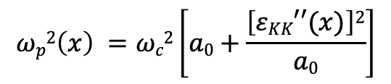



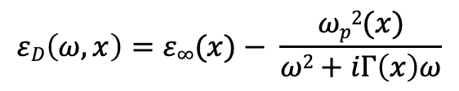
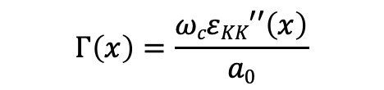
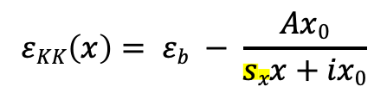
Represent sKK Profile as a Drude Material
$$εD\left(ω,x\right)=ε∞(x)− \frac{ωp2(x)}{ω2+iΓ\left(x\right)ω}$$
, with
$$Γ\left(x\right)=\frac{ωcεKK′′\left(x\right)}{a0}$$
$$ωp2\left(x\right) =ωc2\left[a0+\frac{\left[εKK′′(x)\right]2}{a0}\right]$$
$$ε∞\left(x\right)=εKK′(x)+a0$$
,
,
,
$$a0>0$$
at ω=ω_{c} :
$$εD\left(ωc,x\right)=εKK(x)$$
- multiply spatial term in sKK permittivity by -1 or 1 to flip direction of propagation:
$$εKK\left(x\right)= εb − \frac{Ax0}{sxx+ix0}$$
$$, sx=1\left(LR\right), −1(RL)$$
- can modify ‘s_{x}’ in study sweeps without changing geometry or material info.

Slide 6
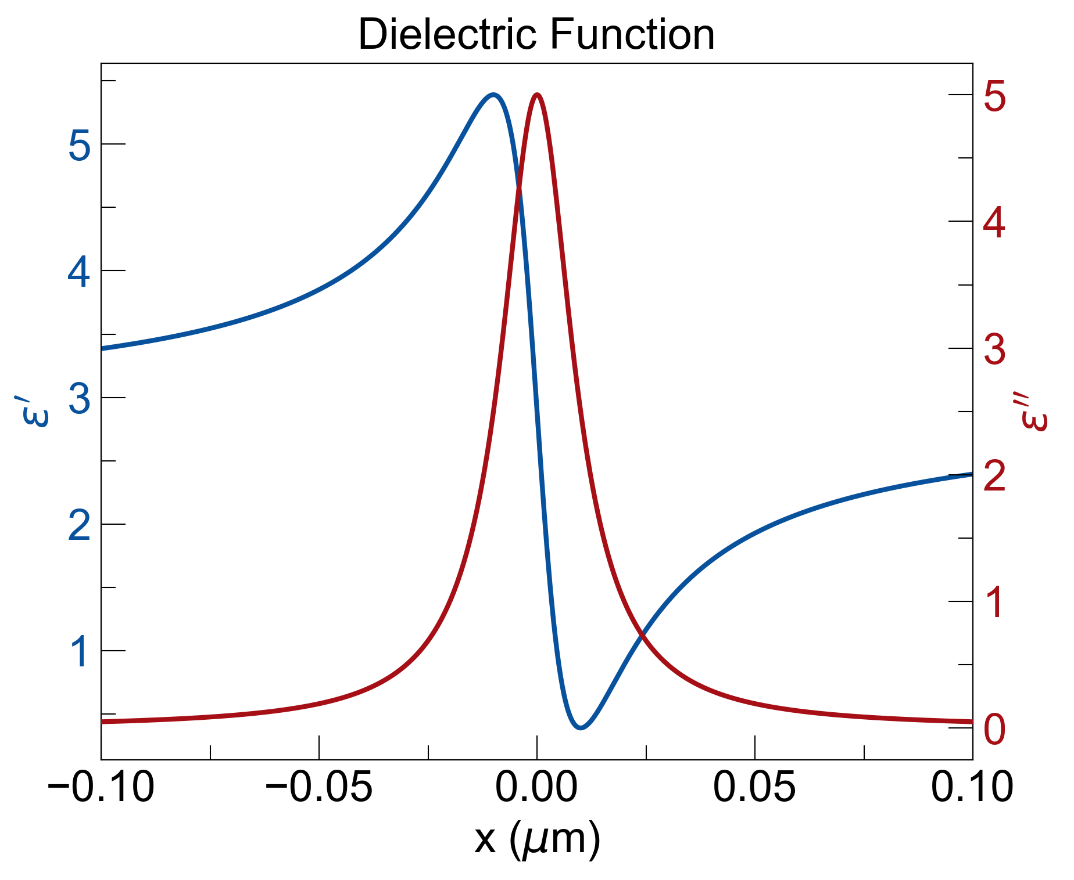
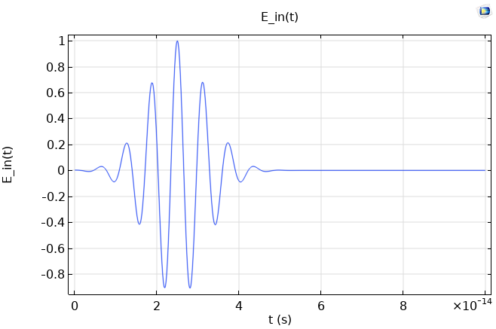
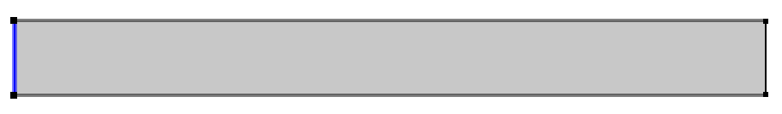
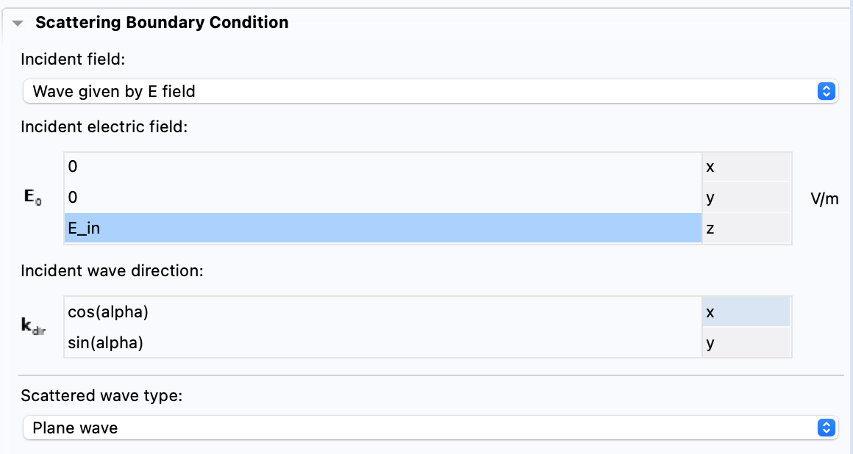
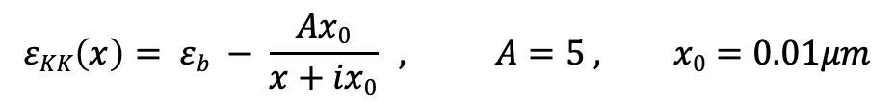
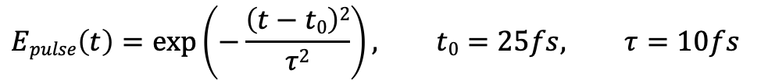
Baseline Run
$$εKK\left(x\right)= εb − \frac{Ax0}{x+ix0} , A=5 , x0=0.01μm$$
sample KK profile:
$$Epulse\left(t\right)=exp\left(−\frac{\left(t−t0\right)2}{τ2}\right), t0=25fs, τ=10fs$$
input pulse:
$$Eband\left(t\right)=E0\cos\left(ωct −kcx\right), E0=1\frac{V}{m}, ωc=1015 rad/s$$
$$Ein\left(t\right)=Epulse\left(t\right)∗Eband\left(t\right)$$
L_{x} = 20um
L_{y} = 2um

Slide 7
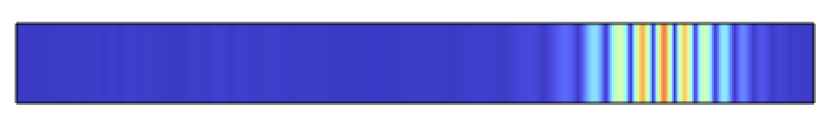
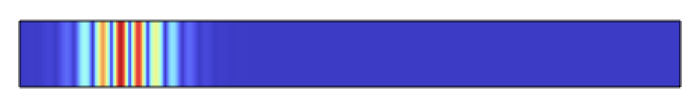
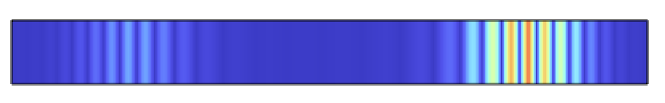
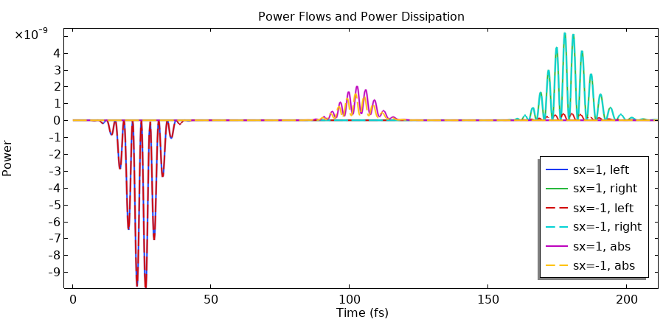
Results
s_{x} = 1
color plot of ewt.normE:
t = 50fs
s_{x} = -1
t = 150fs
calculated outgoing power and dissipated power as a function of time. legend:
left: surface integral of outgoing power from the left (ewt.nPo)
right: surface integral of outgoing power from the right (ewt.nPo)
abs: volume integral of resistive losses (ewt.Qrh)

Slide 8
Results
calculated total, transmitted, reflected, and absorbed energy by integrating over time :
T_{LR} = 0.75 , T_{RL} = 0.75 , R_{LR} = 0.0005 , R_{RL} = 0.05 , A_{LR} = 0.25 , A_{RL} = 0.2
ran a quick TMM calculation with the same parameters (λ = 1.88um):
T_{LR} = 0.74 , T_{RL} = 0.74 , R_{LR} = 5e-6 , R_{RL} = 0.056 , A_{LR} = 0.26 , A_{RL} = 0.21

Slide 9
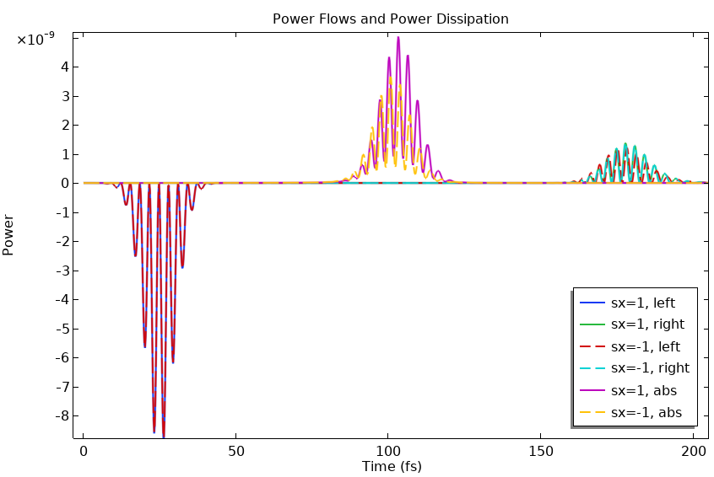
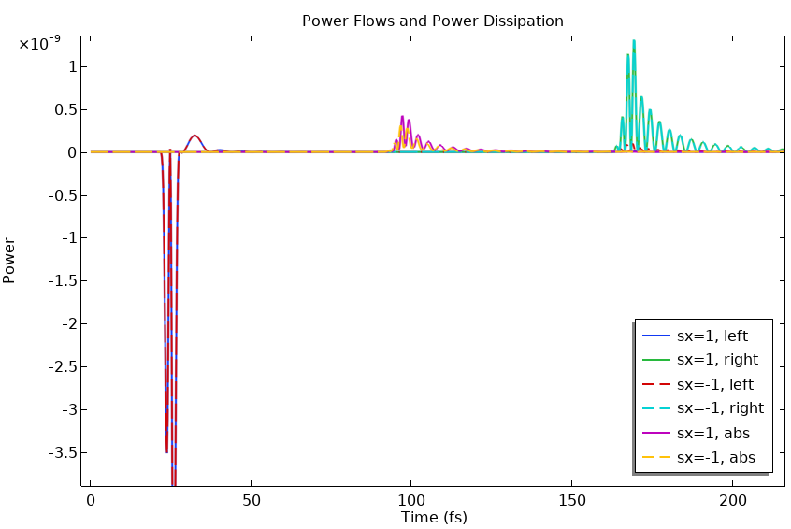
Results
alpha (AoI) = 30° , x₀ = 0.05um (broader) :
𝜏 = 2fs (5 times smaller):
what about the physics is changing here?
what about the model needs to change?

Slide 10
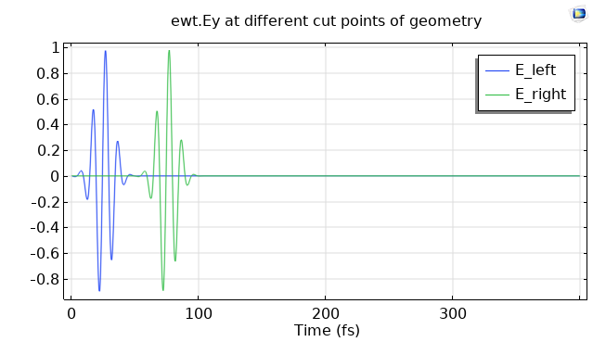
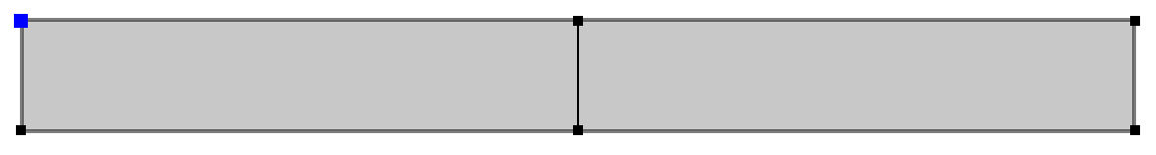
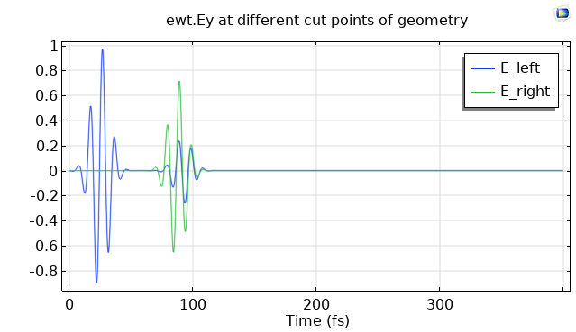
both sides air (𝜀_{r}=1)
.
E_left
E_right
.
left side 𝜀_{r}=1, right side 𝜀_{r}=3

