Slide 1
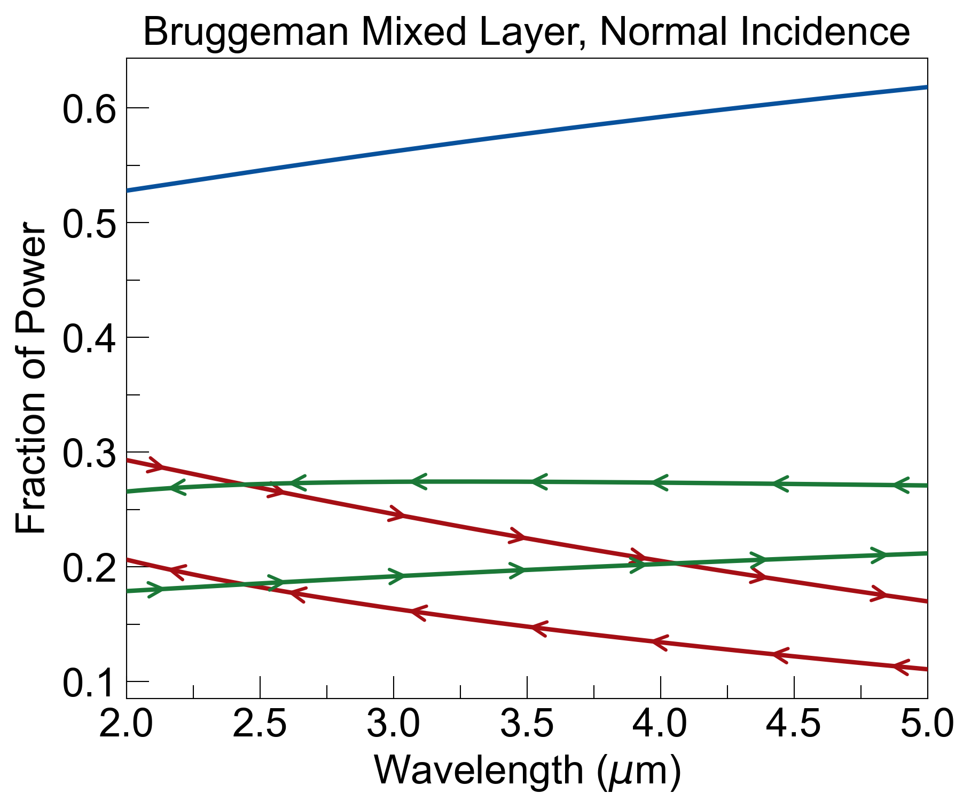
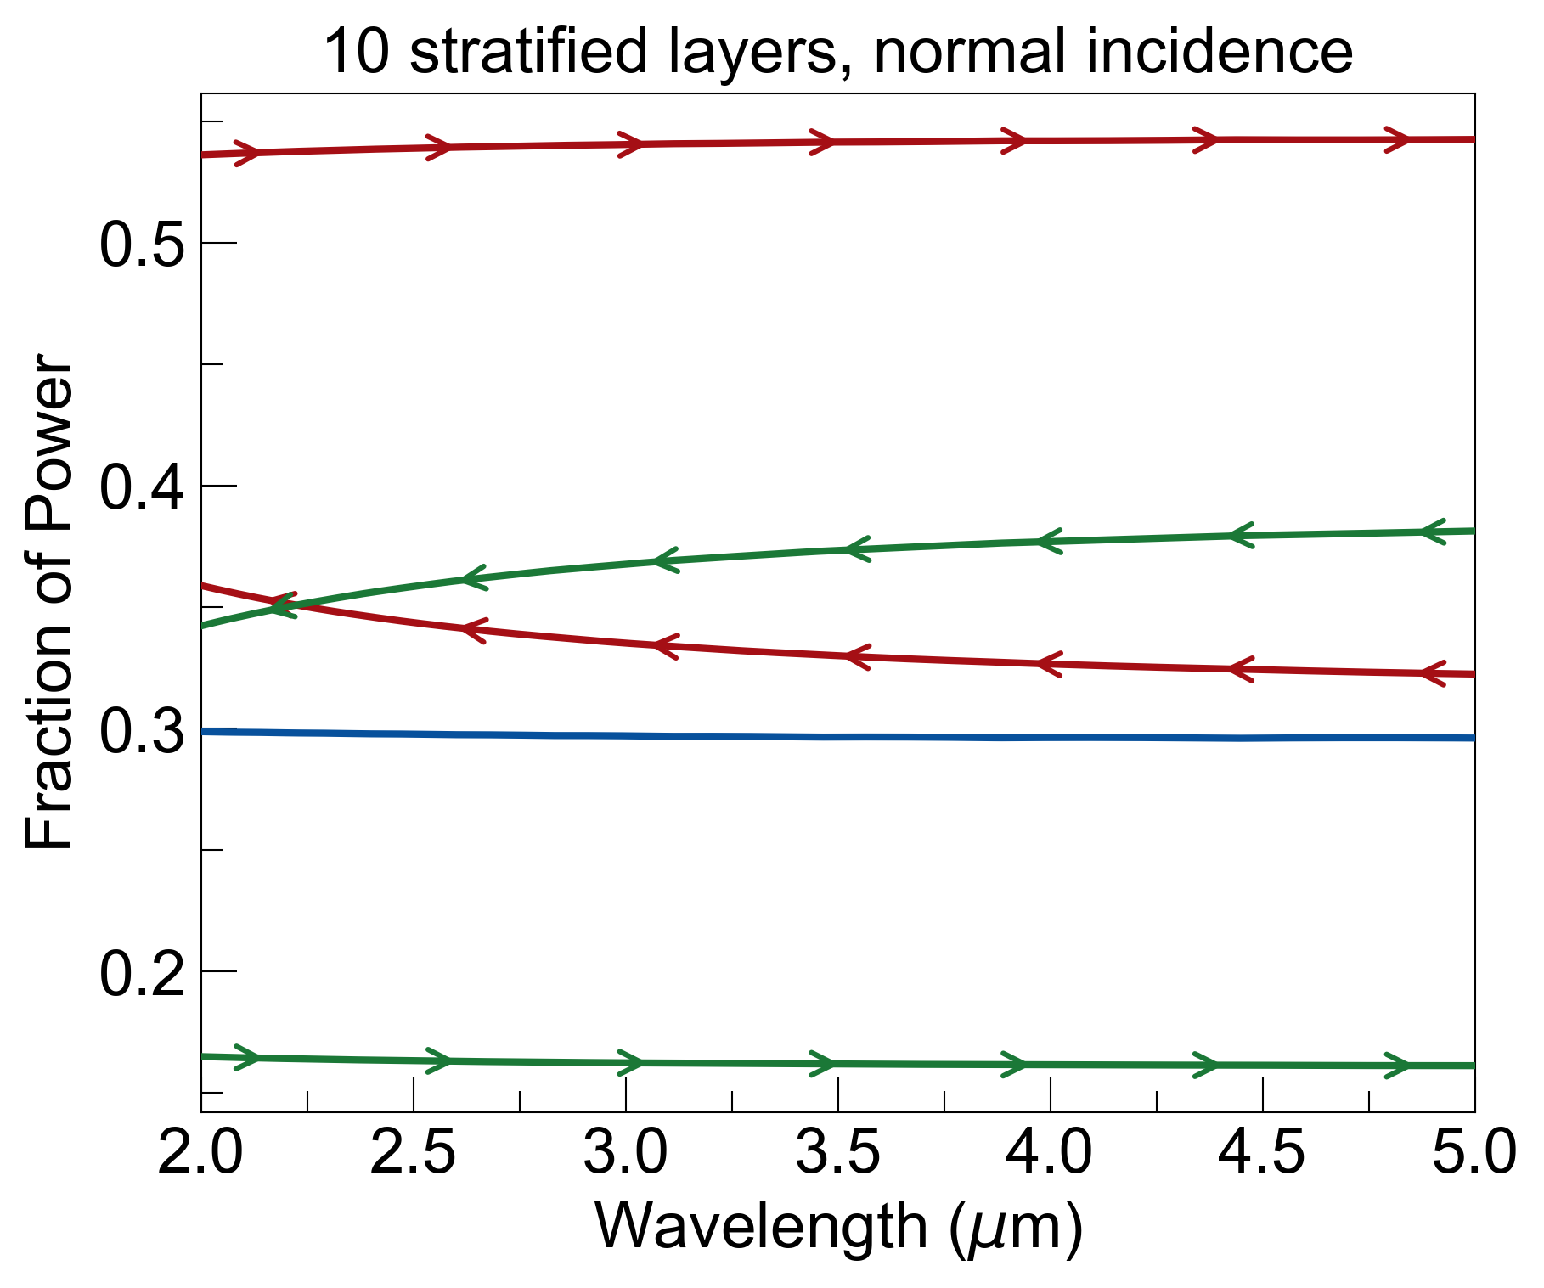
stratified layers do not match response from Bruggeman mixed layer
concentration f = 0.75
material A = sapphire
material B = graphite
total layer thickness = 100nm
A
B
A
B
A
B
…
…
a
b

Slide 2
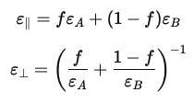
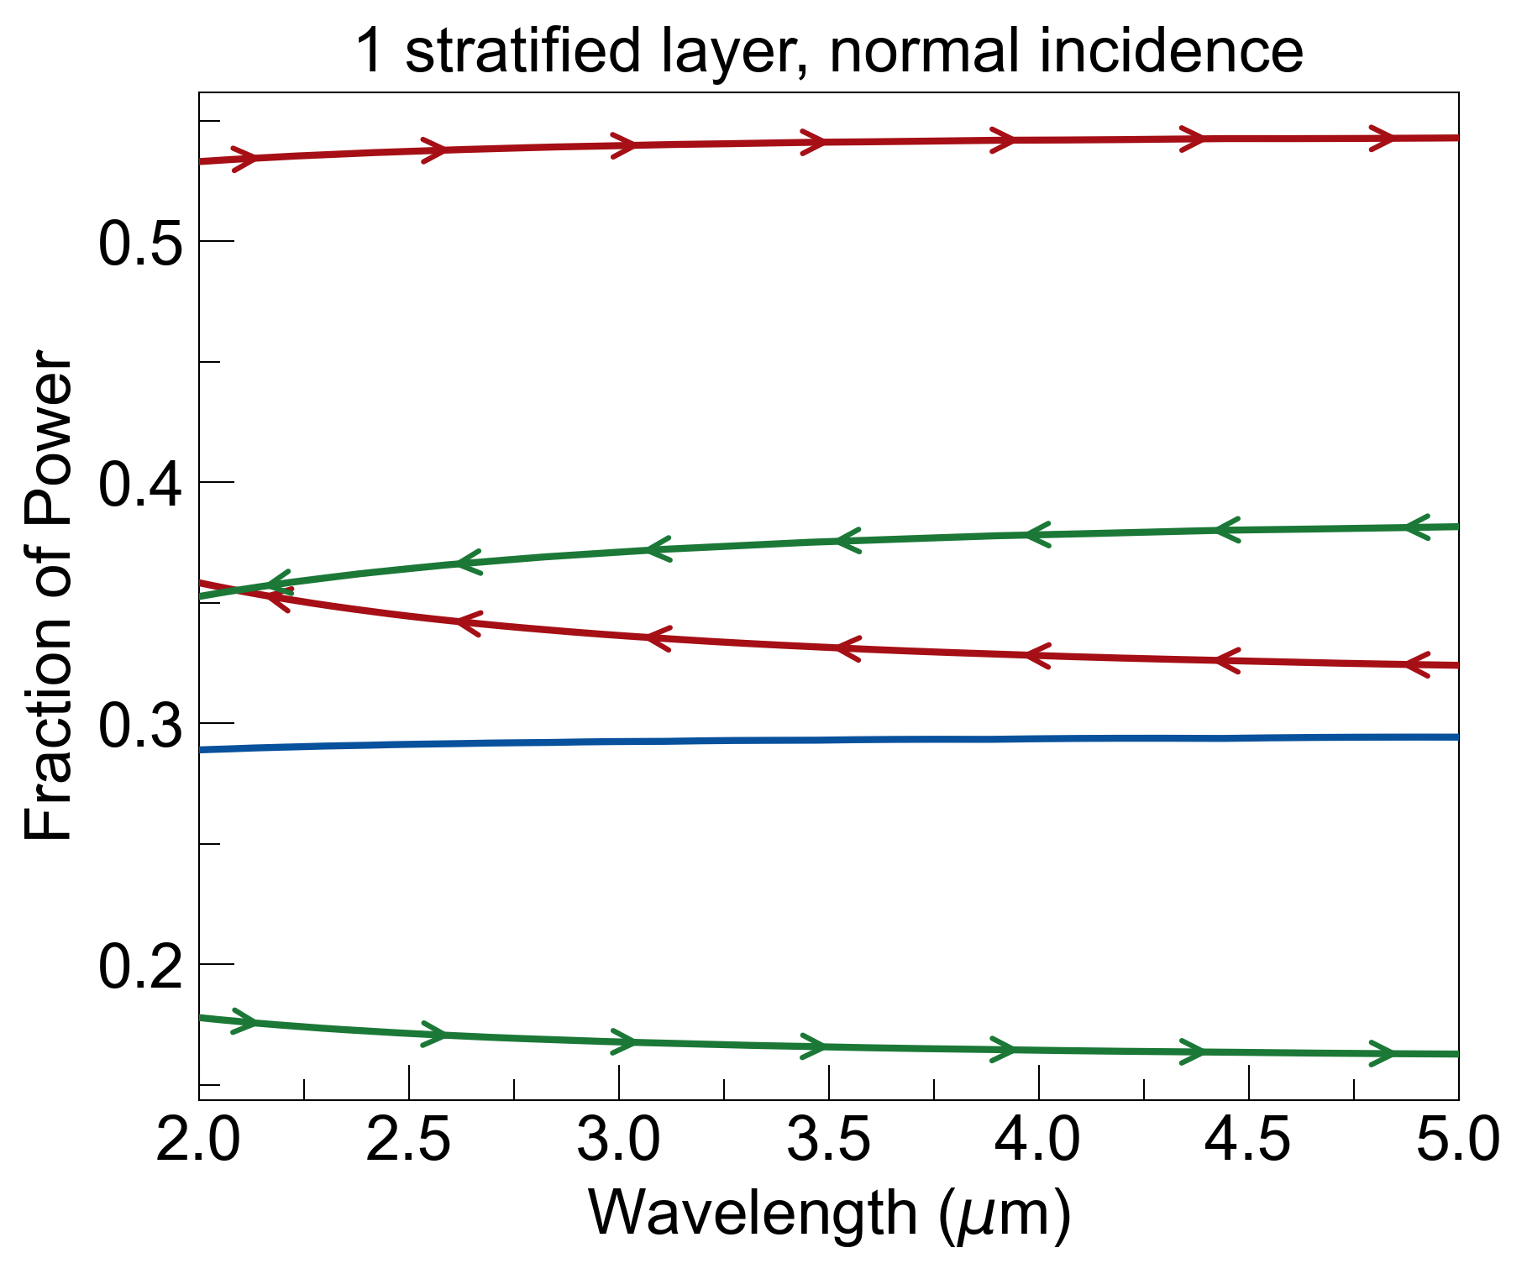
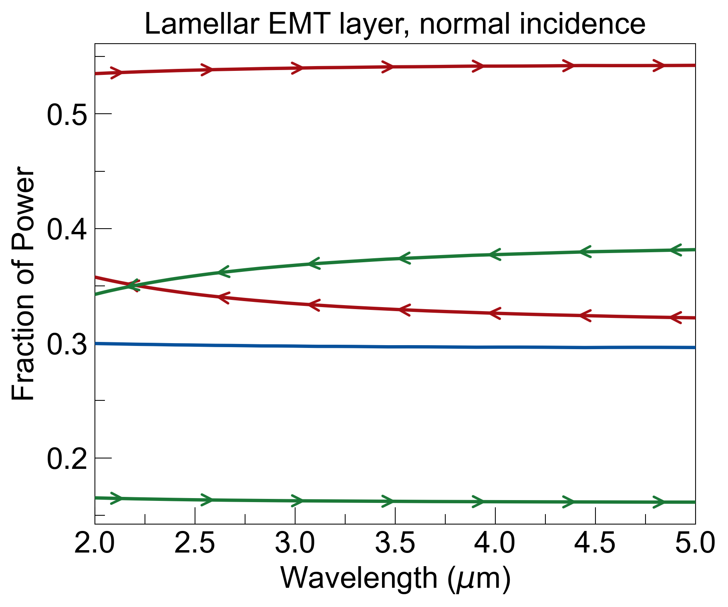
lamellar/Rytov effective medium theory
E||
or
x
E⟂
if a + b << λ:
A
B
A
B
A
B
…
…
a
b

Slide 3
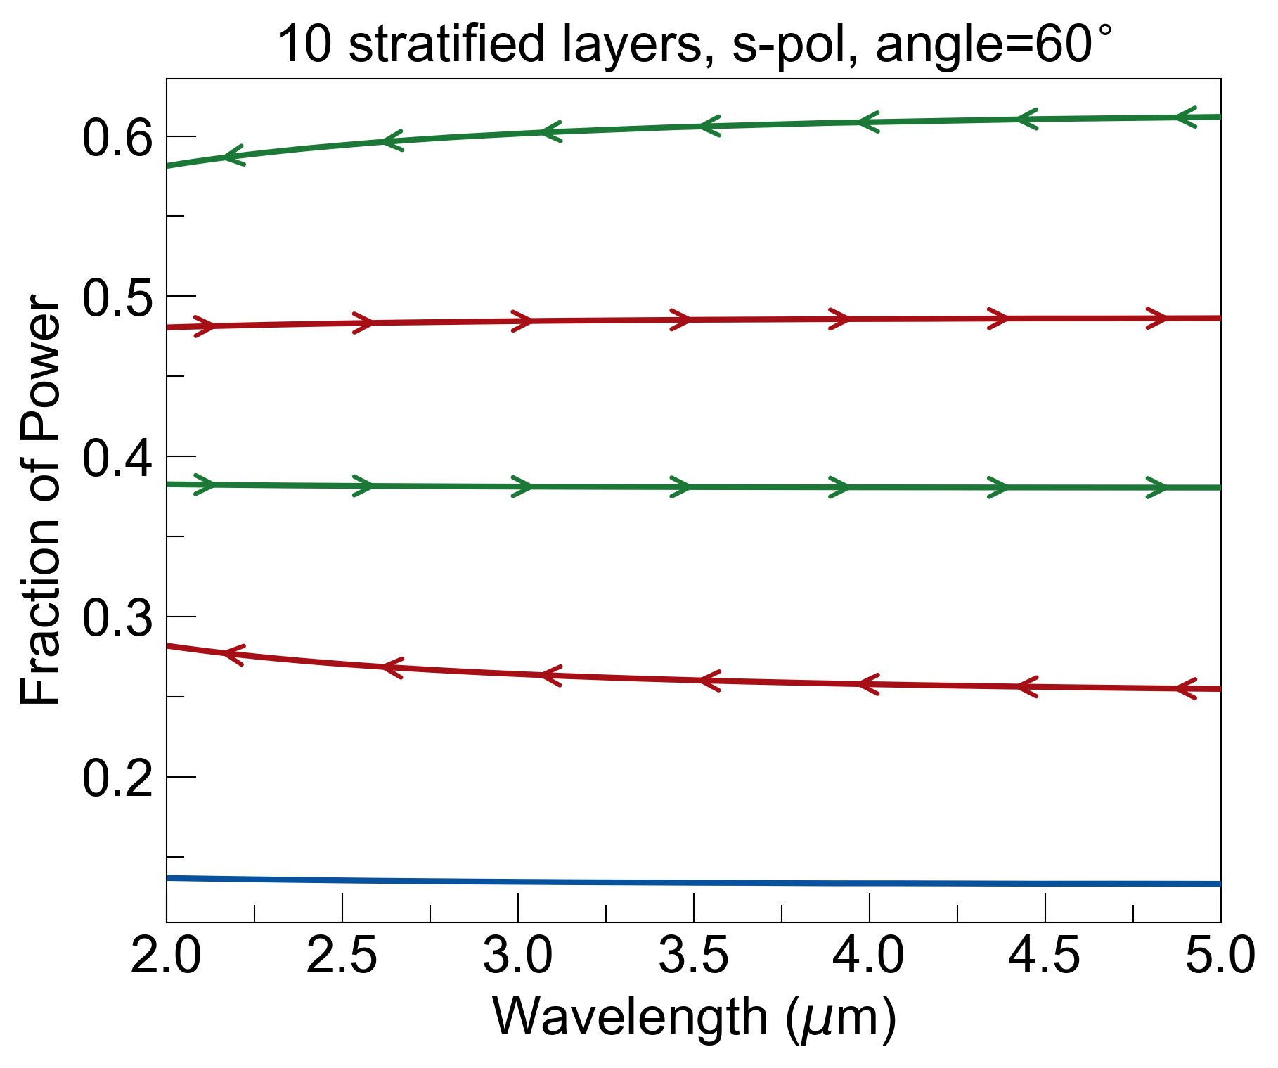
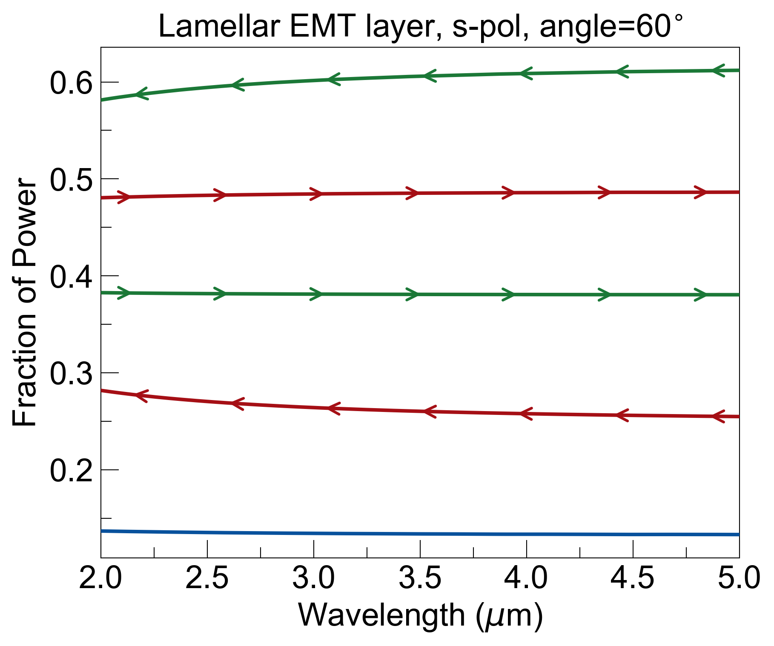
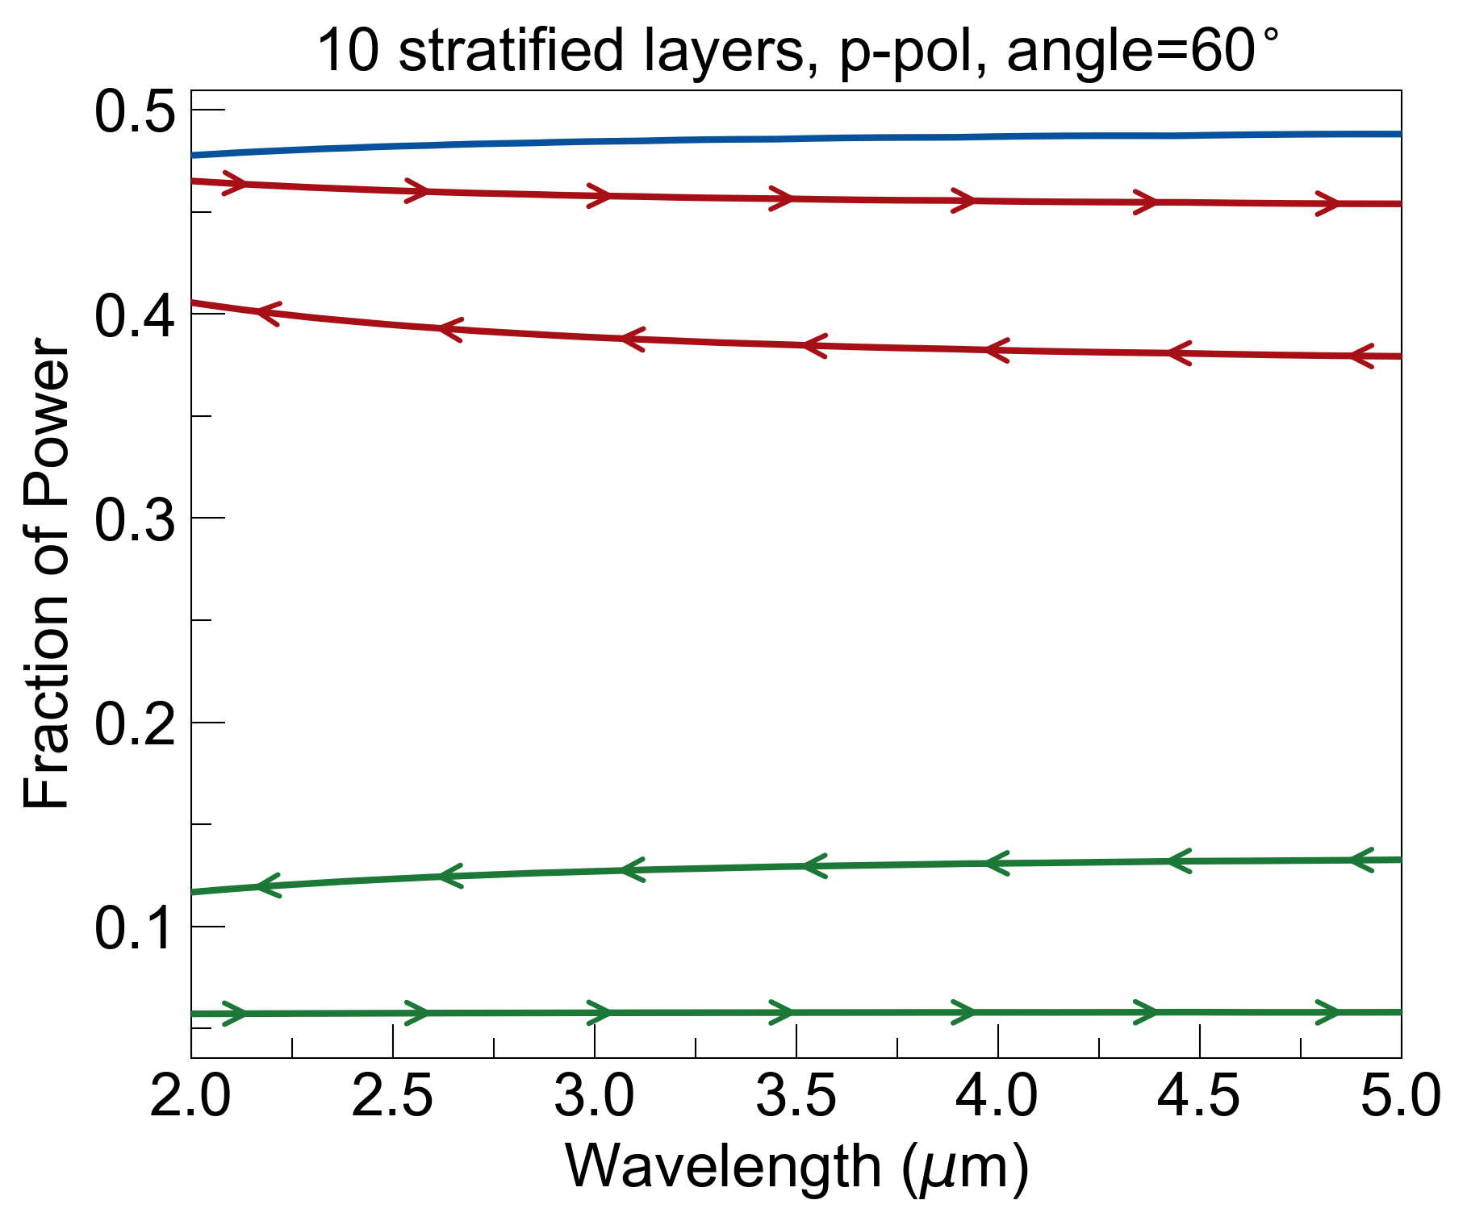
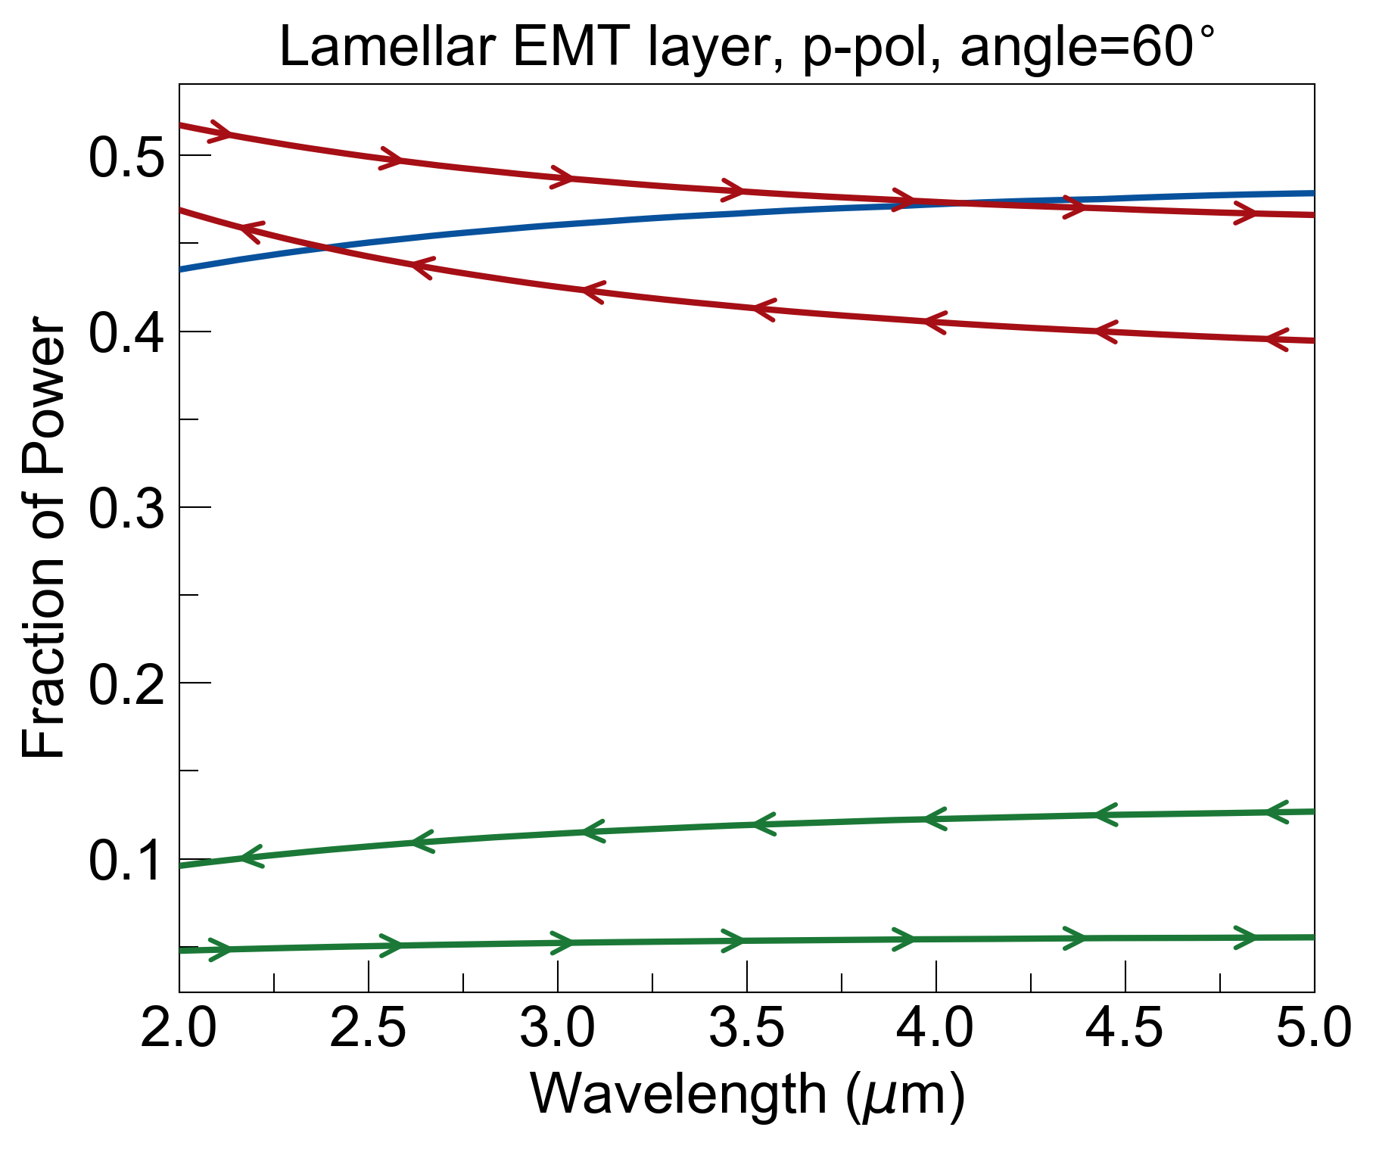
oblique incidence
current TMM software does not support anisotropic layers (different dielectric for different field components)
E||
or
x
E⟂
A
B
A
B
A
B
…
…
a
b

Slide 4
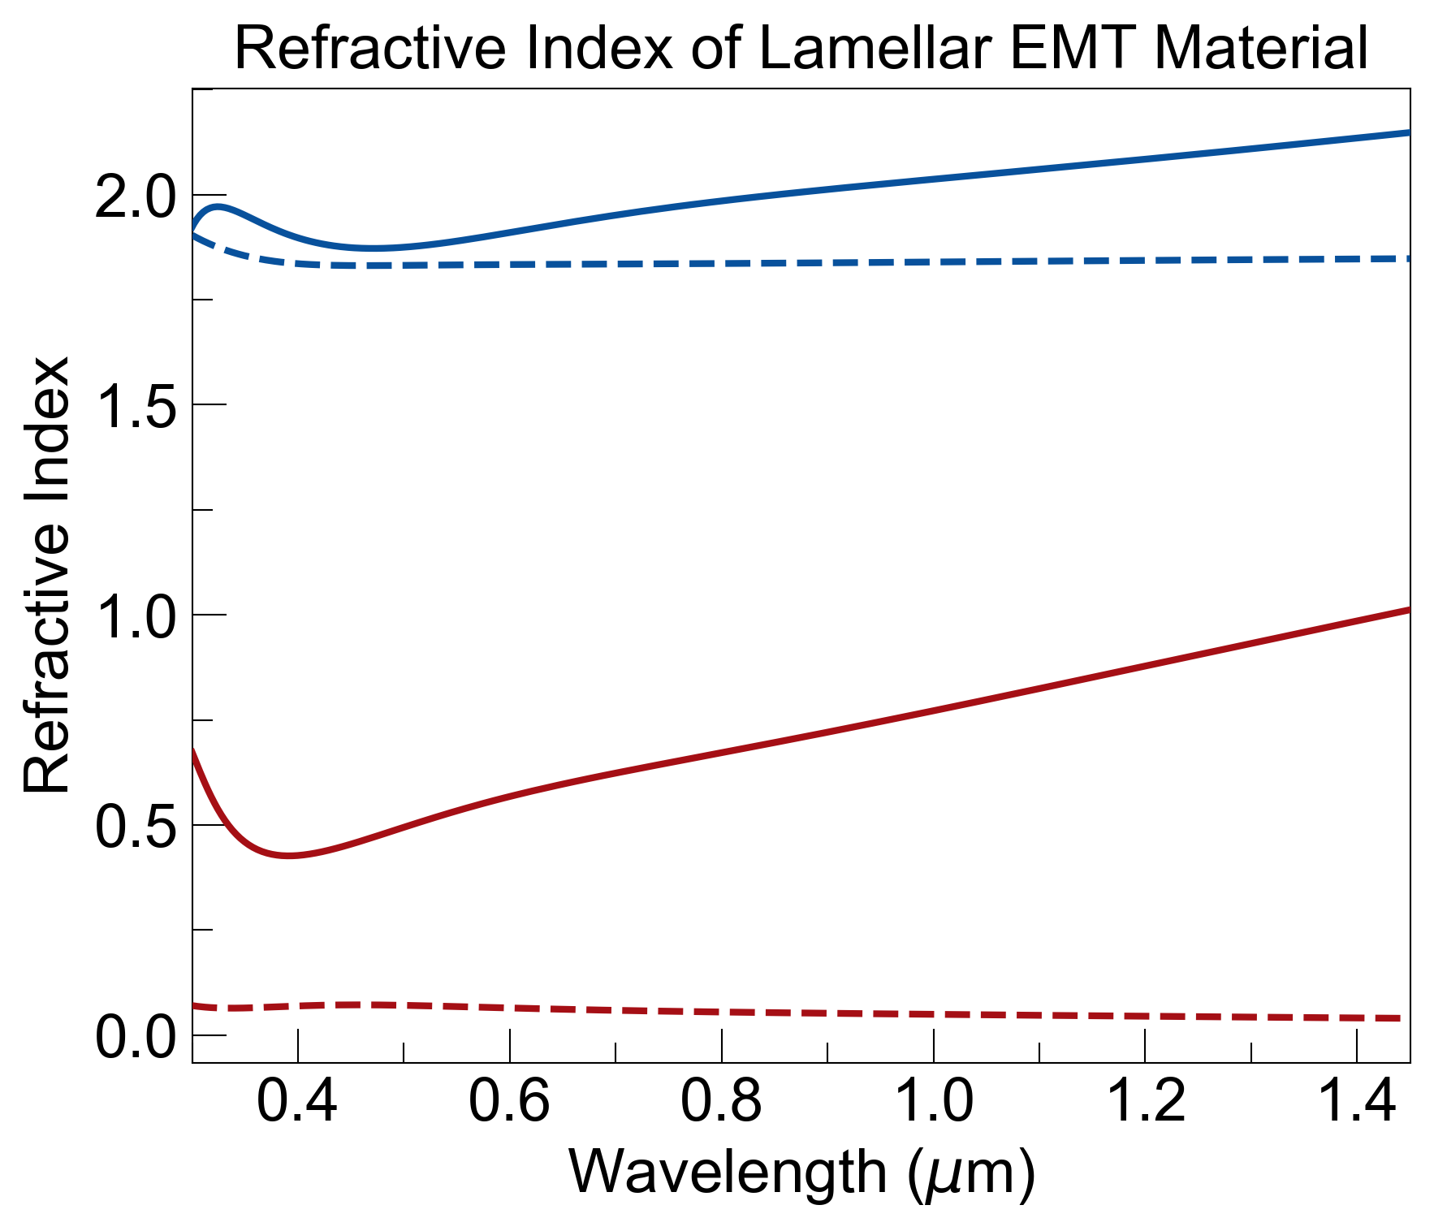
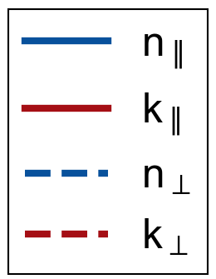
Expected RI from Lamellar EMT from 300–1400nm
E||
or
x
E⟂
A
B
A
B
A
B
…
…
a
b

Slide 5
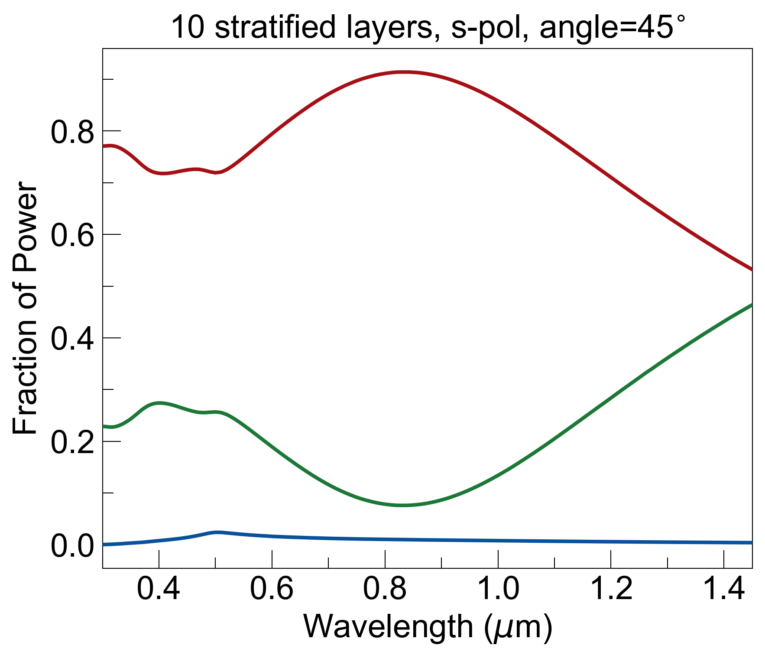
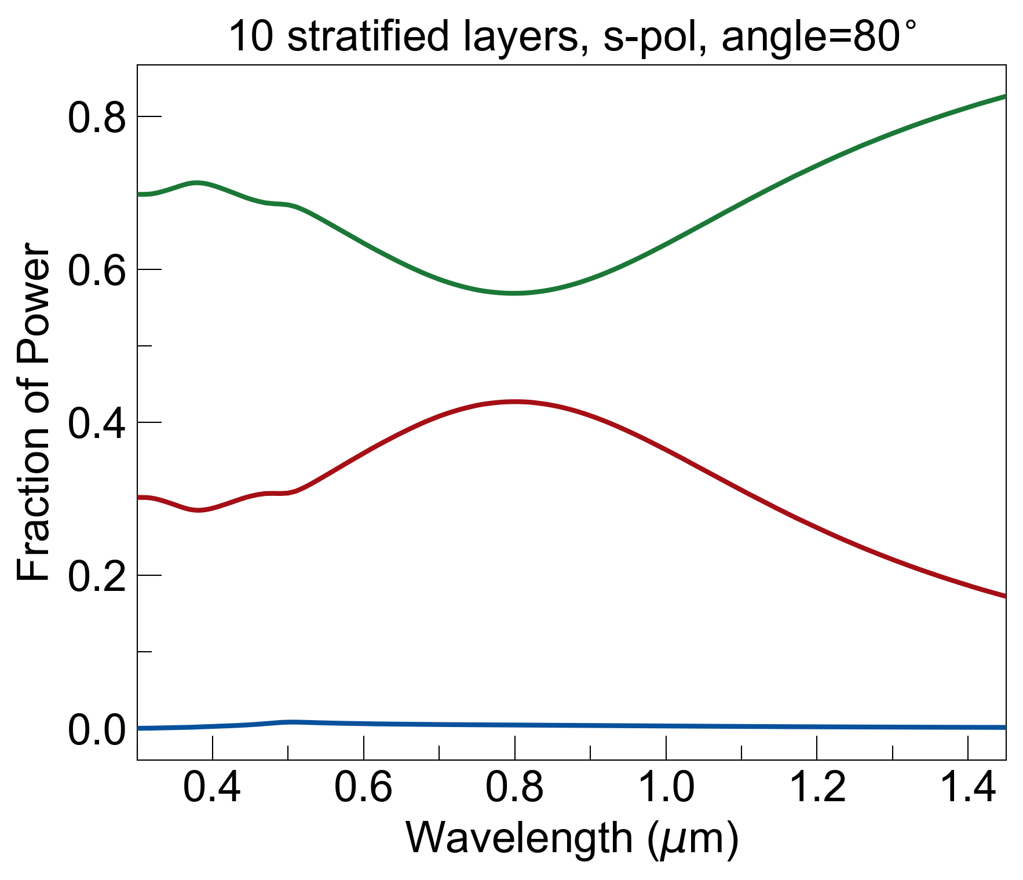
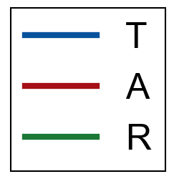
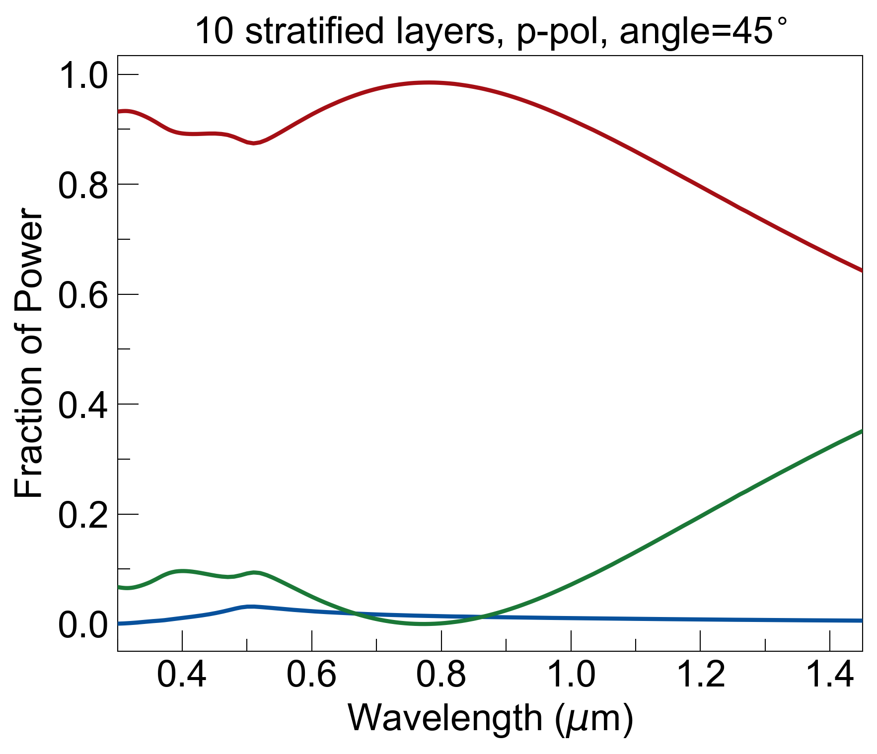
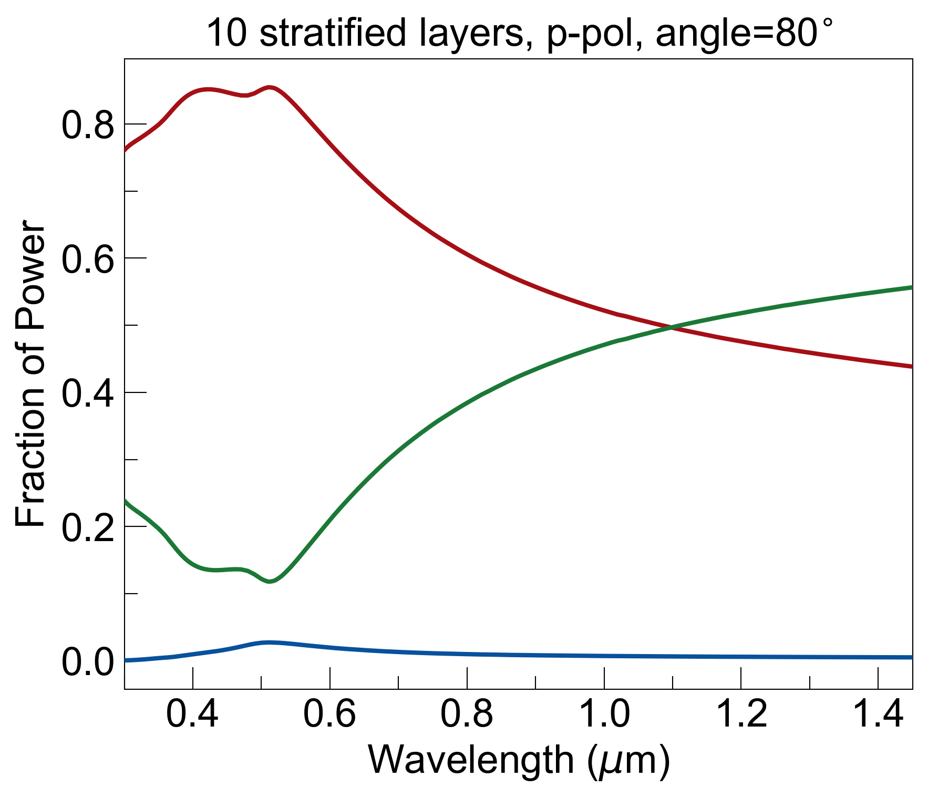
Optical Response of MS
100nm stratified layers
Si substrate
50nm gold
*did not use lamellar EMT for these calculations*

Slide 6
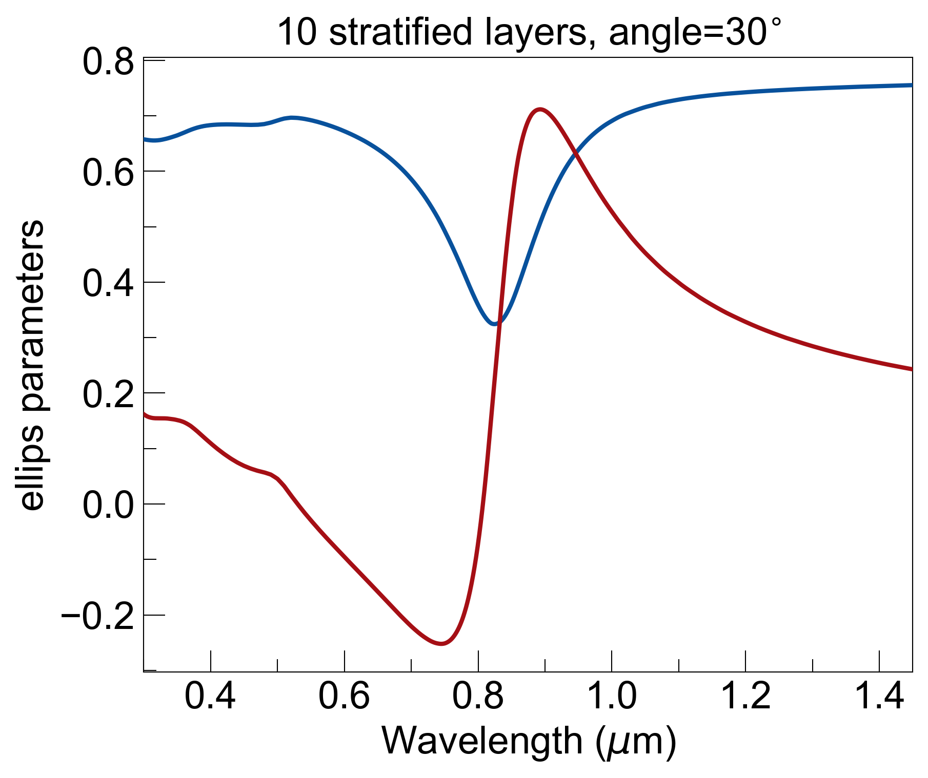
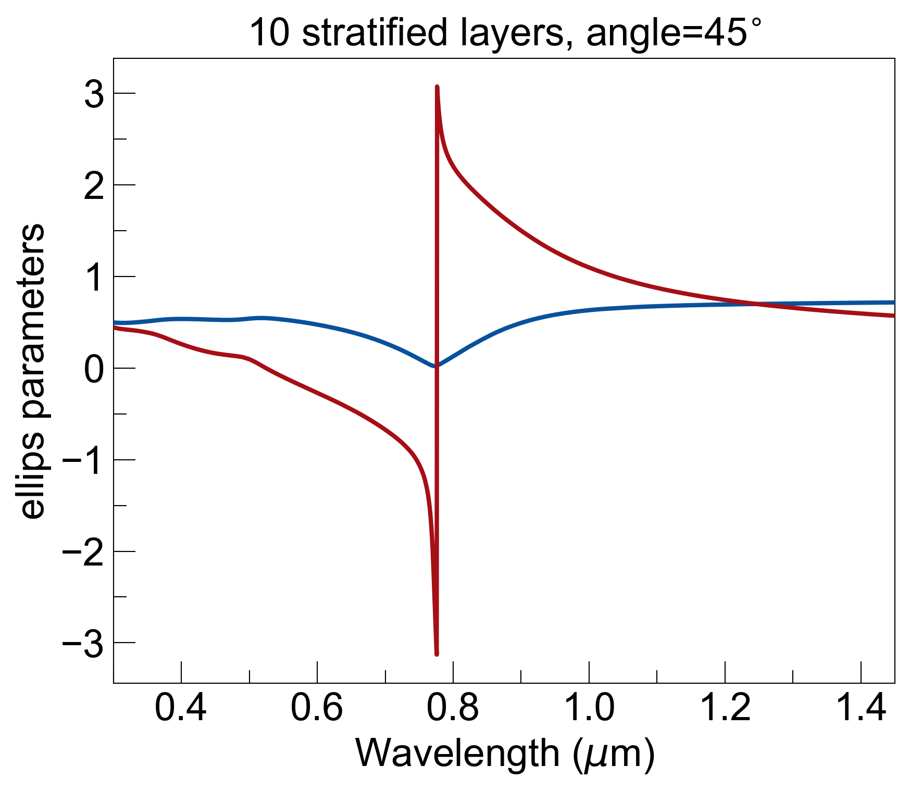
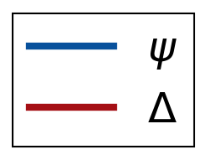
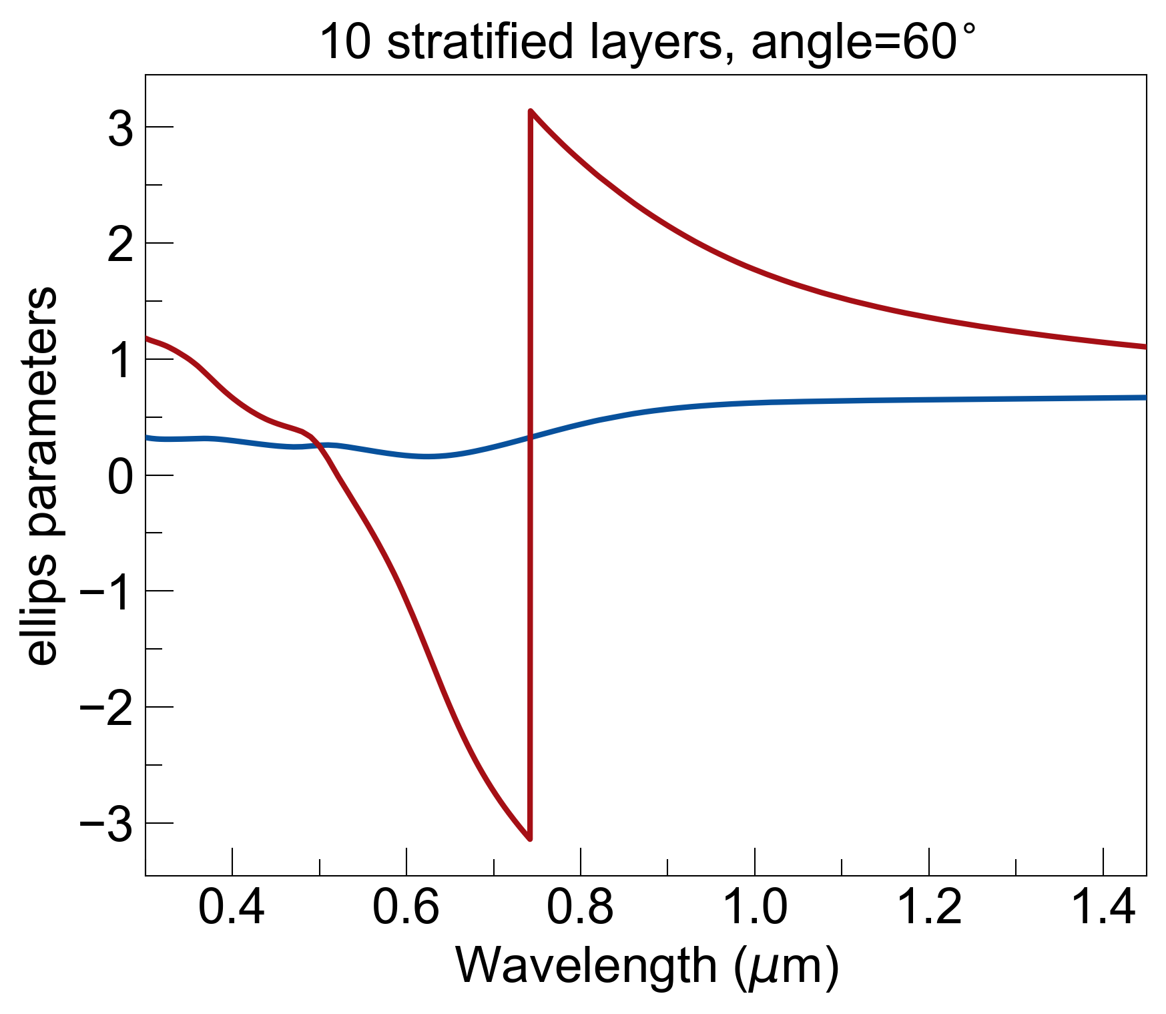
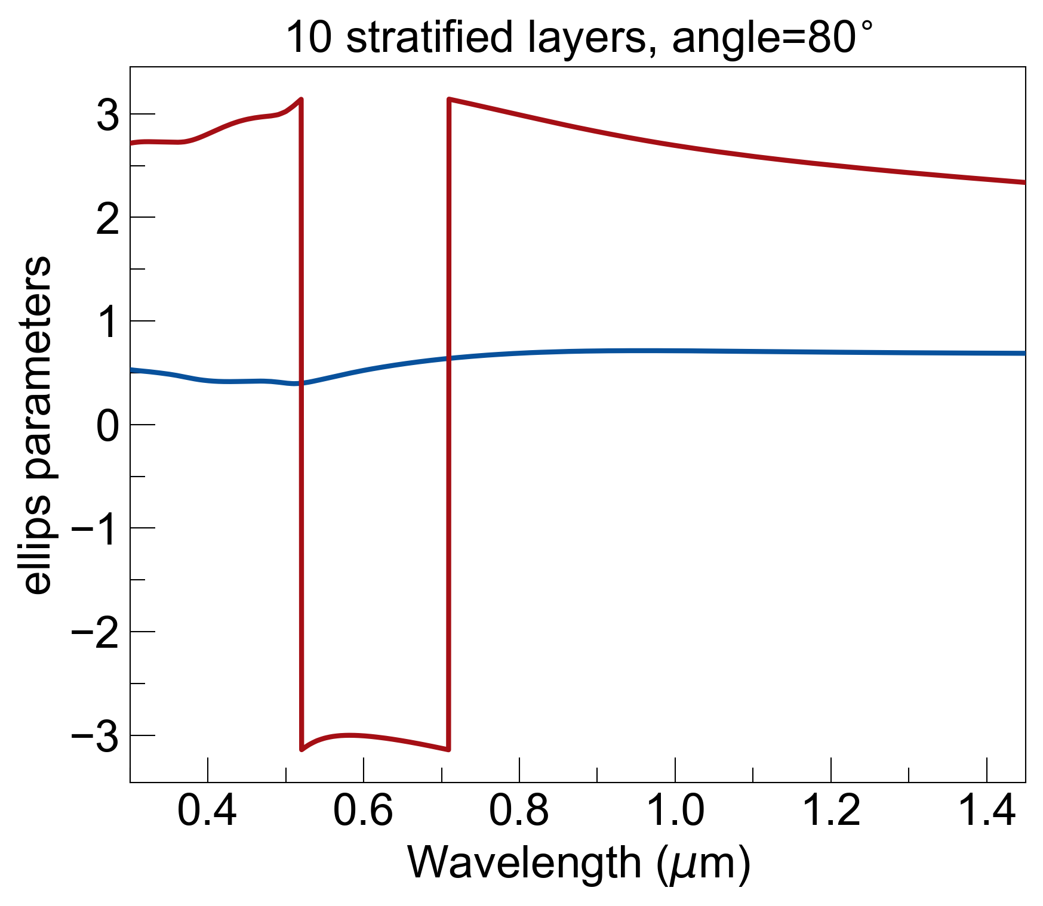
Ellipsometry Parameters
100nm stratified layers
Si substrate
50nm gold
*did not use lamellar EMT for these calculations*

Slide 7
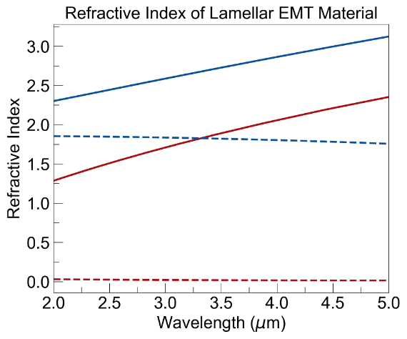
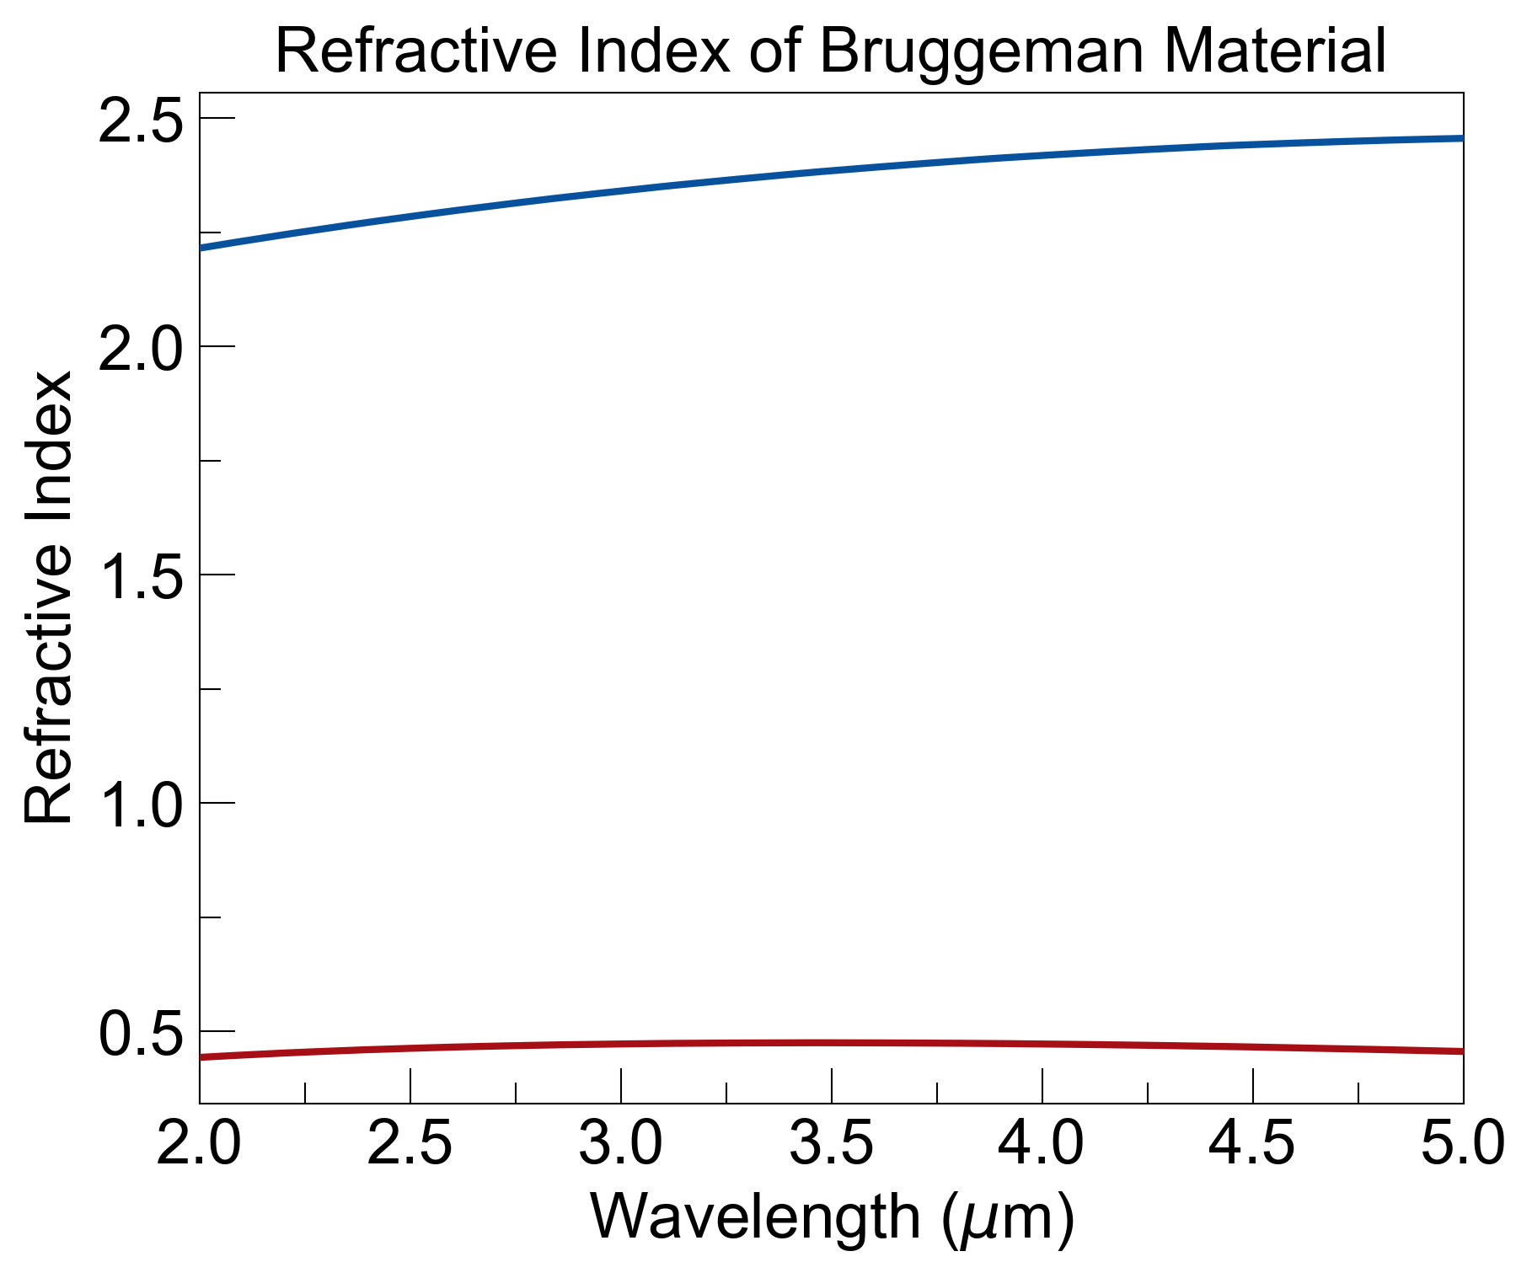
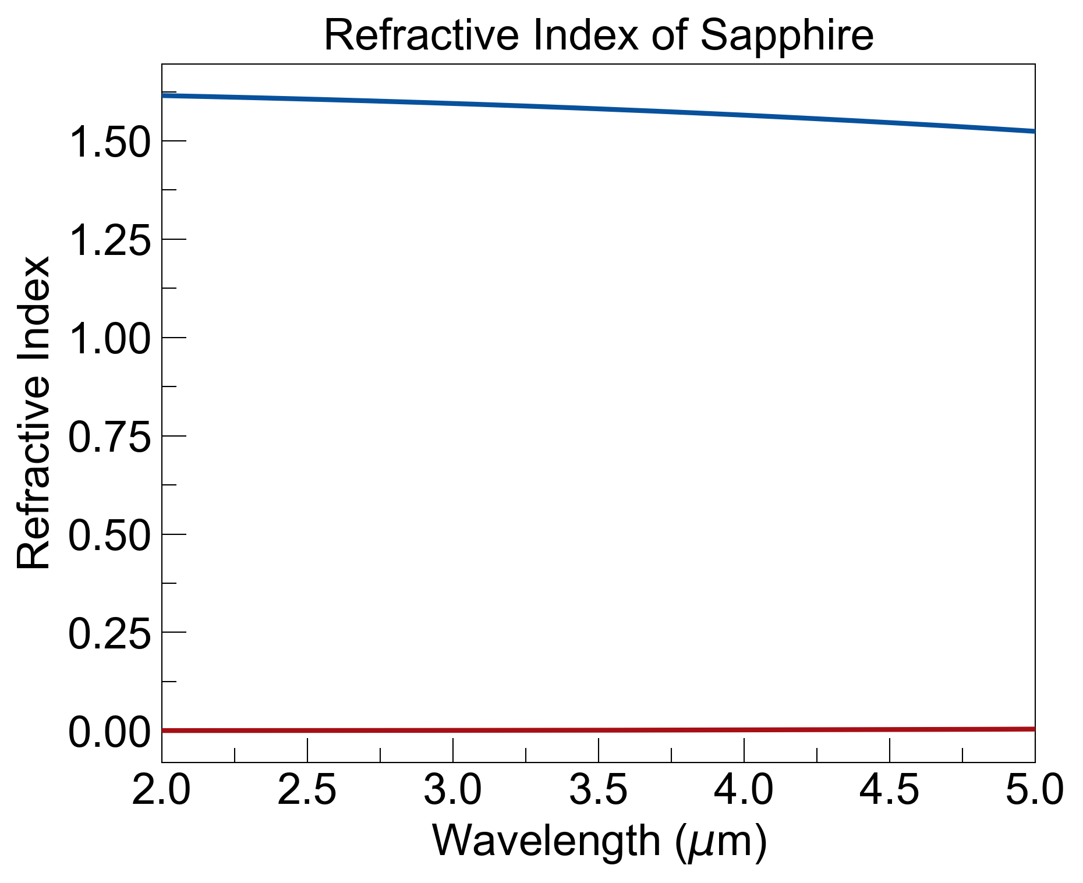
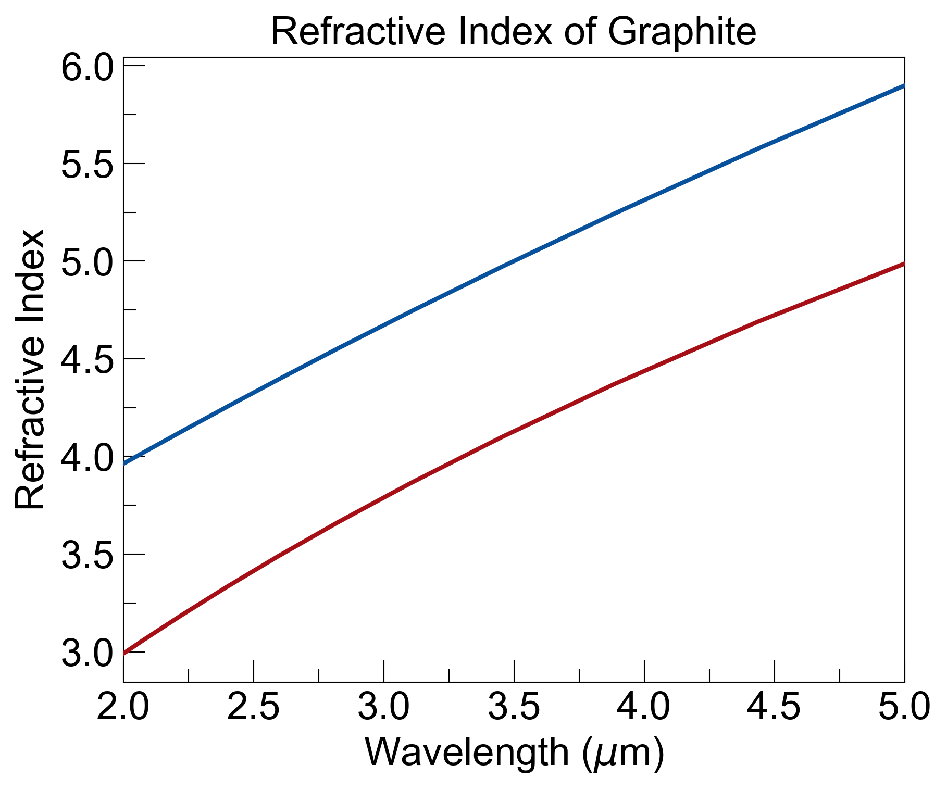
E||
or
x
E⟂
A
B
A
B
A
B
…
…
a
b

Slide 8
