Slide 1
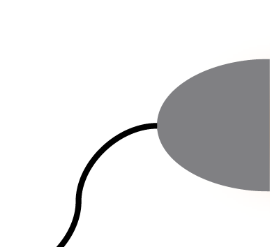
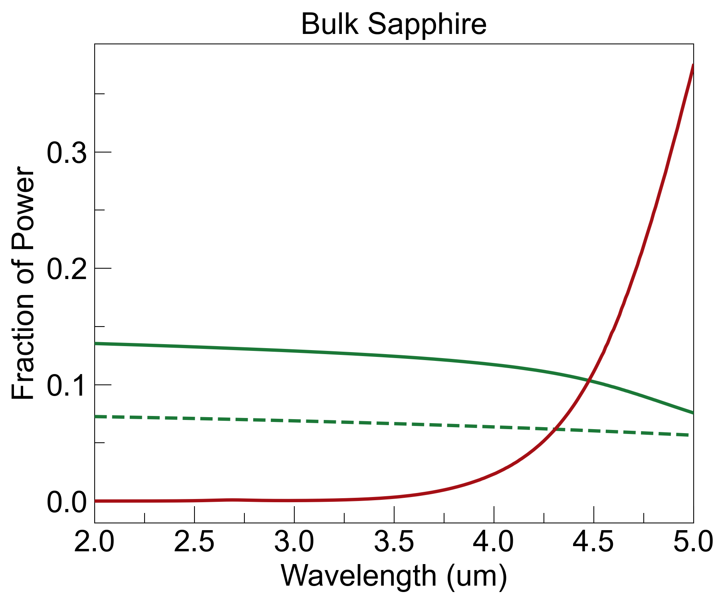
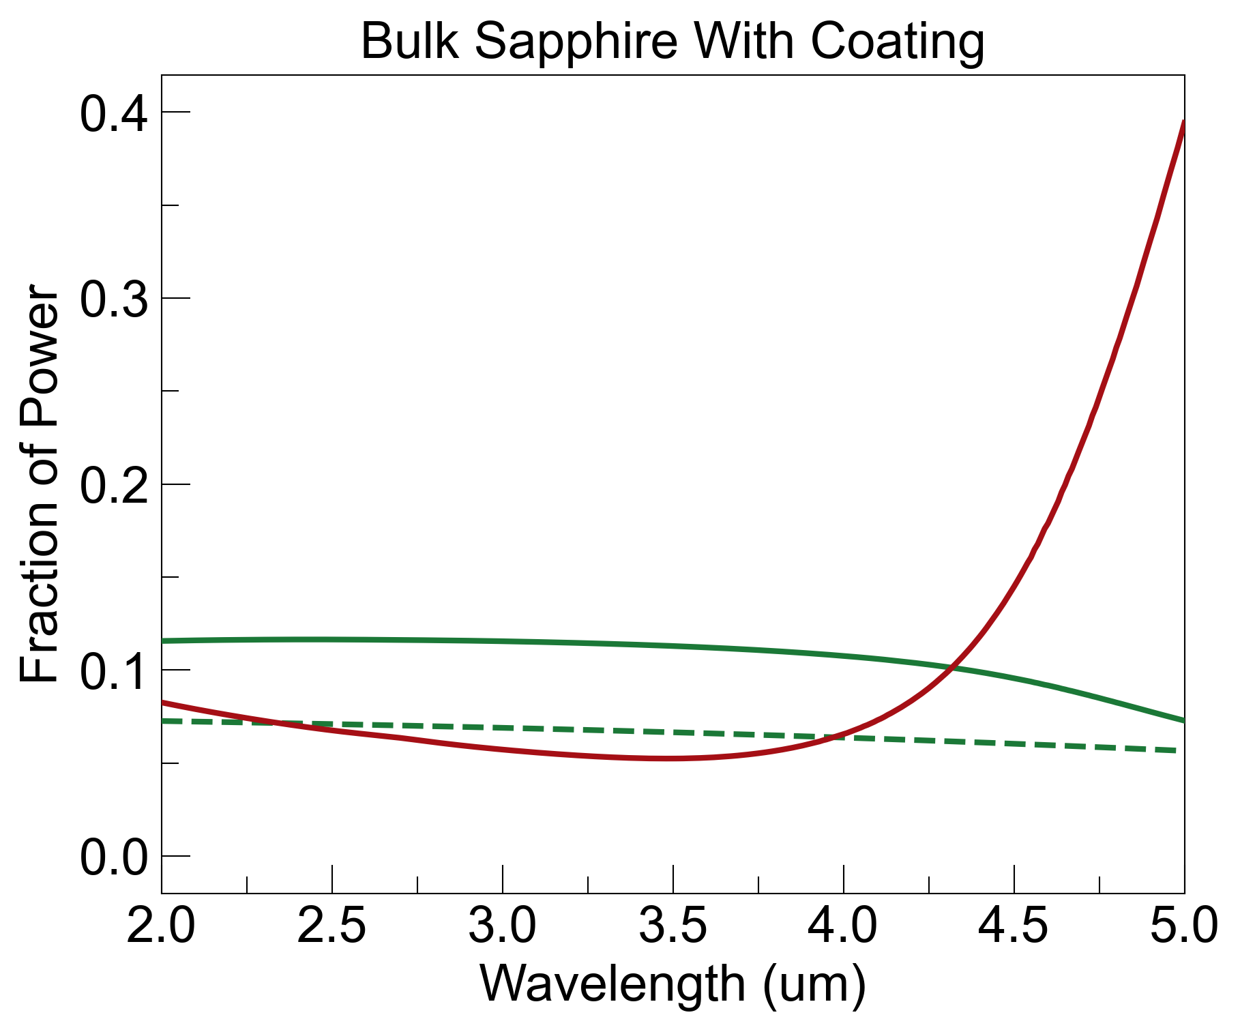
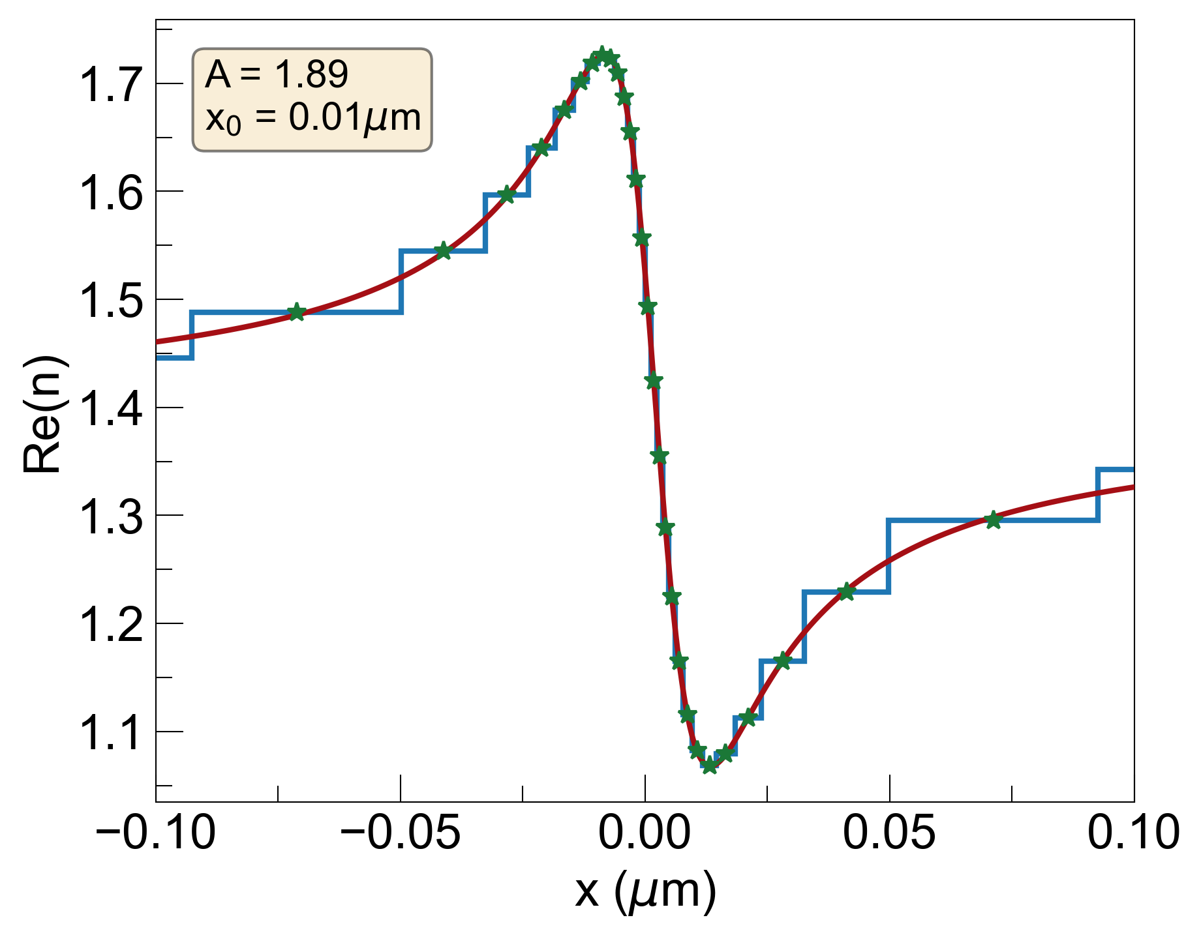
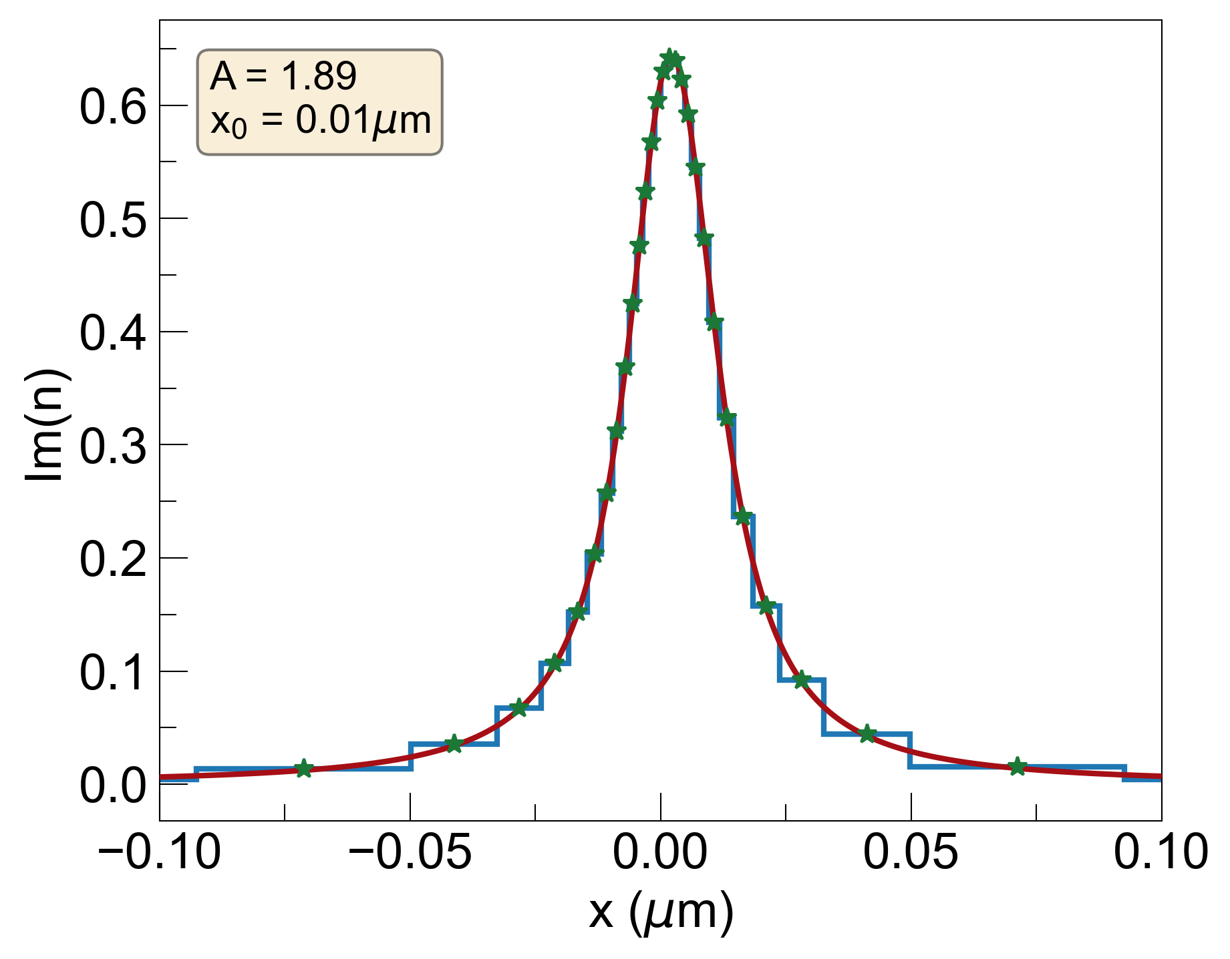
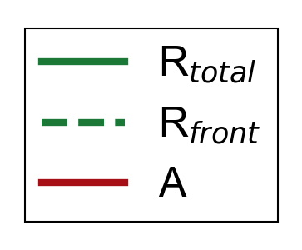
1. With x₀=0.01um s-KK Coating (ellipsometry)
noise = R_{b} + A_{b}
R_{b}=0.05, A_{b}=0.05, noise=0.1
R_{b}=0.04, A_{b}=0.1, noise=0.14
coating slightly decreases R_{b} but increases E_{b}, causing overall noise to increase

Slide 2
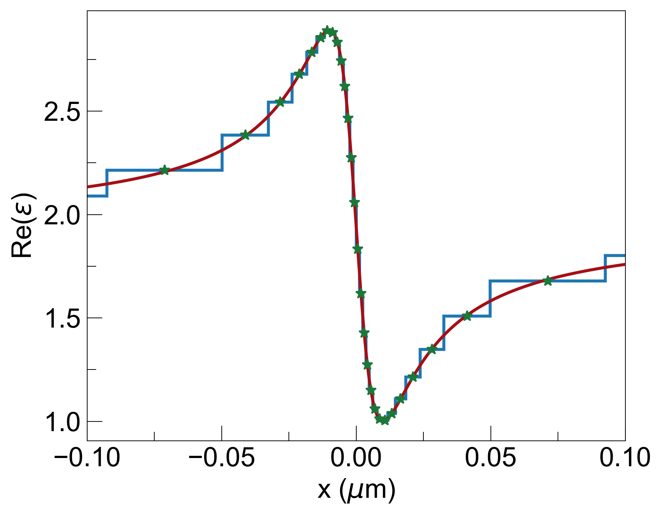
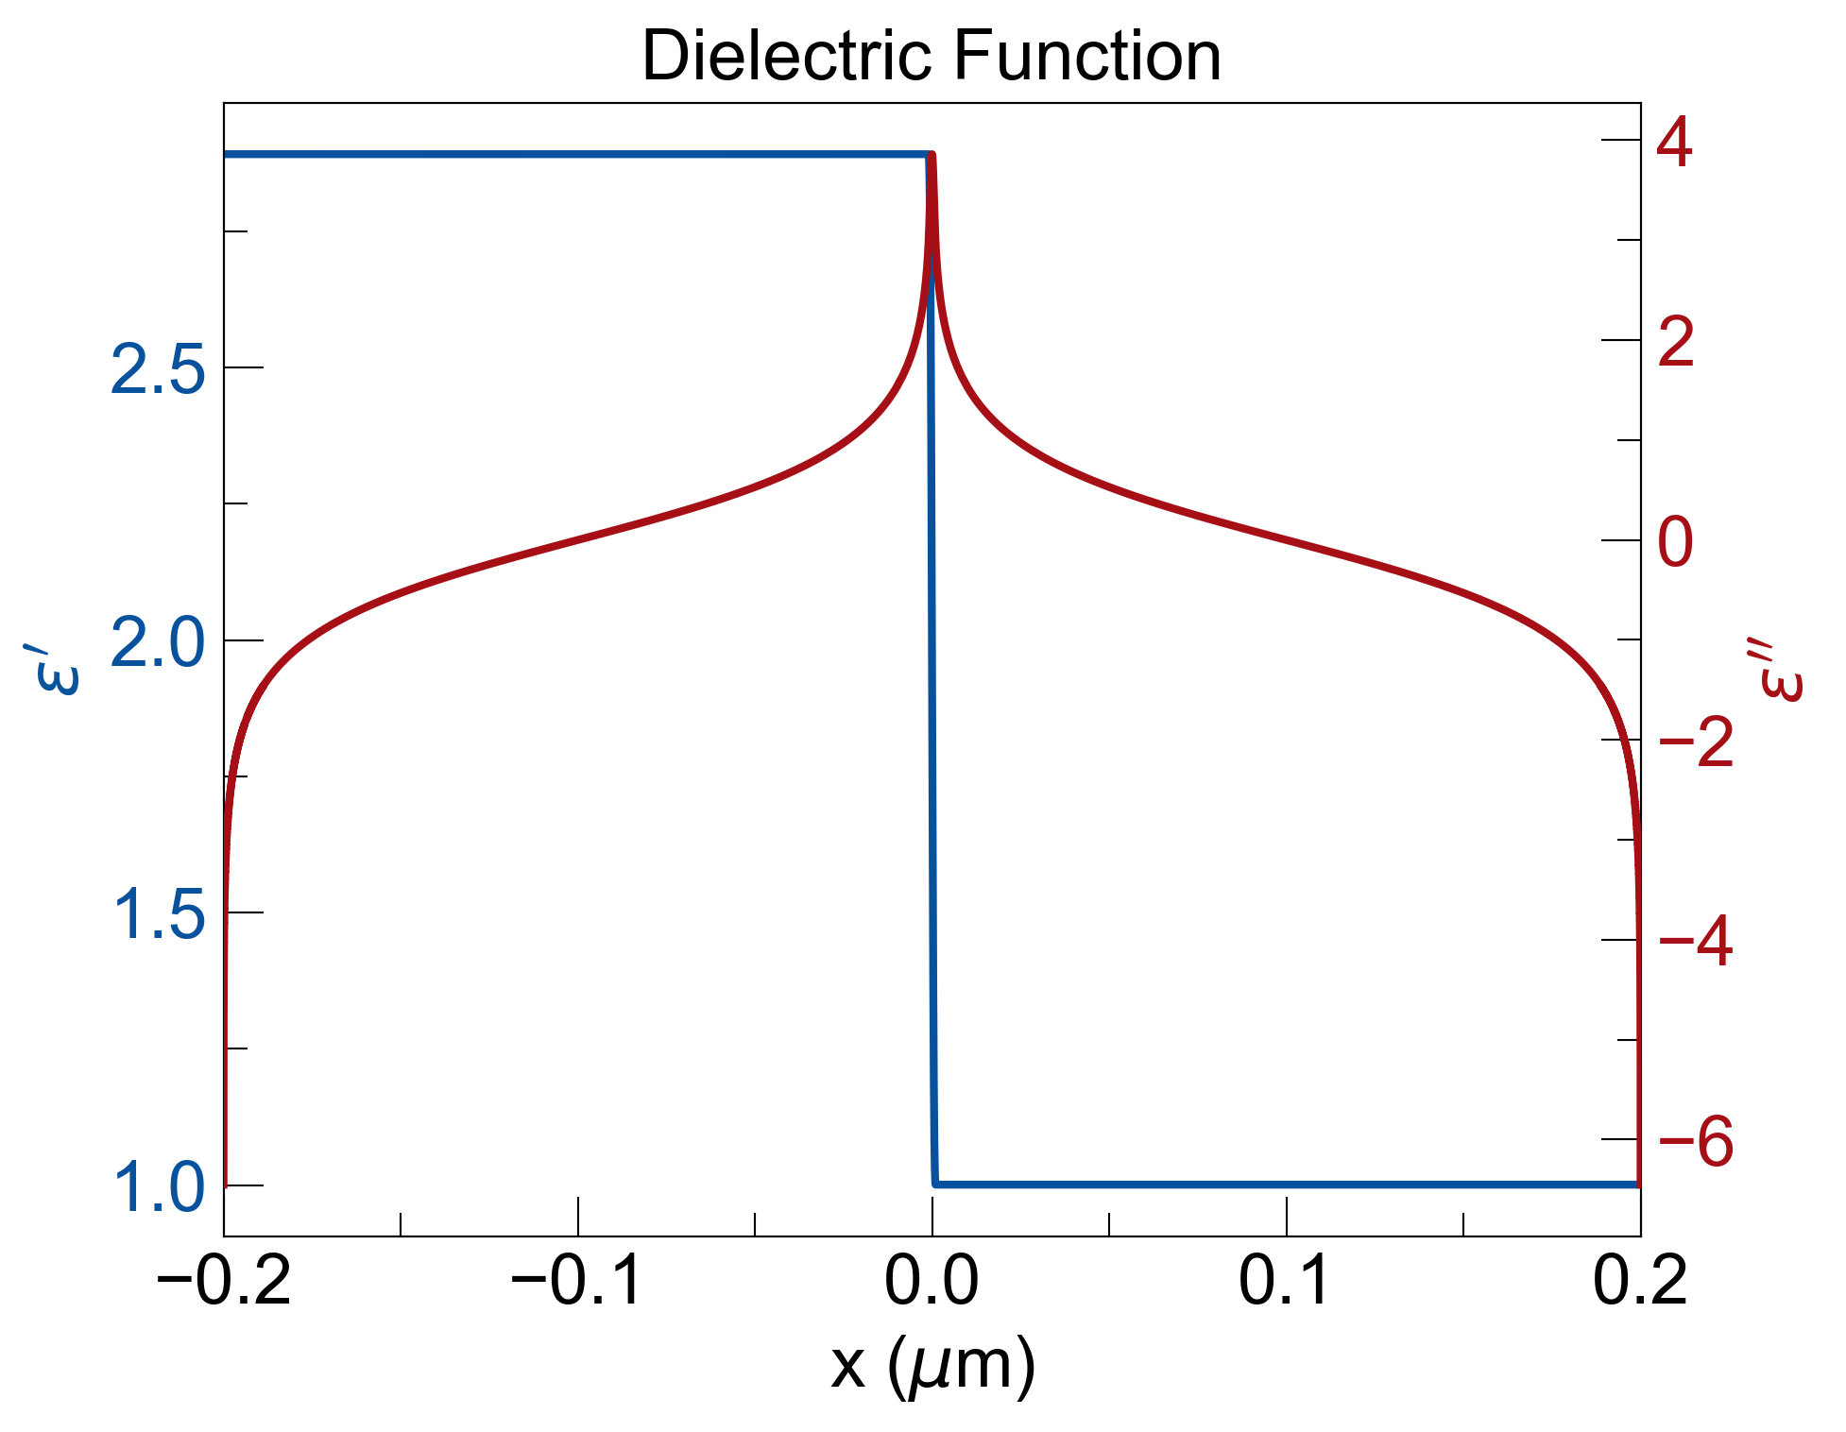
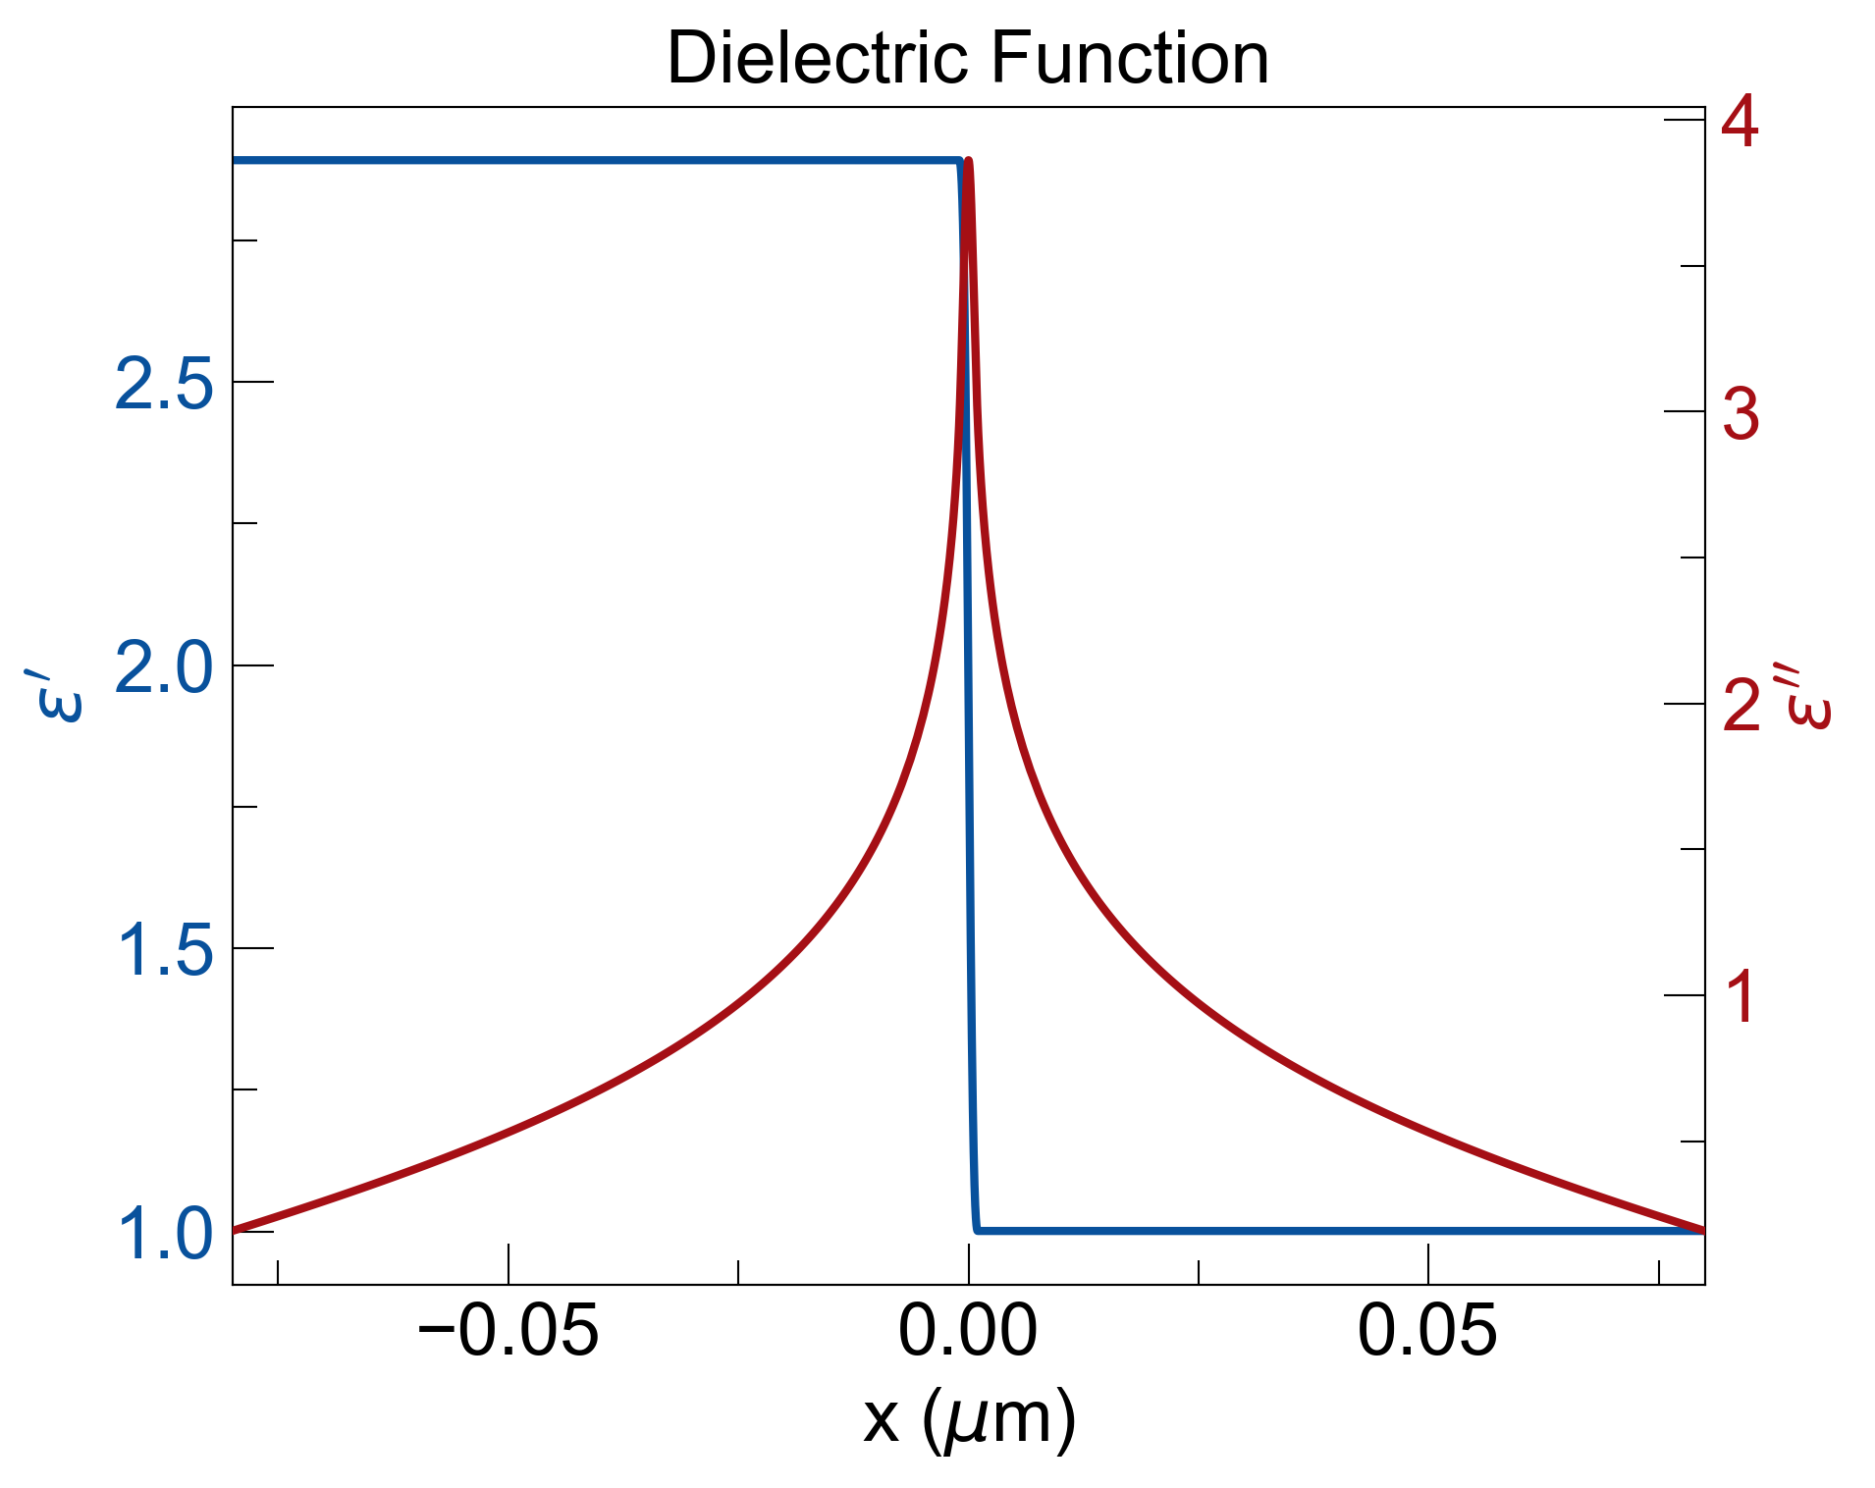
Hilbert Transform of Truncated 𝜀’ to get 𝜀’’
Truncate dielectric function further to avoid gain from HT

Slide 3
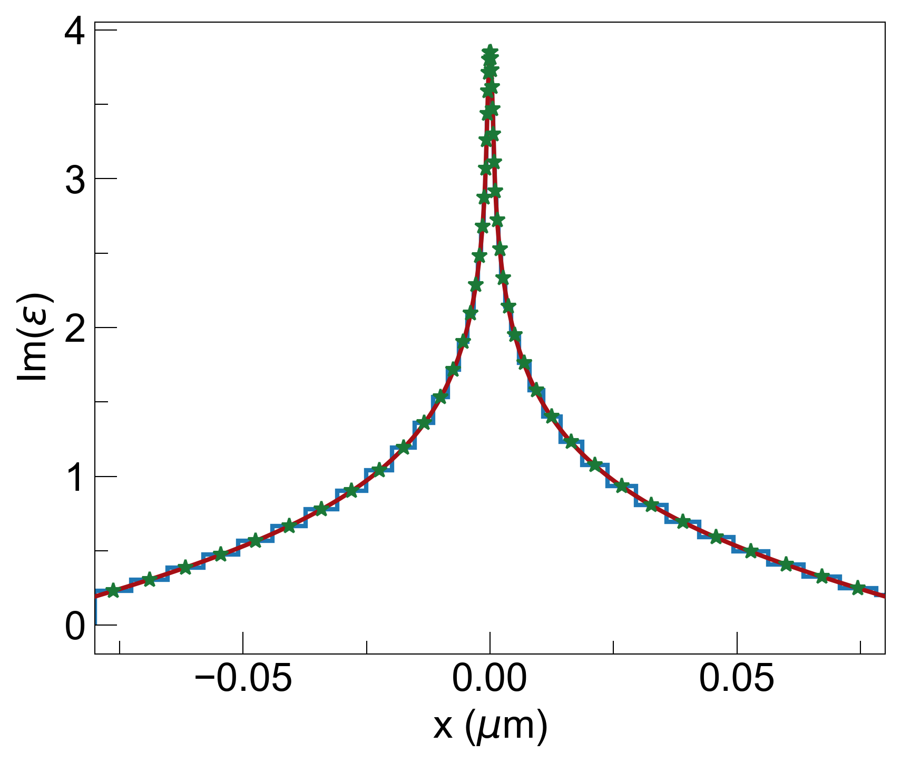
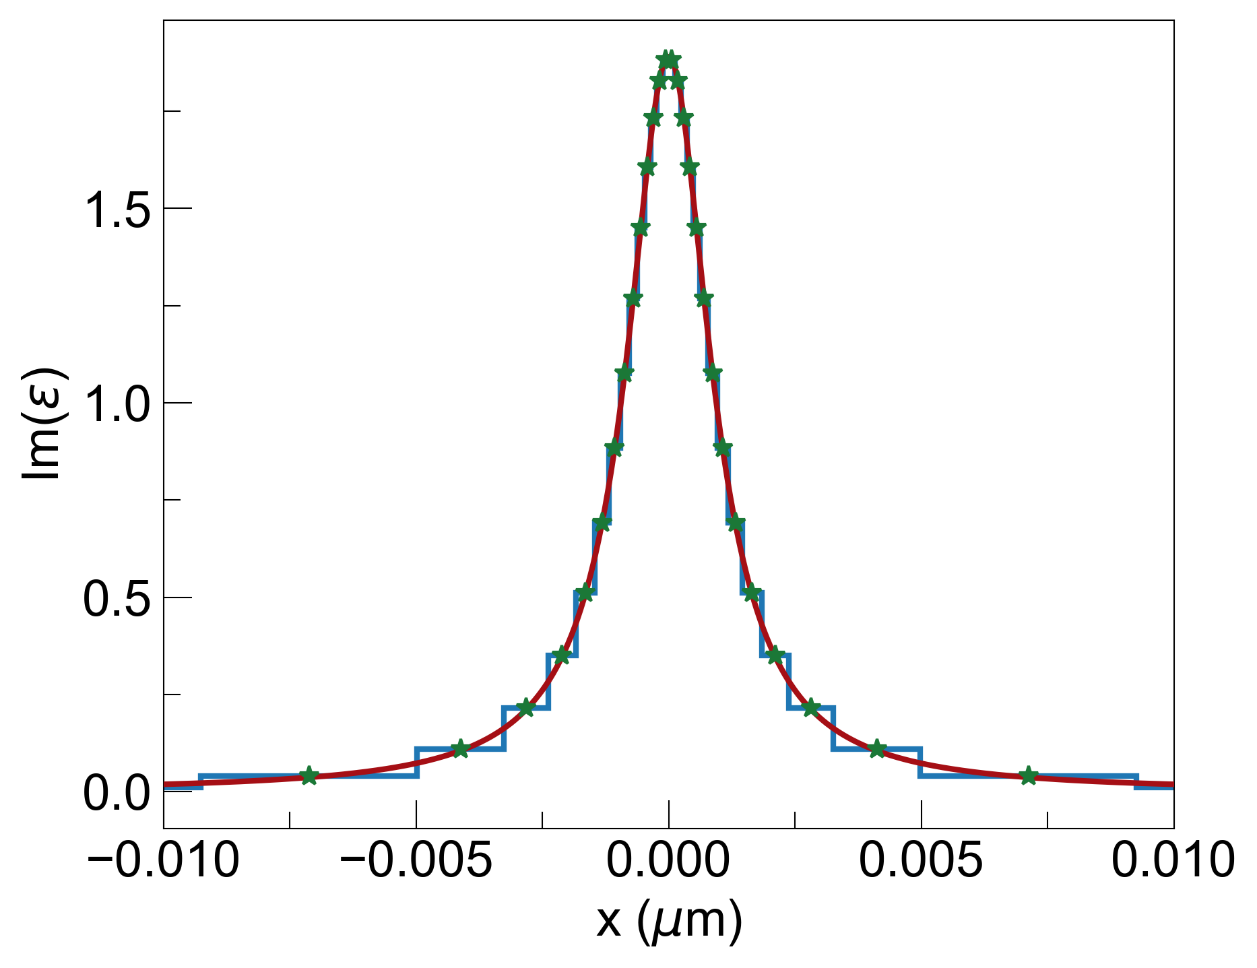
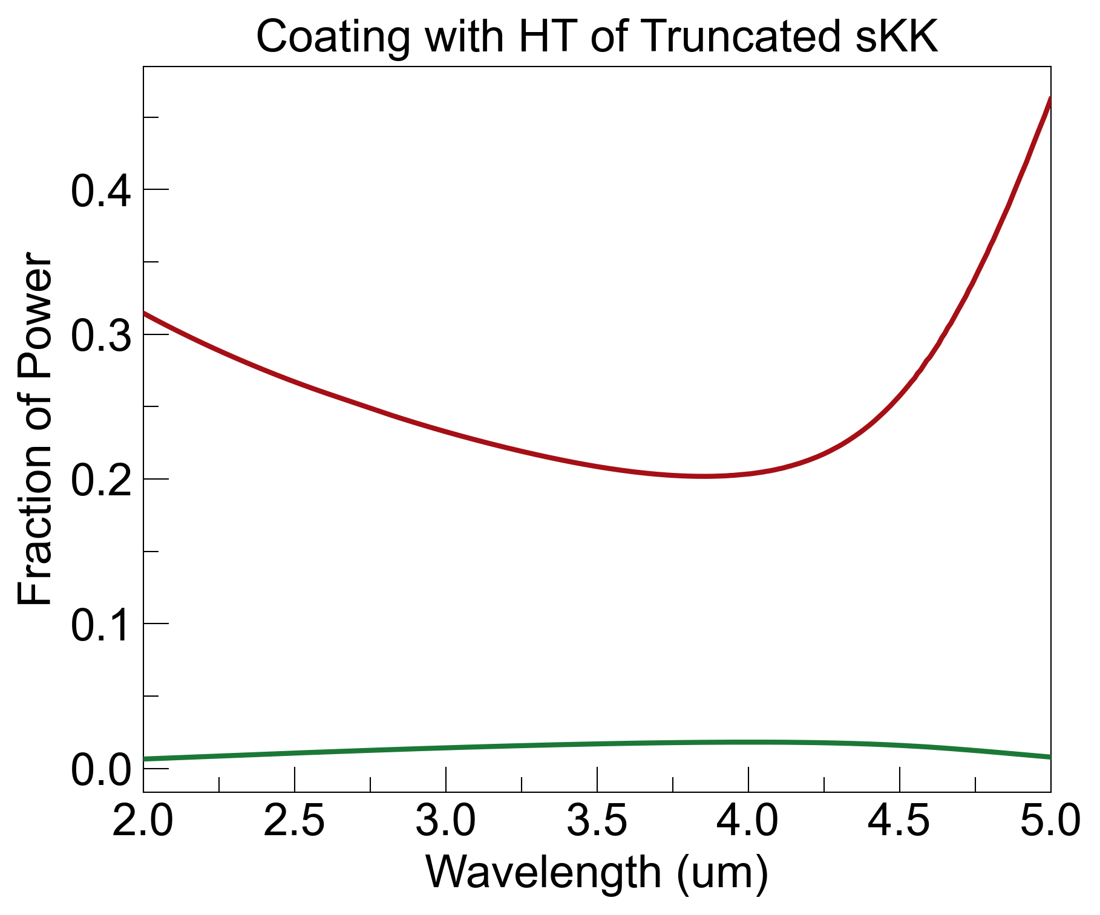
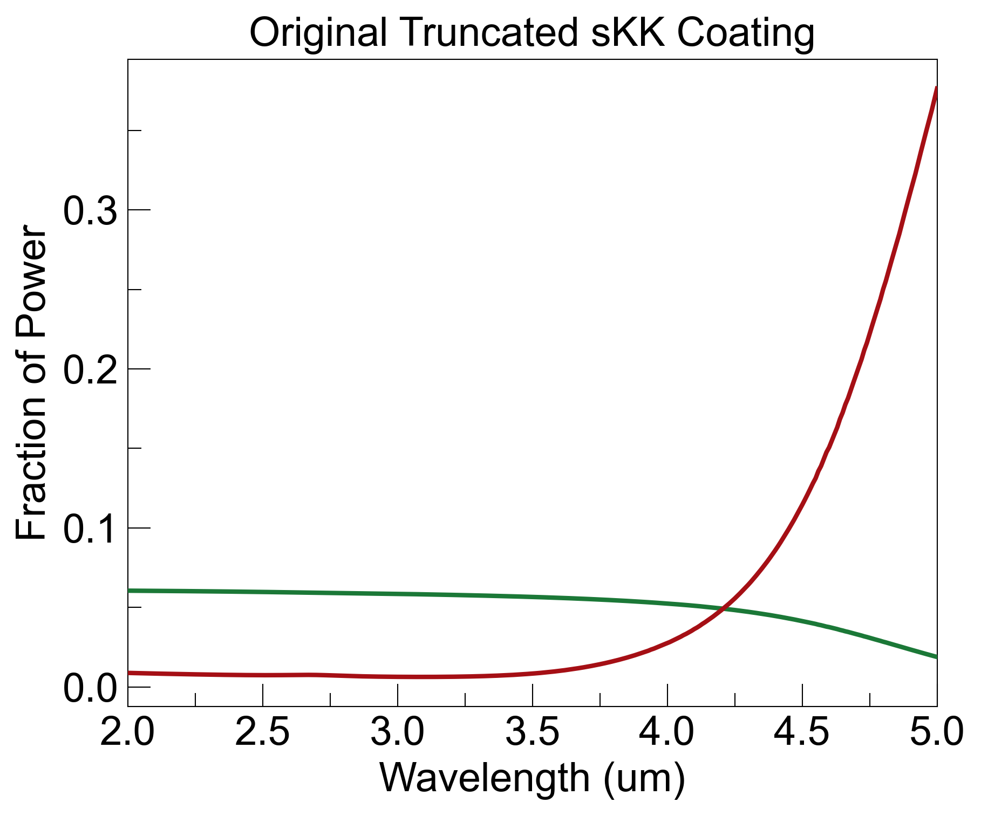
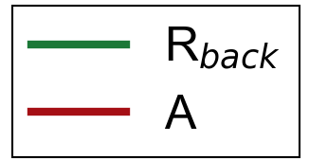
1. With x₀=0.001um s-KK Coating (ellipsometry)
noise = R_{b}
HT coating increases absorption, but reduces backside reflections
Next step: rigorous comparison between HT coating and GRIN coating over angles and wavelengths (is there a significant advantage?)
R_{back}=0.01, A=0.25, noise=0.01
R_{back}=0.05, A=0.05, noise=0.05

