Slide 1
What we know so far:
Spatial KK does not help solve the window problem (high losses needed for appreciable asymmetry, which reduces transmission
Even replacing bulk window with “stack of stacks” showed that one sKK stack was most asymmetric
Directions to take project:
AR Coating: Horsley paper and a follow up by Liang et al mention using Spatial KK as AR coating, but no paper has yet done an exhausting comparison of sKK coating compared to state of the art (moth eye, GRIN coatings)
One sided coherent perfect absorber: unsure of applications but there is research done and papers published on this topic
Just showing high thermal emission asymmetry

Slide 2
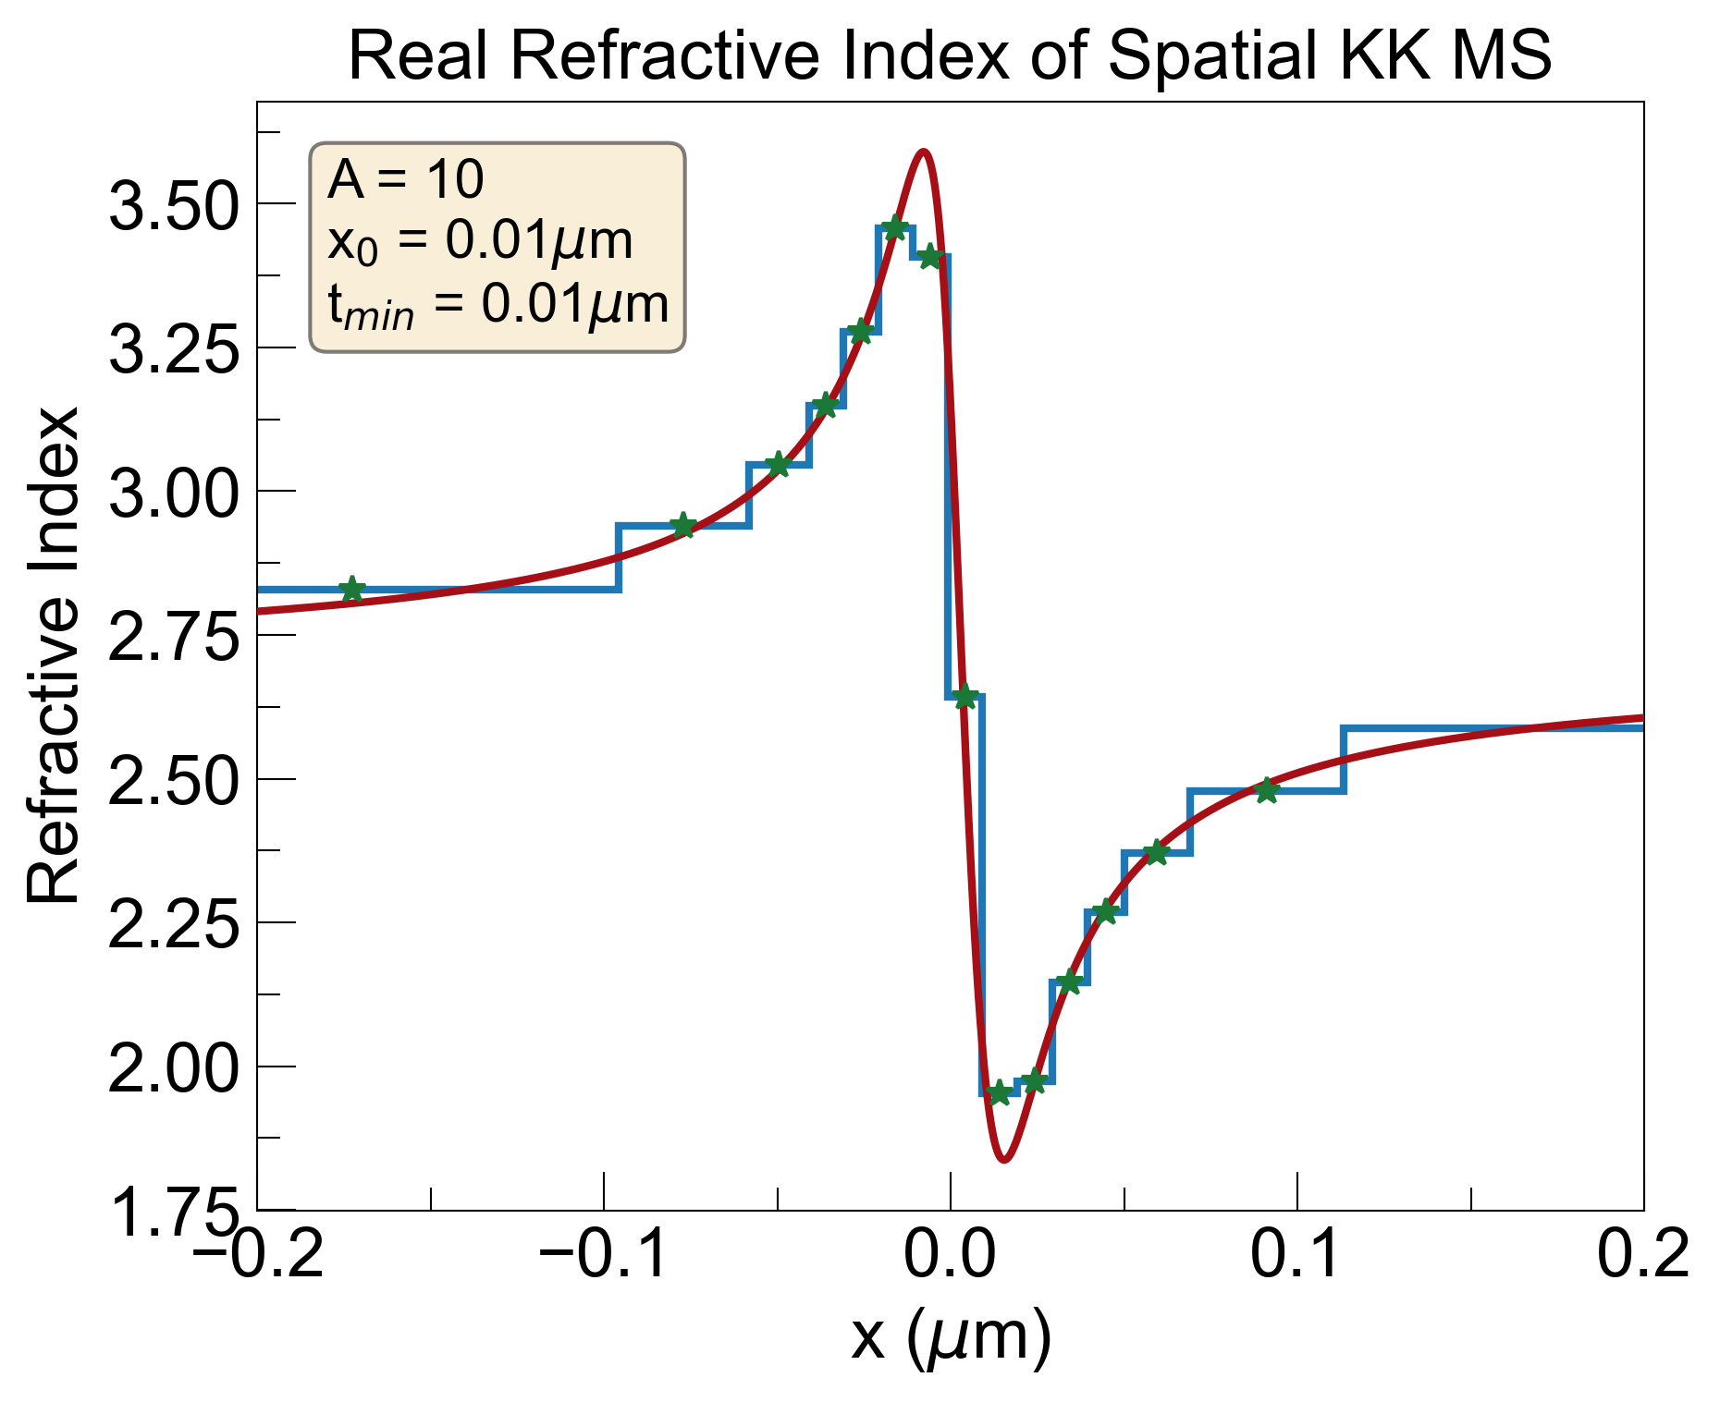
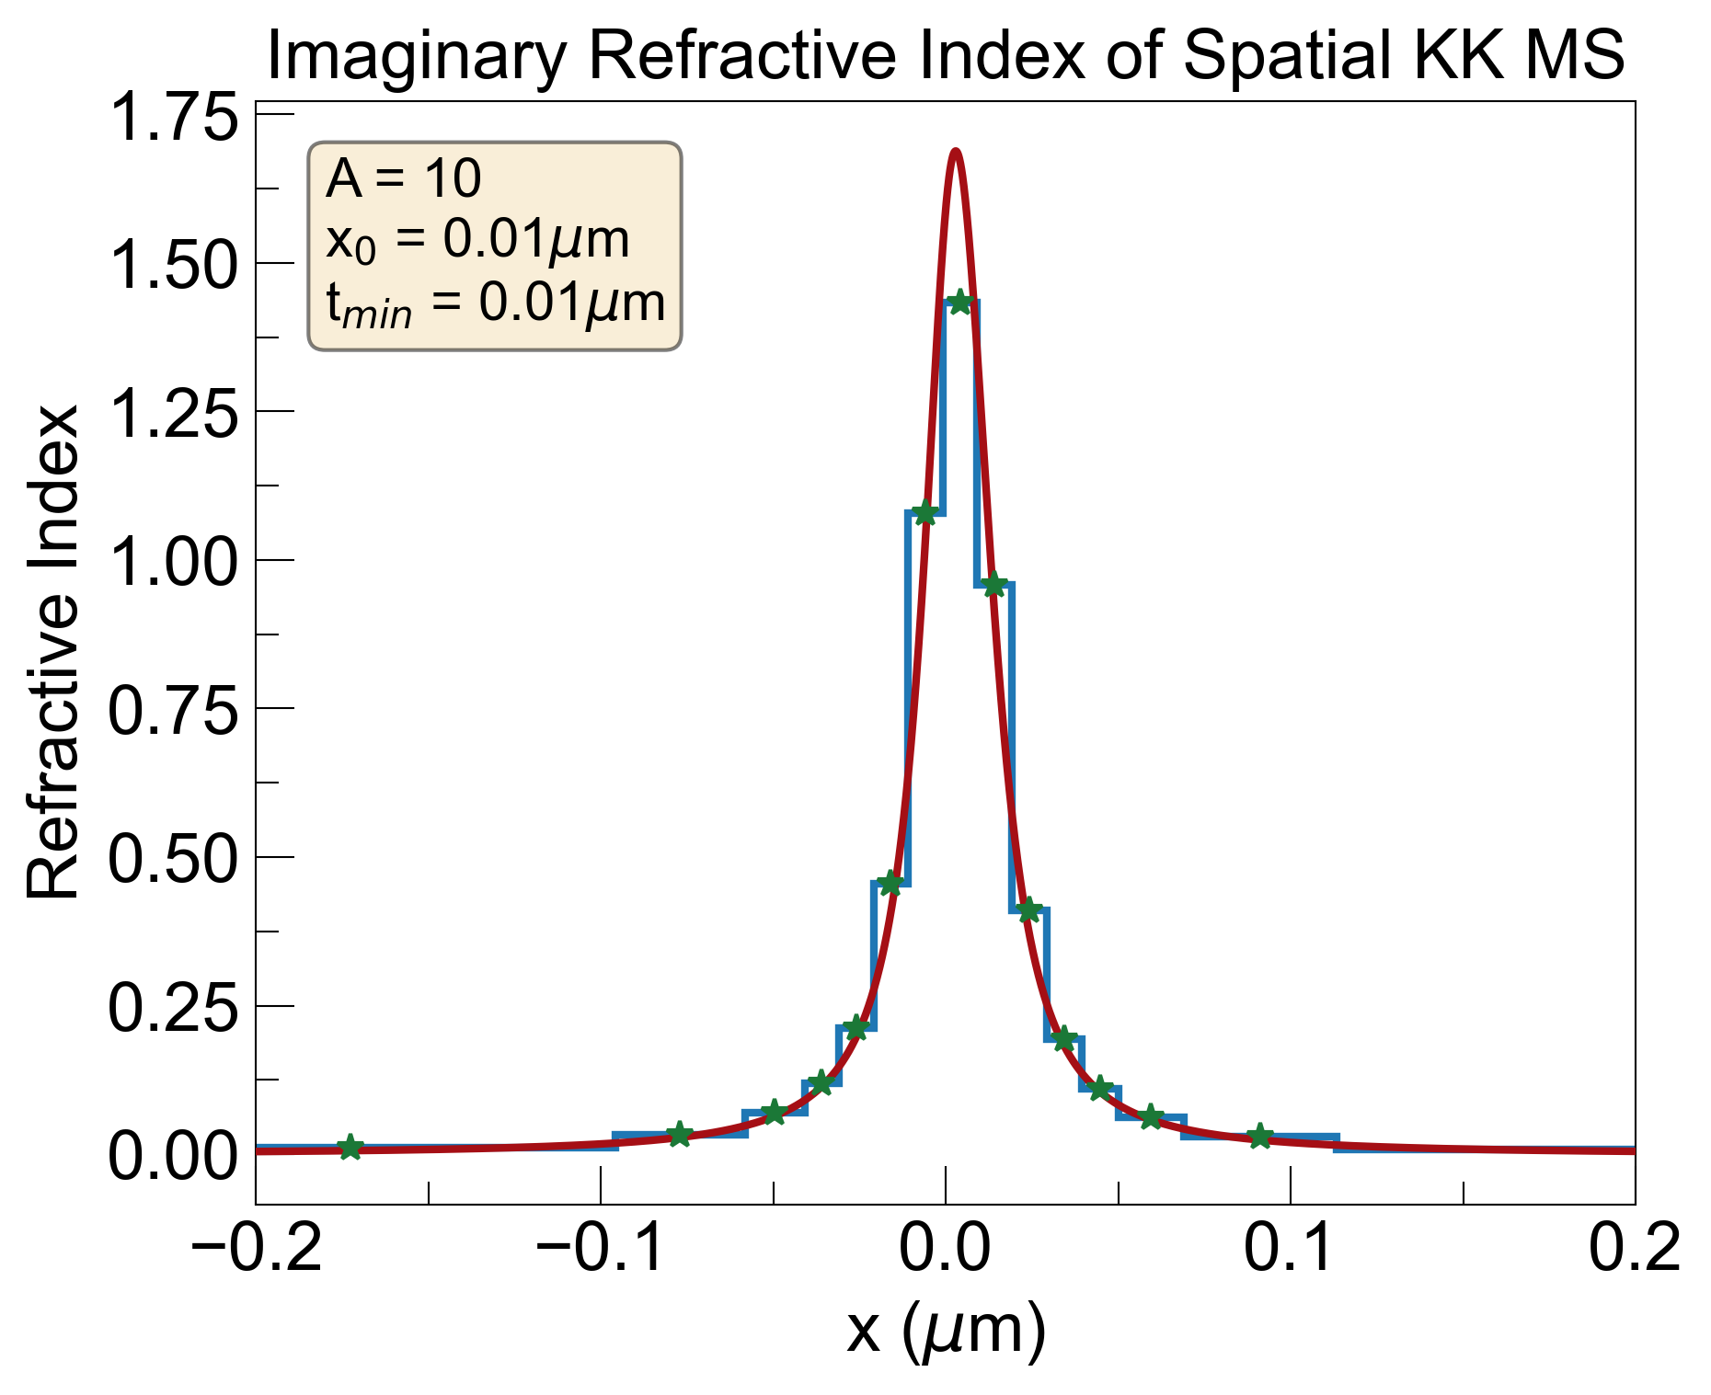
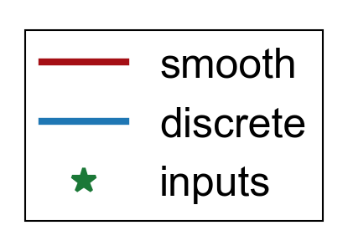
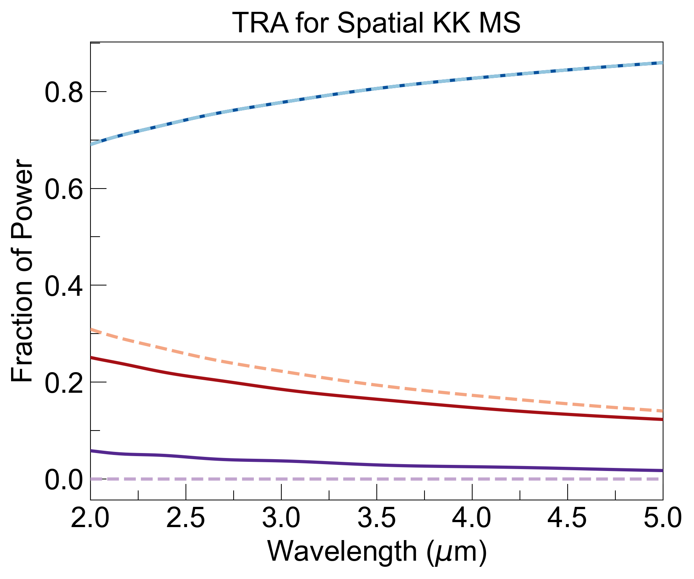
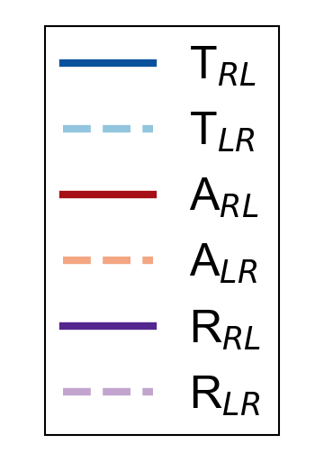
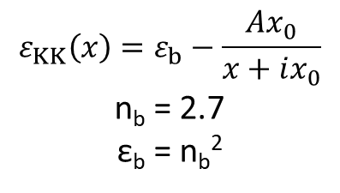
Calculation of Transmittance, Reflectance, Absorbance Using TMM
$$ε_{KK}\left(x\right)=ε_{b}−\frac{Ax_{0}}{x+ix_{0}}$$
n_{b} = 2.7
ε_{b} = n_{b}²

Slide 3
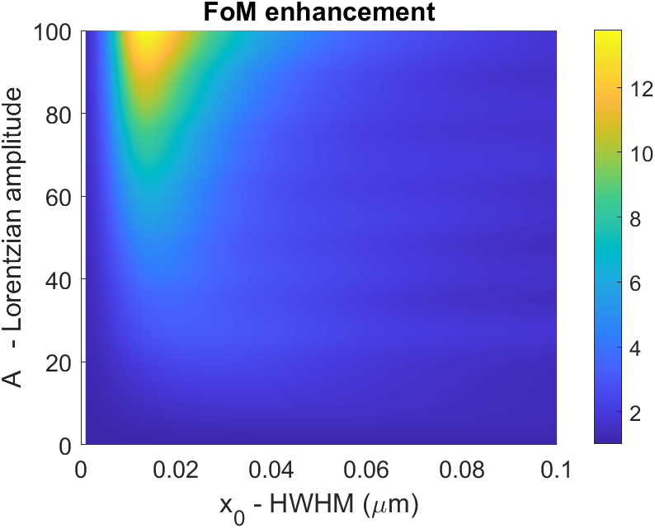
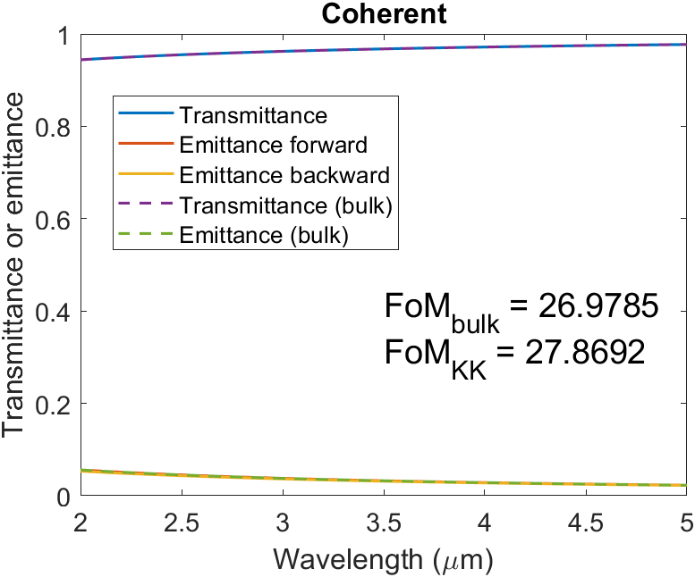
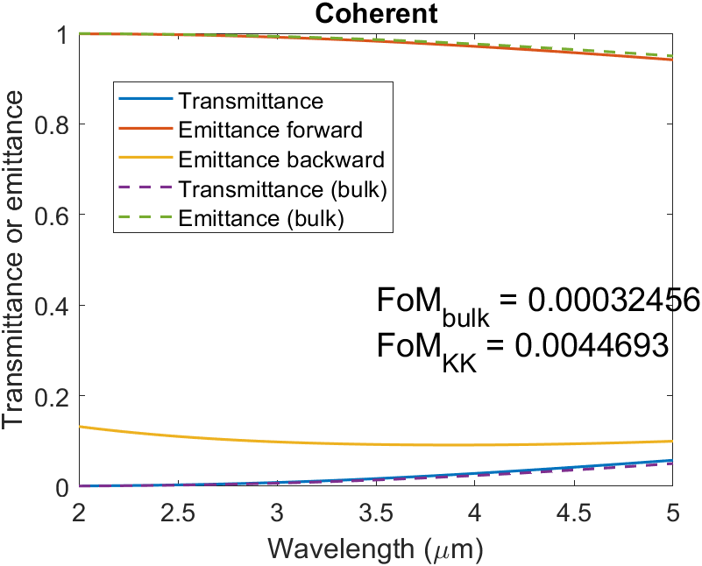
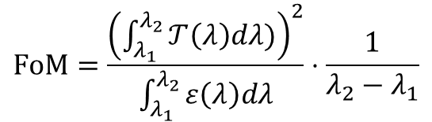


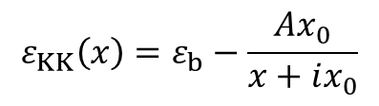
$$FoM=\frac{{\left(\int_{λ_{1}}^{λ_{2}}{𝒯\left(λ\right)dλ)}\right)}^{2}}{\int_{λ_{1}}^{λ_{2}}{ε\left(λ\right)dλ}}⋅\frac{1}{λ_{2}−λ_{1}}$$
$$ε_{KK}\left(x\right)=ε_{b}−\frac{Ax_{0}}{x+ix_{0}}$$
$$T_{Bulk}\left(λ\right)=e^{−\frac{4π}{λ}\int_{MS}{κ(x)dx}}$$
$$ε_{Bulk}\left(λ\right)=1−T_{Bulk}\left(λ\right)$$
Largest enhancement happens for large A & small x_{0,} but FoM is terrible there (too lossy)
Regions of good absolute FoMs show low enhancement

Slide 4
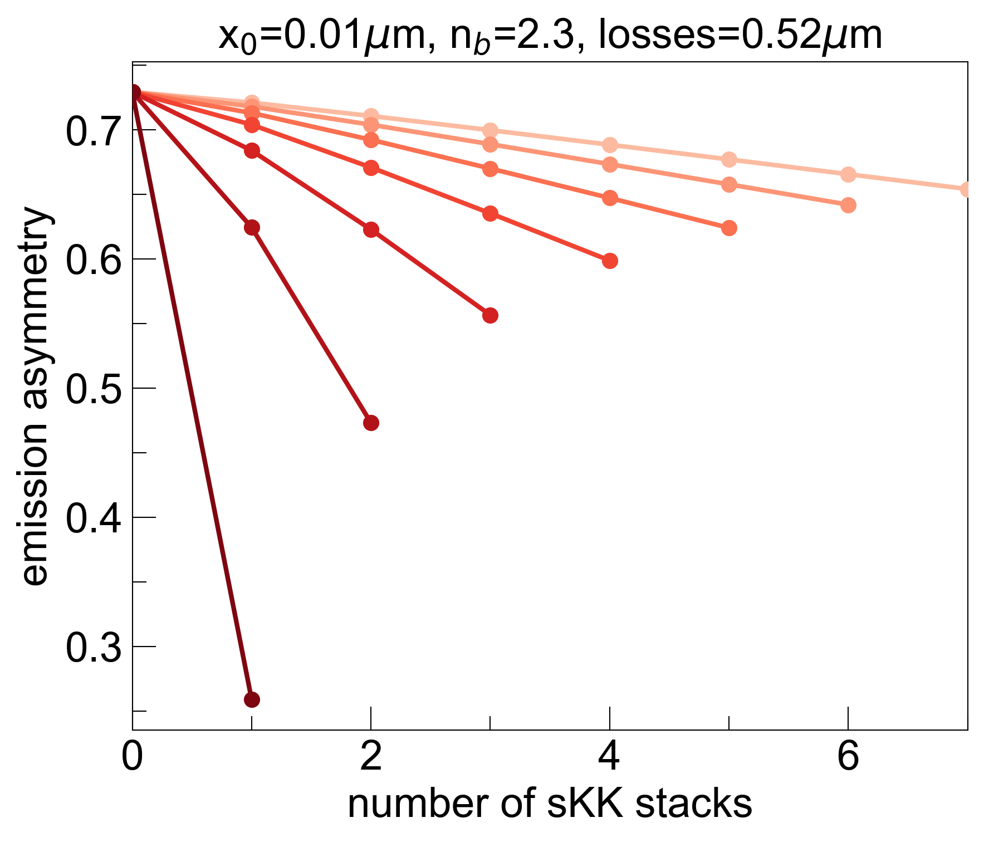
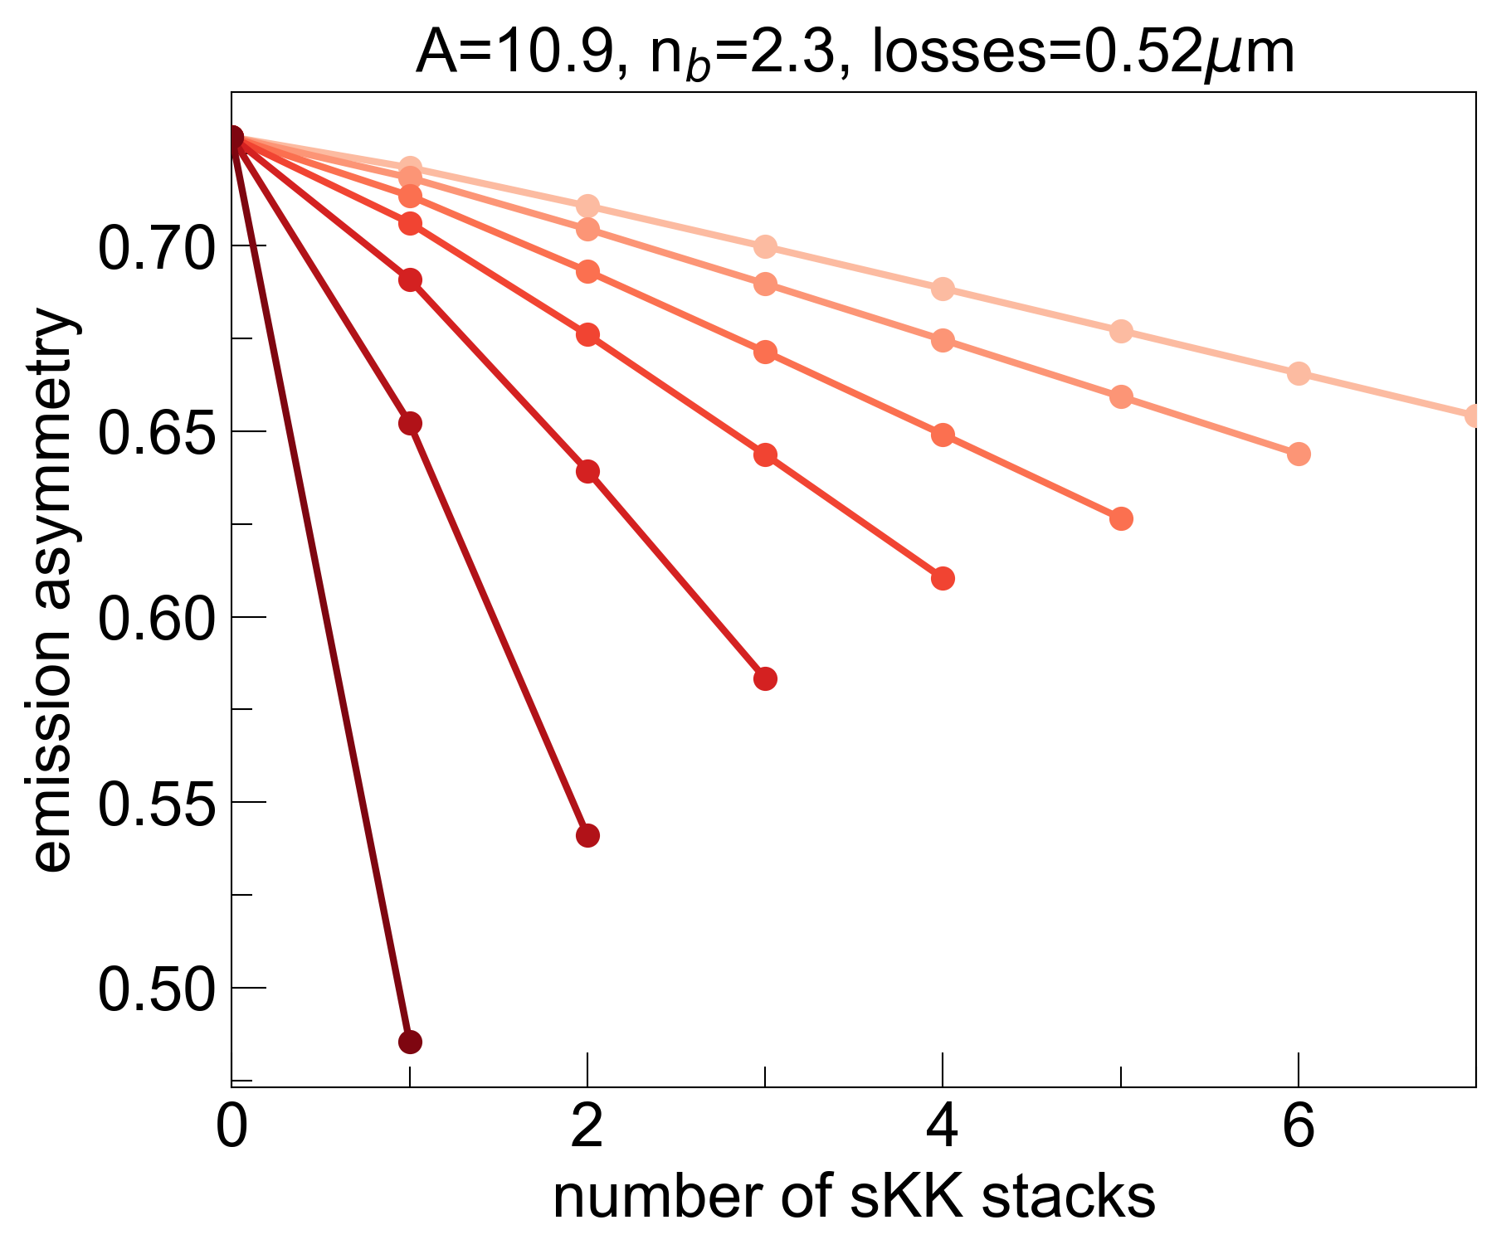
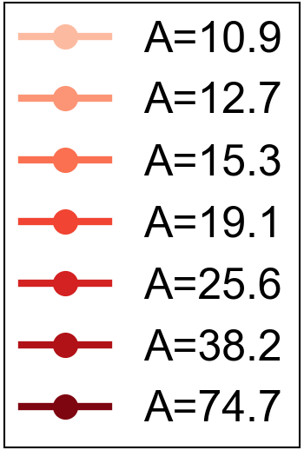
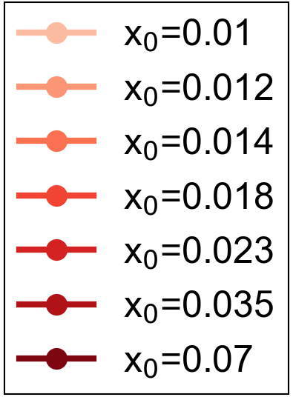
Sweep specific A or x₀ values so that maximum number of sKK stacks addable fully replaces bulk material:
k_{bulk}
s-KK
s-KK
s-KK
s-KK
Both amplitude sweep and width sweep show that maximum asymmetry is achieved when all losses are built into a single KK stack
Focusing losses into a thinner region (large A, small x₀) yields larger asymmetry compared to spreading out losses (small A, large x₀)

Slide 5
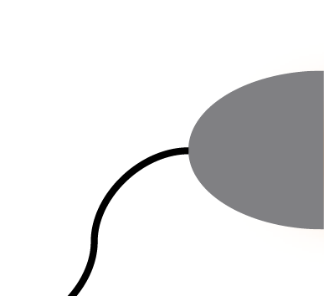
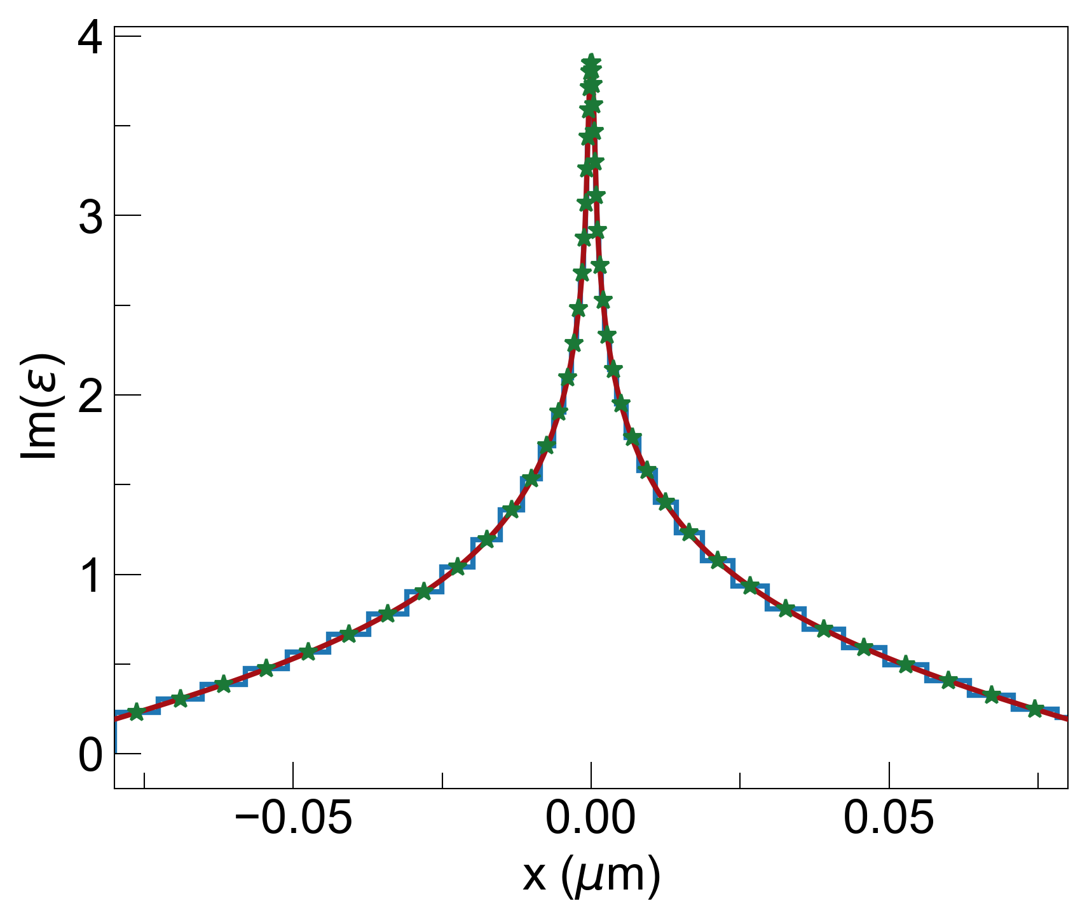
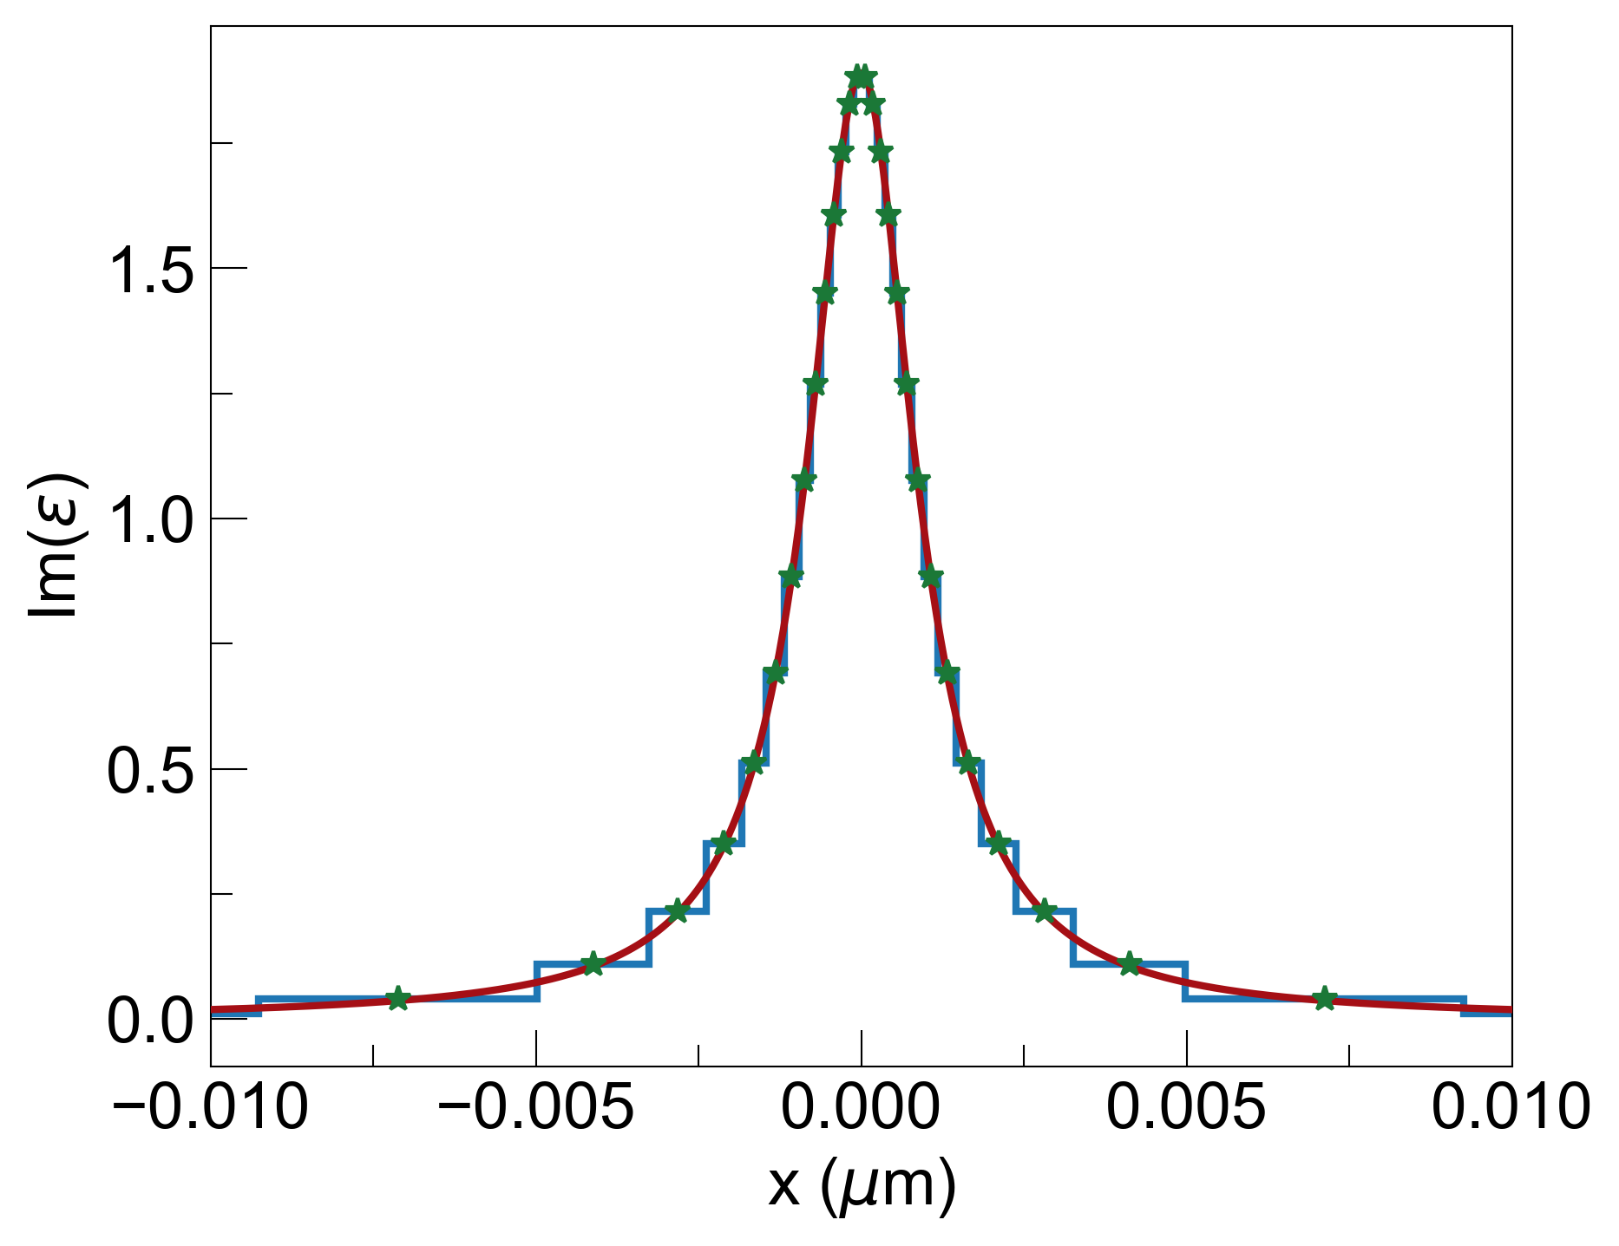
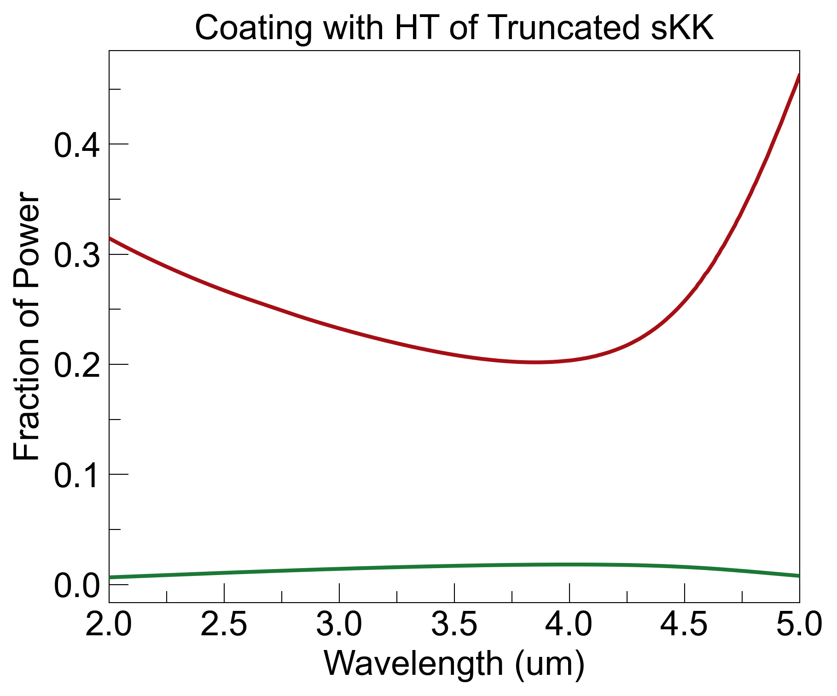
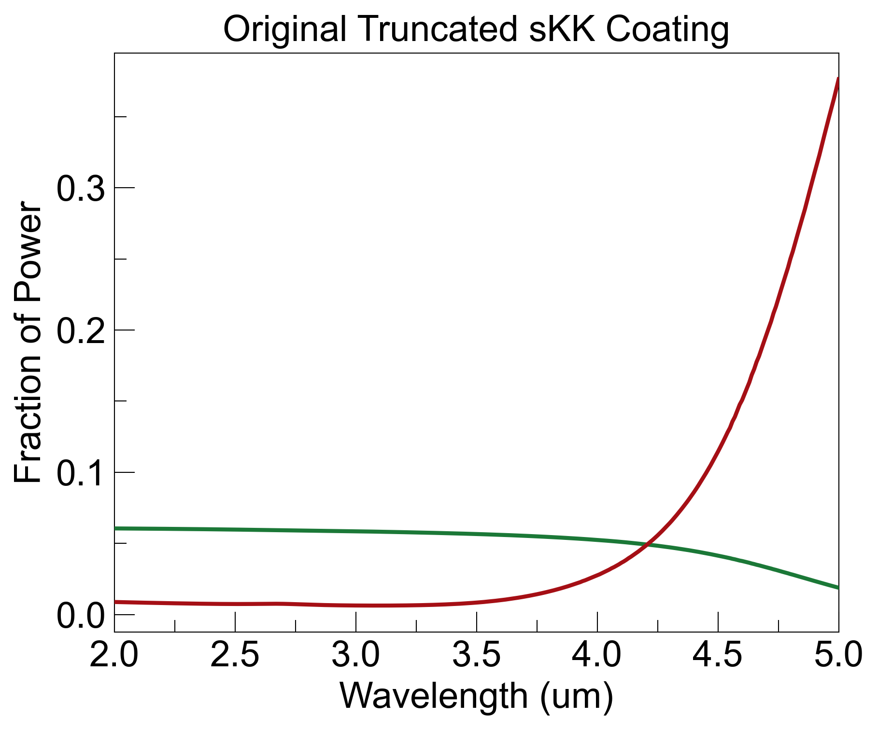
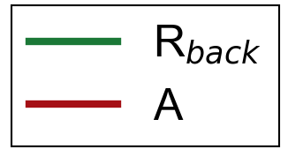
1. With x₀=0.001um s-KK Coating (ellipsometry)
noise = R_{b}
HT coating increases absorption, but reduces backside reflections
Next step: rigorous comparison between HT coating and GRIN coating over angles and wavelengths (is there a significant advantage?)
R_{back}=0.01, A=0.25, noise=0.01
R_{back}=0.05, A=0.05, noise=0.05

