Slide 1
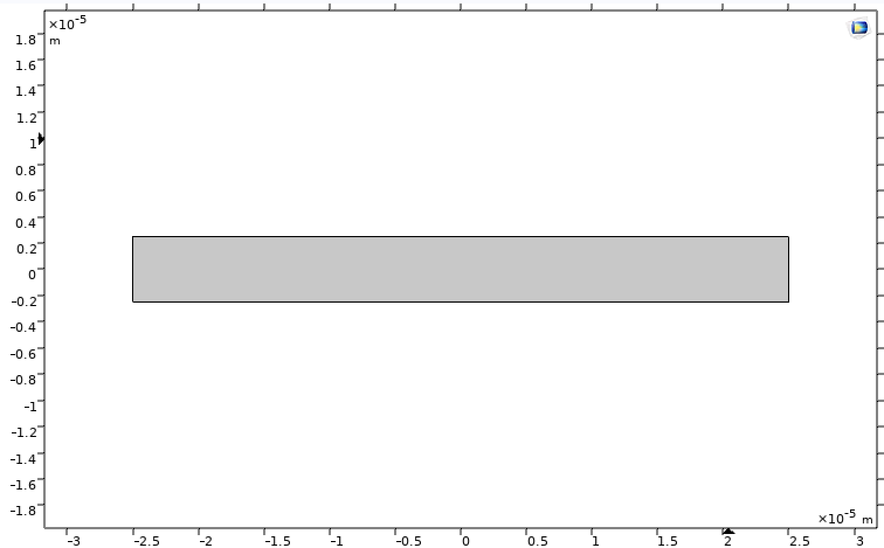

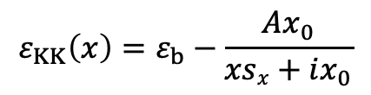

Pulsed, Time-Domain Simulation of Spatial KK MS
2D Model
Dielectric Function:
Geometry: rectangular
Physics: EM Waves, Time-Explicit (teew)
Pulse: Gaussian (launched from left)
Study: time dependent 2[fs] step, 1[ps] stop
$$ε_{KK}\left(x\right)=ε_{b}−\frac{Ax_{0}}{xsx+ix_{0}}$$
$$, sx=1 \left(LR\right), −1(RL)$$
Issue 1: Study was complaining about imaginary 𝜀. Embedded losses into conductivity via this equation:
$σ=ω$ 𝜀₀ 𝜀’’
Is this valid? If not, how to add losses to time dependent study?

Slide 2


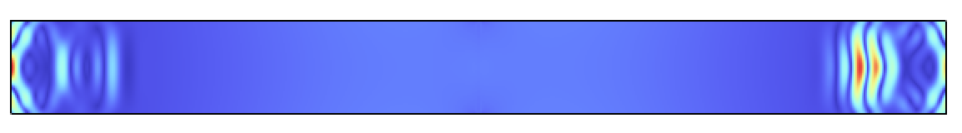
Pulsed, Time-Domain Simulation of Spatial KK MS
No reflection, but pulse went through MS undisturbed (near perfect transmission)
Issue 2: pulse did not get absorbed by boundaries (backside reflections). How do you add those in this physics?
Study 2: Increased conductivity by 100x, Comsol threw an error, reduced to 10x and it ran:

Slide 3
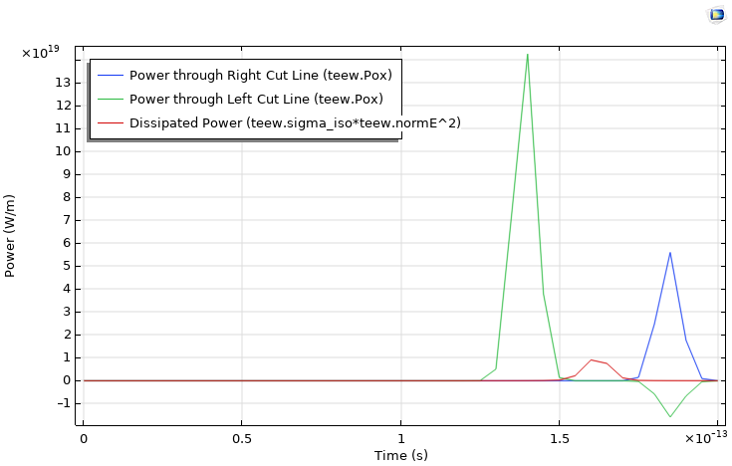
Issue 3: wanted to broaden permittivity profile to avoid multiplying conductivity. changed x₀ from 0.01[um] to 0.1[um] and Comsol threw an error.
Changed amplitude from 5 to 1, and it ran. What is the issue here?

