Slide 1
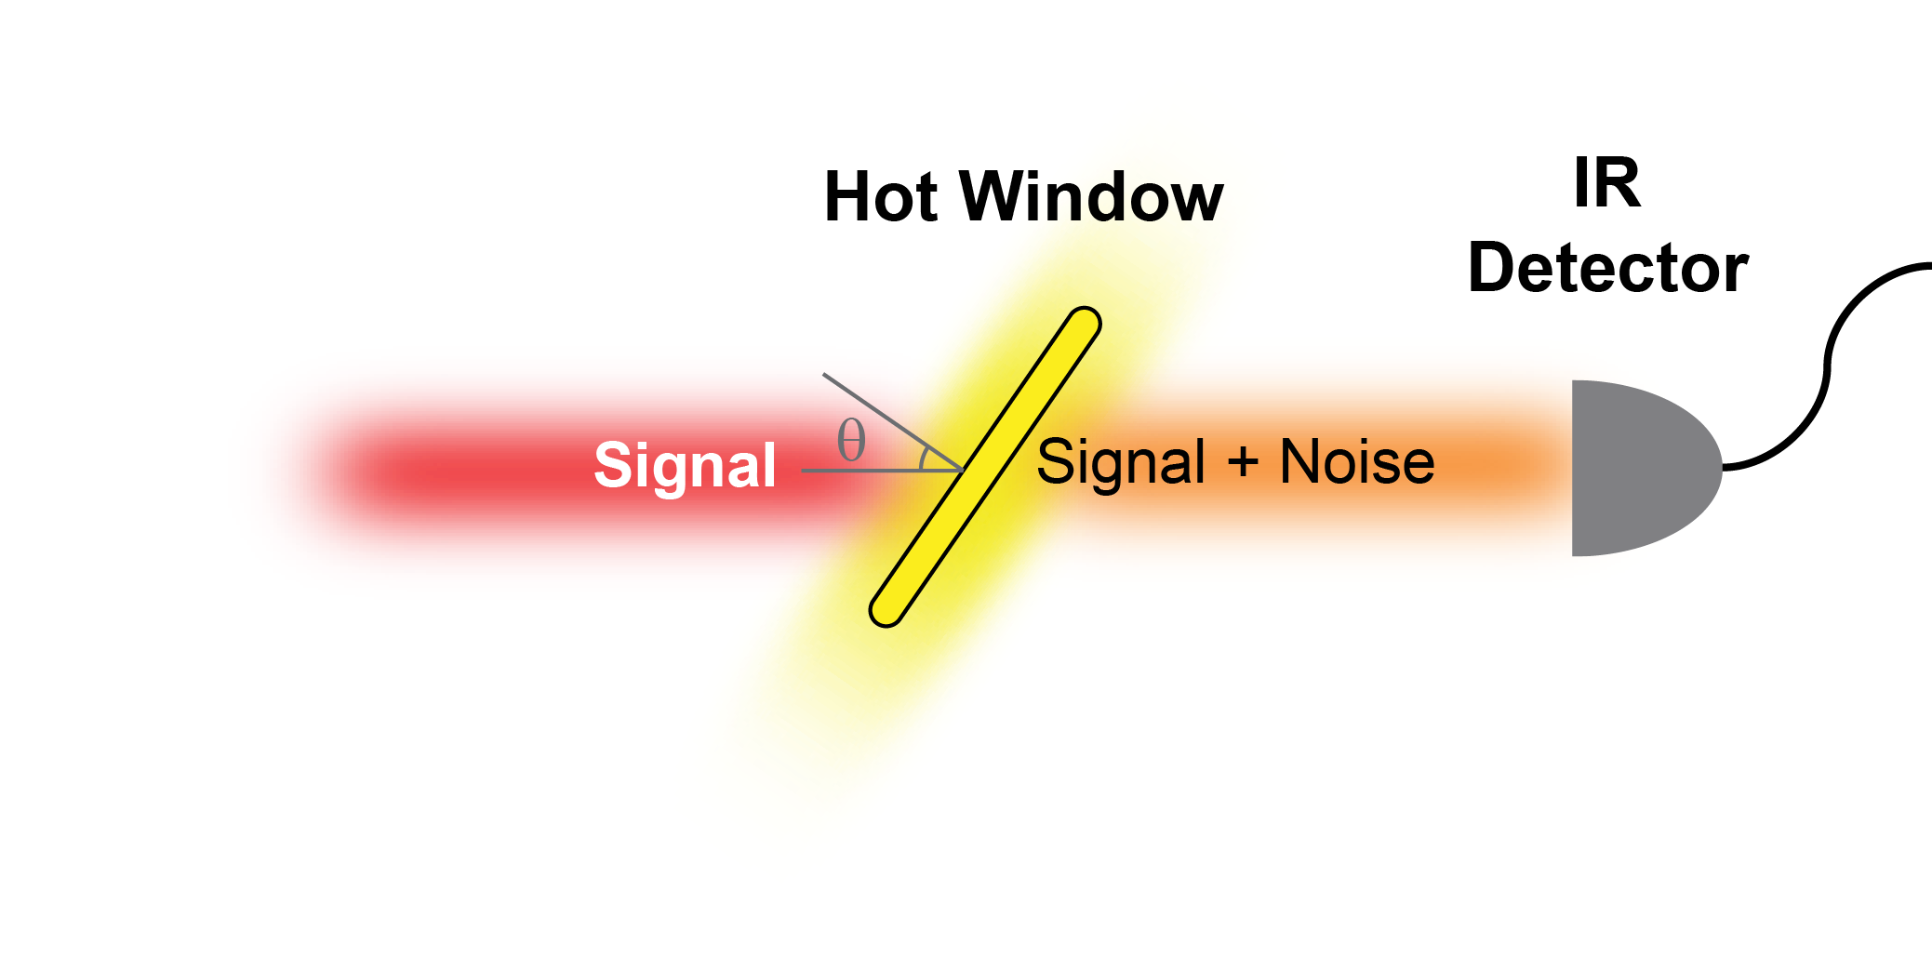
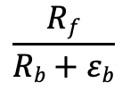

How can a spatial Kramers–Kronig coating help?
1. Coating behind window (e.g. ellipsometry)
window
coating
I₀
T
$$\frac{Rf}{Rb+εb}$$
FOM:
R_{f} (signal)
R_{b} (noise)
ε_{b} (noise)
2. Coating in front of window (e.g. TE detection)
coating
window
T
I₀
FOM:
$$\frac{T}{ε}$$
ε (noise)

Slide 2
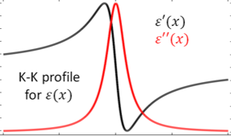
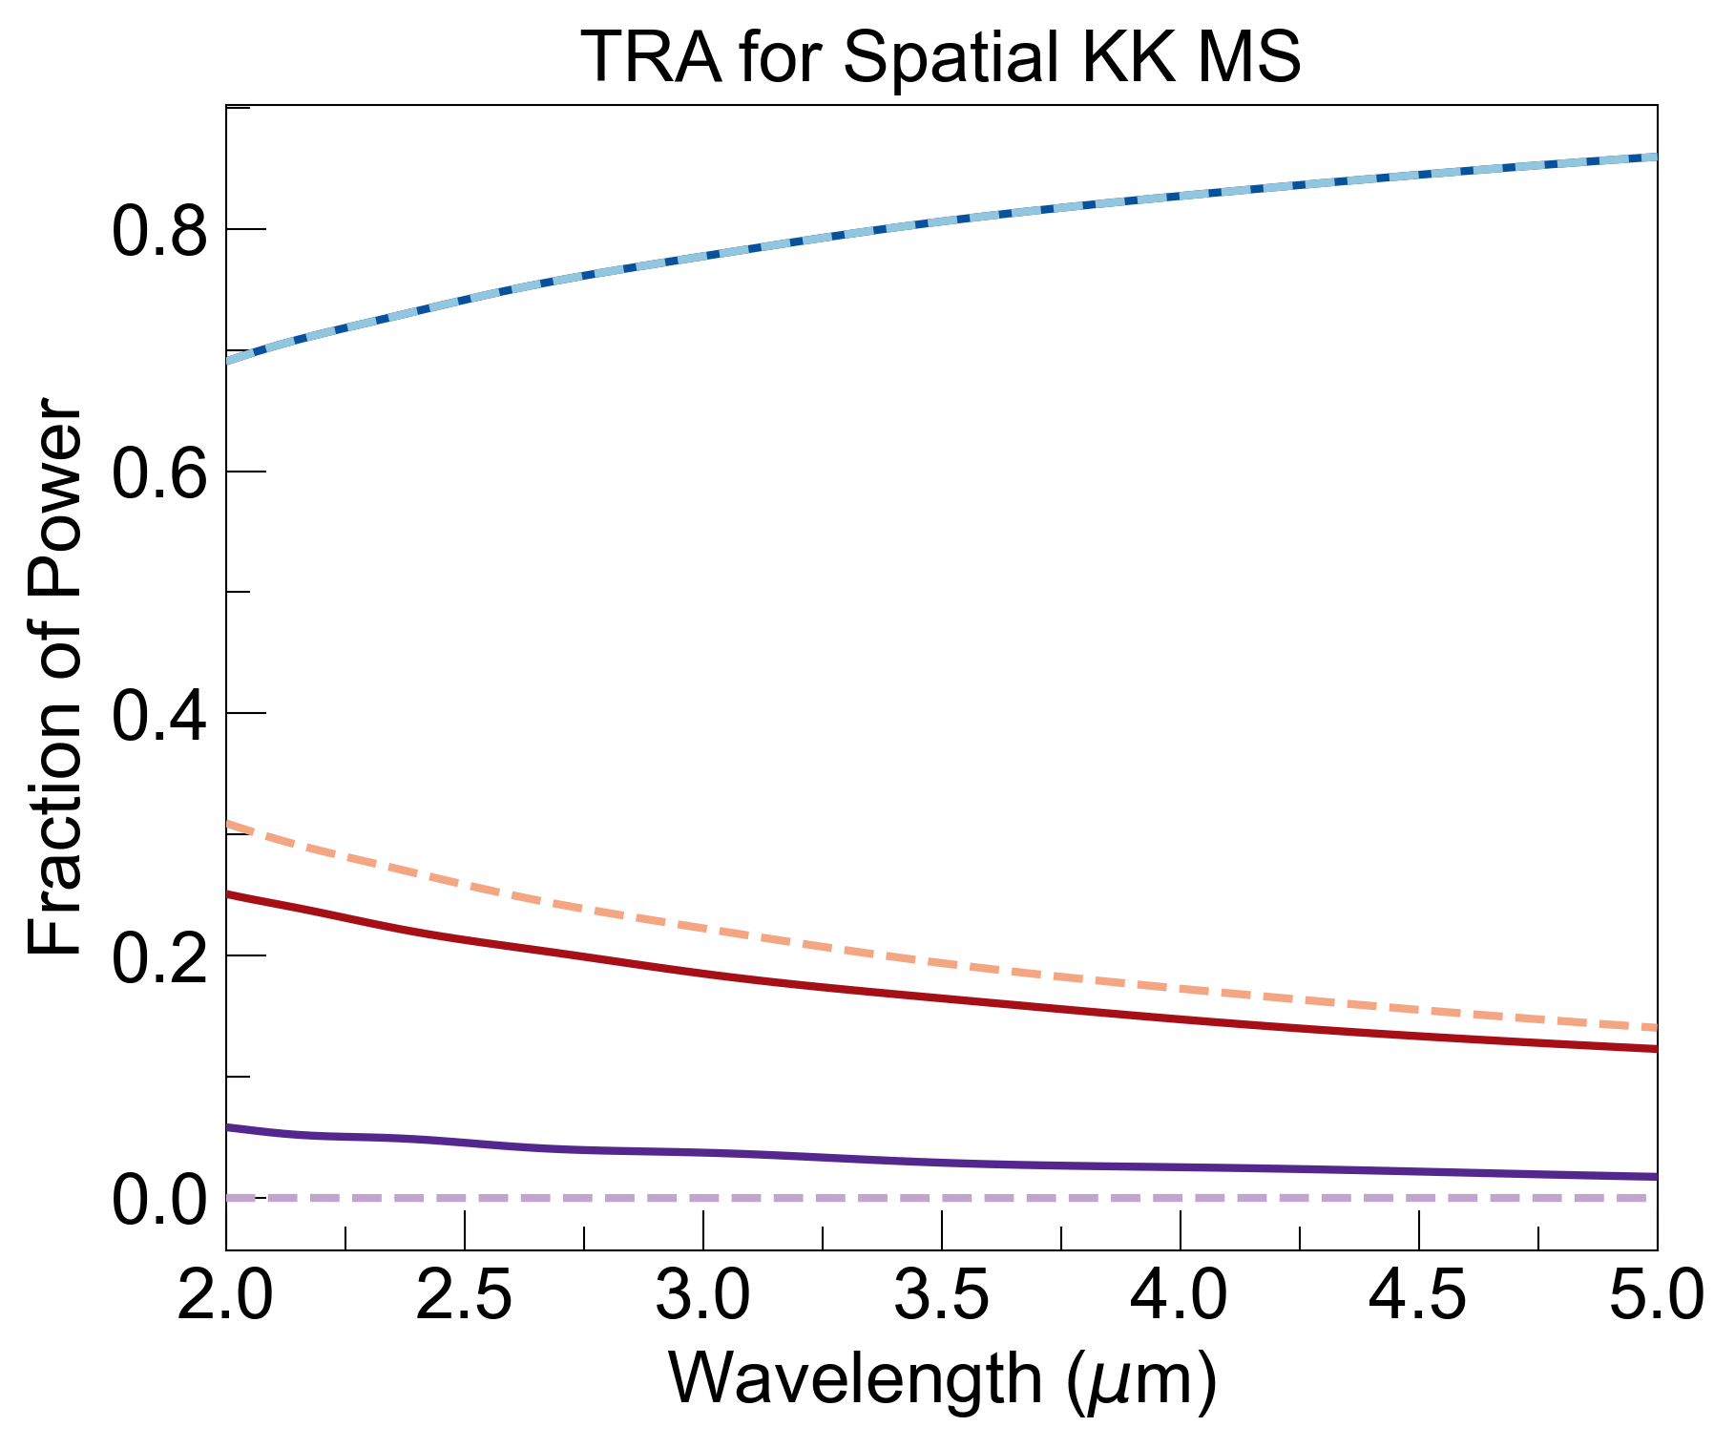
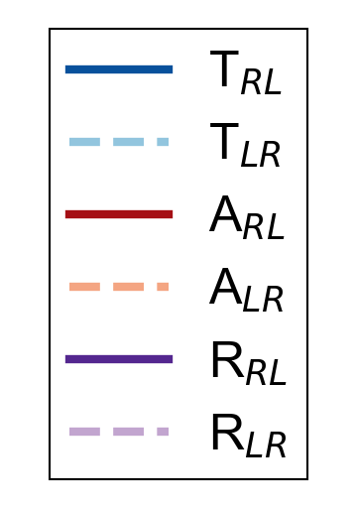
Plan and Intuition
Use different portions of KK profile for coating
Compare FOM of sKK coating and AR coating
Intuition: sKK coating will not help (trading reflection for absorption, not transmission)

Slide 3
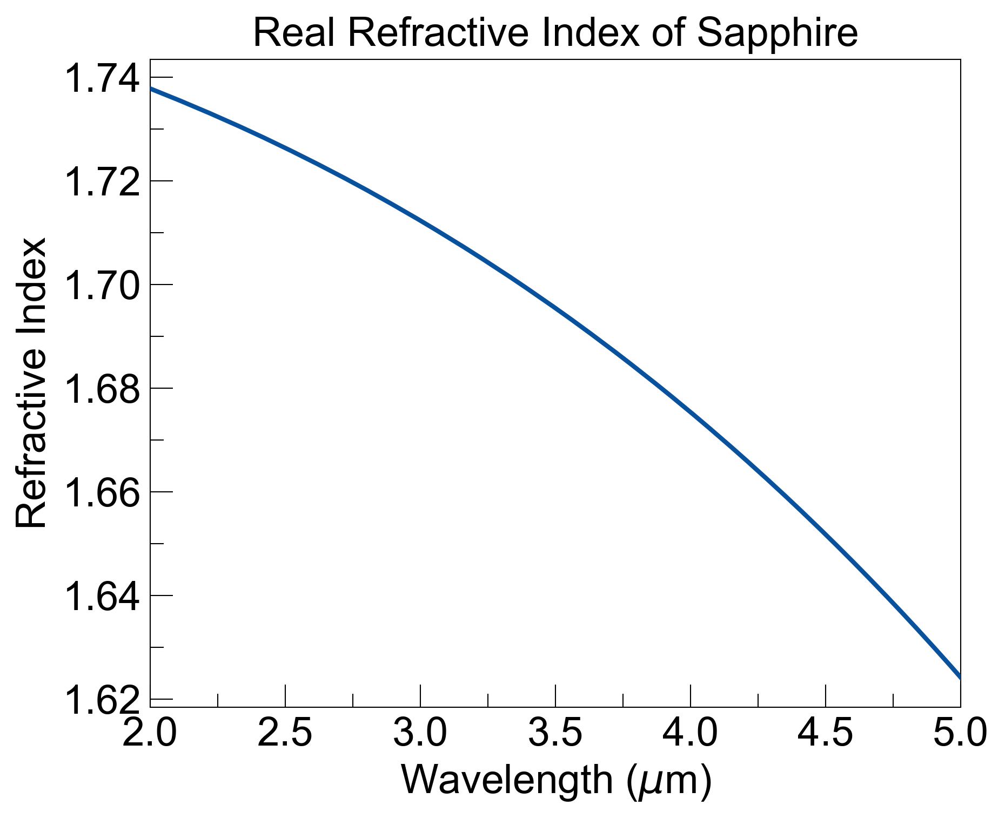
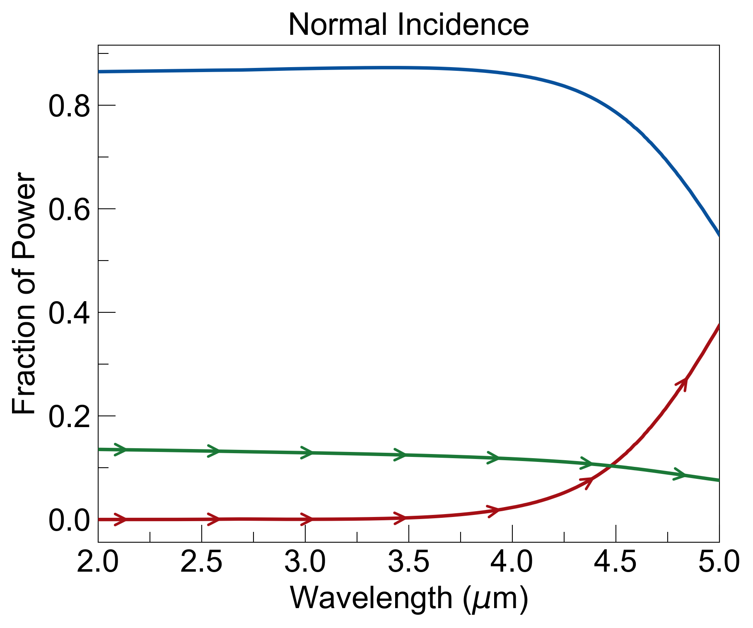
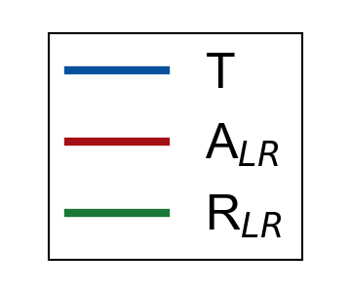
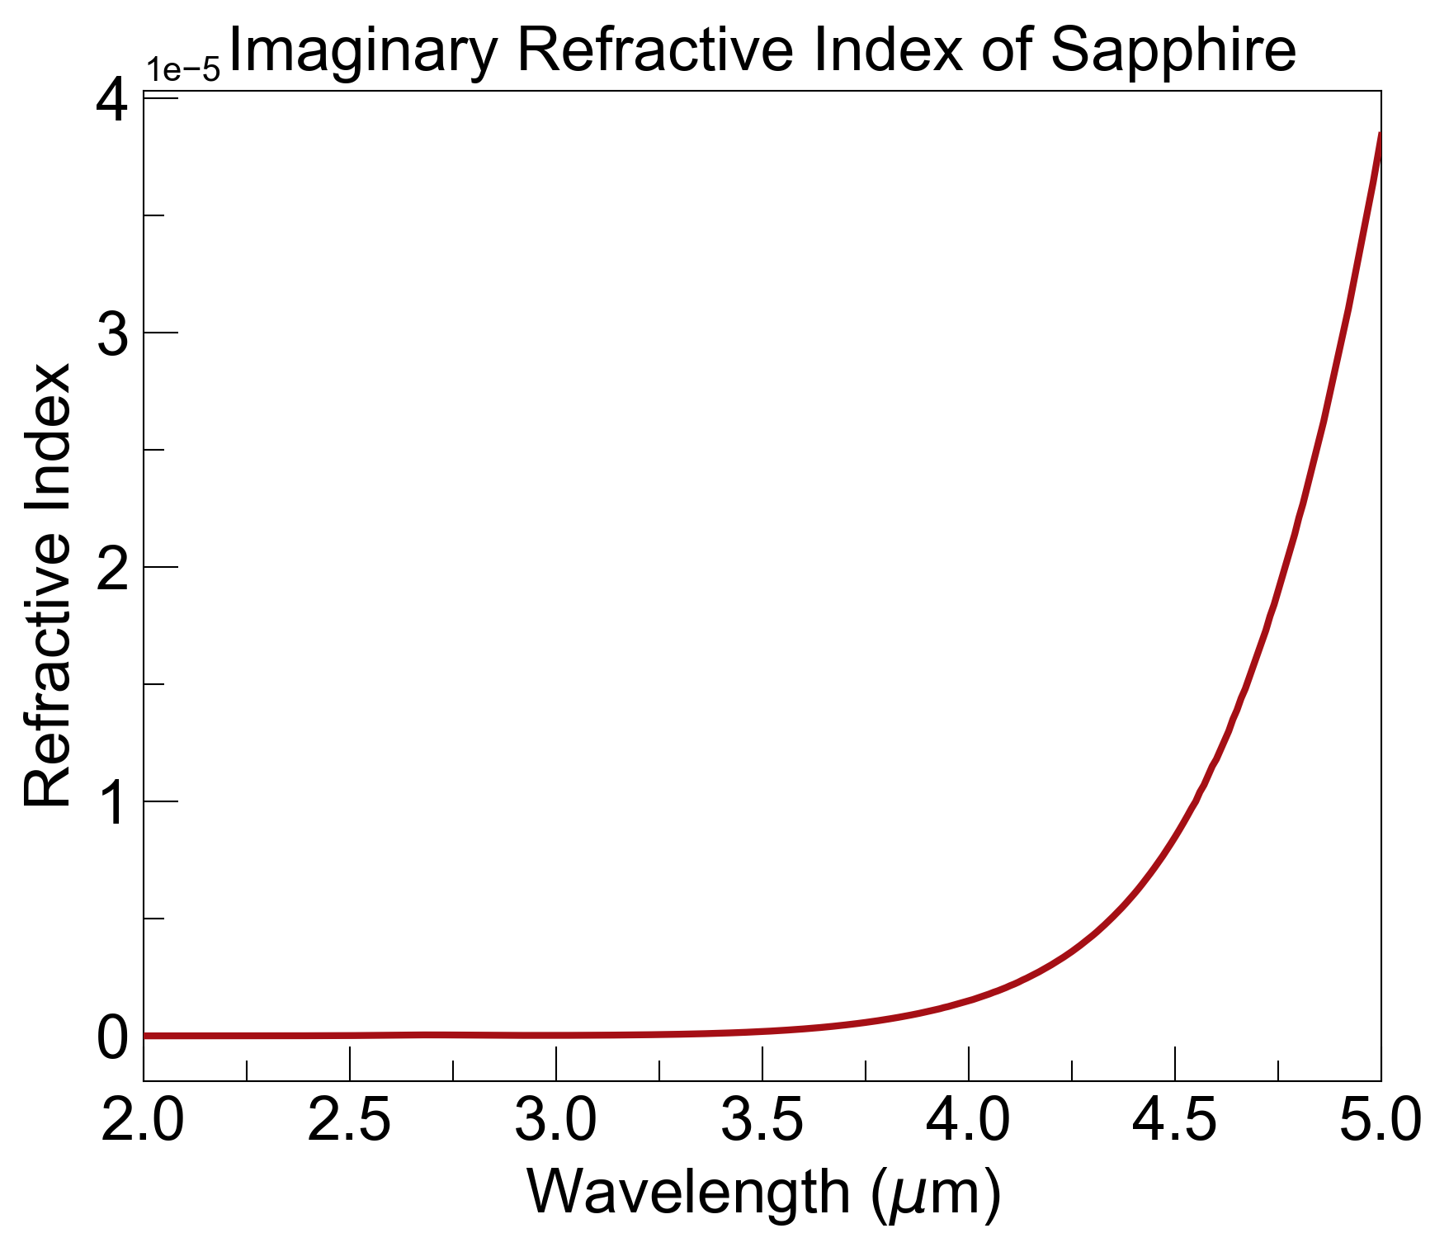
Optical Response of 5mm Bulk Sapphire

Slide 4
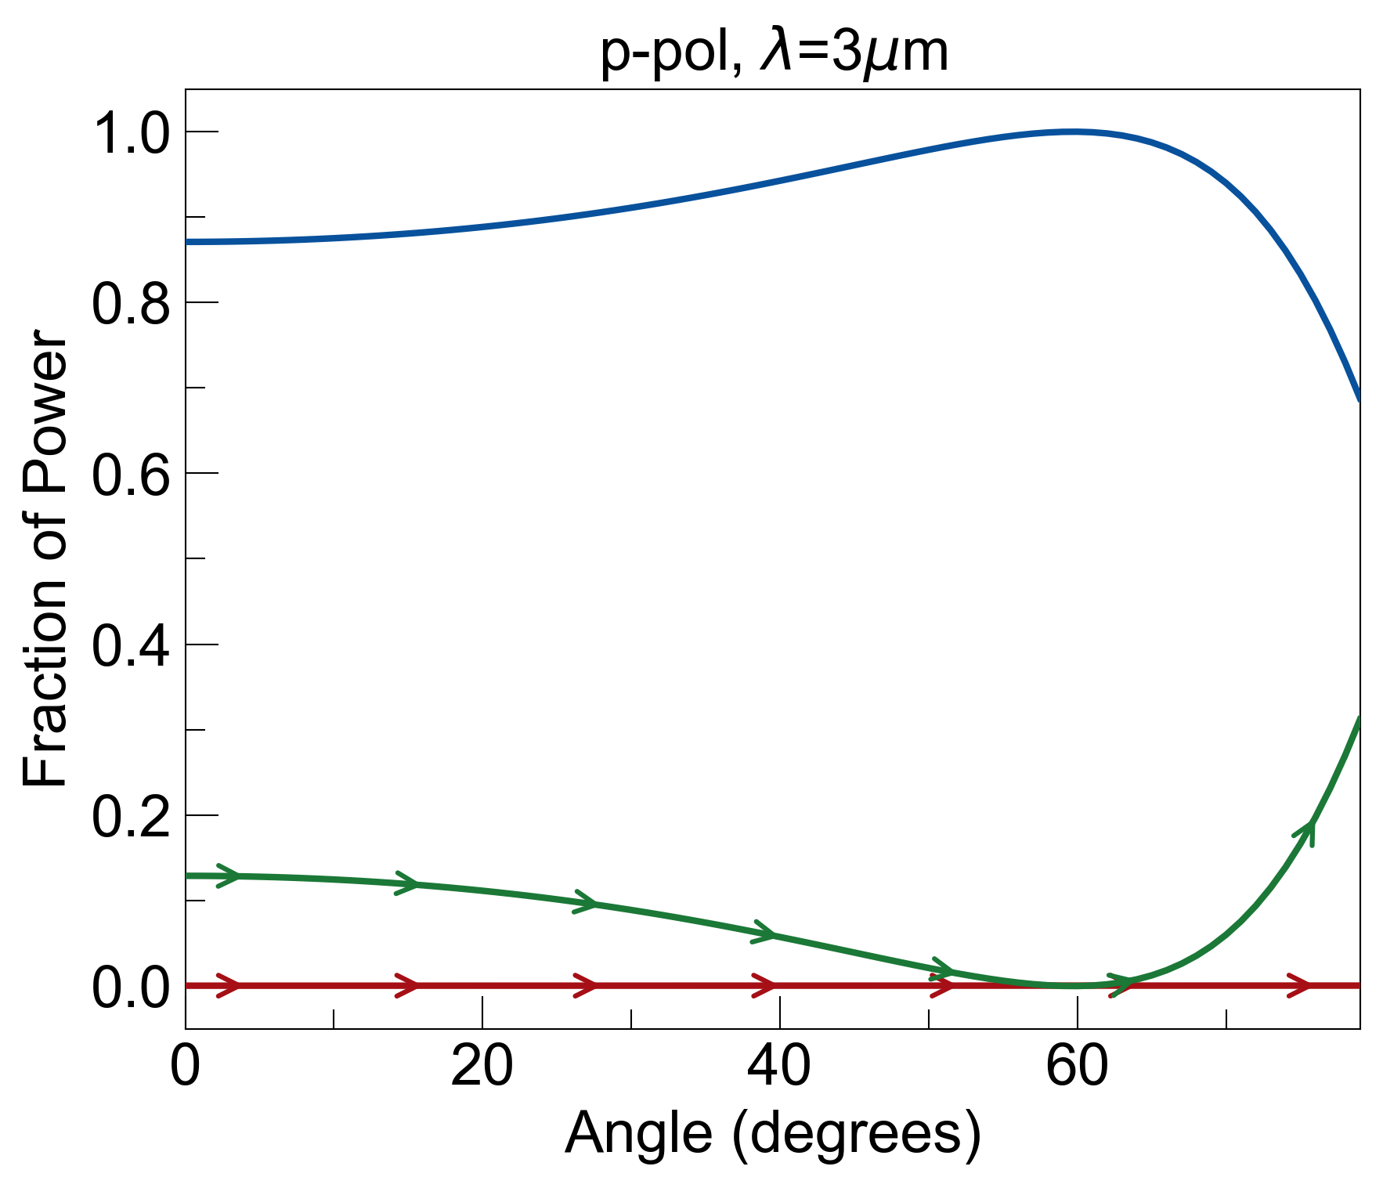
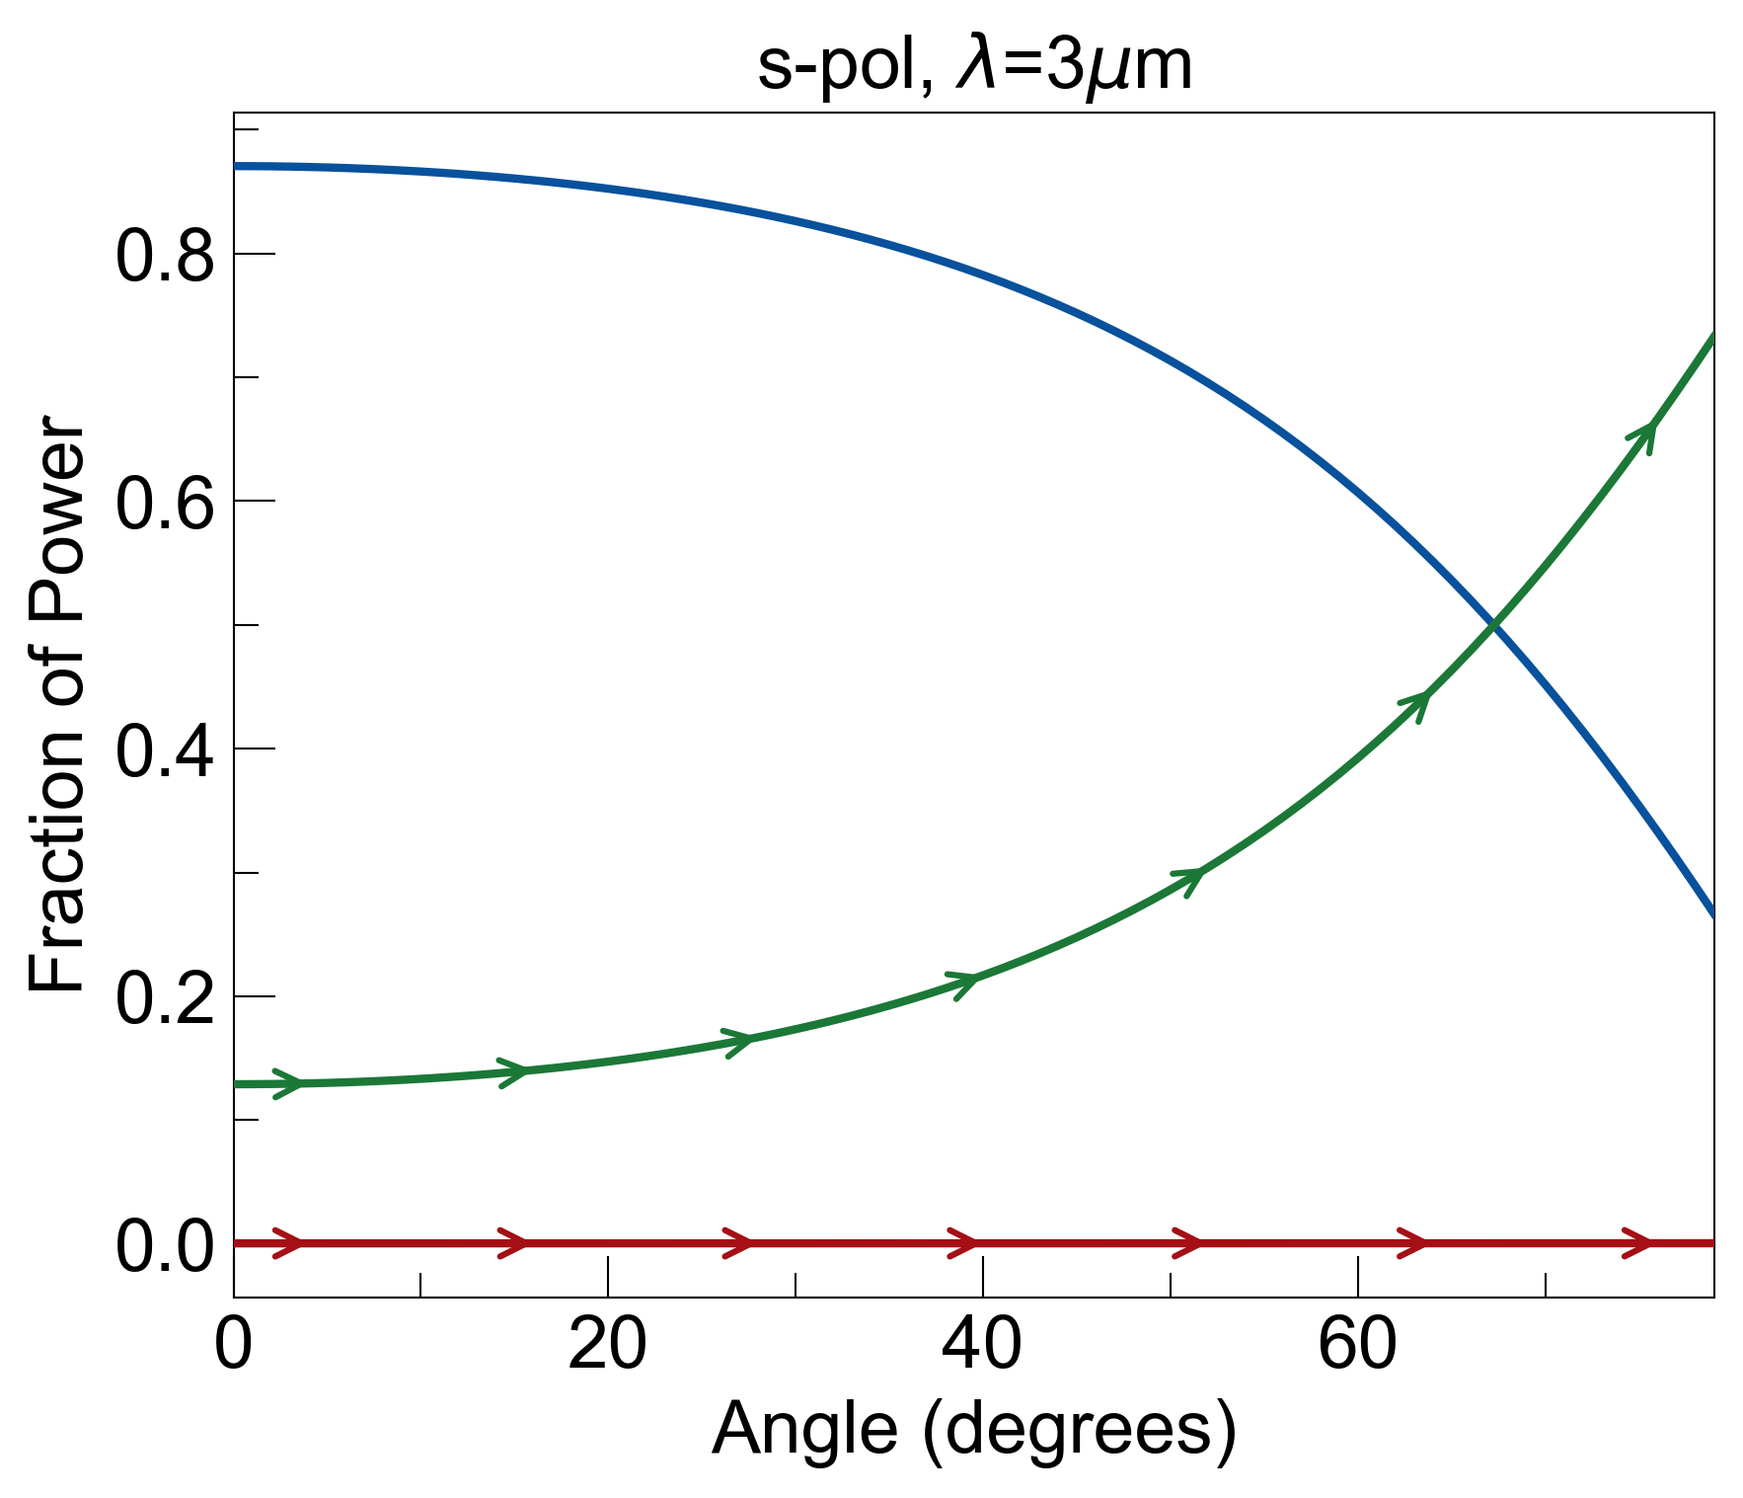
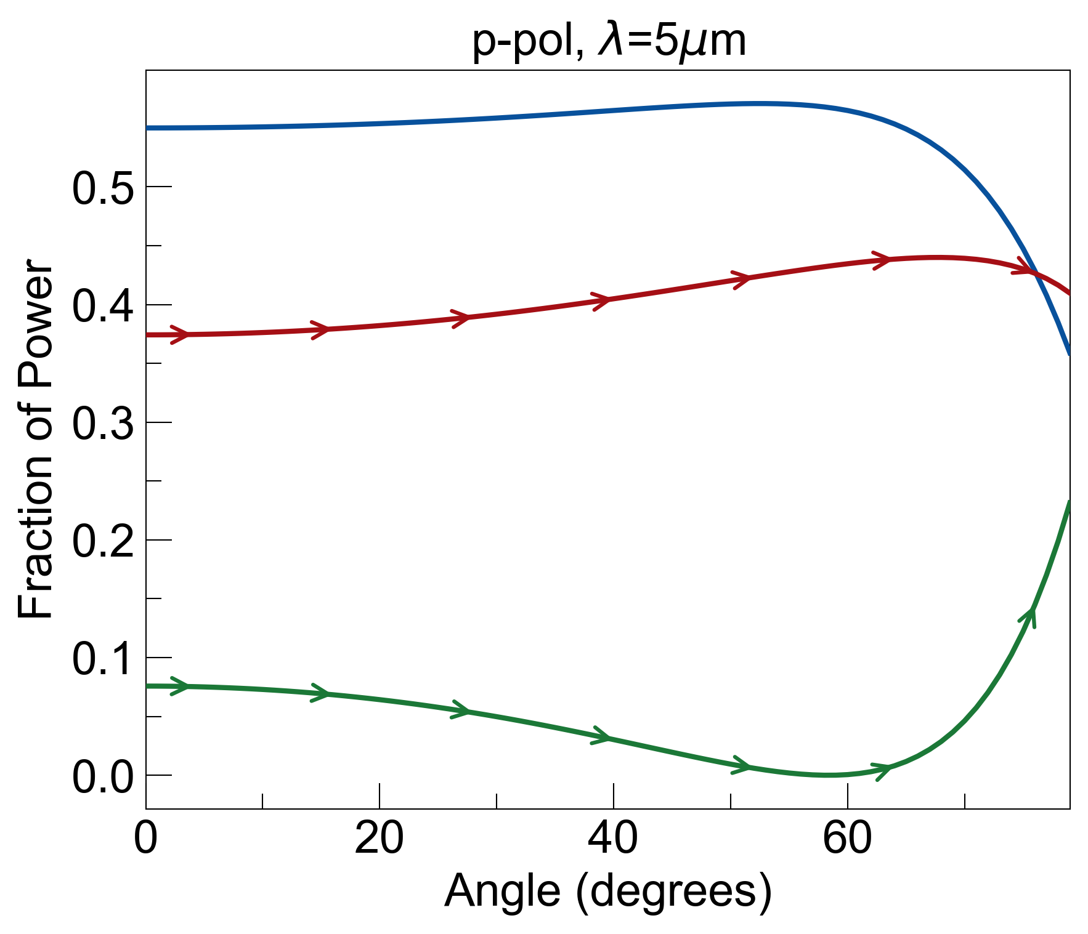
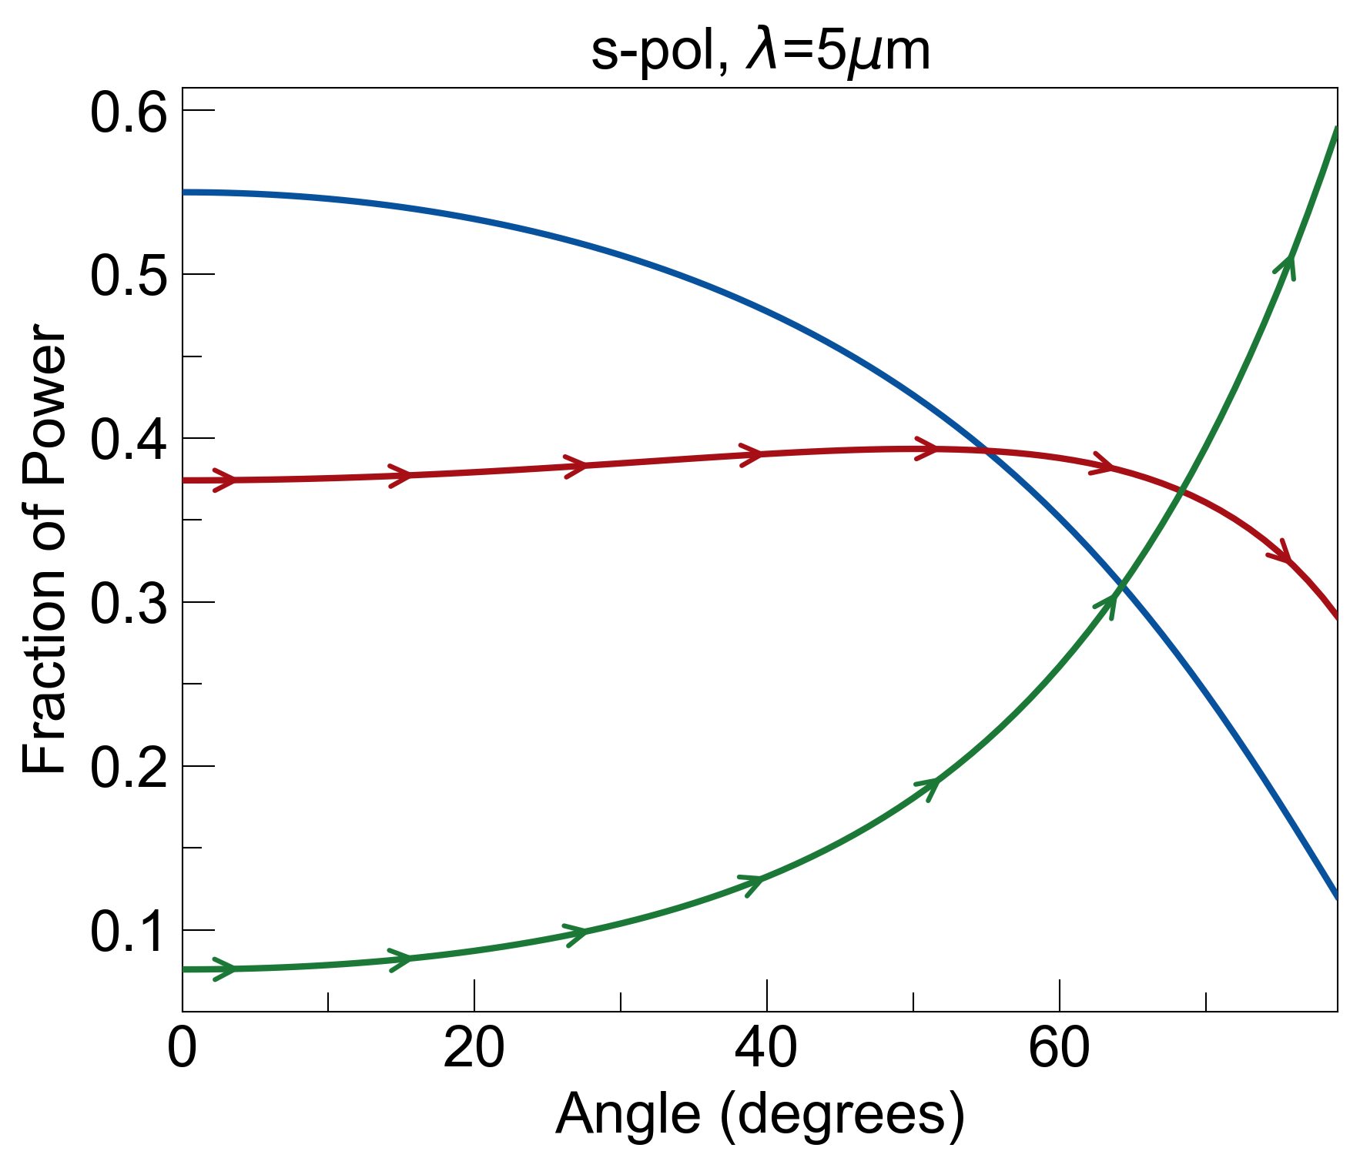
Optical Response of 5mm Bulk Sapphire (Angle Dependence)

Slide 5
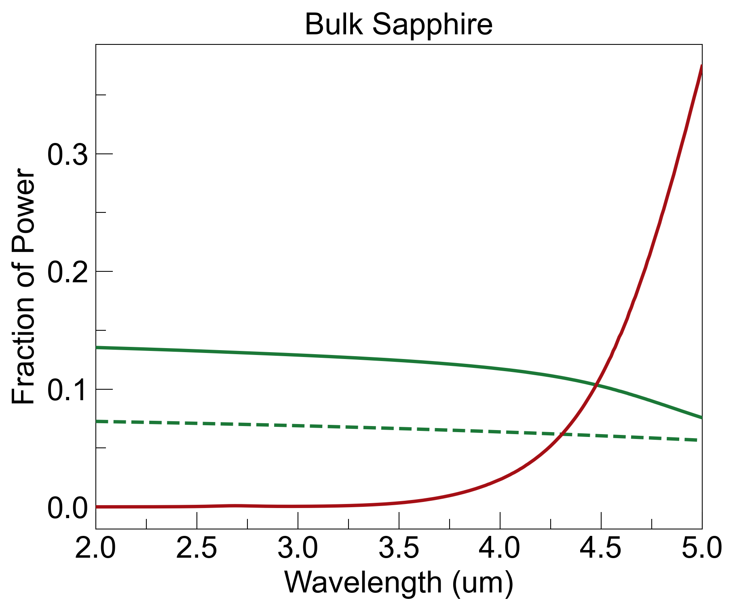
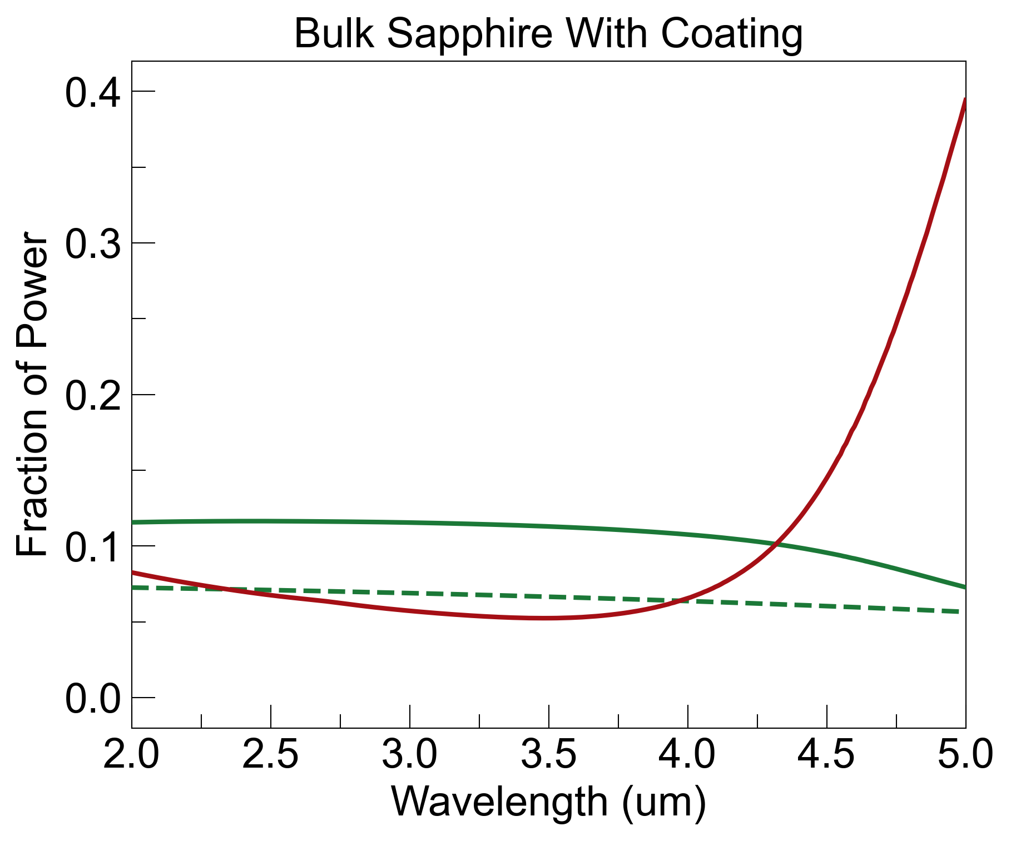
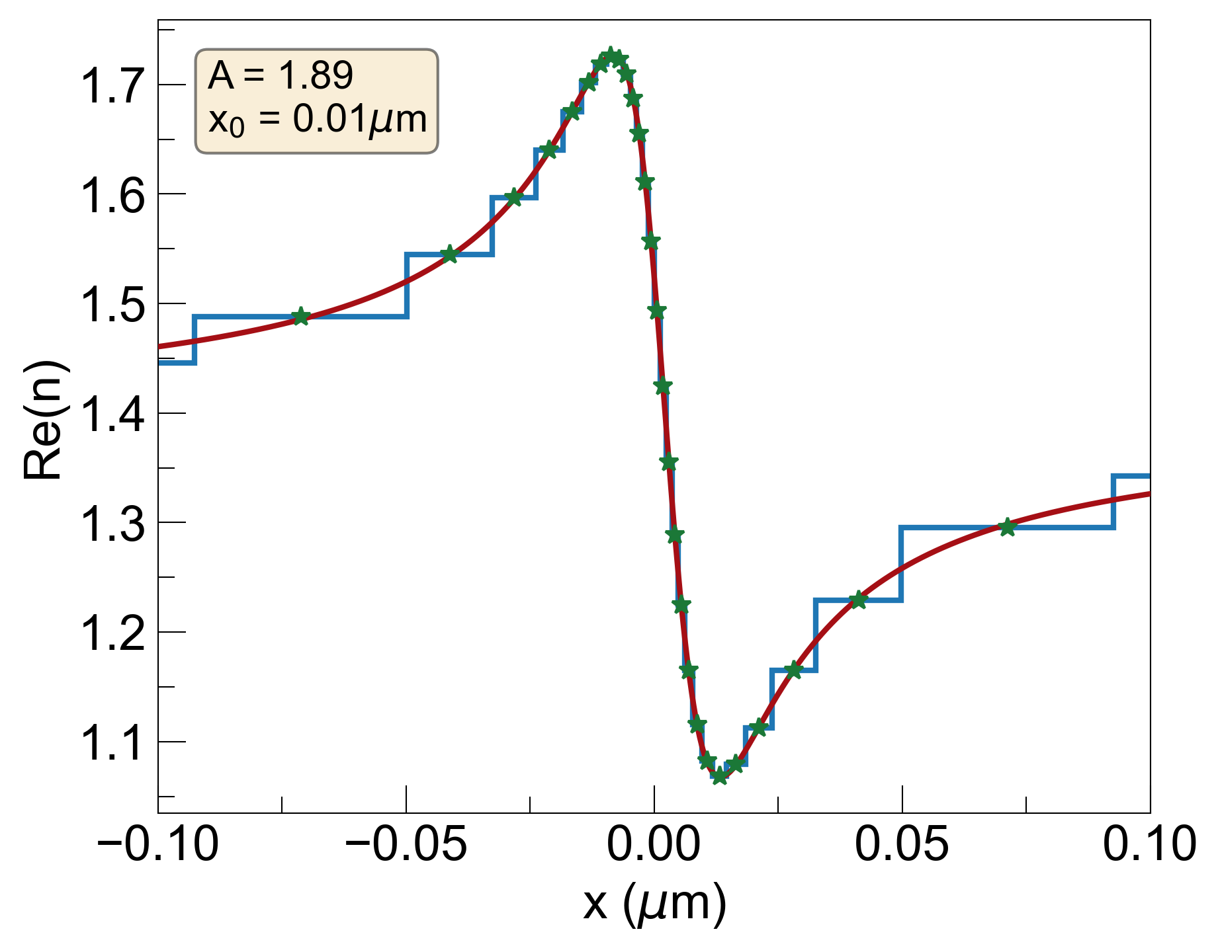
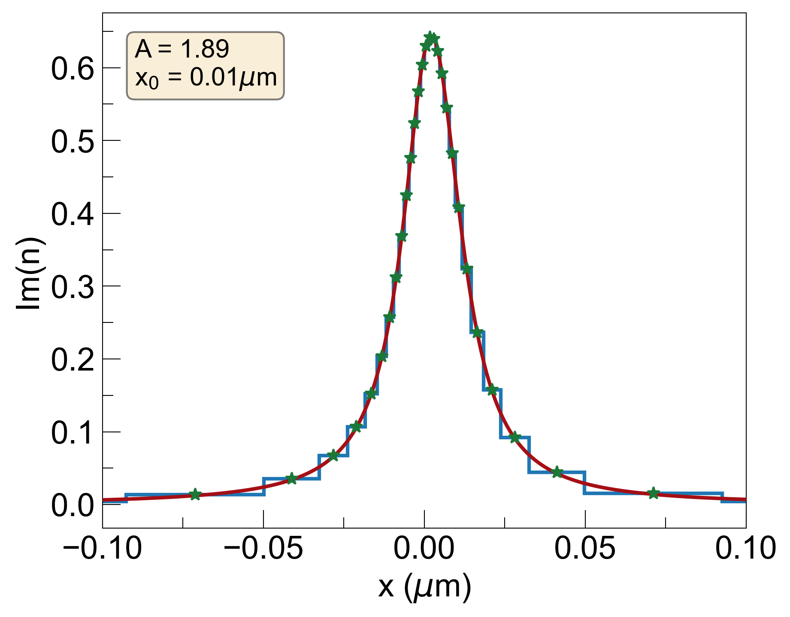
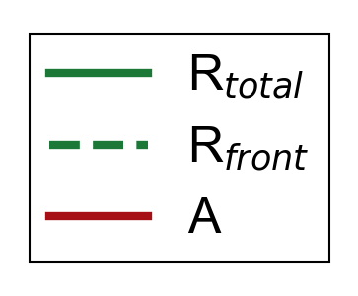
1. With x₀=0.01um s-KK Coating (ellipsometry)
noise = R_{b} + A_{b}
R_{b}=0.05, A_{b}=0.05, noise=0.1
R_{b}=0.04, A_{b}=0.1, noise=0.14
coating slightly decreases R_{b} but increases E_{b}, causing overall noise to increase

Slide 6
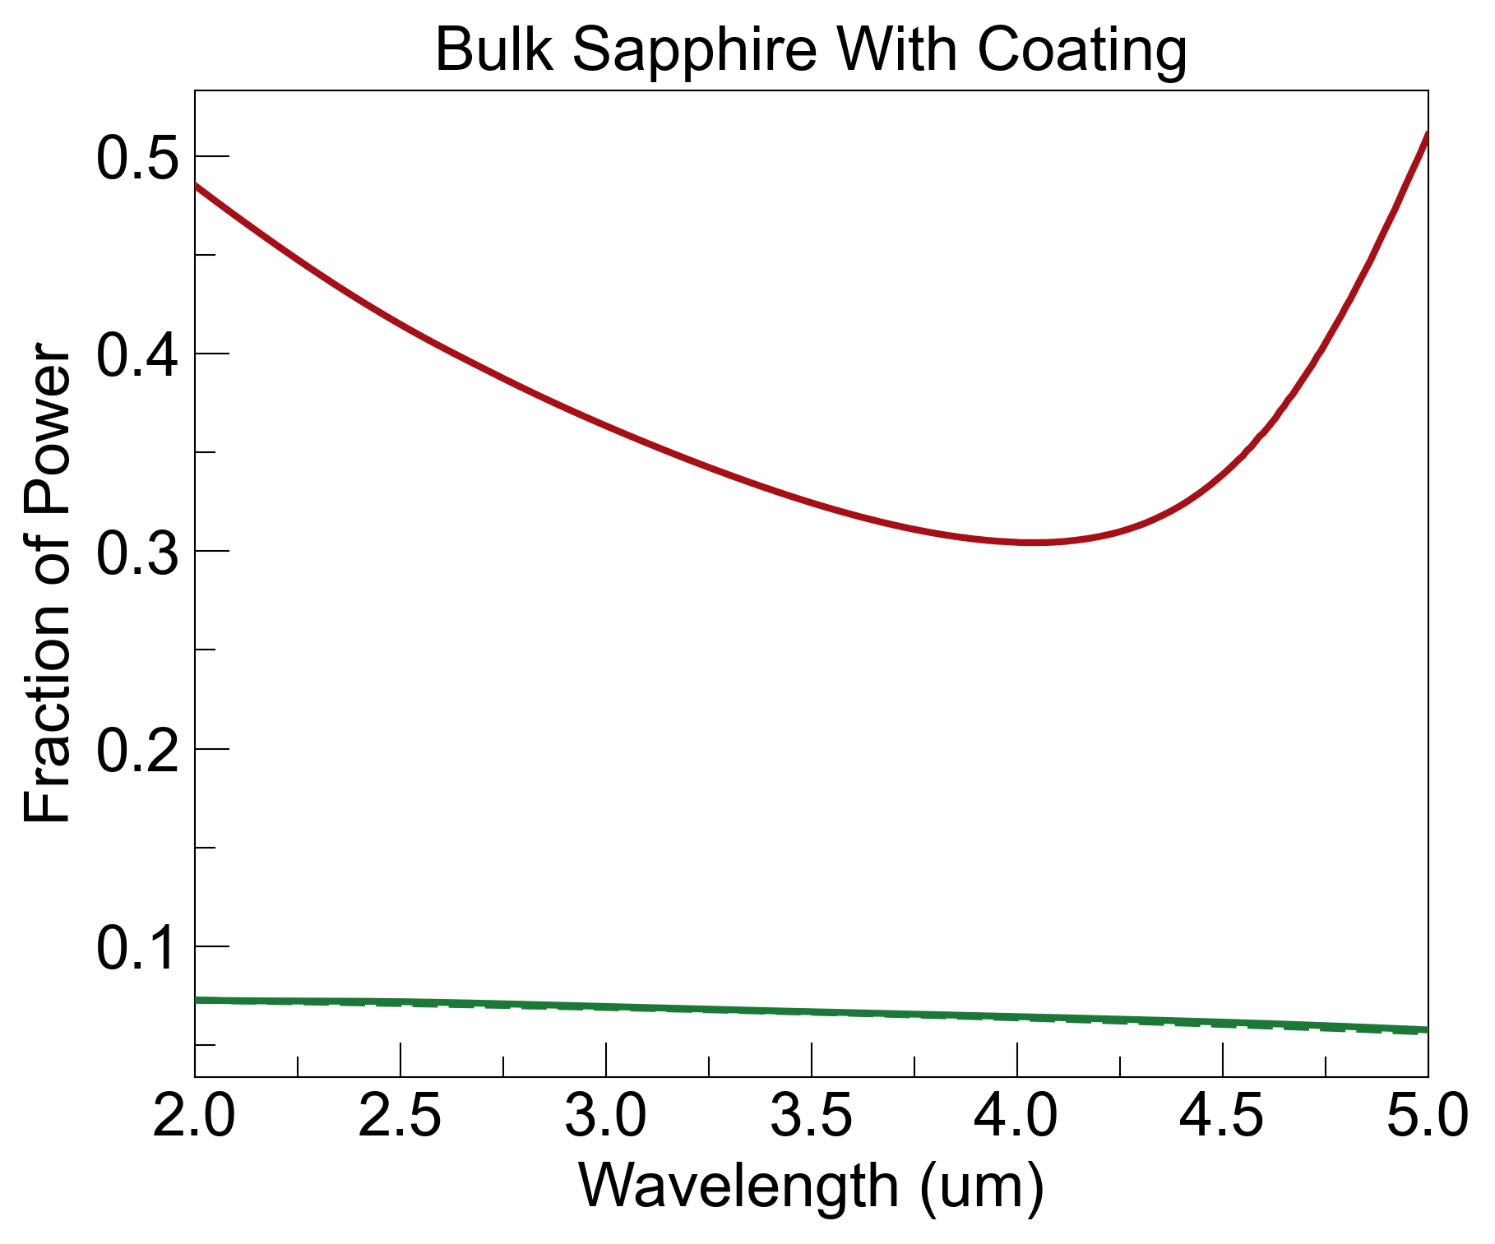

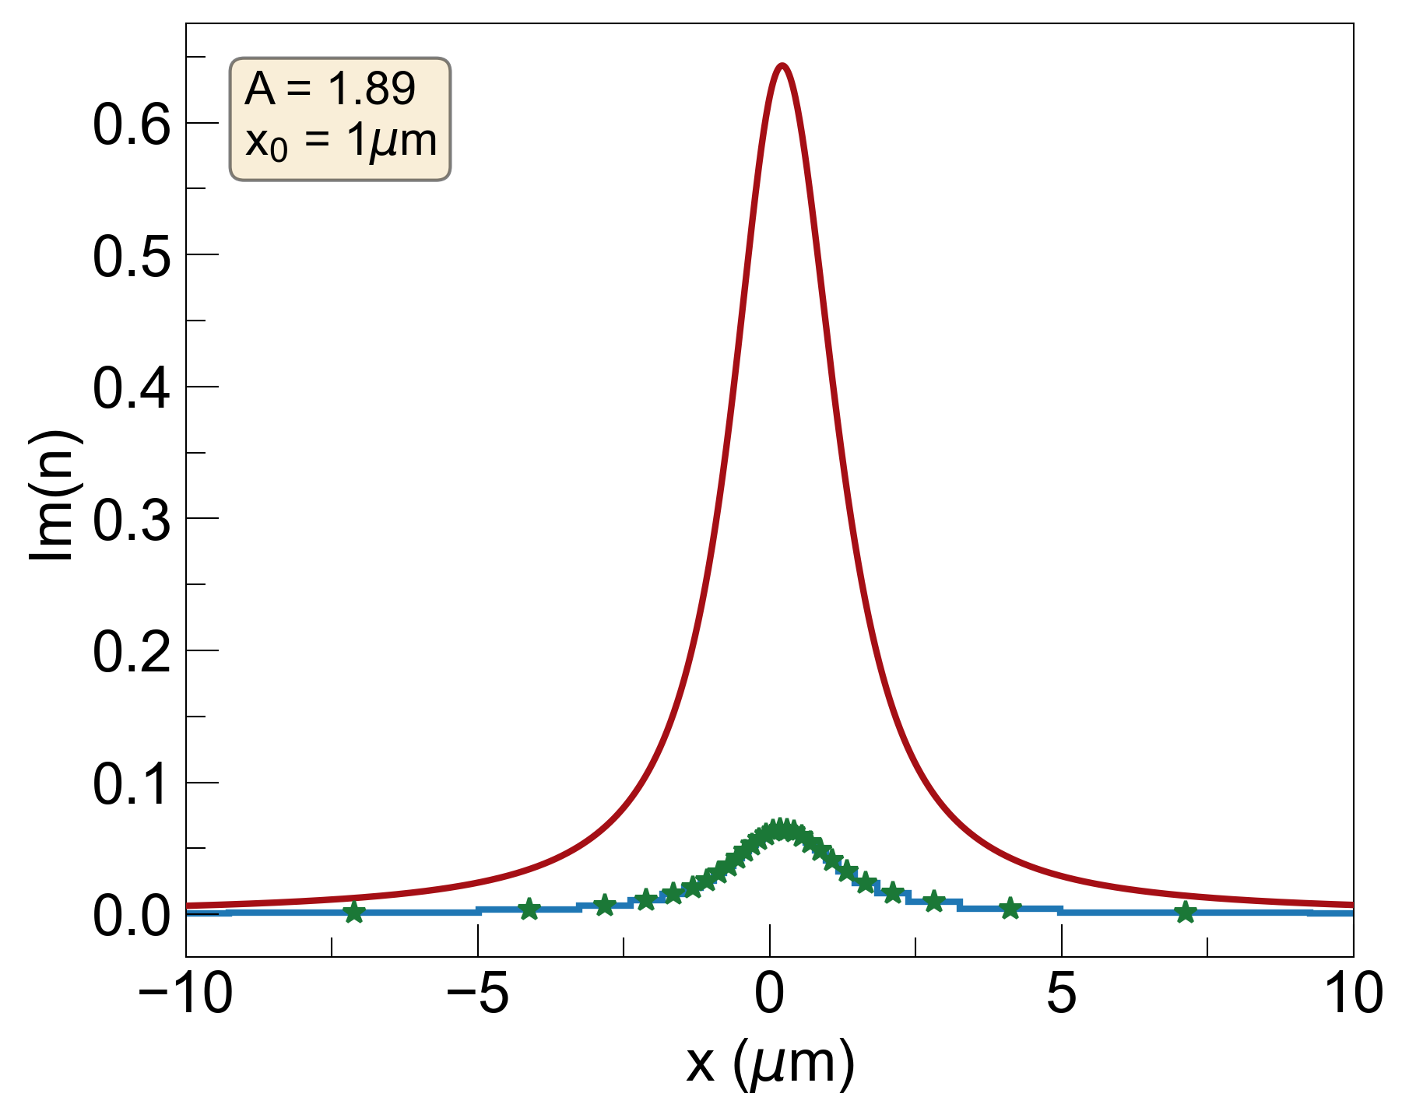
1. With x₀=1um, 10% Im(n) s-KK Coating
noise = R_{b} + E_{b}
R_{b}=0.05, E_{b}=0.05, noise=0.1
R_{b}=0, E_{b}=0.37, noise=0.37
thicker coating layers eliminate R_{b} but increase E_{b} significantly, even when 10% Im(n) used

Slide 7
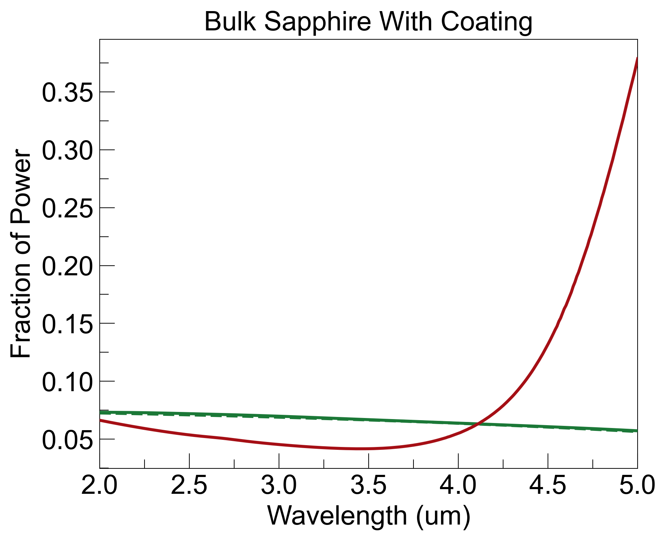
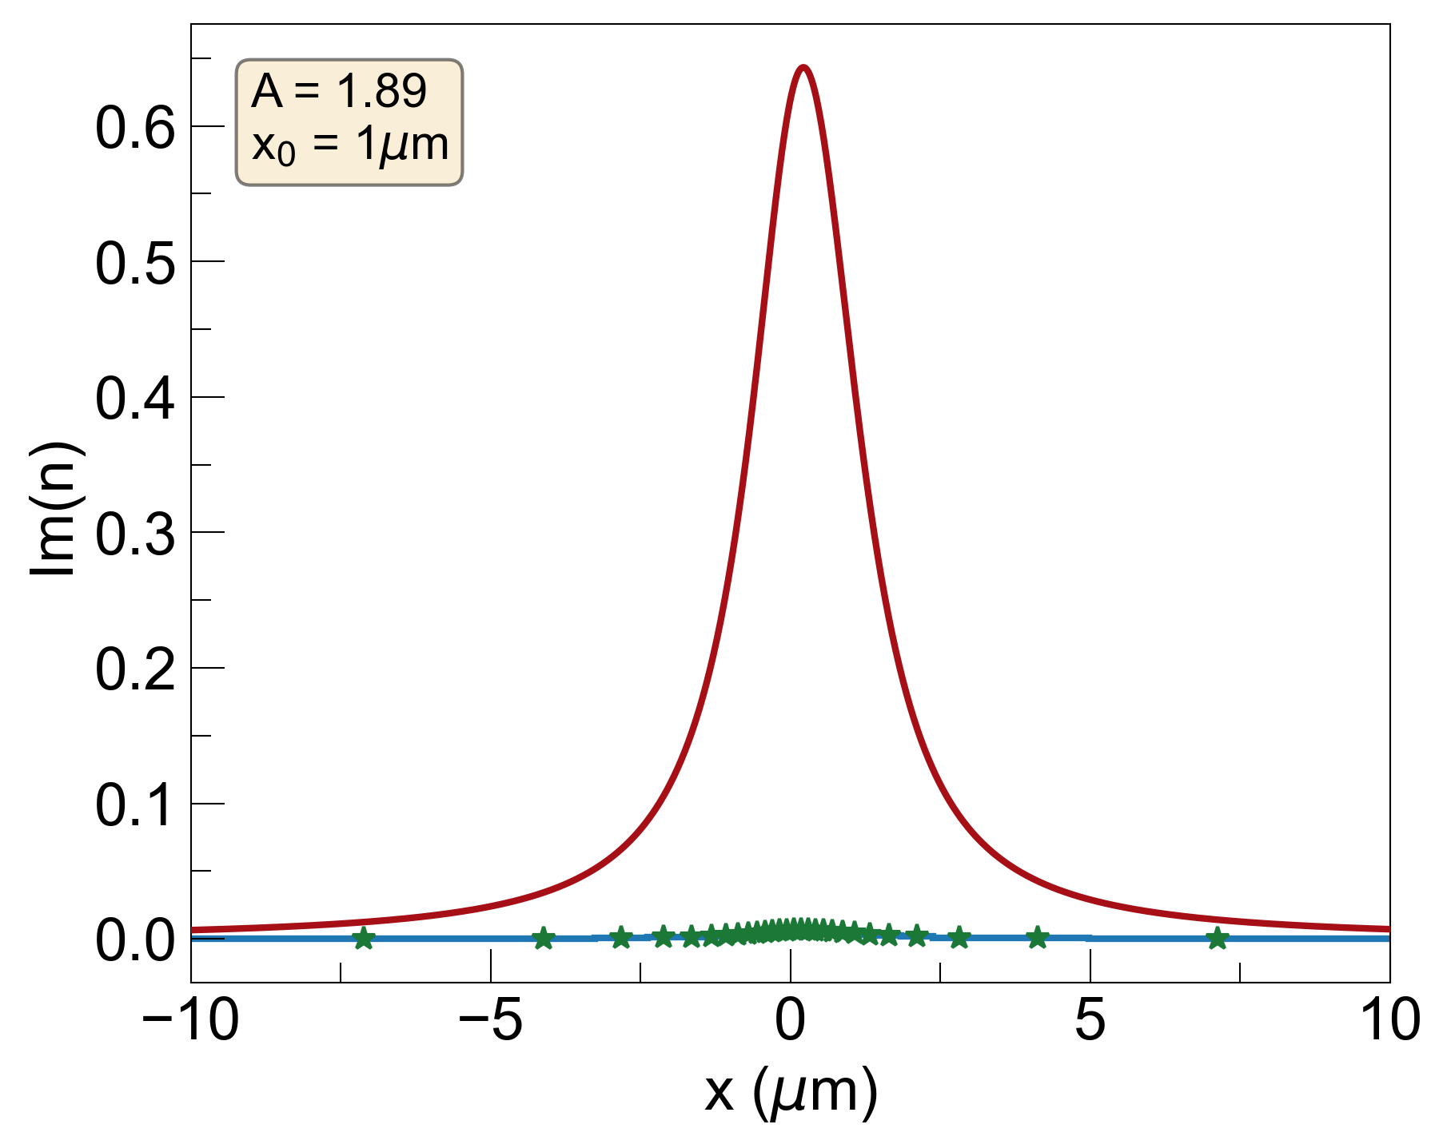
1. With x₀=1um, 1% Im(n) s-KK Coating
noise = R_{b} + E_{b}
R_{b}=0.05, E_{b}=0.05, noise=0.1
R_{b}=0, E_{b}=0.087, noise=0.087
with 1% Im(n), noise is lower, showing that traditional GRIN coating is better than coating with losses

Slide 8
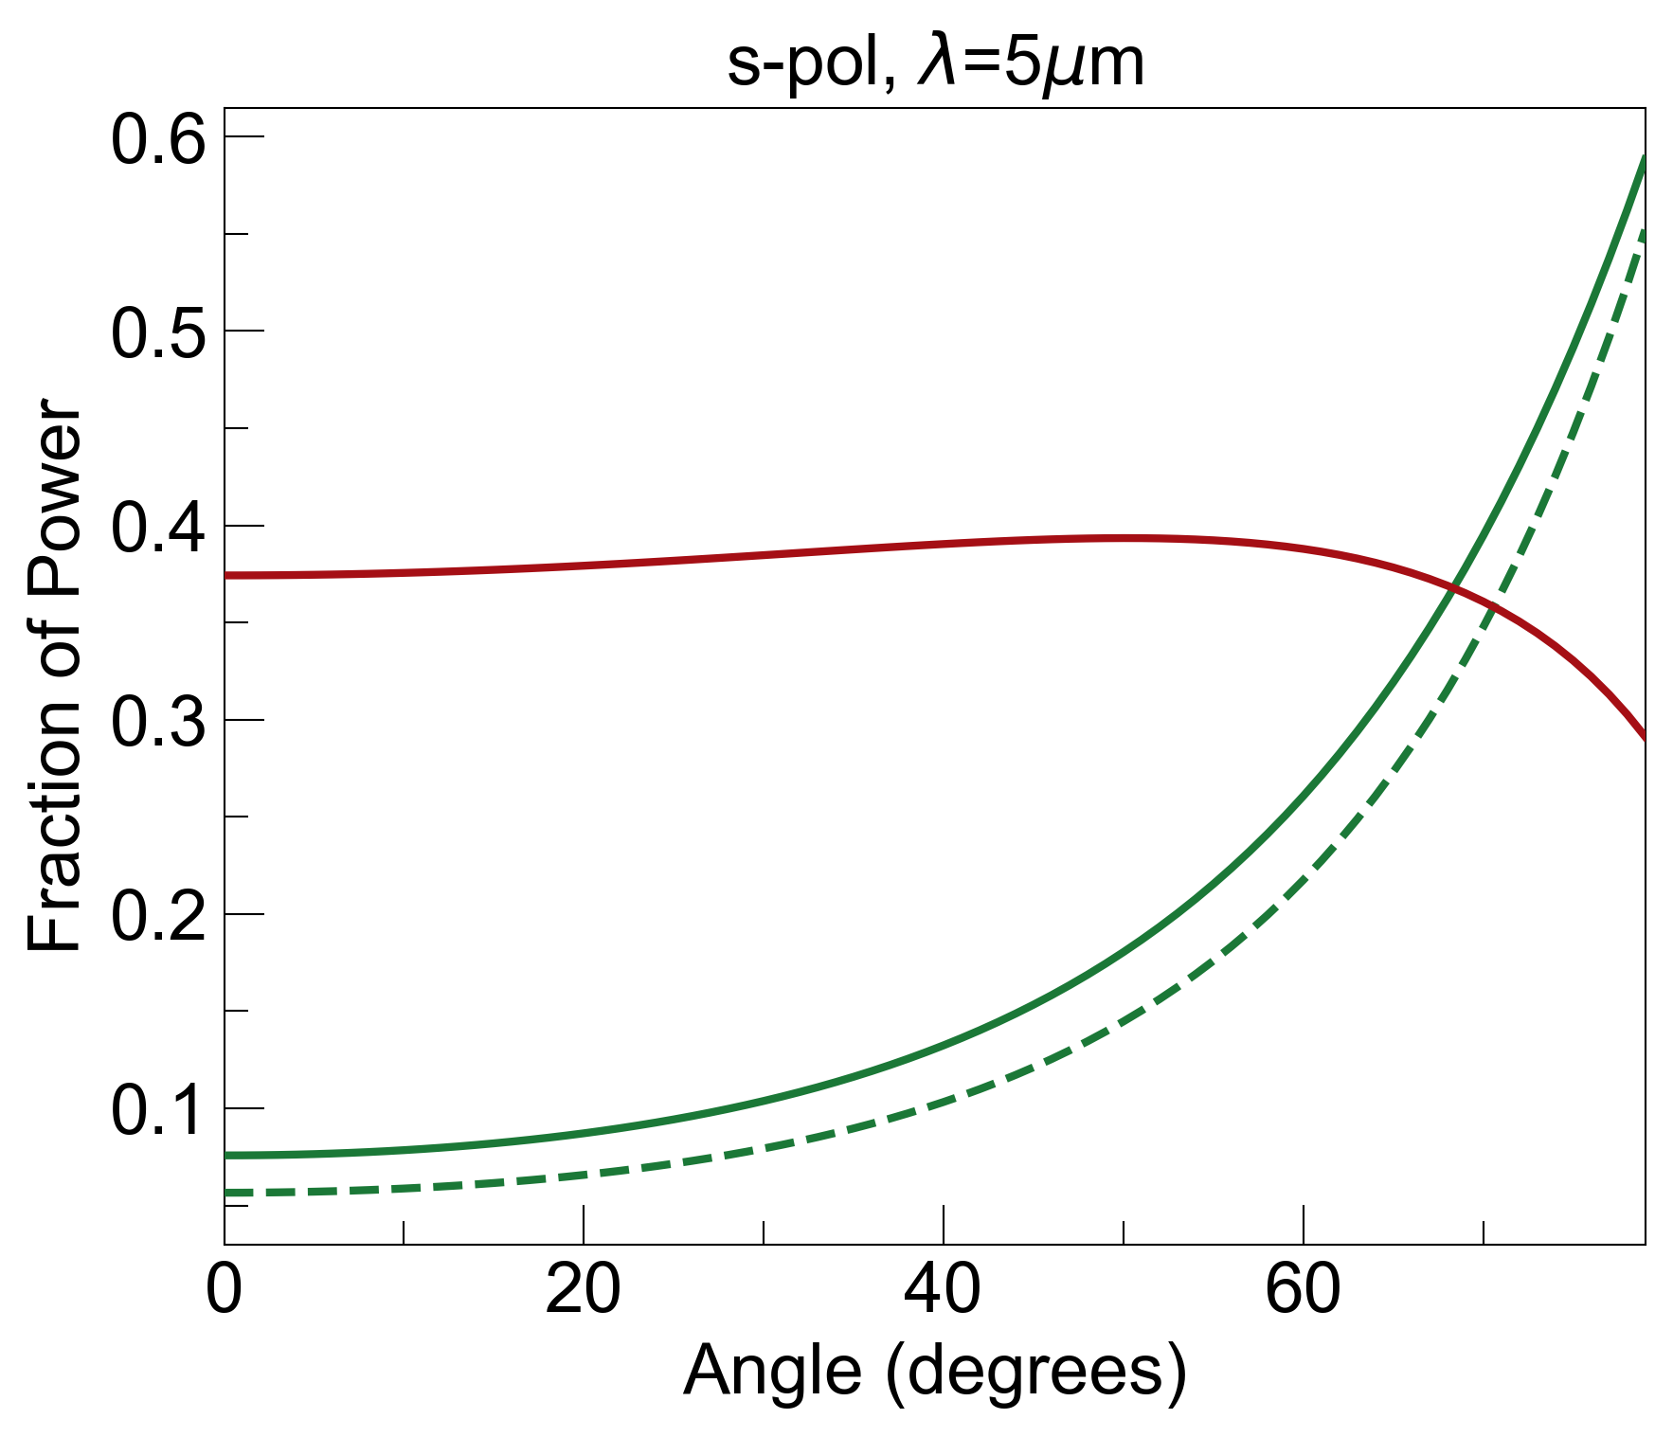
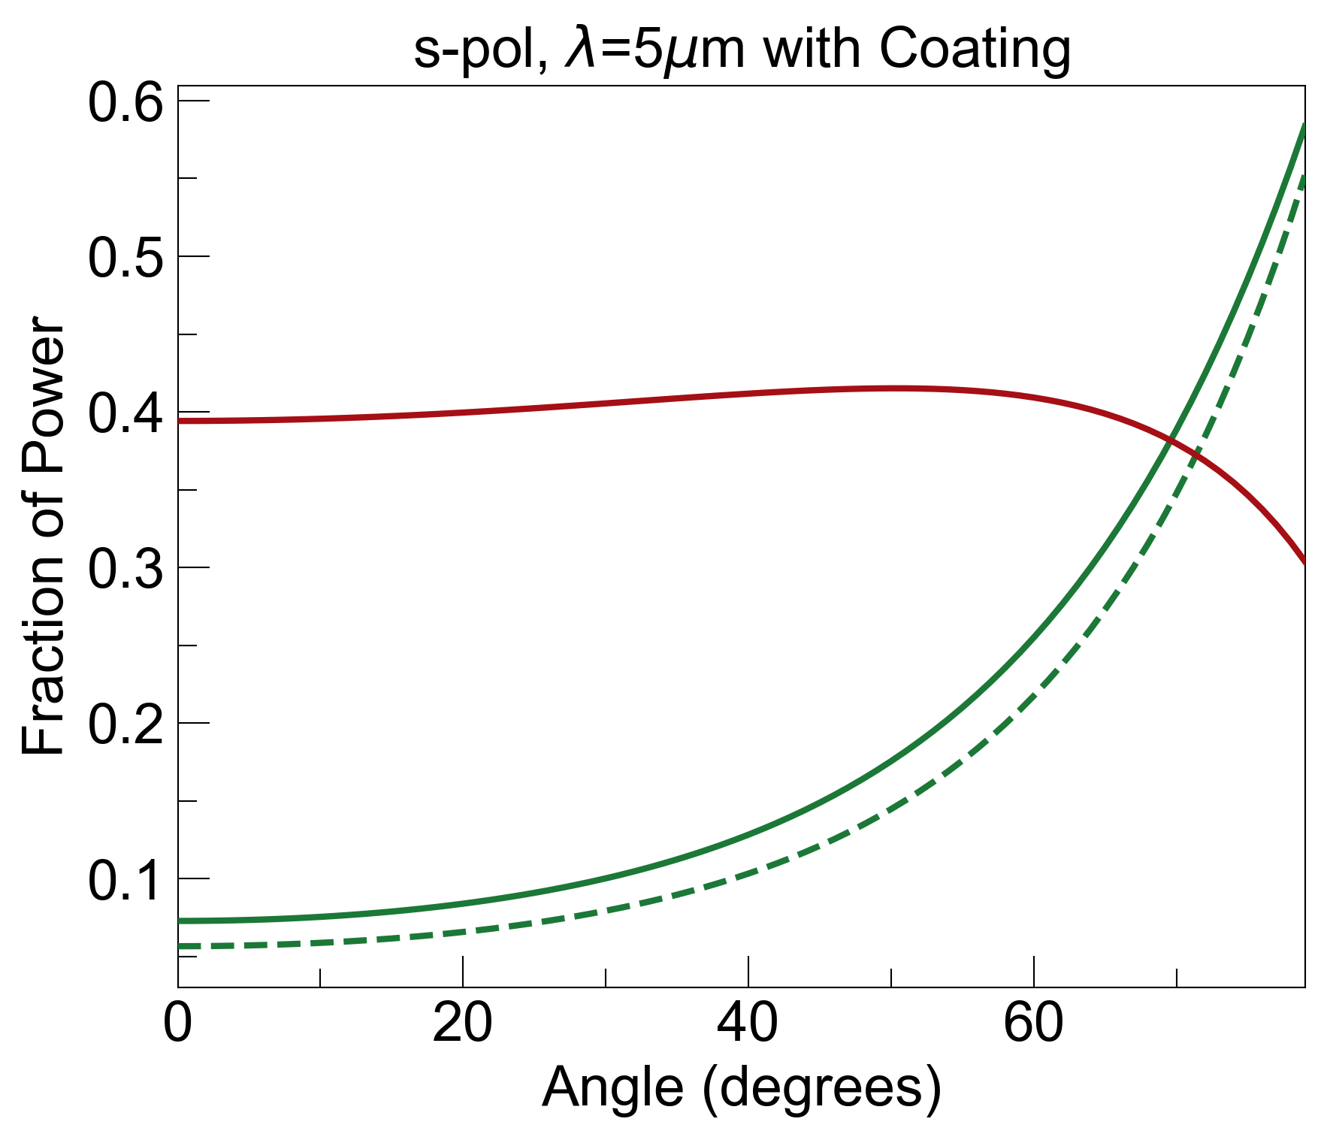
1. Angle Dependence With x₀=0.01um s-KK Coating
noise = R_{b} + E_{b}
R_{b}=0.03, E_{b}=0.38, noise=0.41
R_{b}=0.027, E_{b}=0.4, noise=0.42
similar to wavelength dependence: coating slightly decreases R_{b} but increases E_{b}

Slide 9
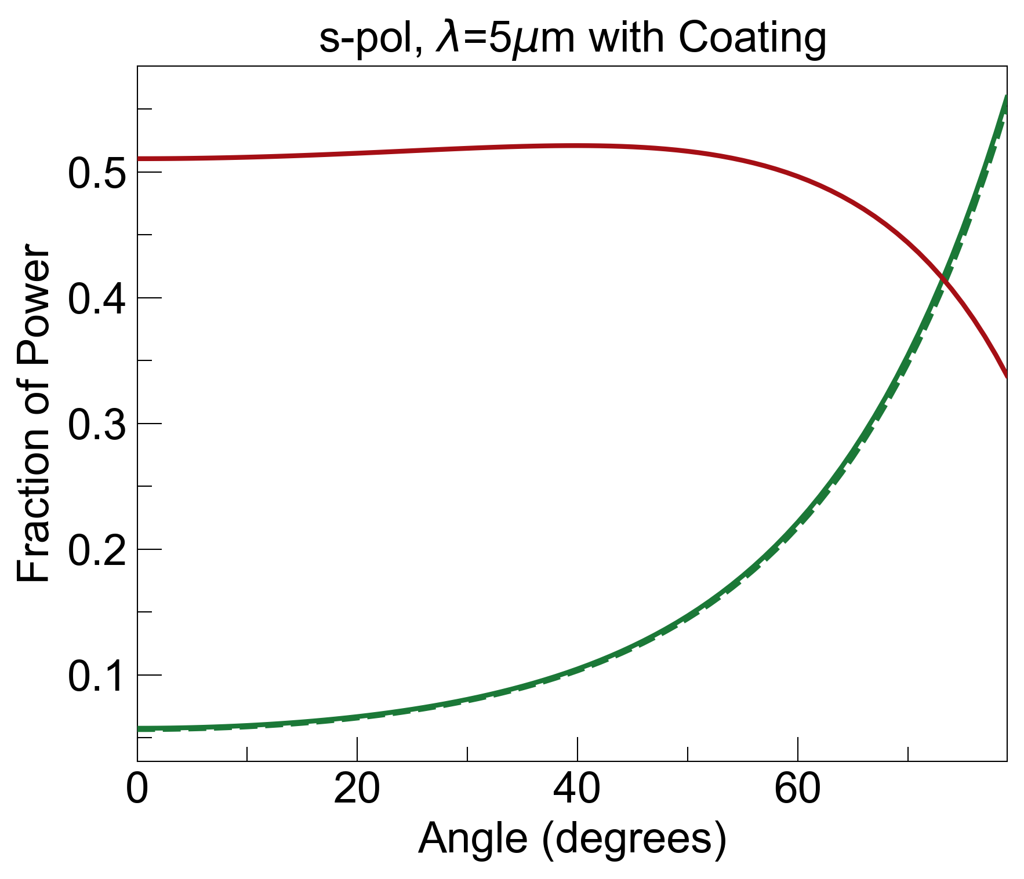
1. With x₀=1um, 10% Im(n) s-KK Coating
noise = R_{b} + E_{b}
R_{b}=0.03, E_{b}=0.38, noise=0.41
R_{b}=0.003, E_{b}=0.5, noise=0.5
same story: thicker coating layers eliminate R_{b} but increase E_{b}

Slide 10
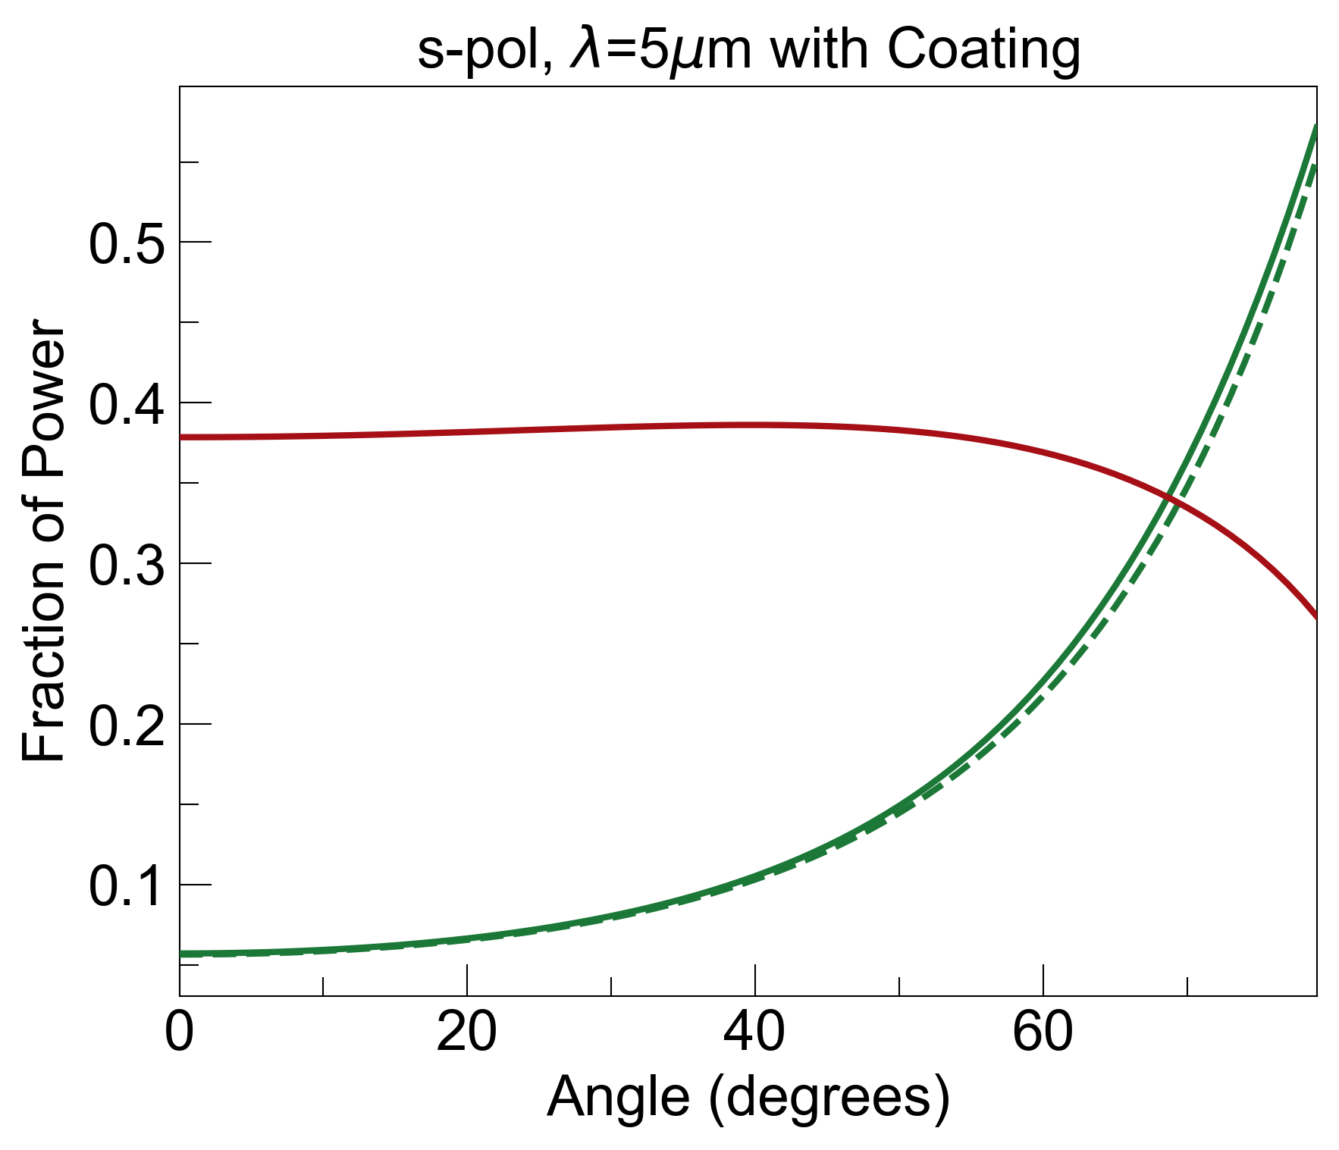
1. With x₀=1um, 1% Im(n) s-KK Coating
noise = R_{b} + E_{b}
R_{b}=0.03, E_{b}=0.38, noise=0.41
R_{b}=0.005, E_{b}=0.38, noise=0.38
same conclusion: losses do not help with this problem

Slide 11
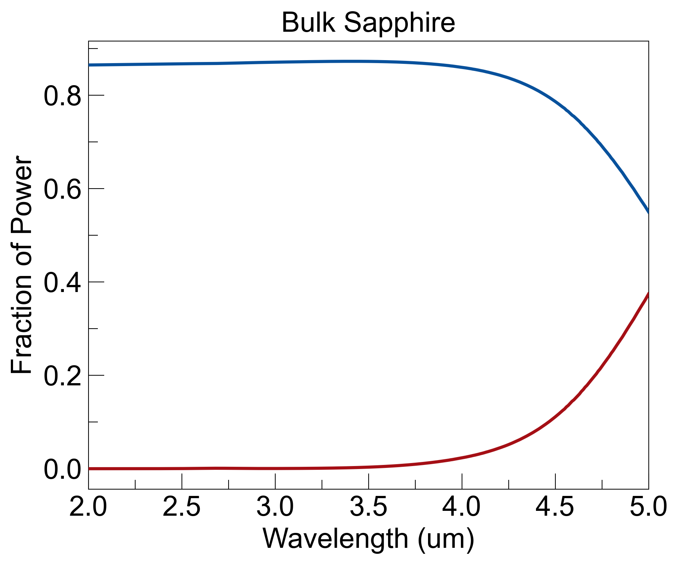
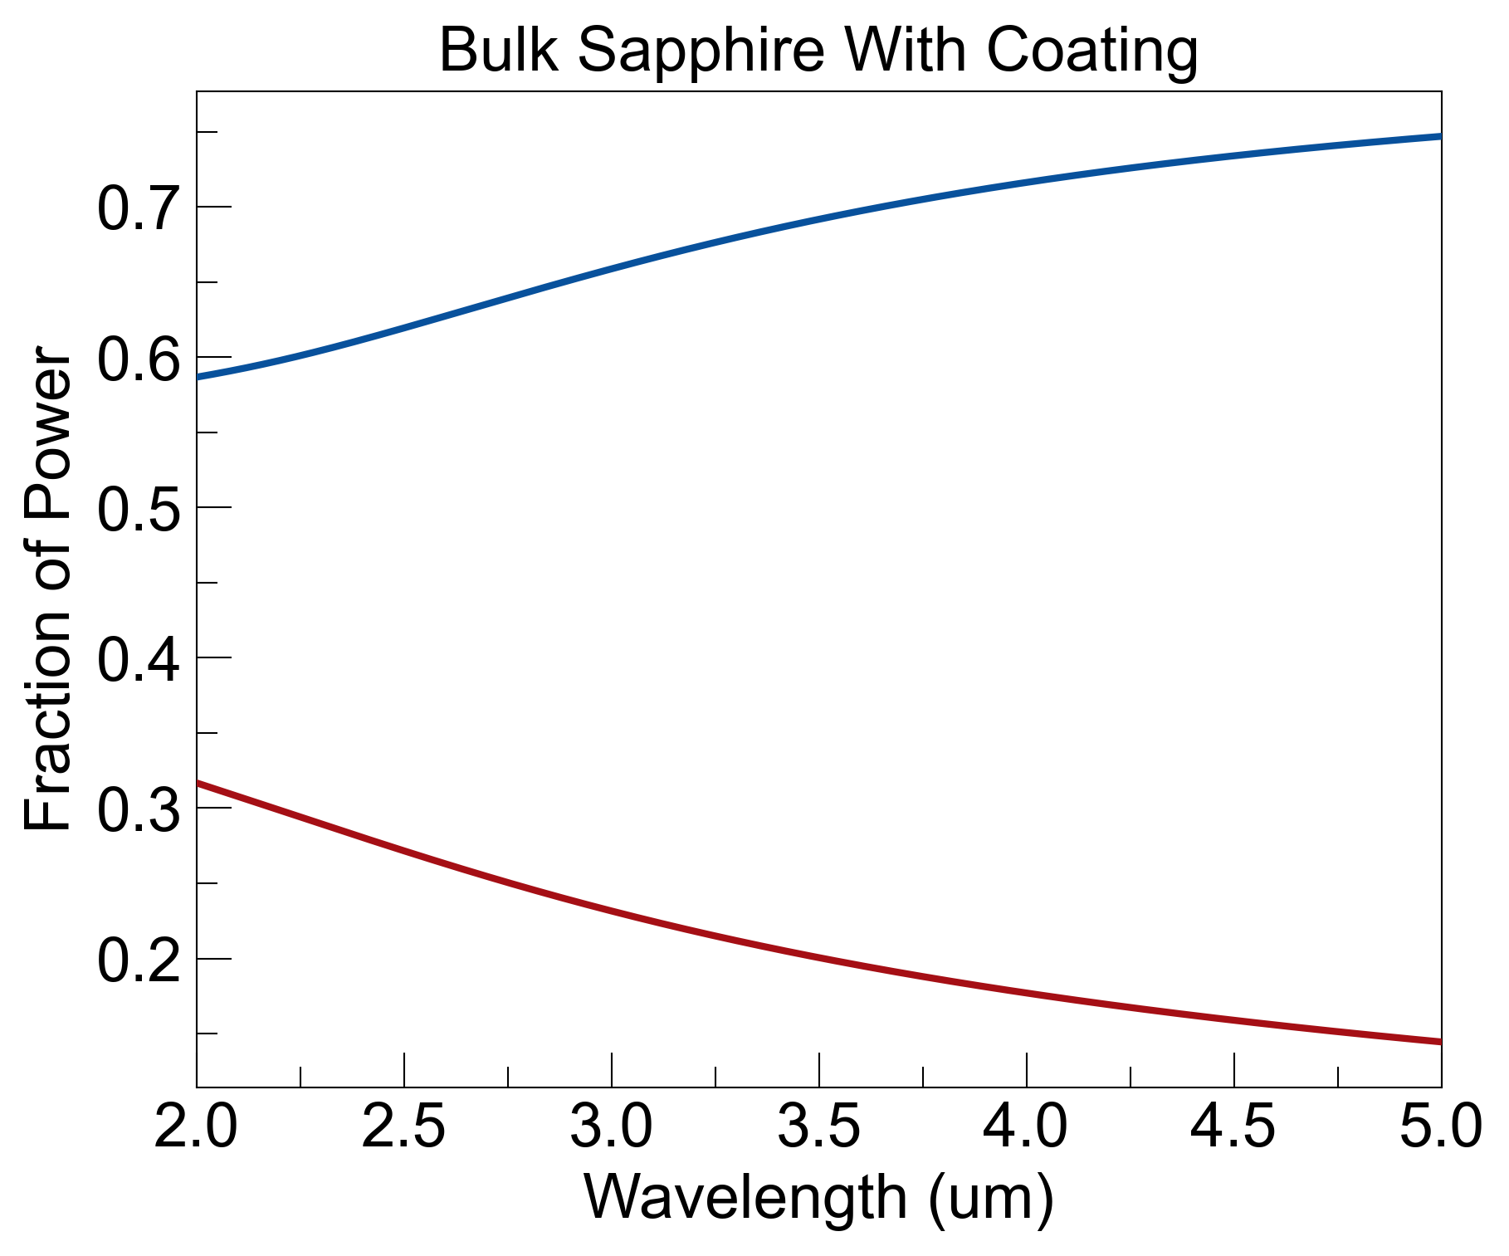
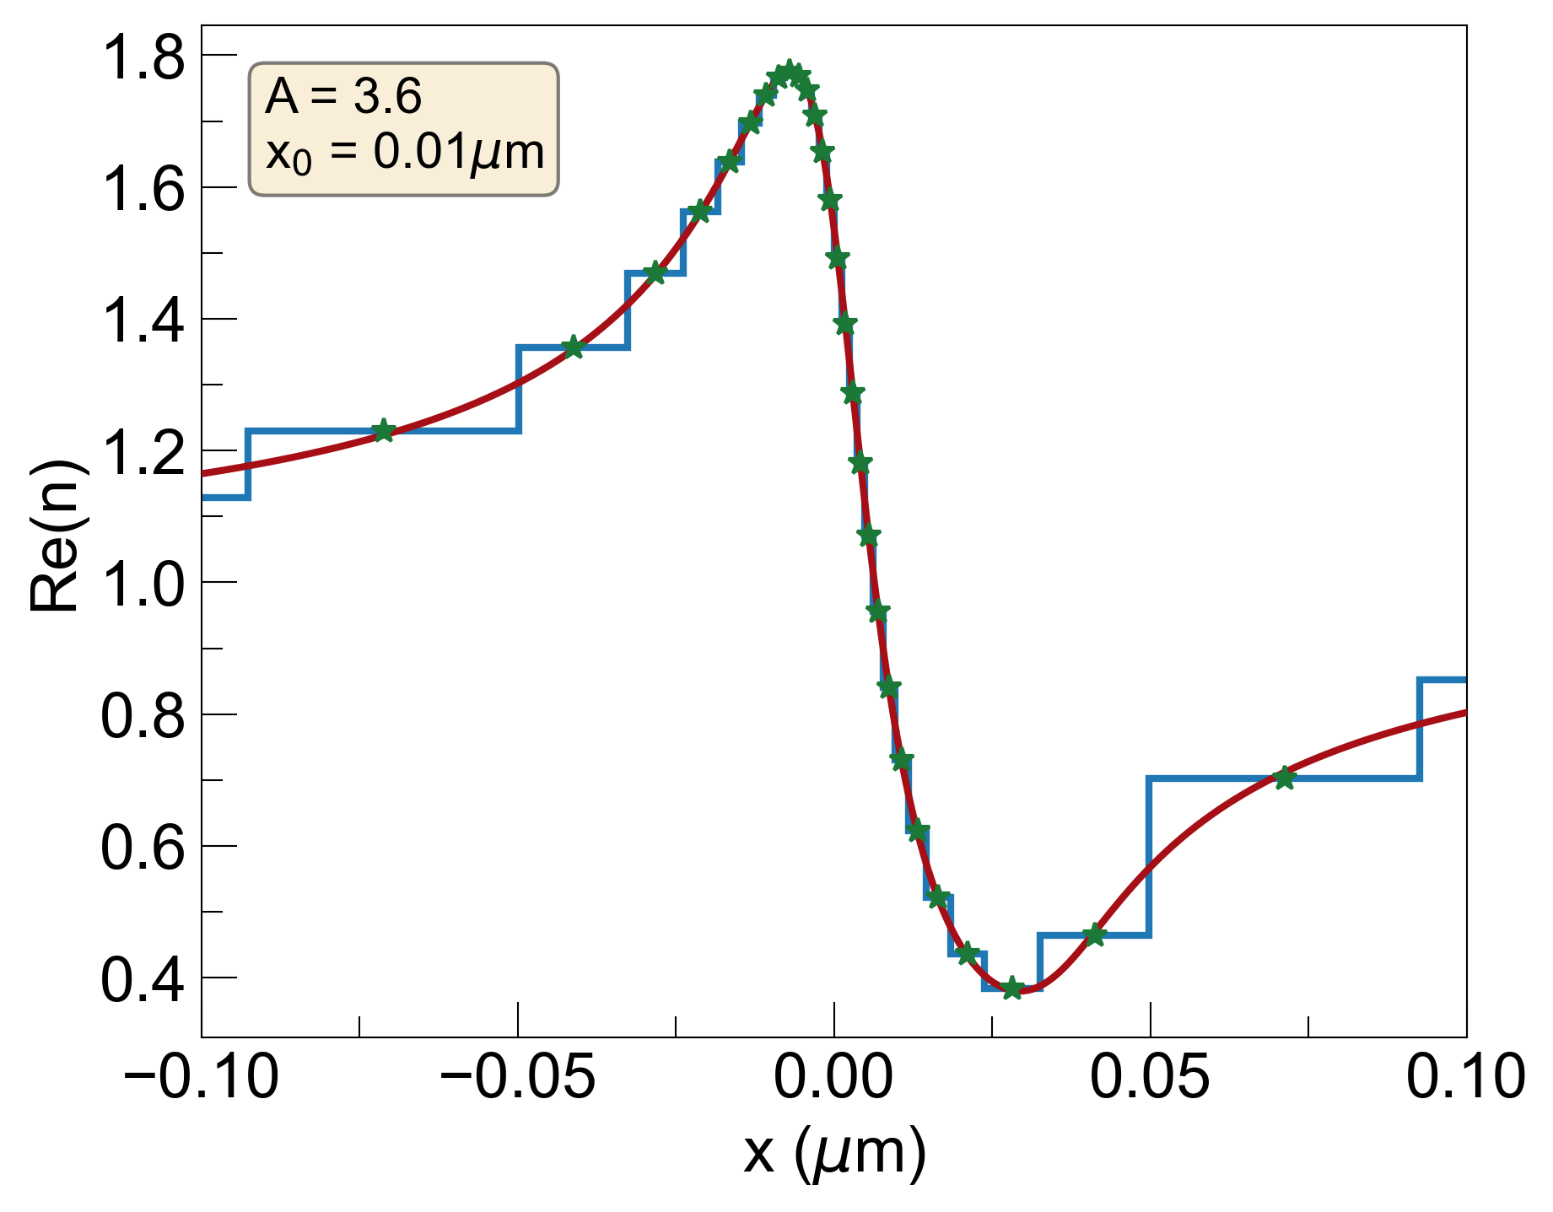
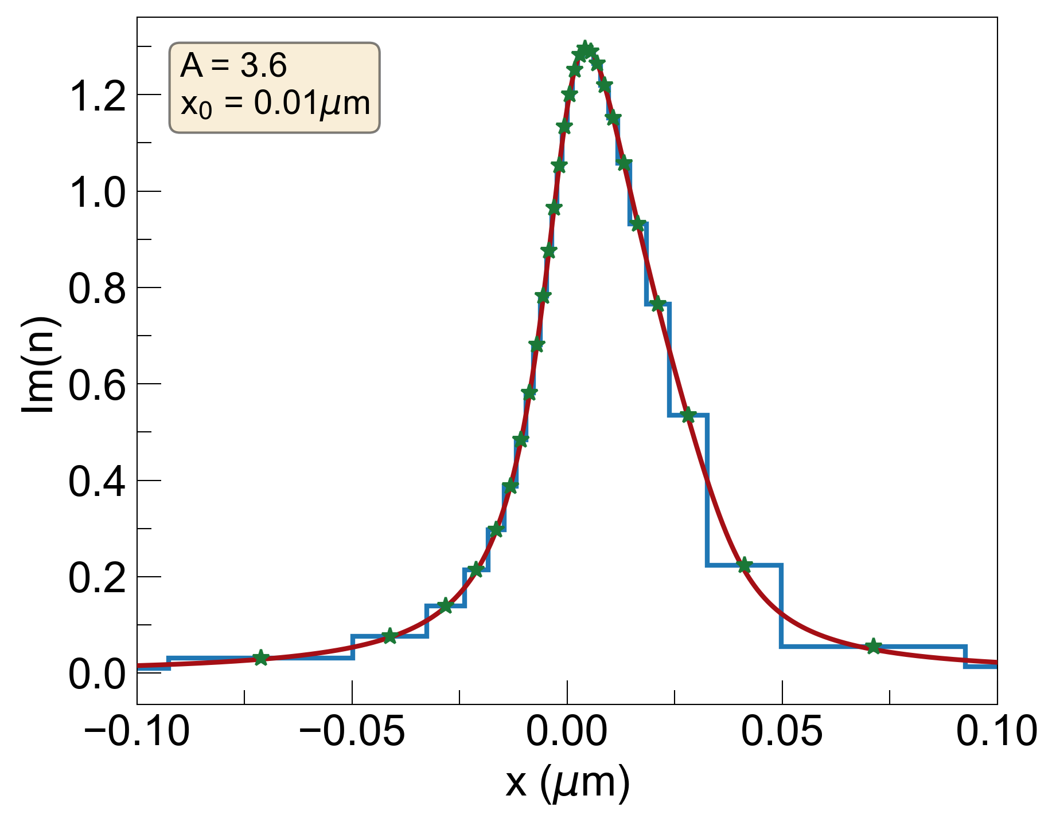
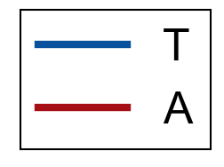
2. With x₀=0.01um s-KK Coating (TE)
FOM = T_{avg} / E_{avg}
T_{avg}=0.83, E_{avg}=0.05, FOM=16.8
T_{avg}=0.68, E_{avg}=0.21, FOM=3.22
coating decreases transmission and increases emission (opposite of what we want)

