Slide 1
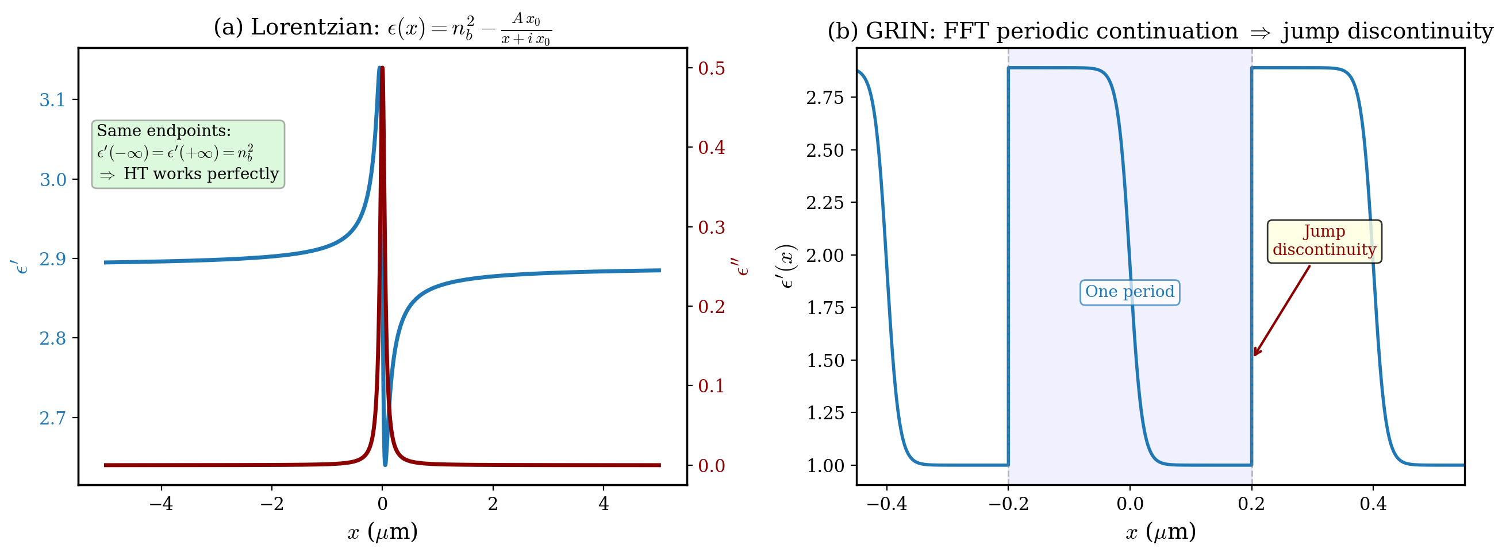
Hilbert Transform: Why Symmetric Endpoints Matter
Left: Lorentzian profile has same endpoints — FFT-based HT works perfectly. Right: GRIN coating has different endpoints. FFT assumes periodicity → jump discontinuity → the root cause of unwanted artifacts.

Slide 2
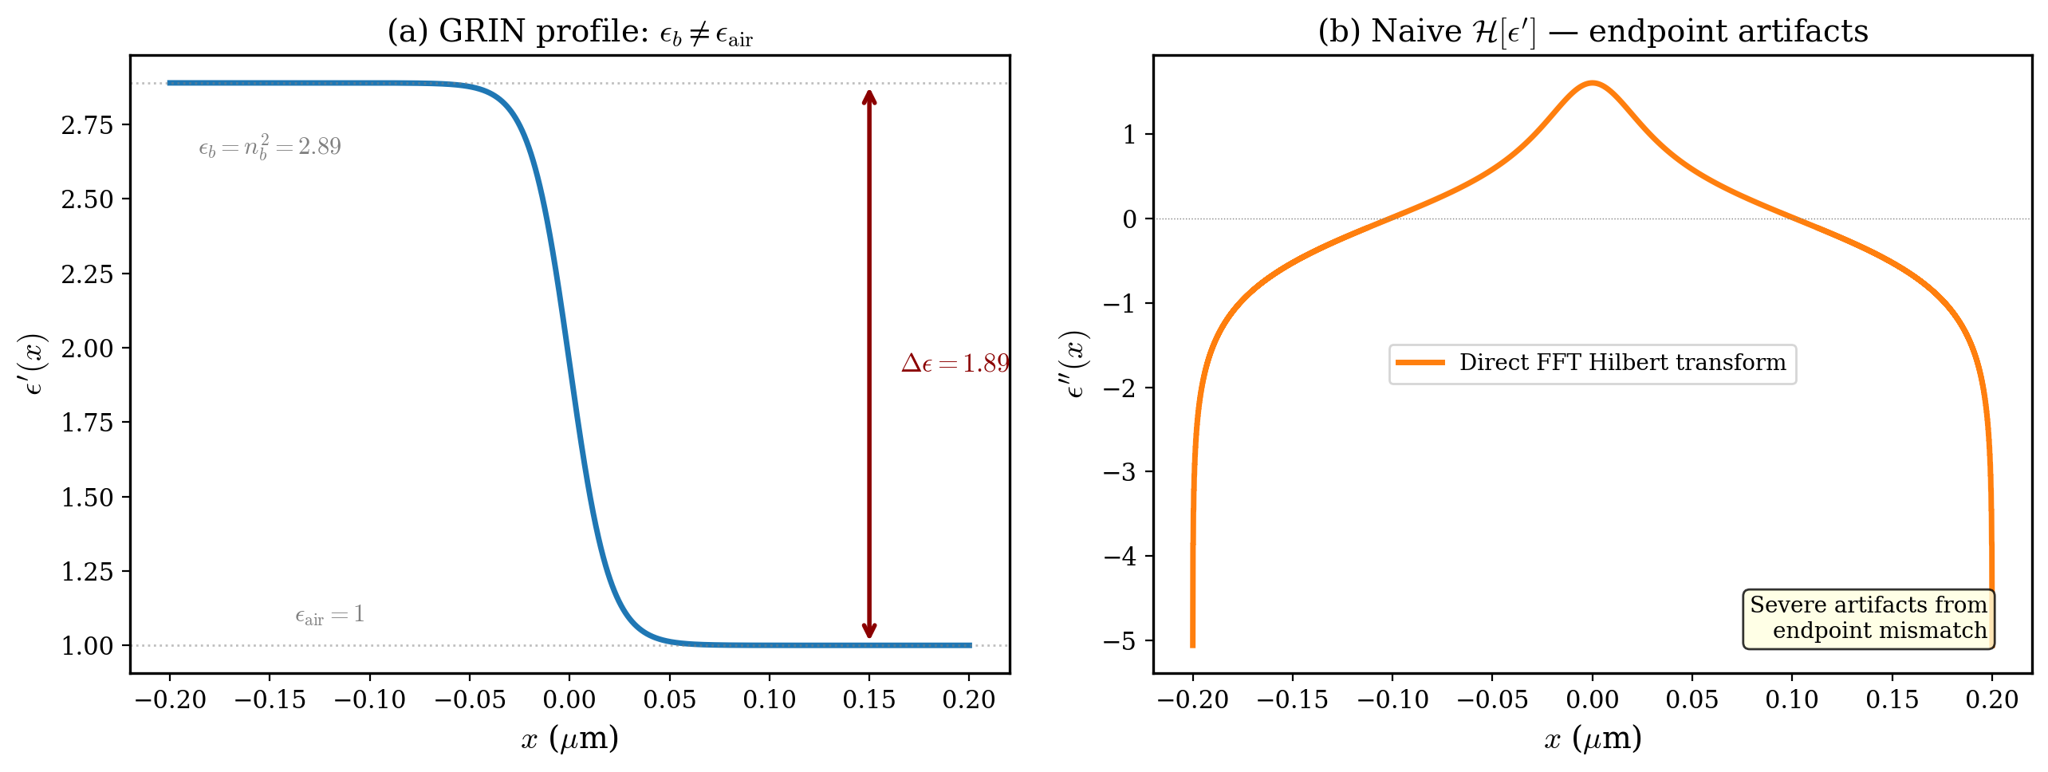
The Hilbert Transform Problem: Asymmetric Endpoints
sKK requires computing ε'' = H[ε']. For coatings on substrates, ε'(−∞) = εb ≠ 1 = ε'(+∞). FFT-based HT assumes periodicity → endpoint mismatch causes gain regions.

Slide 3
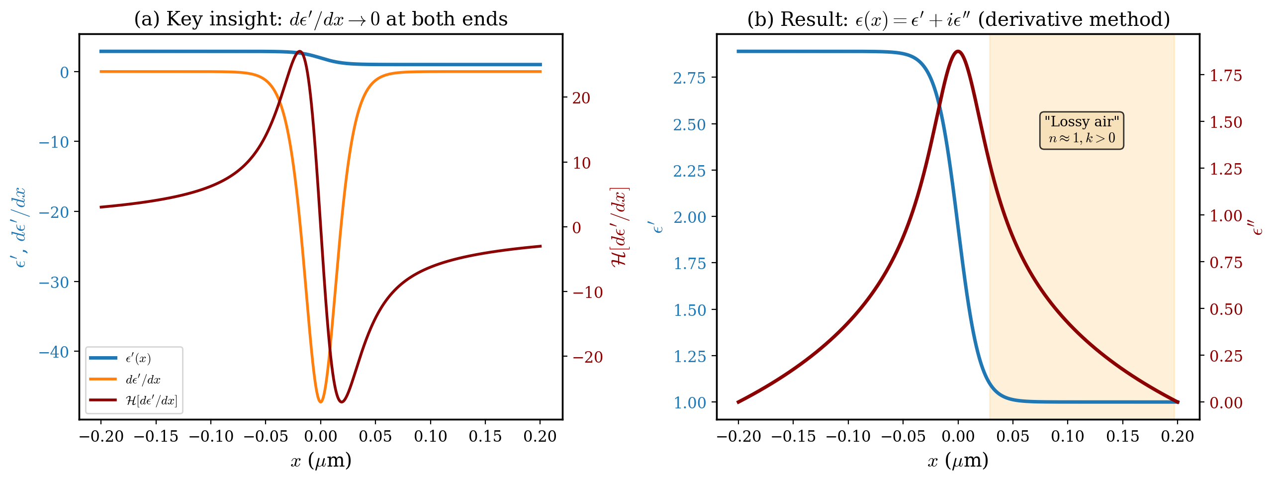
Derivative-then-Integrate: Solving the Endpoint Problem
Take derivative of ε'(x) → both endpoints go to 0 → standard HT works → integrate back. Result: well-localized ε'' peak, but "lossy air" region (n ≈ 1, k > 0) persists — this is fundamental to the asymmetric HT.

Slide 4
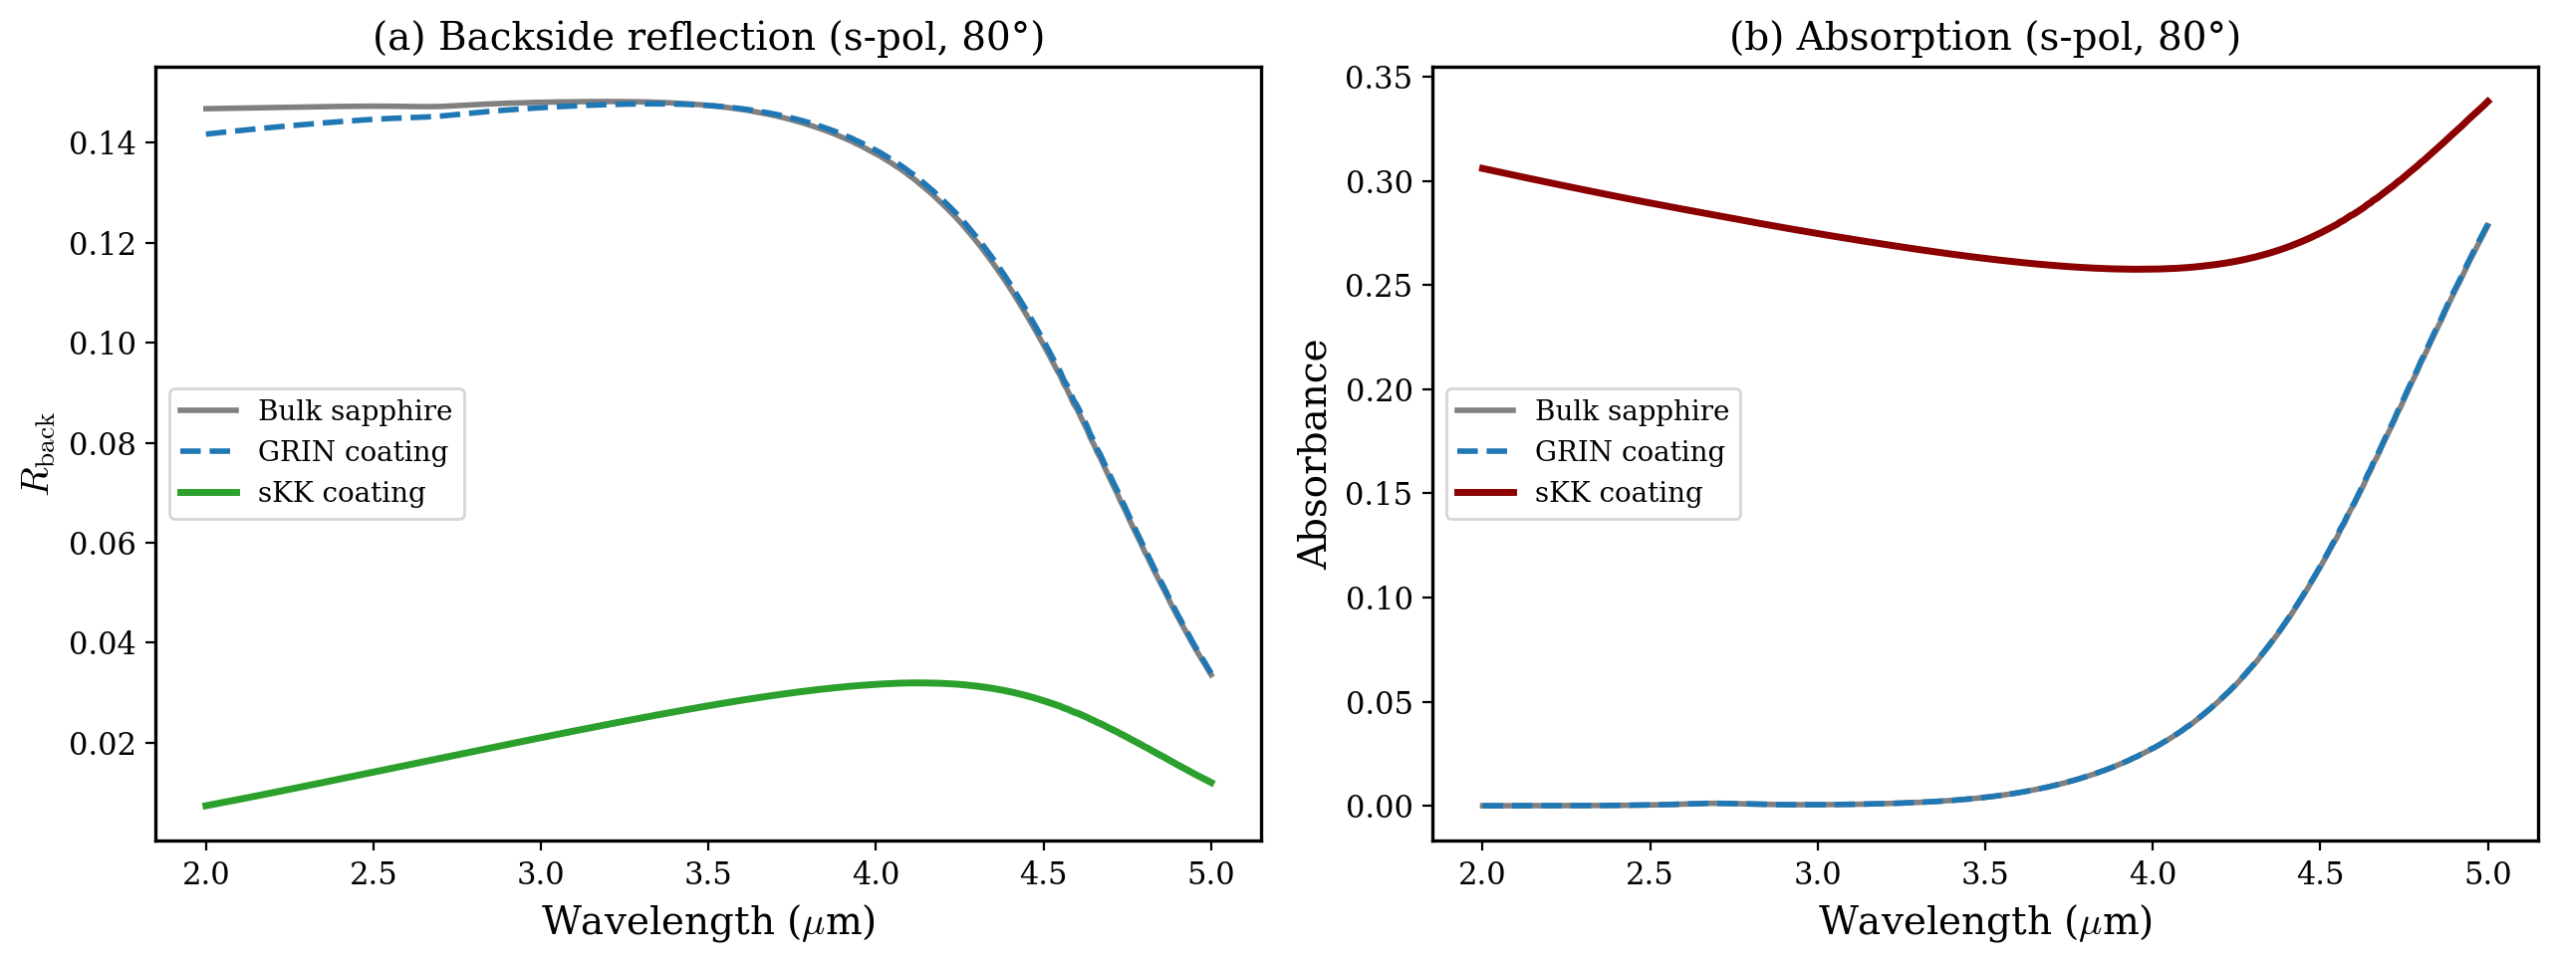
Backside Reflection Reduction: sKK vs GRIN vs Bulk
s-pol, 80°: sKK coating reduces ⟨Rback⟩ from 0.129 (bulk) to 0.022, a >5× improvement. GRIN alone provides negligible benefit (0.128) at this sub-λ thickness.

Slide 5
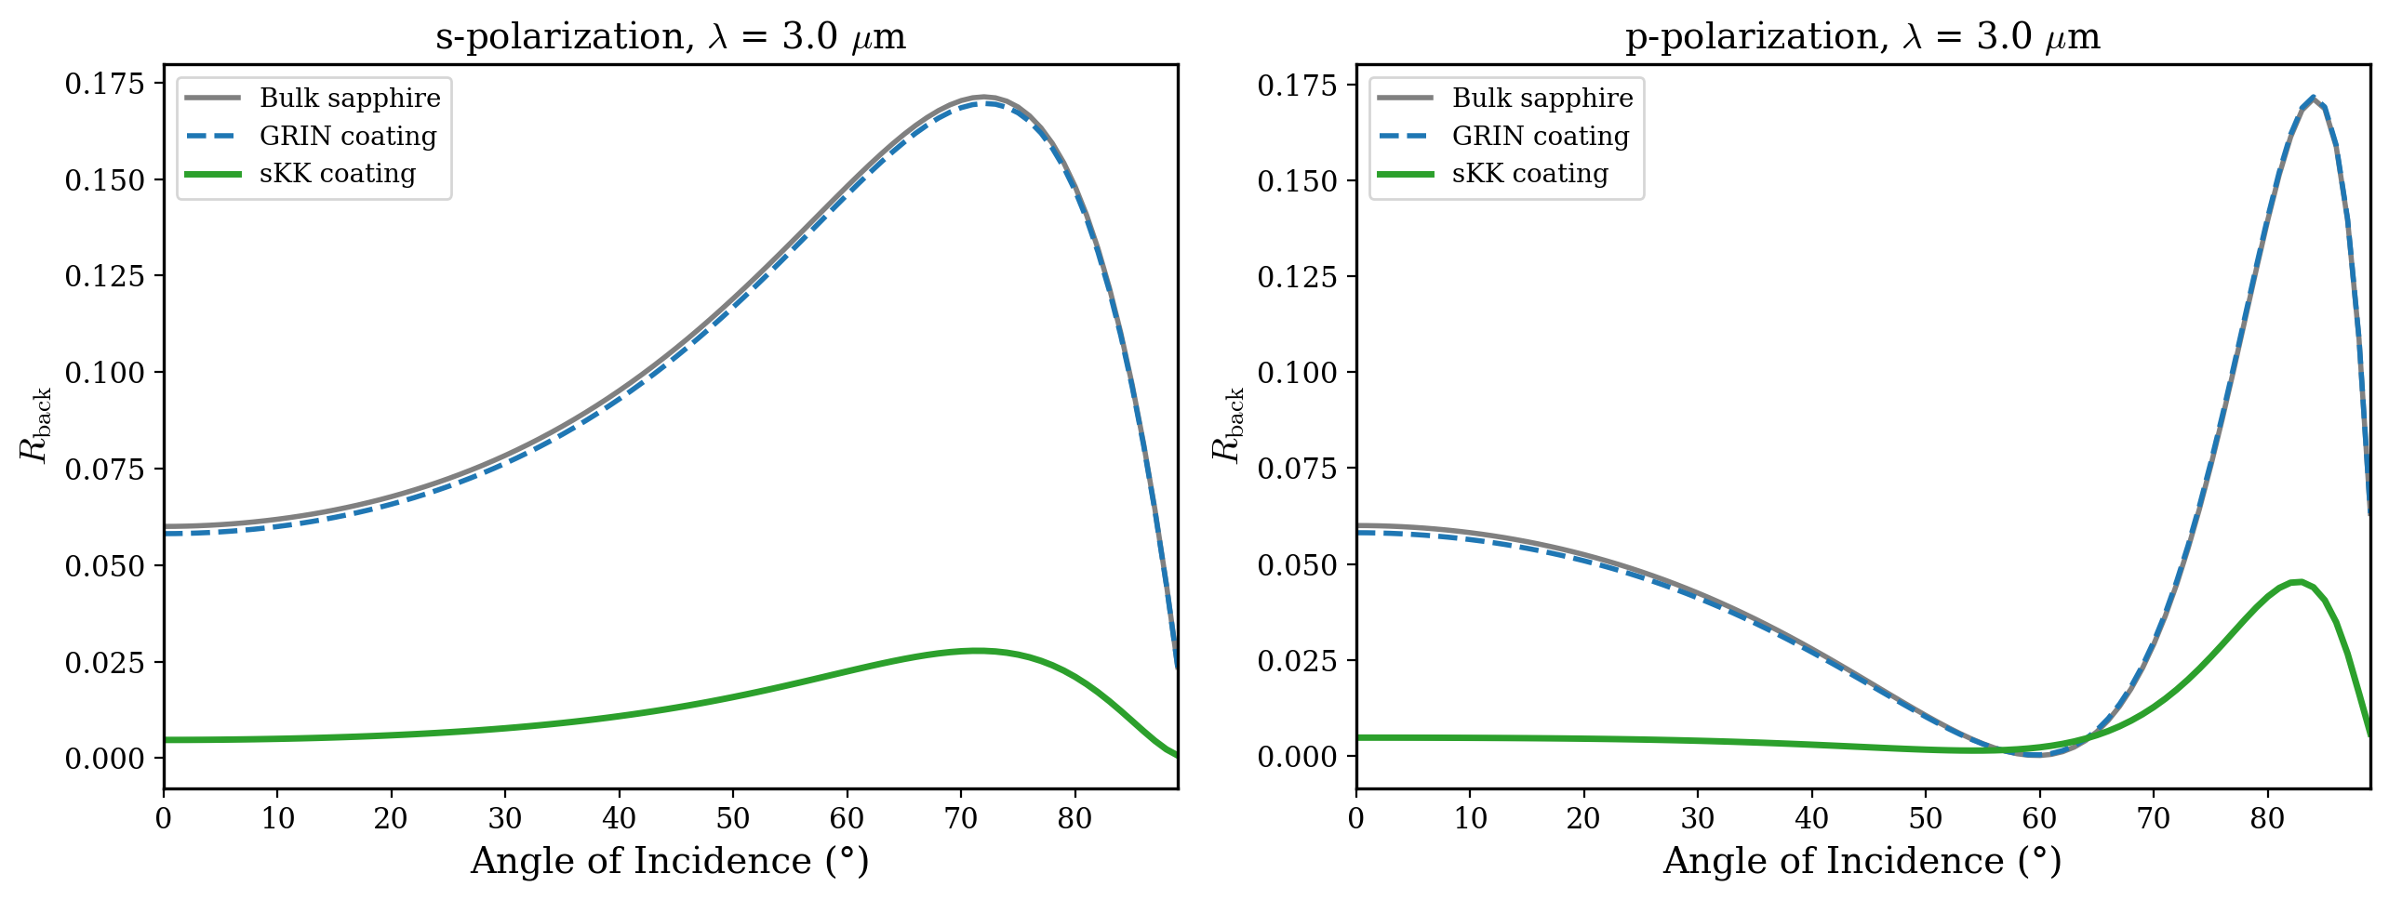
Angle-Dependence of Backside Reflection at λ = 3 μm
sKK coating reduces backside reflection at all angles for both polarizations. Performance particularly strong at ellipsometric angles (60–80°).

Slide 6
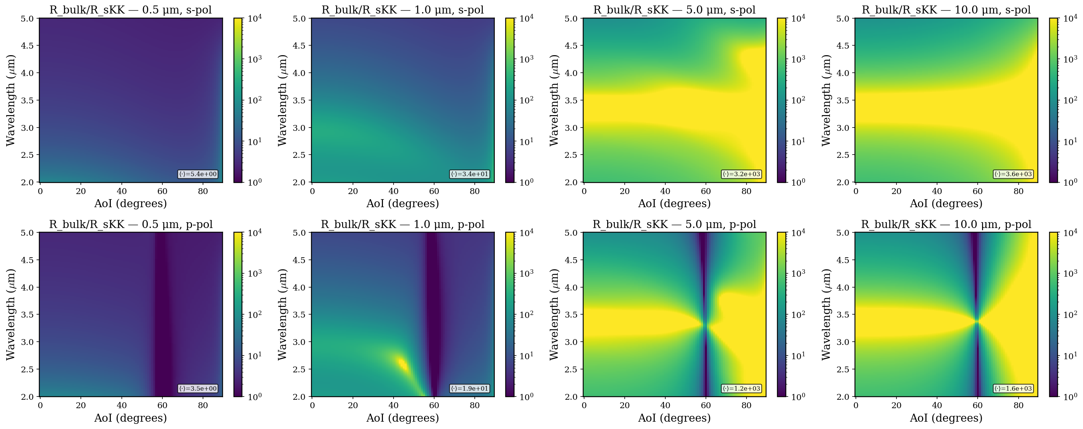
Colorplot of sKK vs. Bulk at Different Thicknesses
Geometric mean of the enhancement shown on the bottom right of each colorplot
Enhancement gets better as coating gets thicker (layers need to be thick enough for sKK cancellation to come into play)
for 5um and 10um thickness, AoI of 60 degrees and wavelength 3.4um, competing effects of Brewsters angle and perfect impedance matching (n_sapphire(lambda=3.4um)=1.7)

Slide 7
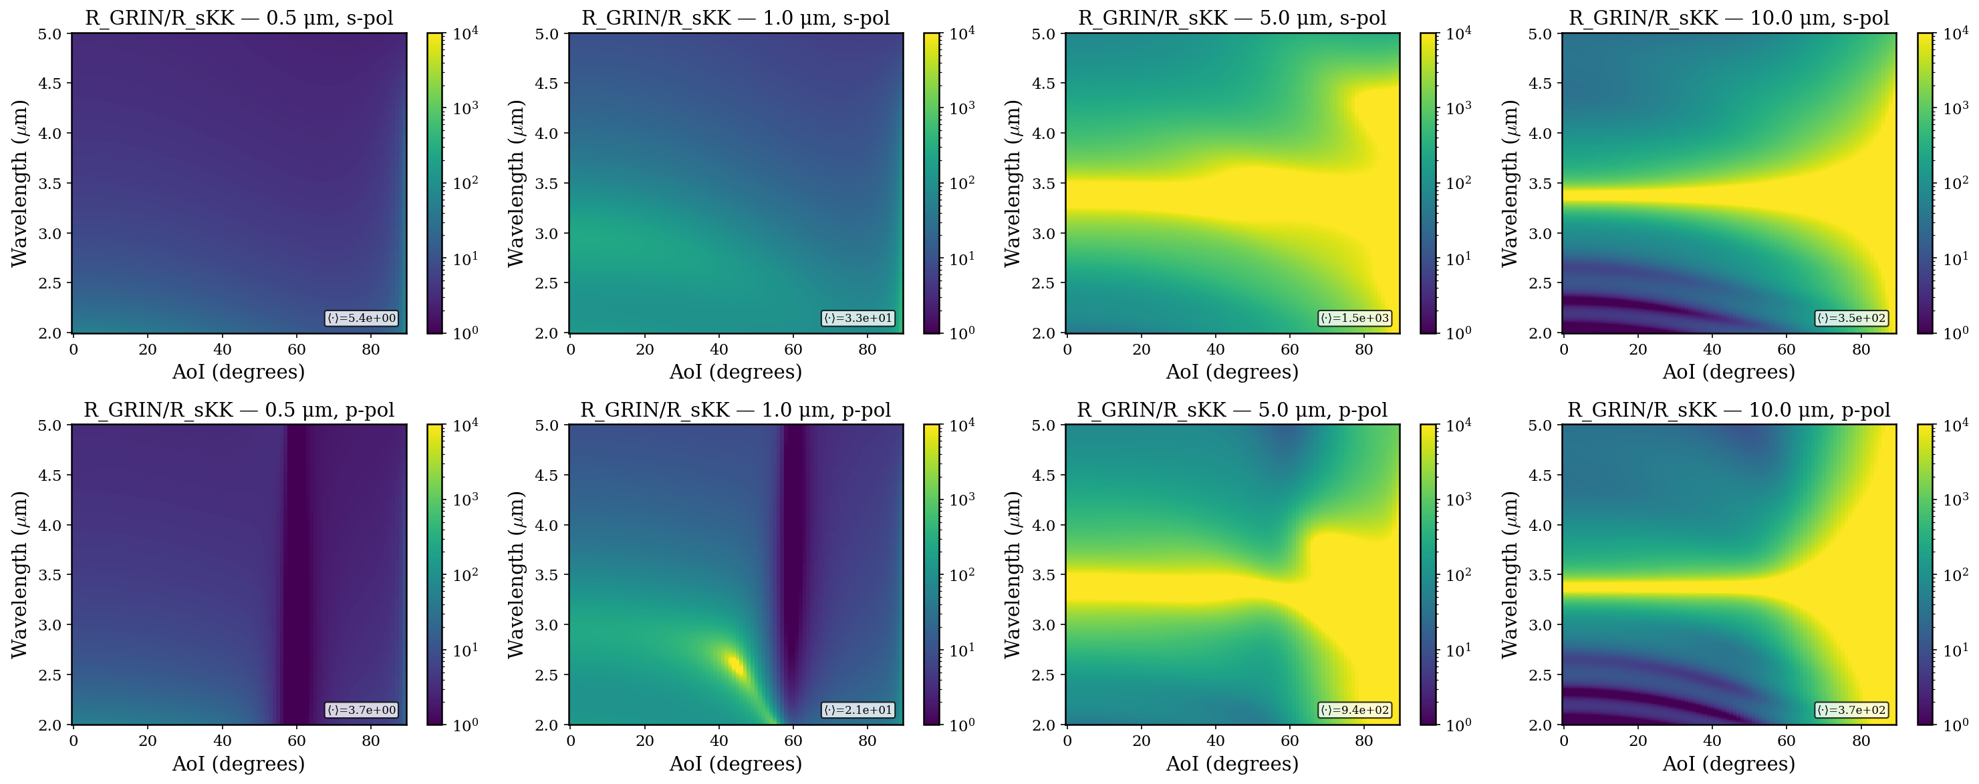
Colorplot of sKK vs. GRIN at Different Thicknesses
Geometric mean of the enhancement shown on the bottom right of each colorplot
Enhancement maximizes around 5um thickness (~3 orders of magnitude smaller R_back for sKK coating)

Slide 8
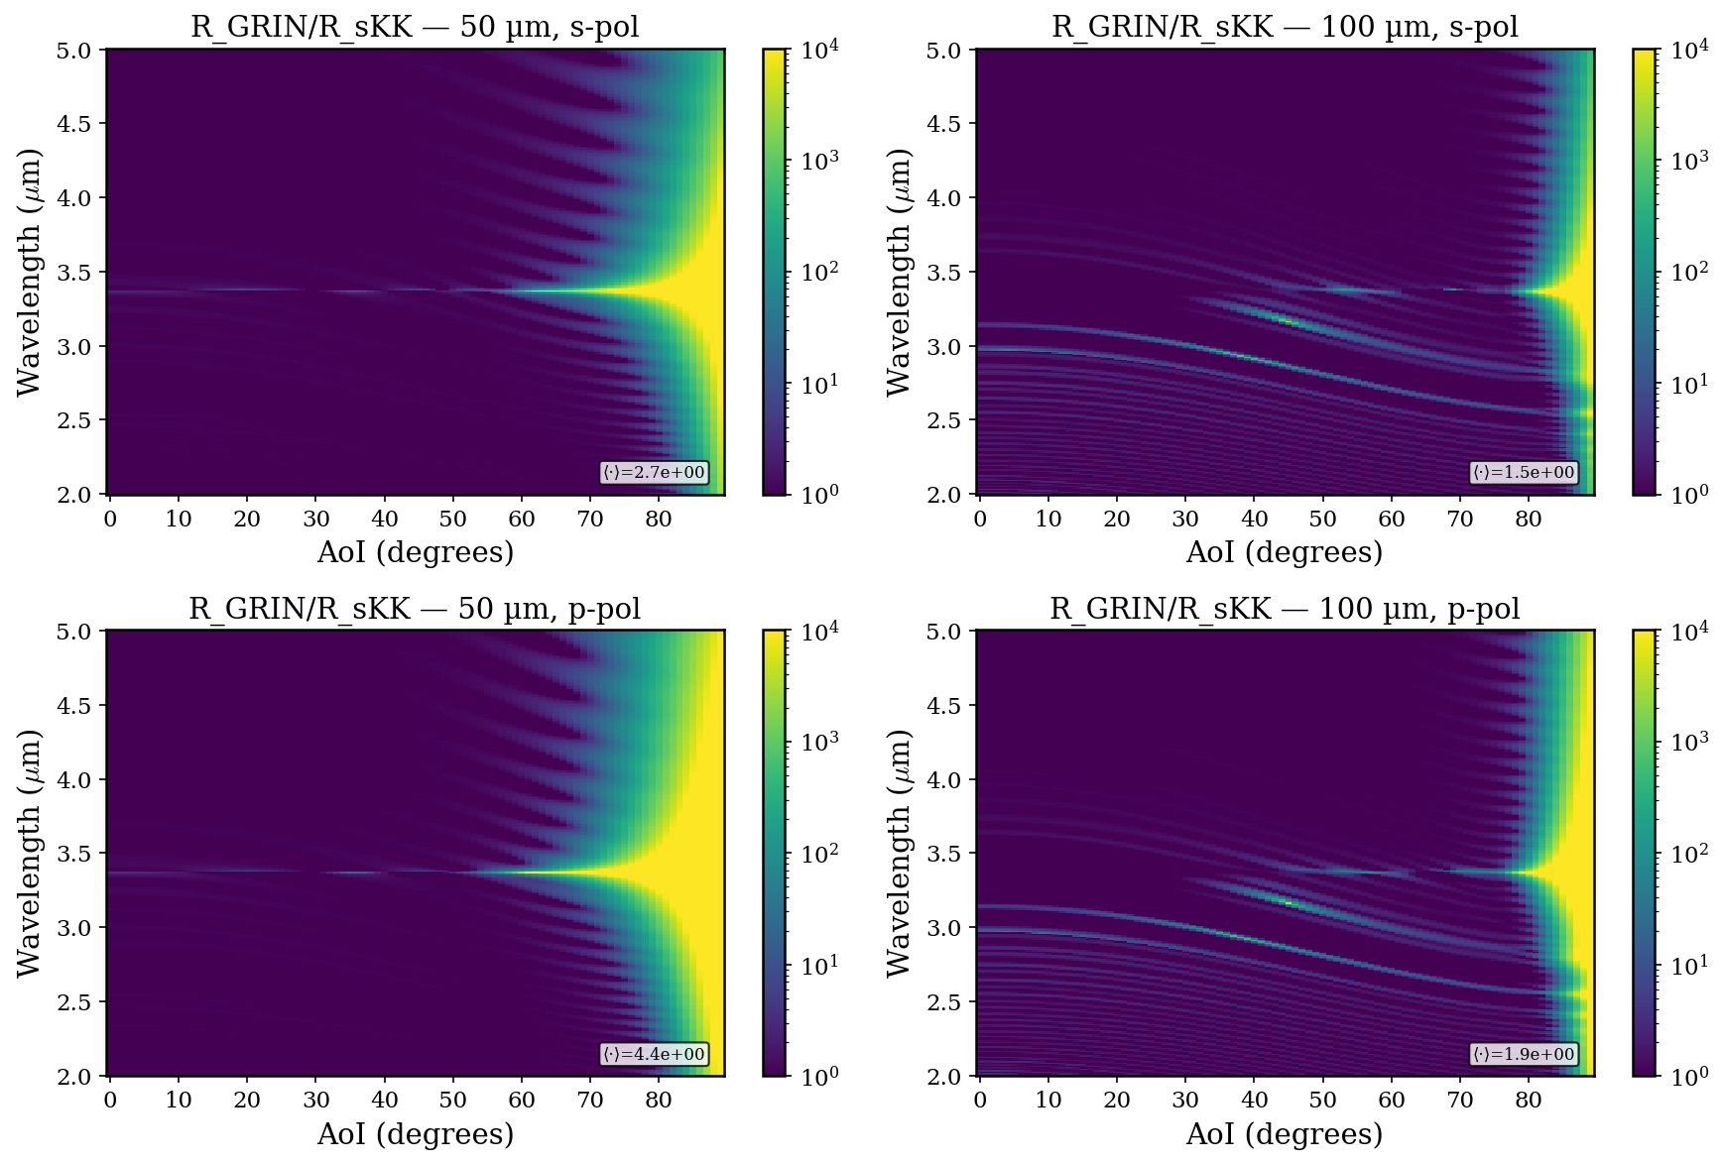
Colorplot of sKK vs. GRIN at Different Thicknesses
By these thicknesses, GRIN is sufficient.

Slide 9
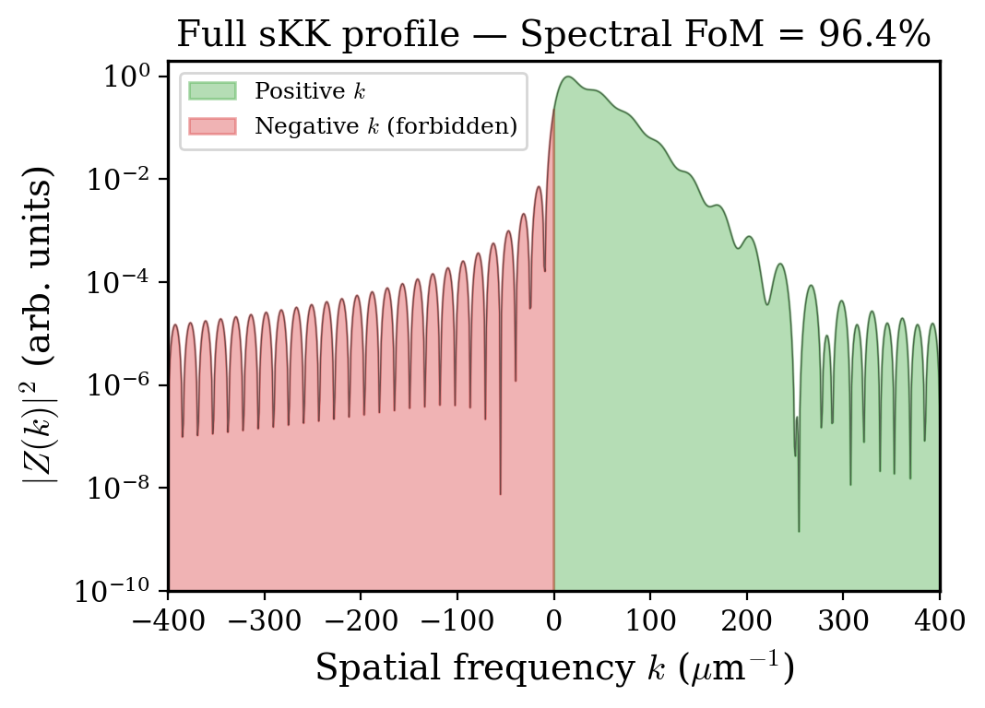
Quantifying Analyticity: Spectral One-Sidedness (before)
1. Form complex derivative function:
z(x) = dε′/dx + i · dε′′/dx
2. Fourier transform to spatial frequency:
Z(k) = FFT{ z(x) } (k = spatial frequency (μm⁻¹))
3. Measure one-sidedness:
E₊ = ∫ |Z(k)|² dk for k > 0
E₋ = ∫ |Z(k)|² dk for k < 0
FoM = 100 * (E₊ − E₋) / (E₊ + E₋)
Physical meaning: sKK requires ε(x) analytic in upper half-plane → its spatial spectrum is one-sided. Positive k = no reflection from one direction.

Slide 10
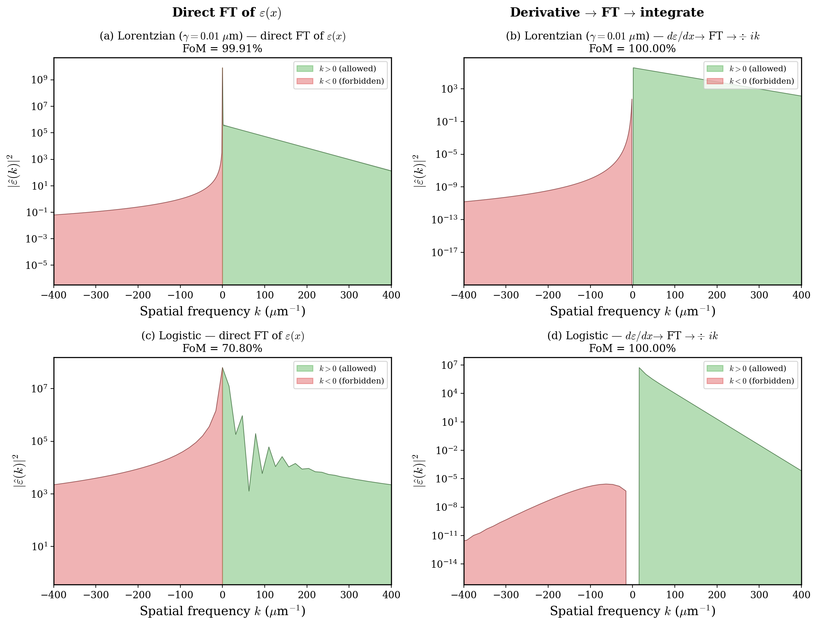
Quantifying Analyticity: Spectral One-Sidedness (after)
1. Form complex derivative function:
z(x) = dε′/dx + i · dε′′/dx
2. Fourier transform to spatial frequency:
Z(k) = FFT{ z(x) } (k = spatial frequency (μm⁻¹))
3. Undo derivative by ÷ ik (integral in Fourier space):
ε(k) = Z(k) ÷ ik
4. Measure one-sidedness:
E₊ = ∫ |Z(k)|² dk for k > 0
E₋ = ∫ |Z(k)|² dk for k < 0
FoM = 100 * (E₊ − E₋) / (E₊ + E₋)
Notes: got rid of normalization and padding since profile’s domains are large enough already.

Slide 11
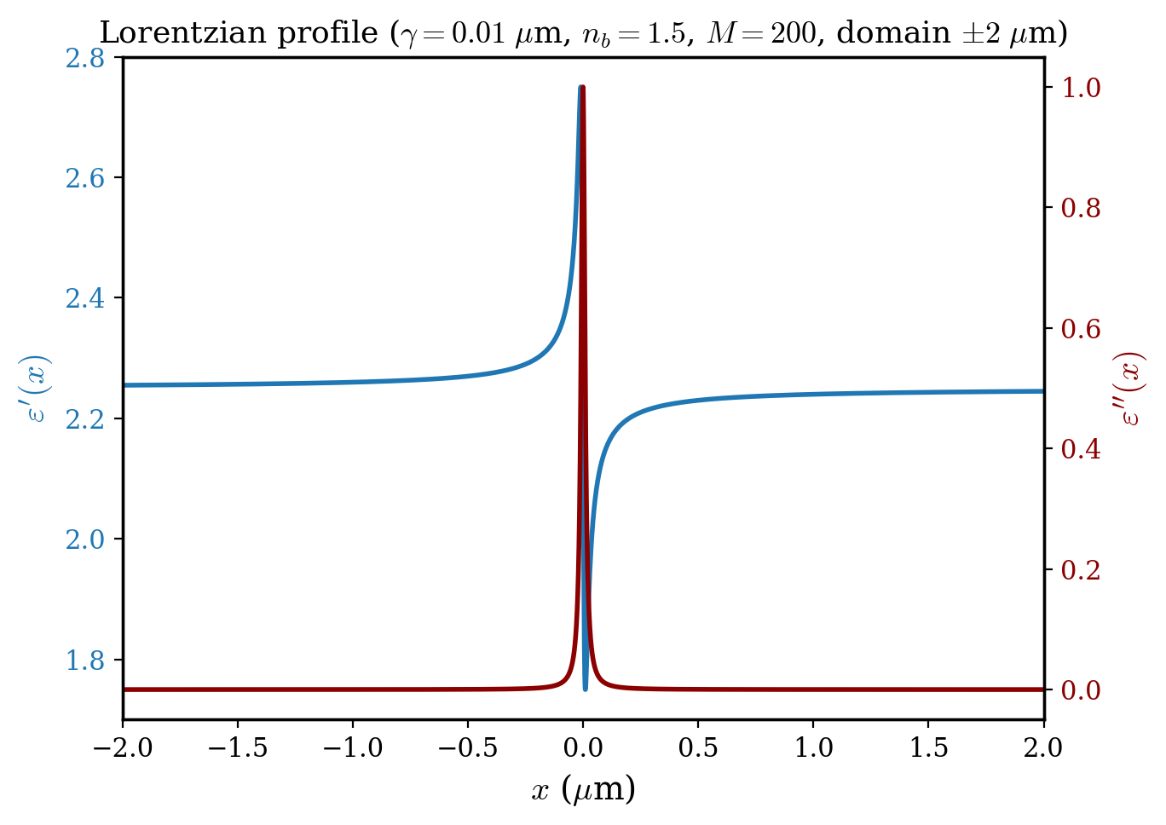
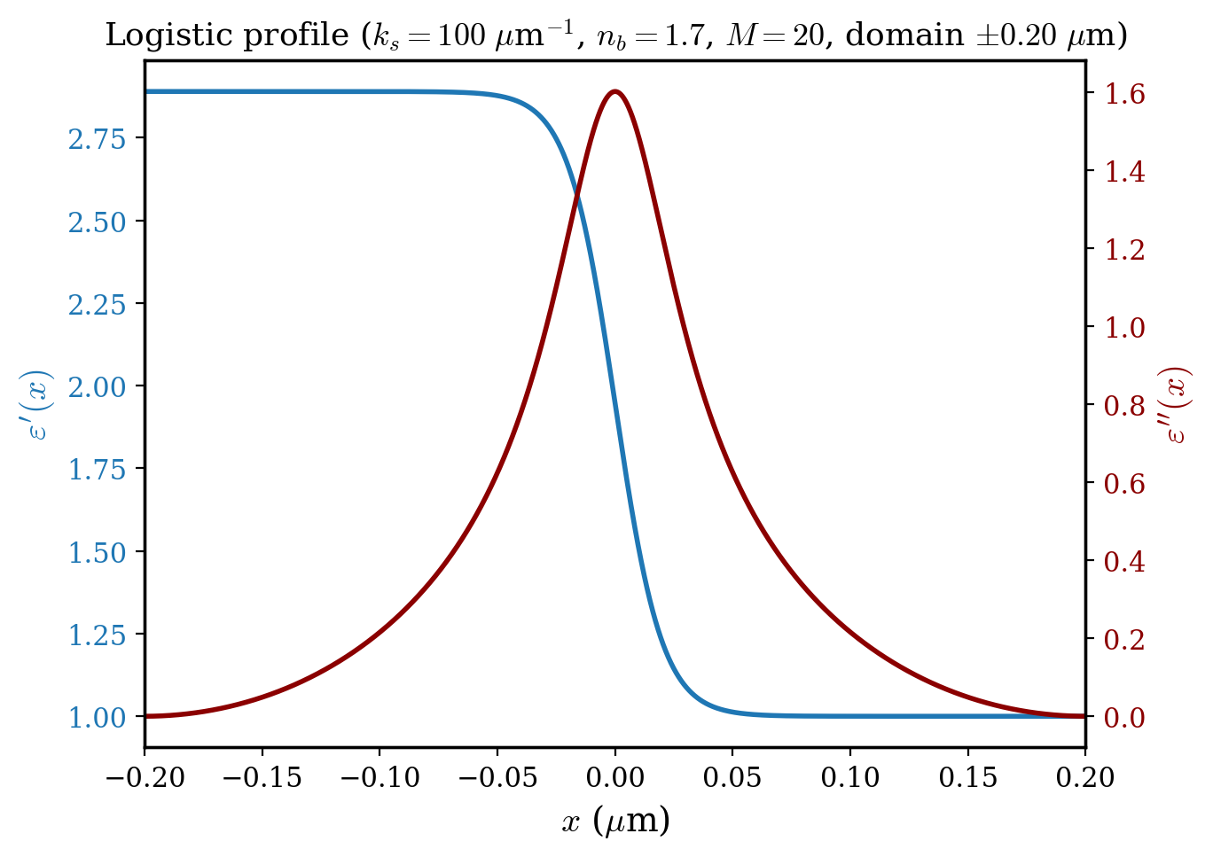
derivative method helps to get rid of DC offset spike in Lorentzian case, and helps to see the true FoM of logistic profile.

Slide 12
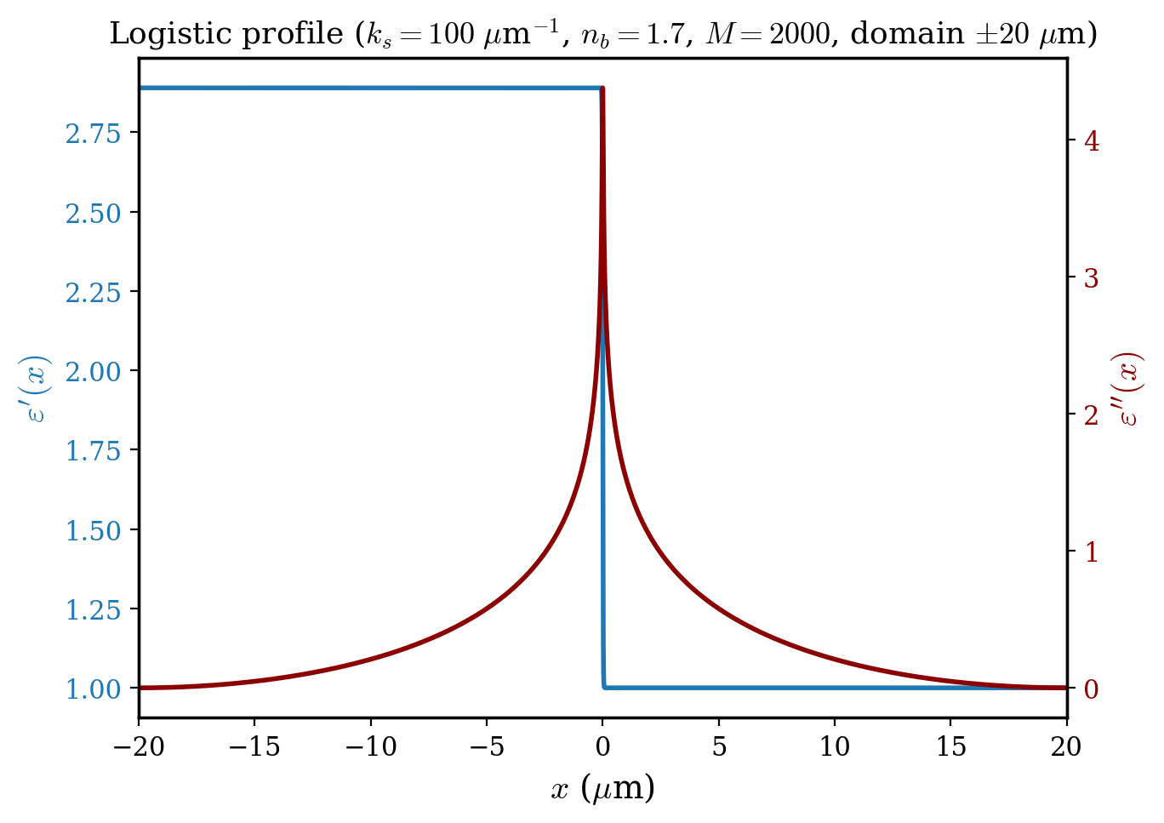
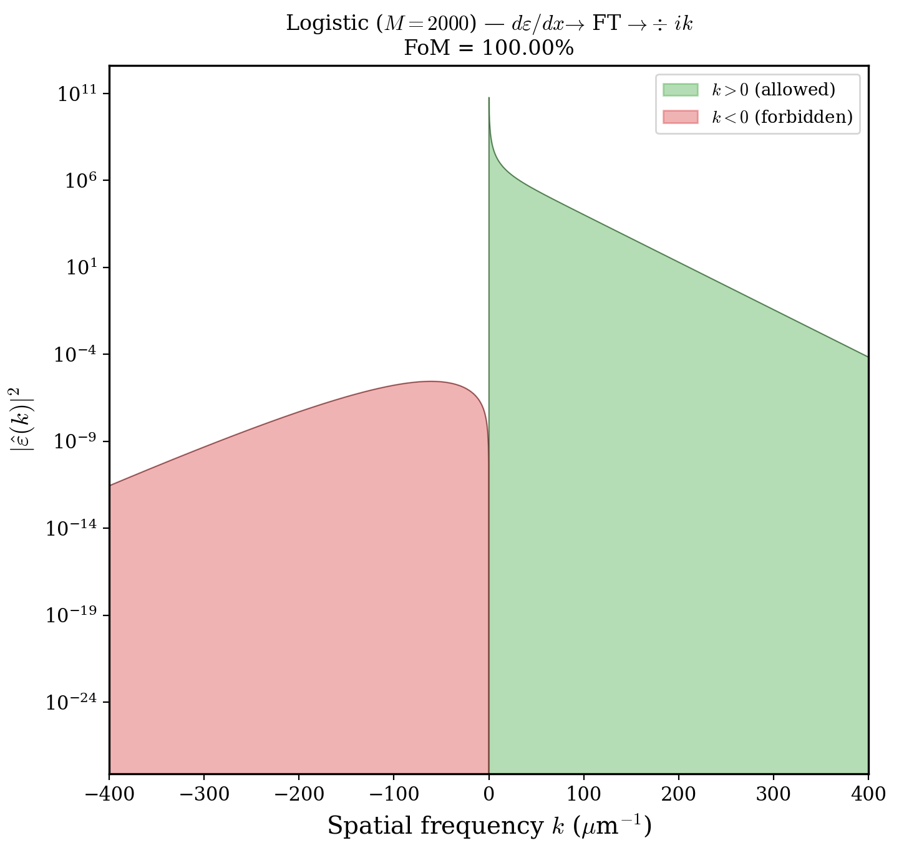
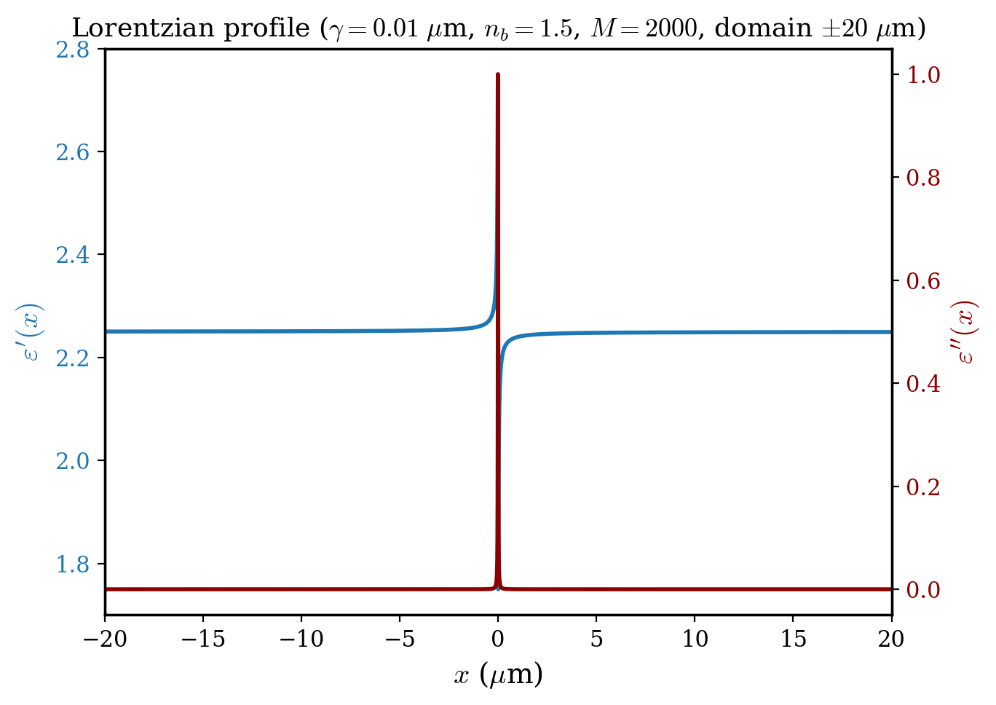
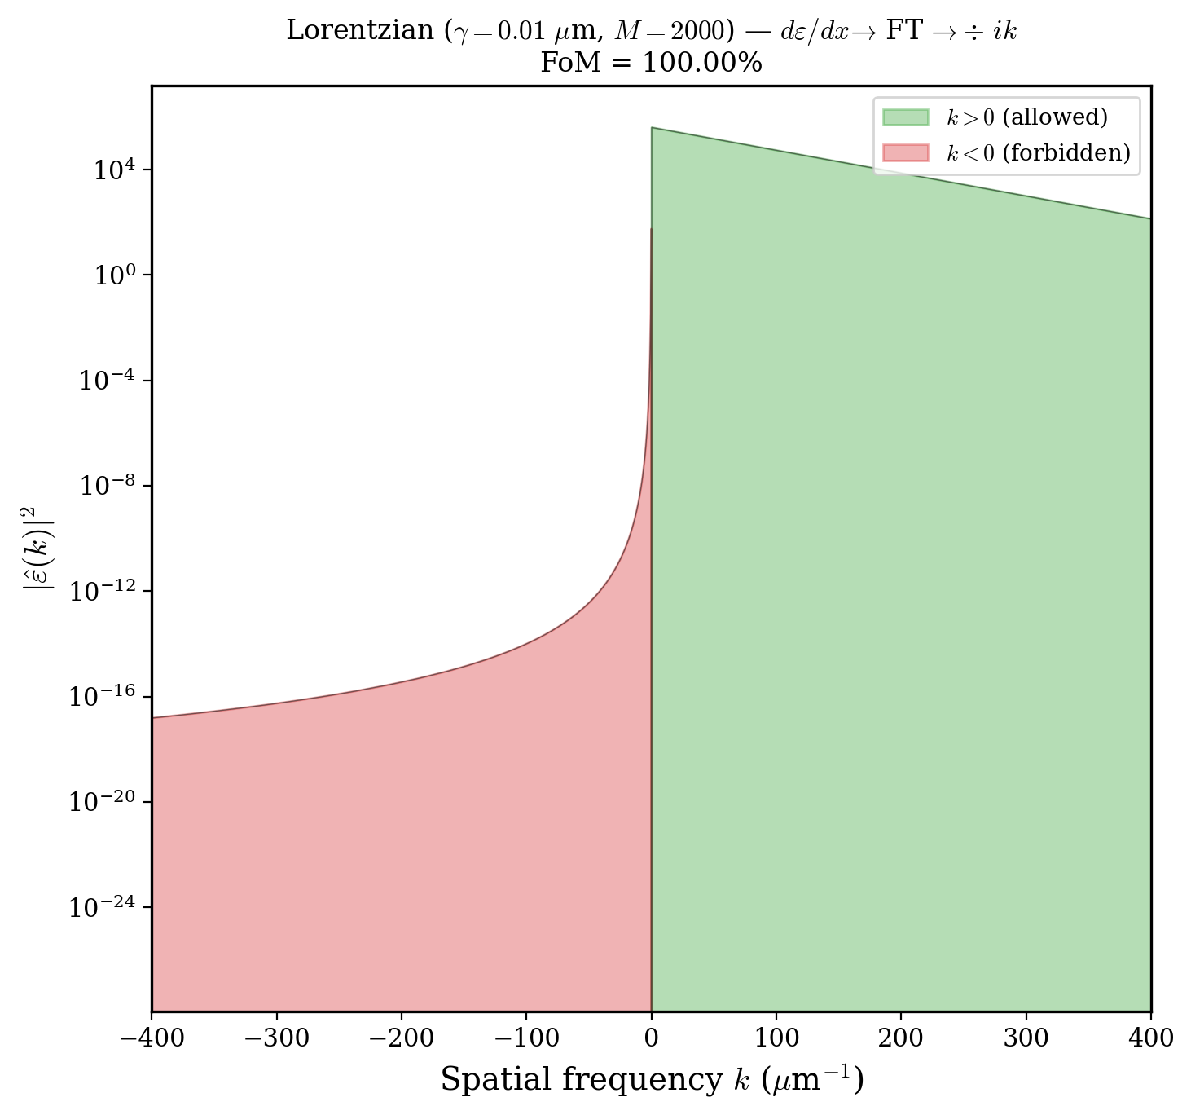
increased domain size of both profiles to get finer resolution in k-space
Fourier spectrum for logistic shows nonexponential behavior near k=0
spatial frequency k is the fourier conjugate of position x. low k means slowly varying spatial features
Lorentzian Fourier spectrum has more high k content because sharper spatial features

Slide 13
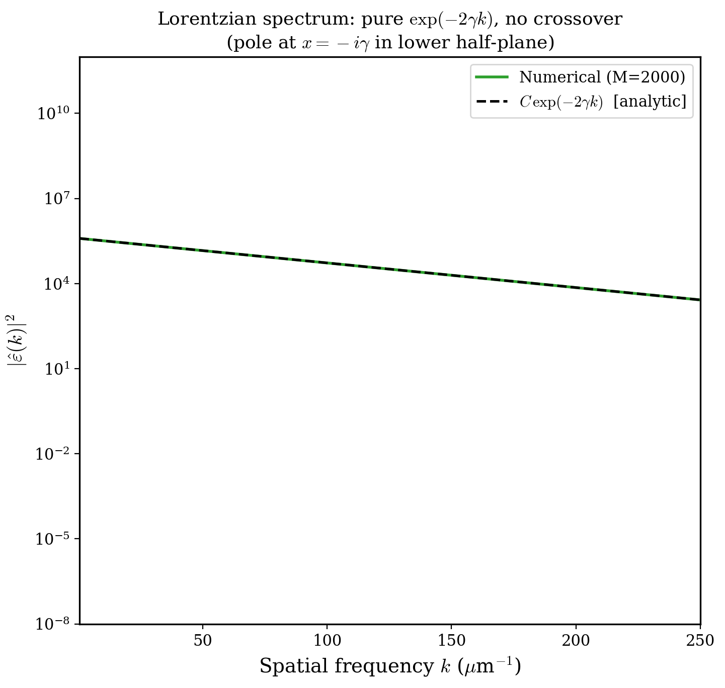
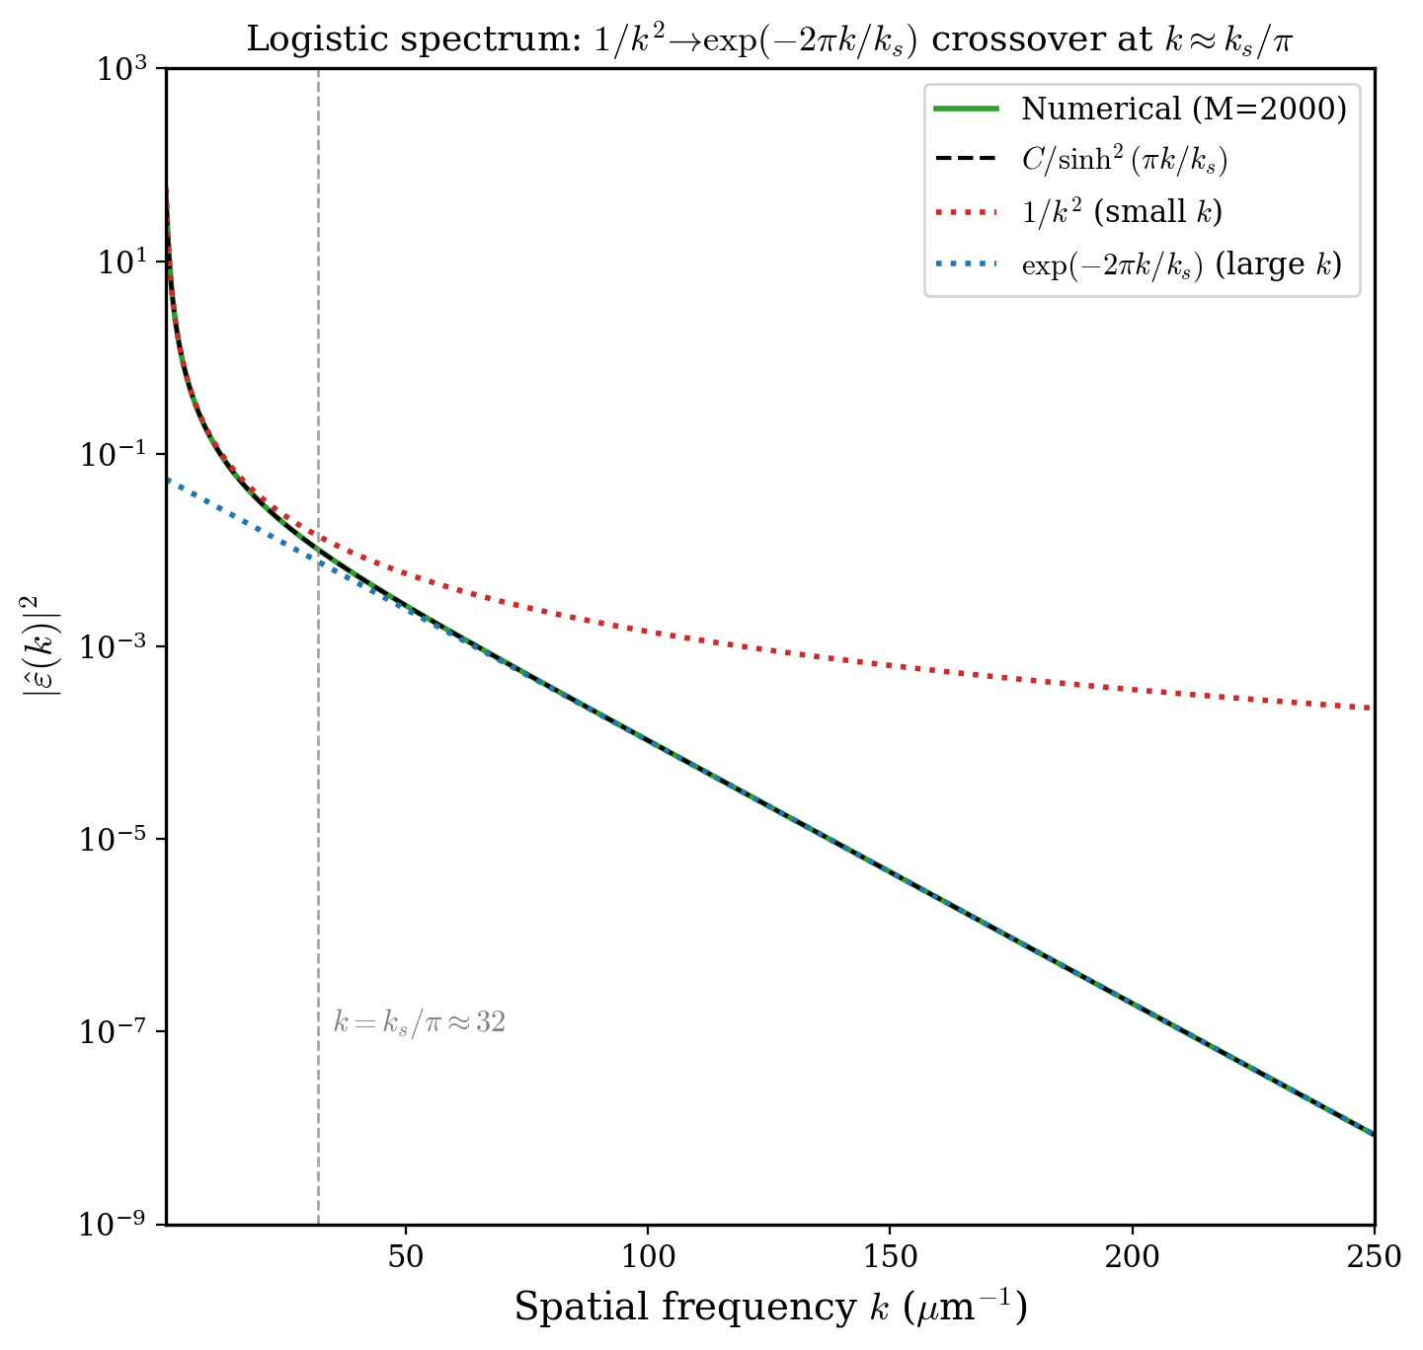
confirmed numerical Fourier transform results with analytical solutions. perfect agreement.

Slide 14
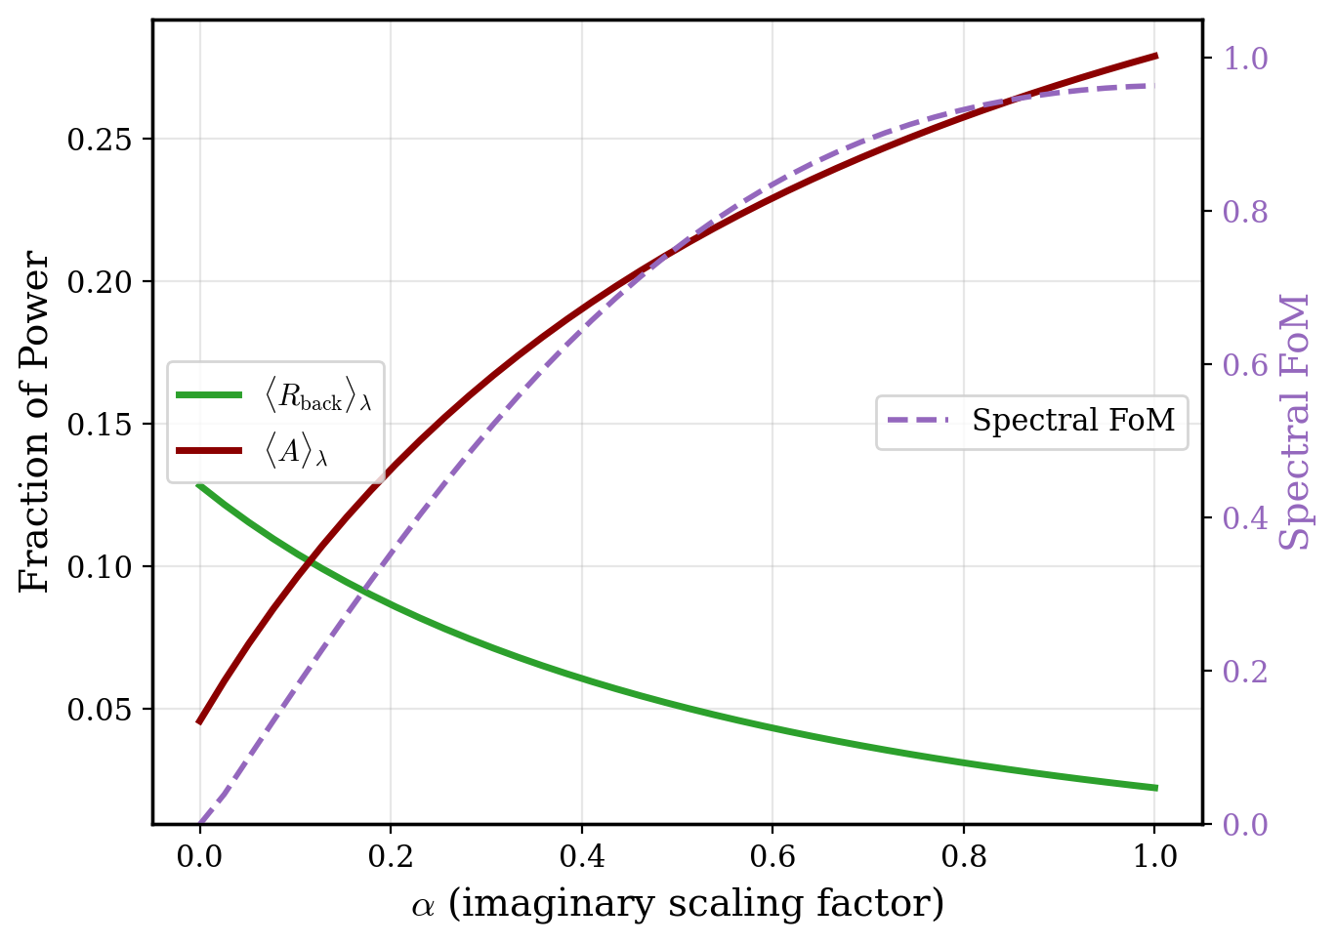
R → A Trade-off: Sweeping Loss Magnitude
ε''mod = α · ε''sKK
R, A averaged over 2–5 μm.
Crossing point at α ≈ 0.12:
⟨R⟩ = ⟨A⟩ ≈ 0.10
α = 0 (GRIN only):
⟨R⟩ = 0.128, FoM = 0%
α = 1 (full sKK):
⟨R⟩ = 0.022, FoM = 96.4%
Reducing α lowers absorption but also destroys analyticity (purple dashed).

Slide 15
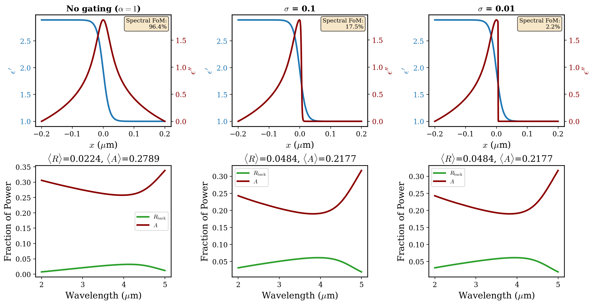
Smooth Gating Removes Unphysical "Lossy Air" Region

Slide 16
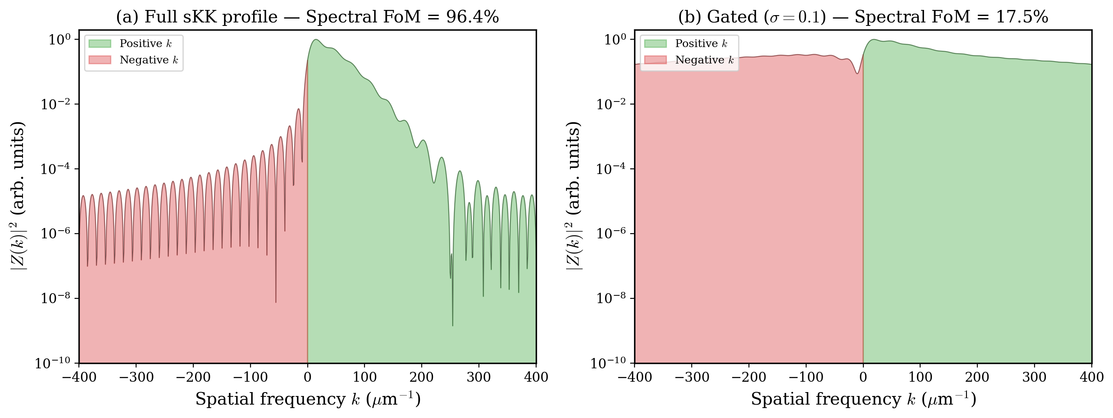
Analyticity Cost: Full sKK vs Gated Profile
Full sKK (left): nearly all spectral weight on positive k → FoM = 96.4%. Gated σ = 0.1 (right): removing lossy air injects power into forbidden (negative k) side → FoM drops to 17.5%. Every practical mitigation breaks analyticity.

Slide 17
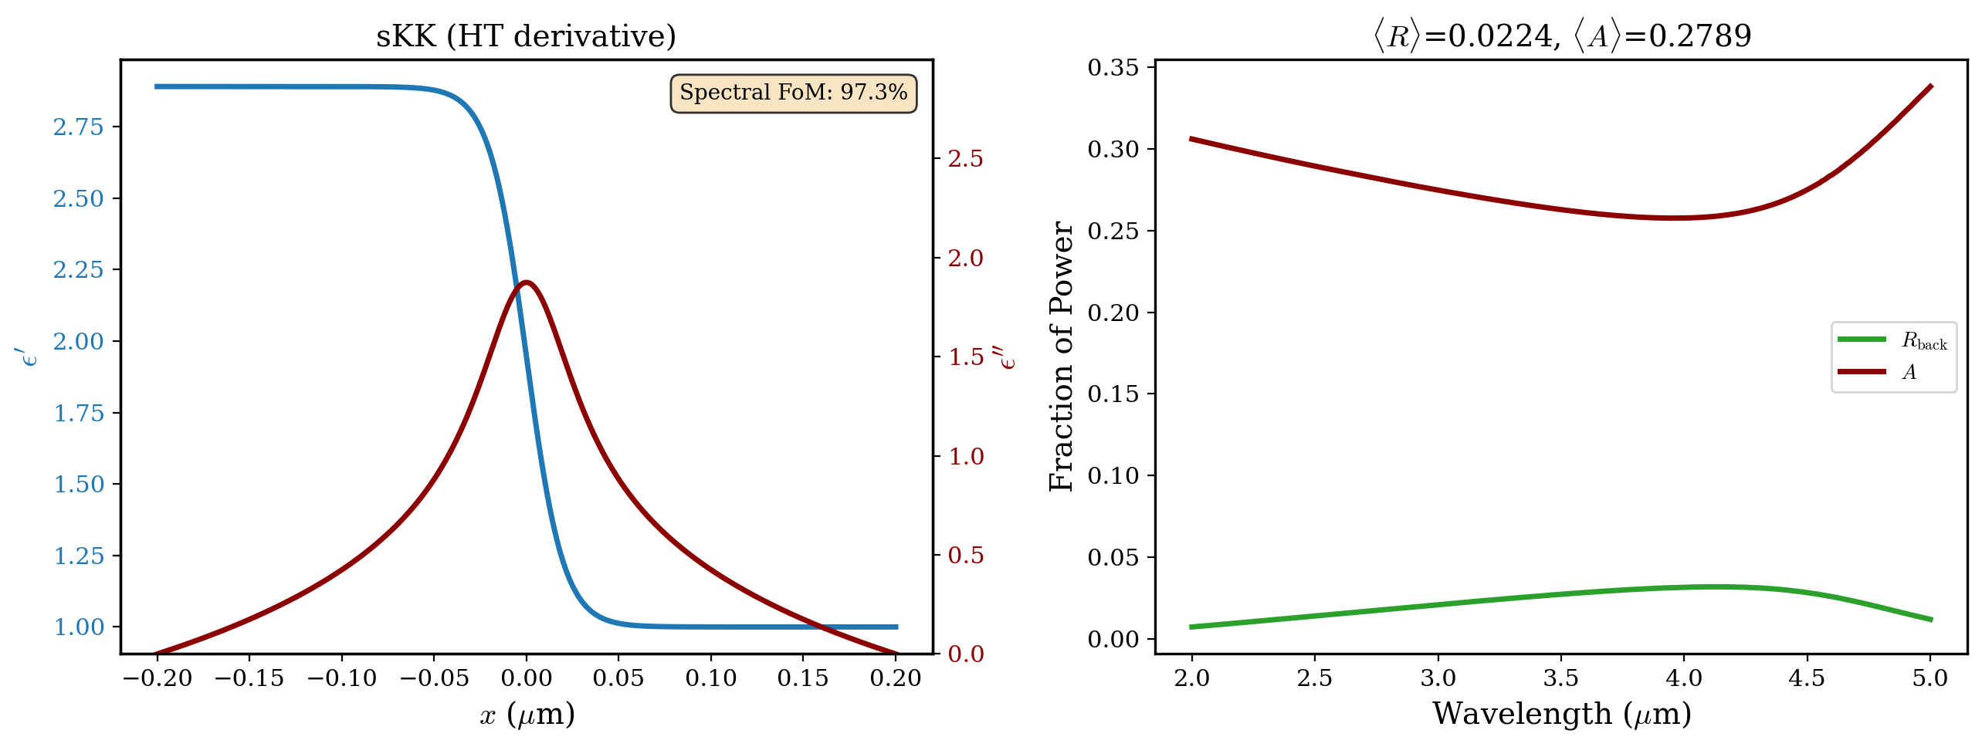
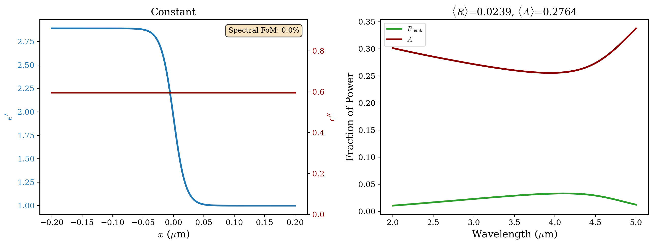
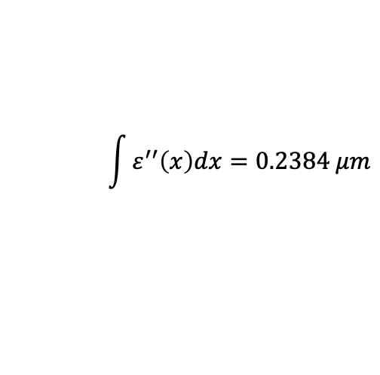
Hold Total Losses Constant, Vary Loss Shape (s-pol, 80°)
$$\int{ε^{′′}\left(x\right)dx=0.2384 μm}$$
constant profile performs slightly worse than sKK profile

Slide 18
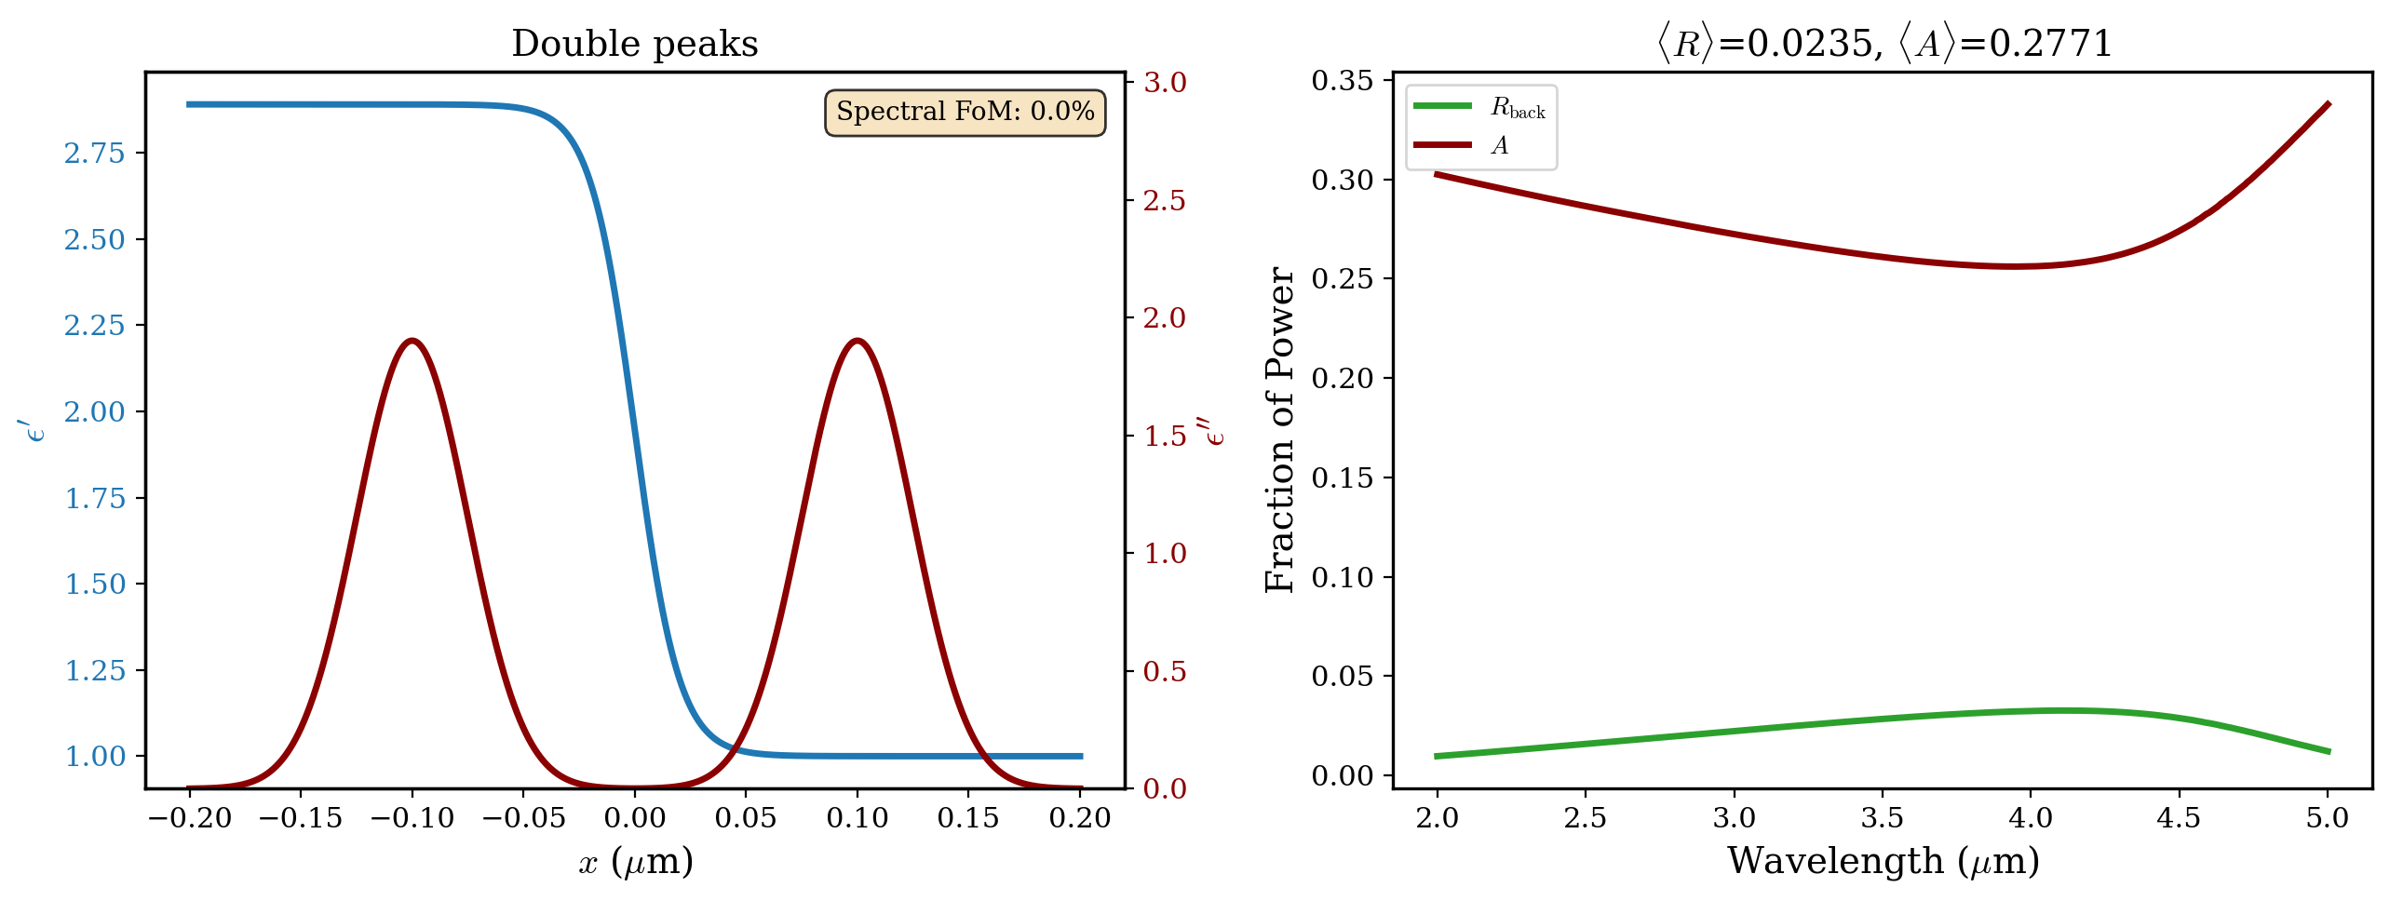
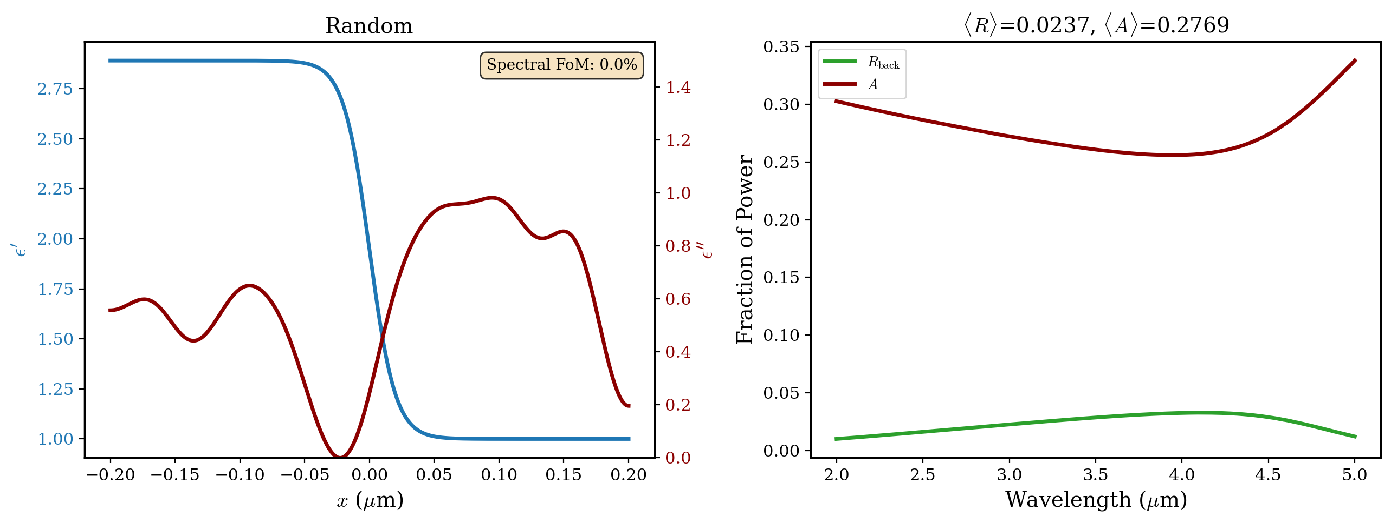
Hold Total Losses Constant, Vary Loss Shape (s-pol, 80°)
$$\int{ε^{′′}\left(x\right)dx=0.2384 μm}$$
both double peaks and random distribution perform slightly worse than sKK profile

Slide 19
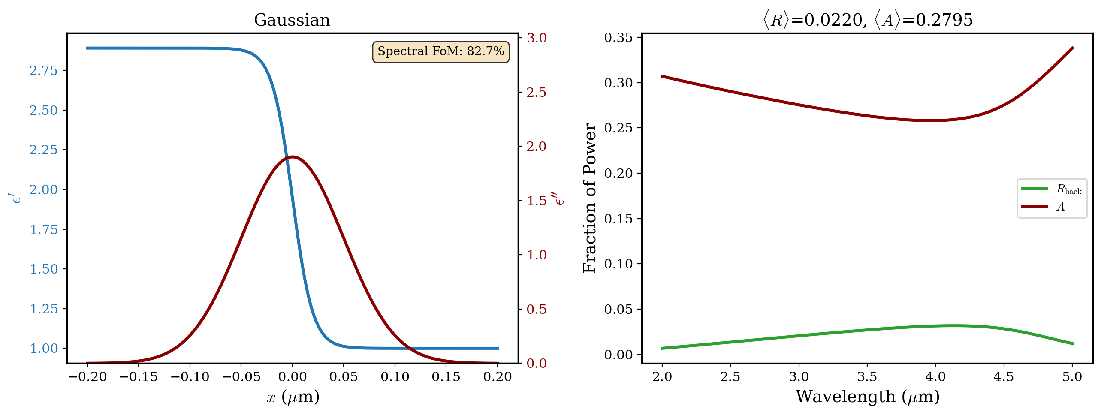
Hold Total Losses Constant, Vary Loss Shape (s-pol, 80°)
$$\int{ε^{′′}\left(x\right)dx=0.2384 μm}$$
gaussian performs slightly better than sKK with lower FoM

Slide 20
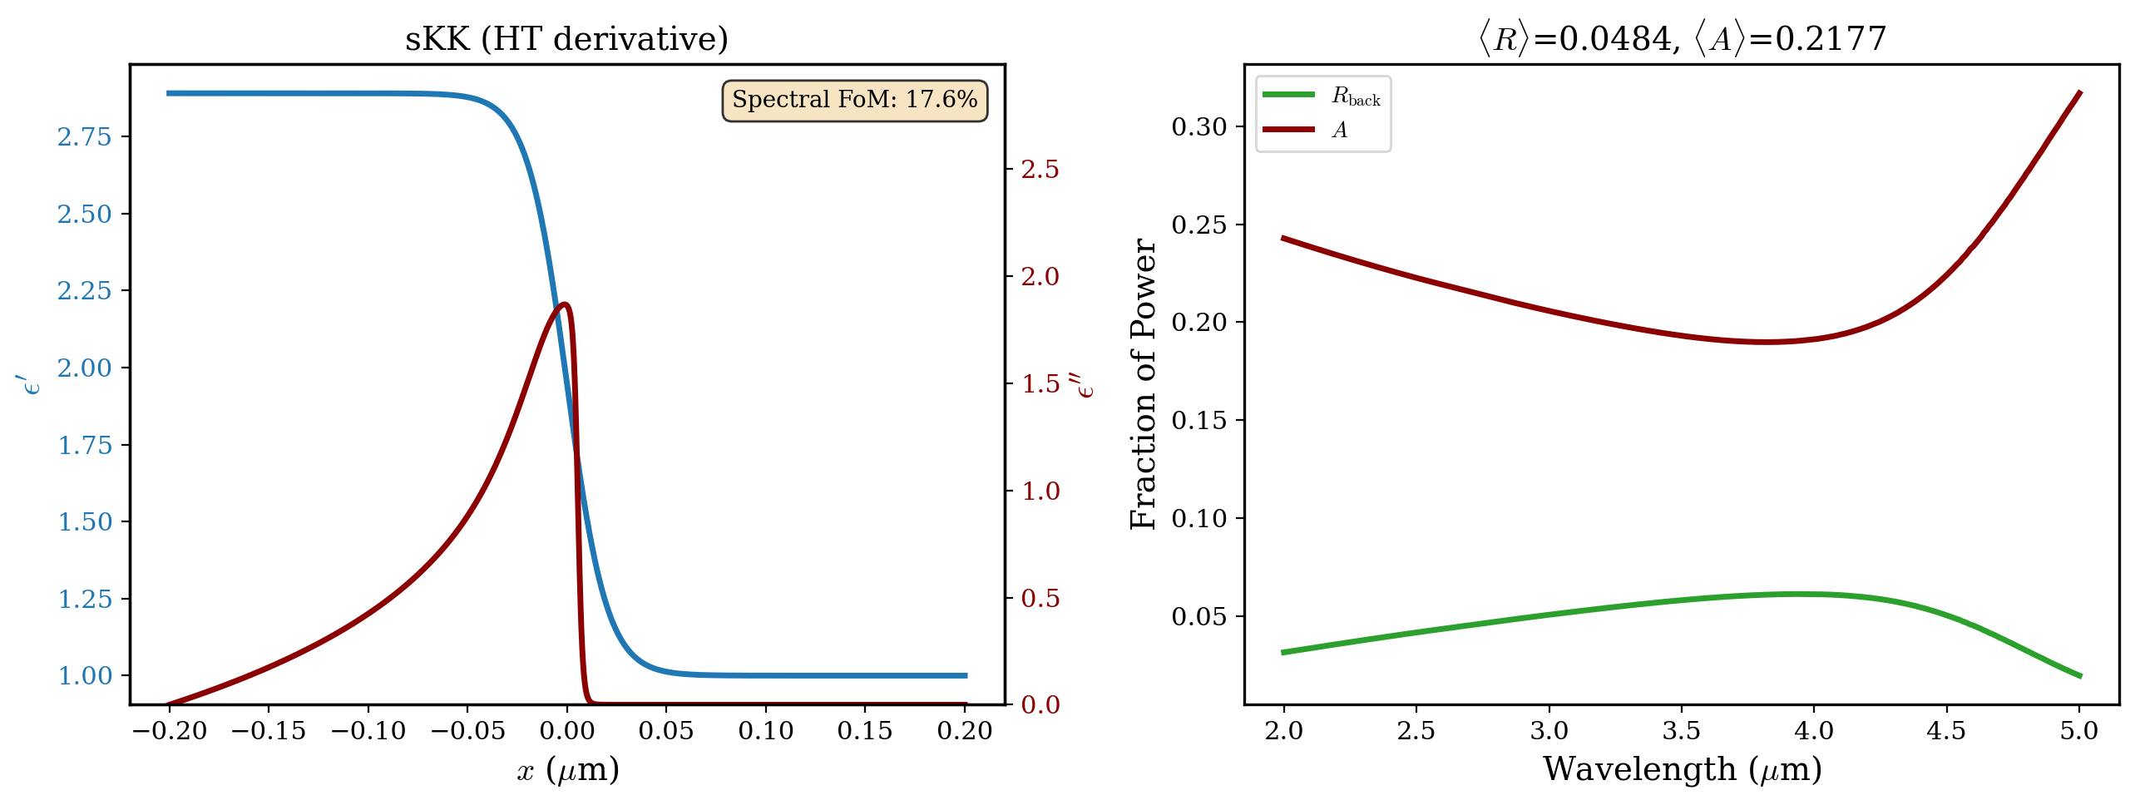
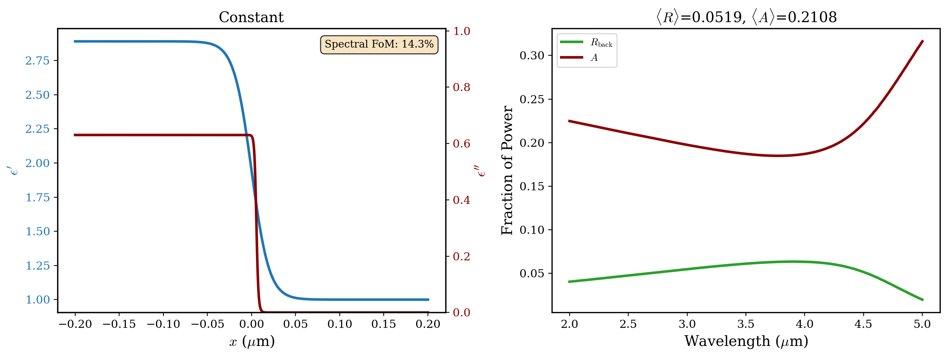
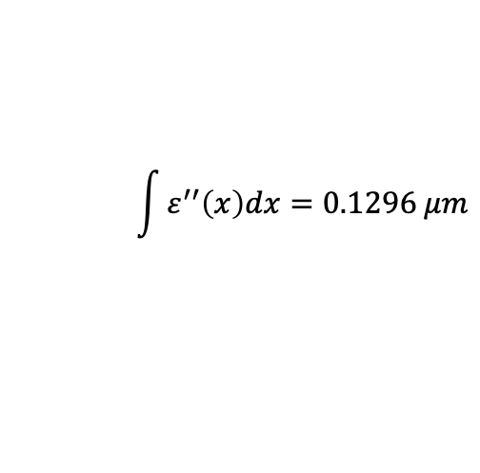
Hold Total Losses Constant, Vary Loss Shape (s-pol, 80°, gated)
$$\int{ε^{′′}\left(x\right)dx=0.1296 μm}$$
for gated profiles, constant again performs slightly worse than sKK gated

Slide 21
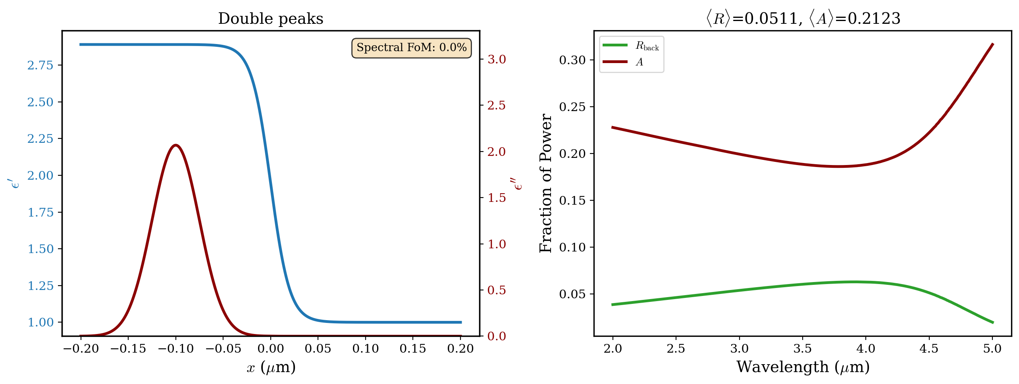
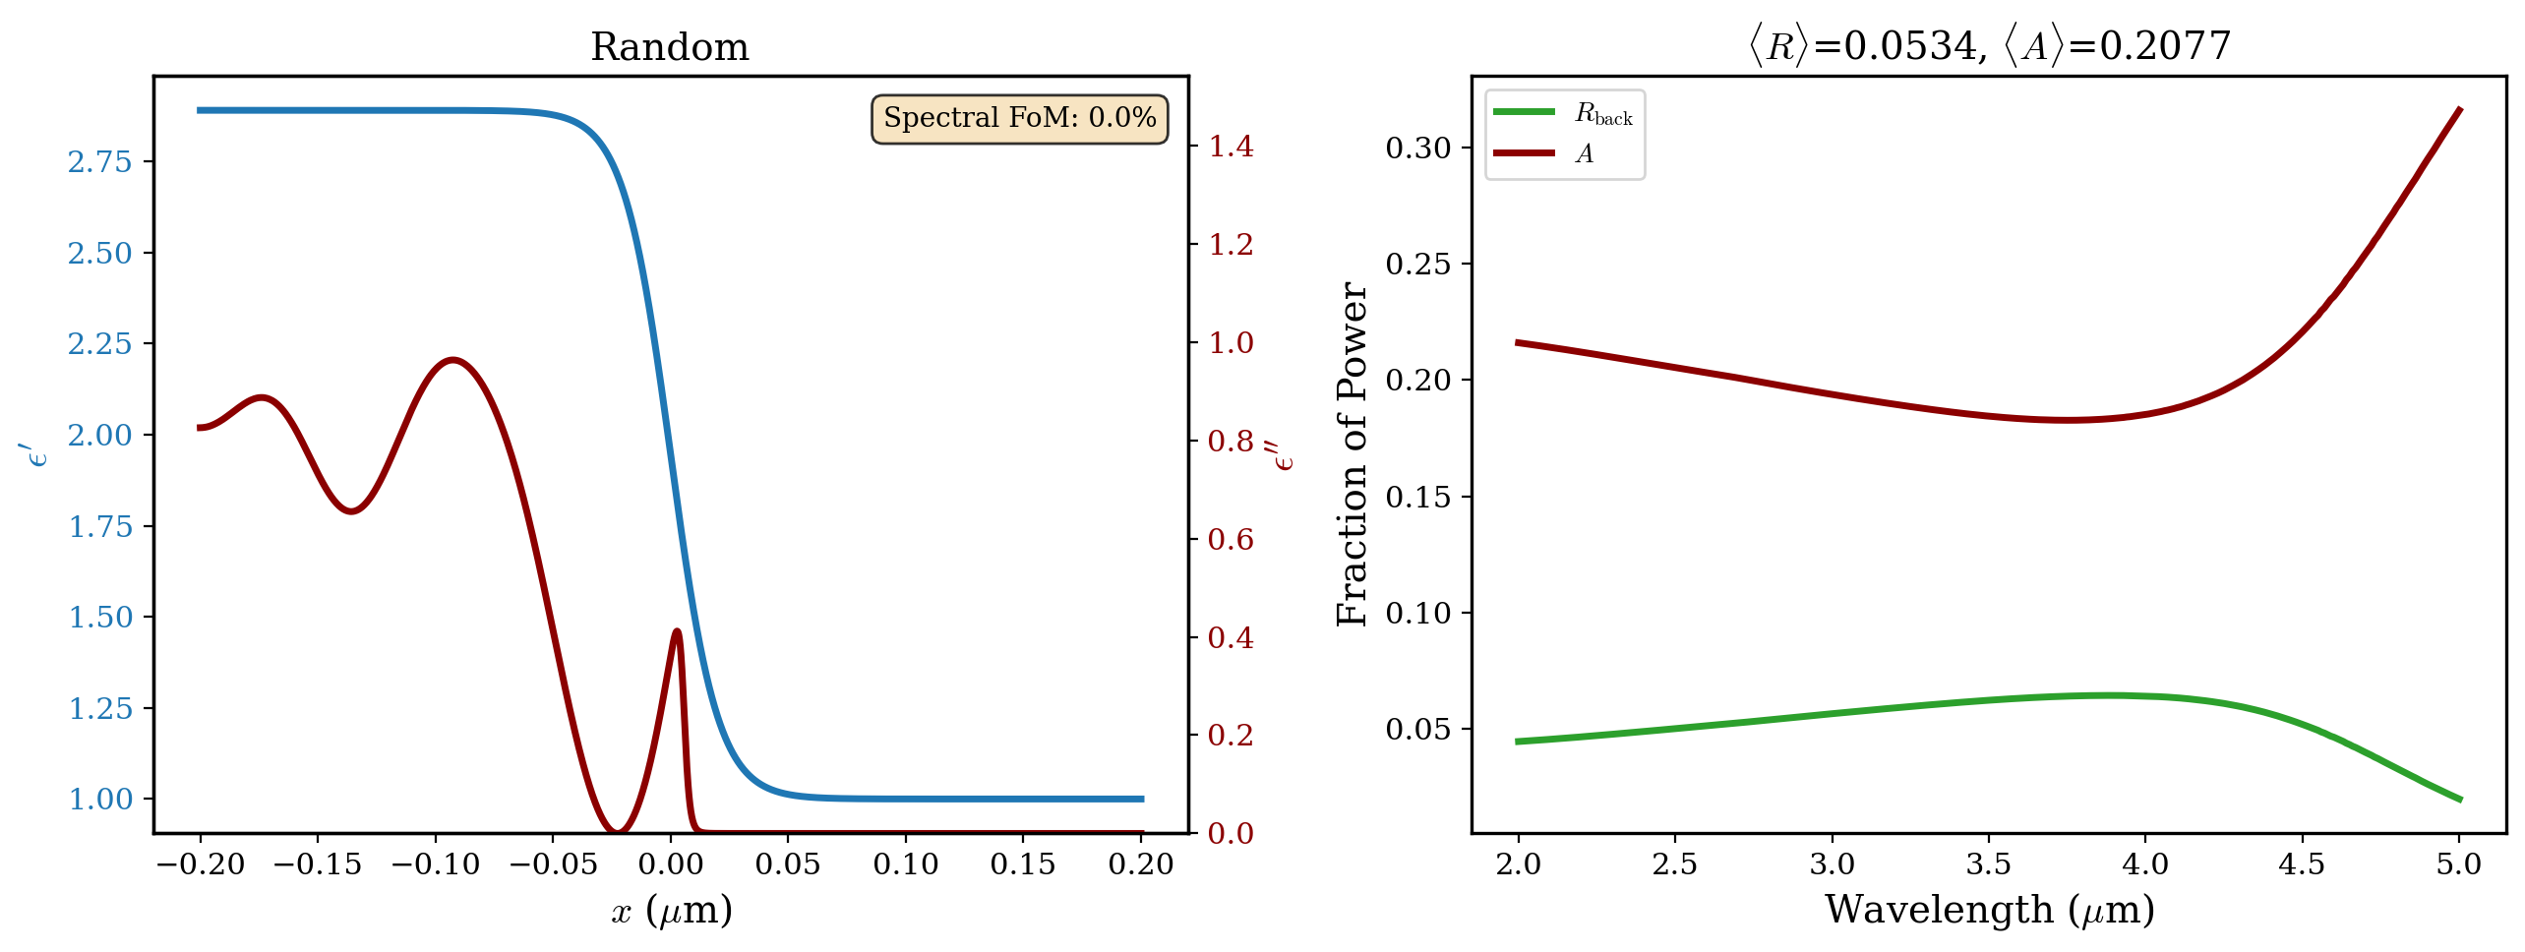
Hold Total Losses Constant, Vary Loss Shape (s-pol, 80°, gated)
$$\int{ε^{′′}\left(x\right)dx=0.1296 μm}$$
both double peaks and random distribution perform slightly worse than sKK gated

Slide 22
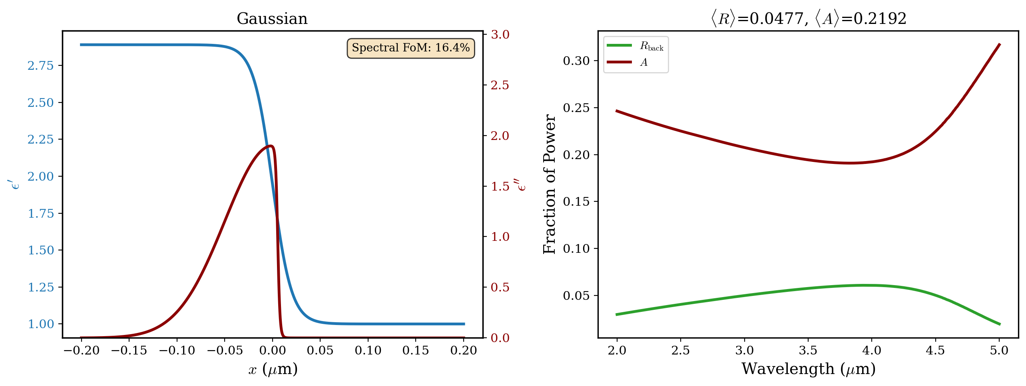
Hold Total Losses Constant, Vary Loss Shape (s-pol, 80°, gated)
$$\int{ε^{′′}\left(x\right)dx=0.1296 μm}$$
again, gaussian performs better than sKK. could be the smoother increase in imaginary part.

Slide 23
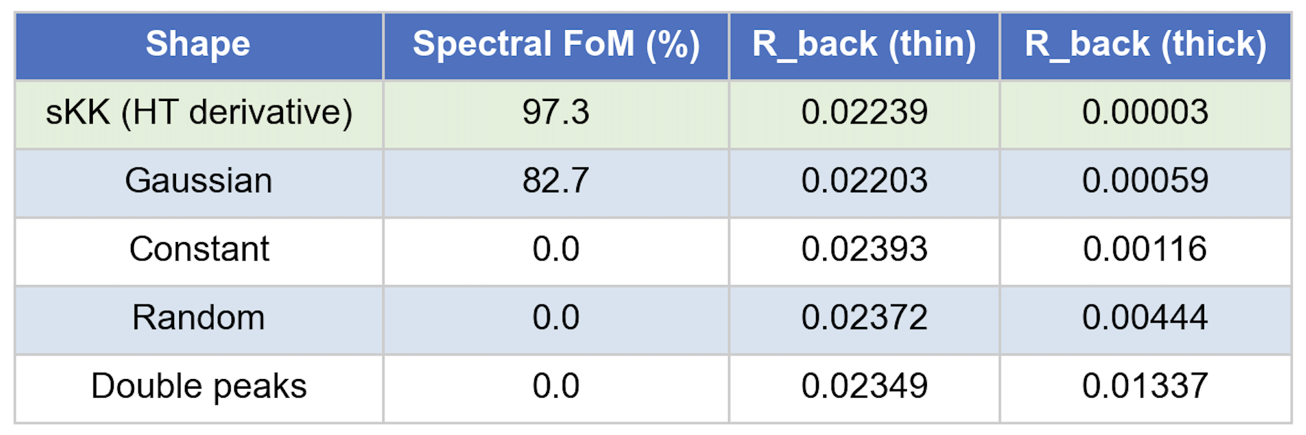
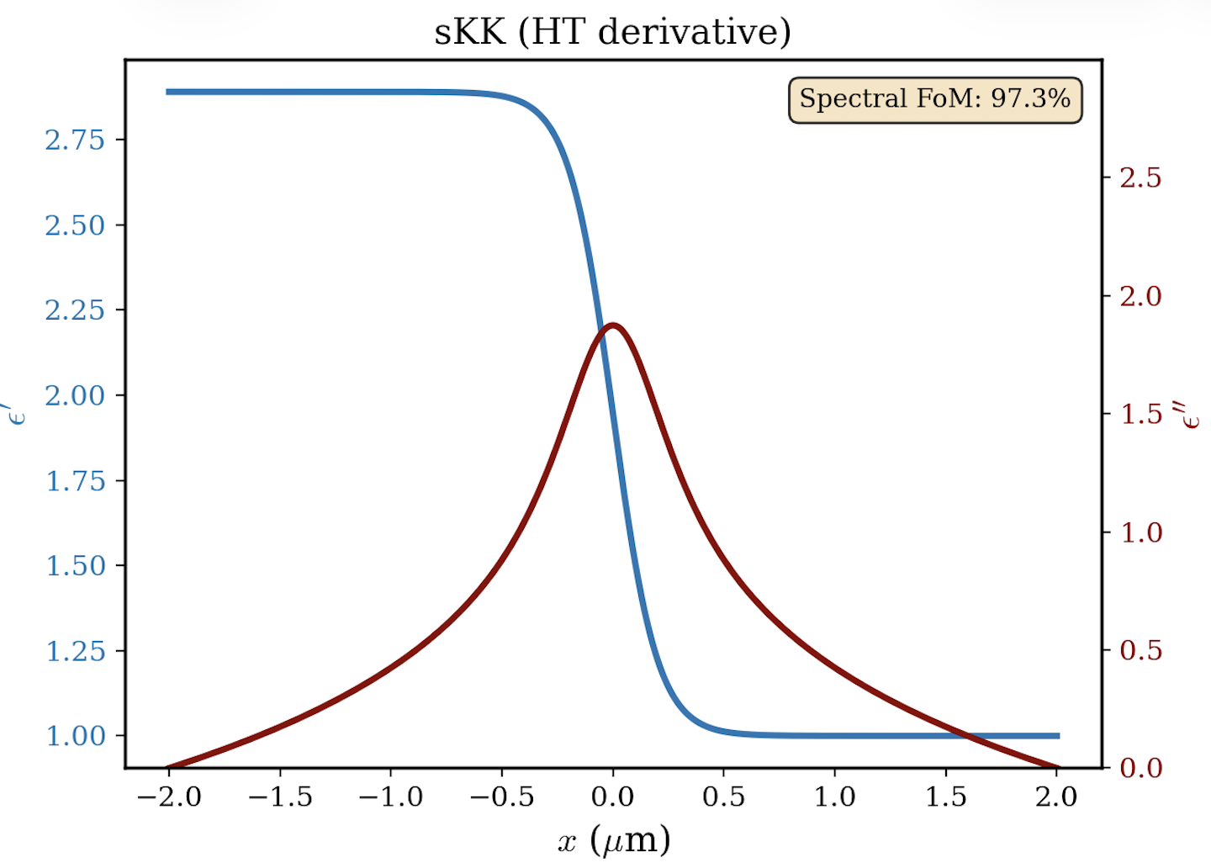
Repeat Experiment with 10x Coating Thickness (s-pol, 80°)
sKK shape outperforms other shapes at 4um thickness, but not at 0.4um
my guess: sKK is a coherent effect, which requires phase to accumulate within each layer. if layers are much smaller than the incoming wavelength (2-5um), there is no phase accumulation or cancellation, so only the total loss matters (not the shape). thicker layers allow for sKK to do its thing, while accumulating reflections for other non-HT profiles.
next slide shows thickness sweeps at different polarizations, wavelengths, angles.

Slide 24
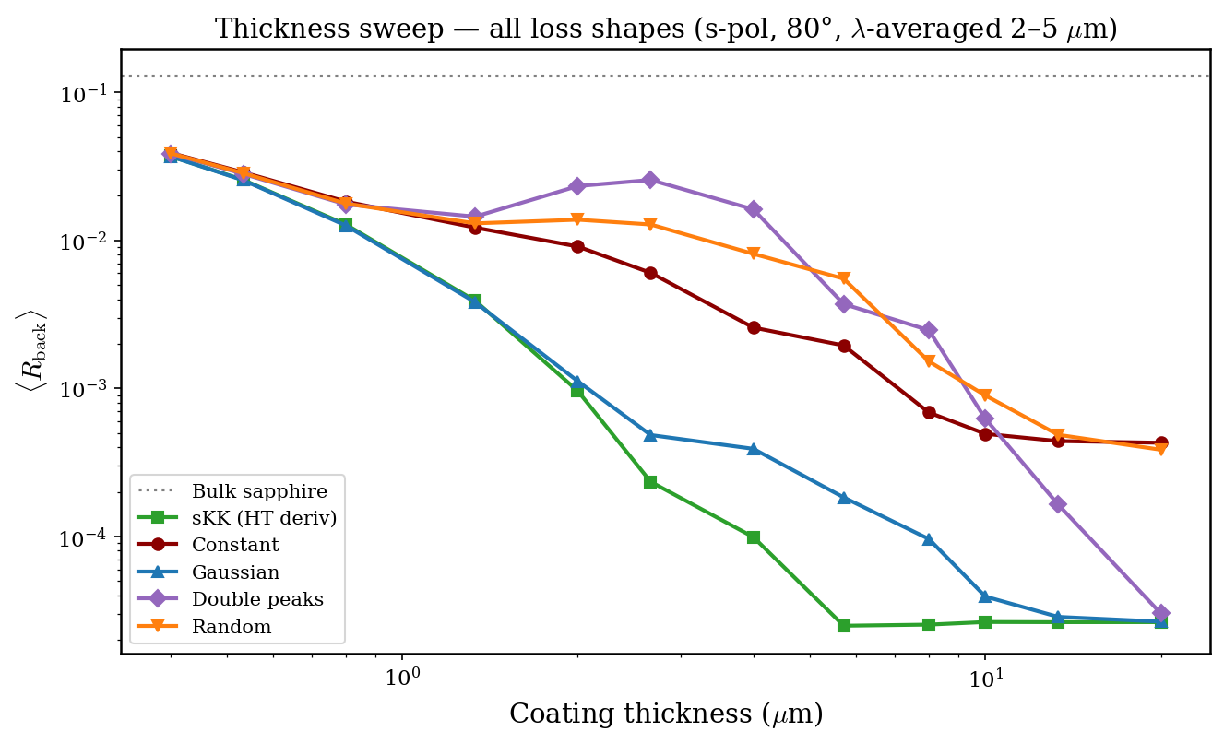
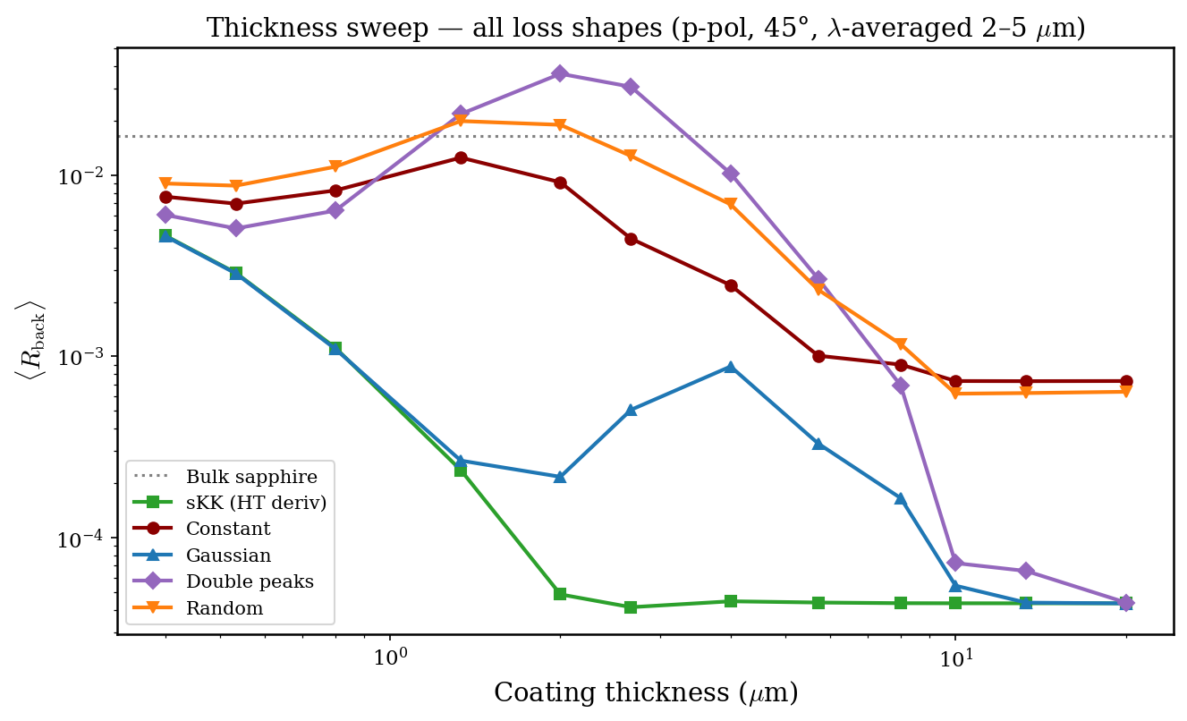
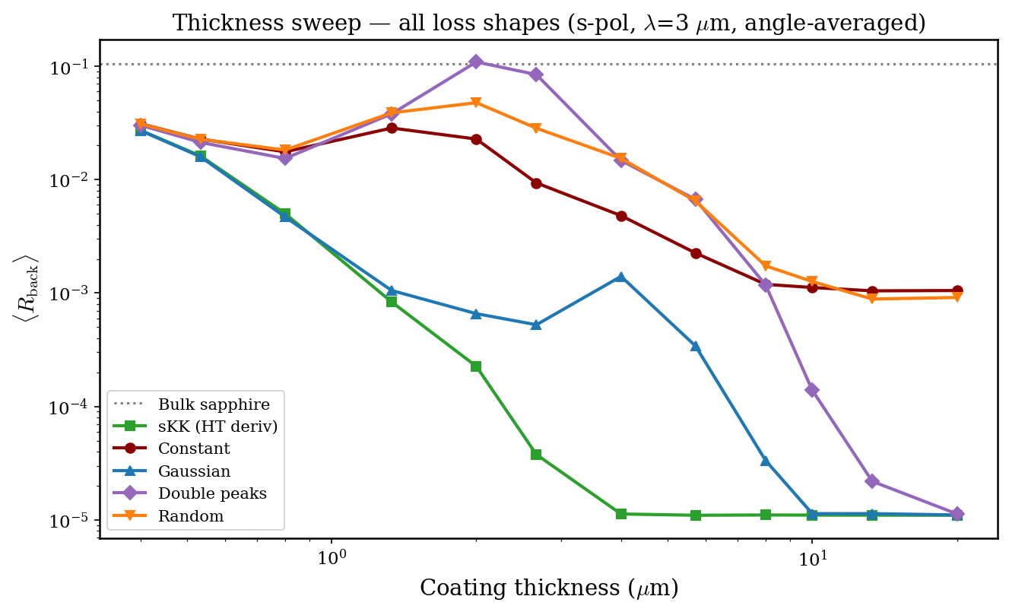
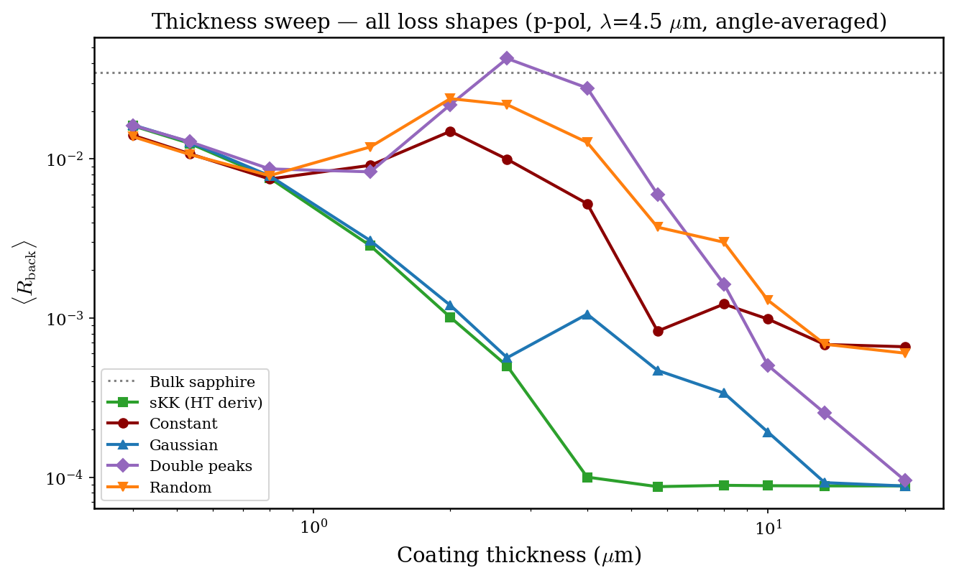

Slide 25
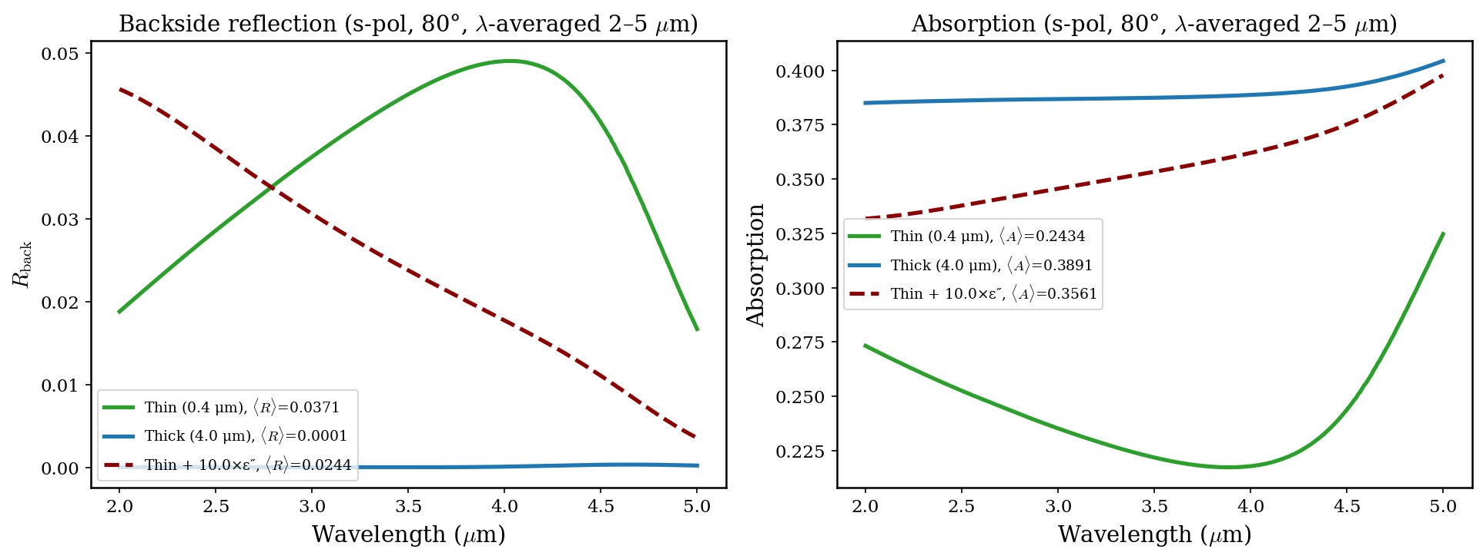
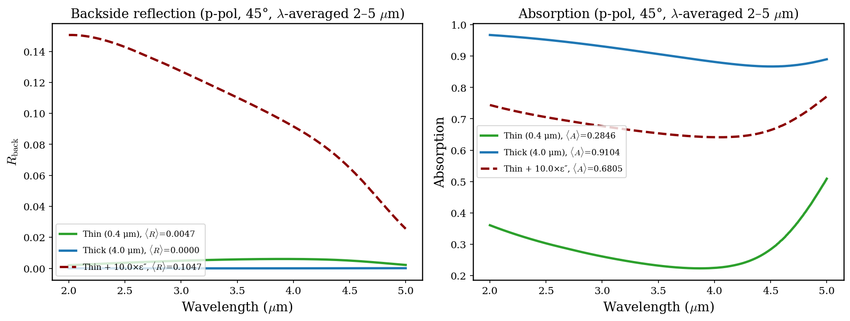
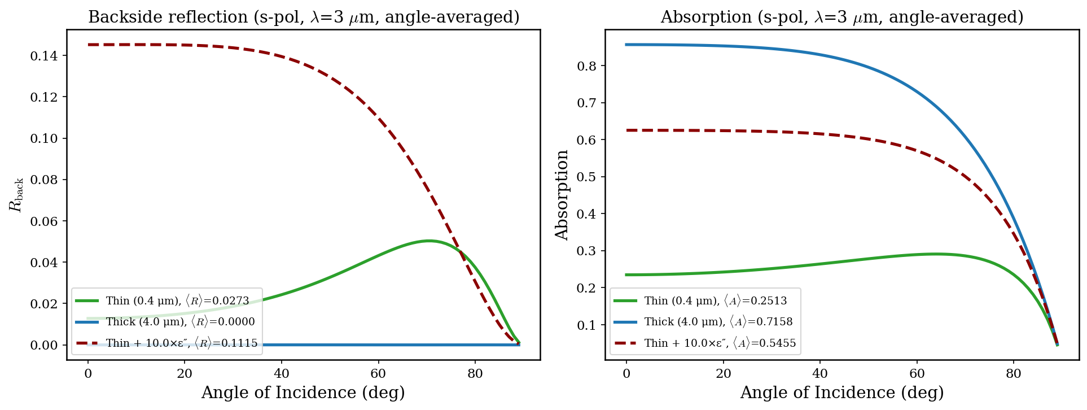
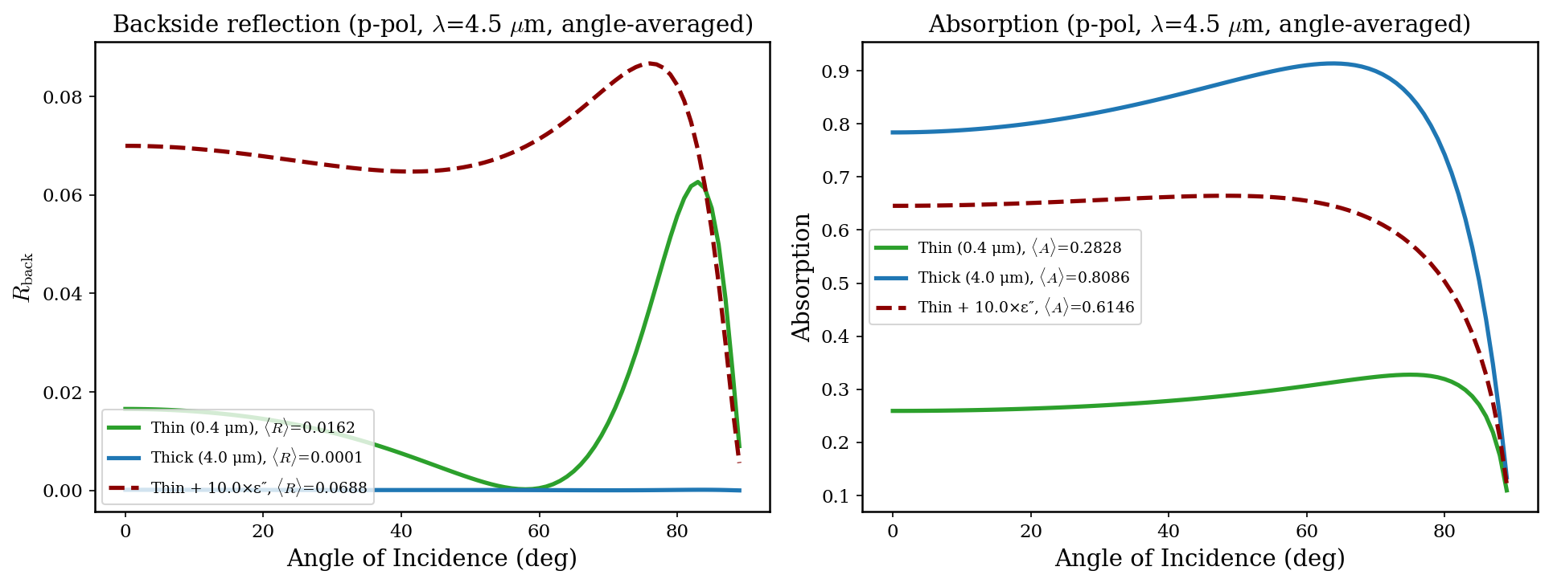
Thick vs. thin with 10x losses to match the thick coating shows a significant degradation in R_back, showing that the thick sKK coating is not just reducing R_back because of more losses, but rather, the coherent cancellation effect due to analyticity in space

Slide 26
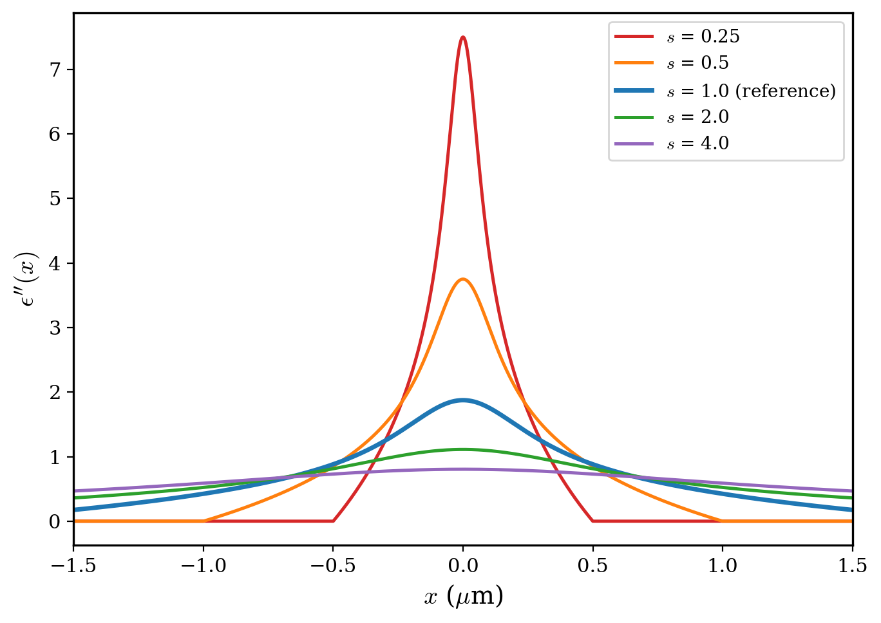
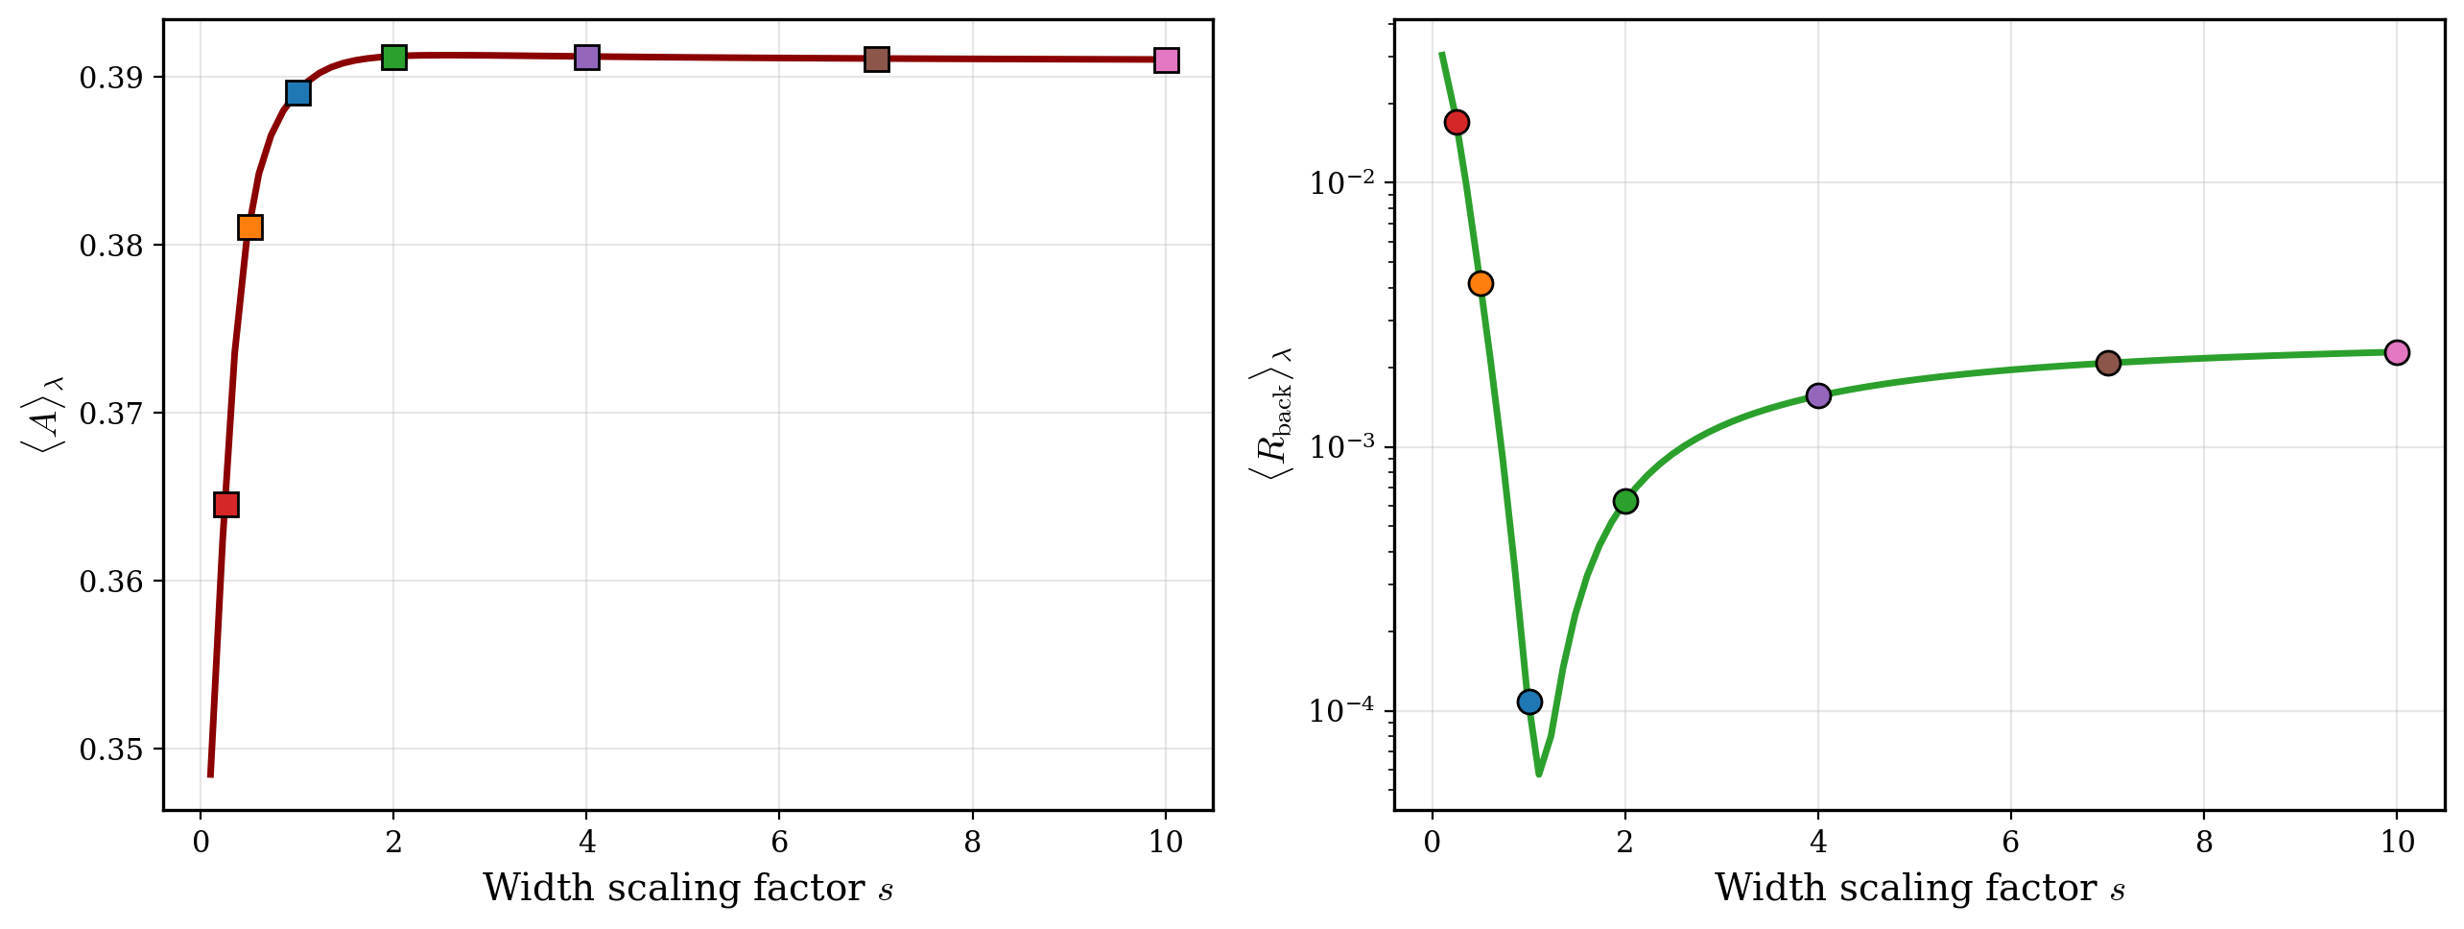
sweeping the width of the imaginary part of the dielectric function, holding total losses and real part constant, highlights the importance of the shape of the losses themselves (R_back minimizes when width is original width from Hilbert transform).

Slide 27
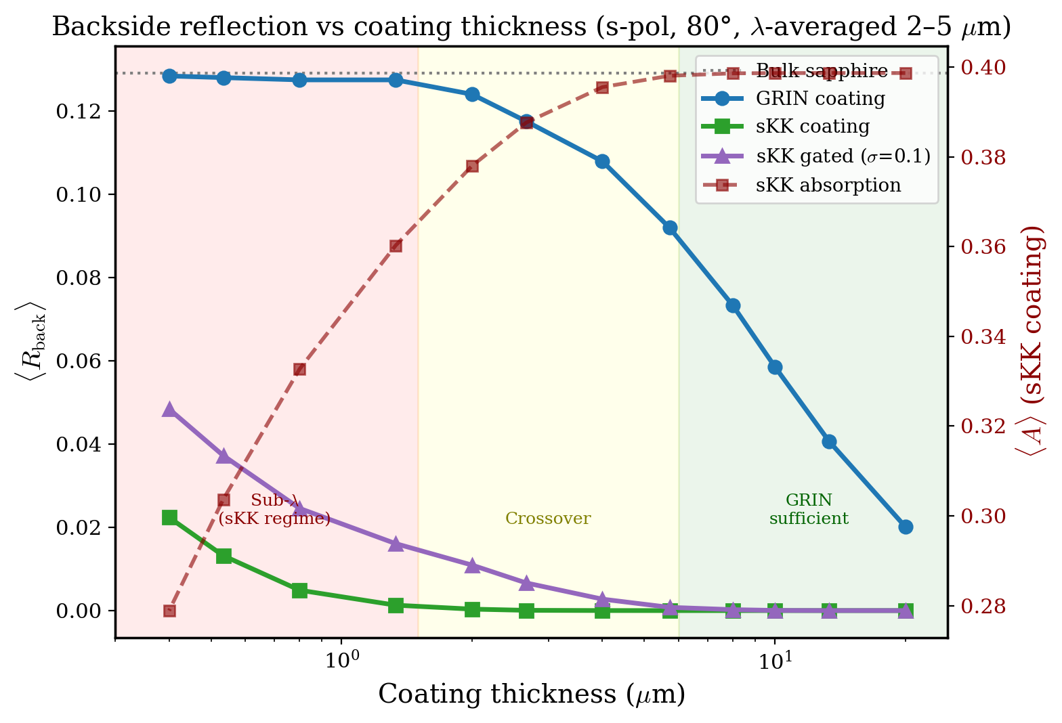
Design Space: GRIN vs sKK Across Coating Thickness
averaged R_{back} between 2-5um (s-pol, 80deg):
Three regimes: Sub-λ coatings (<1.5 μm) where GRIN is ineffective and sKK provides the only path to low R — but at the cost of absorption and broken analyticity. Thick coatings (>6 μm) where GRIN alone achieves low R without absorption. Crossover region (1.5–6 μm) is where the design tradeoff is most nuanced.

Slide 28
Paper Plan
The Problem
Computing the Hilbert transform of GRIN profiles with asymmetric endpoints (ε′(−∞) ≠ ε′(+∞)) is essential for coating application of sKK, and the standard FFT-based HT fails due to periodic continuation artifacts.
The Method
Derivative-then-integrate: dε′/dx → 0 at both endpoints, so the standard HT works on the derivative. Integrate back to recover ε′′.
Results
Achieve zero-reflectance for all angles and wavelengths but with “lossy air” (n ≈ 1, k > 0), which is fundamental to the asymmetric HT — not a numerical artifact (Horsley et al. perfect transmission via gain). First quantitative characterization of the analyticity–physicality tradeoff using spectral one-sidedness FoM.
Three thickness regimes: sub-λ (sKK essential, GRIN ineffective), crossover (1.5–6 μm), and thick coatings (>6 μm, GRIN alone suffices).
Practical mitigations (α-scaling, σ-gating) trade practicality for reflection reduction and broken analyticity.

