Slide 1
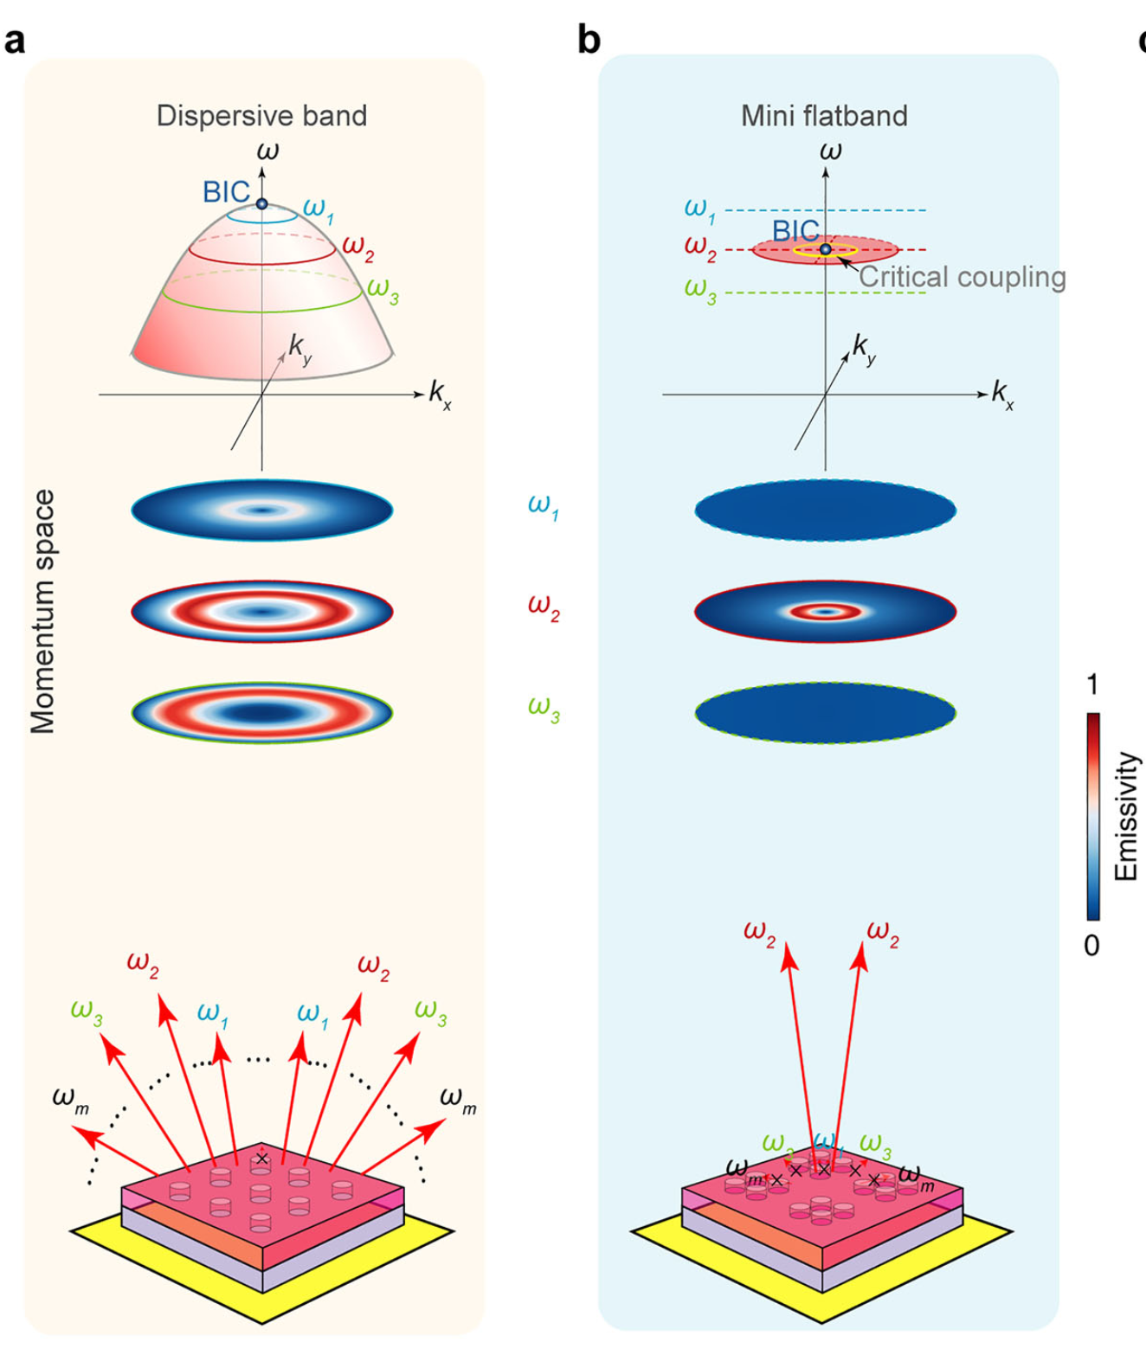
Structured Coherent Thermal Emission from Non-Hermitian Metasurfaces
First demonstration of coherent, vectorially polarized thermal emission from a heated metasurface — narrowband, highly directional, rainbow-free, doughnut-shaped beams in the 3–5 μm window.
Thermal radiation is normally broadband, omnidirectional, incoherent, and unpolarized
Their method transforms it into laser-like structured light — no external optics needed
Key mechanism: non-Hermitian engineering (exceptional points + mini-flatbands + BICs)
Applications: on-chip IR sources, thermal imaging, infrared optical manipulation
Conventional BIC systems: critical coupling persists over wide angles → emission at many wavelengths (rainbow).
This work: confines critical coupling to a narrow angular + spectral window.

Slide 2
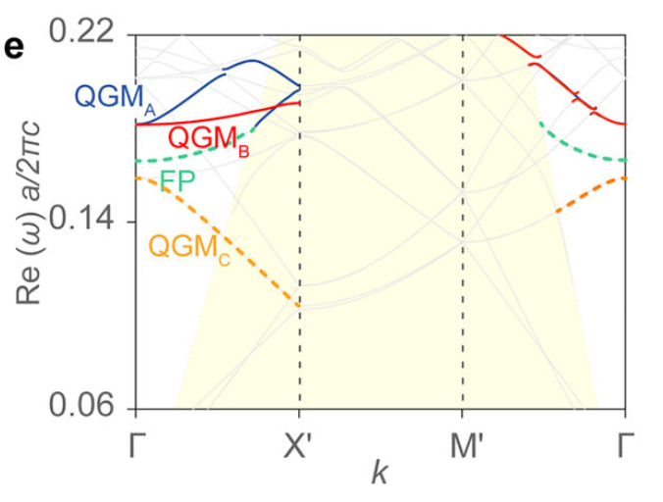
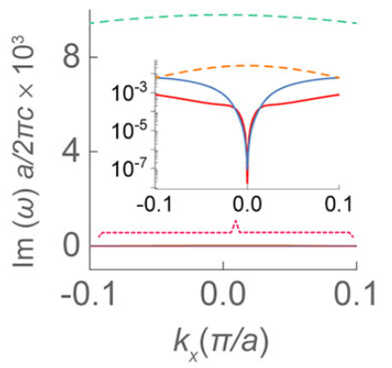
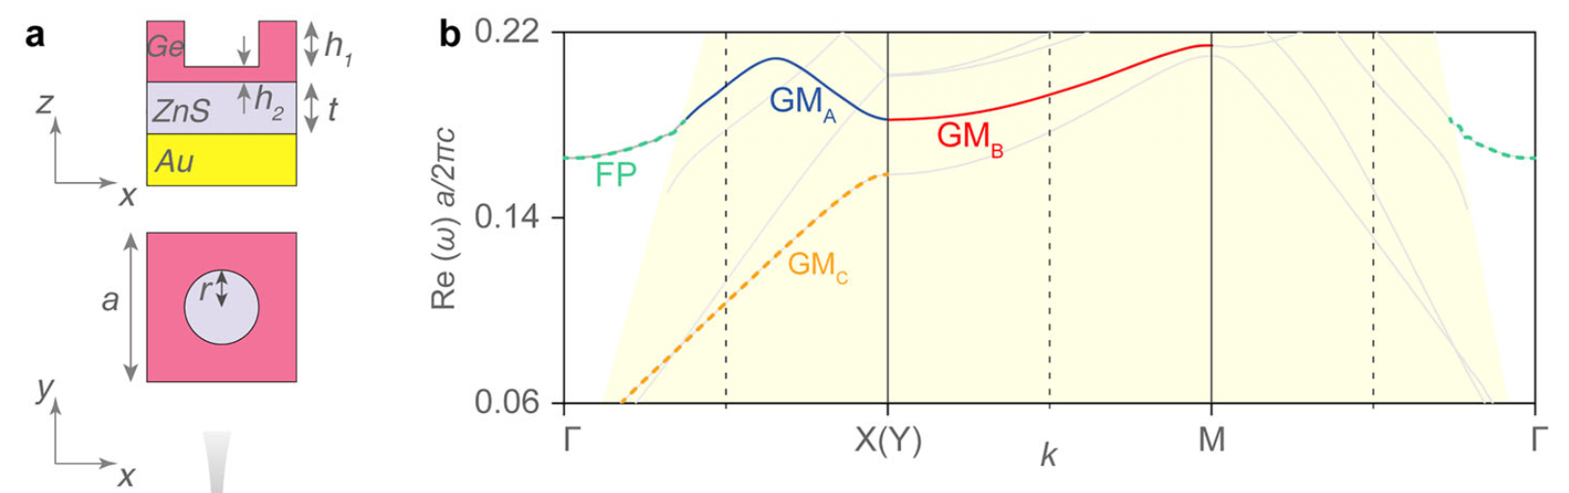
Some Concepts to Understand
BIC: Bound State in the Continuum. a mode that sits above the light line, but cannot radiate.
Guided Modes (GMs): photonic modes that sit below the light line. trapped within structure.
Q-factor: ratio of energy stored in the mode to energy lost per oscillation cycle.
Q_{abs}: energy lost to material absorption
Q_{rad}: energy lost by radiation into free space. infinitely large for a BIC
Perfect emission occurs at critical coupling condition: Q_{abs} = Q_{rad}
Non-Hermitian System: an open system that can have loss or gain (or both). complex eigenvalues, with the real part gives resonant frequency of the photonic mode, and imaginary part gives the decay rate (radiative loss).

Slide 3
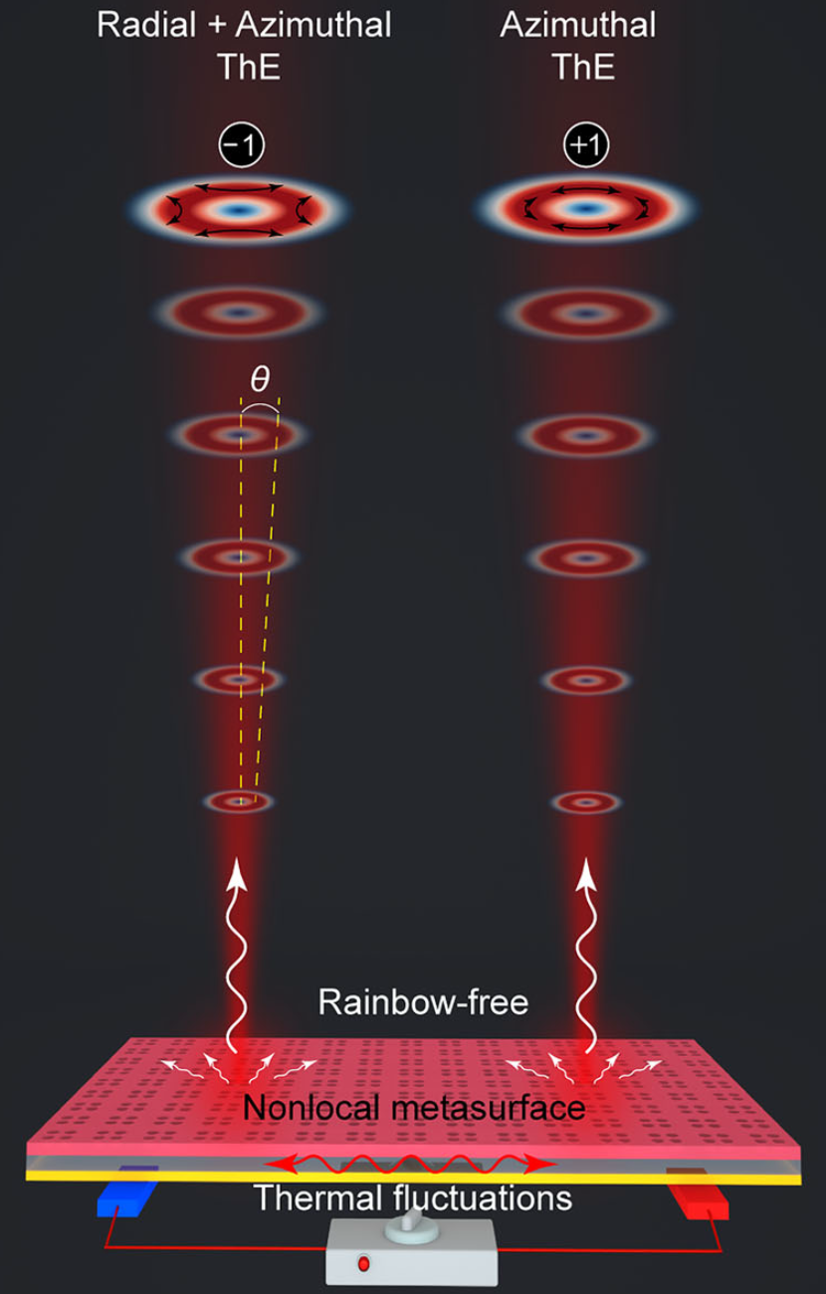
Their Method: Three-Pronged Non-Hermitian Engineering
Topological
Engineering
Band
Engineering
Brillouin zone folding
→ BICs with topological
charges −1 and +1
→ vectorial polarizations
Mode coupling via δ-tuning
→ exceptional points form
→ mini-flatbands emerge
→ flat dispersion
Dissipation
Engineering
EP-induced steep Q_{rad}(k)
→ critical coupling only at
small angles (~1.2°)
→ rainbow-free emission
All three mechanisms operate within a single Ge/ZnS/Au metasurface with a four-hole unit cell. No external optics, filters, or gain media required.

Slide 4
Device Structure and Supported Modes
Au Layer: supplies thermal emission that the rest of the MS confines, and provides absorption channel
Patterned Ge Layer: Takes the thermal emission and confines it through physics explained later. supports guided modes (GMs) that run laterally within Ge layer, while Fabry-Perot (FP) mode propagates vertically
ZnS Spacer: separates GMs in Ge layer from being absorbed by gold layer, and tunes the FP mode.

Slide 5
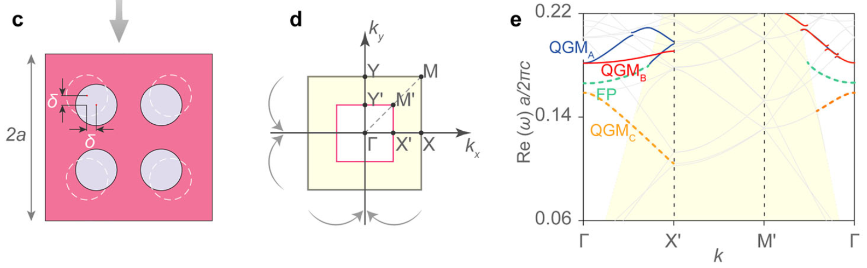
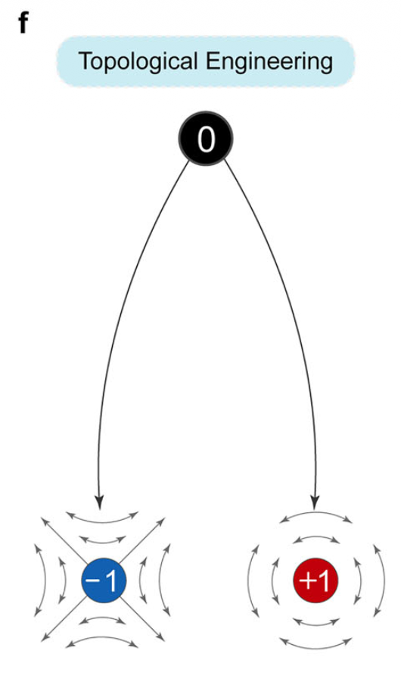
Topological Engineering: Brillouin Zone Folding
1. This mechanism makes the emission vectorially polarized
2. Introduce perturbation δ in hole positions, unit cell doubles (4 holes), FBZ shrinks
3. Guided modes fold above light cone, become quasi-guided modes (QGMs) that can radiate
4. C₄ᵥ symmetry → symmetry-protected BICs at Γ
5. Topological charge conservation: QGM_{A} (BIC_{A}): charge = −1, QGM_{B} (BIC_{B}): charge = +1

Slide 6
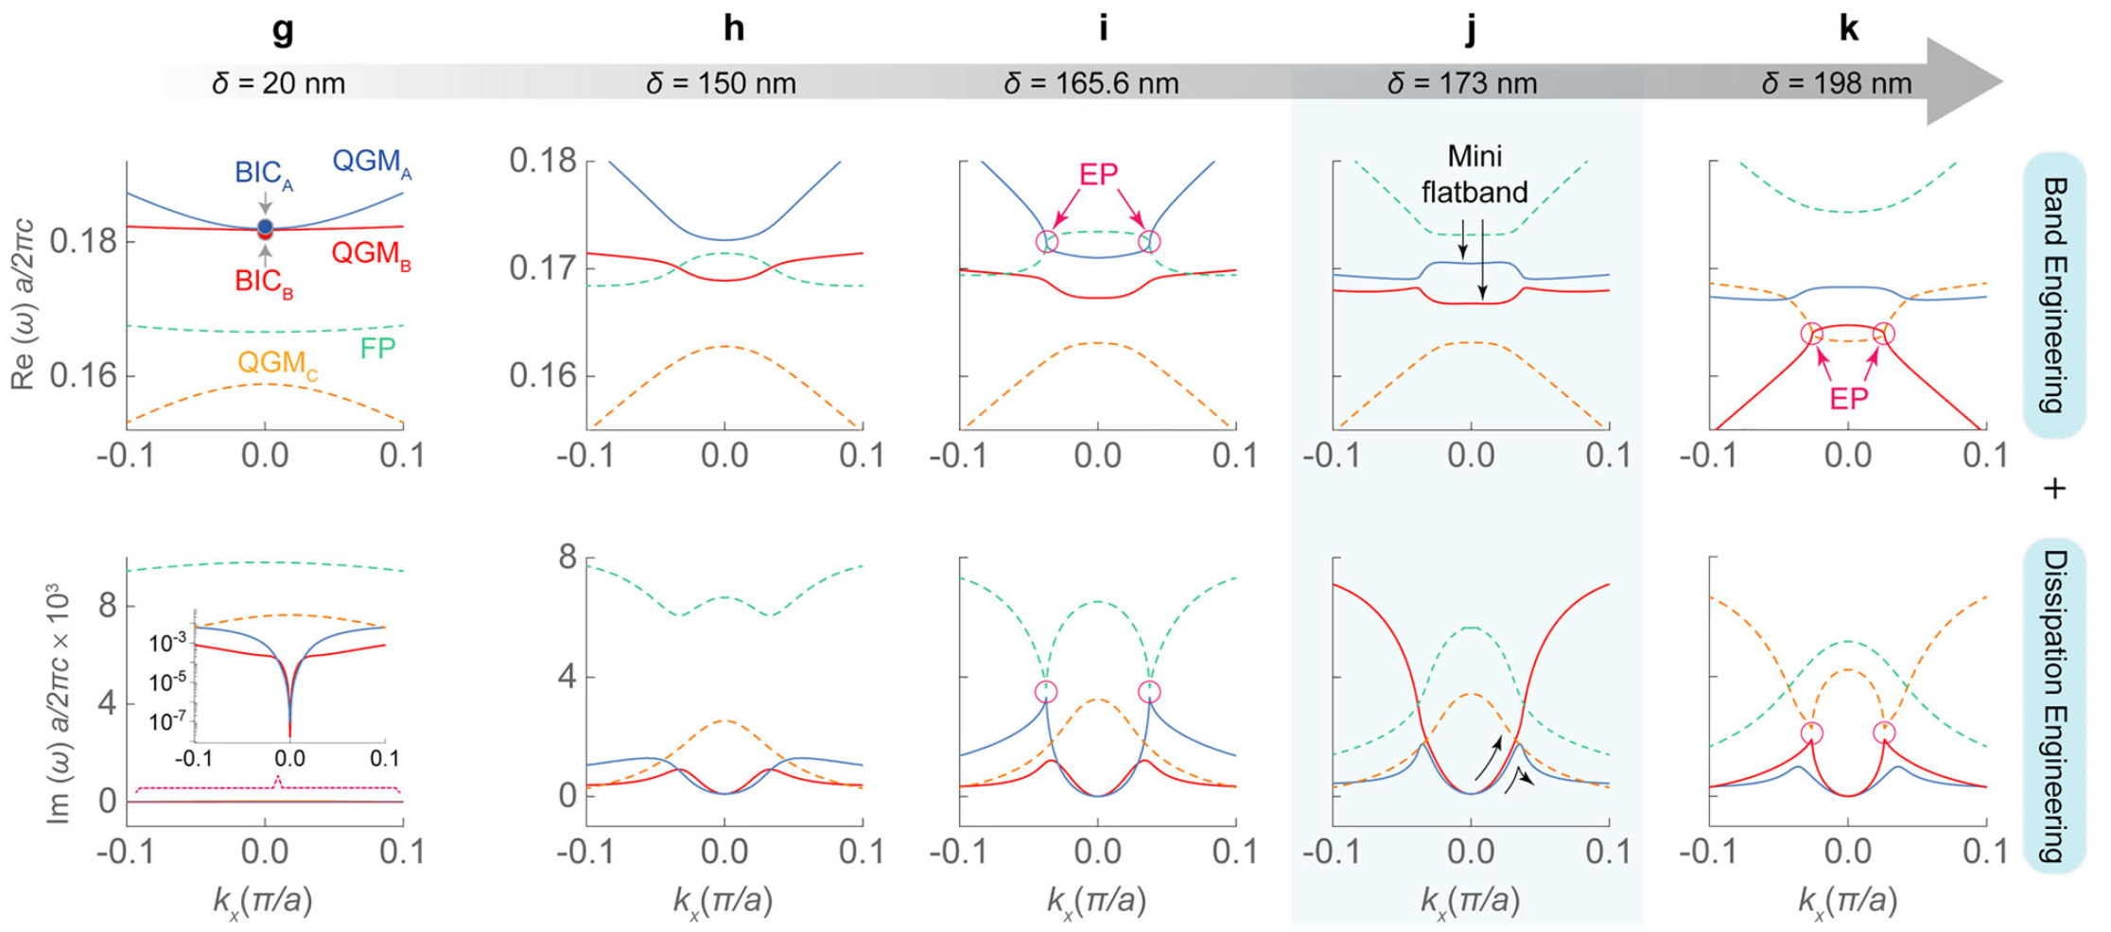
Band + Dissipation Engineering: δ-Tuning and Exceptional Points
4×4 Hamiltonian: QGM_{A}, QGM_{B}, QGM_{C}, FP. describes mode coupling. Simplifies to 2×2 near EPs.
Exceptional points: both real and imaginary parts of two eigenvalues coalesce → sharp features in between EPs
δ = 173 nm: two mini-flatbands emerge — nearly flat dispersion near Γ. imaginary part quickly rises and decays.
No gain required: all non-Hermitian behavior arises from radiative losses alone (open channels to free space).

Slide 7
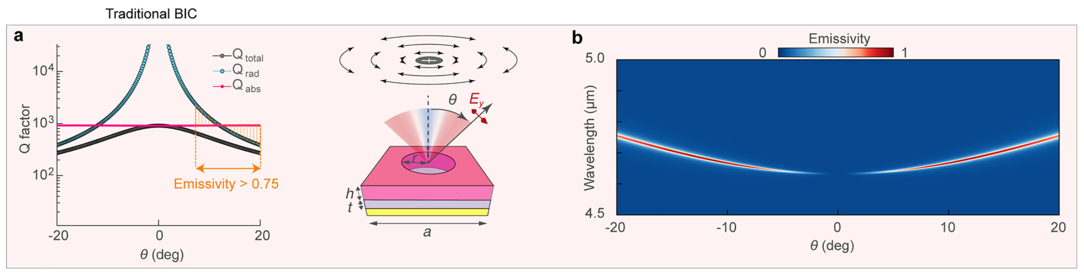
Thermal Emission of a Traditional BIC
Critical coupling condition: emissivity peaks (→ 1) when Q_{rad} ≈ Q_{abs}.
Conventional BIC: Q_rad ∝ k⁻² but transitions to weak k-dependence → critical coupling sustained over broad angles.

Slide 8
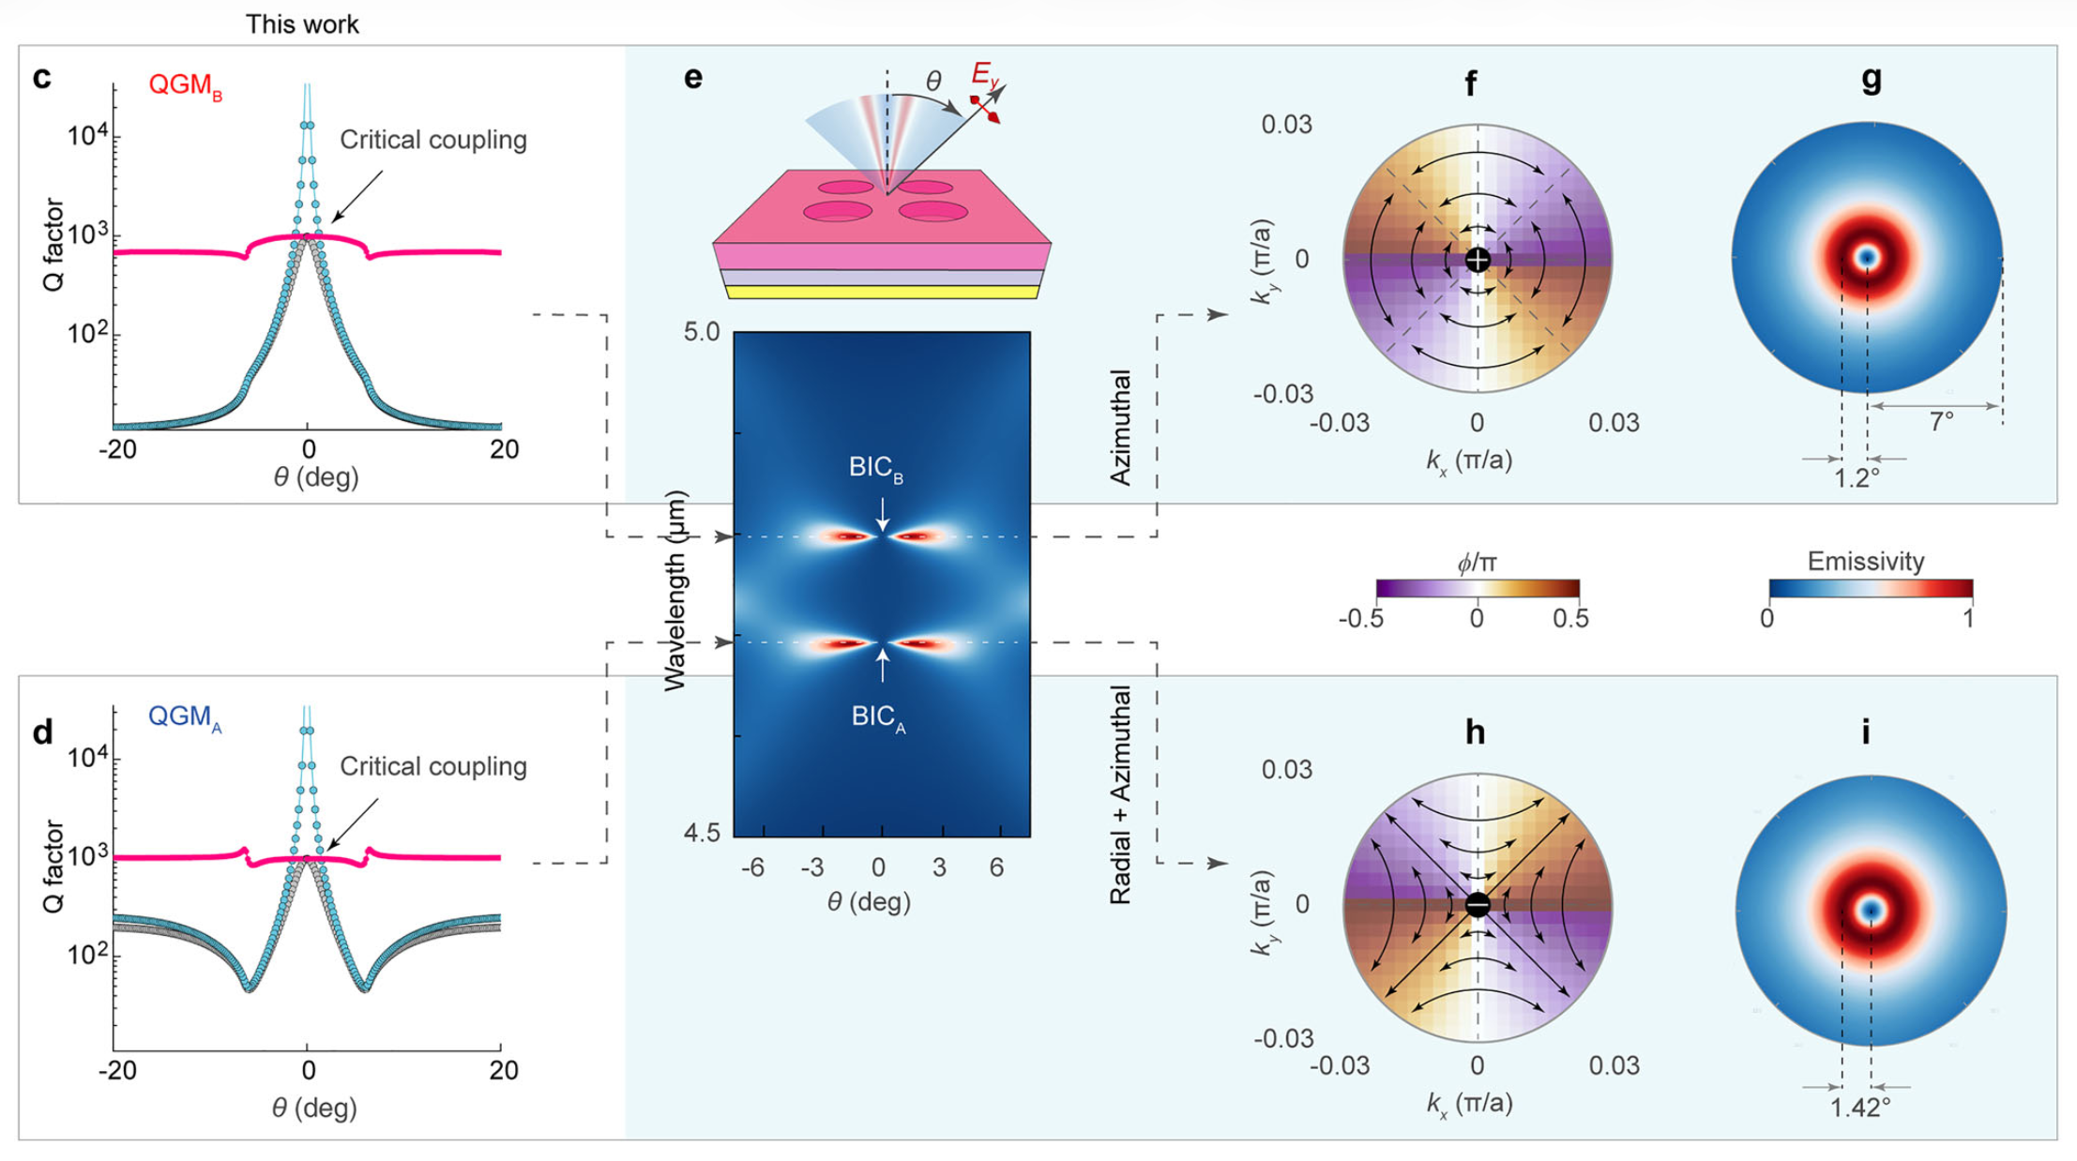
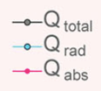
TE of their Structure: Two Mini-Flatbands
Because of EP, steep Q_{rad} variation keeps Q_{rad} highly sensitive even at the critical coupling point. ~10× reduction in emission angle. Beyond ~1.5°, Q_{rad} drops far below Q_{abs} → emissivity collapses.

Slide 9
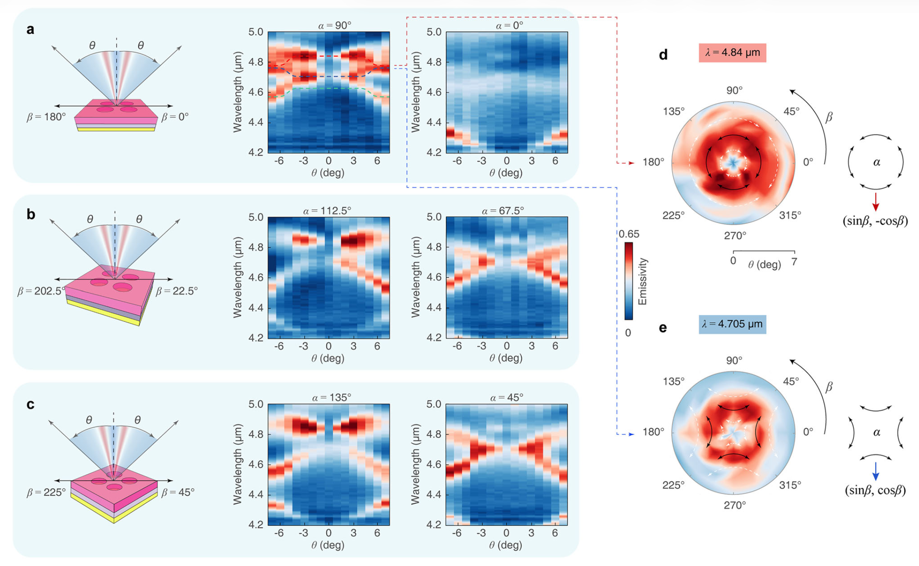
Experimental Validation

Slide 10
Summary
First coherent, vectorially polarized thermal emitter with strong directionality
Non-Hermitian engineering transforms broadband thermal noise → structured light, no laser required
Topological engineering: BZF gives BICs with charges −1 and +1 → vectorial polarization control
Band engineering: δ-tuning through EPs produces mini-flatbands → flat dispersion kills rainbow
Dissipation engineering: EP-induced steep Q_rad(k) → critical coupling at ~1.2° only → extreme directionality
Single device, two wavelengths, two distinct vectorial polarization states
Scalable to other wavelength regimes — general non-Hermitian platform for structured thermal radiation

