Slide 1
HUMS 138 Fall 2025
Project Presentation Template

Slide 2
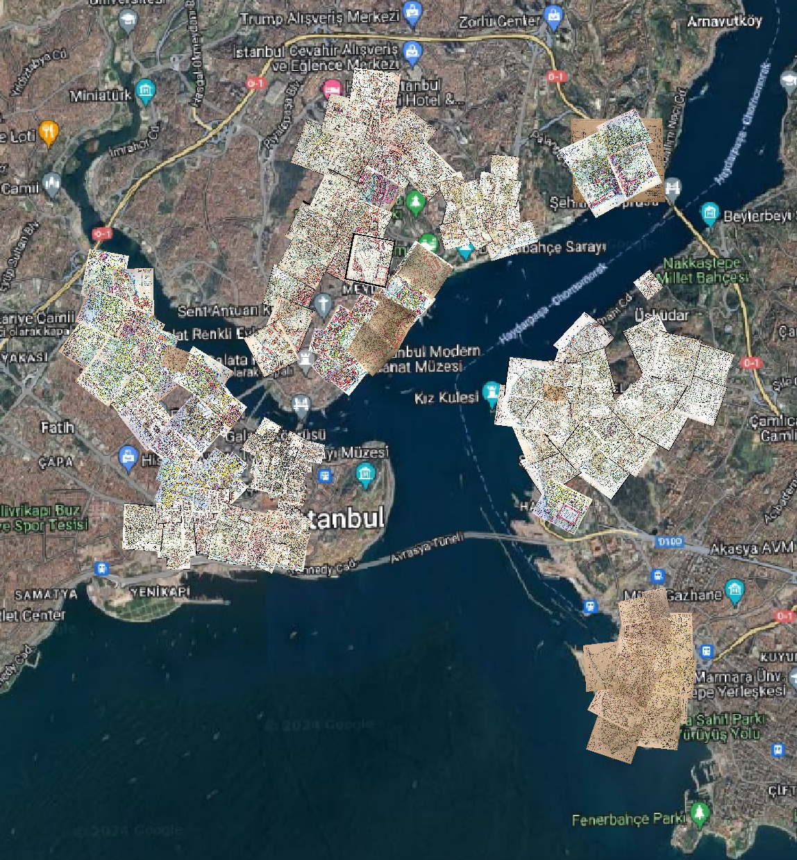
Pervititch Fire Insurance Maps

Slide 3
Presentation Outline - I
Chosen map sheet:
Date
Scale
Coverage
Urban profile of the chosen neighborhood in the time of the map making
Ethno-religious demographics
Public buildings
Public spaces
Infrastructure
Economic profile (1922-Annuaire Oriental, Oriental Directory. Commerce, industrie, administration, magisture: Addresses, 135-512; Professions, 516-762; Streets, 764-1067; Provinces, 1068-1379; Balkan Countries, 1380-1441; Foreigns, 1442-1449; Announcements, 1550-1569)

Slide 4
Presentation Outline - II
Chosen buildings on the map
Building 1 & 2
Function
Structure
Neighboring objects in the block
Chosen sheet / area through time (1946, 1966, 1970, 1982 and today: (https://harita.istanbul/) assessing the change in the building stock
Ethno-religious demographics
Public buildings
Public spaces
Infrastructure

Slide 5
Presentation Outline - III
Data extraction and Building Information Modeling (BIM) for 1920s/1930s
Provide the information extracted from the map using the legend in excel format (provide a screen shot of the excel file used in the power point and mail the excel file to mkabadayi@ku.edu.tr before presenting)
Footprint (LOD0/1)
Roof material (LOD2)
Architectural modelling, façade details (LOD3)
Buildings and Inhabitants Today
Street views

