Slide 1

HUMS · A PERVITITCH STUDY
Pervititch
OPEN THE LIVE 3D MODEL
1923 / 1938 · Block 147
From paper to digital city —
the story of one Kadıköy block and its century of transformation.
hums.ilkeryoru.com
scan with your phone — rotate the LOD3 model live
İlker Yörü
10 minutes · 10 slides · 1 city block
ilkeryoru.com
Kadıköy · İstanbul · 2026
Notes:
[45 seconds] Welcome. Please scan the QR on the right with your phone — it opens our live 3D model so you can rotate it while I talk. Keep it open during the whole talk. In the next ten minutes I'll do two things: walk you through turning a single 1923 fire-insurance map sheet — Block 147 in Kadıköy — into a structured LOD3 BIM, and tell you about the hundred-year transformation of the neighborhood around that block. The map is paper. The block is real. The model is live.

Slide 2
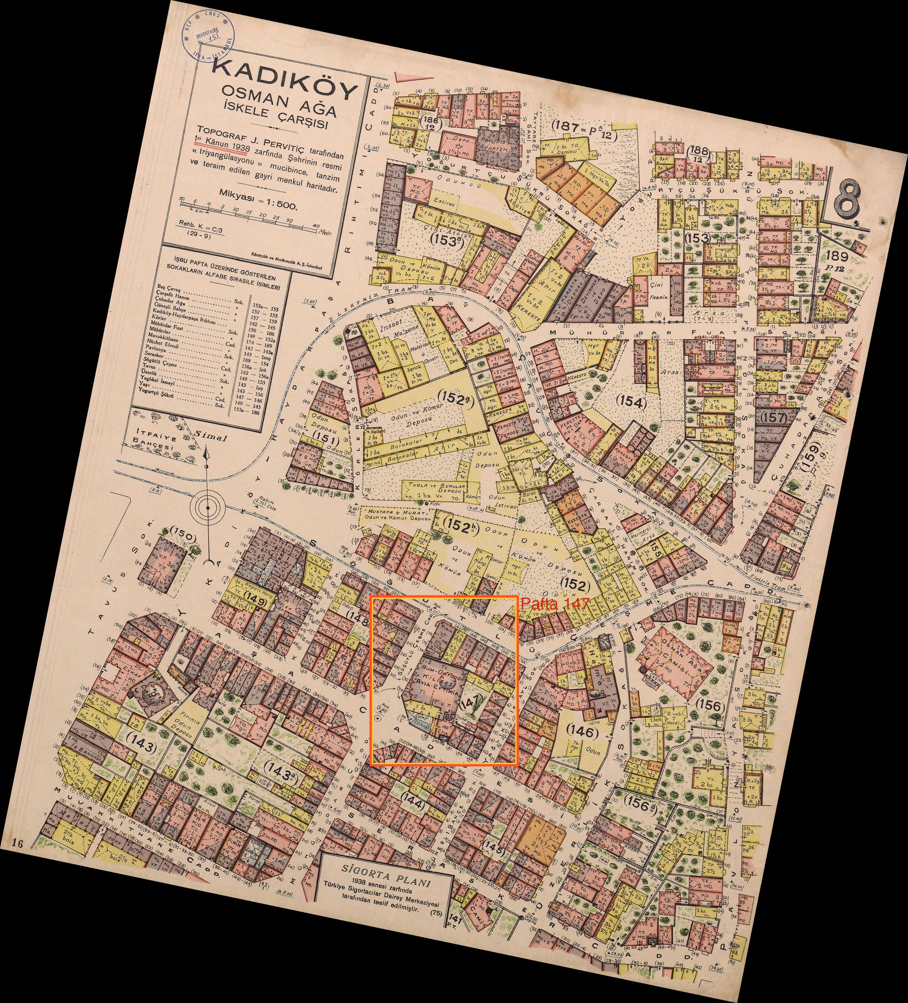
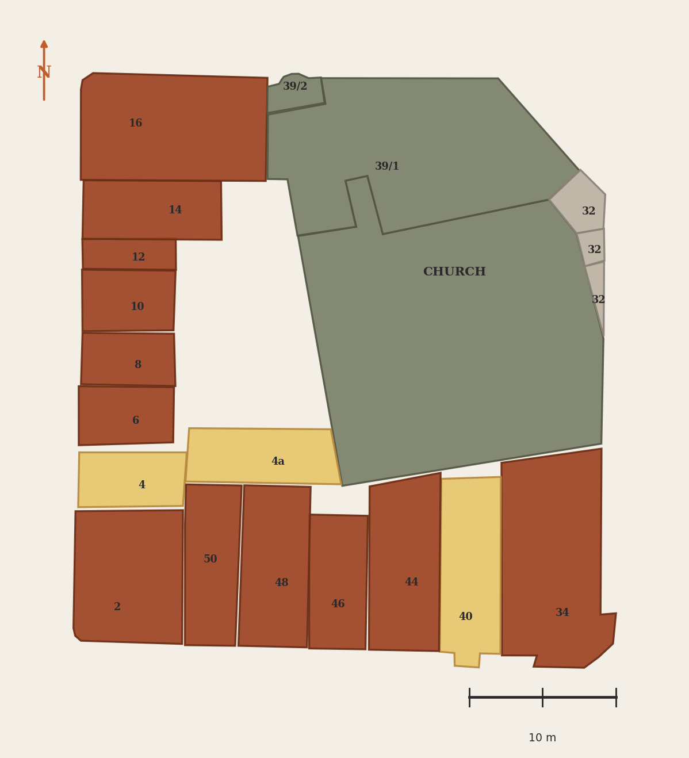
SLIDE 02 · THE ARCHIVE
A paper photograph of an era
Jacques Pervititch · Fire-insurance maps of İstanbul · 1922–1945
PER PARCEL
Wall material, storey count, vault type (V.F. / V.T.), openings, courtyard trees.
PURPOSE
WE EXTRACT
Risk classification for fire-insurance underwriters — every line is data, not aesthetics.
21 KML / 34 parcels
WHY IT MATTERS
The most detailed surviving record of early-Republican İstanbul — block by block.
FOR HUMS
Each parcel carries its own BIM seed: material, height, roof pitch, opening pattern.
1938 · Kadıköy 1:500 · plate 08 (SALT Research)
Block 147 · 21 KML footprints · LOD3 vector extract
21
34
321 m²
1,372 m²
KML footprints
parcels (LOD3)
church body
total block
HUMS · Block 147 · LOD3 BIM
Refs: R-A1 · R-A2 · R-J2 · R-J4
2 / 11
Notes:
[45 seconds] Jacques Pervititch was a Croatian-born fire-insurance cartographer who mapped İstanbul block by block from 1922 to 1945. His purpose wasn't aesthetic — every notation is risk classification. For each parcel he recorded the wall material, the storey count, the vault type, the openings, even the courtyard trees. We use the 1938 Kadıköy 1:500 sheet, plate eight, from SALT Research — that's the picture on the left. On the right you see the 21 KML footprints we extracted from it by hand, 34 parcels at LOD3: the church body and the fountain in olive green, the wooden parcels in amber, the masonry shops in brick red. That diagram is what bridges his paper to our digital model.

Slide 3
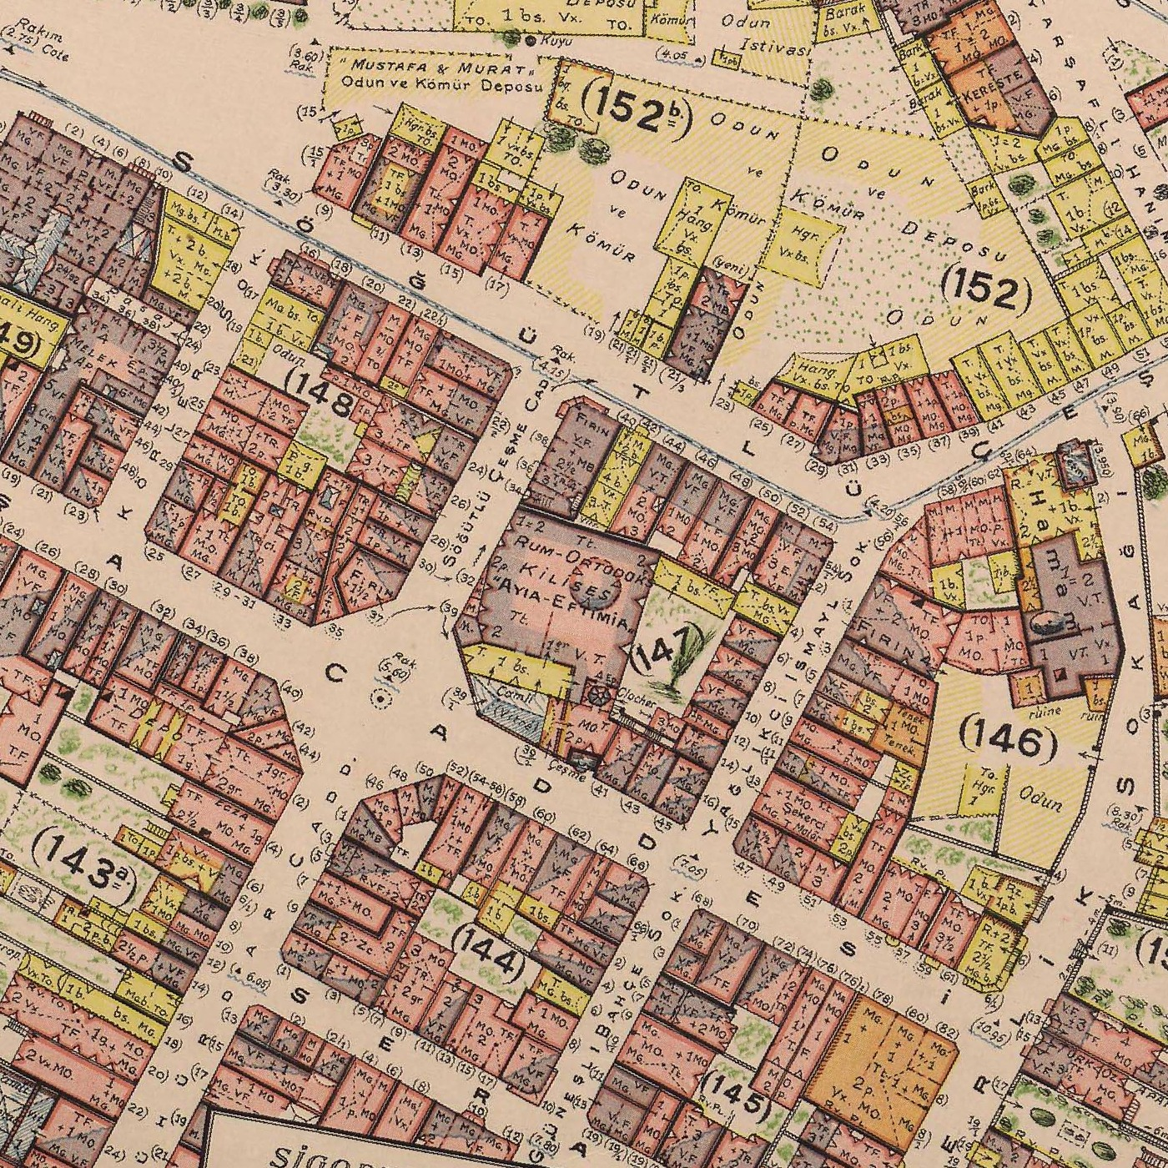
SLIDE 03 · THE BLOCK
Block 147 · The heart of Kadıköy Market
Osmanağa neighbourhood · today: Yasa Cd. × Mühürdar Cd.
46×52
1,372
34
21
metres
square metres
parcels modeled
KML footprints
Anchor
Hagia Euphemia Greek-Orthodox Church — building 1694, present form 1830
Pervititch street names
“Söğütlü Çeşme Cad.” (W) · “İsmail Sok.” (E) · italic French legend (V.F., V.T., Mg., Tt.)
Why this grid exists
14 Aug 1855 — Kadıköy fire burns ~400 buildings. In 1856 engineer Hasan Tahsin Efendi lays the Ottoman Empire’s first modern orthogonal plan over this exact ground. Mühürdar Cd. is its main axis.
The pages we use
1923 sheet (raw working file) and 1938 sheet (Kadıköy 1:500 · plate 08 · SALT Research).
1938 · Block 147 with neighbours (143–148)
HUMS · Block 147 · LOD3 BIM
Refs: R-A1 · R-A2 · R-B1 · R-D1 · R-D3
3 / 11
Notes:
[75 seconds] Block 147 sits in the heart of Kadıköy Market — Osmanağa neighborhood, on today's Yasa and Mühürdar streets. In Pervititch's vocabulary the west street is Söğütlü Çeşme Caddesi, the east is İsmail Sokak. Forty-six by fifty-two meters, thirteen hundred seventy-two square meters, thirty-four parcels modeled, twenty-one KML footprints. The anchor is the Hagia Euphemia Greek-Orthodox Church — original 1694, present form 1830. But there is a deeper layer here. This grid plan exists because of the 1855 Kadıköy fire. On August fourteenth, 1855, four hundred buildings burned. In 1856 the engineer Hasan Tahsin Efendi drew the Ottoman Empire's first modern orthogonal city plan over this exact ground. Mühürdar Caddesi is its main axis. So when we look at this block, we're looking at a piece of urban-planning history that's a hundred and seventy years old — and Pervititch caught it seventy years into its life.

Slide 4
SLIDE 04 · HERO
Transformation · 100 years around one block
Three scales · İstanbul / Kadıköy · the market · Block 147 — 1925 → 2026
Greek-Orthodox
population
≈ 100,000
6–7 September
Istanbul pogrom
4,214 homes · 73 churches
Condominium Law
→ apartmentisation
Greek-Orthodox
pop. ≈ 2,500
(2.5% of 1925)
HUMS · Block 147
LOD3 BIM live
1925
1942
1955
1964
1965
1973
2006
2022
2026
Wealth Tax
(Varlık Vergisi)
≈ 12,000 Greek
citizens deported
1st Bosphorus Bridge
→ construction boom
Heritage Board
Decision 9900
87 ha Urban Site
İSTANBUL / KADIKÖY the city-level forces
KADIKÖY ÇARŞI around the block
BLOCK 147 inside the parcel
−97.5%
İstanbul Greek-Orthodox population · 1925 → 2006
1856
Empire's first orthogonal grid plan · Hasan Tahsin Efendi
1,372 m²
block area · 46 × 52 m · 34 parcels modeled
73 / 73
Greek-Orthodox churches damaged in 1955 pogrom
1.5 → 4
average storeys: 1923 (timber) → today (concrete)
≈ 85 %
individually registered immovable cultural property
12,000
Greek citizens deported overnight · 1964
87 ha
Urban Heritage Site · Decision 9900 · 28 Sept 2022
4 · 100+
centenarian institutions still trading: church + 3 brands
HUMS · Block 147 · LOD3 BIM
Refs: R-E1 · R-F1 · R-F2 · R-G1 · R-G3 · R-H1 · R-I1
4 / 11
Notes:
[135 seconds — this is the hero slide, take your time] Today's Kadıköy is not Pervititch's Kadıköy. Read this slide at three scales — the city, the market around the block, and the block itself. SCALE 1 — İSTANBUL / KADIKÖY. After Lausanne in 1925, Anatolian Greeks were exchanged but İstanbul Greeks were exempted; about one hundred thousand lived in the city, and Kadıköy was one of their dense districts. Then the chain begins. The 1942 Wealth Tax struck non-Muslim commerce hard. September sixth and seventh, 1955: looting and arson sweep Beyoğlu, Şişli, Nişantaşı, Kadıköy, Kuzguncuk, Ortaköy, and the Princes' Islands. Four thousand two hundred fourteen homes, one thousand businesses, and all seventy-three Greek-Orthodox churches in İstanbul damaged. In 1964, twelve thousand Greek citizens deported overnight. By 2006 the İstanbul Greek population had fallen to two thousand five hundred — minus ninety-seven and a half percent. SCALE 2 — KADIKÖY ÇARŞI, AROUND THE BLOCK. This whole market exists because of the 1855 Kadıköy fire — four hundred buildings burned, and in 1856 the engineer Hasan Tahsin Efendi laid the Empire's first orthogonal grid plan over this exact ground. Mühürdar Caddesi is its main axis. After the 1965 Condominium Law, the average building goes from about one and a half storeys of timber to four storeys of concrete. In 2022, Decision number nine thousand nine hundred declares eighty-seven hectares of this market an Urban Heritage Site and a third-degree archaeological site. SCALE 3 — INSIDE BLOCK 147 ITSELF. The block is thirteen hundred and seventy-two square meters. Thirty-four parcels modeled at LOD3 from twenty-one KML footprints. About eighty-five percent of the parcels are individually registered cultural property on the harita.istanbul layer. And four centenarian institutions still trade inside this single block: the church and three brands — Beyaz Fırın, Akveren, Mehmet Efendi — all over a hundred years old. So when we model Block 147 in LOD3 BIM, we record three things in one: the city's loss, the market's plan, and the block's stubborn survival.

Slide 5
SLIDE 05 · MEMORY INVENTORY
What survived · What was lost
One block · 1,372 m² · 100 years
SURVIVED
LOST / CHANGED
Hagia Euphemia Church
×
Yellow (wooden) parcels
1694 / 1830 · still active
Class C timber shops: (40), (42), (4)+(4a), (39)
Beyaz Fırın
×
19th-c. shop-house typology
founded 1920 · 5th generation
small ground-floor magasins with V.T. vaults
Akveren Pasta
×
Greek-Orthodox neighbours
founded 1925 · 4th generation
Pervititch-era Rum population evaporated
Kurukahveci Mehmet Efendi
×
Greek-script signage
brand 1871 · Kadıköy branch
shop fronts re-lettered post-1955
Çeşme (fountain)
×
Pervititch street names
parcel 39/2 · in place
“Söğütlü Çeşme Cd.” → Yasa Cd. · “T…L Sok.” → Söğütlüçeşme Cd.
The 1856 grid plan
×
Inner-yard timber & cumbas
Hasan Tahsin Efendi’s axis
wooden cantilevers and (4a) inner-court galleries gone
HUMS · Block 147 · LOD3 BIM
Refs: R-B1 · R-C1–C9 · R-D2 · R-H2
5 / 11
Notes:
[75 seconds] What survives in a block? In Block 147 the list is clear. The church — since 1694, through three fires and one restoration — still standing. The Söğütlüçeşme fountain — in place at parcel 39/2. The Beyaz Fırın bakery, opened in 1920 on the northwest corner. Akveren pasta from 1925. The Kadıköy branch of Kurukahveci Mehmet Efendi, whose parent brand goes back to 1871. All three businesses still operating within a thirty-meter stretch. And the 1856 grid plan itself — that's a survivor too. What was lost: hundreds of square meters of timber shop-houses Pervititch colored yellow; the Greek-Orthodox neighbors; Greek-script signage; the original street names — Söğütlü Çeşme Caddesi is now Yasa, and the older T-something Sokak is now Söğütlüçeşme. The fountain's name traveled while the street that carried it changed. And the inner-yard timber elements — the wooden cantilevers and the inner-courtyard galleries — are gone.

Slide 6
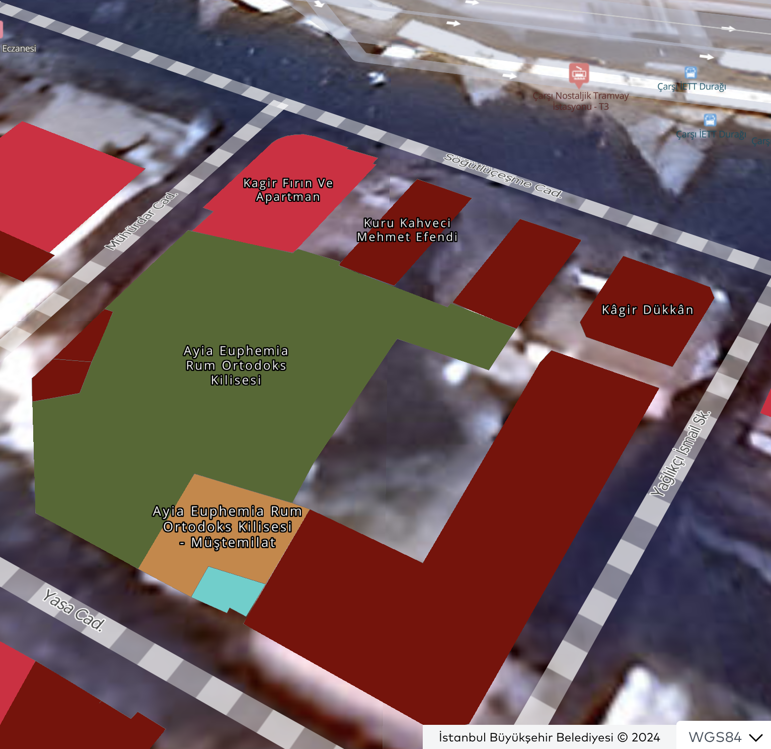
SLIDE 06 · THE REGISTER
The heritage register confirms it
İBB · harita.istanbul · cultural-heritage layer · 2024
LEGEND · WHAT THE COLOURS MEAN
Hagia Euphemia · church body
olive green
Hagia Euphemia · müştemilat (annex)
amber
Çeşme (fountain) · parcel 39/2
cyan
Registered masonry buildings (Kâgir)
brick red
≈ 85 %
of Block 147 is individually registered as immovable cultural property — not just inside the 2022 urban-site perimeter.
By name
the register lists “Kâgir Fırın Ve Apartman” (Beyaz Fırın block) and “Kuru Kahveci Mehmet Efendi” explicitly.
Annex too
the church müştemilat is registered separately — a level of granularity the 1923 Pervititch sheet already anticipated with its “Enclos” notation.
Block 147 · centroid 40.99077 N · 29.02521 E · harita.istanbul layer k123 · © İBB 2024
HUMS · Block 147 · LOD3 BIM
Refs: R-I1 · R-I2
6 / 11
Notes:
[60 seconds] Here is the official confirmation. This is the İstanbul Metropolitan Municipality's heritage layer at harita.istanbul, centered exactly on Block 147. The colored polygons are individually registered cultural property — not just inside the urban-site perimeter, but on the immovable-cultural-property register by name. The olive-green polygon is the church body. The amber polygon south of it is its müştemilat — the annex — registered separately. The cyan parcel is the fountain. And the brick-red polygons are registered masonry buildings, including, by name, 'Kâgir Fırın ve Apartman' — the Beyaz Fırın block — and 'Kuru Kahveci Mehmet Efendi.' About eighty-five percent of the block is individually protected. The 1923 Pervititch sheet already anticipated this granularity, with its 'Enclos' notation around the church yard.

Slide 7
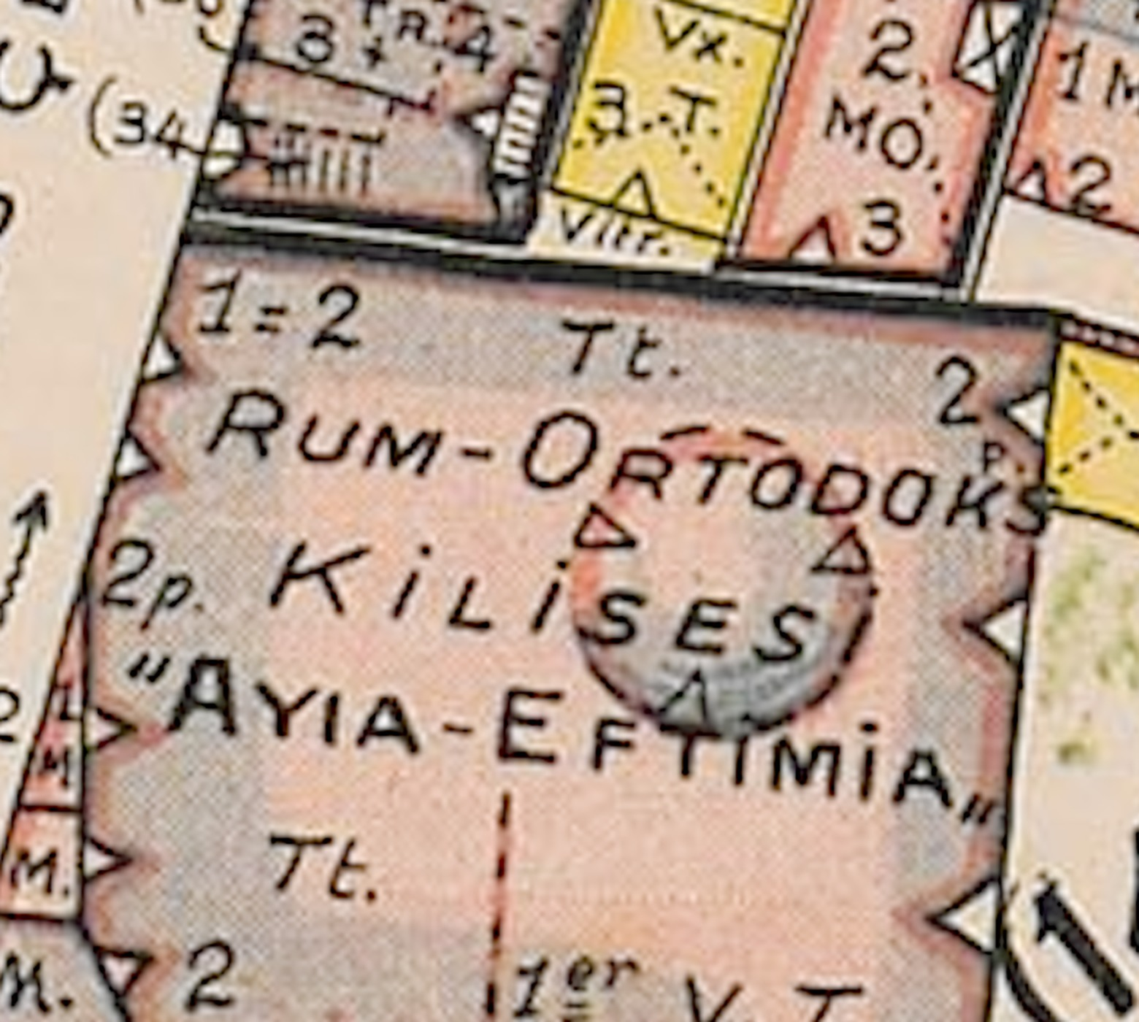
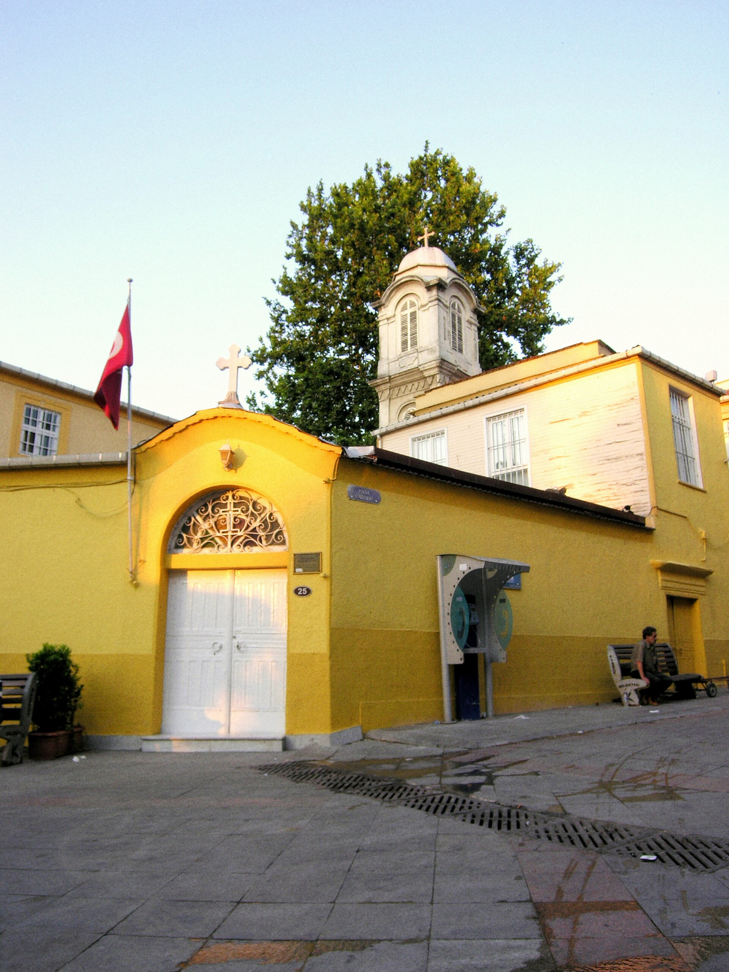
SLIDE 07 · SURVIVOR #1
Hagia Euphemia · the martyr of Chalcedon
Greek-Orthodox Church · 1694 / 1830 · re-opened 1 April 1993
Building biography
451
Council of Chalcedon — Khalkedon = Kadıköy. The saint of this city.
1694
Metropolitan Gabriel rebuilds the church on the site of a Byzantine monastery.
1830
Metropolitan Zacharias II enlarges it with Russian-collected donations — present form.
1955
All 73 Greek-Orthodox churches in İstanbul damaged during the 6–7 September pogrom.
1 Apr 1993
Metropolitan Joachim III restoration · re-consecration.
1923 · Pervititch · church footprint · “Enclos” saw-toothed wall, central dome, Clocher
PERVITITCH CODES ON THIS PARCEL
today · saffron courtyard wall, white gate · CC-BY-SA · Wikimedia Commons
Tt. tiled roof · 1=2 full-height nave · 2p two partial floors · 1er V.T. Turkish vault · central dome · Enclos saw-toothed yard wall.
HUMS · Block 147 · LOD3 BIM
Refs: R-B1 · R-B2 · R-B3 · R-F1
7 / 11
Notes:
[75 seconds] The church's name is not accidental. Euphemia is Chalcedon's own martyr — Khalkedon is the Greek name of Kadıköy. The 451 Council of Chalcedon, one of the great crossroads of Christian theology, was held in this very city. The church is its symbolic seal. The story is short. After a Byzantine monastery on the site fell, Metropolitan Gabriel rebuilt the church in 1694. In 1830 Metropolitan Zacharias the Second enlarged it with donations collected from Russia — and what you see today is from that phase: brick body, tile roof, a high drumed central dome carried by four pier-pilasters, with three small arched glazed openings on the drum. In 1955, like all seventy-three Greek-Orthodox churches in İstanbul, it was damaged during the pogrom. On April first, 1993, Metropolitan Joachim the Third reconsecrated it. Pervititch's notation on the parcel — Tt for tile roof, V.T. for Turkish vault, the dome symbol, the saw-toothed 'Enclos' yard wall — describes the building accurately. Our LOD3 model is built directly to those codes.

Slide 8
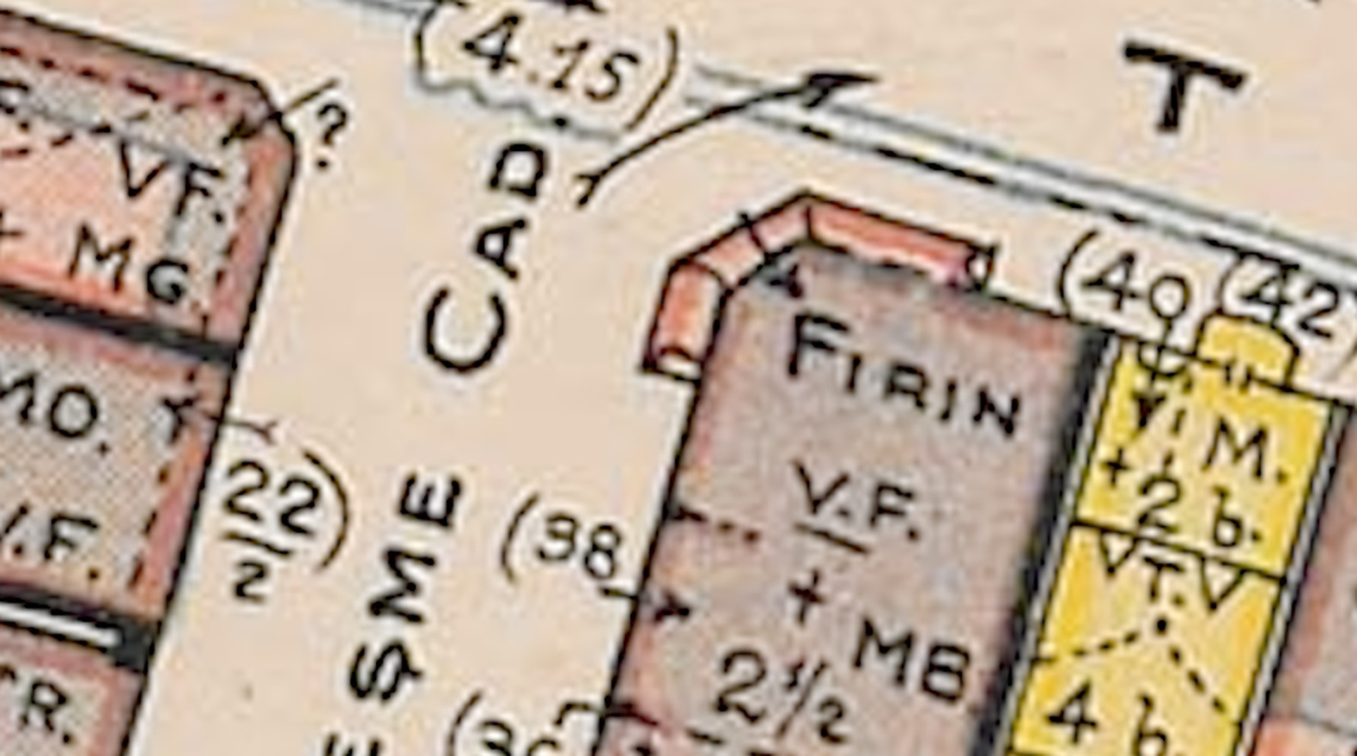
SLIDE 08 · SURVIVOR #2
One corner · three brands · 100+ years
Pervititch records a single FİRİN — today three institutions still trade there
1920
Beyaz Fırın
Stoyanof family · Bulgarian-Macedonian Orthodox · 5th generation
On the map: westernmost magasin on the W façade (~10 m²)
Today: Yasa Cd. 23, Osmanağa Mh., Kadıköy [R-C1 · R-C2 · R-C4]
1925
Akveren Makarna
founded by Mehmet Coşkunsu · 4th generation in same building
On the map: parcel (40)/(42) north façade — under the large FİRİN label
Today: Söğütlüçeşme Cd. 12/1 [R-C5]
Pervititch 1923 · NW corner · parcel (40) “FİRİN”, parcels (34)(36) “Fırın”
1871
Kurukahveci Mehmet Efendi
STREET-NAME MIGRATION
brand opened in Eminönü Spice Bazaar · Kadıköy branch after 1934
“Söğütlü Çeşme Cad.” → Yasa Cd.
“T…L Sok.” → Söğütlüçeşme Cd.
On the map: next-door north façade · post-Republic expansion store
Today: Söğütlüçeşme Cd. 12/1, 40.990911 N · 29.025160 E [R-C6 · R-C7 · R-C9]
HUMS · Block 147 · LOD3 BIM
Refs: R-C1 · R-C2 · R-C4 · R-C5 · R-C6 · R-C7 · R-C9 · R-I2
8 / 11
Notes:
[90 seconds] Now zoom into the block's northwest corner. Pervititch labels parcel forty in large letters: 'FIRIN' — fire oven. Parcels thirty-four and thirty-six also carry a 'fırın' note. Three small magasins hug the western wall. To Pervititch's risk-classification eye, they're all the same type — fire ovens. Today on that exact spot three separate historic brands operate. Beyaz Fırın — opened in 1920 by the Bulgarian-Macedonian Orthodox Stoyanof family. Fifth generation now, Yasa Caddesi number twenty-three, on the location of the largest western-wall magasin. Just five years later, in 1925, Mehmet Coşkunsu opened Akveren pasta on the same corner — north façade, still fourth generation, still the same building. And third: Kurukahveci Mehmet Efendi, the iconic Turkish coffee brand founded in 1871 in the Eminönü Spice Bazaar, opened its Kadıköy branch next door to Akveren. So in this thirteen-hundred-seventy-two square-meter block: a Greek-Orthodox church, a Bulgarian-Orthodox bakery, a Turkish-Muslim pasta maker, and a nineteenth-century Turkish coffee roaster — all next to each other. A hundred years of an unbroken food-and-faith spine. This is what 'transformation' looks like on the side that resists.

Slide 9
SLIDE 09 · METHOD
From paper to LOD3 BIM
A reproducible pipeline · one block today, one atlas tomorrow
STAGE 1
STAGE 2
STAGE 3
STAGE 4
STAGE 5
1938 Pervititch
21 KML
buildings.json
block147.glb
IFC
raster (TIF)
georeferenced
footprints
1,372 m² block
34 parcels · LOD3
material + vault
model-viewer
WebGL · CC-BY
BIM downstream
interop
LOD3 means
Block 147 is a lab
Open on your phone
every façade, opening, vault, roof pitch is its own mesh element — not a textured box.
the same workflow scales to every Pervititch plate — and to other cities.
hums.ilkeryoru.com · WebGL model-viewer · annotated parcel data sheets.
HUMS · Block 147 · LOD3 BIM
Refs: R-J1 · R-J2 · R-J3 · R-A2
9 / 11
Notes:
[45 seconds] The data pipeline is short. We start with the 1938 Pervititch raster — georeferenced TIFF. We overlay twenty-one KML polygons of the actual building footprints. Then per parcel we encode Pervititch's material and storey codes into a buildings.json — thirty-four parcels at LOD3. We export to glTF for the web viewer, and to IFC for downstream BIM work. LOD3 means: not a textured box per building — every façade, opening, vault, and roof pitch is its own mesh element. Block 147 is a laboratory. The same method scales to every Pervititch plate — and to other cities.

Slide 10
THANK YOU
TAKE IT WITH YOU
hums.ilkeryoru.com
Rotate the model on your phone · open the parcel data sheets · ask questions.
İlker Yörü · ilkeryoru.com · Kadıköy · İstanbul · 2026
Notes:
[15 seconds] Keep rotating the model on your phone — you can also open the parcel data sheets from the viewer. I'm here for questions. Thank you.

Slide 11
SLIDE 11 · SOURCES
Sources & References
APA 7th edition · hanging-indent convention
A · Pervititch & HUMS
B · Hagia Euphemia Church
C · Living brands (1871–1925)
[R-A1] SALT Research. (1938). Pervititch sigorta haritaları: Kadıköy 1:500, plate 08 [Map]. https://archives.saltresearch.org/
[R-B1] İstanbul Ansiklopedisi. (n.d.). Ayia Efimia Rum Ortodoks Kilisesi. In İstanbul Ansiklopedisi. https://istanbulansiklopedisi.org/handle/rek/5128
[R-C1] Beyaz Fırın. (n.d.). Hikâye. https://beyazfirin.com/beyazfirin-hikaye
[R-A2] Yörü, İ. (2026). HUMS — Block 147 LOD3 dataset [Dataset]. GitHub. https://github.com/1lker/hums-project
[R-B2] Tarihi İstanbul. (n.d.). Ayia Efimia Rum Ortodoks Kilisesi. https://tarihi.ist/ayia-efimia-rum-ortodoks-kilisesi/
[R-C5] Akveren. (n.d.). Tarihçe. https://akveren.com
[R-J4] Büktel, E. (n.d.). 1922 öncesinde Jacques Pervititch. Toplumsal Tarih Akademi. https://dergipark.org.tr/
[R-B3] Wikimedia Commons. (n.d.). Saint Euphemia Greek Orthodox Church in Kadıköy [Image collection]. https://commons.wikimedia.org/
[R-C6] Kurukahveci Mehmet Efendi. (n.d.). Tarihçe — Marka dönemi. https://mehmetefendi.com/
D · Kadıköy urban history
E–G · Demography & politics
I–J · Site status & HUMS
[R-D1] Erkan, P. (n.d.). 1855 Kadıköy yangını ve ilk ızgara plan uygulaması. Gazete Kadıköy. https://gazetekadikoy.com.tr/
[R-E1] Wikipedia contributors. (2024). Varlık Vergisi. In Wikipedia. https://tr.wikipedia.org/wiki/Varlık_Vergisi
[R-I1] İstanbul Büyükşehir Belediyesi Şehir Planlama Müd. (2022). Kadıköy Merkez sit alanı: Karar 9900 (28 Eylül 2022). https://sehirplanlama.ibb.istanbul/
[R-D4] Kadıköy Kaymakamlığı. (n.d.). Geçmişin modern mimarisi: Kadıköy. https://kadikoy.gov.tr/
[R-F1] Wikipedia contributors. (2024). 6–7 Eylül olayları. In Wikipedia. https://tr.wikipedia.org/wiki/6-7_Eylül_Olayları
[R-I2] İstanbul Büyükşehir Belediyesi. (2024). Harita.istanbul — Cultural heritage layer [GIS data]. https://harita.istanbul/2d/layer/k123
[R-D5] Arkitera. (n.d.). Geçmişin modern mimarisi — 1: Kadıköy. https://arkitera.com/
[R-F2] İnsan Hakları Derneği. (n.d.). 6–7 Eylül 1955: Yalnızca bir devlet operasyonu mu? https://ihd.org.tr/
[R-J1] Yörü, İ. (2026). HUMS Block 147 LOD3 viewer [Web application]. https://hums.ilkeryoru.com
HUMS · Block 147 · LOD3 BIM
Refs: Full reference list — see §6 of the prompt package
11 / 11
Notes:
[reference slide — show during Q&A if asked] Full reference list — every claim today is tied to a code on this slide. Pervititch raster from SALT Research. Hagia Euphemia from the İstanbul Encyclopedia and Wikimedia Commons. Brand histories from the brands' own websites. Demographic and political history from Wikipedia and the Human Rights Association. Heritage register from harita.istanbul. HUMS dataset from our GitHub. Everything is linkable.

