Slide 1

Note: The data and information in this document is reflective of a hypothetical situation and client. This document is to be used for KPMG Virtual Internship purposes only.
Sprocket Central Pty Ltd
Data analytics approach
[Division Name] - [Engagement Manager], [Senior Consultant], [Junior Consultant]

Slide 2
Note: The data and information in this document is reflective of a hypothetical situation and client. This document is to be used for KPMG Virtual Internship purposes only.
Agenda
Introduction
Data Exploration
Model Development
Interpretation

Slide 3
Note: The data and information in this document is reflective of a hypothetical situation and client. This document is to be used for KPMG Virtual Internship purposes only.
Introduction
Targeting the top customers from the Dataset
Outline
Sprocket is a bike retail company that specializes in high quality bikes and cycling accessories.
Their marketing team is looking to boost their business by analyzing the dataset.
The three datasets provided gives us an insight to the top customers which drive the company value.
Content of data analysis
New and Old customer age distributions.
Bike retail purchases from the last 3 years by gender.
Job industry distributions
Wealth segmentation by age category
Number of cars owned by state
RFM analysis and customer classification

Slide 4
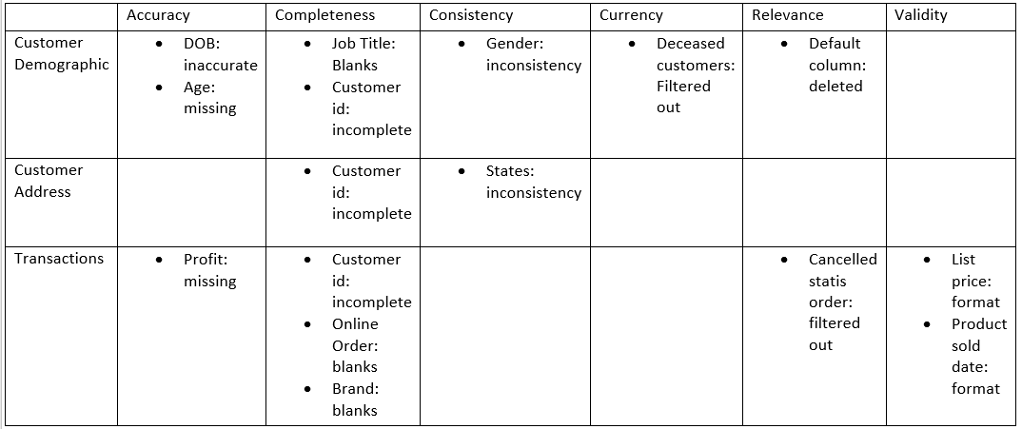
Note: The data and information in this document is reflective of a hypothetical situation and client. This document is to be used for KPMG Virtual Internship purposes only.
Data Exploration
Data quality assessment and Clean up
Issues with data quality assessment
Accuracy: Correct Values
Completeness: Data fields with values
Consistency: Values free from contradiction
Currency: Values up-to-date
Relevancy: Data items with value Meta-data
Validity: Data containing allowable values
Uniqueness: Duplication of records
Place any supporting images, graphs, data or extra text here.

Slide 5
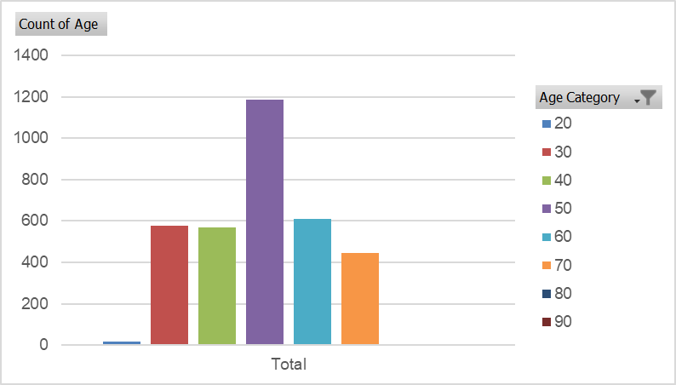
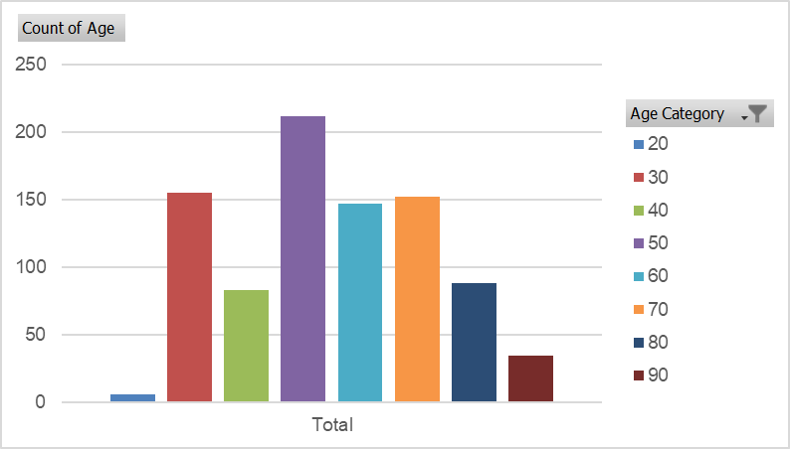
Note: The data and information in this document is reflective of a hypothetical situation and client. This document is to be used for KPMG Virtual Internship purposes only.
Data Exploration
New and Old customer
age distributions by age category
The first graph indicates new and second graphs indicates old.
In both, customers aged 40-49 are in majority.
The lowest amount of purchases are by customers below age 20
The old customer list suggests age group of 20-69
The new customer list suggests age group of 20-29 and 40-49.
There is a drop of customers in age group 30-39 in new.
Place any supporting images, graphs, data or extra text here.

Slide 6
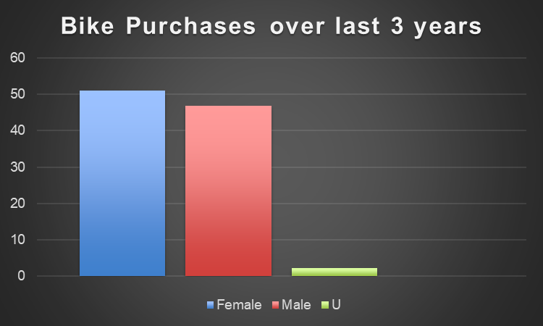
Note: The data and information in this document is reflective of a hypothetical situation and client. This document is to be used for KPMG Virtual Internship purposes only.
Data Exploration
Percentage of bike purchases
over the last three years
Over the last 3 years 50% of the purchases were made by females and 48% were made by men and rest by unknown gender.
Females make up majority of the bike purchases.
Place any supporting images, graphs, data or extra text here.

Slide 7
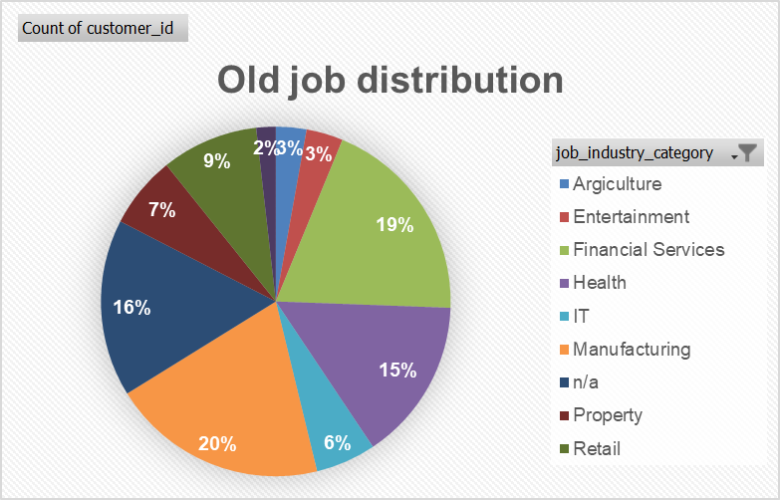
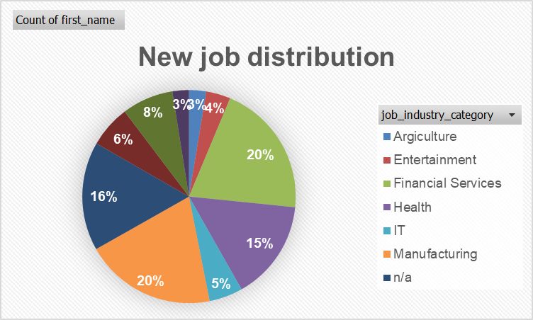
Note: The data and information in this document is reflective of a hypothetical situation and client. This document is to be used for KPMG Virtual Internship purposes only.
Data Exploration
Job industry distribution
20% of the new customers are in Manufacturing and Financial services.
The lowest amount of customers are in Agriculture and Health industry.
Place any supporting images, graphs, data or extra text here.

Slide 8
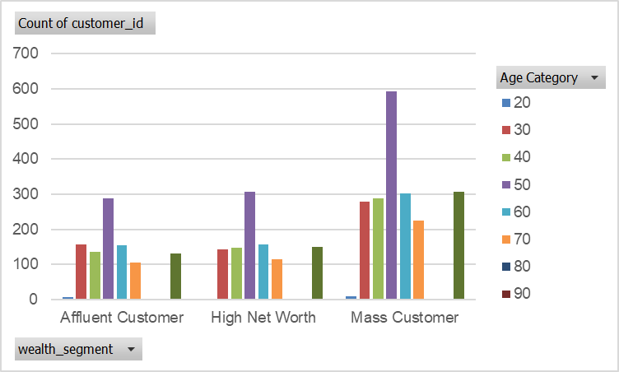
Note: The data and information in this document is reflective of a hypothetical situation and client. This document is to be used for KPMG Virtual Internship purposes only.
Data Exploration
Wealth segmentation by age category
In all age categories the largest number of customers are classified as “mass customers”.
The next category is the “High net worth customers”.
The “Affluent customers” can outperform the “High net worth” customer in 40-49 range.
Place any supporting images, graphs, data or extra text here.

Slide 9
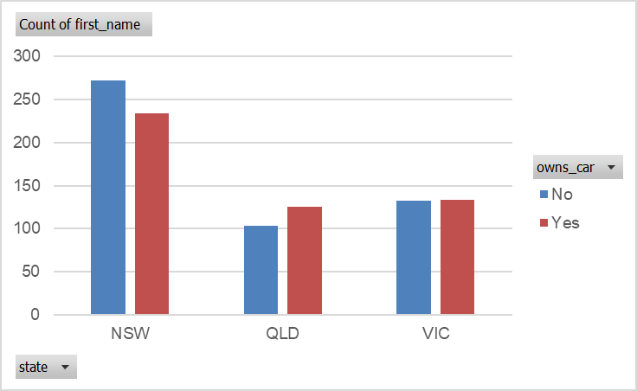
Note: The data and information in this document is reflective of a hypothetical situation and client. This document is to be used for KPMG Virtual Internship purposes only.
Data Exploration
Number of cars owned and not owned by state
NSW has the highest number of people that do not own a car and from the dataset the majority of customers are from NSW.
VIC is split quite evenly but the numbers are quite lower than NSW.
QLD has a high number of people that do own a car.
Place any supporting images, graphs, data or extra text here.

Slide 10
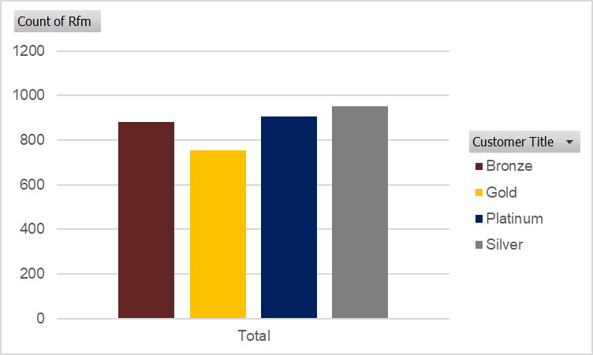
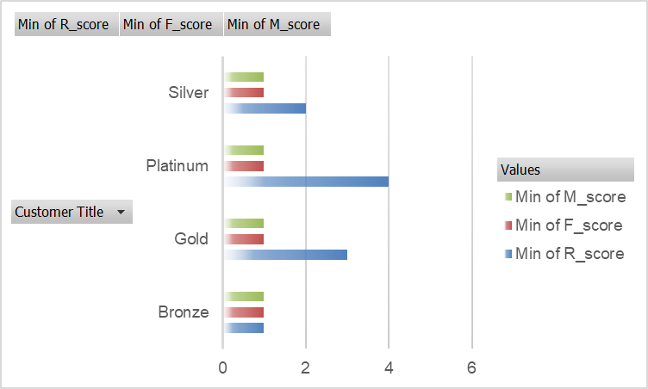
Note: The data and information in this document is reflective of a hypothetical situation and client. This document is to be used for KPMG Virtual Internship purposes only.
Model Development
RFM analysis and customer
classification
RFM analysis gives an understanding of the amount of customers that are benefiting the business.
The RFM (Recency, Frequency, Monetarily), model gives us an insight of how many customers have displayed high level of engagement with the business.
.
Place any supporting images, graphs, data or extra text here.

Slide 11
Note: The data and information in this document is reflective of a hypothetical situation and client. This document is to be used for KPMG Virtual Internship purposes only.
Interpretation
Place headline insight or information here. This should be the most important point for this slide.
Customer Title and RFM score | Count and interpretation
PLATINUM (RFM score > 411) | 906 These are high value customers and should be the target for business.
GOLD (RFM score > 311) | 753 These are also part of high value customers and should be targeted as well.
SILVER (RFM score> 144) | 953 These are customers which will fall under the category of low value customers.
Place any information about this point here.
Place any supporting images, graphs, data or extra text here.

Slide 12
Note: The data and information in this document is reflective of a hypothetical situation and client. This document is to be used for KPMG Virtual Internship purposes only.
THANK YOU

