Slide 1

MicroHack SAP + Data & AI Thijs Zandvliet / Julien Michel / Bart Delanghe

Slide 2
Purpose
Get Hands-on experience with
SAP data extraction
Combine SAP and non SAP data
PowerBI
Azure Machine Learning
OpenHack - like
Duration ~4 hours

Slide 3
Scenario : Cash Prediction
Customers pay X days after receiving invoice
Goal : predict when a customer will pay
Value
Sales value
Payment value
Time

Slide 4








Architecture Overview
Update Business Partner
Sales Order Headers CDS View / SAP Table Adapter
Data Alerts
Sales Order Items oData / SAP ECC Adapter
Power BI
Power Automate
Payments
Synapse Pipelines
Azure Synapse
Azure Cosmos DB
Azure Machine Learning
Based on Sales Data available in S/4 HANA Fully Activated Appliance – SAP CAL Image 1909 / 2020

Slide 5

Architecture Overview
Update Business Partner , Change Credit Score, Reduce line of Credit etc.
☣️Bad payer found! 😱
Sales Order Headers CDS View / SAP Table Adapter
Data Alerts
Send pay-me-NOW⏱️E-Mail
Sales Order Items OData / SAP ECC Adapter
Power BI
Power Automate
Outlook
Payments
Synapse Pipelines
Azure Synapse
Azure Cosmos DB
Azure Machine Learning
Based on Sales Data available in S/4 HANA Fully Activated Appliance – SAP CAL Image 1909 / 2020

Slide 6
Architecture Overview
Update Business Partner
Sales Order Headers CDS View / SAP Table Adapter
Data Alerts
Sales Order Items oData / SAP ECC Adapter
Power BI
Power Automate
Payments
Synapse Pipelines
Azure Synapse
Azure Cosmos DB
Azure Machine Learning
Based on Sales Data available in S/4 HANA Fully Activated Appliance – SAP CAL Image 1909 / 2020

Slide 7
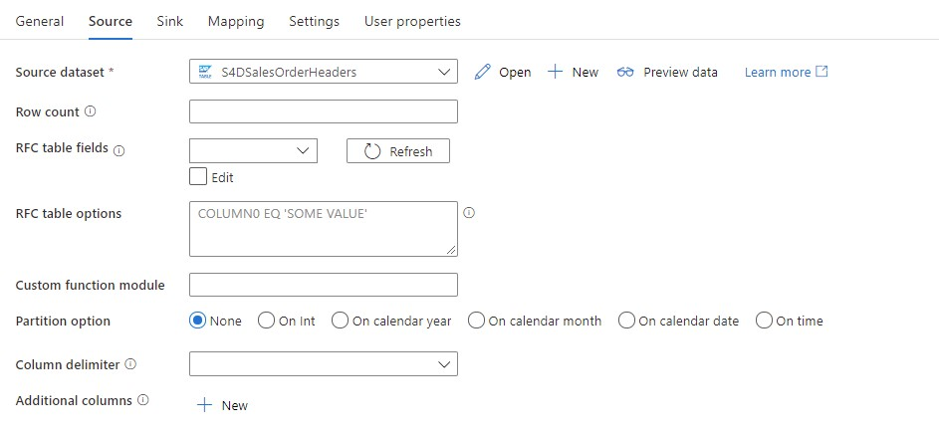
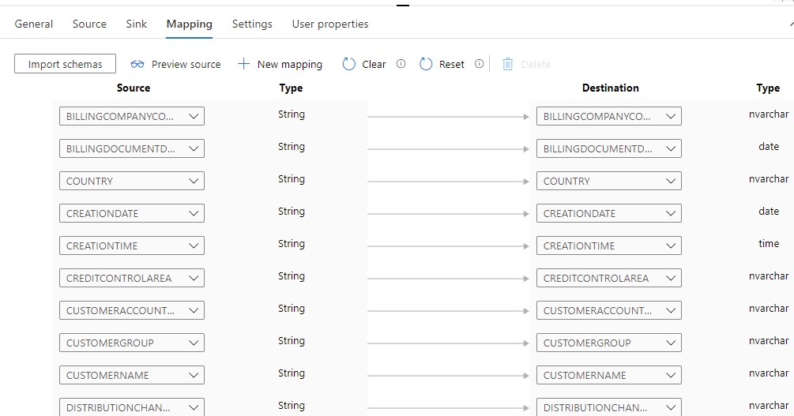
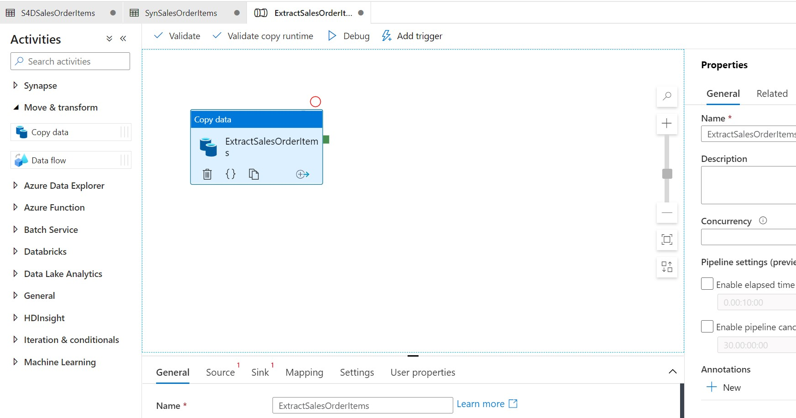
SAP Extraction – Synapse Pipelines
Sales Order Headers – SAP Table Connector
Sales Order Items – SAP ECC Adapter (oData)
Payments – CosmosDB – SQL API Adapter
Upload to Synapse SQL Pool - Tables

Slide 8
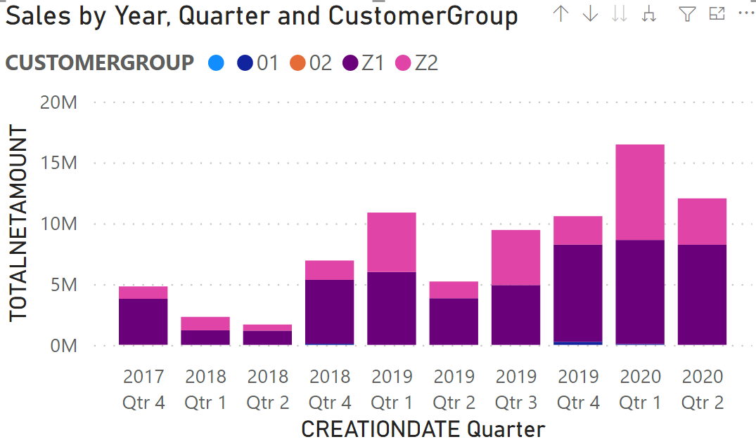
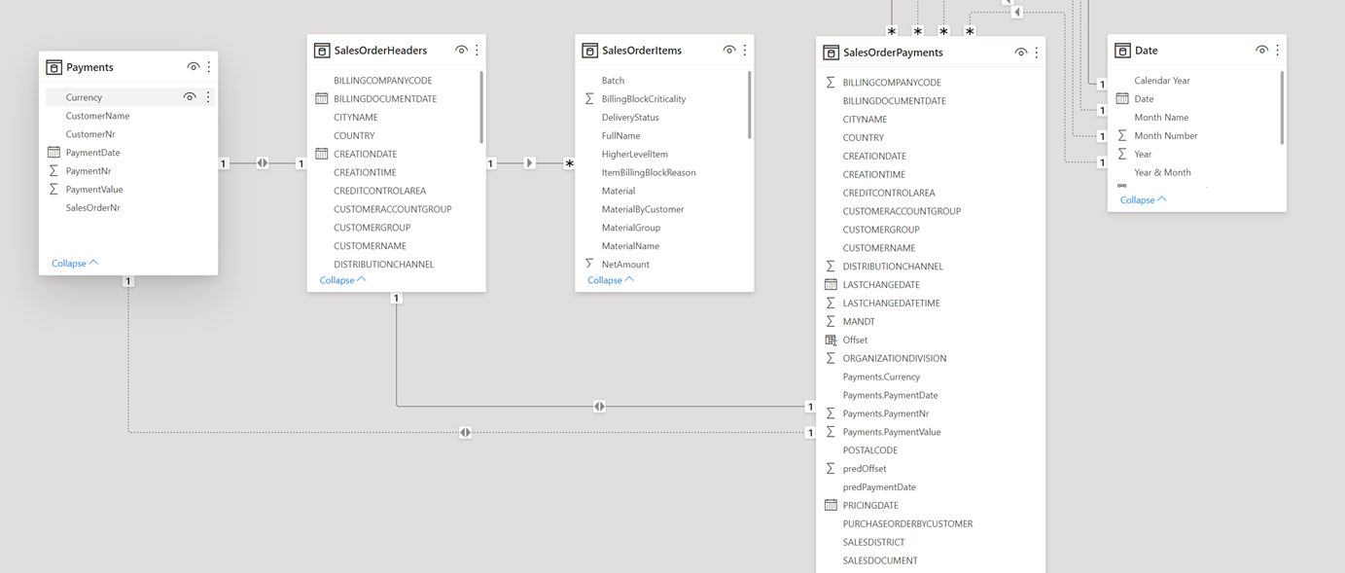
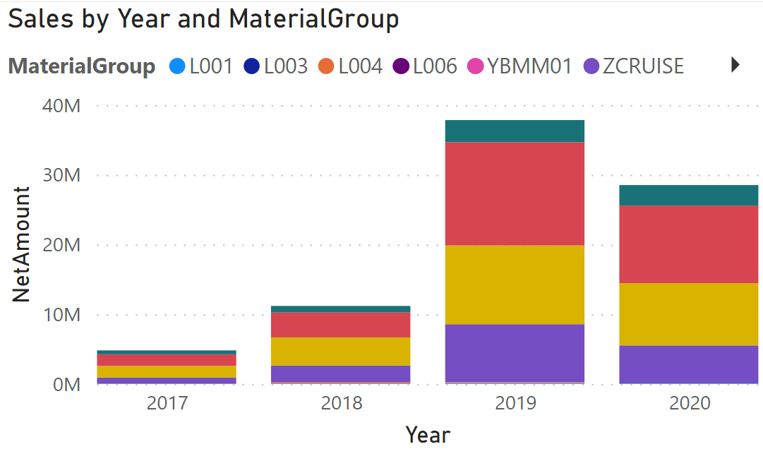
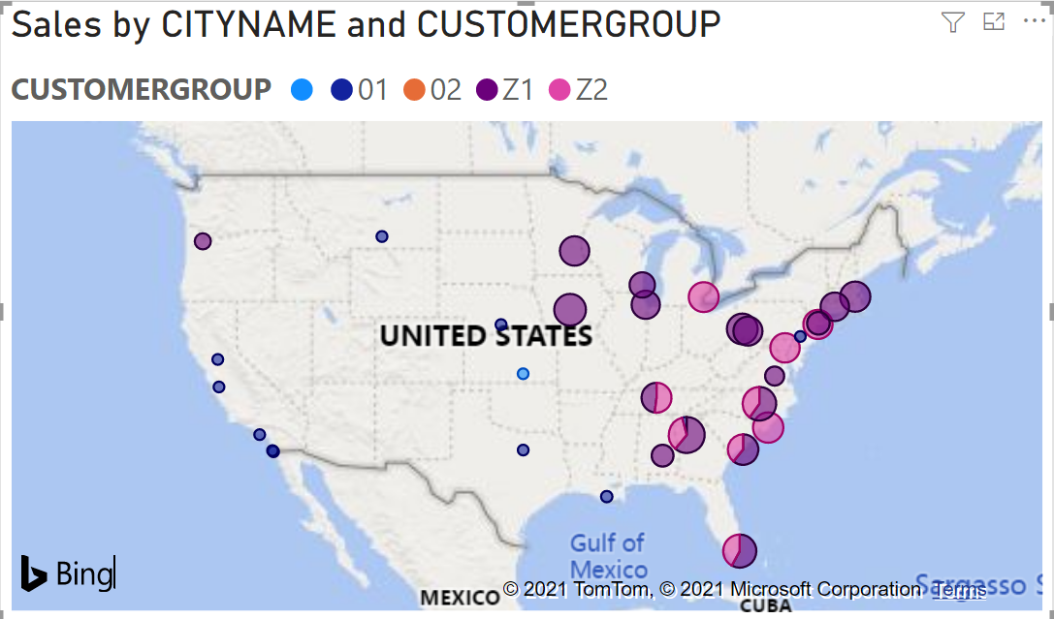
PowerBI
Create PowerBI reports based on extracted data

Slide 9
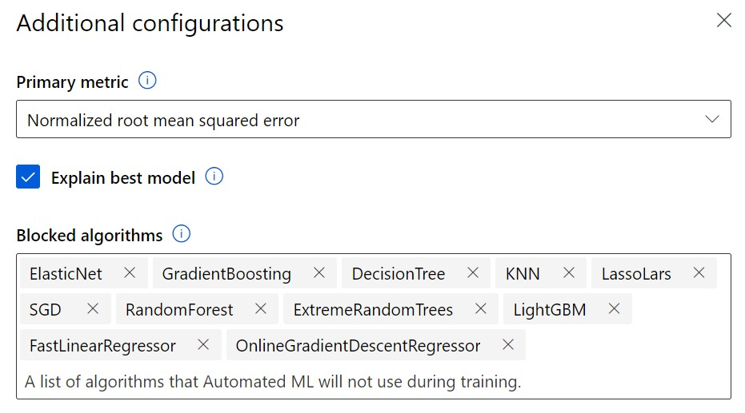
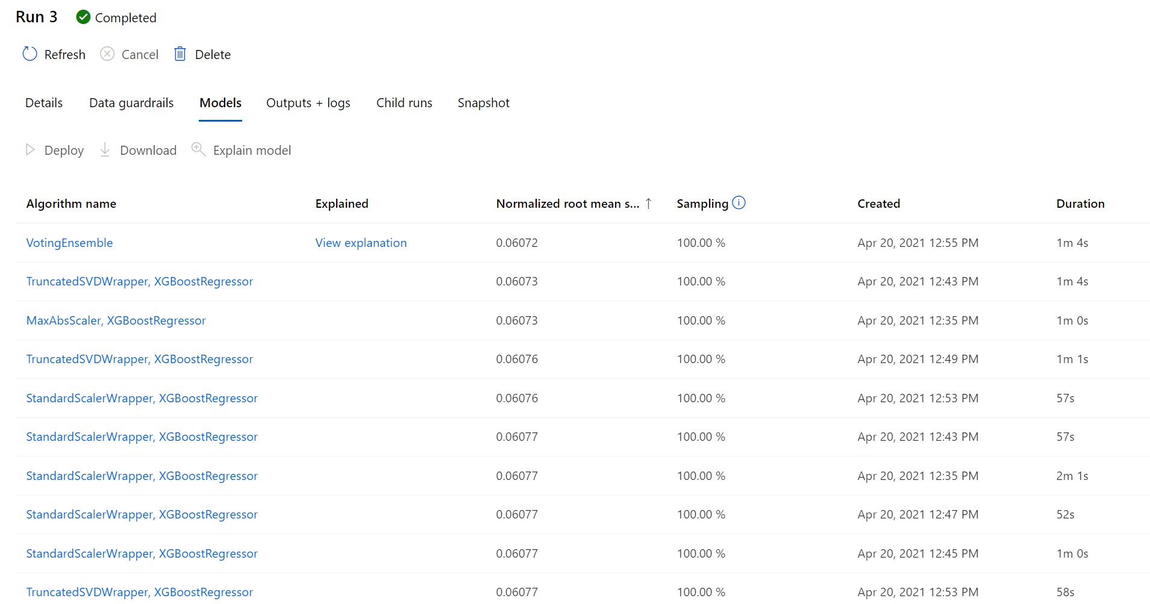
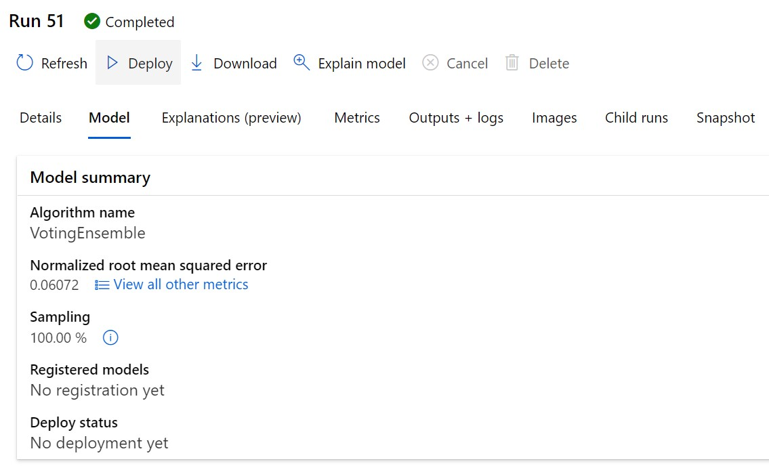
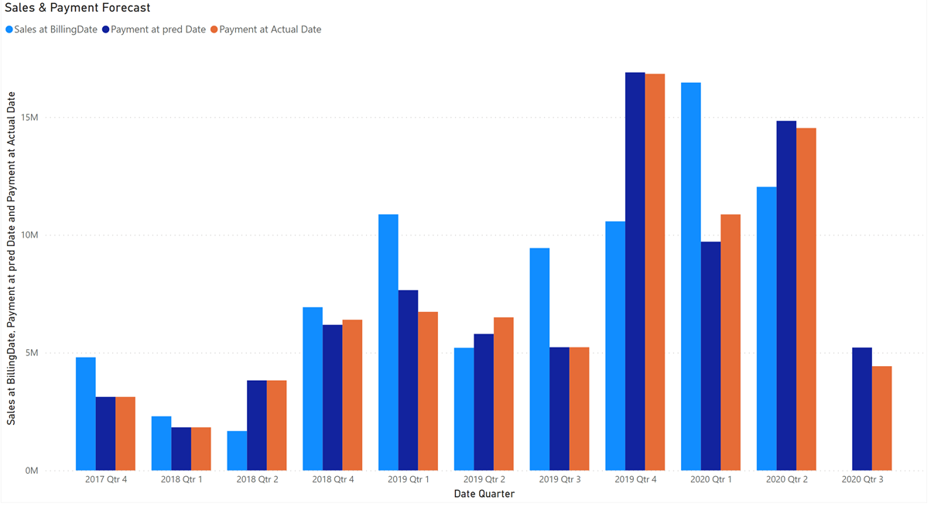
Azure ML
Configure Auto ML Run
Configure ‘Regression’
Create Cluster
Evaluate Different Models
Deploy best model
Integrate with PowerBI

Slide 10
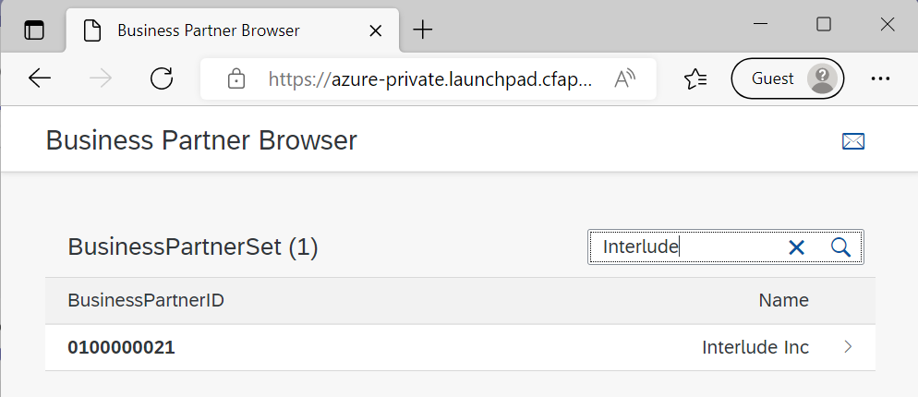
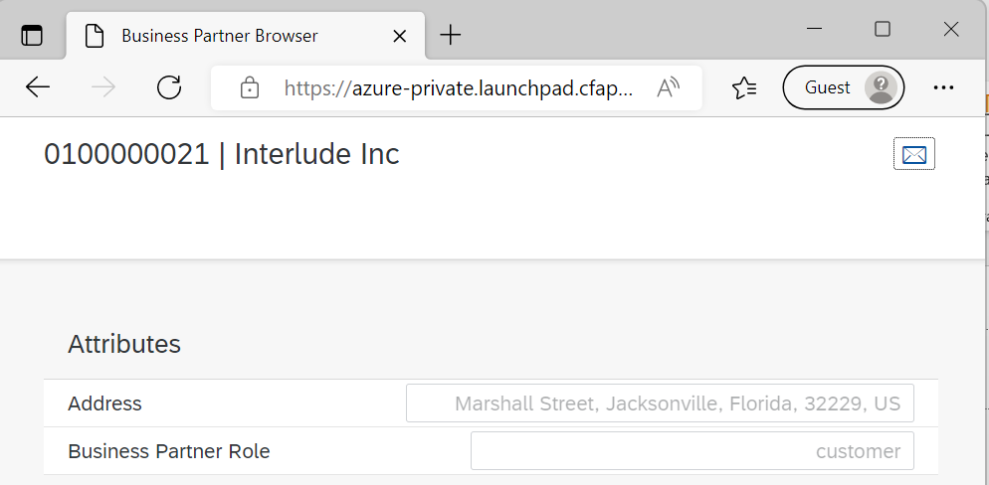
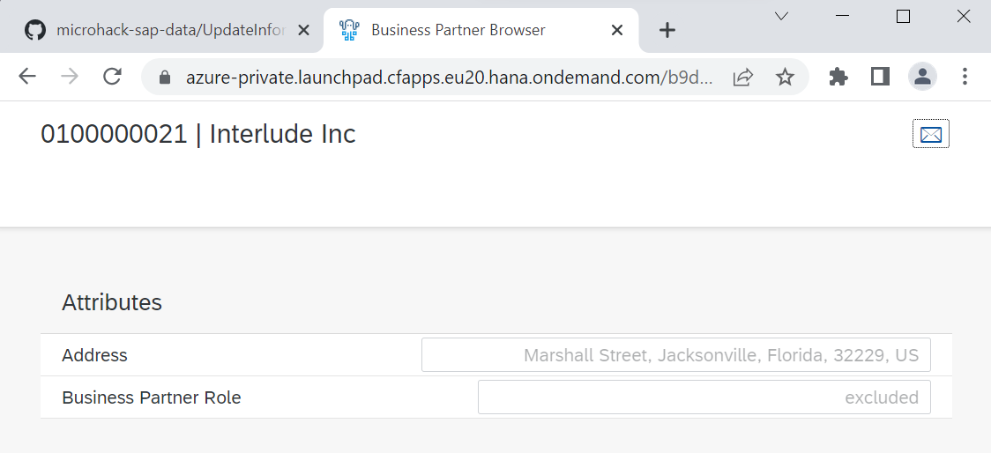
Verify Business Partner Role before updating from PowerBI

Slide 11
Architecture Setup
S4HANA/CosmosDB
Option 2 : Own Subscription
Synapse, Azure ML, ...
Own Subscription
Synapse Workspace
Azure ML
Deployment using Terraform
Tooling
PowerBI Desktop
Azure Storage Explorer
Azure Data Studio [Optional]
Option1 : Pre-Installed
S4HANA -SAP CAL deployment
CosmosDB - deployment using Terraform
Connection details on request
Payment Generation & upload to CosmosDB
VM for Integration Runtime and SAP .Net Connector

Slide 12
Instructions
Instructions :
https://aka.ms/microhack-sap-data
Self explanatory / Step-by-step instructions
Feedback is welcome
Note: SAP .Net Connector needs SAP S-User to download

Slide 13
Thank You
Bart Delanghe
Thijs Zandvliet
Julien Michel

