Slide 1

MicroHack SAP + Data & AI Thijs Zandvliet / Julien Michel / Bart Delanghe

Slide 2
Purpose
Get Hands-on experience with
SAP data extraction
Combine SAP and non SAP data
PowerBI
Azure Machine Learning
OpenHack - like
Duration ~4 hours

Slide 3
Scenario : Cash Prediction
Customers pay X days after receiving invoice
Goal : predict when a customer will pay
Value
Sales value
Payment value
Time

Slide 4








Architecture Overview
Update Business Partner
Sales Order Headers CDS View / SAP Table Adapter
Data Alerts
Sales Order Items oData / SAP ECC Adapter
Power BI
Power Automate
Payments
Synapse Pipelines
Azure Synapse
Azure Cosmos DB
Azure Machine Learning
Based on Sales Data available in S/4 HANA Fully Activated Appliance – SAP CAL Image 1909 / 2020

Slide 5
Architecture Overview
Update Business Partner
Sales Order Headers CDS View / SAP Table Adapter
Data Alerts
Sales Order Items oData / SAP ECC Adapter
Power BI
Power Automate
Payments
Synapse Pipelines
Azure Synapse
Azure Cosmos DB
Azure Machine Learning
Based on Sales Data available in S/4 HANA Fully Activated Appliance – SAP CAL Image 1909 / 2020

Slide 6
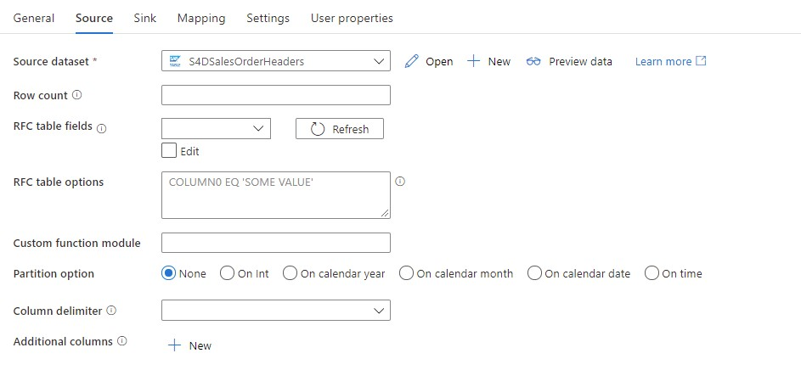
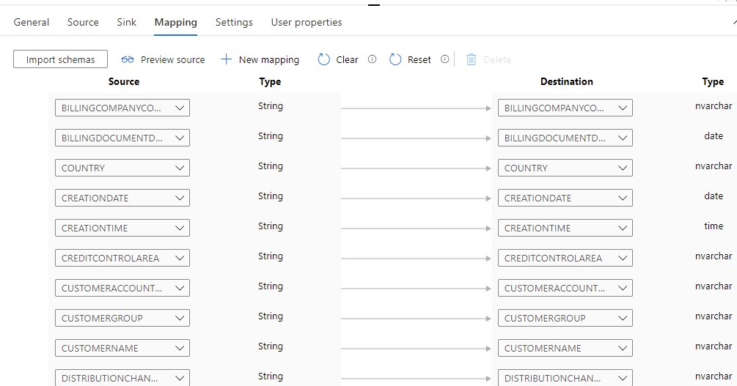
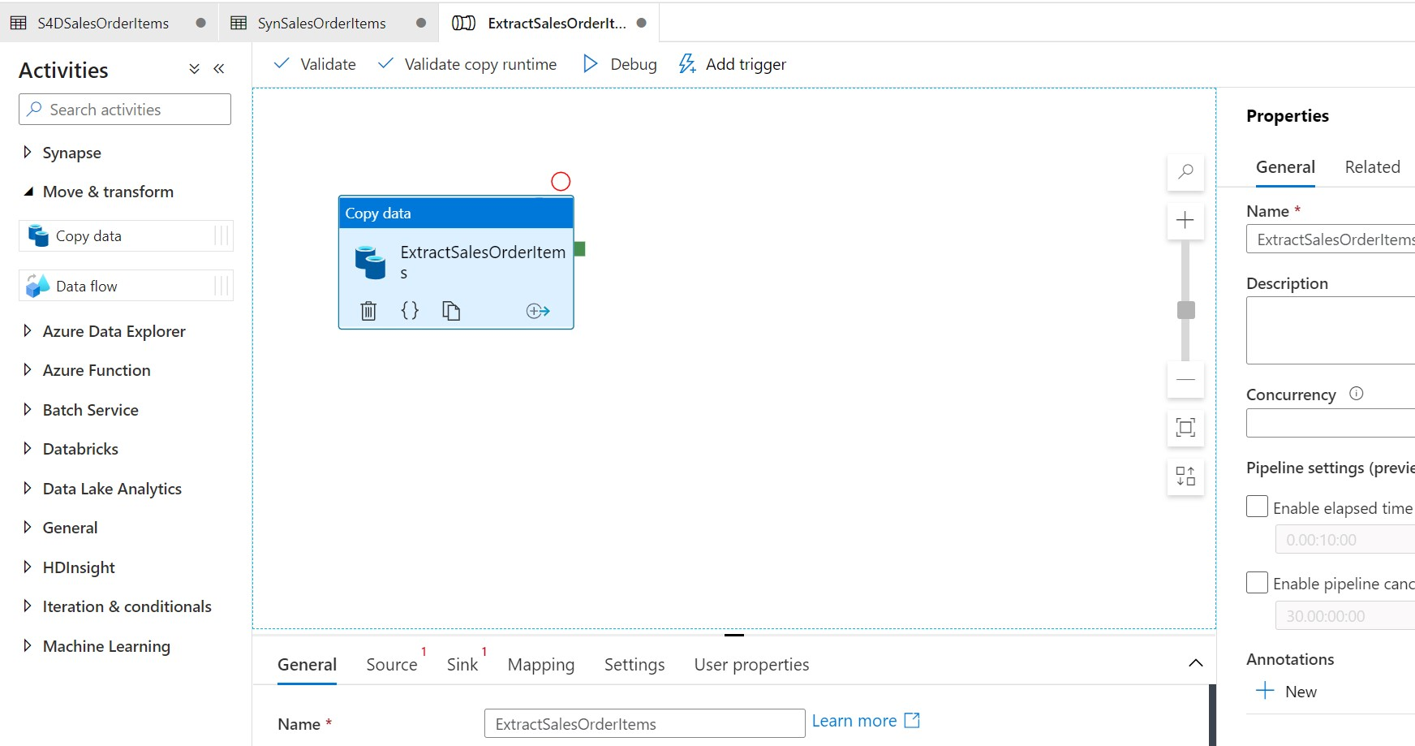
SAP Extraction – Synapse Pipelines
Sales Order Headers – SAP Table Connector
Sales Order Items – SAP ECC Adapter (oData)
Payments – CosmosDB – SQL API Adapter
Upload to Synapse SQL Pool - Tables

Slide 7
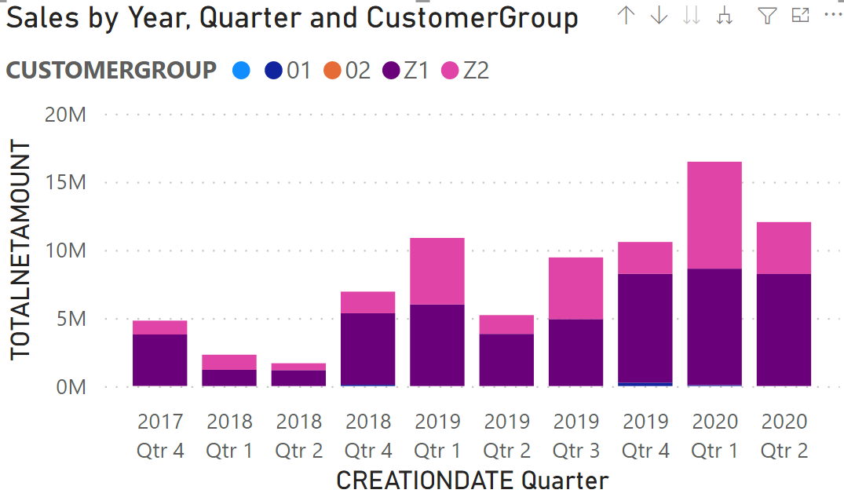
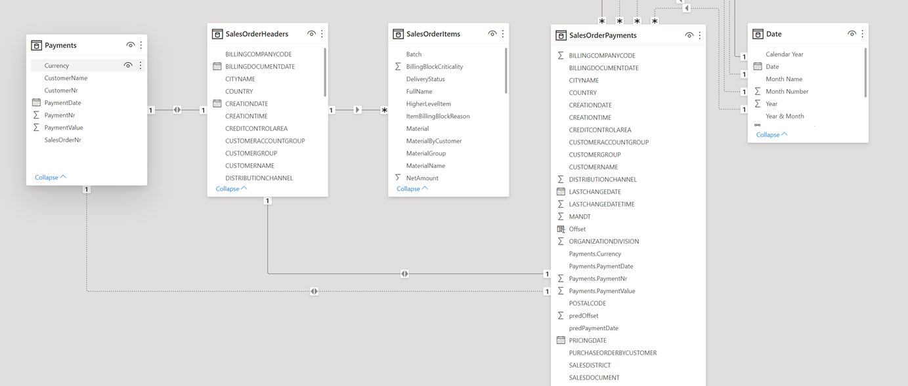
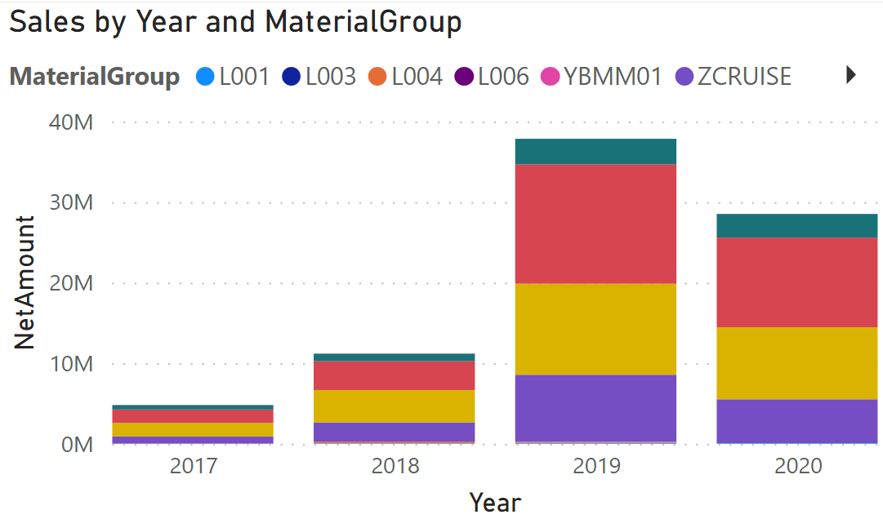
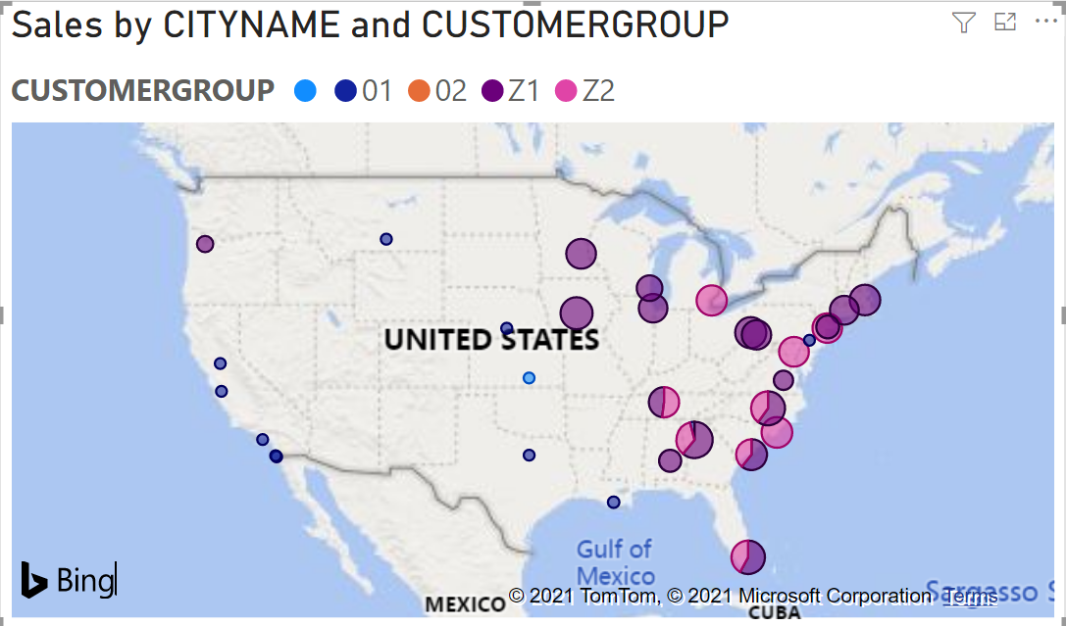
PowerBI
Create PowerBI reports based on extracted data

Slide 8
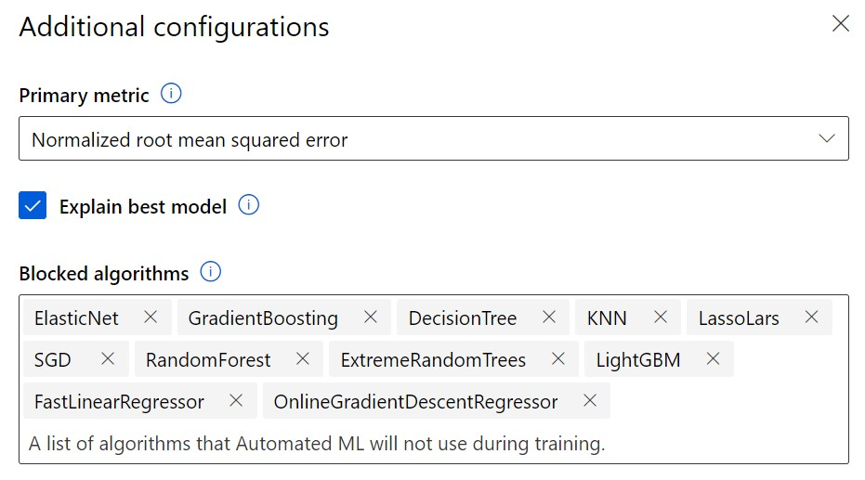
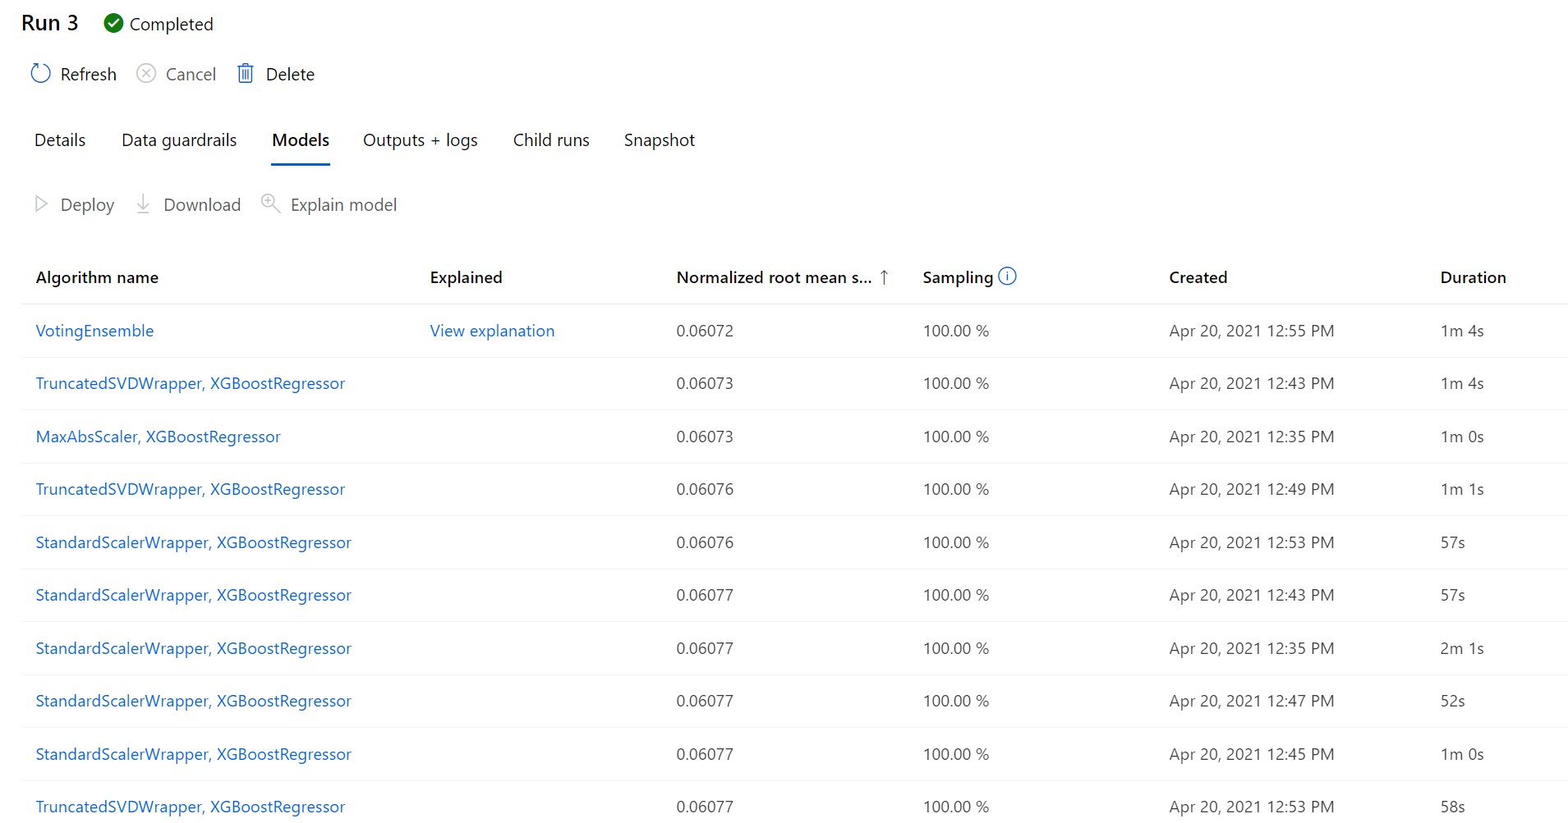
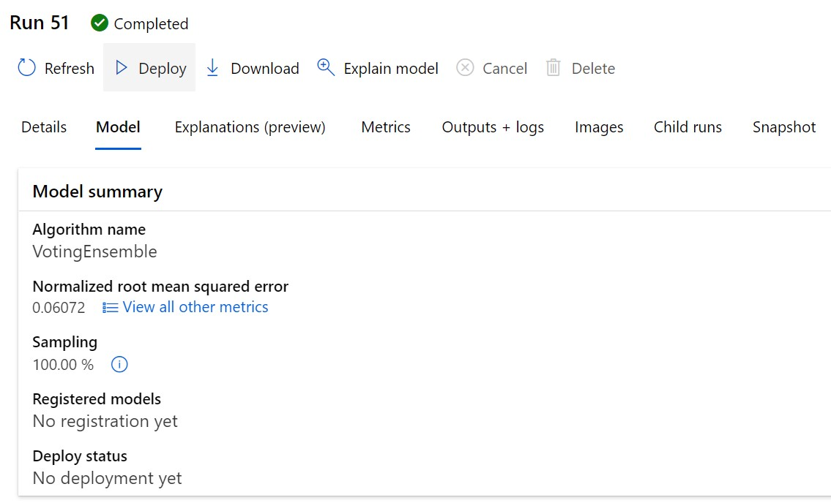
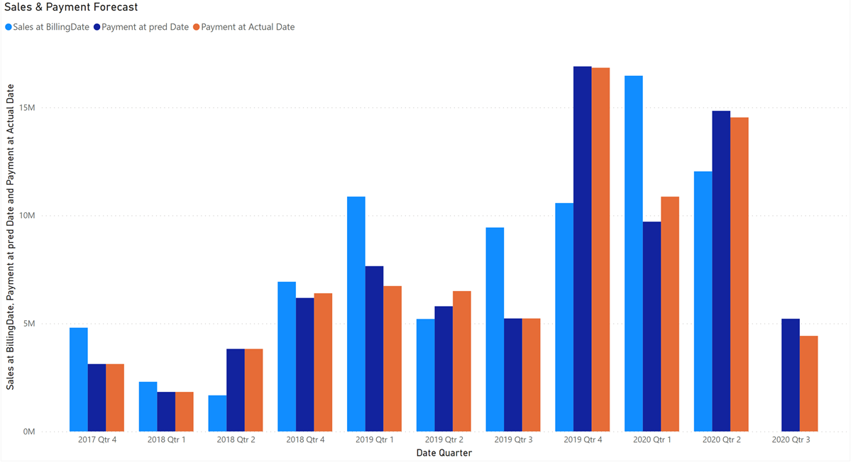
Azure ML
Configure Auto ML Run
Configure ‘Regression’
Create Cluster
Evaluate Different Models
Deploy best model
Integrate with PowerBI

Slide 9
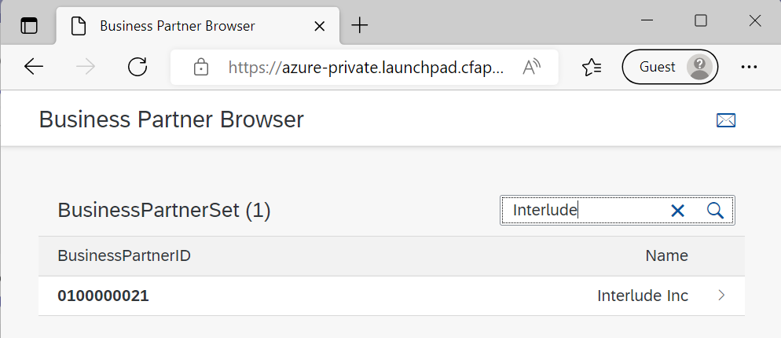
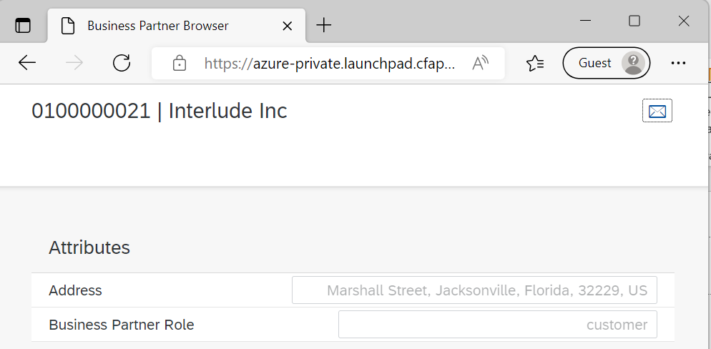
Verify Business Partner Role before updating from PowerBI

Slide 10
Architecture Setup
S4HANA/CosmosDB
Option 2 : Own Subscription
Synapse, Azure ML, ...
Own Subscription
Synapse Workspace
Azure ML
Deployment using Terraform
Tooling
PowerBI Desktop
Azure Storage Explorer
Azure Data Studio [Optional]
Option1 : Pre-Installed
S4HANA -SAP CAL deployment
CosmosDB - deployment using Terraform
Connection details on request
Payment Generation & upload to CosmosDB
VM for Integration Runtime and SAP .Net Connector

Slide 11
Instructions
Instructions :
https://aka.ms/microhack-sap-data
Self explanatory / Step-by-step instructions
Feedback is welcome
Note: SAP .Net Connector needs SAP S-User to download

Slide 12
Thank You
Bart Delanghe
Thijs Zandvliet
Julien Michel

