Slide 1


Distributed systems-17IS52
-Dr. Sanjay H A

Slide 2
Course Outcomes
Understand the goals and challenges of distributed system
Comprehend the two most prominent remote invocation techniques for communication in distributed systems
Illustrate the architecture for file systems and describe Google File System
Analyze how name services are implemented
Understand the fundamental concepts and algorithms related to monitoring distributed systems as their execution unfolds, and to timing the events that occur in their executions
Understand the topics and algorithms related to the issue of how processes coordinate their actions and agree on shared values in distributed systems, despite failures
Illustrate the fundamental concepts and algorithms related to distributed transactions
Describe the architectural components and a system model for services that employ replication

Slide 3
CO-PO-PSO Mapping
COs | PO1 | PO2 | PO3 | PO4 | PO5 | PO6 | PO7 | PO8 | PO9 | PO10 | PO11 | PO12 | PSO1 | PSO2
CO1 | 3 |  |  |  |  |  |  |  | 2 | 2 |  | 1 | 3
CO2 | 3 |  |  |  |  |  |  |  | 2 | 2 |  | 1 | 3
CO3 | 3 |  |  |  |  |  |  |  | 2 | 2 |  | 1 | 3
CO4 | 3 | 2 |  |  |  |  |  |  | 2 | 2 |  | 1 | 3
CO5 | 3 |  |  |  |  |  |  |  | 2 | 2 |  | 1 | 3
CO6 | 3 |  |  |  |  |  |  |  | 2 | 2 |  | 1 | 3
CO7 | 3 |  |  |  |  |  |  |  | 2 | 2 |  | 1 | 3
CO8 | 3 |  |  |  |  |  |  |  | 2 | 2 |  | 1 | 3
17IS52 | 3 | 2 |  |  |  |  |  |  | 2 | 2 |  | 1 | 3

Slide 4
Teaching Methodology
Black Board Teaching / Power Point Presentation
Programming Assignment
Case Study

Slide 5
Assessment Methods
Programming Assignment for 10 Marks
Case Study for 10 marks, evaluated on the basis of rubrics
Three internals, 30 Marks each will be conducted and the Average of best of two will be taken.
Final examination of 100 Marks will be conducted and will be evaluated for 50 Marks.

Slide 6
Course Contents: Unit-1
CHARACTERIZATION OF DISTRIBUTED SYSTEMS: Introduction, Trends in distributed systems, Focus on resource sharing, Challenges
REMOTE INVOCATION :Introduction , Request-reply protocols , Remote procedure call, Introduction to Remote Method Invocation

Slide 7
Unit-2
DISTRIBUTED FILE SYSTEMS : Introduction ,File service architecture, The Google File System (GFS)
NAME SERVICES : Introduction ,Name services and the Domain Name System ,Directory services

Slide 8
Unit-3
TIME AND GLOBAL STATES: Introduction , Clocks, events and process states , Synchronizing physical clocks , Logical time and logical clocks , Global states

Slide 9
Unit-4
COORDINATION AND AGREEMENT: Introduction, Distributed mutual exclusion, Elections , Coordination and agreement in group communication ,Consensus and related problems

Slide 10
Unit-5
DISTRIBUTED TRANSACTIONS : Introduction ,Flat and nested distributed transactions , Atomic commit protocols , Concurrency control in distributed transactions , Distributed deadlocks , Transaction recovery
REPLICATION : Introduction , System model and the role of group communication , Fault-tolerant services

Slide 11
Materials
Text books:
George Coulouris, Jean Dollimore and Tim Kindberg, “Distributed Systems Concepts and Design”, Fifth Edition, Pearson Education, 2012.
Reference Books:
Distributed systems: Principles and Paradigms: by Andrew S. Tannenbaum, Maarten van Steen. Second edition. PH
Distributed Computing Principles, Algorithms & Systems By Ajay D. Kshemkalyani&MukeshSinghal, Cambridge
Online Materials:
https://nptel.ac.in/courses/106106168/

Slide 13
Distributed Systems
Networks of computers are everywhere.
The Internet is one, as are the many networks of which it is composed.
Mobile phone networks
corporate networks,
Factory networks,
Campus networks
Home networks
in-car networks

Slide 14
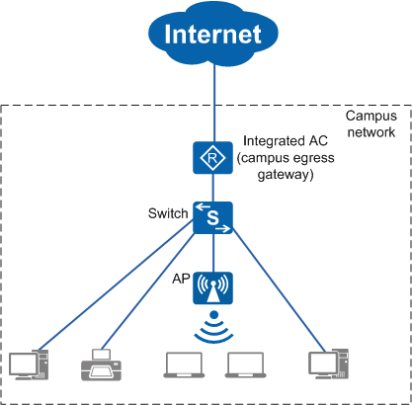
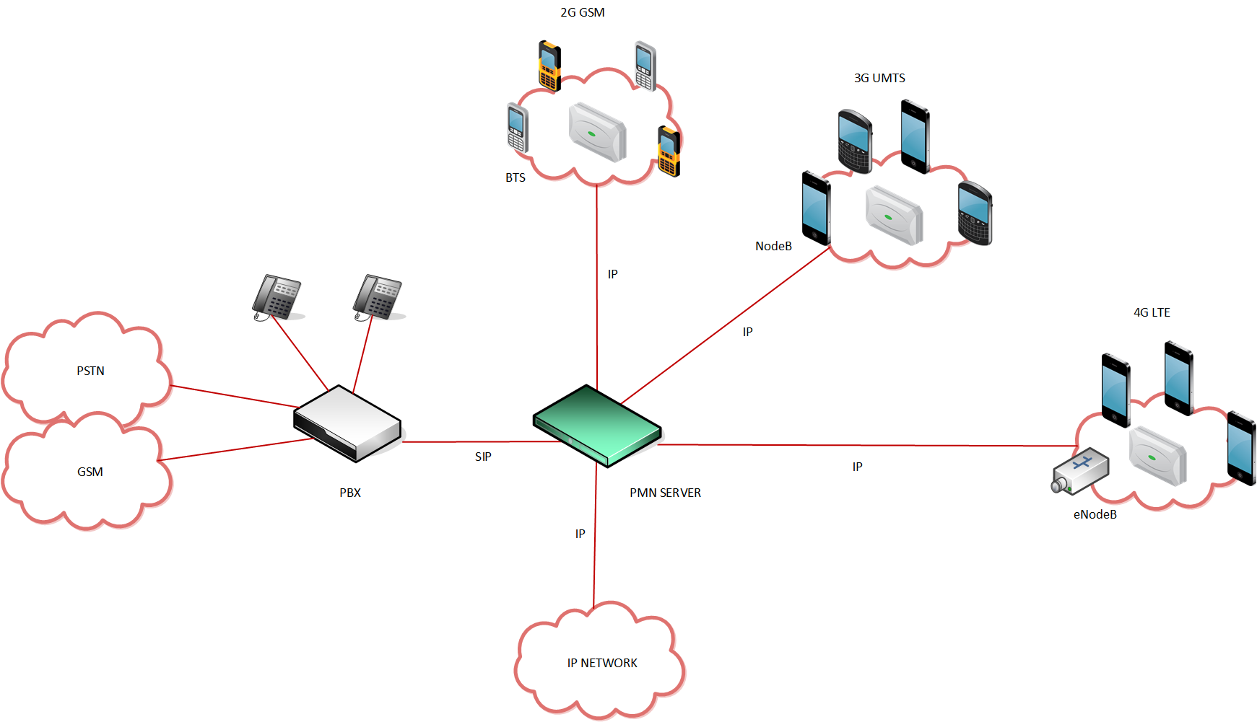
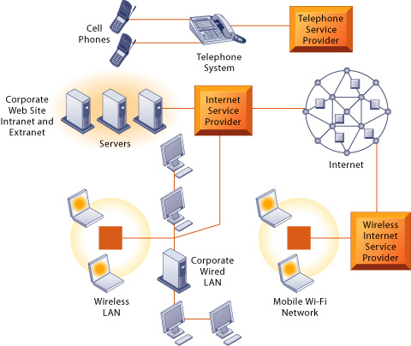
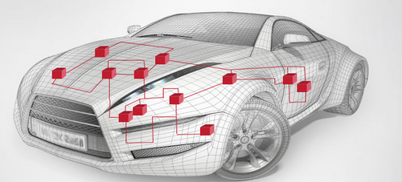

Slide 15
Distributed system
Hardware or software components located at networked computers communicate and coordinate their actions only by passing messages.
Computers that are connected by a network may be spatially separated by any distance

Slide 16
Definition of distributed systems has the following significant consequences:
Concurrency
In a network of computers, concurrent program execution is the norm.
The coordination of concurrently executing programs that share resources is also an important and recurring topic.
No global clock:
When programs need to cooperate they coordinate their actions by exchanging messages.
There is no single global notion of the correct time.
Independent failures:
All computer systems can fail, and it is the responsibility of system designers to plan for the consequences of possible failures.
Faults in the network result in the isolation of the computers that are connected to it, but that doesn’t mean that they stop running

Slide 17
Distributed Systems
The prime motivation
Desire to share resources.
Term ‘resource’ is a rather abstract one
Range of things
Disks , printers etc
Files, Databases , data objects of all kinds, etc
Stream of video frames that emerges from a digital video camera
Audio connection that a mobile phone call represents

Slide 18
Definition of a Distributed System
A distributed system is
a collection of independent computers
that appears to its users
as a single coherent system.
... or ...
as a single system.

Slide 19
Resource Sharing and the Web
Hardware resources (reduce costs)
Data resources (shared usage of information)
Service resources
search engines
computer-supported cooperative working 
Service vs. server (node or process )

Slide 24
Figure 1.1 (see book for the full text) Selected application domains and associated networked applications
Finance and commerce | eCommerce e.g. Amazon and eBay, PayPal, online banking and trading
The information society | Web information and search engines, ebooks, Wikipedia; social networking: Facebook and MySpace.
Creative industries and entertainment | online gaming, music and film in the home, user-generated content, e.g. YouTube, Flickr
Healthcare | health informatics, on online patient records, monitoring patients
Education | e-learning, virtual learning environments; distance learning
Transport and logistics | GPS in route finding systems, map services: Google Maps, Google Earth
Science | The Grid as an enabling technology for collaboration between scientists
Environmental management | sensor technology to monitor earthquakes, floods or tsunamis
Instructor’s Guide for Coulouris, Dollimore, Kindberg and Blair, Distributed Systems: Concepts and Design Edn. 5 © Pearson Education 2012

Slide 25
Trends in distributed systems
Distributed systems are undergoing a period of significant change
Influential trends:
Emergence of pervasive networking technology;
Emergence of ubiquitous computing coupled with the desire to support user mobility in distributed systems;
Increasing demand for multimedia services;
View of distributed systems as a utility.

Slide 26
Pervasive networking and the modern Internet
The modern Internet is a vast interconnected collection of computer networks of many different types, for example
Wide range of wireless communication technologies such as WiFi, WiMAX, Bluetooth and 3/4/5-generation mobile phone networks.
Net result is that networking has become a pervasive resource and devices can be connected at any time and in any place.

Slide 27
Figure 1.3 A typical portion of the Internet
intranet
☎
ISP
☎
☎
☎
backbone
satellite link
desktop computer:
server:
network link:
Instructor’s Guide for Coulouris, Dollimore, Kindberg and Blair, Distributed Systems: Concepts and Design Edn. 5 © Pearson Education 2012

Slide 28
Internet
The Internet is also a very large distributed system.
It enables users, wherever they are, to make use of services such as the World Wide Web, email and file transfer.
The set of services is open-ended – it can be extended by the addition of server computers and new types of service.
Subnetworks operated by companies and other organizations and typically protected by firewalls.
The implementation of the Internet and the services that it supports has entailed the development of practical solutions to many distributed system issues

Slide 29
Mobile and ubiquitous computing
Technological advances in device miniaturization and wireless networking have led to
Small and portable computing devices into distributed systems
Laptop computers.
Handheld devices (Mobile phones/smart phones,/GPS-enabled devices/personal digital assistants (PDAs)/ Video cameras and digital cameras/Wearable devices)
Devices embedded in appliances such as washing machines, hi-fi systems, cars and refrigerators.
The portability of many of these devices, together with their ability to connect conveniently to networks in different places, makes mobile computing possible
Location-aware or context-aware computing

Slide 30
Mobility introduces a number of challenges for distributed systems
Need to deal with variable connectivity and indeed disconnection
Need to maintain operation in the face of device mobility
Ubiquitous computing is the harnessing of many small, cheap computational devices that are present in users’ physical environments
Ubiquitous and mobile computing overlap, since the mobile user can in principle benefit from computers that are everywhere.
Service discovery

Slide 31
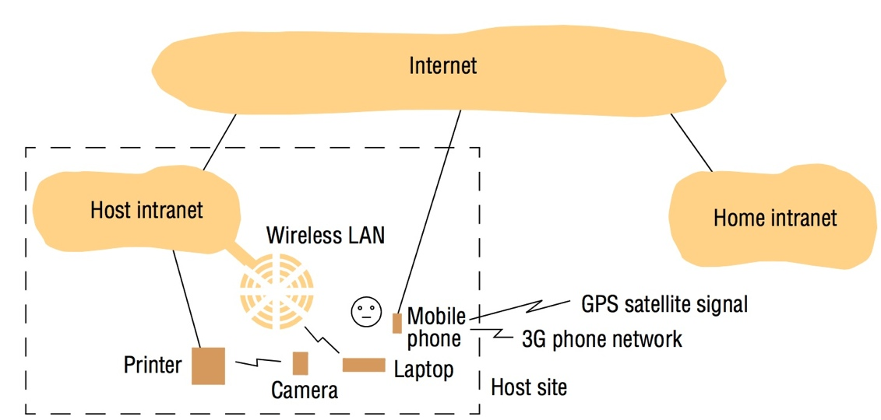
Figure 1.4 Portable and handheld devices in a distributed system
Instructor’s Guide for Coulouris, Dollimore, Kindberg and Blair, Distributed Systems: Concepts and Design Edn. 5 © Pearson Education 2012

Slide 32
Distributed multimedia systems
Multimedia support can usefully be defined as the ability to support a range of media types in an integrated manner.
Distributed system should support the storage, transmission and presentation of what are often referred to as discrete media types, such as pictures or text messages.
A distributed multimedia system should be able to
perform the functions for continuous media types such as audio and video;
store and locate audio or video files
To transmit them across the network

Slide 33
The benefits of distributed multimedia computing are
live or pre-recorded television broadcasts
access to film libraries offering video-on-demand services
access to music libraries,
audio and video conferencing facilities
Integrated telephony features including IP telephony or related technologies such as Skype
Webcasting is an application of distributed multimedia technology

Slide 34
Distributed multimedia applications such as webcasting place considerable demands on the underlying distributed infrastructure in terms of:
providing support for an range of encoding and encryption formats, such as the MPEG series of standards and HDTV;
Providing a range of mechanisms to ensure that the desired quality of service can be met;
Providing associated resource management strategies, including appropriate scheduling policies to support the desired quality of service;
Providing adaptation strategies to deal with the inevitable situation in open systems where quality of service cannot be met or sustained

Slide 35
Distributed computing as a utility
With the increasing maturity of distributed systems infrastructure, a number of companies are promoting the view of distributed resources as a commodity or utility
Physical resources
Software services
cloud computing is used to capture vision of computing as a utility
cloud is defined as a set of Internet-based application, storage and computing services sufficient to support most users’ needs

Slide 36
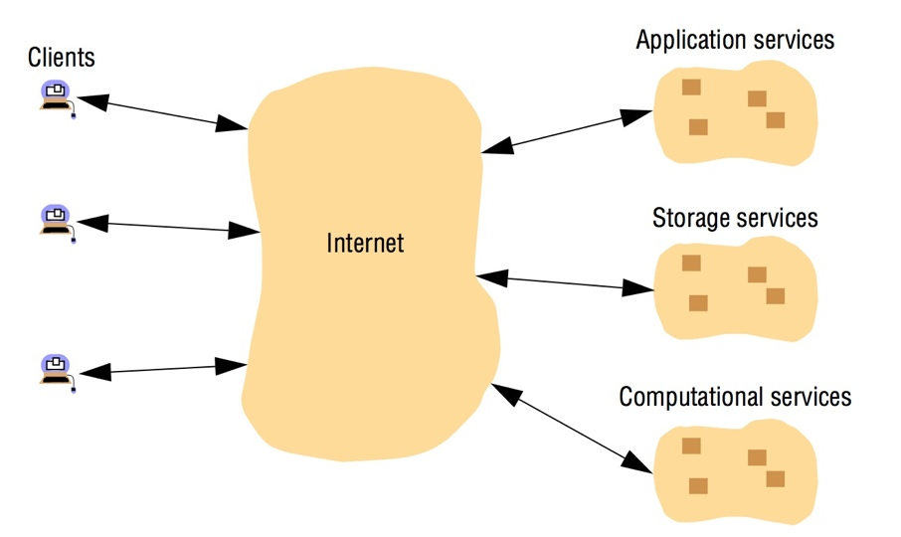
Figure 1.5 Cloud computing
Instructor’s Guide for Coulouris, Dollimore, Kindberg and Blair, Distributed Systems: Concepts and Design Edn. 5 © Pearson Education 2012

Slide 37
Clouds are generally implemented on cluster computers to provide the necessary scale and performance required by such services.
A cluster computer is a set of interconnected computers that cooperate closely to provide a single, integrated high-performance computing capability
The overall goal of cluster computers is to provide a range of cloud services,
High-performance computing capabilities
Mass storage
Richer application services such as web search
Grid computing: more general paradigm of cloud computing with a bias towards support for scientific applications.

Slide 38
Focus on resource sharing
Looked at from the point of view of hardware provision, we share equipment such as printers and disks to reduce costs.
Far greater significance to users is the sharing of the higher-level resources that play a part in their applications and in their everyday work and social activities.
Similarly, users think in terms of shared resources such as a search engine or a currency converter, without regard for the server or servers that provide these.
Patterns of resource sharing vary widely in their scope and in how closely users work together
Search engine on the Web provides a facility to users
Computer-supported cooperative working (CSCW), a group of users who cooperate directly share resources such as documents in a small, closed group.

Slide 39
Service : Distinct part of a computer system that manages a collection of related resources and presents their functionality to users and applications.
For example, we access shared files through a file service
Resources in a distributed system are physically encapsulated within computers and can only be accessed from other computers by means of communication.
For effective sharing, each resource must be managed by a program that offers a communication interface enabling the resource to be accessed and updated reliably and consistently.

Slide 40
client-server computing.
Same process may be both a client and a server,
Clients are active (making requests) and servers are passive
servers run continuously
client’ and ‘server’ refer to processes rather than the computers that they execute upon
distributed system written in an object-oriented language, resources may be encapsulated as objects and accessed by client objects

Slide 41
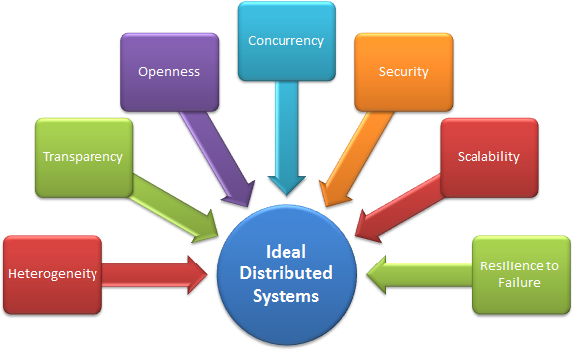
Challenges -

Slide 42
Heterogeneity
The Internet enables users to access services and run applications over a heterogeneous collection of computers and networks.
Heterogeneity
Networks
Although the Internet consists of many different sorts of network their differences are masked by the fact that all of the computers attached to them use the Internet protocols to communicate with one another.
Computer hardware
Data types such as integers may be represented in different ways on different sorts of hardware
.

Slide 43
Operating systems
Although the operating systems of all computers on the Internet need to include an implementation of the Internet protocols, they do not necessarily all provide the same application programming interface to these protocols
Programming languages
Different programming languages use different representations for characters and data structures such as arrays and records.
Implementations by different developers
Programs written by different developers cannot communicate with one another unless they use common standards

Slide 44
Middleware
The term middleware applies to a software layer that provides a programming abstraction as well as masking the heterogeneity of the underlying networks, hardware, operating systems and programming languages.
Heterogeneity and mobile code
The term mobile code is used to refer to program code that can be transferred from one computer to another and run at the destination
Java applets.
The virtual machine approach provides a way of making code executable on a variety of host computers

Slide 45
Openness
Openness facilitates
interoperability, portability, extensibility, adaptively
The openness of a computer system is the characteristic that determines whether the system can be extended and re-implemented in various ways.
Degree to which new resource-sharing services can be added and be made available for use by a variety of client programs.
Openness cannot be achieved unless the specification and documentation of the key software interfaces of the components of a system are made available to software developers.
The challenge to designers is to tackle the complexity of distributed systems consisting of many components engineered by different people.

Slide 46
Open systems are characterized by the fact that their key interfaces are published.
Open distributed systems are based on the provision of a uniform communication mechanism and published interfaces for access to shared resources.
Open distributed systems can be constructed from heterogeneous hardware and software, possibly from different vendors.
The conformance of each component to the published standard must be carefully tested and verified if the system is to work correctly.
Example: Twitter and Facebook have API that allows developers to develop theirs own software interactively.

Slide 47
Security
Information resources that are made available and maintained in distributed systems have a high intrinsic value to their users.
Security for information resources has three components:
Confidentiality :protection against disclosure to unauthorized individuals
Integrity :protection against alteration or corruption
Availability: protection against interference with the means to access the resources.
In a distributed system, clients send requests to access data managed by servers, which involves sending information in messages over a network
challenge is to send sensitive information in a message over a network in a secure manner
challenge is to identify a remote user or other agent correctly.

Slide 48
Two security challenges have not yet been fully met
Denial of service attacks: Bombarding the service with such a large number of pointless requests that the serious users are unable to use it.
such attacks are countered by attempting to catch and punish the perpetrators after the event
Security of mobile code: Mobile code needs to be handled with care.

Slide 49
Challenges for Security
Security: confidentiality, integrity, availability
Vulnerable components
channels (links <–> end-to-end paths)
processes (clients, servers, outsiders)
Threats
information leakage
integrity violation
denial of service
illegitimate usage
Current issues:
Denial-of-service attacks, security of mobile code, information flow;
open wireless ad-hoc environments

Slide 50
Scalability
Distributed systems operate effectively and efficiently at many different scales, ranging from a small intranet to the Internet.
A system is described as scalable if it will remain effective when there is a significant increase in the number of resources and the number of users.

Slide 51
Figure 1.6 Growth of the Internet (computers and web servers)
Date
Computers
Web servers
Percentage
1993, July
1,776,000
130
0.008
1995, July
6,642,000
23,500
0.4
1997, July
19,540,000
1,203,096
6
1999, July
56,218,000
6,598,697
12
2001, July
125,888,197
31,299,592
25
2003, July
~200,000,000
42,298,371
21
2005, July
353,284,187
67,571,581
19
Instructor’s Guide for Coulouris, Dollimore, Kindberg and Blair, Distributed Systems: Concepts and Design Edn. 5 © Pearson Education 2012

Slide 52
The design of scalable distributed systems presents the following challenges:
Controlling the cost of physical resources: As the demand for a resource grows, it should be possible to extend the system, at reasonable cost
Controlling the performance loss: Consider the management of a set of data whose size is proportional to the number of users or resources in the system
Preventing software resources running out: An example of lack of scalability is shown by the numbers used as Internet (IP) addresses
Avoiding performance bottlenecks: In general, algorithms should be decentralized to avoid having performance bottlenecks

Slide 53
Ideally, the system and application software should not need to change when the scale of the system increases, but this is difficult to achieve.
The issue of scale is a dominant theme in the development of distributed systems.

Slide 54
Challenges for Scalability
The system will remain effective when there is a significant increase in
number of resources
number of users
The architecture and the implementation must allow it
The algorithms must be efficient under the circumstances to be expected

Slide 55
Failure handling
Computer systems sometimes fail.
When faults occur in hardware or software, programs may produce incorrect results or may stop before they have completed the intended computation.
Failures in a distributed system are partial – that is, some components fail while others continue to function

Slide 56
Failure Handling
More components
increased fault rate
Increased possibilities
more redundancy => more possibilities for fault tolerance
no centralized control => no fatal failure
Issues
Detecting failures
Masking failures
Recovery from failures
Tolerating failures
Redundancy
Partial failures

Slide 57
Techniques for dealing with failures are
Detecting failures: Some failures can be detected
Masking failures: Some failures that have been detected can be hidden or made less severe.
Tolerating failures: Most of the services in the Internet do exhibit failures – it would not be practical attempt to detect and hide all of the failures that might occur in such a large network with so many components
Their clients can be designed to tolerate failures, which generally involves the users tolerating them as well.
Recovery from failures: Recovery involves the design of software so that the state of permanent data can be recovered or ‘rolled back’ after a server has crashed.
Redundancy: Services can be made to tolerate failures by the use of redundant components

Slide 58
examples:
There should always be at least two different routes between any two routers in the Internet.
In the Domain Name System, every name table is replicated in at least two different servers.
A database may be replicated in several servers to ensure that the data remains accessible after the failure of any single server;
the servers can be designed to detect faults in their peers; when a fault is detected in one server, clients are redirected to the remaining servers.

Slide 59
Failure Handling
Distributed systems provide a high degree of availability in the face of hardware faults.
The availability of a system is a measure of the proportion of time that it is available for use

Slide 60
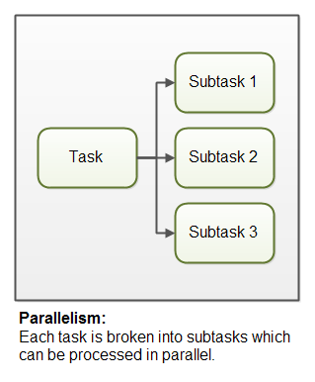
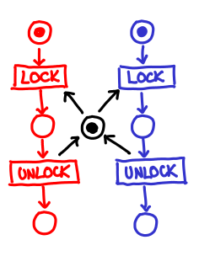
Concurrency

Slide 61
Concurrency
The process that manages a shared resource could take one client request at a time. But that approach limits throughput.
Therefore services and applications generally allow multiple client requests to be processed concurrently
suppose that each resource is encapsulated as an object and that invocations are executed in concurrent threads.
Operations on the object may conflict with one another and produce inconsistent results.
Any object that represents a shared resource in a distributed system must be responsible for ensuring that it operates correctly in a concurrent environment.

Slide 62
For an object to be safe in a concurrent environment, its operations must be synchronized in such a way that its data remains consistent.
Semaphores

Slide 63
Concurrency
Concurrency:
Several simultaneous users => integrity of data
mutual exclusion
synchronization
transaction processing in data bases
Replicated data: consistency of information?
Partitioned data: how to determine the state of the system?
Order of messages?
There is no global clock!

Slide 64
Transparency
Defined as the concealment from the user and the application programmer of the separation of components in a distributed system
so that the system is perceived as a whole rather than as a collection of independent components.
The implications of transparency are a major influence on the design of the system software.
Transparency hides and renders anonymous the resources

Slide 65
Transparencies
Access : Hide differences in data representation and how a resource is accessed
Location: Hide where a resource is located
Migration :Hide that a resource may move to another location
Relocation :Hide that a resource may be moved to another location while in use (the others don’t notice)
Replication :Hide that a resource is replicated
Concurrency :Hide that a resource may be shared by several competitive users
Failure :Hide the failure and recovery of a resource
Persistence: Hide whether a (software) resource is in memory or on disk

Slide 66
Network transparency:
consider the use of an electronic mail address such as Fred.Flintstone@stoneit.com. The address consists of a user’s name and a domain name.
Sending mail to such a user does not involve knowing their physical or network location.

Slide 67
Quality of service
Once users are provided with the functionality that they require of a service, we can go on to ask about the quality of the service provided.
The main nonfunctional properties of systems that affect the quality of the service experienced by clients and users are
Reliability
security
performance.
Adaptability to meet changing system configurations and resource availability has been recognized as a further important aspect of service quality.

Slide 68
Reliability and security issues are critical in the design of most computer systems.
The performance aspect of quality of service was originally defined in terms of responsiveness and computational throughput
It has been redefined in terms of ability to meet timeliness guarantees
QoS achievement depends upon the availability of the necessary computing and network resources at the appropriate times.
This implies a requirement for the system to provide guaranteed computing and communication resources that are sufficient to enable applications to complete each task on time

Slide 69
REMOTE INVOCATION
How processes communicate in a distributed system?
Request-reply protocols
Remote procedure call, or RPC
Remote method invocation (RMI).

Slide 70
Request-reply protocols
This form of communication is designed to support the roles and message exchanges in typical client-server interactions.
Request-reply communication is synchronous because the client process blocks until the reply arrives from the server.
Request-reply communication can be reliable because the reply from the server is effectively an acknowledgement to the client.
Asynchronous request-reply communication is an alternative that may be useful in situations where clients can afford to retrieve replies later

Slide 71
The client-server exchanges are described in the following paragraphs in terms of the send and receive operations for UDP datagrams
Acknowledgements are redundant, since requests are followed by replies.
Establishing a connection involves two extra pairs of messages in addition to the pair required for a request and a reply.
Flow control is redundant for the majority of invocations, which pass only small arguments and results.

Slide 72
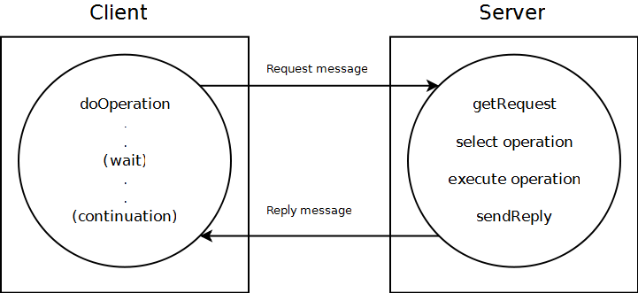
The request-reply protocol

Slide 73
The protocol we describe here is based on a trio of communication primitives
doOperation
getRequest
sendReply,.
This request-reply protocol matches requests to replies and designed to provide certain delivery guarantees.
In case of UDP datagrams
Delivery guarantees must be provided by the request-reply protocol
Use the server reply message as an acknowledgement of the client request message.

Slide 74
Operations of the request-reply protocol
public byte[] doOperation (RemoteRef s, int operationId, byte[] arguments);
Sends a request message to the remote server and returns the reply.
The arguments specify the remote server, the operation to be invoked and the arguments of that operation.
public byte[] getRequest ();
Acquires a client request via the server port.
public void sendReply (byte[] reply, InetAddress clientHost, int clientPort);
Sends the reply message reply to the client at its Internet address and port.

Slide 75
doOperation method
The doOperation method is used by clients to invoke remote operations.
Arguments specify the remote server and which operation to invoke, together with additional information (arguments) required by the operation.
Result is a byte array containing the reply.
Client calling doOperation marshals the arguments into an array of bytes and unmarshals the results from the array of bytes that is returned.
RemoteRef, represents references for remote servers.
This class provides methods for getting the Internet address and port of the associated server
After sending the request message, doOperation invokes receive to get a reply message, from which it extracts the result and returns it to the caller.
The caller of doOperation is blocked until the server performs the requested operation and transmits a reply message to the client process.

Slide 76
getRequest & send Reply
getRequest is used by a server process to acquire service requests
When the server has invoked the specified operation, it then uses sendReply to send the reply message to the client.
When the reply message is received by the client the original doOperation is unblocked and execution of the client program continues.

Slide 77
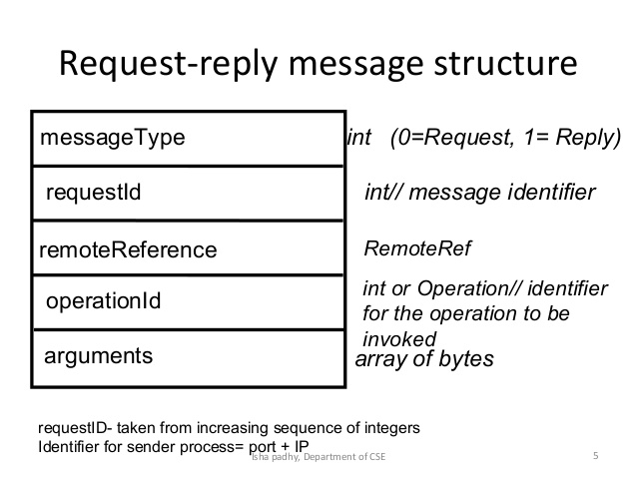

Slide 78
Message Identifier
A message identifier consists of two parts:
requestId, which is taken from an increasing sequence of integers by the sending process;
an identifier for the sender process, for example, its port and Internet address.
First part makes the identifier unique to the sender
Second part makes it unique in the distributed system.
When the value of the requestId reaches the maximum value for an unsigned integer (for example, 232 – 1) it is reset to zero

Slide 79
Failure model of the request-reply protocol
doOperation, getRequest and sendReply are implemented over UDP datagrams, then they suffer from the same communication failures.
They suffer from omission failures.
Messages are not guaranteed to be delivered in sender order.
In addition, the protocol can suffer from the failure of processes
We assume that processes have crash failures.
That is, when they halt, they remain halted – they do not produce Byzantine behaviour.
When a server has failed or a request or reply message is dropped,
doOperation uses a timeout when it is waiting to get the server’s reply message

Slide 80
Discarding duplicate request messages
In cases when the request message is retransmitted, the server may receive it more than once.
This can lead to the server executing an operation more than once for the same request.
To avoid this, the protocol is designed to recognize successive messages (from the same client) with the same request identifier and to filter out duplicates.
If the server has not yet sent the reply, it need take no special action
it will transmit the reply when it has finished executing the operation.

Slide 81
Lost reply messages
If the server has already sent the reply when it receives a duplicate request
it will need to execute the operation again to obtain the result, unless it has stored the result of the original execution.
Some servers can execute their operations more than once and obtain the same results each time.
An idempotent operation is an operation that can be performed repeatedly with the same effect as if it had been performed exactly once.
Operation to append an item to a sequence is not an idempotent operation because it extends the sequence each time it is performed.
A server whose operations are all idempotent need not take special measures to avoid executing its operations more than once.

Slide 82
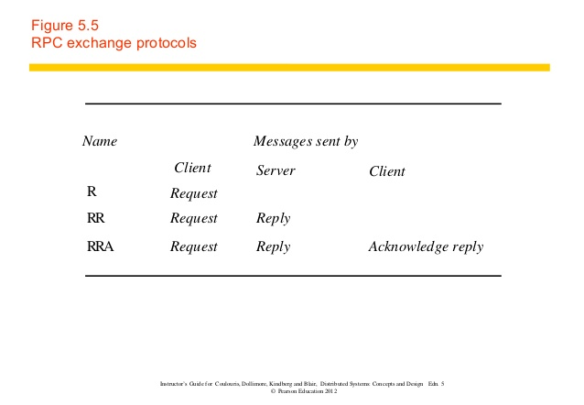
Exchange protocols
Request (R) protocol
Request-reply (RR) protocol;
Request-reply-acknowledge reply (RRA) protocol.

Slide 83
R protocol
Single Request message is sent by the client to the server.
R protocol may be used when there is no value to be returned from the remote operation
Client requires no confirmation that the operation has been executed.
Protocol is implemented over UDP datagrams

Slide 84
RR protocol
RR protocol is useful for most client-server exchanges because it is based on the request-reply protocol.
Special acknowledgement messages are not required, because a server’s reply message is regarded as an acknowledgement of the client’s request message.
Subsequent call from a client may be regarded as an acknowledgement of a server’s reply message.
Communication failures due to UDP datagrams being lost may be masked by the retransmission

Slide 85
RRA protocol
RRA protocol is based on the exchange of three messages: request-reply-acknowledge reply.
Acknowledge reply message contains the requestId from the reply message being acknowledged.
This will enable the server to discard entries from its history.
Arrival of a requestId in an acknowledgement message will be interpreted as acknowledging the receipt of all reply messages with lower requestIds,
So the loss of an acknowledgement message is harmless

Slide 86
Use of TCP streams to implement the request-reply protocol
TCP ensures that request and reply messages are delivered reliably,
No need for the request-reply protocol to deal with retransmission of messages and filtering of duplicates or with histories
Flow-control mechanism allows large arguments and results to be passed without taking special measures to avoid overwhelming the recipient.
If successive requests and replies between the same client-server pair are sent over the same stream, the connection overhead need not apply to every remote invocation.
Overhead due to TCP acknowledgement messages is reduced when a reply message follows soon after a request message.

Slide 87
Remote procedure call
Procedures on remote machines can be called as if they are procedures in the local address space.
The underlying RPC system then hides important aspects of distribution
Encoding and decoding of parameters and results
passing of messages
Preserving of the required semantics for the procedure call
This concept was first introduced by Birrell and Nelson [1984]

Slide 88
Remote Procedure Call (RPC)
An extension of conventional procedure call (used for transfer of control and data within a single process)
Allows a client application to call procedures in a different address space in the same or remote machine
Ideal for the client-server modeled applications
Primary goal is to make distributed programming easy, which is achieved by making the semantics of RPC as close as possible to conventional local procedure call
what is the semantics of local procedure call?

Slide 89
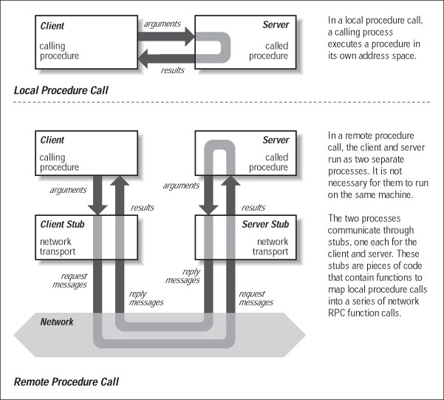
Local vs. Remote Procedure Calls

Slide 90
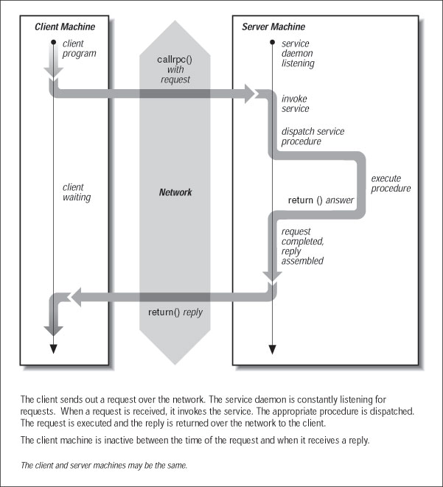
RPC Communication

Slide 91
RPC System Components
Message module
IPC module of Send/Receive/Reply
responsible for exchanging messages
Stub procedures (client and server stubs)
a stub is a communications interface that implements the RPC protocol and specifies how messages are constructed and exchanged
responsible for packing and unpacking of arguments and results (this is also referred to as “marshaling”)
these procedures are automatically generated by “stub generators” or “protocol compilers”

Slide 92
Client stub
packs the arguments with the procedure name or ID into a message
sends the msg to the server and then awaits a reply msg
unpacks the results and returns them to the client
Server stub
receives a request msg
unpacks the arguments and calls the appropriate server procedure
when it returns, packs the result and sends a reply msg back to the client

Slide 93
RPC Design Issues
Parameter Passing
In conventional calls: pass by-value and pass by-reference possible
in RPC: pass by-value only (why?)
pointers (addresses) are meaningless in a separate address space
Also called copy-in/copy-out parameter passing
Single vs. multiple input and output parameters

Slide 94
Transport Support for RPC
RPC mechanisms can be built on top of either connection oriented (reliable) or connectionless (unreliable) transport service (e.g., on top of TCP or UDP)
most RPC implementations allow the user to choose the underlying transport service
why is the connectionless transport service more desirable for supporting RPCs?
RPC messages are generally short and overhead involved with connections may be undesirable
Servers generally serve a large number of clients and maintaining state information on connections may be undesirable
LANs are generally reliable

Slide 95
RPC Interface Definition Language and Compiler
Interface definition language (IDL) is used to define the interfaces of procedures provided by a server
Interface contains a list of procedure signatures
include names of the procedures plus the types of their input and output parameters
Client and server procedures are type checked against interface definitions
Interface compiler (or stub generator) generates client and server stubs automatically

Slide 96
Figure 5.8 CORBA IDL example
// In file Person.idl
struct Person {
string name;
string place;
long year;
} ;
interface PersonList {
readonly attribute string listname;
void addPerson(in Person p) ;
void getPerson(in string name, out Person p);
long number();
};
Instructor’s Guide for Coulouris, Dollimore, Kindberg and Blair, Distributed Systems: Concepts and Design Edn. 5 © Pearson Education 2012

Slide 97
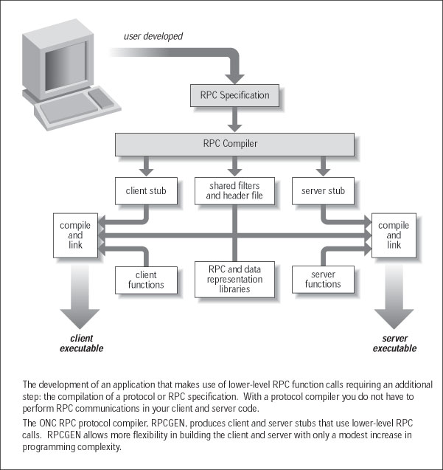

Slide 98
RPC Semantics
during a RPC, problems may occur:
Request msg may be lost
Reply msg may be lost
Server & client may crash
→ in the last two cases, the procedure may have been called (What are possible consequences?)

Slide 99
Some strategies for different RPC msg delivery guarantees
Retry request message - retransmit the request msg until either a reply is received or the server is assumed to have failed
Duplicate filtering - filtering duplicate requests at the server when retransmissions are used
Retransmission of replies - keep a history of reply messages to enable lost replies to be retransmitted without re-executing the server operations

Slide 100
RPC mechanisms usually include timeouts to prevent clients waiting indefinitely for reply msgs
RPC call semantics
“maybe” call semantics
“at-least-once” call semantics
“at-most-once” call semantics
“maybe” call semantics
no retransmission of request messages
not certain whether the procedure has been executed
no fault-tolerance measures
generally not acceptable

Slide 101
2. “at-least-once” call semantics
msg module repeatedly resends request msg after timeouts until it either gets a reply msg or some max.
# of retries have been made
no duplicate request msg filtering
remote procedure is called at least once if server not down
client does not know how many times the remote procedure has been called
Unless the called procedure is “idempotent” (i.e., repeatable), this could produce undesirable results (e.g., money transfer)

Slide 102
3. “at-most-once” call semantics
Retransmission of request messages
Duplicate request msg filtering
If the server does not crash and the client receives the result of a call, then the procedure has been called exactly once
Otherwise, an exception is reported and the procedure will have been called either once or not at all
Works for both idempotent and non-idempotent operations
More complex support required due to the need for request msg filtering and for keeping track of replies

Slide 103
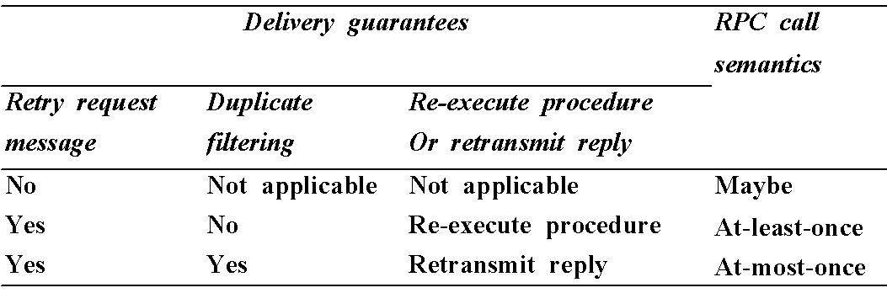

Slide 104
Binding
Binding refers to determining the location and identity (communication ID) of the called procedure
In UNIX: a communication ID is a socket address containing host’s Internet address and a port number
Static binding (which binds the host address of a server into the client program at compilation time) is undesirable (why?)
The client and server programs are compiled separately and often at different times
The server may be moved from one host to another
dynamic binding is more desirable
allows servers to register their exporting services
allows servers to remove services
allows clients to lookup the named service

Slide 105
Binder Interface Example
PROCEDURE Register (serviceName:String; serverPort:Port; version:integer) causes the binder to record the service name and server port of a service in its table, together with a version number.
PROCEDURE Withdraw (serviceName:String; serverPort:Port; version:integer) causes the binder to remove the service from its table.
PROCEDURE LookUp (serviceName:String; version:integer): Port the binder looks up the named service and returns its address (or set of addresses) if the version number agrees with the one stored in its table.

Slide 106
Locating the Binding Service
Clients and servers need to know where the binder is available before they can use it
Some approaches for locating the binder
Always run the binder on a “well-known” address (i.e., fixed host and port)
what is the problem with this approach?
OS supplies the current address of the binder (e.g., via environment variable in UNIX)
client & server programs need not be recompiled
Use a broadcast message to locate the binder
Binder can be easily relocated
Client & server programs need not be recompiled
most flexible approach

Slide 107
Asynchronous RPC
RPC calls that do not block waiting for replies
More efficient than synchronous RPC when replies are not required
When no reply message is required
- a client can make a RPC and proceed without waiting for the server to complete the operation
- several client requests can be buffered and transmitted together
When a reply message is required
- a client can make a call, proceed with other operations and claim the reply later
e.g., X-Window system

Slide 108
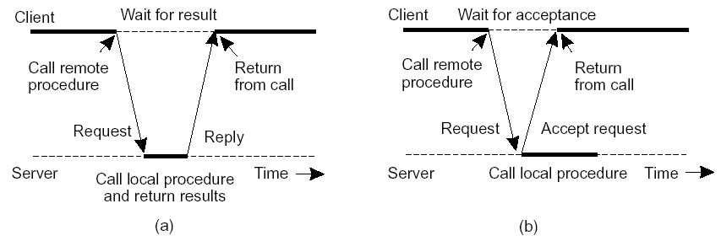
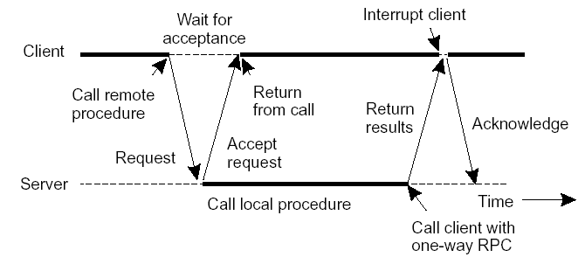
Asynchronous RPCs
Essence: Try to get rid of the strict request-reply behavior, but let the client continue without waiting for an answer from the server.
- Variation: deferred synchronous RPC:

Slide 109
Sun RPC
Designed for client-server communication in the Sun Network File System (NFS
Supplied as a part of the various Sun and other UNIX operating systems and is also available with NFS installations.
Implementers have the choice of using remote procedure calls over either UDP or TCP.
It uses atleast- once call semantics.
The Sun RPC system provides an interface language called XDR and an interface compiler called rpcgen, which is intended for use with the C programming language.

Slide 110
Interface definition language
The Sun XDR language, which was originally designed for specifying external data representations,
was extended to become an interface definition language.
It may be used to define a service interface for Sun RPC by specifying a set of procedure definitions together with supporting type definitions.
Notation is rather primitive in comparison with that used by CORBA IDL or Java.

Slide 111
Most languages allow interface names to be specified, but Sun RPC does not
program number and a version number are supplied.
The program number can be obtained from a central authority to allow every program to have its own unique number.
The version number is intended to be changed when a procedure signature changes.
Both program and version number are passed in the request message,
A procedure definition specifies a procedure signature and a procedure number.
The procedure number is used as a procedure identifier in request messages.

Slide 112
Only a single input parameter is allowed. Therefore, procedures requiring multiple parameters must include them as components of a single structure.
The output parameters of a procedure are returned via a single result.
The procedure signature consists of the result type, the name of the procedure and the type of the input parameter.
This interface definition language provides a notation for defining constants, typedefs, structures, enumerated types, unions and programs
The interface compiler rpcgen can be used to generate the following from an interface definition:
client stub procedures;
server main procedure, dispatcher and server stub procedures;
XDR marshalling and unmarshalling procedures

Slide 113
Binding
Sun RPC runs a local binding service called the port mapper at a well-known port number on each computer.
Each instance of a port mapper records the program number, version number and port number in use by each service running locally.
When a server starts up it registers its program number, version number and port number with the local port mapper.
When a client starts up, it finds out the server’s port by making a remote request to the port mapper at the server’s host, specifying the program number and version number.
clients make multicast remote procedure calls by multicasting them to all the port mappers, specifying the program and version number. Each port mapper forwards all such calls to the appropriate local service program,

Slide 114
Authentication
Sun RPC request and reply messages provide additional fields enabling authentication information to be passed between client and server.
The request message contains the credentials of the user running the client program
Access control mechanisms can be built on top of the authentication information which is made available to the server procedures via a second argument.
The server program is responsible for enforcing access control by deciding whether to execute each procedure call according to the authentication information.
For example, if the server is an NFS file server, it can check whether the user has sufficient rights to carry out a requested file operation.
Several different authentication protocols can be supported
Kerberos

Slide 115
Remote method invocation
Remote method invocation (RMI) is closely related to RPC but extended into the world of distributed objects.
In RMI, a calling object can invoke a method in a potentially remote object.
The commonalities between RMI and RPC are as follows:
They both support programming with interfaces,
They are both typically constructed on top of request-reply protocols and can offer a range of call semantics such as at-least-once and at-most-once.
They both offer a similar level of transparency – that is, local and remote calls employ the same syntax but remote interfaces typically expose the distributed nature of the underlying call

Slide 116
Remote method invocation
Differences.
The programmer is able to use the full expressive power of object-oriented programming in the development of distributed systems software, including the use of objects, classes and inheritance,
Richer parameter-passing semantics
All objects in an RMI-based system have unique object references such object references can also be passed as parameters

Slide 117
Remote method invocation
RMI allows the programmer to pass parameters not only by value, as input or output parameters, but also by object reference.
Passing references is particularly attractive if the underlying parameter is large or complex.
The remote end, on receiving an object reference, can then access this object using remote method invocation, instead of having to transmit the object value across the network.

Slide 118
Local Objects
Within one process’ address space
Object
consists of a set of data and a set of methods.
E.g., C++ object, Java object.
Object reference
an identifier via which objects can be accessed.
i.e., a pointer (e.g., virtual memory address within process)
Interface
provides a definition of the signatures of a set of methods (i.e., the types of their arguments, return values, and exceptions) without specifying their implementation.

Slide 119
Remote Objects
May cross multiple process’ address spaces
Remote method invocation
method invocations between objects in different processes (processes may be on the same or different host).
Remote Procedure Call (RPC): procedure call between functions on different processes in non-object-based system
Remote objects
objects that can receive remote invocations.
Remote object reference
an identifier that can be used globally throughout a distributed system to refer to a particular unique remote object.
Remote interface
Every remote object has a remote interface that specifies which of its methods can be invoked remotely. E.g., CORBA interface definition language (IDL).

Slide 120
A Remote Object and Its Remote Interface
remote
object
remote
Data
interface
m4
{
m1
implementation
m2
m5
m3
of methods
m6
Example Remote Object reference=(IP,port,objectnumber,signature,time)

Slide 121
Remote Reference Module
Is responsible for translating between local and remote object references and for creating remote object references.
Has a remote object table
An entry for each remote object held by any process. E.g., B at P2.
An entry for each local proxy. E.g., proxy-B at P1.
When a new remote object is seen by the remote reference module, it creates a remote object reference and adds it to the table.
When a remote object reference arrives in a request or reply message, the remote reference module is asked for the corresponding local object reference, which may refer to either to a local proxy or a remote object.
In case the remote object reference is not in the table, the RMI software creates a new proxy and asks the remote reference module to add it to the table.

Slide 122
Proxy and Skeleton in Remote Method Invocation
Process P1 (“client”)
Process P2 (“server”)
client
server
skeleton
remote
object A
proxy for B
& dispatcher
object B
Request
for B’s class
Reply
Remote
Communication
Communication
Remote reference
reference module
module
module
module

Slide 123
Middleware Layers
Applications
RPCs and RMIs, e.g., CORBA
Middleware
Request reply protocol
layers=
Provide
support to the
application
Run at all servers
@user level
External data representation
Operating System
RPC = Remote Procedure Call
RMI=Remote Method Invocation
CORBA=Common Object Request Brokerage Architecture

Slide 124
References
George Coulouris, Jean Dollimore and Tim Kindberg, “Distributed Systems Concepts and Design”, Fifth Edition, Pearson Education, 2012
https://www.cs.helsinki.fi/u/jakangas/Teaching/DistSys/DistSys-08f-1.pdf
Web Materials

Slide 125


