Slide 1

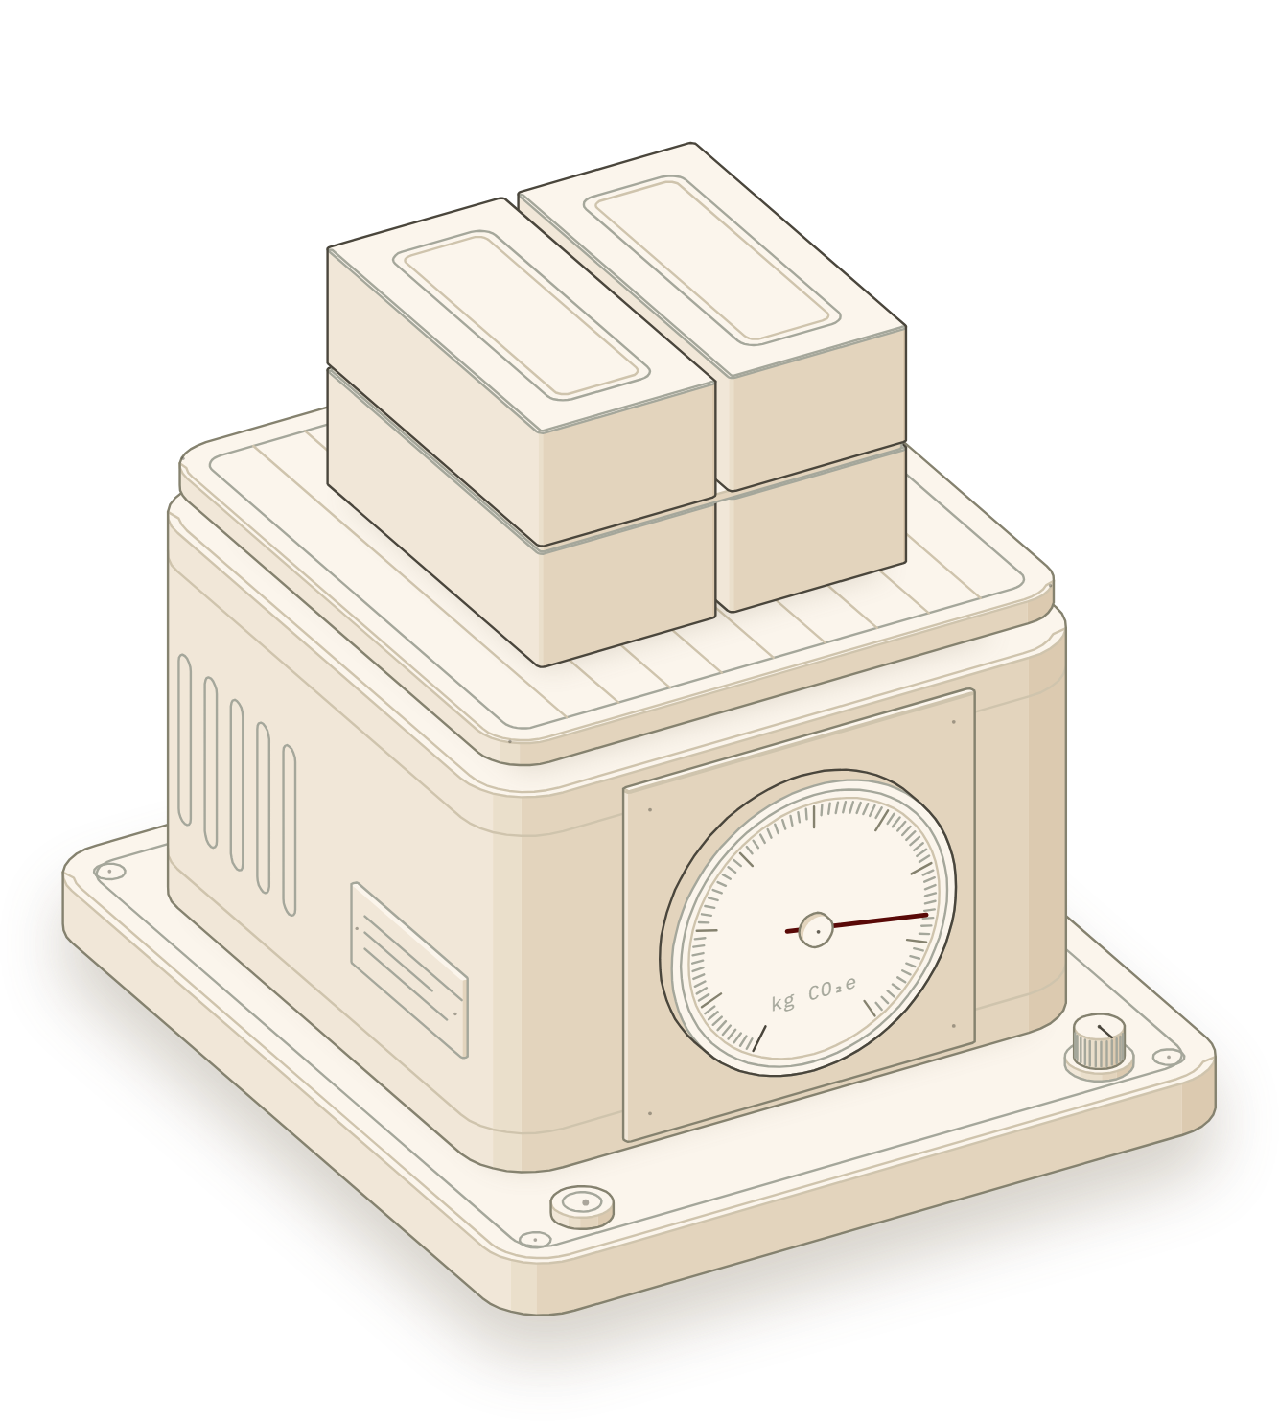

DEPARTMENT OF CIVIL ENGINEERING
INDIAN INSTITUTE OF TECHNOLOGY KHARAGPUR
Fig 1
CARBON SCALE
B.TECH THESIS PROJECT · 2026
Cradle
Embodied carbon of Indian building materials, with every number cited.
PRESENTED BY
SUPERVISOR
Durgesh Kumar
Dr. Vihangraj V. Kulkarni
Roll no. 23CE36005
Assistant Professor, Civil Engineering
1 m³ OF CLAY BRICK WALL
665 kg CO₂e
Notes:
Cradle is a free web calculator for the embodied carbon of Indian building materials. Every factor it uses is cited to a page, and every result shows its working. The figure on the right is from the app's home page: a dial scale that weighs one cubic metre of wall, driven by the same engine.

Slide 2
Half of a building's carbon is in its materials
01 INTRODUCTION
30%
INDIA HAS STARTED TO ASK FOR THIS NUMBER
ECSBC 2024
BEE · APPENDIX A6
of India's greenhouse gas emissions come from buildings
Report embodied carbon per m² for stages A1–A3
GRIHA v2019
CRITERION 20
48%
Up to 5 points for a lower GWP, using LCA and EPDs
IGBC Net Zero
CARBON RATING
Design limit of 700 kg CO₂e per m²
of building emissions are embodied: from making the materials, not running the building
CCTS 2023
MINISTRY OF POWER
Emission-intensity targets for 186 cement plants
Researchers need a number they can defend.
SOURCE: NITI AAYOG (2026), SCENARIOS TOWARDS VIKSIT BHARAT AND NET ZERO: BUILDINGS
Notes:
Buildings cause about 30% of India's emissions, and nearly half of that is embodied in the materials. Indian codes and rating systems now ask for this number: ECSBC 2024, GRIHA, IGBC and the carbon credit scheme for cement.

Slide 3
Published Indian numbers are hard to check
01 LITERATURE REVIEW
SAME INPUT, DIFFERENT INDIAN SOURCES · HIGHEST ÷ LOWEST VALUE
2 of 9
Indian studies reproduce when their arithmetic is redone
0 of 9
give a range (uncertainty) on their result
71
South Asian building LCAs reviewed: all used ecoinvent, a paid European database
A fired clay brick is 0.097 to 0.59 kg CO₂e per kg, depending on the source.
SOURCES: THESIS FIG. 2.2 AND TABLE 2.2; TALPUR ET AL. (2023)
Notes:
Three problems recur in Indian studies. Factors disagree: the same brick ranges about six times between sources. Results can't be checked: of nine studies that printed enough data, only two reproduce. And none gives an uncertainty range. Most also lean on European data.

Slide 4
Aim: a free calculator you can check by hand
02 OBJECTIVES AND SCOPE
01
02
03
04
Factor library
Engine
Validation
Application
Indian emission factors, each cited to its table or page
EN 15804 modules A1–A3 to D, with an uncertainty range
Reproduce a published Indian study, line by line
Compare Indian walls and cements, and test the factor choice
SCOPE · EN 15804 LIFE-CYCLE MODULES
A1–A3
A4
A5
B1–B7
C1–C4
D
Product
Transport to site
Construction
Use stage
End of life
Beyond life
ALWAYS IN
OPTIONAL
OPTIONAL
NOT INCLUDED
OPTIONAL
SHOWN APART
Total = A1–A3 + A4 + A5 + C1–C4 D shown apart
GWP only, kg CO₂e
Building materials
Free data only
Notes:
The aim is a free calculator in which every number traces to a source and can be checked by hand. Four objectives: the factor library, the engine, a validation against a published study, and an application to Indian walls and cements. Scope: building materials, one impact (global warming potential), EN 15804 modules except the use stage.

Slide 5
Method: the four steps of ISO 14044
03 METHODOLOGY
STEP 1
STEP 2
STEP 3
STEP 4
Goal and scope
Inventory
Impact
Interpretation
Functional unit
Life-cycle modules
Assumptions
Manual entry
BoQ import
AI draft (size only)
Quantity × factor
For each module
Working on each line
Largest contributors
Monte Carlo range
Indian-data share
STANDARDS
CPWD DAR 2014
Factor library
Outputs
IS/ISO 14040 and 14044
EN 15804+A2
Materials per unit of work, from the official rate analysis
106 Indian factors, each with source, page and licence
Report, Excel with live formulas, BibTeX, project file
Notes:
The method follows the four ISO 14044 steps. The user sets the goal and boundary and enters the materials. Quantities per unit of work come from CPWD's Analysis of Rates 2014. The engine multiplies each quantity by a cited factor from the library, then reports the biggest contributors, a Monte Carlo range and the share of the result that rests on Indian data.

Slide 6
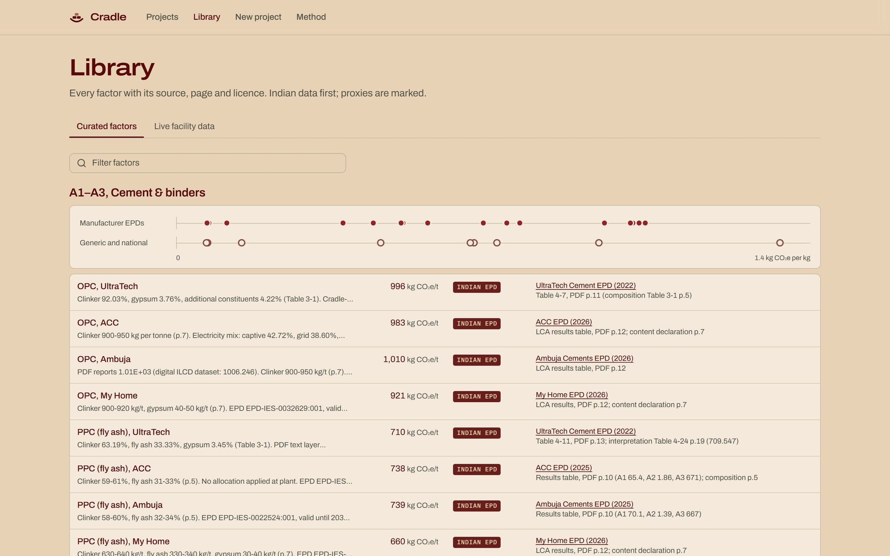
106 Indian factors, each traced to a page
03 METHODOLOGY · DATA
106
cradle / library
emission factors (A1–A3), all for products made in India
WHERE THEY COME FROM
Free data only
Indian first
Read from the document
Cited to a page
FIG 2 · EACH FACTOR SHOWS ITS EPD, PAGE AND DATA TAG
Notes:
The library holds 106 factors for Indian products: 54 from Indian EPDs, 45 from Indian studies such as the IFC 2017 database, 6 from government reports and one from live plant data. Every value was read from its PDF, and stores its source, page, year and licence. No paid databases.

Slide 7
Every number is a quantity times a factor
03 METHODOLOGY · ENGINE
A1–A3
Q × EF
WORKING SHOWN ON EVERY LINE
A4
m × d × EF per t·km
RAIL, SHIP
1,540 kg × 0.39
= 600.5 kg CO₂e
(m ÷ payload) × d × EF per vehicle·km
TRUCK
Clay bricks in 1 m³ of wall, IFC 2017 India average
A5
waste % × (A1–A3 + A4) + site energy × EF
C1–C4
m × EF of the end-of-life route
UNCERTAINTY
Monte Carlo, 5,000 runs
Triangular draws on each published range; 95% band; seed 42
D
reported beside the total, never added
Total = A1–A3 + A4 + A5 + C1–C4
DATA STRENGTH
Indian-data share
Q quantity · EF factor · m mass (t) · d distance (km)
Each kg tagged by its source, e.g. 83% Indian, 17% proxy
Notes:
The engine is linear. Each module is a quantity times a factor; transport uses tonne-km or vehicle-km; construction adds the wasted share and site energy. Module D is shown beside the total, as EN 15804 requires. Every line prints its working, so any number can be checked by hand. Where a source gives a range, a 5,000-run Monte Carlo gives a 95% band.

Slide 8
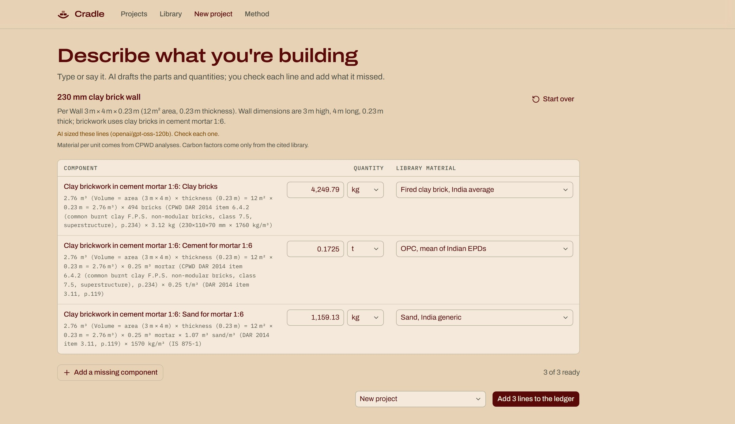
Describe the work; CPWD supplies the materials
04 THE TOOL · INVENTORY
1
You type or say
cradle / new project
“230 mm clay brick wall, 3 m × 4 m”
2
AI only sizes it
3 m × 4 m × 0.23 m = 2.76 m³
3
CPWD gives the materials
DAR 2014 item 6.4.2: 494 bricks + 0.25 m³ mortar per m³
4
Library gives the factors
You check each line, then add it to the ledger
The AI never picks a factor. When it did, bricks and mortar came out 2× wrong.
Notes:
Three ways to enter materials: manual, a CPWD-style bill of quantities, or an AI draft. In the draft, the language model only works out the size of the work item. The materials per cubic metre come from CPWD's rate analysis, and the factors from the cited library. The user confirms every line. In an early test where the model chose quantities itself, bricks and mortar were off by about two times.

Slide 9
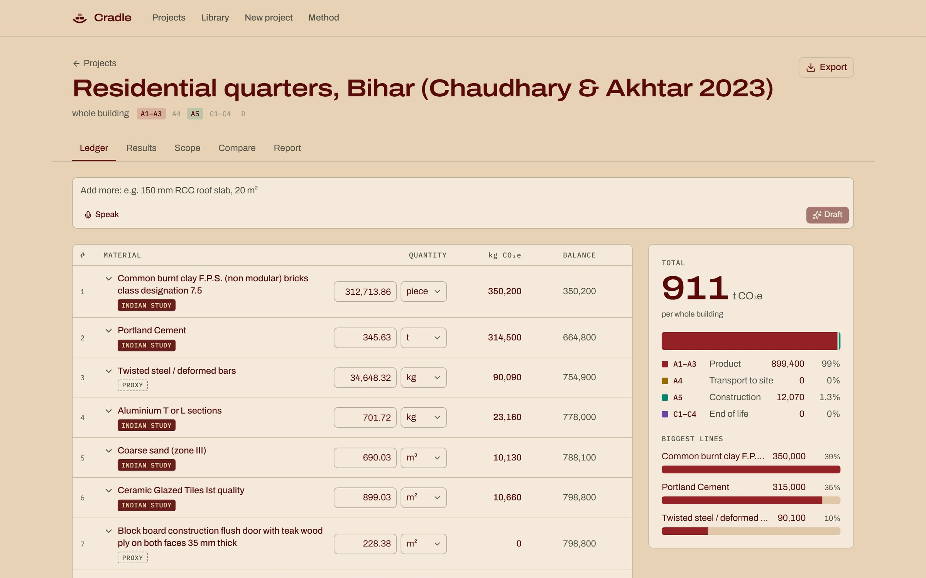
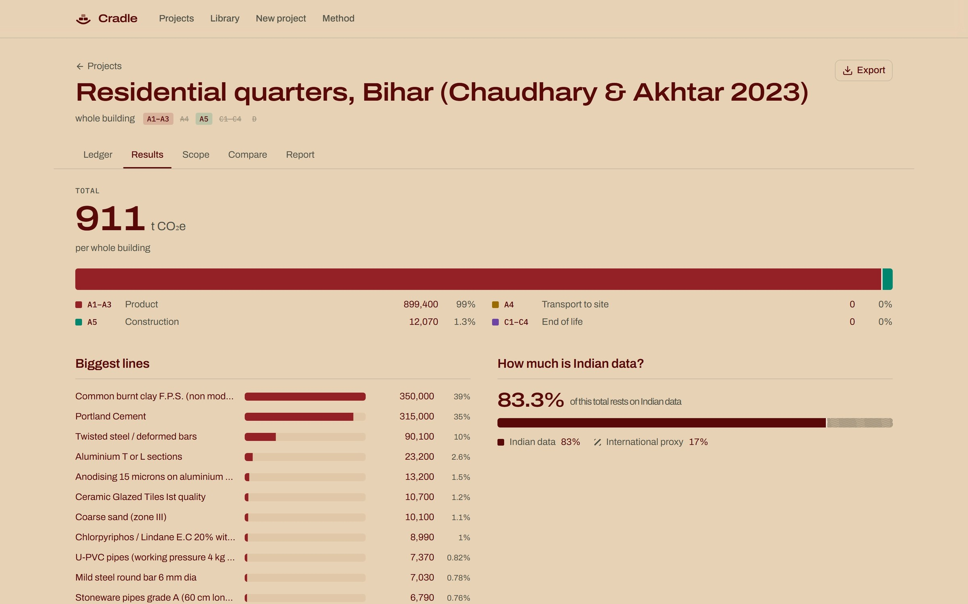
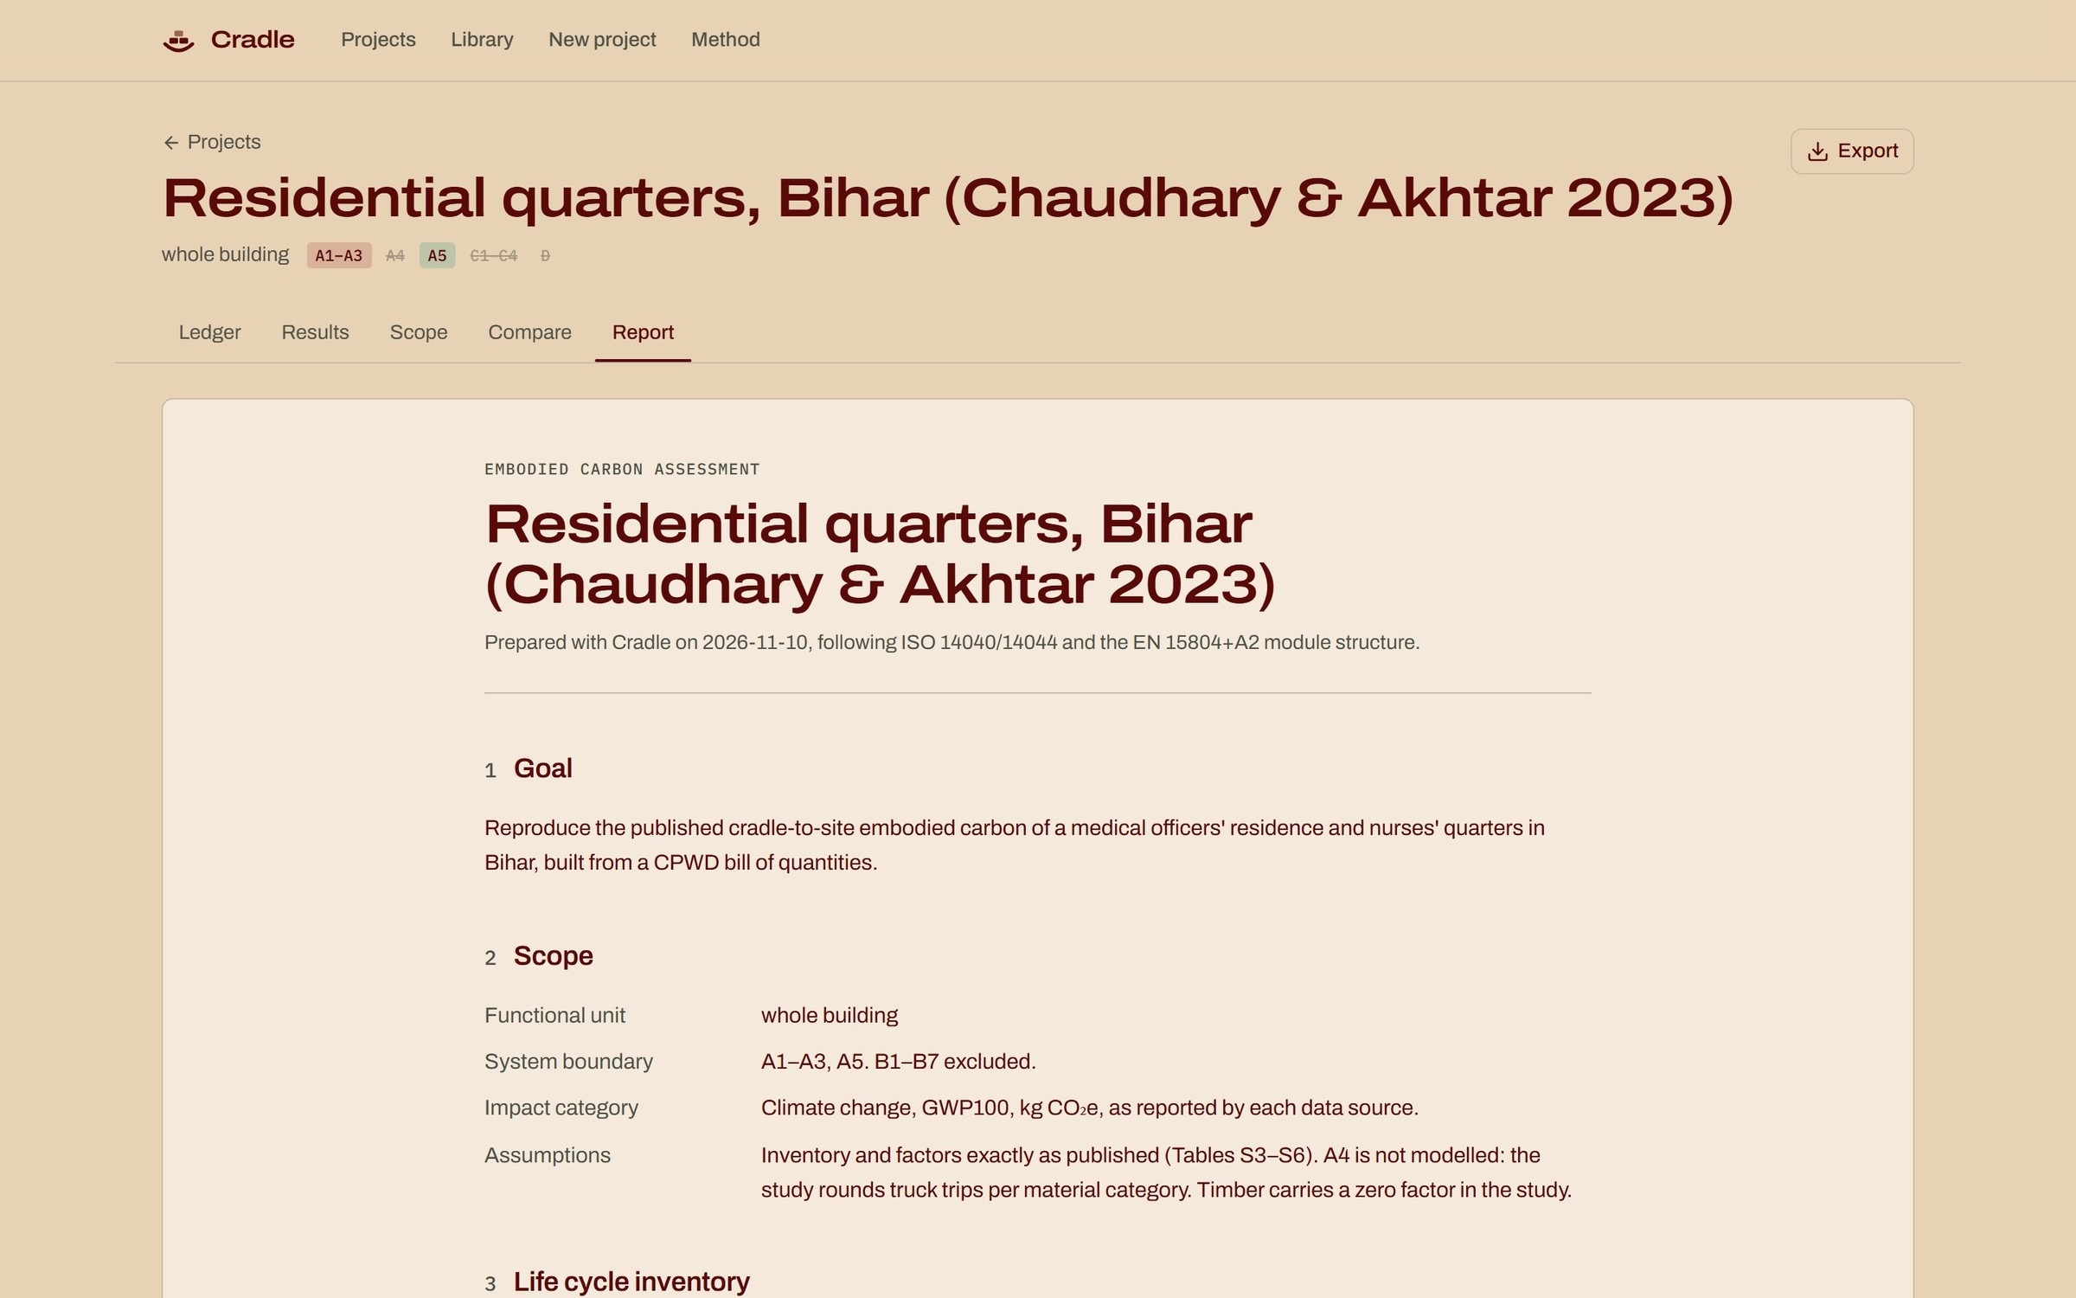
From the first line to the final report
04 THE TOOL · WORKFLOW
cradle / ledger
cradle / results
cradle / report
01
Ledger
02
Results
03
Report
Every material with its quantity, data tag and running total
Total by module, the biggest lines and the Indian-data share
ISO 14044 order; exports Excel, BibTeX and the project file
REAL SCREENS OF CRADLE · THE VALIDATED BIHAR BUILDING, 78 LINES
Notes:
These are real screens of the app with the validated building loaded. The ledger is the working screen. Results give the total by module, the biggest lines and how much rests on Indian data. The report follows ISO 14044 order and exports to Excel with live formulas, BibTeX and a project file. Projects stay in the browser; no login.

Slide 10
Cradle reproduces a published Indian study
05 VALIDATION
CHAUDHARY & AKHTAR (2023), ACS ENVIRONMENTAL AU · RESIDENTIAL QUARTERS, BHOJPUR, BIHAR · 78 MATERIALS FROM A CPWD BOQ
A1–A3 DIFFERENCE
STAGE | PUBLISHED | CRADLE | DIFFERENCE
A1–A3 materials | 899,412.37 | 899,412.37 | 0.00
A5 construction | 12,075.01 | 12,074.60 | 0.41 (0.003%)
A4 transport | 24,631 | not compared | see note
0.00
kg CO₂e, on 899,412.37 kg
KG CO₂E
The paper's own quantities, units and factors were entered, so any gap could only come from the calculation itself.
A5
The 0.41 kg gap is one welding item the paper gives per cm, a unit Cradle does not have.
A4
The paper rounds whole truck trips per group; Cradle shares trips by mass. A4 is 2.6% of the total.
78 of 78 lines match
49 automated tests pass
Notes:
To validate the engine, all 78 materials of Chaudhary and Akhtar (2023) were entered with the paper's own quantities, units and factors. A1-A3 matches to the hundredth of a kilogram. A5 differs by 0.41 kg because one welding item is given per centimetre. A4 is left out of the check because the paper rounds truck trips per material group; adding that method is future work.

Slide 11
Bricks and cement are three-quarters of the total
06 RESULTS · VALIDATED BUILDING
SHARE OF A1–A3 EMISSIONS · TOTAL 899.4 t CO₂e · 78 MATERIALS
74%
from bricks and cement alone, so their factors matter most
83.3%
of the total rests on Indian data; the rest on foreign factors the paper used
Notes:
Where does the validated building's carbon come from? Burnt clay bricks are 39% and Portland cement 35%: together about three-quarters. So the factors for these two materials matter most. The data-share check finds 83% of the total rests on Indian data.

Slide 12
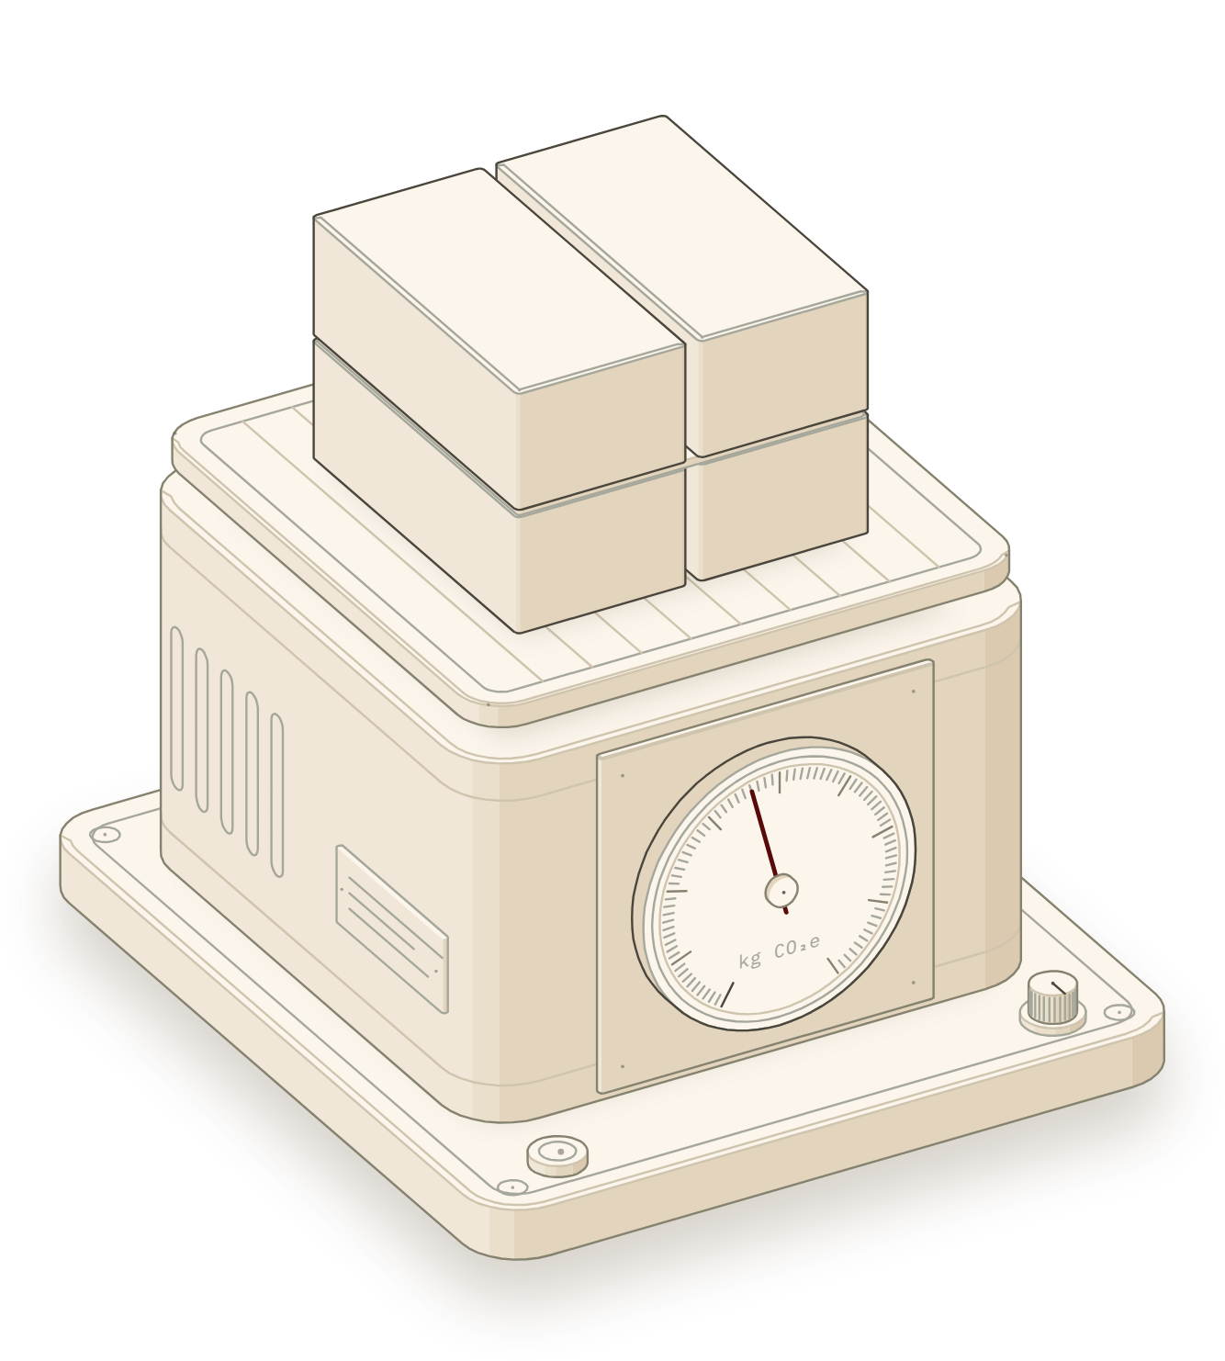
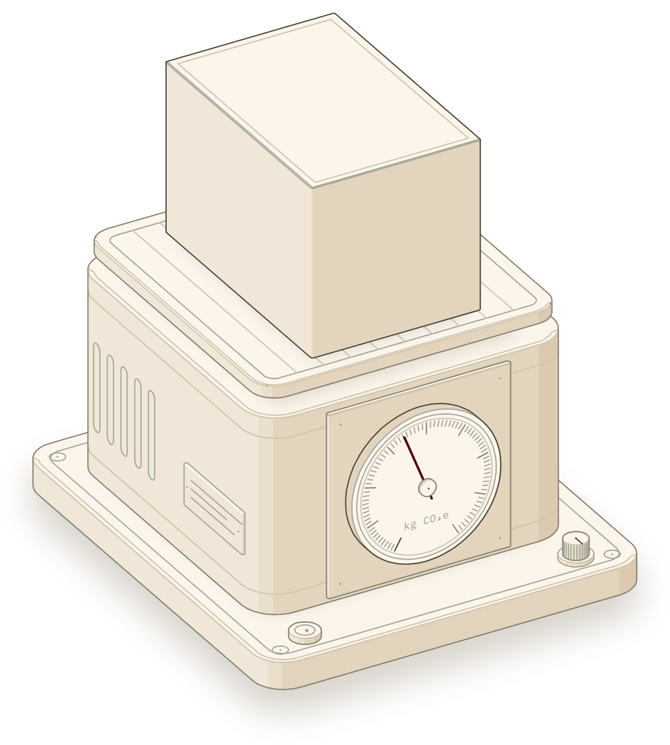
Fly ash brick and AAC walls carry about half
06 RESULTS · 1 m³ OF MASONRY
FIG 3a
FIG 3b
FIG 3c
Clay brick, mortar 1:6
Fly ash–lime brick, mortar 1:6
AAC block, mortar 1:4
665 kg CO₂e
361 kg CO₂e
342 kg CO₂e
BASELINE
−46%
−49%
A1–A3 · QUANTITIES FROM CPWD DAR 2014 (ITEMS 6.4.2, 6.34.2, 6.38) · FACTORS FROM THE LIBRARY · THE SAME SCALE IS THE APP'S HOME FIGURE
Notes:
One cubic metre of three common walls, with CPWD quantities and library factors. Clay brick masonry is 665 kg CO2e. Fly ash-lime brick is 361 and AAC block 342: about half. The bricks or blocks cause most of each total; mortar cement adds 54 to 61 kg.

Slide 13
The factor you pick can matter more than the wall
06 RESULTS · SENSITIVITY
SAME CLAY WALL, FIVE BRICK FACTORS · kg CO₂e PER m³
CEMENT TYPES, MEAN OF INDIAN EPDs · kg CO₂e PER TONNE
1.8× from the kiln assumption alone: more than the gap between clay brick and AAC.
Under half of OPC for slag cement. Even OPC brands range 921 to 1,010.
A result should always say which factor it used, and where it came from.
Notes:
Keeping the CPWD quantities fixed and changing only the brick factor moves the same wall from 542 to 973 kg, 1.8 times. That is bigger than the gap between clay brick and AAC. The sources also conflict: IFC ranks zigzag kilns worst, while a survey of 500 kilns found they use the least energy. For cement, slag cement is under half of OPC, and OPC brands differ too.

Slide 14
What the project delivers
07 CONCLUSION
01
A free calculator for EN 15804 modules A1–A3, A4, A5, C1–C4 and D, with the working shown for every number.
NEXT STEPS
106 Indian factors, each cited to its table or page; 54 come from Indian EPDs.
A second validation case (Patil et al. 2023)
02
A4 by whole truck trips, then re-check
03
It reproduces a published Indian building: A1–A3 exactly, A5 within 0.41 kg.
Published ranges on more factors (9 of 106)
04
Per m³, fly ash brick (361) and AAC (342) walls are about half of clay brick (665 kg CO₂e).
Compare walls per m² of equal function
Indian end-of-life data for C1–C4 and D
05
The brick factor alone moves a clay wall from 542 to 973 kg CO₂e/m³, so the factor must be stated.
New Indian EPDs for bricks and blocks
Notes:
To conclude: a free, validated calculator with 106 cited Indian factors. It reproduces a published study exactly. Fly ash brick and AAC walls come out at about half of clay brick, and the brick factor alone moves a result by 1.8 times. Next steps: a second validation case, the truck-trip method for A4, wider uncertainty ranges, and better Indian end-of-life data.

Slide 15
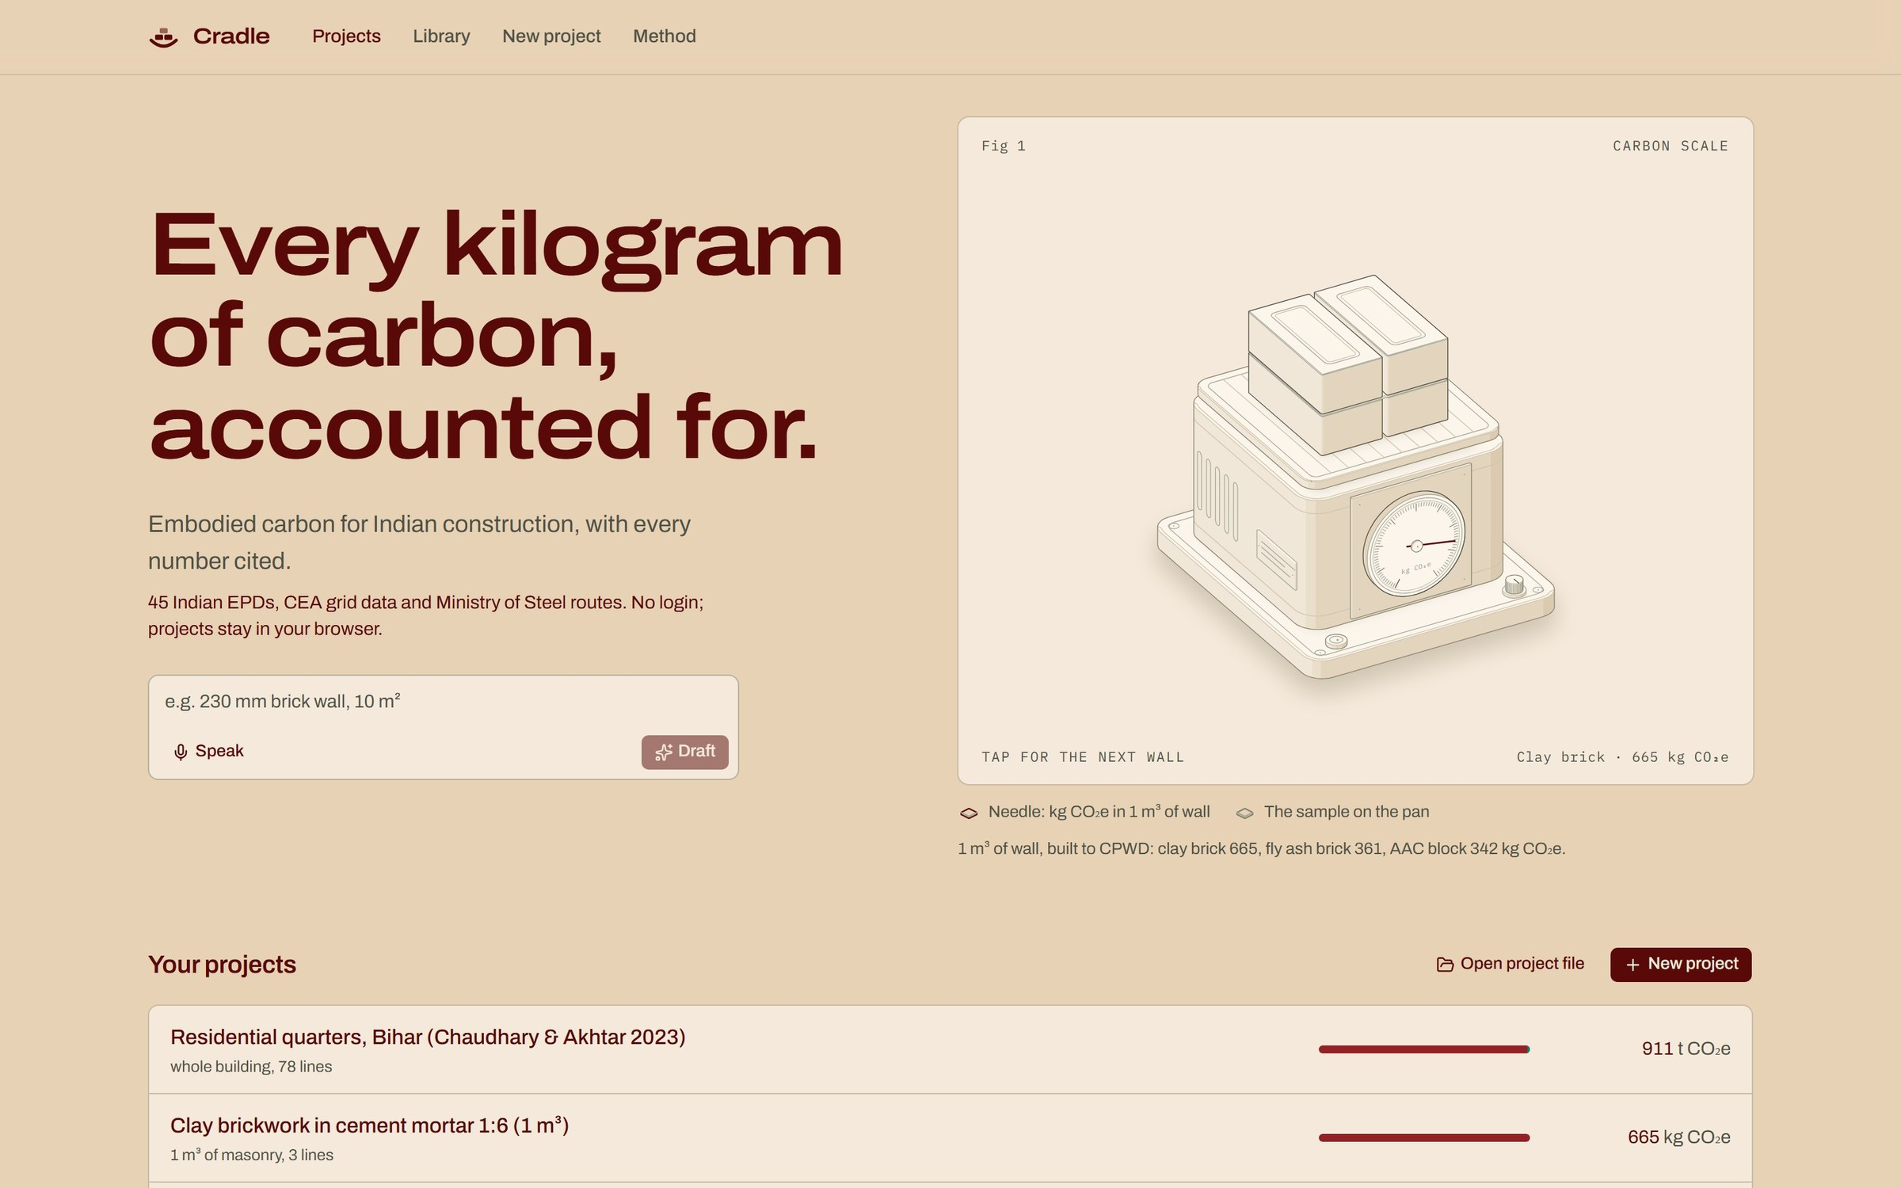
Thank you
Questions are welcome.
Durgesh Kumar · 23CE36005
Supervisor: Dr. Vihangraj V. Kulkarni
Department of Civil Engineering, IIT Kharagpur
CRADLE · HOME
Notes:
Thank you. I'm happy to take questions, and to show the app live.

