Slide 1
Secret agent
Of raw

Slide 2
About code
This code is for a secret agent who is working as a member, in a bank but he also work for indian goverment
This agent is a member of RAW (Research and Analysis Wing) so he have to keep his identity a secret form his family and friend
Because his true side don’t come out this program is made

Slide 3
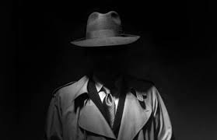

Slide 4
I manily use in this code
I manily use in this code is switch funtion
Because I wanted to keep is code simple so everybody can easily understand the code
The sencond thing I use in this code is Class & object because of function re-usability and for privacy
The third thing i have used in code is if and else
Because for checking parameter’s

Slide 5
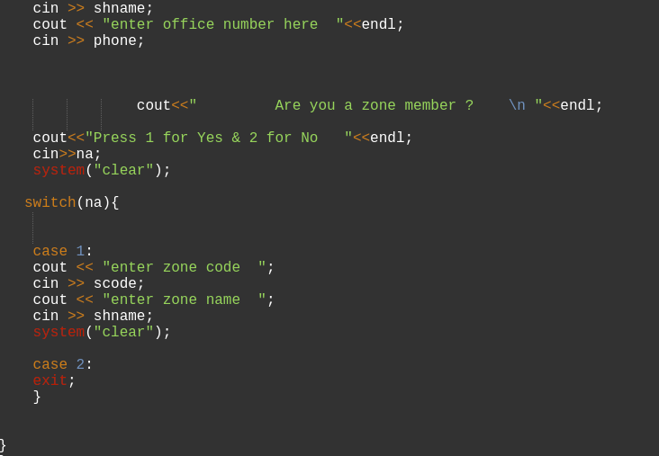
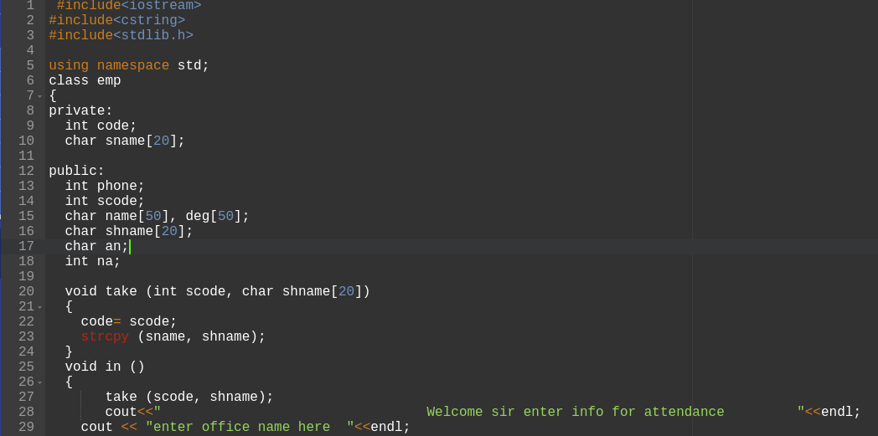
Some picture

Slide 6
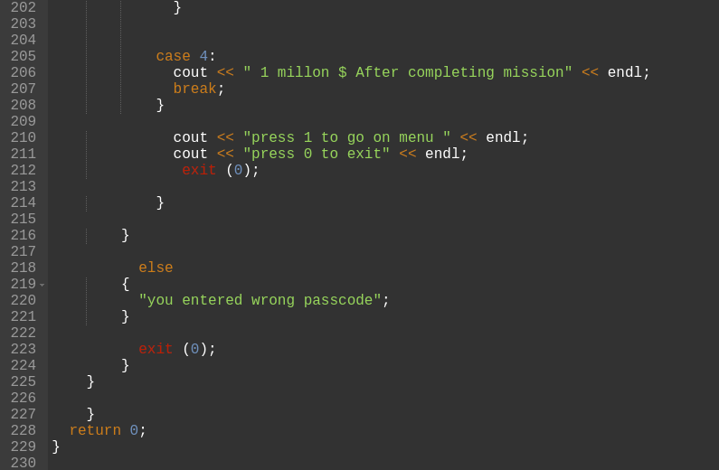
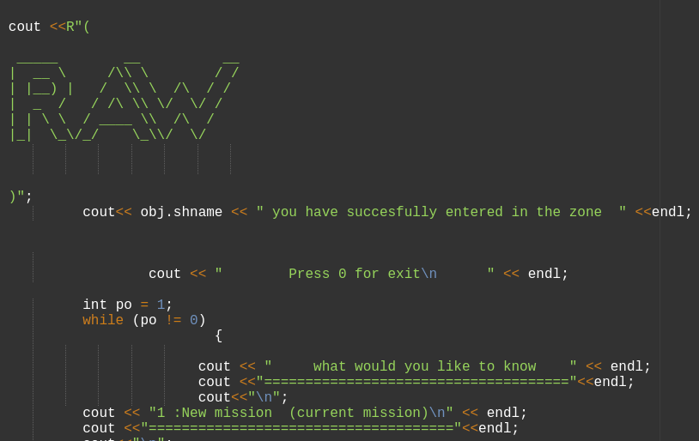

Slide 7
Made by :-
Mayur singh rathour
Batch -CS
Class -B
Roll no -21162171012

