Slide 1
Introduction to Computational Labs
David Dickinson
York Plasma Institute, Department of Physics, University of York, Heslington, York YO10 5DD
Fusion Labs : Computational Lab: MSc & CDT Plasma Strand

Slide 2
Outline
Overview of unit
Overview of code
Overview of physics
First steps

Slide 3
Overview of the course : What, why and when
You’ll be given an existing PIC code written in Python and you’re tasked with using this to undertake a plasma physics study.
  Meant to (partially) emulate something like project work, you have some flexibility in what you look at and how you go about it.
  Various tasks described on the VLE, broken down into different sections.
  Gain experience in computational experiments – some generic experimentation skills but also other more specific skills such as picking up an existing code and modifying as required, dealing with large amounts of data etc.
Four timetabled sessions (4 x 7 = 28 hours – some work outside timetabled session).
  Sessions are run flexibly – I don’t expect you to be in the room all day, feel free to structure your time as suits your schedule.
  In addition to in room questions for immediate support do feel free to send me a an email if you’re working outside of the timetabled hours and need some support.

Slide 4
Overview of the course : Assessment
Unlike the ICF/MCF labs you’ll be using a google doc to provide an electronic lab book (and gives you something to compare to eLog).
  This removes some of the challenges associated with eLog but gives you more responsibility for maintaining a high quality record (time stamping etc.).
  You might want to look back at the guidance provided in the PMDA labs.
  Make sure you create the google doc using your York IT account.
  The assessment is based entirely off your lab book so make sure you keep a good quality record of what you do.
  Lab book submitted via the VLE – download a pdf copy and submit via the submission point.

Slide 5
Overview of the course : Assessment
Unlike the ICF/MCF labs you’ll be using a google doc to provide an electronic lab book (and gives you something to compare to eLog).
  This removes some of the challenges associated with eLog but gives you more responsibility for maintaining a high quality record (time stamping etc.).
  You might want to look back at the guidance provided in the PMDA labs.
  Make sure you create the google doc using your York IT account.
  The assessment is based entirely off your lab book so make sure you keep a good quality record of what you do.
  Lab book submitted via the VLE – download a pdf copy and submit via the submission point.
Much better to submit a succinct high quality record than a verbose low quality one!

Slide 6
Overview of the code : Quick start guide
The python code is available to download from the “Introduction to the computational lab” document on the VLE.
  Written in python 3 and requires matplotlib, scipy and numpy.
  Evolves a distribution of electrons and associated Electric field. See Fitzpatrick’s page on 1D PIC codes for more details (linked from VLE).
  Implements a PIC algorithm in a 1D periodic domain, using RK4 for time integration and FFTs for spatial derivatives (see lecture 7 and lecture 8 of computational techniques).
  In practical terms we start with some perturbation to the Electric field and electron distribution and then evolve this in time to see how the Electric field and electrons evolve. Can then make interesting measurements from this time dependent data.
The primary use of the code is to look at wave-particle interactions. For example impose a wave in the electric field and see how the electrons respond.
Two main physics phenomena will be explored in the tasks:
  Landau damping – Transfer of energy from wave to plasma
  Two stream instability – Transfer of energy from plasma to wave

Slide 7
Overview of the code : Tips
I recommend that one of the first activities is to look through the code to work out what is going on.
The code can be quite slow, you may want to consider if you can speed it up.
Don’t forget that computational measurements have errors and uncertainties. The PIC method suffers from noise – so you may need lots of repeats and this may generate lots of data – you will need to plan how you handle this.
You don’t want to have to rerun entire sets of simulations just because you’ve improved your analysis routines. Split into two stages:
  generation of raw data by running the code → save the raw data.
  Measure derived quantities from saved raw data using analysis code.

Slide 8
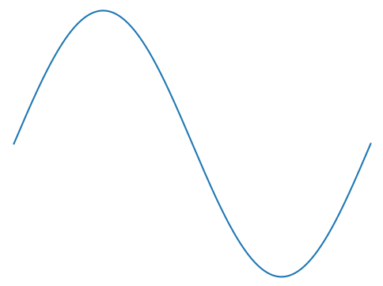
Overview of the physics : Wave-particle interactions
Suppose you are an electron sitting still as an oscillating electric field passes by.
Field will raise and lower electron potential, but no net change.

Slide 9
Overview of the physics : Wave-particle interactions
Suppose you are an electron sitting still as an oscillating electric field passes by.
Field will raise and lower electron potential, but no net change.

Slide 10
Overview of the physics : Wave-particle interactions
Suppose you are an electron sitting still as an oscillating electric field passes by.
Field will raise and lower electron potential, but no net change.
Now suppose electron moving at almost the same speed as the wave – Can get sustained interaction and a net transfer between wave and particle. Basics behind physics we’ll be looking at.

Slide 11
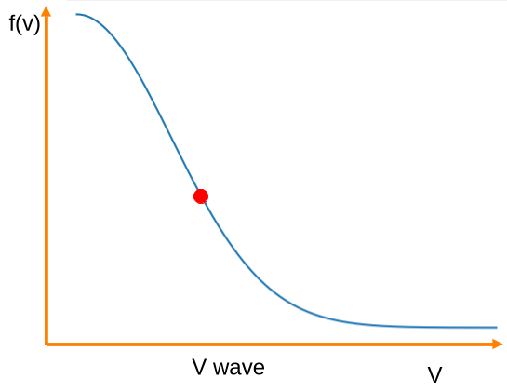
Overview of the physics : Wave-particle interactions
We have a distribution of particles, with a range of velocities – most particles won’t interact with the wave, just those with velocity near the wave velocity.
Depending on the gradient of f where v = v wave there will be more/fewer particles going faster/slower than the wave. This determines the net transfer of energy.
In the figure shown there are more particles moving a little slower than the wave than going a little faster, this means there’s a net transfer of energy from the wave to the particles. This flattens the distribution slightly and will continue until the distribution is flat.
Very crudely this is Landau damping in action.

Slide 12
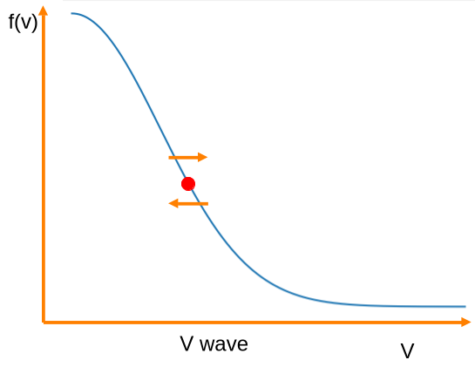
Overview of the physics : Wave-particle interactions
We have a distribution of particles, with a range of velocities – most particles won’t interact with the wave, just those with velocity near the wave velocity.
Depending on the gradient of f where v = v wave there will be more/fewer particles going faster/slower than the wave. This determines the net transfer of energy.
In the figure shown there are more particles moving a little slower than the wave than going a little faster, this means there’s a net transfer of energy from the wave to the particles. This flattens the distribution slightly and will continue until the distribution is flat.
Very crudely this is Landau damping in action.

Slide 13
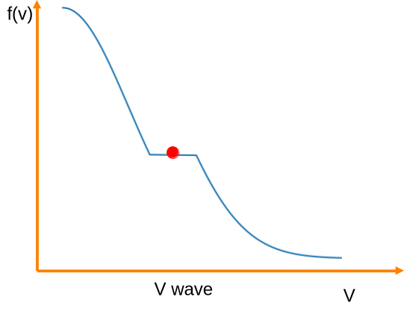
Overview of the physics : Wave-particle interactions
We have a distribution of particles, with a range of velocities – most particles won’t interact with the wave, just those with velocity near the wave velocity.
Depending on the gradient of f where v = v wave there will be more/fewer particles going faster/slower than the wave. This determines the net transfer of energy.
In the figure shown there are more particles moving a little slower than the wave than going a little faster, this means there’s a net transfer of energy from the wave to the particles. This flattens the distribution slightly and will continue until the distribution is flat.
Very crudely this is Landau damping in action.

Slide 14
First steps
Review the tasks.
Read up a little on wave-particle interactions, in particular Landau damping.
  Considering producing a summary in your lab book.
Read through the code and produce a summary of the key sections in your lab book.
  Lecture 8 is probably most useful, but others (like lecture 7) can also help.
Check you can run the code and what the screen output looks like.
Produce a data management plan.
Modify the code to save the relevant raw data.
  You’ll need to think how you are going to organise your data (how will you know what each case is etc.)
Make a plan for how you’re going to tackle the tasks.

