Slide 1
Unit 4 Model Order Selection
EL-GY 6143: Introduction to machine learning
Prof. Pei Liu

Slide 2
Learning Objectives
Compute the model order for a given model class
Visually identify overfitting and underfitting of a model in a scatterplot
Determine if there is under-modeling for a given true function and model class
Compute the bias and variance for linear models (advanced)
Perform cross-validation for selecting an optimal order selection

Slide 3
Outline
Motivating Example: What polynomial degree should a model use?
Bias and variance
Bias and variance for linear models (Advanced)
Cross-validation

Slide 4
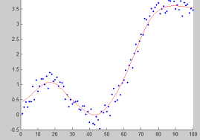
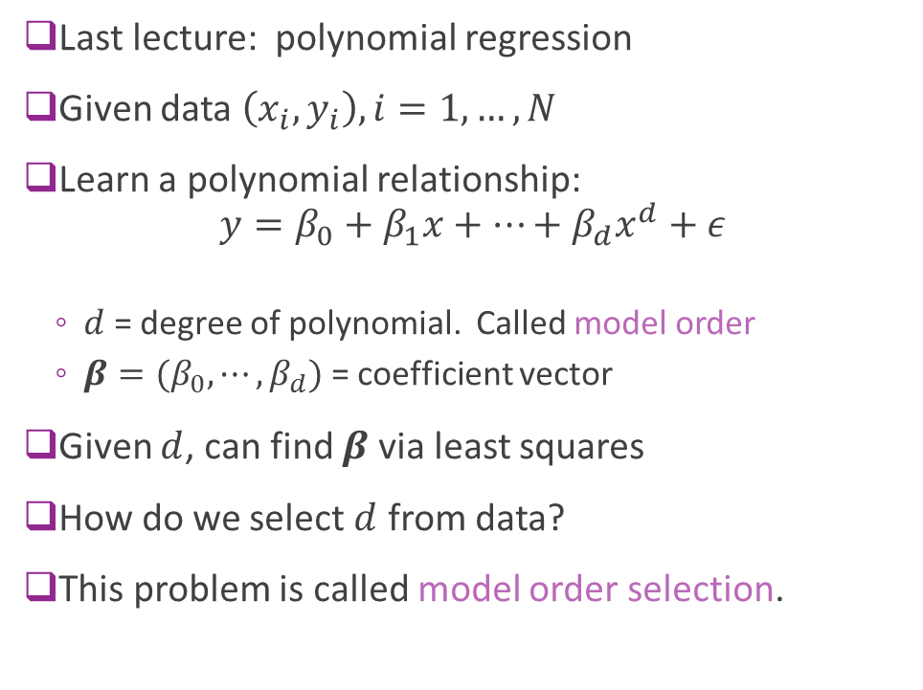
Polynomial Fitting
Last lecture: polynomial regression
Given data $\left(x_{i},y_{i}\right), i=1,…, N$
Learn a polynomial relationship: $y=β_{0}+β_{1}x+⋯+β_{d}x^{d}+ε$
$d$ = degree of polynomial. Called model order
$β=(β_{0},⋯,β_{d})$ = coefficient vector
Given $d$, can find $β$ via least squares
How do we select $d$ from data?
This problem is called model order selection.

Slide 5
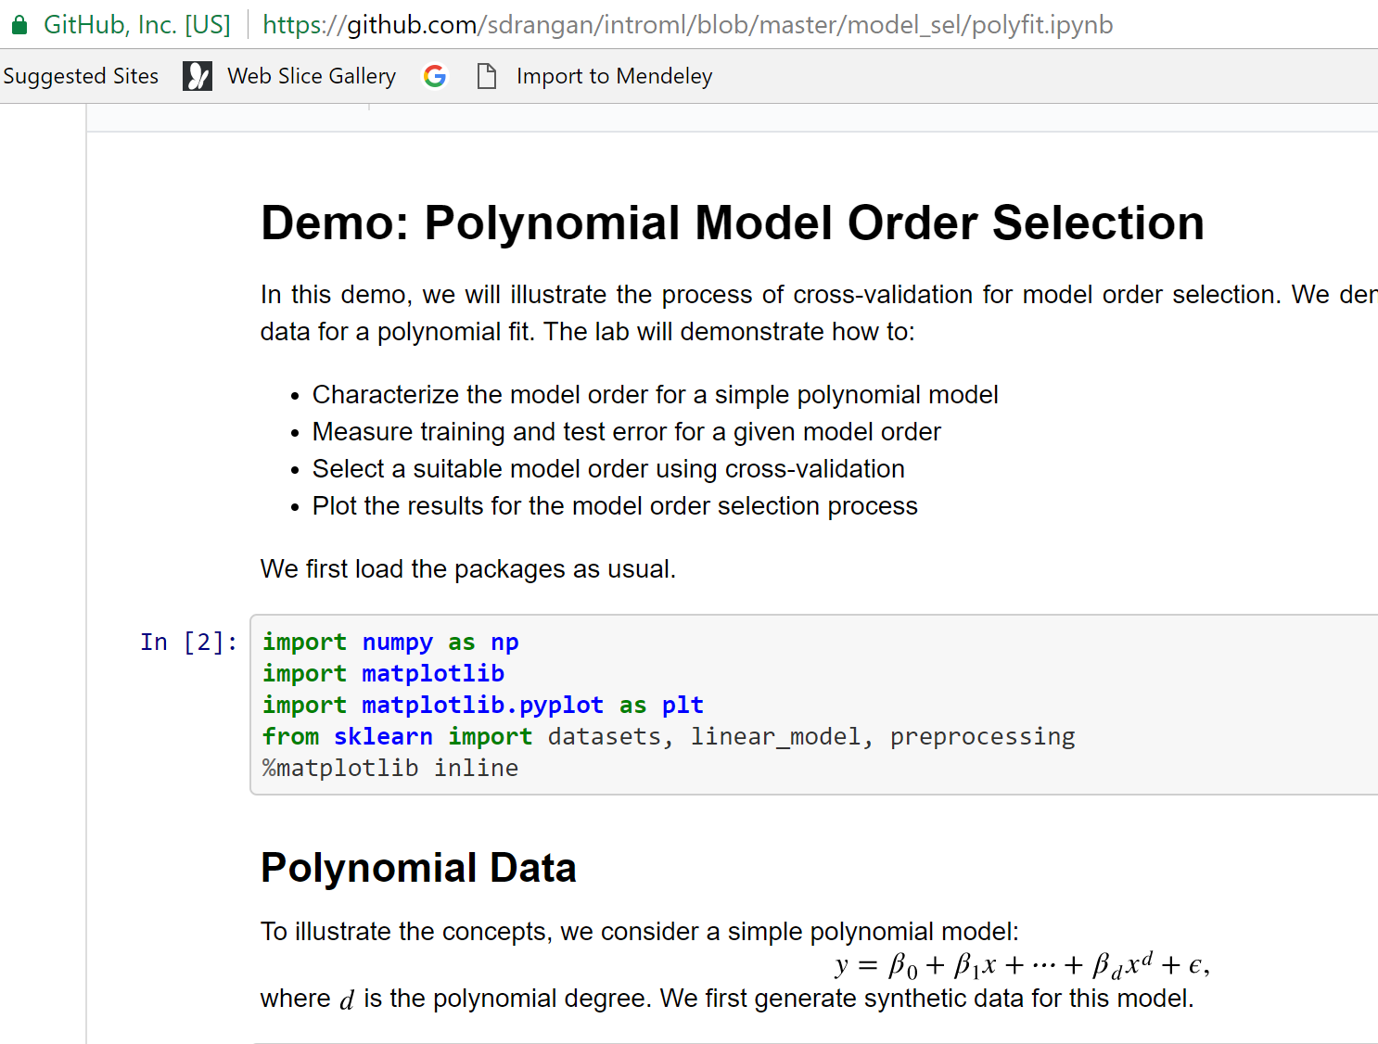
Demo on Github
Demo on github: https://github.com/pliugithub/MachineLearning/blob/master/unit04_model_sel/demo_polyfit.ipynb

Slide 6
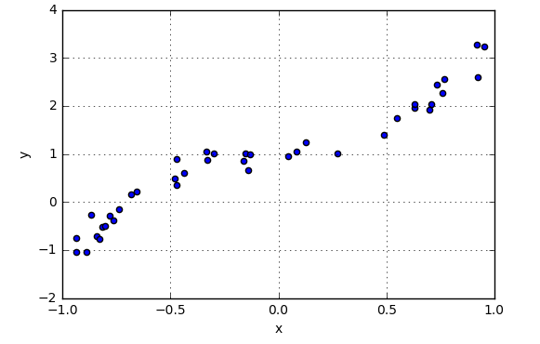
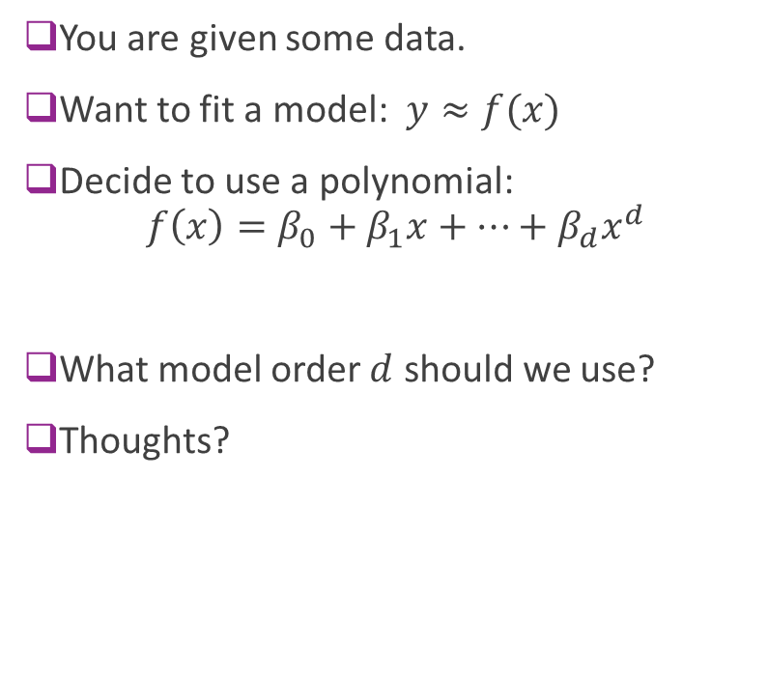
Example Question
You are given some data.
Want to fit a model: $y≈f(x)$
Decide to use a polynomial: $f\left(x\right)=β_{0}+β_{1}x+⋯+β_{d}x^{d}$
What model order $d$ should we use?
Thoughts?

Slide 7
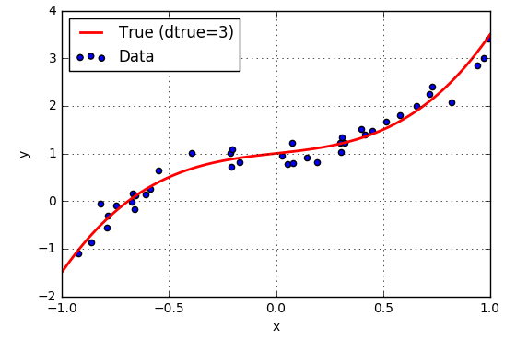
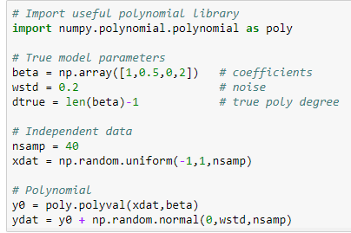
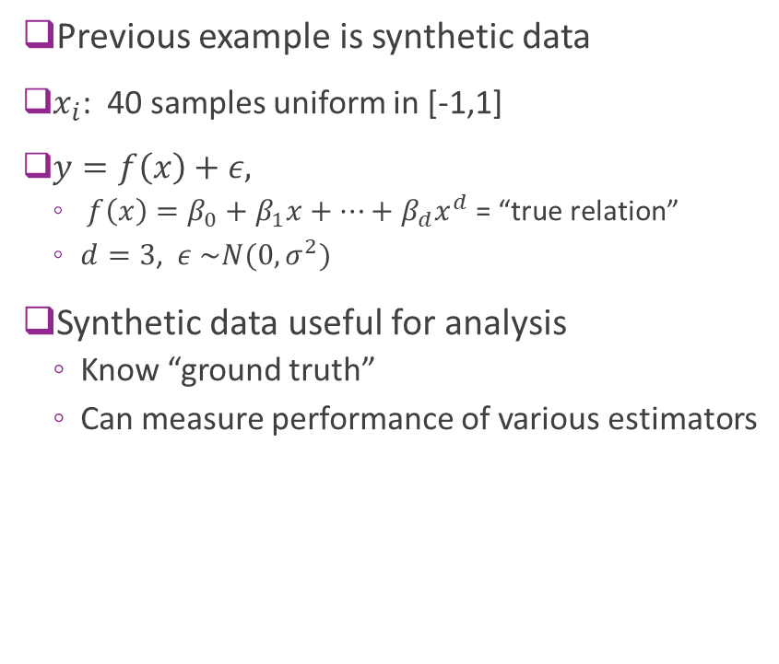
Synthetic Data
Previous example is synthetic data
$x_{i}$: 40 samples uniform in [-1,1]
$y=f\left(x\right)+ε,$
$f\left(x\right)=β_{0}+β_{1}x+⋯+β_{d}x^{d}$ = “true relation”
$d=3$, $ε \sim N(0,σ^{2})$
Synthetic data useful for analysis
Know “ground truth”
Can measure performance of various estimators

Slide 8
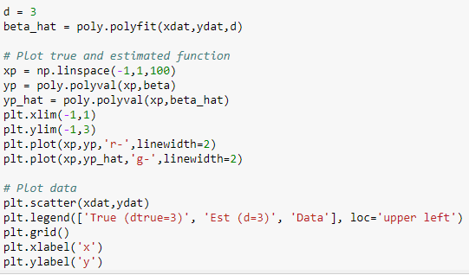
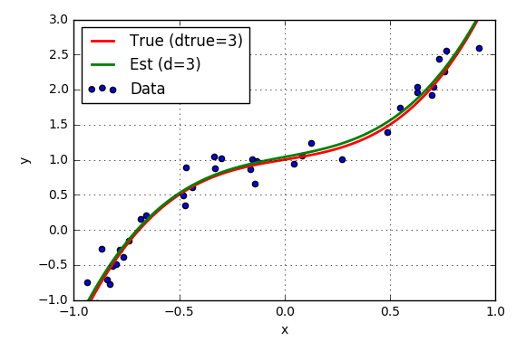
Fitting with True Model Order
Suppose true polynomial order, d=3, is known
Use linear regression
numpy.polynomial package
Get very good fit

Slide 9
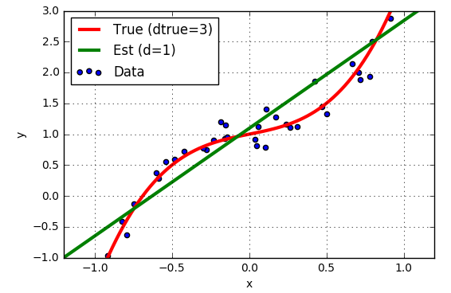
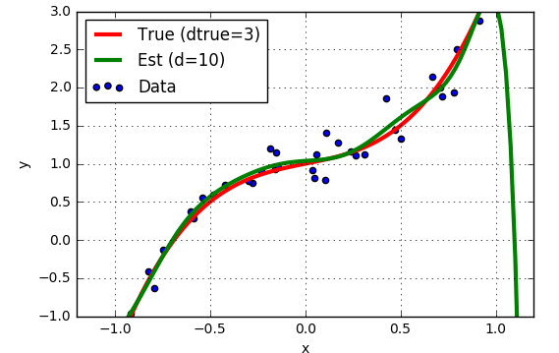
But, True Model Order not Known
Suppose we guess the wrong model order?
d=1 “Underfitting”
d=10 “Overfitting”

Slide 10
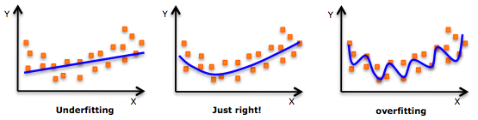
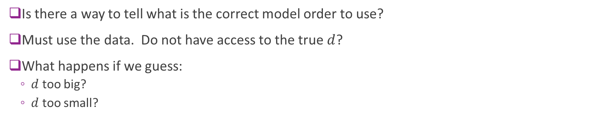
How Can You Tell from Data?
Is there a way to tell what is the correct model order to use?
Must use the data. Do not have access to the true $d$?
What happens if we guess:
$d$ too big?
$d$ too small?

Slide 11
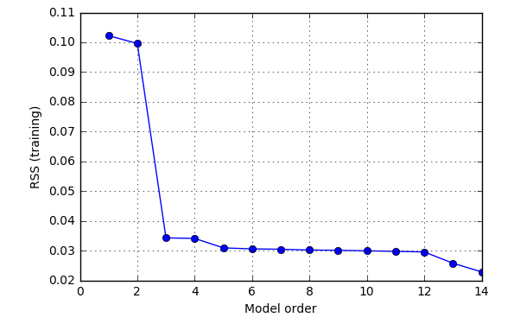
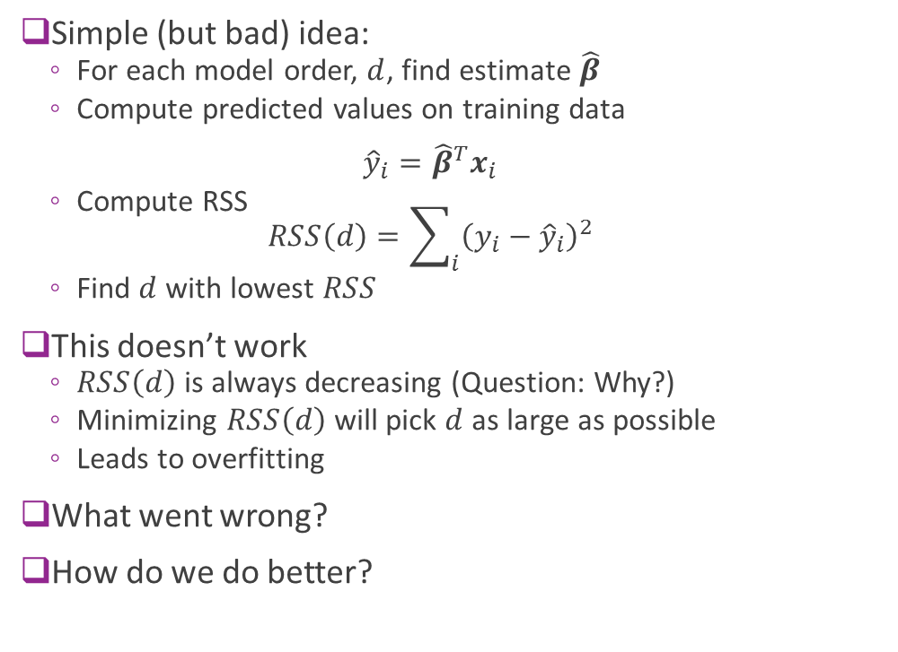
Using RSS on Training Data ?
Simple (but bad) idea:
For each model order, $d$, find estimate $\hat{β}$
Compute predicted values on training data ${\hat{y}}_{i}={\hat{β}}^{T}x_{i}$
Compute RSS $RSS\left(d\right)=\sum_{i}{{\left(y_{i}−{\hat{y}}_{i}\right)}^{2}}$
Find $d$ with lowest $RSS$
This doesn’t work
$RSS\left(d\right)$ is always decreasing (Question: Why?)
Minimizing $RSS\left(d\right)$ will pick $d$ as large as possible
Leads to overfitting
What went wrong?
How do we do better?

Slide 12
Outline
Motivating Example: What polynomial degree should a model use?
Bias and variance
Bias and variance for linear models (Advanced)
Cross-validation

Slide 13
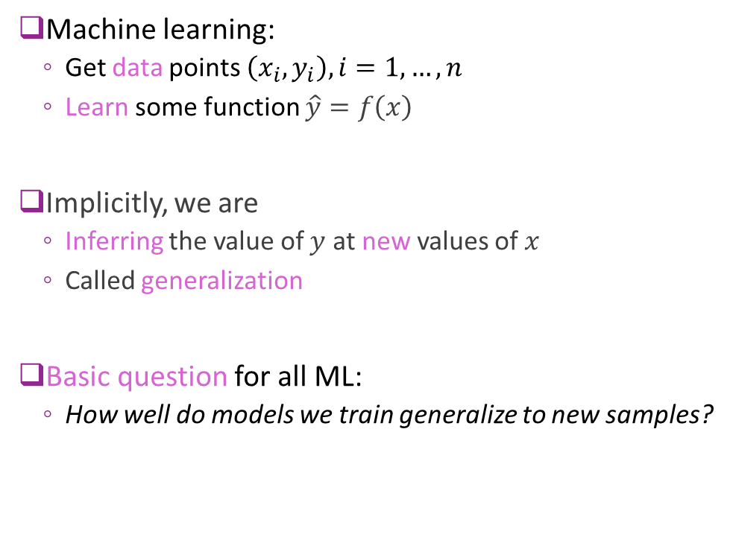




Generalization
Machine learning:
Get data points $\left(x_{i},y_{i}\right), i=1,…,n$
Learn some function $\hat{y}=f\left(x\right)$
Implicitly, we are
Inferring the value of $y$ at new values of $x$
Called generalization
Basic question for all ML:
How well do models we train generalize to new samples?
$$y$$
?
$${\hat{y}}_{new}$$
$$x$$
$$x_{new}$$

Slide 14
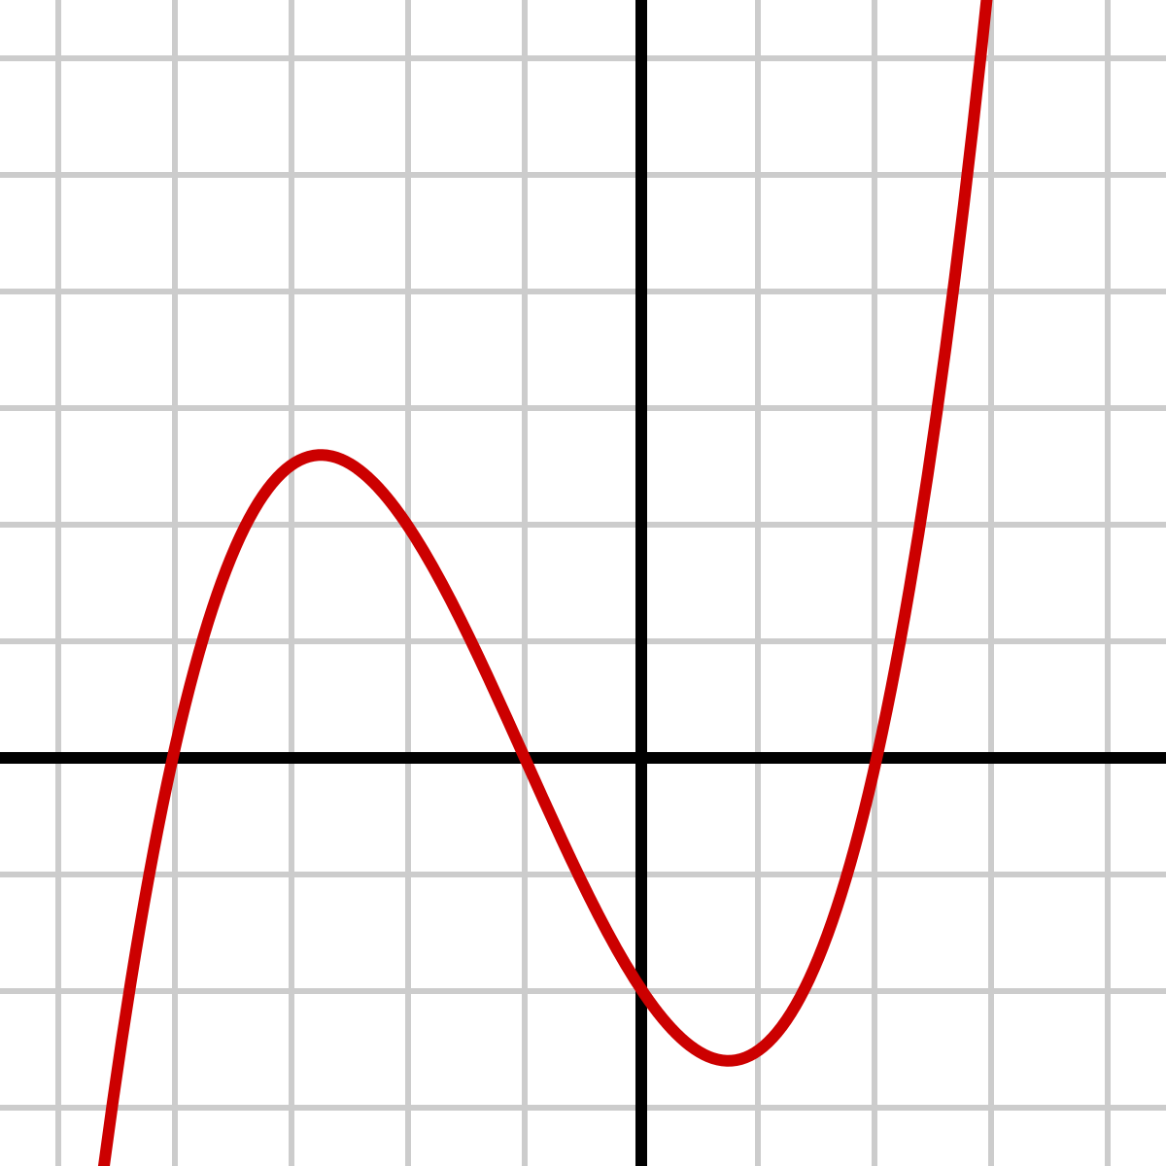
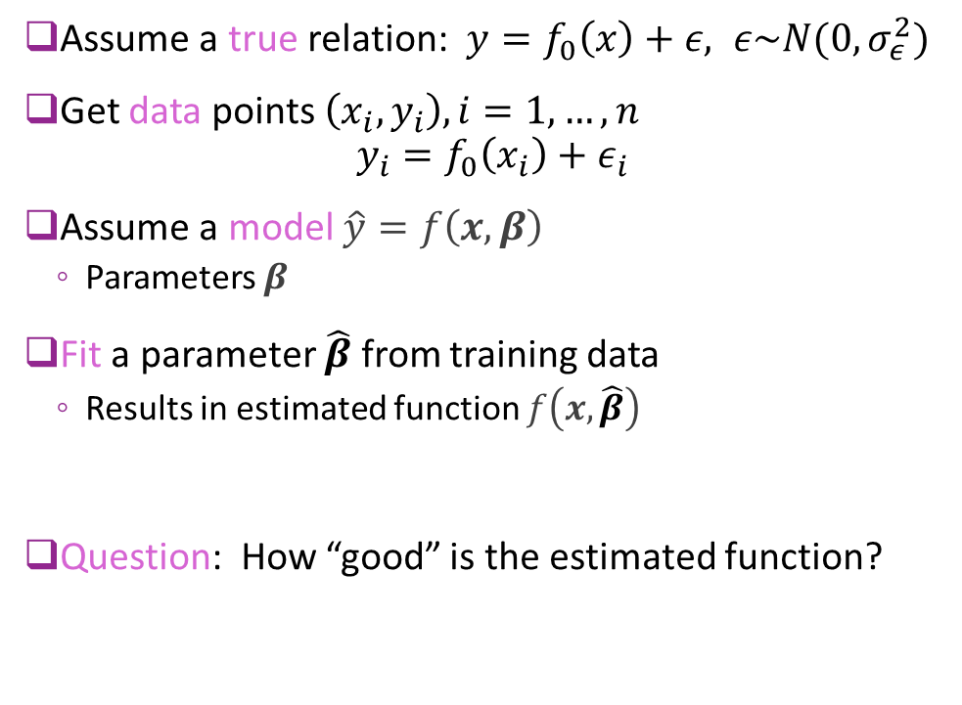


A Model To Understand Generalization
Assume a true relation: $y=f_{0}\left(x\right)+ε, ε\sim N(0,σ_{ε}^{2})$
Get data points $\left(x_{i},y_{i}\right), i=1,…,n$ $y_{i}=f_{0}\left(x_{i}\right)+ε_{i}$
Assume a model $\hat{y}=f\left(x,β\right)$
Parameters $β$
Fit a parameter $\hat{β}$ from training data
Results in estimated function $f\left(x,\hat{β}\right)$
Question: How “good” is the estimated function?
True $f_{0}(x)$
Estimate $f\left(x,\hat{β}\right)$

Slide 15

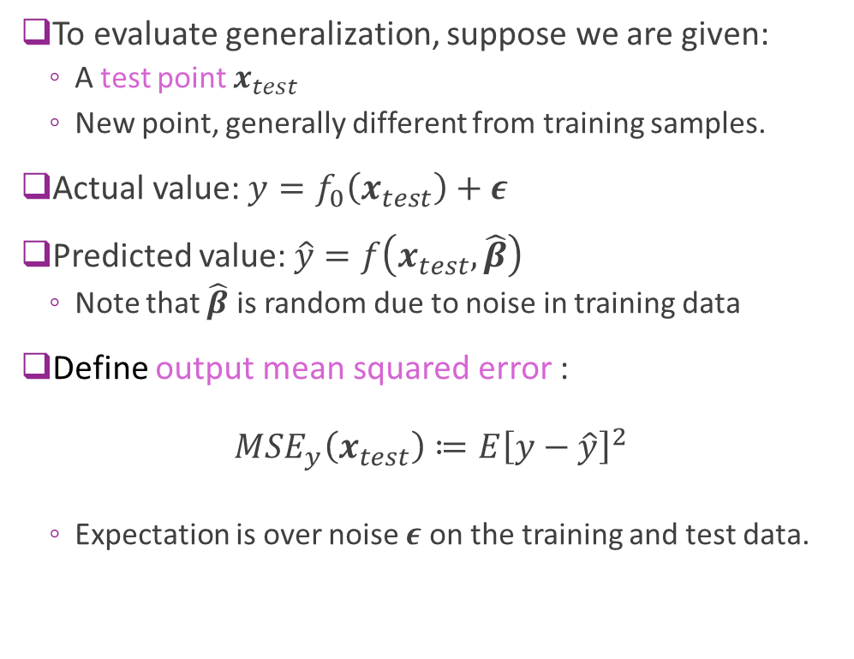


Output Mean Squared Error
To evaluate generalization, suppose we are given:
A test point $x_{test}$
New point, generally different from training samples.
Actual value: $y=f_{0}\left(x_{test}\right)+ε$
Predicted value: $\hat{y}=f\left(x_{test},\hat{β}\right)$
Note that $\hat{β}$ is random due to noise in training data
Define output mean squared error : $MSE_{y}\left(x_{test}\right)≔E{\left[y−\hat{y}\right]}^{2}$
Expectation is over noise $ε$ on the training and test data.
$$y$$
$$\hat{y}$$
$$x_{test}$$
True $f_{0}(x)$
Estimate $f\left(x,\hat{β}\right)$

Slide 16
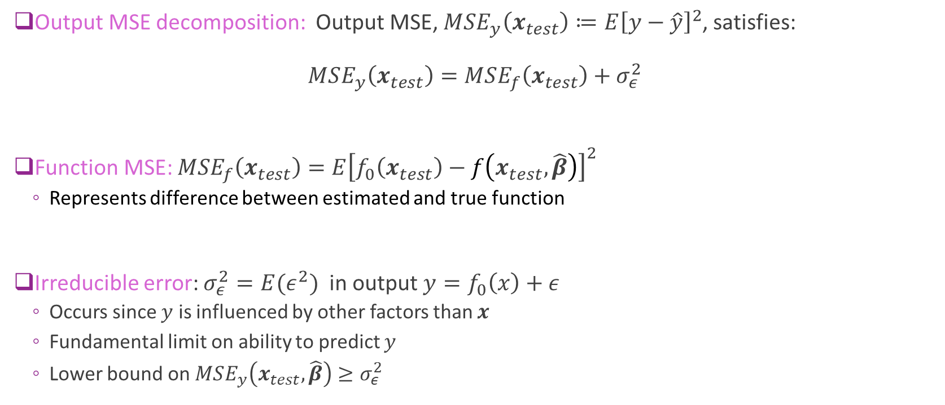
Function MSE and Irreducible Error
Output MSE decomposition: Output MSE, $MSE_{y}\left(x_{test}\right)≔E{\left[y−\hat{y}\right]}^{2}$, satisfies: $MSE_{y}\left(x_{test}\right)=MSE_{f}\left(x_{test}\right)+σ_{ε}^{2}$
Function MSE: $MSE_{f}\left(x_{test}\right)=E{\left[f_{0}\left(x_{test}\right)−f\left(x_{test},\hat{β}\right)\right]}^{2}$
Represents difference between estimated and true function
Irreducible error: $σ_{ε}^{2}=E(ε^{2})$ in output $y=f_{0}\left(x\right)+ε$
Occurs since $y$ is influenced by other factors than $x$
Fundamental limit on ability to predict $y$
Lower bound on $MSE_{y}\left(x_{test},\hat{β}\right)≥σ_{ε}^{2}$

Slide 17
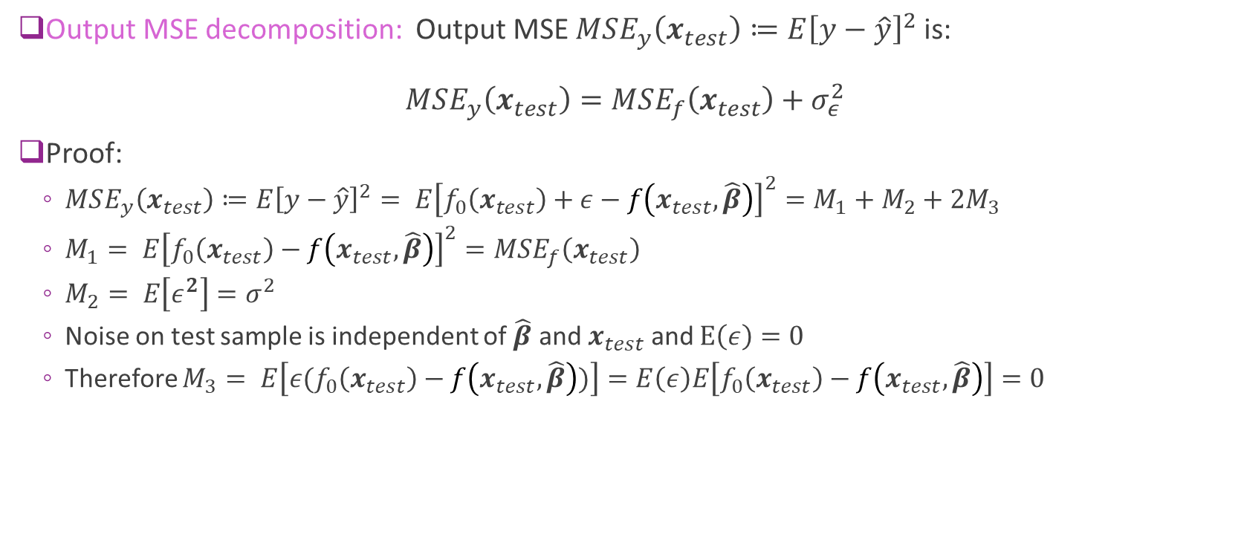
Proof of the MSE Decomposition
Output MSE decomposition: Output MSE $MSE_{y}\left(x_{test}\right)≔E{\left[y−\hat{y}\right]}^{2}$ is: $MSE_{y}\left(x_{test}\right)=MSE_{f}\left(x_{test}\right)+σ_{ε}^{2}$
Proof:
$MSE_{y}\left(x_{test}\right)≔E{\left[y−\hat{y}\right]}^{2}= E{\left[f_{0}\left(x_{test}\right)+ε−f\left(x_{test},\hat{β}\right)\right]}^{2}=M_{1}+M_{2}+2M_{3}$
$M_{1}= E{\left[f_{0}\left(x_{test}\right)−f\left(x_{test},\hat{β}\right)\right]}^{2}=MSE_{f}\left(x_{test}\right)$
$M_{2}= E\left[ε^{2}\right]=σ^{2}$
Noise on test sample is independent of $\hat{β}$ and $x_{test}$ and $E\left(ε\right)=0$
Therefore $M_{3}= E\left[ε(f_{0}\left(x_{test}\right)−f\left(x_{test},\hat{β}\right))\right]=E\left(ε\right)E\left[f_{0}\left(x_{test}\right)−f\left(x_{test},\hat{β}\right)\right]=0$

Slide 18
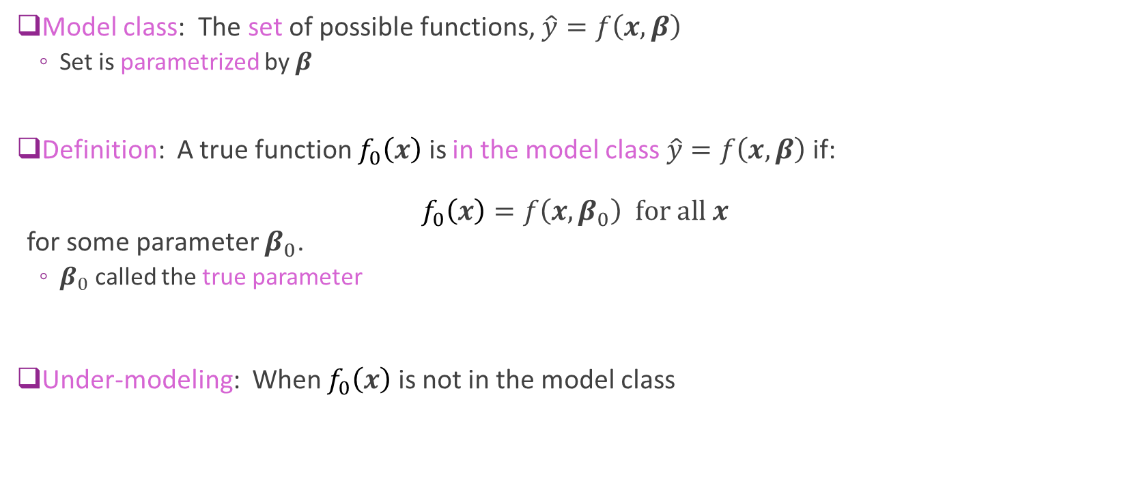
Model Class and Under-Modeling
Model class: The set of possible functions, $\hat{y}=f\left(x,β\right)$
Set is parametrized by $β$
Definition: A true function $f_{0}\left(x\right)$ is in the model class $\hat{y}=f\left(x,β\right)$ if: $f_{0}\left(x\right)=f\left(x,β_{0}\right) for all x$ for some parameter $β_{0}$.
$β_{0}$ called the true parameter
Under-modeling: When $f_{0}\left(x\right)$ is not in the model class

Slide 19
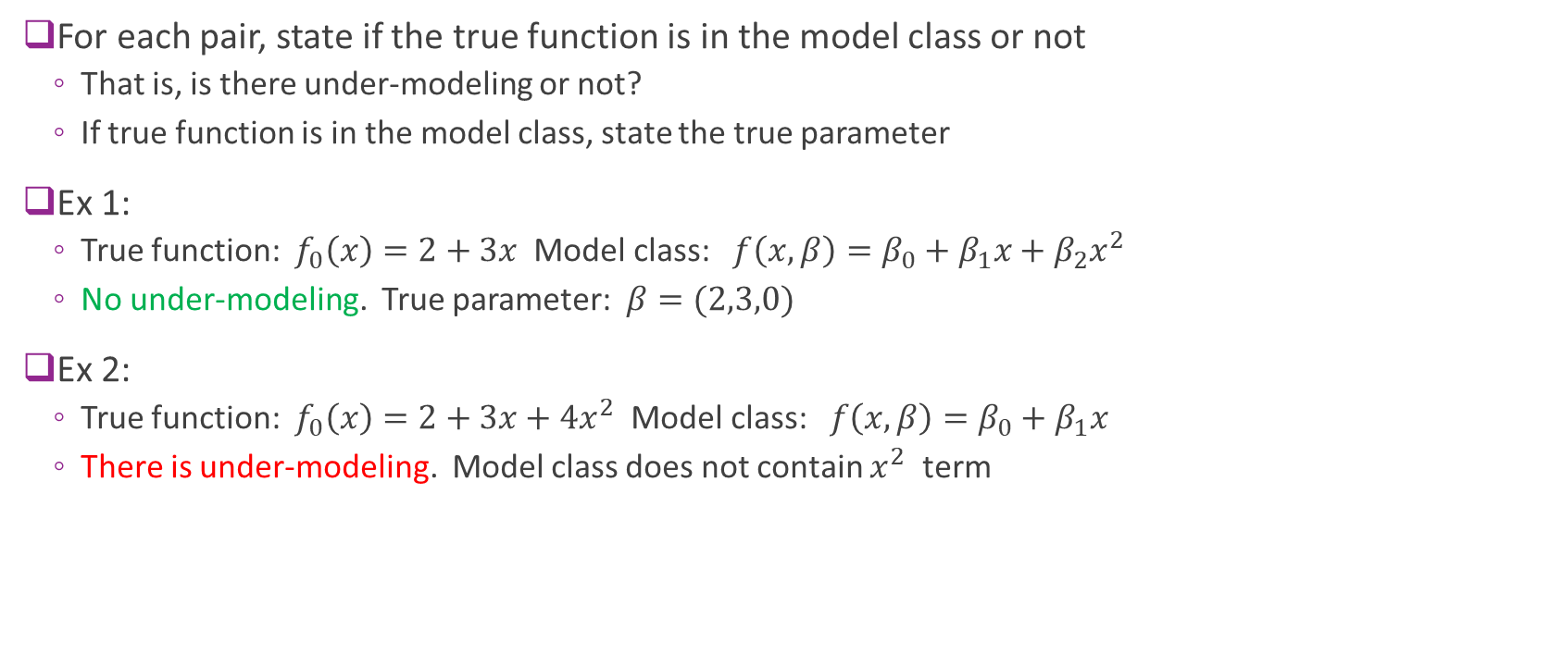
Sample Questions 1 and 2
For each pair, state if the true function is in the model class or not
That is, is there under-modeling or not?
If true function is in the model class, state the true parameter
Ex 1:
True function: $f_{0}\left(x\right)=2+3x$ Model class: $f\left(x,β\right)=β_{0}+β_{1}x+β_{2}x^{2}$
No under-modeling. True parameter: $β=(2,3,0)$
Ex 2:
True function: $f_{0}\left(x\right)=2+3x+4x^{2}$ Model class: $f\left(x,β\right)=β_{0}+β_{1}x$
There is under-modeling. Model class does not contain $x^{2}$ term

Slide 20
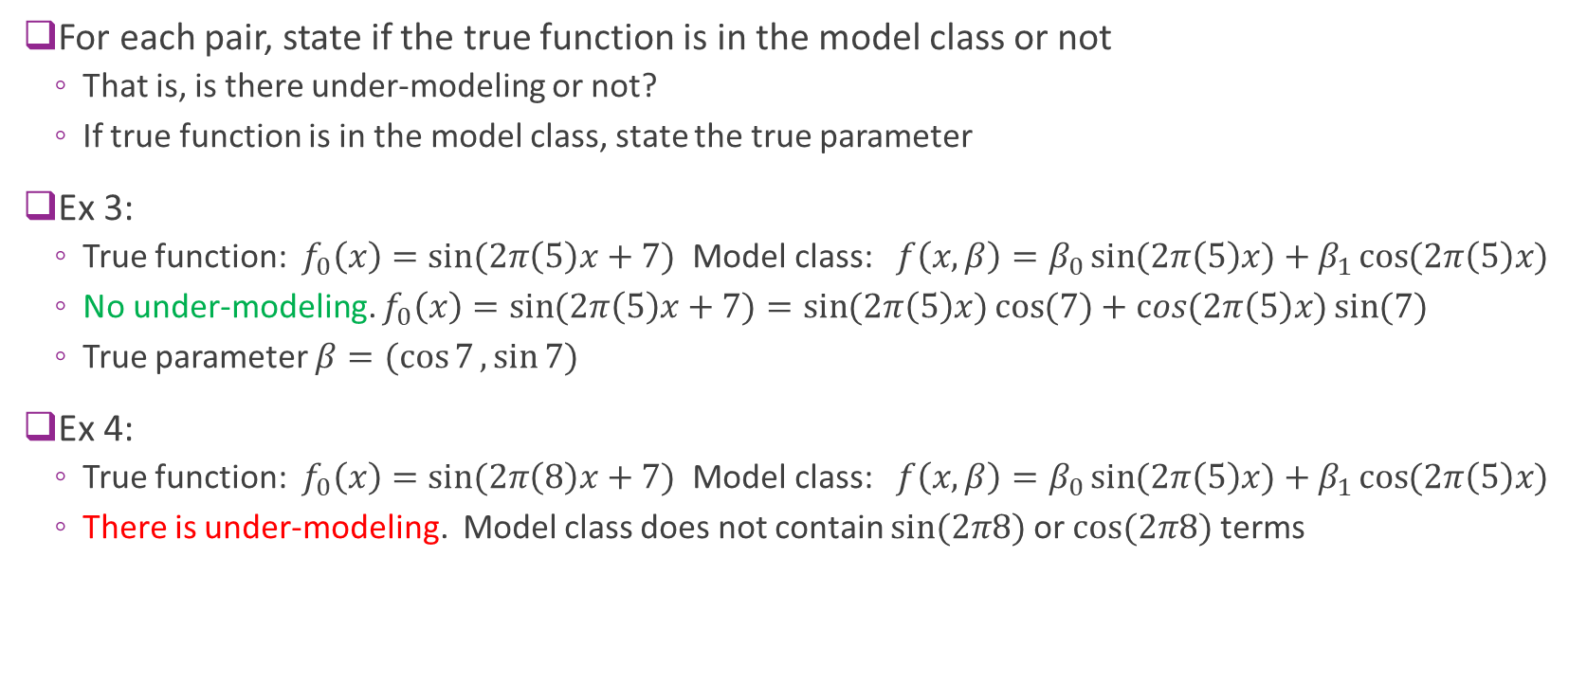
Sample Questions 3 and 4
For each pair, state if the true function is in the model class or not
That is, is there under-modeling or not?
If true function is in the model class, state the true parameter
Ex 3:
True function: $f_{0}\left(x\right)=\sin{(2π\left(5\right)x+7)}$ Model class: $f\left(x,β\right)=β_{0}\sin{(2π\left(5\right)x)}+β_{1}\cos{(2π\left(5\right)x)}$
No under-modeling. $f_{0}\left(x\right)=\sin{(2π\left(5\right)x+7)}=\sin{(2π\left(5\right)x)}\cos{(7)}+\cos{(2π\left(5\right)x)}\sin{(7)}$
True parameter $β=(\cos{7},\sin{7)}$
Ex 4:
True function: $f_{0}\left(x\right)=\sin{(2π\left(8\right)x+7)}$ Model class: $f\left(x,β\right)=β_{0}\sin{(2π\left(5\right)x)}+β_{1}\cos{(2π\left(5\right)x)}$
There is under-modeling. Model class does not contain $sin⁡(2π8)$ or $cos⁡(2π8)$ terms

Slide 21
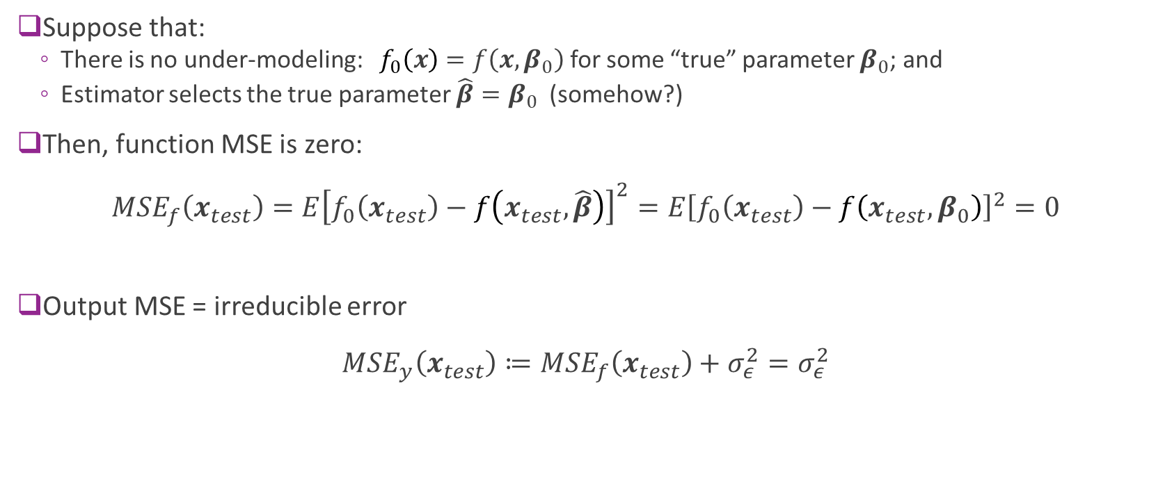
Under-Modeling and Irreducible Error
Suppose that:
There is no under-modeling: $f_{0}\left(x\right)=f\left(x,β_{0}\right)$ for some “true” parameter $β_{0}$; and
Estimator selects the true parameter $\hat{β}=β_{0}$ (somehow?)
Then, function MSE is zero: $MSE_{f}\left(x_{test}\right)=E{\left[f_{0}\left(x_{test}\right)−f\left(x_{test},\hat{β}\right)\right]}^{2}=E{\left[f_{0}\left(x_{test}\right)−f\left(x_{test},β_{0}\right)\right]}^{2}=0$
Output MSE = irreducible error $MSE_{y}\left(x_{test}\right)≔MSE_{f}\left(x_{test}\right)+σ_{ε}^{2}=σ_{ε}^{2}$

Slide 22
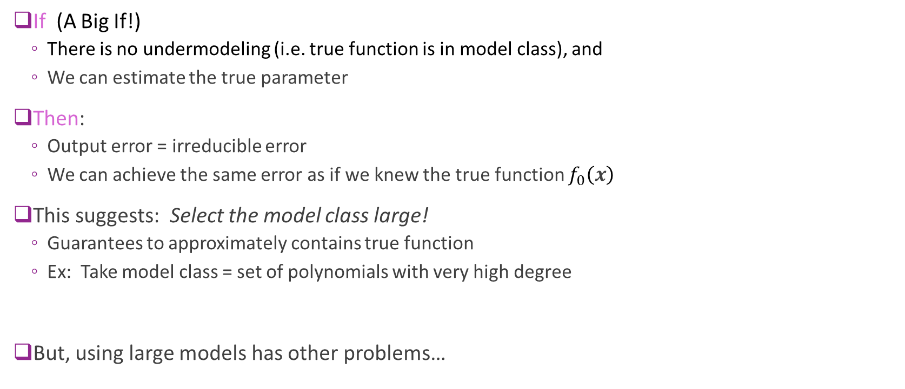
What We Have Learned So Far
If (A Big If!)
There is no undermodeling (i.e. true function is in model class), and
We can estimate the true parameter
Then:
Output error = irreducible error
We can achieve the same error as if we knew the true function $f_{0}\left(x\right)$
This suggests: Select the model class large!
Guarantees to approximately contains true function
Ex: Take model class = set of polynomials with very high degree
But, using large models has other problems…

Slide 23
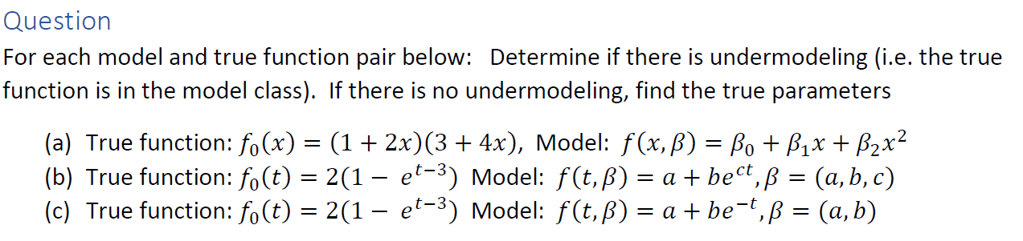
In-Class Exercise

Slide 24
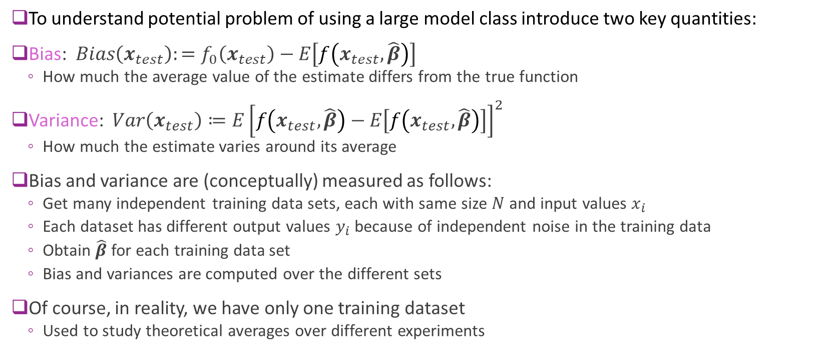
Bias and Variance
To understand potential problem of using a large model class introduce two key quantities:
Bias: $Bias\left(x_{test}\right):=f_{0}\left(x_{test}\right)−E\left[f\left(x_{test},\hat{β}\right)\right]$
How much the average value of the estimate differs from the true function
Variance: $Var\left(x_{test}\right)≔E{\left[f\left(x_{test},\hat{β}\right)−E\left[f\left(x_{test},\hat{β}\right)\right]\right]}^{2}$
How much the estimate varies around its average
Bias and variance are (conceptually) measured as follows:
Get many independent training data sets, each with same size $N$ and input values $x_{i}$
Each dataset has different output values $y_{i}$ because of independent noise in the training data
Obtain $\hat{β}$ for each training data set
Bias and variances are computed over the different sets
Of course, in reality, we have only one training dataset
Used to study theoretical averages over different experiments

Slide 25
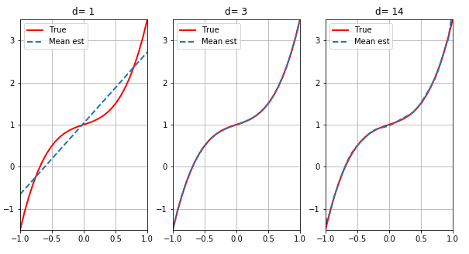
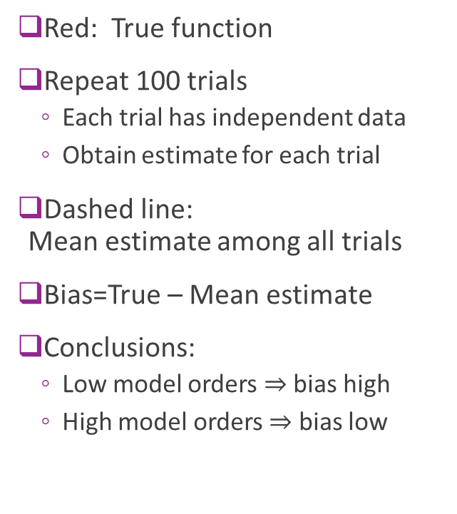
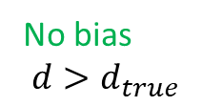

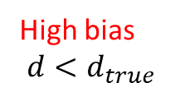
Bias Illustrated
Red: True function
Repeat 100 trials
Each trial has independent data
Obtain estimate for each trial
Dashed line: Mean estimate among all trials
Bias=True – Mean estimate
Conclusions:
Low model orders $⇒$ bias high
High model orders $⇒$ bias low
Bias(x)
High bias
$$d<d_{true}$$
No bias
$$d=d_{true}$$
No bias
$$d>d_{true}$$

Slide 26
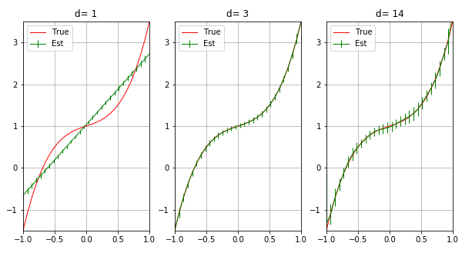
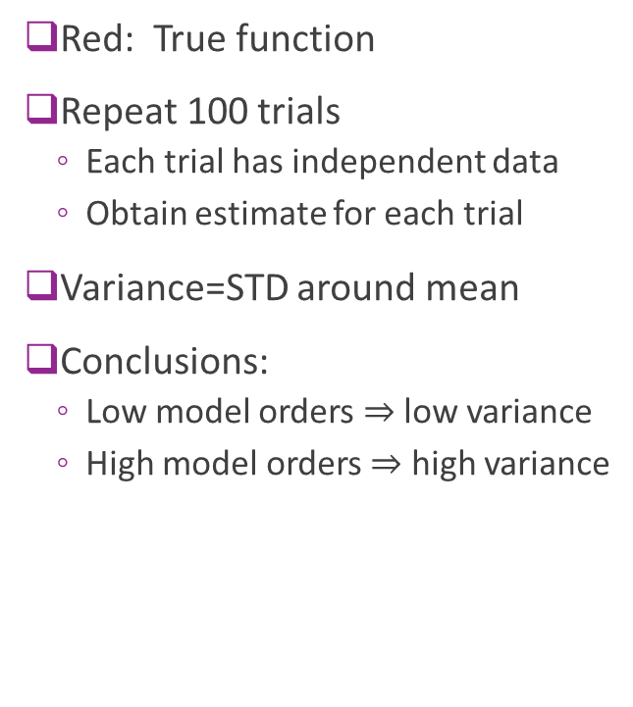


Variance Illustrated
Red: True function
Repeat 100 trials
Each trial has independent data
Obtain estimate for each trial
Variance=STD around mean
Conclusions:
Low model orders $⇒$ low variance
High model orders $⇒$ high variance
$$\text{High} \text{bias}$$
$$\text{No} \text{bias}$$
No bias
Low variance
Med variance
High variance

Slide 27
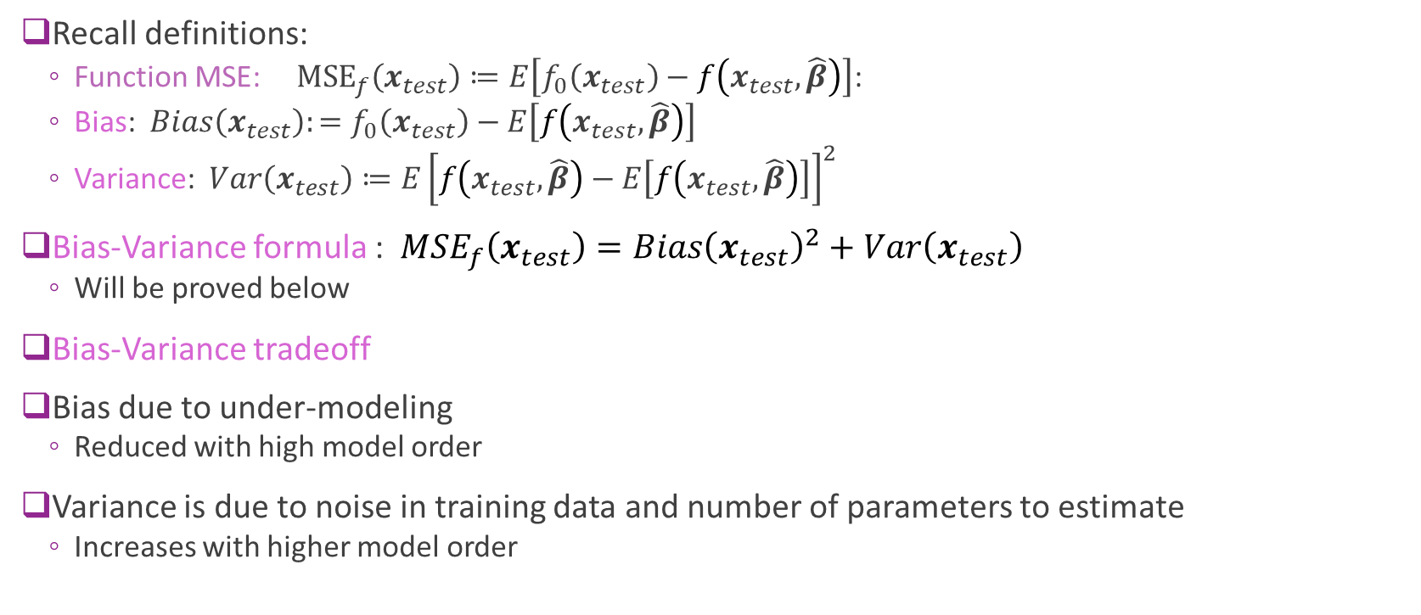
Bias-Variance Formula
Recall definitions:
Function MSE: ${\text{MSE}}_{f}\left(x_{test}\right)≔E\left[f_{0}\left(x_{test}\right)−f\left(x_{test},\hat{β}\right)\right]$:
Bias: $Bias\left(x_{test}\right):=f_{0}\left(x_{test}\right)−E\left[f\left(x_{test},\hat{β}\right)\right]$
Variance: $Var\left(x_{test}\right)≔E{\left[f\left(x_{test},\hat{β}\right)−E\left[f\left(x_{test},\hat{β}\right)\right]\right]}^{2}$
Bias-Variance formula : $MSE_{f}\left(x_{test}\right)={Bias\left(x_{test}\right)}^{2}+Var\left(x_{test}\right)$
Will be proved below
Bias-Variance tradeoff
Bias due to under-modeling
Reduced with high model order
Variance is due to noise in training data and number of parameters to estimate
Increases with higher model order

Slide 28
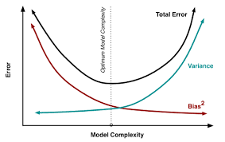
Bias-Variance Tradeoff
Bias:
Due to under-modeling
Reduced with high model order
Variance:
Increases with noise in training data
Increase with high model order
Optimal model order depends on:
Amount of samples available
Underlying complexity of the relation
Floor is the noise variance
Simpler models
Less parameters
Under-fitting
Richer models
More parameters
Over-fitting

Slide 29
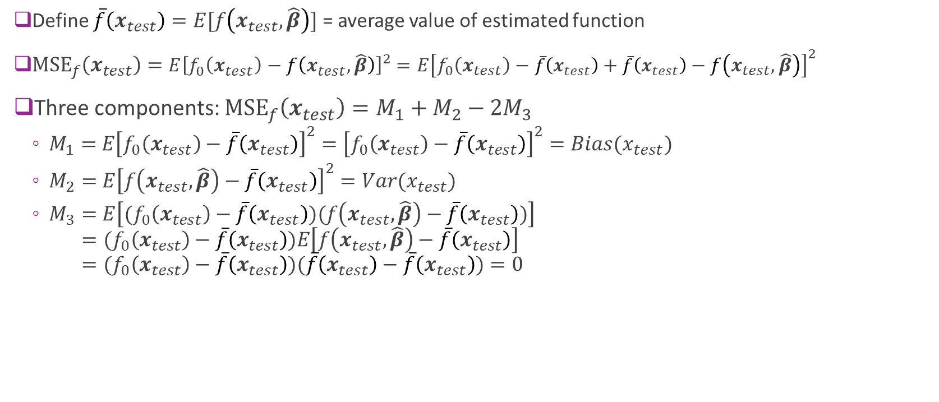
Bias-Variance Formula Proof
Define $\overline{f}\left(x_{test}\right)=E[f\left(x_{test},\hat{β}\right)]$ = average value of estimated function
${\text{MSE}}_{f}\left(x_{test}\right)=E{\left[f_{0}\left(x_{test}\right)−f\left(x_{test},\hat{β}\right)\right]}^{2}$ $=E{\left[f_{0}\left(x_{test}\right)−\overline{f}\left(x_{test}\right)+\overline{f}\left(x_{test}\right)−f\left(x_{test},\hat{β}\right)\right]}^{2}$
Three components: ${\text{MSE}}_{f}\left(x_{test}\right)=M_{1}+M_{2}−{2M}_{3}$
$M_{1}=$ $E{\left[f_{0}\left(x_{test}\right)−\overline{f}\left(x_{test}\right)\right]}^{2}={\left[f_{0}\left(x_{test}\right)−\overline{f}\left(x_{test}\right)\right]}^{2}=Bias(x_{test})$
$M_{2}=$ $E{\left[f\left(x_{test},\hat{β}\right)−\overline{f}\left(x_{test}\right)\right]}^{2}=Var(x_{test})$
$M_{3}=$ $E\left[{(f}_{0}\left(x_{test}\right)−\overline{f}\left(x_{test}\right))(f\left(x_{test},\hat{β}\right)−\overline{f}\left(x_{test}\right))\right]$ $={(f}_{0}\left(x_{test}\right)−\overline{f}\left(x_{test}\right))E\left[f\left(x_{test},\hat{β}\right)−\overline{f}\left(x_{test}\right)\right]$ $={(f}_{0}\left(x_{test}\right)−\overline{f}\left(x_{test}\right))(\overline{f}\left(x_{test}\right)−$ $\overline{f}\left(x_{test}\right))=0$

Slide 30
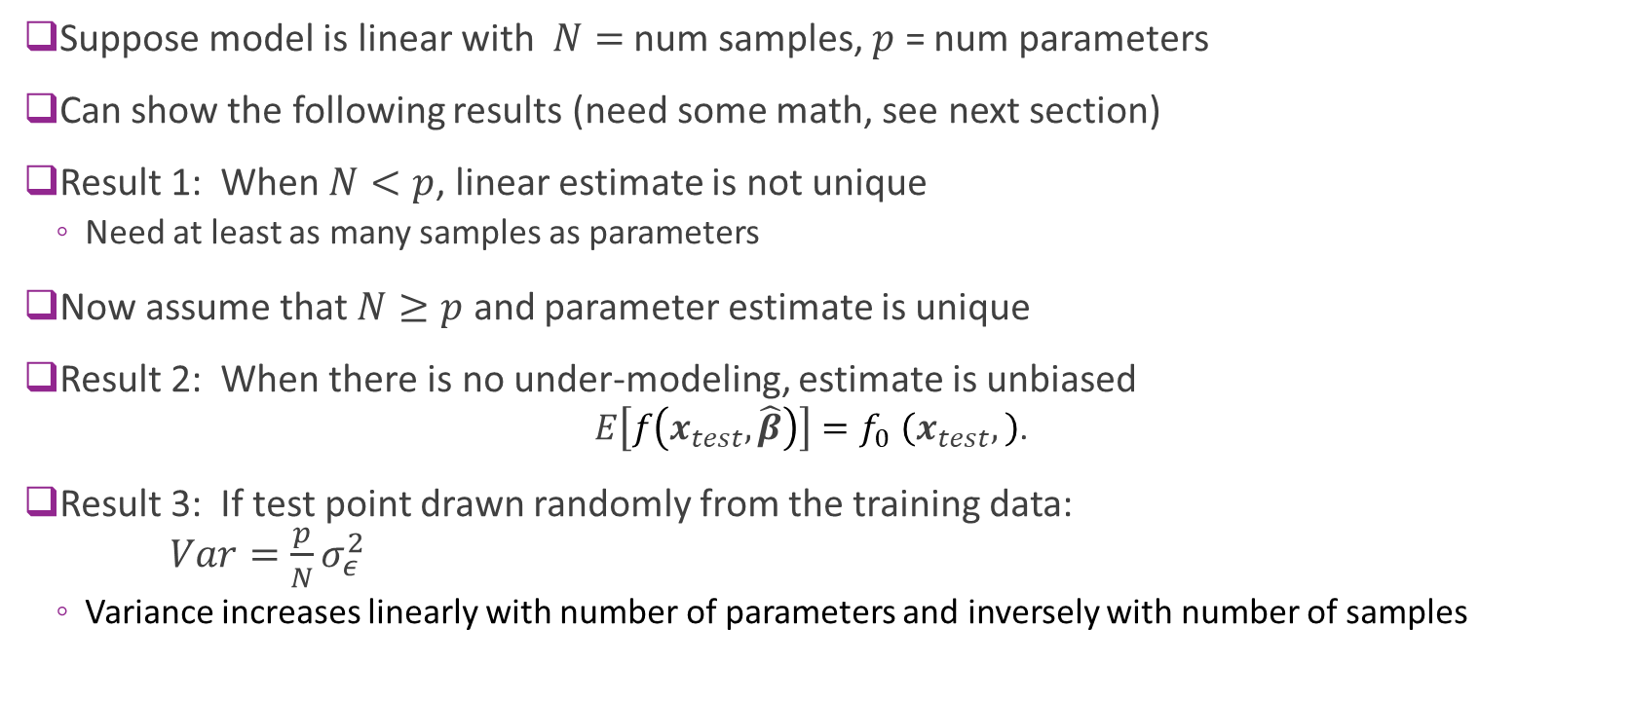
Summary of Results for Linear Models
Suppose model is linear with $N=$ num samples, $p$ = num parameters
Can show the following results (need some math, see next section)
Result 1: When $N<p$, linear estimate is not unique
Need at least as many samples as parameters
Now assume that $N≥p$ and parameter estimate is unique
Result 2: When there is no under-modeling, estimate is unbiased
$$E\left[f\left(x_{test},\hat{β}\right)\right]{=f}_{0}\left(x_{test},\right)\text{.}$$
Result 3: If test point drawn randomly from the training data: $Var=\frac{p}{N}σ_{ε}^{2}$
Variance increases linearly with number of parameters and inversely with number of samples

Slide 31
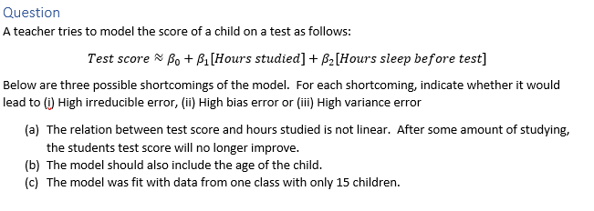
In-Class Exercise

Slide 32
Outline
Motivating Example: What polynomial degree should a model use?
Bias and variance
Bias and variance for linear models (Advanced)
Cross-validation

Slide 33
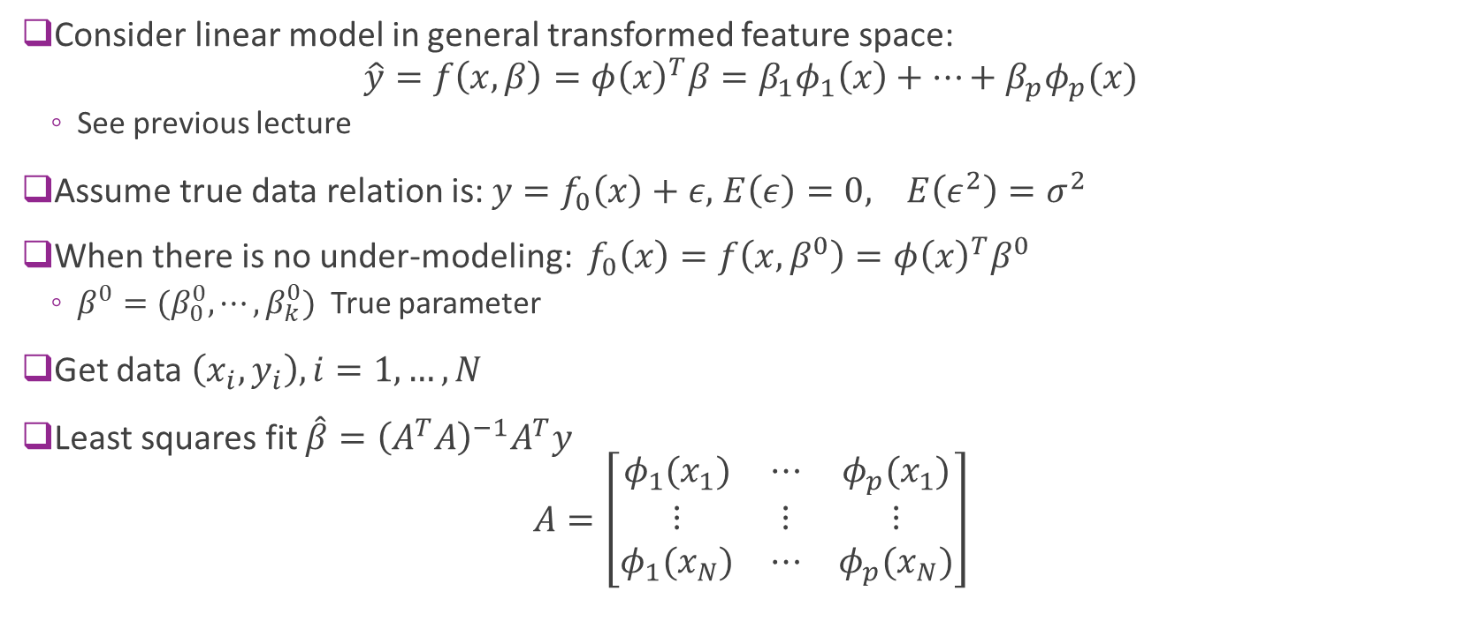
Linear Models
Consider linear model in general transformed feature space: $\hat{y}=f\left(x,β\right)=φ{\left(x\right)}^{T}β=β_{1}φ_{1}\left(x\right)+⋯+β_{p}φ_{p}(x)$
See previous lecture
Assume true data relation is: $y=f_{0}\left(x\right)+ε,$ $E\left(ε\right)=0, E\left(ε^{2}\right)=σ^{2}$
When there is no under-modeling: $f_{0}\left(x\right)=f\left(x,β^{0}\right)=φ{\left(x\right)}^{T}β^{0}$
$β^{0}=(β_{0}^{0},⋯,β_{k}^{0})$ True parameter
Get data $\left(x_{i},y_{i}\right), i=1,…, N$
Least squares fit $\hat{β}={\left(A^{T}A\right)}^{−1}A^{T}y$ $A=\left[\begin{matrix}φ_{1}(x_{1}) & ⋯ & φ_{p}(x_{1}) \\ ⋮ & ⋮ & ⋮ \\ φ_{1}(x_{N}) & ⋯ & φ_{p}(x_{N})\end{matrix}\right]$

Slide 34
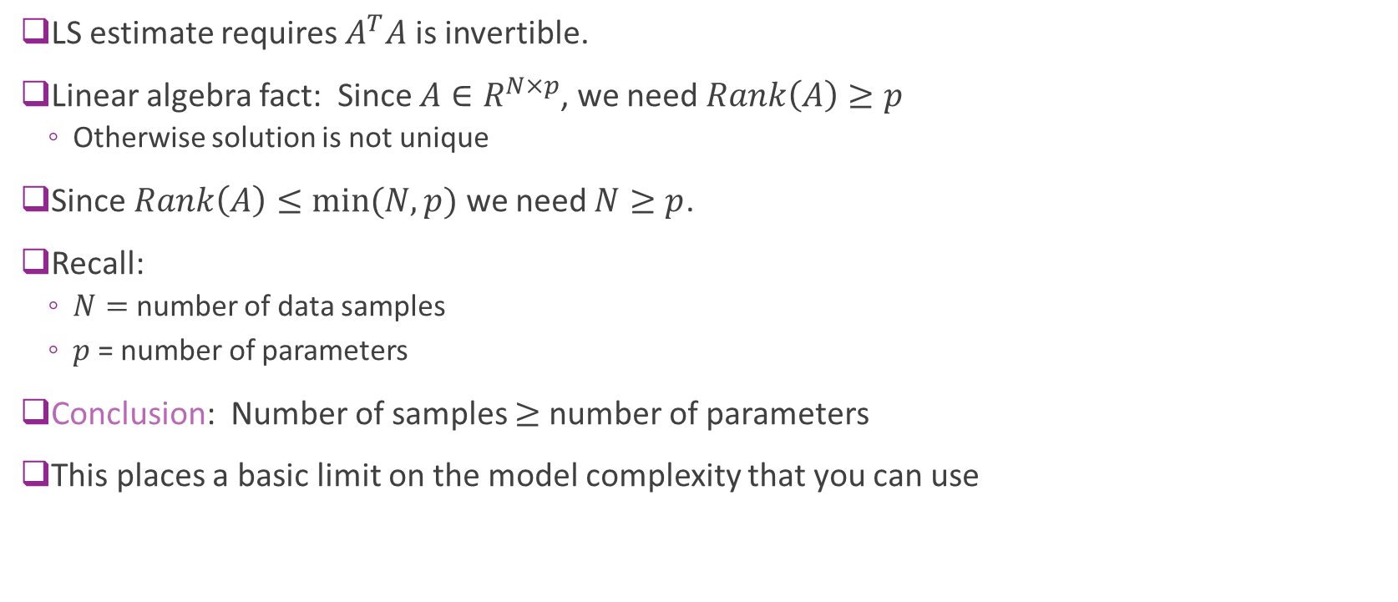
Minimum Number of Samples
LS estimate requires $A^{T}A$ is invertible.
Linear algebra fact: Since $A∈R^{N×p}$, we need $Rank\left(A\right)≥p$
Otherwise solution is not unique
Since $Rank\left(A\right)≤\min{(N,p)}$ we need $N≥p$.
Recall:
$N=$ number of data samples
$p$ = number of parameters
Conclusion: Number of samples $≥$ number of parameters
This places a basic limit on the model complexity that you can use

Slide 35
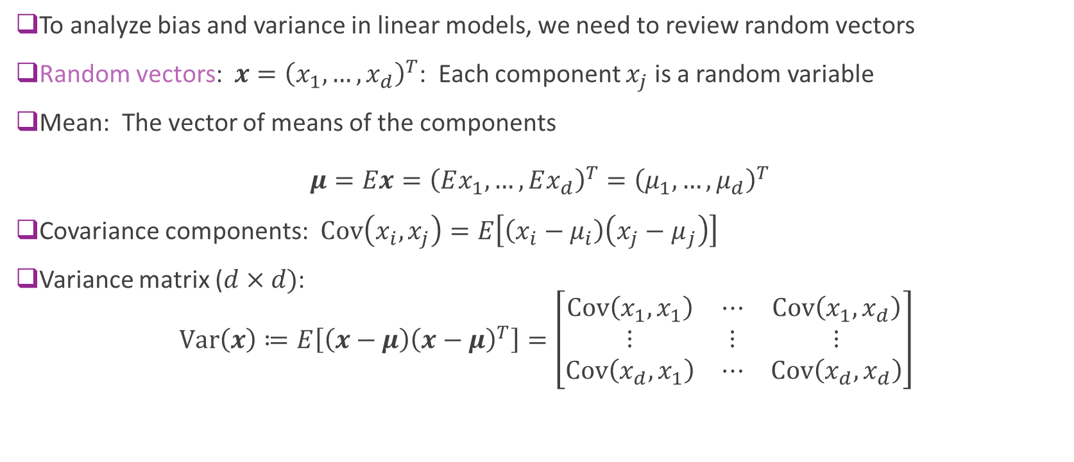
Random Vectors Review
To analyze bias and variance in linear models, we need to review random vectors
Random vectors: $x={\left(x_{1},…,x_{d}\right)}^{T}$: Each component $x_{j}$ is a random variable
Mean: The vector of means of the components $μ=Ex={\left(Ex_{1},…,Ex_{d}\right)}^{T}={\left(μ_{1},…,μ_{d}\right)}^{T}$
Covariance components: $\text{Cov}\left(x_{i},x_{j}\right)=E\left[\left(x_{i}−μ_{i}\right)\left(x_{j}−μ_{j}\right)\right]$
Variance matrix ($d×d)$: $\text{Var}\left(x\right)≔E\left[\left(x−μ\right){\left(x−μ\right)}^{T}\right]=\left[\begin{matrix}\text{Cov}\left(x_{1},x_{1}\right) & ⋯ & \text{Cov}\left(x_{1},x_{d}\right) \\ ⋮ & ⋮ & ⋮ \\ \text{Cov}\left(x_{d},x_{1}\right) & ⋯ & \text{Cov}\left(x_{d},x_{d}\right)\end{matrix}\right]$

Slide 36

Linear Transforms of Random Vectors
A linear transform is a map: $y=Ax+b$
$A∈R^{M×N}$ maps input $x∈R^{N}$ to $Ax∈R^{M}$
Mean and variance matrix under linear map given by
Mean: $E\left(y\right)=AE\left(x\right)+b$
Variance: $Var\left(y\right)=AVar\left(x\right)A^{T}$

Slide 37
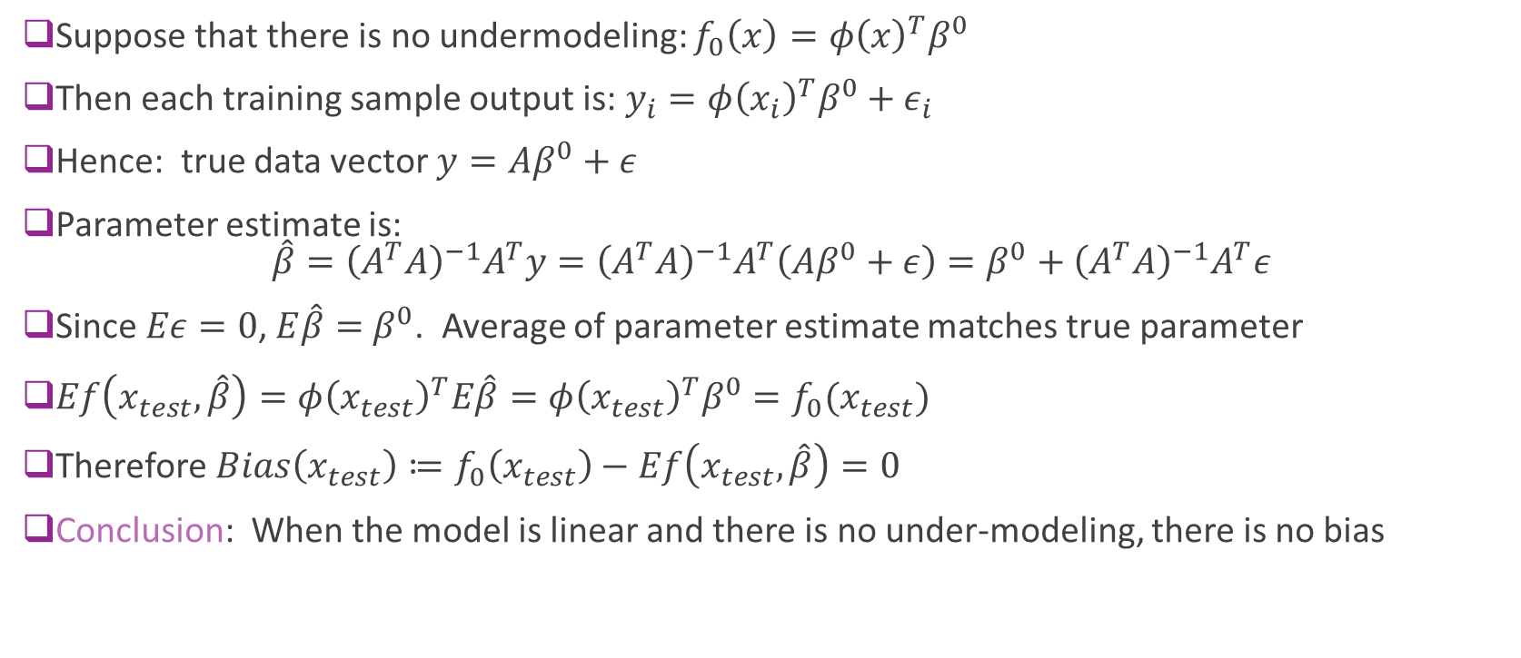
Bias With No Under-Modeling
Suppose that there is no undermodeling: $f_{0}\left(x\right)=φ{\left(x\right)}^{T}β^{0}$
Then each training sample output is: $y_{i}=φ{\left(x_{i}\right)}^{T}β^{0}+ε_{i}$
Hence: true data vector $y=Aβ^{0}+ε$
Parameter estimate is: $\hat{β}={\left(A^{T}A\right)}^{−1}A^{T}y={\left(A^{T}A\right)}^{−1}A^{T}\left(Aβ^{0}+ε\right)=β^{0}+{\left(A^{T}A\right)}^{−1}A^{T}ε$
Since $Eε=0$, $E\hat{β}=$ $β^{0}$. Average of parameter estimate matches true parameter
$Ef\left(x_{test},\hat{β}\right)=φ{\left(x_{test}\right)}^{T}E\hat{β}=φ{\left(x_{test}\right)}^{T}β^{0}=f_{0}(x_{test})$
Therefore $Bias\left(x_{test}\right)≔f_{0}\left(x_{test}\right)−Ef\left(x_{test},\hat{β}\right)=0$
Conclusion: When the model is linear and there is no under-modeling, there is no bias

Slide 38
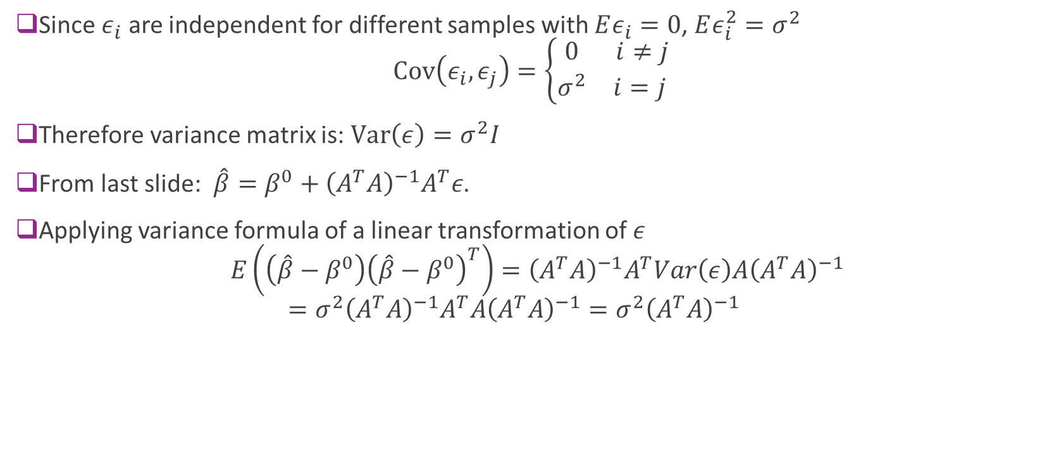
Variance of the Parameters in Linear Models
Since $ε_{i}$ are independent for different samples with $Eε_{i}=0$, $Eε_{i}^{2}=σ^{2}$ $\text{Cov}\left(ε_{i},ε_{j}\right)=\left\{\begin{matrix}0 & i≠j \\ σ^{2} & i=j \end{matrix}\right.$
Therefore variance matrix is: $\text{Var}\left(ε\right)=σ^{2}I$
From last slide: $\hat{β}=β^{0}+{\left(A^{T}A\right)}^{−1}A^{T}ε$.
Applying variance formula of a linear transformation of $ε$ $E\left(\left(\hat{β}−β^{0}\right){\left(\hat{β}−β^{0}\right)}^{T}\right)={\left(A^{T}A\right)}^{−1}A^{T}Var\left(ε\right)A{\left(A^{T}A\right)}^{−1}$ $=σ^{2}{\left(A^{T}A\right)}^{−1}A^{T}A{\left(A^{T}A\right)}^{−1}={σ^{2}\left(A^{T}A\right)}^{−1}$

Slide 39
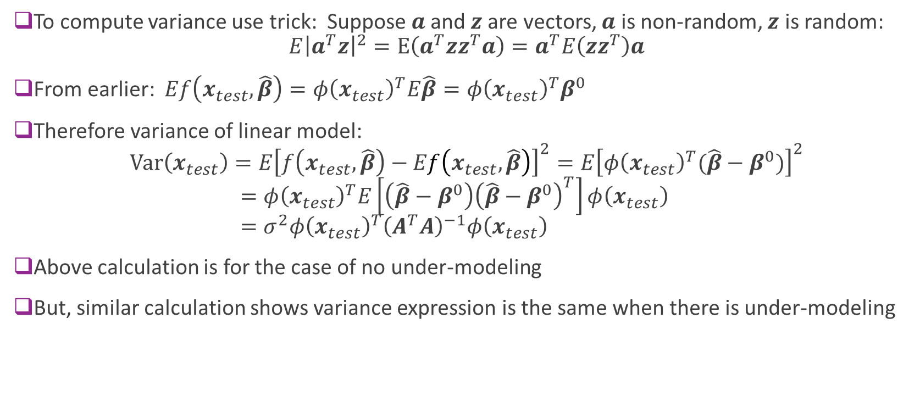
Variance in Linear Estimate
To compute variance use trick: Suppose $a$and $z$are vectors, $a$ is non-random, $z$ is random: $E{\left|a^{T}z\right|}^{2}=E\left(a^{T}zz^{T}a\right)=a^{T}E\left(zz^{T}\right)a$
From earlier: $Ef\left(x_{test},\hat{β}\right)=φ{\left(x_{test}\right)}^{T}E\hat{β}=φ{\left(x_{test}\right)}^{T}β^{0}$
Therefore variance of linear model: $Var\left(x_{test}\right)=E{\left[f\left(x_{test},\hat{β}\right)−Ef\left(x_{test},\hat{β}\right)\right]}^{2}=E{\left[φ{\left(x_{test}\right)}^{T}(\hat{β}−β^{0})\right]}^{2}$ $=φ{\left(x_{test}\right)}^{T}E\left[\left(\hat{β}−β^{0}\right){\left(\hat{β}−β^{0}\right)}^{T}\right]φ\left(x_{test}\right)$ $=σ^{2}φ{\left(x_{test}\right)}^{T}{\left(A^{T}A\right)}^{−1}φ\left(x_{test}\right)$
Above calculation is for the case of no under-modeling
But, similar calculation shows variance expression is the same when there is under-modeling

Slide 40
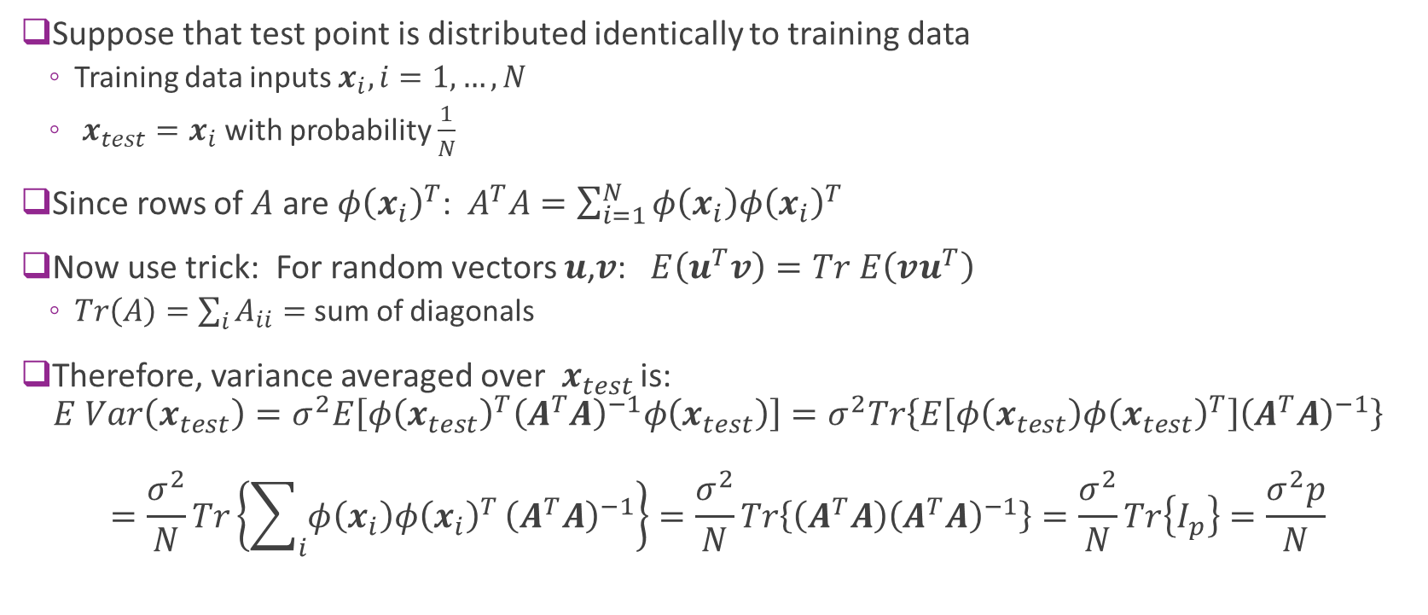
Case with Equal Test & Training Distributions
Suppose that test point is distributed identically to training data
Training data inputs $x_{i},i=1,…,N$
$x_{test}=x_{i}$ with probability $\frac{1}{N}$
Since rows of $A$ are $φ{\left(x_{i}\right)}^{T}$: $A^{T}A=\sum_{i=1}^{N}{φ\left(x_{i}\right)φ{\left(x_{i}\right)}^{T}}$
Now use trick: For random vectors $u$,$v$: $E\left(u^{T}v\right)=Tr E\left(vu^{T}\right)$
$Tr\left(A\right)=\sum_{i}{A_{ii}}=$ sum of diagonals
Therefore, variance averaged over $x_{test}$ is: $E Var\left(x_{test}\right)=σ^{2}E\left[φ{\left(x_{test}\right)}^{T}{\left(A^{T}A\right)}^{−1}φ\left(x_{test}\right)\right]=σ^{2}Tr\left\{E\left[φ\left(x_{test}\right)φ{\left(x_{test}\right)}^{T}\right]{\left(A^{T}A\right)}^{−1}\right\}$ $=\frac{σ^{2}}{N}Tr\left\{\sum_{i}{φ\left(x_{i}\right)φ{\left(x_{i}\right)}^{T}}{\left(A^{T}A\right)}^{−1}\right\}=\frac{σ^{2}}{N}Tr\left\{\left(A^{T}A\right){\left(A^{T}A\right)}^{−1}\right\}=\frac{σ^{2}}{N}Tr\left\{I_{p}\right\}=\frac{σ^{2}p}{N}$

Slide 41
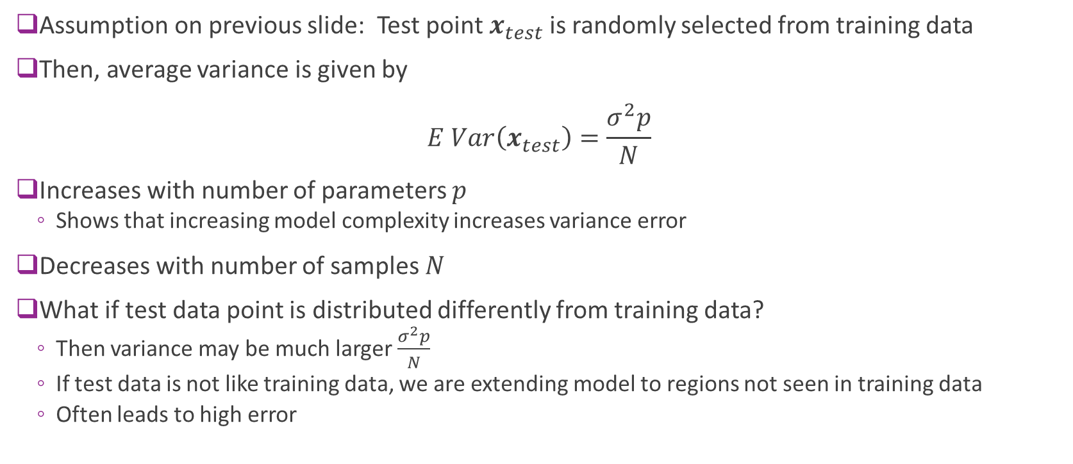
Case with Equal Test & Training Distributions
Assumption on previous slide: Test point $x_{test}$ is randomly selected from training data
Then, average variance is given by $E Var\left(x_{test}\right)=\frac{σ^{2}p}{N}$
Increases with number of parameters $p$
Shows that increasing model complexity increases variance error
Decreases with number of samples $N$
What if test data point is distributed differently from training data?
Then variance may be much larger $\frac{σ^{2}p}{N}$
If test data is not like training data, we are extending model to regions not seen in training data
Often leads to high error

Slide 42
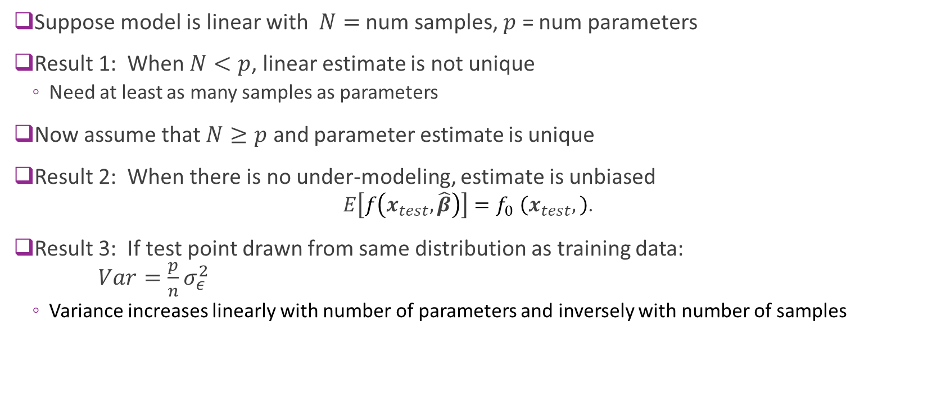
Summary of Results for Linear Models
Suppose model is linear with $N=$ num samples, $p$ = num parameters
Result 1: When $N<p$, linear estimate is not unique
Need at least as many samples as parameters
Now assume that $N≥p$ and parameter estimate is unique
Result 2: When there is no under-modeling, estimate is unbiased
$$E\left[f\left(x_{test},\hat{β}\right)\right]{=f}_{0}\left(x_{test},\right)\text{.}$$
Result 3: If test point drawn from same distribution as training data: $Var=\frac{p}{n}σ_{ε}^{2}$
Variance increases linearly with number of parameters and inversely with number of samples

Slide 43
Outline
Motivating Example: What polynomial degree should a model use?
Bias and variance
Bias and variance for linear models (Advanced)
Cross-validation

Slide 44






Cross Validation
Key idea: Evaluate on samples different from training
Get data $X,y$
Split into training $X_{tr},y_{tr}$ and test $X_{ts},y_{ts}$
For $p=1 \text{to} p_{max}$ // Loop over model order
Fit on training data with model order $p$
Predict values on test data
Score fit on test data (e.g. measure RSS)
Select model order with smallest score: $\hat{p}=\arg{\min_{p}{S[p]}}$
Maximize if higher score is better
Training data $X_{tr},y_{tr}$ $N_{train}$ samples
$$\hat{β}=fit(X_{tr},y_{tr},p)$$
Test data
$X_{ts},y_{ts}$ $N_{test}$ samples
$${\hat{y}}_{ts}=predict\left(X_{ts},\hat{β}\right)$$
$$S[p]=score(y_{ts},{\hat{y}}_{ts})$$

Slide 45


Polynomial Example: Training Test Split
Example: Split data into 20 samples for training, 20 for test

Slide 46



Finding the Model Order
Estimated optimal model order = 3
RSS test minimized at $d=3$
RSS training always decreases

Slide 47
Problems with Simple Train/Test Split
Test error could vary significantly depending on samples selected
Only use limited number of samples for training
Problems particularly bad for data with limited number of samples

Slide 48


K-Fold Cross Validation
$K$-fold cross validation
Divide data into $K$ parts
Use $K−1$ parts for training. Use remaining for test.
Average over the $K$ test choices
More accurate, but requires $K$ fits of parameters
Typical choice: K=5 or 10
Average MSE over K folds estimates the total MSE
(=Bias^2+Variance+irreducible error)
Leave one out cross validation (LOOCV)
Take $K = N$so one sample is left out.
Most accurate, but requires N model fittings
Necessary when N is small.
From http://blog.goldenhelix.com/goldenadmin/cross-validation-for-genomic-prediction-in-svs/

Slide 49

K-Fold Pseudo-Code
Get data $X,y$
For $i=1 \text{to} K$ // Loop over folds
Split into training $X_{tr},y_{tr}$ and test $X_{ts},y_{ts}$ for fold $i$
For $p=1 \text{to} p_{max}$ // Loop over model order
Fit on training data with model order $p$: $\hat{β}=fit(X_{tr},y_{tr},p)$
Predict values on test data: ${\hat{y}}_{ts}=predict(X_{ts},\hat{β})$
Score the fit on test data: $S[p,i]=score(y_{ts},{\hat{y}}_{ts})$
Find average score for each model order: $\overline{S}\left[p\right]=\frac{1}{K}\sum_{i=1}^{K}{S[p,i]}$
Select model order with lowest average score: $\hat{p}=\arg{\min_{p}{\overline{S}[p]}}$

Slide 50

Polynomial Example
Use sklearn Kfold object
Loop
Outer loop: Over K folds
Inner loop: Over D model orders
Measure test error in each fold and order
Averaging test errors from K folds for each model order
Find the model order with the minimal average test errors
Can be time-consuming

Slide 51



Polynomial Example CV Results
For each model order d
Compute mean test RSS over K folds
Compute standard error (SE) of test RSS
SE=STD of mean RSS=RSS std/ $\sqrt{K−1}$
(expectation over different realizations
of data in each fold)
Simple model selection
Select d with lowest mean test RSS
For this example
Estimate model order = 3

Slide 52

One Standard Error Rule
Previous slide: Select d to minimize RSS_mean[d]
Average RSS across the folds and select lowest average
Problem: Often over-predicts model order
One standard deviation rule
Use simplest model “within one SE of minimum”
Optimal model order

Slide 53

One SE Rule Pseudo-Code
Get data $X,y$
Compute score as before: $S\left[p,i\right]=$ score for model order $p$ on fold $i$
Compute average, std deviation and standard error of the scores:
$\overline{S}\left[p\right]=\frac{1}{K}\sum_{i=1}^{K}{S[p,i]}, σ^{2}\left[p\right]=\frac{1}{K}\sum_{i=1}^{K}{{\left(S\left[p,i\right]−\overline{S}\left[p\right]\right)}^{2}}, SE\left[p\right]=\frac{\sqrt{K}}{\sqrt{K−1}}σ\left[p\right]$
Find model order via normal rule: ${\hat{p}}_{0}=\arg{\min_{p}{\overline{S}[p]}}$ (lowest average score)
Compute target score: $S_{tgt}=\overline{S}\left[p_{0}\right]+SE[p_{0}]$
One SE rule: Find simplest model with score lower than target: $\hat{p}=\min\left\{p \right|\overline{S}\left[p\right]≤S_{tgt}\}$
Note that one SE rule always produce a model order $≤$ normal rule ($\hat{p}≤$ ${\hat{p}}_{0}$)

Slide 54




Lab: Neural ECoG Data
Record arm motion
Read a monkey’s brain!
Predict hand motion from electrode measurements (number of spikes in each neuron)
Data from https://crcns.org/
Open source website on neural data
Great for projects
Arm velocity
Velocity y
Velocity x
Spikes
Neuron
Record spikes (ECoG in M1)
Time

Slide 55

Lab: Neural ECoG Data
Linear filter model: $y\left[t,k\right]=\sum_{ℓ=0}^{d}{\sum_{j=0}^{p−1}{X\left[t−ℓ,j\right]W[ℓ,j,k]}}+b[k]$
$X\left[t,j\right]=$ spikes from neuron $j$ at time $t$
$y\left[t,k\right]=$ Output $k$ at time $t$ (two outputs for x and y motion)
$W\left[ℓ,j,k\right]=$ weight from neuron $j$ to output $k$ at time delay $ℓ$
Linear fitting: Find $W$ and $b$ from $X$and $y$
Model order selection:
Find optimal maximum delay $d$
Higher $d$ allows better fit, but uses more parameters
Arm velocity
Velocity y
Velocity x
Spikes
Neuron
Time

