Slide 1
Machine Learning
Team 18
Andrew Lagattuta, Tian Lu, Clay McCollum, Anthony Mensah

Slide 2
outline
Overview of the competition
Objective (problem to solve)
Critique
Our solution:
Why that particular model?
Model performance
Dataset – key features

Slide 3

Overview
Predict restaurant earnings
TFI International
Want to invest in new restaurant locations
Model to predict earnings
Key features
Opening data, city, type of restaurant, local demographic data, real estate data

Slide 4

background
TFI International is a global company with 1,200+ quick service restaurants worldwide. Deciding where and when to open new restaurants is a subjective process that can result in operating losses.
TFI International seeks a mathematical model to accurately predict annual restaurant sales for 100,000 regional locations using opening data, city, type of restaurant, and local demographic and real estate data.

Slide 5

Machine learning solution
Our machine learning model leverages algorithms to identify patterns and relationships in large datasets. Accurate earnings predictions help TFI International make informed investment decisions and allocate resources more effectively.

Slide 6
The team decided to critique three models but have a tailed analysis of one. 1. The code does not evaluate the performance of the machine learning models on a test set. link 2. This submission is an unfinished visualization. It is not a machine-learning model. link
Critique

Slide 7
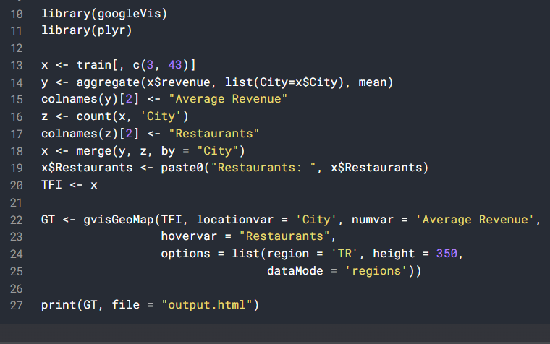
This is an unfinished visualization. It’s not even a machine-learning model. link￼
Critique
Create training set
Creating a geographical heat map that displays the average revenue for restaurants
Output to .html Done, no more lines??

Slide 8
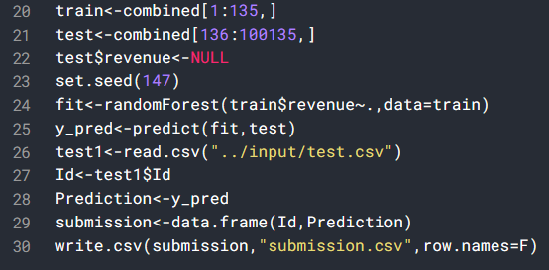
The code does not evaluate the performance of the machine learning models on a test set. It's important to evaluate the quality of these predictions to ensure that they are reliable and accurate. link
Critique
Here is the prediction
Directly put in .csv

Slide 9
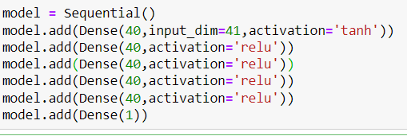
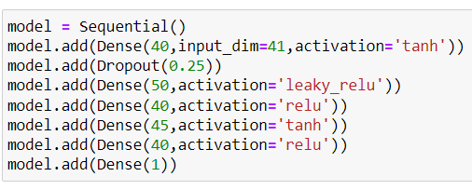




The Model
Original Model
Modified Model

Slide 10
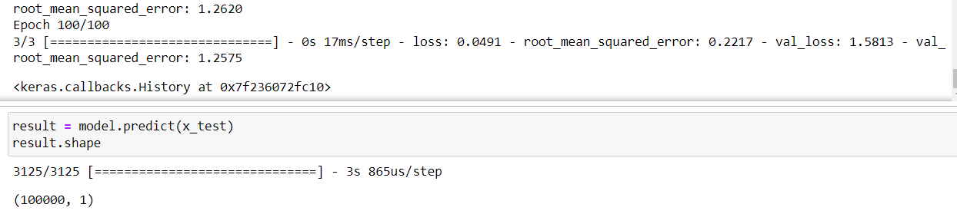
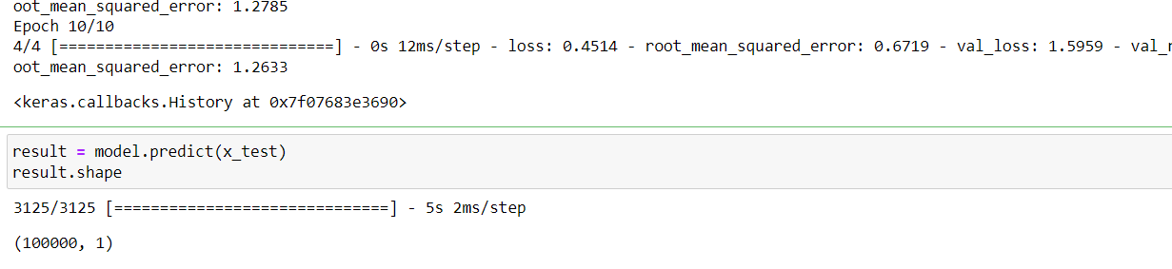










results
Original Model
Modified NN Model

Slide 11
Performance
Lower loss
The loss value of the modified model (0.0491) is significantly lower than the original model (0.4514).
Lower RMSE
The RMSE value of the modified model (0.2217) is also significantly lower than the original model (0.6719).
Validation Loss Improvement
The validation loss of the modified model (1.5813) is slightly lower than the original model (1.5959)

Slide 12
Performance
Activation function changes
The modified model uses 'leaky_relu' and 'tanh' activation functions in addition to 'relu', which could provide the model with more flexibility in capturing different types of non-linearities in the data
Varying no. of nodes
The modified model has varying numbers of neurons in each hidden layer, with 50, 45, and 40 neurons in different layers. This variation in neuron count could provide the model with different levels of complexity and capacity to capture different patterns in the data.
Dropout regularization
The modified model includes a Dropout layer with a dropout rate of 0.25, which can help mitigate overfitting by randomly dropping out some neurons during training, thus reducing their dependency on specific input features

Slide 13
Link
Dataset

