Slide 1






The Open Security Community

Slide 2
Idea behind n|u
- Started as an idea to share knowledge in the area of information security
- Promote and advance security research
- Make InfoSec learning fun! ☺

Slide 3
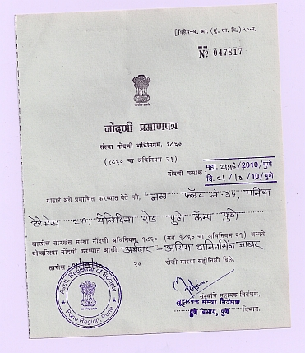
We are non-profit!
- Registered as a non-profit Society and Trust in Pune, since 2010
- Everything in null is free and open!
- No place for hate speech, piracy and any unlawful activity

Slide 4
n|u meets
n|u monthly meets take place in multiple cities where InfoSec enthusiasts discuss security.

Slide 5
n|u Hands on Workshops
Periodically conducted free workshops on offensive(Humla), defensive(Bachaav) & short skill-bridging(Puliya).

Slide 6
n|u Portal (null.co.in)
Event Hosting Platform of null.

Slide 7
n|u mailing list
The primary discussion and announcements channel of null

Slide 8
n|u jobs (jobs.null.community)
Free job portal for security jobs

Slide 9
Who is a n|u community member?
Any one who wants to be associated with us.

Slide 10
Highlights of 2018
More than 120 events happened across all chapters of null
Nearly 245 speakers presented
More than 4000 people attended meets and workshops around the year in 2018

Slide 11
Where are we headed?
Increasing number of chapters and participation in the community
Increased collaboration among various communities to help evangelizing information security
Mentoring students from colleges and universities
More meeting formats
Record and live stream events

Slide 12
Organizations supporting us!
Some organizations being kind enough to constantly support us by providing us space to meet and share knowledge:
Citrix (Bangalore), Thought Works (Chennai)
Sophos, Ganpat University(Ahmedabad),
Adobe (Delhi), Open Text (Hyderabad),
Airtel (Delhi), Progress Software (Hyderabad),
Institute For Technical Education (Bhopal),
Directiplex (Mumbai), Emirates (Dubai)
Payatu (Pune), KPN (Amsterdam),
.. and many more who are not in this list. A Big Thank You ☺

Slide 13
A shout out to other InfoSec communities doing great work locally!
Garage4Hackers
Cysinfo
OWASP chapters
Defcon Groups
InfoSec girls
and many others doing great work out there

Slide 14
A note of thanks!
- To all chapter leaders
- All organizations/institutions who have supported in some format in conducting meets.
- And all volunteers who volunteer for hours for community.

Slide 15
Thank you

