Slide 1

Welcome

Slide 2
Agenda
What is null and how it starts
Why null ?
Types of events
Contribution from audience

Slide 3
About Null Community
null is India's largest open security community
It is Non- profit society registered in 2010
Null community idea behind
Aseem jakhar

Slide 4
Why Null community
Here you can gain knowledge for free
And meet different security domain experts
Start sharing knowledge and get appreciation from the null people called networking session
The only place where you grow yourself much better in your career by the guidance

Slide 5
Null Community Providing
Job Portal
Blog
Email discussion
Humla
Bachaav
Puliya
Meets

Slide 6
Humla

Slide 7
Humla | हमला
•
Means attack in Hindi
•
Offensive Security workshops
•
Clear focus on learning the tools,
techniques
and approaches of offensive security using
simulated servers and networks

Slide 8
Humla LOGO
Need
a
logo
from
the
community

Slide 9
#nullhumla
Please use the above mentioned
tagging on social media.
•
hashtag for
•
Give us more ideas for sessions by tweeting
@null0x00 using the above hash tag.
to

Slide 10
Keep in Mind
null sessions are conducted by volunteers out of their passion and willingness to contribute to the security community.
•
•
While the knowledge shared is pro-bono it
doesn't mean that the training and knowledge
imparted is lacking in quality or depth.

Slide 11
Code of Conduct
•
Please ensure that we follow the schedule
completely by being on time.
•
We will be giving regular breaks,
are back on time.
please ensure
you
•
Please ensure your full attention
to the champion
and address all questions to the champion.

Slide 12
Code of Conduct
•
If you really need to take
leave the room.
a phone call, please
•
If it is possible keep
your
phone on silent.
•
Don’t misuse the internet provided by the
venues. Don’t download excessively, don’t
watch streaming video and be professional

Slide 13

Schedule for the day (10 AM – 6 PM)
Time Remark
10:00 AM – 10:10 AM Introduction to the session
10:10 AM – 11:40 AM humla session
11:40 AM – 11: 55 AM Break
11:55 AM – 01:30 PM humla session
01-30 PM – 02-45 PM Lunch Break
02:45 PM – 04:15 PM humla session
04:15 PM – 04:30 PM Break
04:30 PM – 05:45 PM humla session
05:45 PM – 06:00 PM Feedback and Closing of the session

Slide 14
BACHAAV

Slide 15
Bachaav
Means defense in Hindi
-
बचाव
•
•
Defensive Security workshops
•
Clear focus on learning the tools,
techniques
and approaches of defensive security using
simulated servers and networks

Slide 16
BACHAAV LOGO
Need
a
logo
from
the
community

Slide 17
#nullbachaav
Please use the above mentioned
tagging on social media.
•
hashtag for
•
Give us more ideas for sessions by tweeting
@null0x00 using the above hash tag.
to
•
Tell more people about this new meeting
format that we are starting from today

Slide 18
Keep in Mind
null sessions are conducted by volunteers out of their passion and willingness to contribute to the security community.
•
•
While the knowledge shared is pro-bono it
doesn't mean that the training and knowledge
imparted is lacking in quality or depth.

Slide 19
Code of Conduct
•
Please ensure that we follow the schedule
completely by being on time.
•
We will be giving regular breaks,
are back on time.
please ensure
you
•
Please ensure your full attention
to the champion
and address all questions to the champion.

Slide 20
Code of Conduct
•
If you really need to take
leave the room.
a phone call, please
•
If it is possible keep
your
phone on silent.
•
Don’t misuse the internet provided by the
venues. Don’t download excessively, don’t
watch streaming video and be professional

Slide 21
Schedule for the day (10 AM – 6 PM)
Time Remark
10:00 AM – 10:10 AM Introduction to the session
10:10 AM – 11:40 AM Bachaav session
11:40 AM – 11: 55 AM Break
11:55 AM – 01:30 PM Bachaav session
01-30 PM – 02-45 PM Lunch Break
02:45 PM – 04:15 PM Bachaav Session
04:15 PM – 04:30 PM Break
04:30 PM – 05:45 PM Bachaav Session
05:45 PM – 06:00 PM Feedback and Closing of the session

Slide 22
PULIYA

Slide 23
Puliya -
Means culvert or a small bridge in Hindi
It is totally for bridging gap of your security skills
Feedback from the champions attendees are lacking the some of the skills

Slide 24
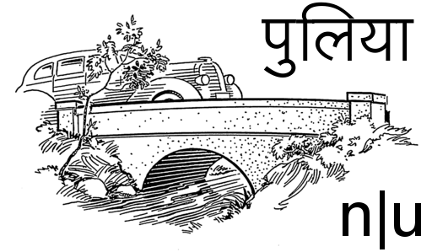

Slide 26
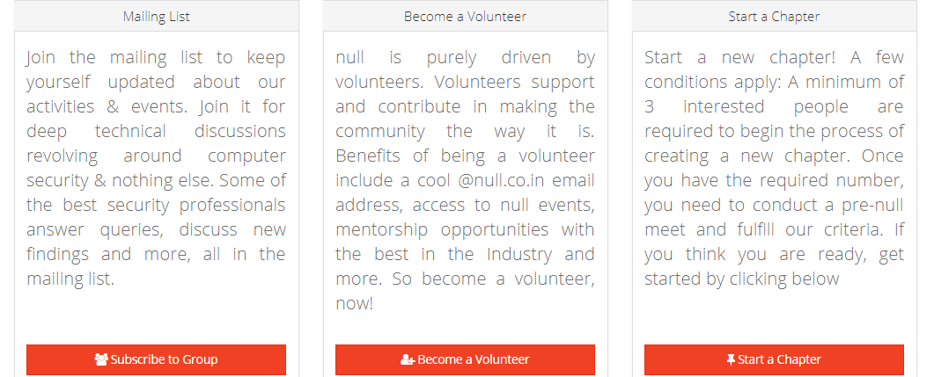
Contribution from the audience

