Slide 1


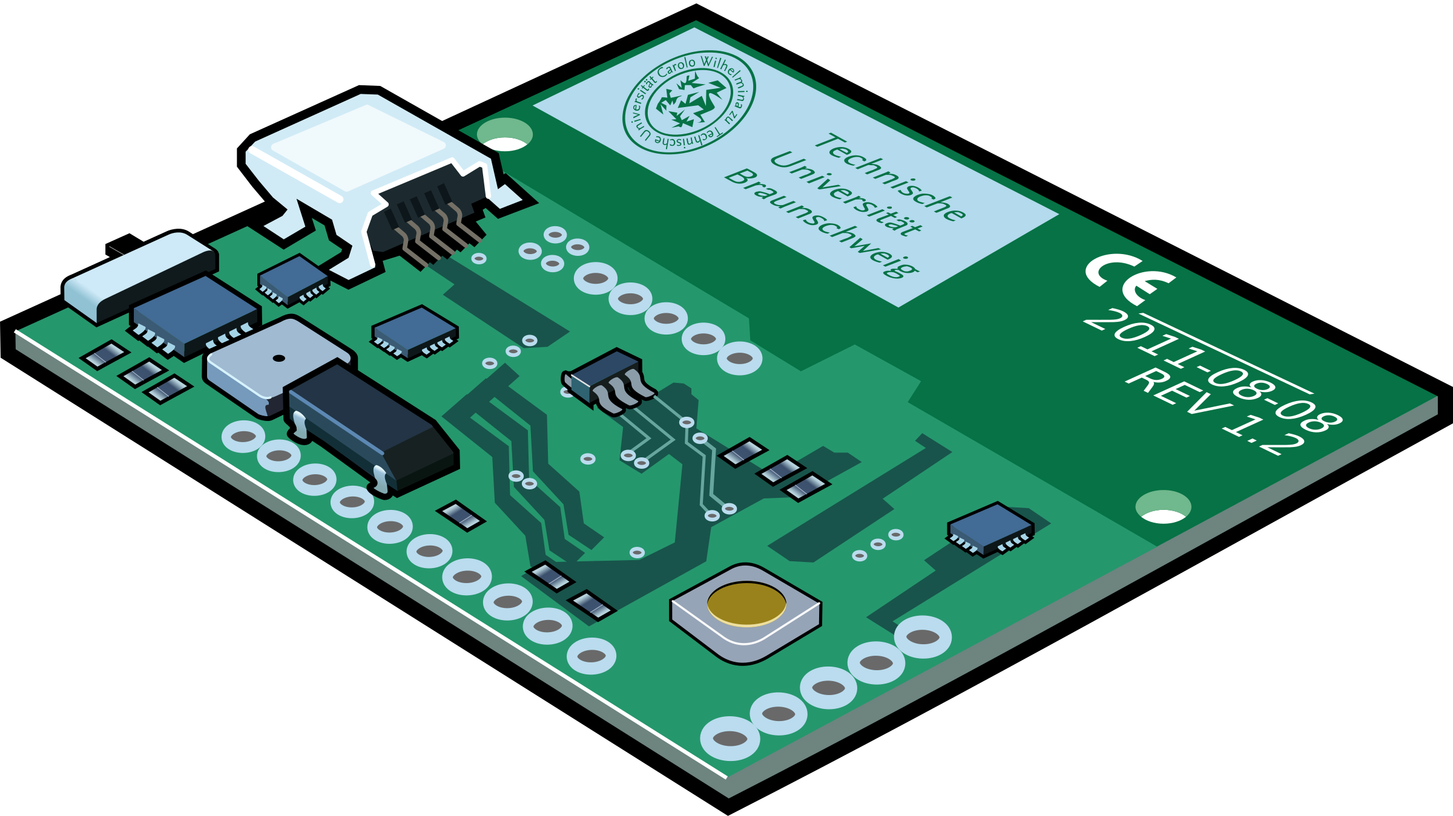
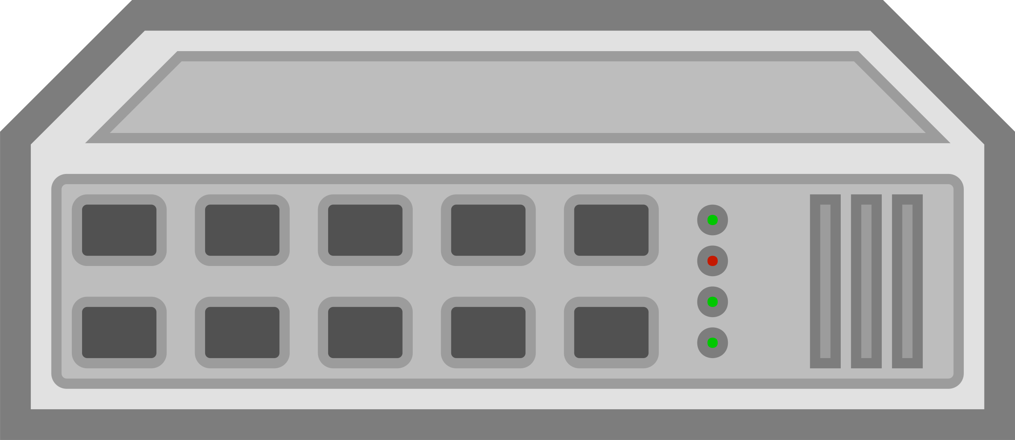


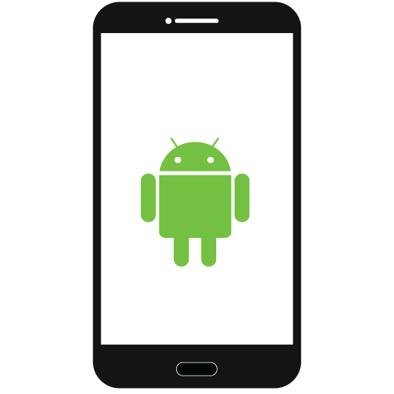
Ethernet
UDP Communication
(Ethernet)
TCP Socket

Slide 2






POST
Async
Response
LanguageTool
Message
Polling
Async
대화
대화
Web Socket
MongoDB
ParlAI
Michin AI

