Slide 1
Capstone Project: Event-driven Stock Prediction
Team: Xu Gao
Scott Edenbaum

Slide 2
Table of Content
Research
Reference papers
Our topic
Data scraping and cleaning
Model development
Prediction and trading result

Slide 3
Research
Reference Papers
1. Deep Learning for Event-Driven Stock Prediction
Xiao Ding, Yue Zhang, Ting Liu, Junwen Duan
They built a neural tensor network to transform word embeddings to event embeddings, then passed them to deep neural networks.
2. Deep Learning in Finance
J. B. Heaton , N. G. Polson ,J. H. Witte
They introduced main techniques in the deep learning and some applications in finance area.
Eg: Shallow Factor Models, Default Probabilities , Event Studies

Slide 4
Research
Our topic:
Event-driven Stock Prediction
Reasons:
Lack of researches
NLP
Our background

Slide 5
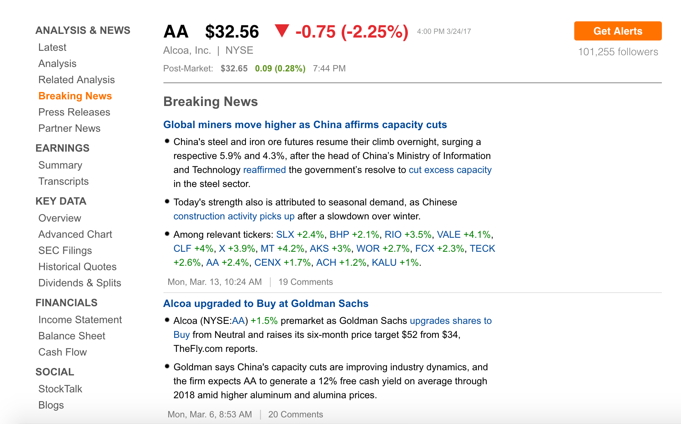
Data Scraping
Data Source:
Seekingalpha

Slide 6
Data Scraping and Cleaning
Difficulties:
Bot Test
Not well structured News and not consistent XPath
Solutions:

Slide 7
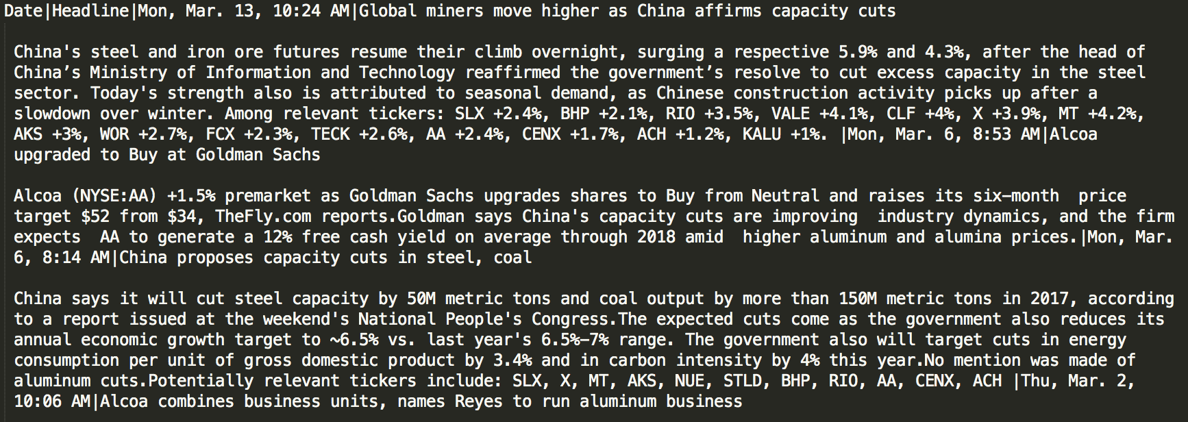
Data Cleaning

Slide 8
For news data some ways to transform to dataset:
1. Sentiment Analysis(textblob)
2. Word Embeddings
3. Doc2Vec
4. Event Embeddings

Slide 9
ReVerb:
ReVerb is a program that automatically identifies and extracts binary relationships from English sentences. ReVerb is designed for Web-scale information extraction, where the target relations cannot be specified in advance and speed is important.
Input: Paragraph

Slide 10
ReVerb Result:
/Users/gaoxu/DataSci/Event-Driven-FinModel/dev/single_news.txt 1 China ‘s steel and iron ore futures resumetheir climb 0 7 7 8 8 10 0.8225299076805256 China 's steel and iron ore futures resume their climb overnight , surging a respective 5.9 % and 4.3 % , after the head of China’s Ministry of Information and Technology reaffirmed the government’s resolve to cut excess capacity in the steel sector . NNP POS NN CC NN NN NNS VBP PRP$ NN RB , VBG DT JJ CD NN CC CD NN , IN DT NN IN NNP NNP NNP IN NNP CC NNP VBD DT NN VBD NN TO VB JJ NN IN DT NN NN . B-NP I-NP I-NP I-NP I-NP I-NP I-NP B-VP B-NP I-NP B-ADVP O B-VP B-NP I-NP I-NP I-NP O B-NP I-NP O B-PP B-NP I-NP I-NP I-NP I-NP I-NP I-NP I-NP I-NP I-NP B-VP B-NP I-NP B-VP B-NP B-VP I-VP B-NP I-NP B-PP B-NP I-NP I-NP O china 's steel and iron ore futures resume their

Slide 11
Model Development
Core model:
Neural Network with 2 hidden layers
1st hidden layer: 300 nodes, with tanh activation function
2nd hidden layer: 50 nodes, with tanh activation function
Output layer: 1 nodes, binary result with sigmoid activation function

Slide 12
Dataset development
I. Market Data:
5 day lag return data, S&P 500, NYSE Volume, Nasdaq Index
II. Add sentiment polarity
III. Word Embeddings
IV. Doc2vec, whole paragraph to 1 vector

Slide 13
Word Embeddings:
After ReVerb, get the sentence with the highest confidence level. And use subject, object, verb to get word embeddings.
Use average of those embeddings as input to Neural Network.
Cons: selection trustworthy?
Doc2Vec
Transform all paragraph to 1 vector, pass it to Neural Network
Part training set ➔ all training set

Slide 14
Result
Different model change:

Slide 15
Result
AA.

Slide 16
AA.
Trading: Start 1 unit
Aggressive:
1. Up,1 unit long position’
2. Short, 1 unit short position
Protective:
1. Up, 1 Unit long

Slide 17
AAPL

Slide 19
BAC.

Slide 21
CHK

