Slide 1
A Case for Shipping ALL Software Using Virtual Instruction Sets: The ALLVM and HPVM Projects
Vikram Adve
with Will Dietz, Sean Bartell, Joshua Cranmer, Tom Chen, Sandeep Dasgupta, Theodoros Kasampalis, Maria Kotsifakou, Hashim Sharif
University of Illinois at Urbana-Champaign
Supported by: NR, NSF, SRC, DARPA, DOE

Slide 2
Compilation Model for Static Languages
C, C++
Compiler 1
bin / IR
Linker +
IP Optimizer
Fortran
Static
Code Gen
OCAML
• • •
bin / IR
Ada
Rust
Compiler N
bin / IR
bin
Developer site
User site
FORTRAN 1, COBOL
FORTRAN 77
ALGOL, PL/1
Fortran 90
Simula 67
Objective C
Pascal
C++, Ada
C
D
Go
Rust
1955
1965
1975
1985
1995
2005
2015

Slide 3
Virtual Instruction Set Computing
C, C++
Compiler 1
Developer
site
IR
Linker +
IP Optimizer
Fortran
Java, C#
• • •
User
site
Javascript
IR
OpenCL, CUDA, …
Idle-time
Reoptimizer
Compiler N
Virtual
ISA
JIT
Code-gen
End-user
profiles
bin
Runtime
Optimizer
End-user
profiles
bin
Key: Virtual ISA can enable
far richer analyses, transforms
than native ISA
Static
Code-gen

Slide 4
Virtual Instruction Set Computing
C, C++
Compiler 1
Developer
site
IR
Linker +
IP Optimizer
Fortran
Java, C#
• • •
User
site
Javascript
IR
OpenCL, CUDA, …
Idle-time
Reoptimizer
Compiler N
Virtual
ISA
JIT
Code-gen
End-user
profiles
bin
Informal Definition:
VISC == Software ISA differs from Target Machine ISA
Runtime
Optimizer
End-user
profiles
bin
Key: Virtual ISA can enable
far richer analyses, transforms
than native ISA
Static
Code-gen

Slide 5
Popular VISC Systems
(Early systems: Lisp; IBM Systems: S/38, AS400, iSeries)
Managed run-times, e.g., JVM, .NET
VISC enables portability across OSs and architectures, type safety, language interoperability, JIT optimization
Scripting languages, e.g., Javascript, Python, PHP, Lua, …
VISC enables portability across OSs and architectures, flexibility, fast prototyping
GPU compute environments, e.g., PTX, HSA, SPIR, RS
VISC enables portability across some GPUs with high performance

Slide 6
Historical VISC Systems: IBM Mid-range Line
PL/1
Developer
site
RPG III
Compiler 1
User
site
COBOL
• • •
Basic
1979-present
IBM System 38, AS 400,
iSeries, Power Systems
Enabled virtual object code programs to be ported automatically to several hardware ISA families.
But … Virtual ISA deeply integrated with
proprietary OS + RDBMS
PL/1
C, C++
Compiler N
MI (System 38)
TIMI (AS 400 onwards)
S38, AS400,
Power/PowerPC, x86
Install-time
Code-gen

Slide 7
Historical VISC Systems: Transmeta
PL/1
Developer
site
Compiler 1
User
site
• • •
2000-2009
Transmeta x86-compatible processors
Compiler N
JIT
Code-gen
Co-designed
VLIW processor
x86 ISA
Runtime
Optimizer
End-user
profiles

Slide 8
Historical VISC Systems: Summary
VISC standard for (a) managed languages, (b) GPU compute
Successes:
Portability: Most or all
High performance: GPU compute
Failures:
Transparent hardware emulation (of x86): Transmeta
Unexplored:
Security and operating systems
Modern software architectures: “native” libraries, user extensions
Modern hardware architectures: vectors, SoCs

Slide 9
Popular VISC Systems: Managed Run-times
PL/1
Developer
site
Java
Compiler 1
User
site
C#
F#
• • •
VB.Net
C++/CLI
1995-present
Managed Run-times: JVM, .NET
Visual
COBOL
Compiler N
JIT
Code-gen
bin
JVM bytecode
CIL bytecode
Runtime
Optimizer
End-user
profiles

Slide 10
Popular VISC Systems: GPU Compute
PL/1
Developer
site
CUDA
Compiler 1
User
site
OpenCL
• • •
Render-script
C++ AMP
2006-present
GPU Compute Environments
Enable virtual object code to be ported between different GPUs
OpenMP
Compiler N
JIT
Code-gen
PTX (CUDA)
SPIR (OpenCL)
LLVM (Renderscript)
HSAIL
Various GPUs
Install-time
Code-gen

Slide 11
Popular Non-VISC Systems
Native code is pervasive for two broad classes of software
High performance software is largely shipped as native code | System software is almost exclusively shipped as native code
HPC applications | Operating systems
Media, Gaming, Finance, CAD, … | Hypervisors
Web browsers | Compilers
Database systems | Managed language runtimes
Libraries galore | Communication / crypto libraries
 | Loaders, linkers, GUI frameworks

Slide 12
But the World is Changing
Modern software architectures
User-installed extensions, dynamically loaded libraries, layering
Modern hardware architectures
Diverse vector hardware, GPUs, accelerators in mobile SoCs
Modern security challenges due to untrusted code
Browser extensions, mobile app markets, BYOD, cloud challenges
Need rich analyses and transformations on end-user systems

Slide 13
Problem: Modern Hardware Architectures
Native machine code is no longer a good match
for modern hardware diversity
Varying memory hierarchies
Varying vector instruction sets
Varying GPU capabilities
Varying heterogeneous mobile processors (SoCs)
Need to adapt software to individual end-user’s hardware

Slide 14
Problem: Modern Software Architectures
Native machine code is no longer a good match
for modern software engineering practices
Deep software stacks
Large numbers of dynamic libraries
User-installed software extensions
Debugging: reproducing in-field software failures
Prepackaged application containers, e.g., Docker
Need to optimize software on end-users’ systems

Slide 15


Problem: Modern Security Challenges
Untrusted code is becoming increasingly common
Browser extensions
Web pages with executable code, e.g., Javascript
Mobile application markets
BYOD: “Bring Your Own Device”
Secure applications on (insecure) commodity OS
Need security checking and instrumentation in end-user systems

Slide 16
Proposal
All future software should “ship” using Virtual ISAs.
NOTE: Different systems can use different Virtual ISAs.
The security benefits are strong
There are no inherent performance penalties (and novel performance benefits are possible)
It is technically feasible and commercially acceptable

Slide 17
Outline
HPVM: VISC for Heterogeneous Parallel Systems
ALLVM: VISC for General Purpose Systems
SVA: VISC for Operating System Security

Slide 18
Outline
VISC Motivation
Background: LLVM as a Virtual ISA
ALLVM: VISC from top to bottom and end-to-end
Overview
ALLVM Status
Early Results: VISC for Heterogeneous Parallel Systems (HPVM)
Dynamic autovectorization
Autotuning
Previous results: SVA?
Why could this be a bad idea? Reverse engineering. Weaker testing guarantees

Slide 19
LLVM Virtual Instruction Set and IR
/* C Source Code */
int SumArray(int A[], int Num)
{
int i, sum = 0;
for (i = 0; i < Num; ++i)
sum += A[i];
return sum;
}
;; LLVM Code
int %SumArray(int* %A, int %Num)
{
bb1:
%cond = icmp sgt i32 %Num, 0
br i1 %cond, label %bb2, label %bb3
bb2:
%sum0 = phi i32 [%t10, %bb2], [0, %bb1]
%iv = phi i64 [%inc, %bb2], [0, %bb1]
%t2 = getelementptr inbounds i32* %A, i64 %t7
%t3 = load i32* %t2, align 4
%t4 = add nsw i32 %t3, %sum0
%inc = add nuw i64 %iv, 1
%t5 = trunc i64 %iv to i32
%exitcond = icmp eq i32 %inc, %Num
br i1 %exitcond, label %bb3, label %bb2
bb3:
%sum1 = phi i32 [0, %bb1], [%t4, %bb2]
ret int %sum1
}
Simple, 3-address IR
Architecture-neutral
Language-neutral
Explicit CFG
Always in SSA form
Typed memory, regs
LLVM enables sophisticated program analyses and transformations

Slide 20
The LLVM Compiler Infrastructure
C, C++
Compiler 1
LLVM
Linker +
IP Optimizer
Fortran
Static
Code Gen
OCAML
• • •
LLVM
OpenCL
LLVM
Render-script
Compiler N
Developer site
User site
JIT
Code-gen
LLVM
bin
bin
LLVM
Runtime
Optimizer
Profile
info
JVM
Simple JIT
CIL
Simple JIT
LLVM
bin
Install-time
Code-gen
Available at: llvm.org
First release: October 2003

Slide 21
Production Uses of LLVM
 | Compile- time | Link-time | Install-time | Load/Run-time | Idle-time
Apple, Sony, Intel… compilers | ✔ | ✔
Dynamic tools | ✔ | ✔
(Apple) tvOS, watchOS, iOS | ✔ |  | ✔
MacOS OpenGL | ✔ |  |  | ✔
OpenCL SPIR | ✔ | ? | ? | ✔
Renderscript | ✔ | ? | ? | ✔
(Google) PNaCl | ✔ | ? |  | ✔
Static, native
compilers
(not VISC)
“For iOS™ apps, bitcode is the default, but optional.
For watchOS™ and tvOS™ apps, bitcode is required.”
-- iOS App Distribution Guide, Apple
VISC
systems

Slide 22
Outline
VISC Motivation
Background: LLVM as a Virtual ISA
ALLVM: VISC from top to bottom and end-to-end
Overview
ALLVM Status
Early Results: VISC for Heterogeneous Parallel Systems (HPVM)
Dynamic autovectorization
Autotuning
Previous results: SVA?
Why could this be a bad idea? Reverse engineering. Weaker testing guarantees

Slide 23
Outline
Why Virtual ISAs? Hw, Sw, Security
ALLVM:
What is it? Userspace version. Full-system version.
What are the software goals? allexe. allee. allout. allgood! binaries.
What are the research goals? HPVM. Autotuning. Dyn. autovec. Auto debugging.
Early results: HPVM
Early results: Dyn. autovec
Early results: Autotuning?
Previous results: SVA?
Why could this be a bad idea? Reverse engineering. Weaker testing guarantees.

Slide 24
ALLVM Overview
Represent “all” software components as Virtual ISA
Applications
Applications
Virtual ISA
Native ISA
Dynamic
libs
Static
libs
Dynamic
libs
Static
libs
libc
libc
OS
OS
Device
drivers
Boot loader
Userspace only
OS and Userspace

Slide 25
ALLVM Toolchain
All tools themselves shipped in .allexe format!
C, C++
Clang
.bc
Linker +
IP Optimizer
bc2allvm
alltogether
• • •
.bc
.allexe
.bc
.allexe
C, C++
Clang
Developer site
User site
bin
allout
AOT opt + code gen
.allexe
Native object
code cache
bin
alley
Execution engine

Slide 26
ALLVM: Statement of Principles
Universal: OS in which all code is represented as LLVM IR
Full-system: Enable full-system analysis and transformation
Single external interface: “libnone” (essentially libc)
AOT translation: essential for performance (but transparent)
JIT optional: dynamic opt. is opportunity, not necessity
Self-contained format: DLL paths; linker semantics; target info
Useful and real: Linux (NixOS); FreeBSD port underway

Slide 27
.allexe: ALLVM File Format
Zip archive of bitcode components + metadata
Based on LLVM IR (bitcode)
main.bc: Default entry point (optional)
All libraries included or indirectly referenced
Fully self-contained ❡: specifies everything needed to run
Target parameter info, ABI choices, etc.
Explicit dependencies only: no “DLL hell”
No unspecified build system choices❡ or linker semantics
❡ Under investigation

Slide 28
The ALLVM Toolchain
All except libnone represented in .allexe format!
Front-end, libs: clang, libc++, libc++abi, libunwind
bc2allvm: wrap bitcode file(s) into .allexe format
alltogether: linker to resolve external name references
libnone: musl libc for simplicity and analyzability
allout: AOT optimizer and code generator
alley: execution engine with optional JIT
Native code cache: transparently used by allout, alley

Slide 29
Making ALLVM Usable: Key Issues
Users: How to “use” ALLVM?
Install the OS
Install/update software
Issue requests for analysis/transformation
Developers/Distributors: How does software get into ALLVM?
How to represent software (that wasn’t written with ALLVM in mind)
How to build software into this format
Handling build systems reasonably
Automatic transparent building of “most” software
Researchers: How to write analysis and transforms for ALLVM?
Without solving these, ALLVM is just a toy

Slide 30
“libnone”: Defining the system platform
Sole external interface for all userspace software
Essentially libc
Well-defined semantics for whole-program analysis
Portable interface across operating systems
Multiple implementations
Linux: Musl libc
FreeBSD: Evaluating native libc

Slide 31
ALLVM: Core System Status
Substantial userspace software, tools in ALLVM:
xterm, libX11, vim, spidermonkey
openssl, openssh
(apache) httpd, nginx, redis, memcached, postgresql
subversion, git
binutils, coreutils, bash, zsh, tcsh
lua, perl, python, ocaml (the C-based bits anyway)
Substantial capabilities for userspace:
Runs on top of existing Linux OS, or in Docker
Can self-bootstrap, e.g., Clang : bash + cmake → make + clang → bc2allvm → alltogether → allout / cache → alley
Binary cache: Local and remote (trusted)
Nix package manager: Atomic software upgrades

Slide 32
ALLVM Core: Near-Future Plans
Public “alpha” release for community involvement
allready: Binary-to-LLVM tool
FreeBSD port
Further refinement of ALLVM Format
Additional tools as part of the ALLVM ecosystem

Slide 33
ALLVM: Research Goals
Decompilation: binary to LLVM (with Ed Schwartz, CMU)
HPVM: Heterogeneous parallel systems
Dynamic autovectorization
OPTIC: Compiler techniques for distributed systems
Verified back end: Increasing trust in VISC
Autotuning: install-time heuristic search

Slide 34
Binary-to-LLVM
allready
bin
.bc
Linker +
IP Optimizer
.bc
bc2allvm
alltogether
C, C++
Clang
• • •
.bc
.allexe
.bc
.allexe
C, C++
Clang
Developer site
User site
bin
allout
AOT opt + code gen
.allexe
Native object
code cache
bin
alley
Execution engine

Slide 35
Binary-to-LLVM
Goal:
Extract “Richer” LLVM IR from binary
The extracted IR includes variable, type information and per-procedure stack frames.
Motivation:
ALLVM envisions to represent all software components in LLVM IR
Some software components are wholly or partially in binary format

Slide 36
Current Status
Binary
McSema
LLVM IR
Stack
Deconstruction
LLVM IR
Variable
Recovery
LLVM IR
Type
Inference
LLVM IR
Ongoing Work
Ongoing Work
Identified some limitations of McSema extracted IR
McSema uses a flat array to model runtime process stack. Prohibits variable recovery
Machine registers mapped in memory; Not promoted to registers
Implemented stack deconstruction
The implementation is tested using McSema provided test suite and custom test cases

Slide 37
Stack Deconstruction
High
High
%rbp + 16
arg2
%rbp + 8
arg2
%rbp + 24
Parent Stack
arg1
Parent Stack
arg1
%rbp + 16
ret addr
%parent_stack_end
ret addr
old %rbp
%rbp
old %rbp
Current Stack
%rbp
(Function Foo)
Current Stack
(Function Foo)
Low
Low
foo:
push %rbp
mov %rsp, %rbp
mov 16(%rbp), %rax
mov 24(%rbp), %r10
foo:
push %rbp
mov %rsp, %rbp
mov 8(%parent_stack_end), %rax
mov 16(%parent_stack_end), %r10

Slide 38
Ongoing Work
Identify variables and promote them as symbols
Represent every symbol in the IR with a meaningful type instead of the generic types provided by McSema
unsigned int foo(char* buf) {
unsigned alligned_len = 0; unsigned int c = strlen(buf);
if(c%8 == 0 ) {
return c;
} alligned_len = 8* (c/8) + 8; return allign_len;
}
Variable Names | C Type
1) buf | char*
2) c | unsigned int
3) alligned_len | unsigned int
1) and 2) inferred using strlen prototype
3) inferred using arithmetic operation

Slide 39
VISC: Research Goals
Sophisticated program analyses, transforms
on end-user systems
“Shipped” code formats that contain enough information to enable such analyses & transforms, e.g., an entire Linux distribution
New performance optimizations that exploit these
New security techniques that exploit these

Slide 40
What About Machine Code Analysis?
Analysis
results
Analysis
results
Not even close!
ISA semantics is complex (e.g,. X86, ARM)
Memory model is extremely low-level
Difficult to transform or instrument reliably
E.g., advanced tools like PIN resort to dynamic analysis & instrumentation
E.g., “reverse engineering” uses extensive manual analysis of names, strings
Analysis
Budget
“Compiler
IR”
Machine
code
Compiler
IR
Some binary analysis will be unavoidable: proprietary libraries, legacy code

Slide 41
Security Benefits of VISC:
Google’s Portable Native Client (PNaCl)
Secure Virtual Architecture (SVA)
John Criswell’s PhD on SVA won an
Hon. Mention for 2014 ACM Doctoral Dissertation Award

Slide 42
Google Portable Native Client (PNaCl)
Web
application
components
C/C++
Front End
Restricted
C, C++
Developer site
User site
LLVM
Chrome
Browser
Static
code-gen
PNaCl
Verifier
Sandboxing for Chrome browser extensions
Shipped as LLVM bitcode; translated & verified on load
Ensures extensions are portable to x86, x86-64, ARM

Slide 43
Secure Virtual Architecture: OS on VISC
Works with commodity kernels, e.g., Linux, FreeBSD
Applications, libraries, languages
OS services
OS kernel
Virtual instruction set
Code gen
Instrumentation
SVA-OS lib
Processor
Native instruction set
Virtual ISA = LLVM + SVA-OS
Translate at install-time, boot-time, and/or run-time

Slide 44
SVA-OS API
Hardware Control
Syscall, interrupt, trap handlers
sva.register.intr (int intnum,
int *handler(…))
Page table manipulation
sva.update.l1.mapping(void *ptp,
unsigned trans)
I/O operations
sva.io.read(void *ioaddress)
State Manipulation
Context-switching
sva.swap (int newid, int *oldid)
Signal delivery
sva.ipush.function(int *f(…), …)
Manipulate interrupted program state
sva.icontext.load(void)

Slide 45
Porting an OS to SVA
E.g., This is how we ported Linux 2.4.22, FreeBSD 9.0
Clang
C/C++ compiler
Existing
OS in
C/C++
OS in LLVM
bitcode
Port kernel to SVA-OS API
Like porting to a new (virtual) architecture

Slide 46
Porting Linux 2.4.22
Component | Total Lines | Lines Modified
Architecture-Independent | 603,232 | 288
Architecture-Dependent | 29,237 | 4,778
Total | 632,469 | 5,066
Total changes: 0.80%
Notes:
Virtual Ghost SVA is about 5,400 source lines of codes (excluding white space and comments).

Slide 47
What is SVA Good For?
SVA provides a unique combination:
Rich compiler capabilities (like JVM, .NET)
+ OS supervision (like a VMM)
… which can enable powerful, new security solutions
SVA-M: memory safety for a commodity OS [SOSP ’07]
KCoFI: control-flow integrity (CFI) for commodity OS [IEEE S&P ’14]
Virtual Ghost: protect applications from hostile OS using fast compiler techniques [ASPLOS ’14]
Each of these is the first-ever system to do so.

Slide 48
SVA-M: Memory Safety with SVA
Provides safety close to a type-safe language
even for a large commodity kernel like Linux
Prevents many common attacks like buffer overflows, heap corruption, code reuse attacks, etc.
Safe pointer arithmetic (no buffer overflows)
Loads & stores access correct subset of objects
Control-flow and code segment integrity
Type-safety for a subset of memory objects
Dangling pointers made harmless; no garbage collection
SOSP 2007, Audience Choice Paper Award

Slide 49
KCoFI: Control-Flow Integrity with SVA
Control-flow cannot be hijacked arbitrarily
even for a large commodity kernel like FreeBSD
Code segment integrity
Indirect calls, branches follow compiler-predicted paths
Context switching, interrupt/trap handling
MMU management
Formal proof of key control-flow integrity theorems, including tricky kernel-specific issues
IEEE S&P 2014

Slide 50
Virtual Ghost = Secure Computation Using SVA
Ghost Memory:
Inaccessible to OS
Application:
Private data in ghost memory
Encrypts private data for I/O
Virtual Ghost (VG) API
SVA-OS + App. Requests
OS Kernel:
Performs all OS services
Application
Public Data
Ghost Memory
Private Data
OS Kernel
Private Key
Private Code
Virtual Ghost (SVA)
Processor
Notes:
Virtual Ghost Runtime is SVA-OS Runtime with new run-time checks.

Slide 51
Virtual Ghost
Secure application can preserve confidentiality, integrity
even if the underlying OS is compromised
Application is given ghost memory for securing data
Application is given secure key for encrypting I/O
OS cannot read/write ghost memory or VG memory
Software Fault Isolation protects Ghost memory, VG memory: more efficient than using MMU
Extends KCoFI to prevent control flow hijacks of application by OS
ASPLOS 2014

Slide 52
Compiler Techniques Used For Security
Difficult to do on
machine code
Call graph analysis
Points-to analysis
Type inference
Escape analysis
Identifying low-level OS operations
Restrictions on native code
Can be effective with machine code but incurs higher overhead
Software fault isolation
Control flow enforcement

Slide 53
VISC for Security: Summary
VISC enables strong security benefits that
would be very difficult with machine code
Strong memory safety for Linux
Control-flow integrity for FreeBSD 9.0
Application confidentiality, integrity on a hostile operating system (using fast compiler techniques)

Slide 54
Ongoing Research On allvm
OPTIC: Compiler techniques for distributed systems
Dynamic autovectorization
Verified back end: Increasing trust in VISC
Decompilation from binaries to LLVM (with Ed Schwartz)
Autotuning: install-time heuristic search

Slide 55
Compiler Techniques for
Distributed Systems
Led by: Will Dietz

Slide 56
Analyzing Distributed Applications
Software often composed of many programs working together
Examples: Microservices pattern, Web Server+Database
Goal: Analyze, optimize distributed applications as single unit
Challenges:
Complex boundaries between programs
Components are unknown until run-time
Solution: ALLVM + OPTIC: Compile all communicating components together at run-time
Fundamentally requires
run-time compilation

Slide 57
OPTIC Overview
Unified Representation
Extended Compiler IR representing communicating programs
Static and Dynamic Analysis
Hybrid analysis overcomes scaling challenges and improves precision
Optimizing Transforms
Improve program performance using novel compiler-based techniques

Slide 58
Example Optimizations w/OPTIC
Constant Propagation
Dead Store Elimination
Protocol Specialization
Code Movement

Slide 59
Status
Published:
Slipstream: Automatic Interprocess Communication Optimization
Dietz, Cranmer, Dautenhahn & Adve, Usenix 2015.
Current:
OPTIC-Trace: “How does software communicate in practice?”
Debugging/research tool for identifying optimization opportunities
Data-structure: dynamic behavior projected onto unified IR

Slide 60
Dynamic Autovectorization
Led by: Joshua Cranmer

Slide 61
Why vectorize dynamically?
Proliferation of vector instruction sets
Uptick in language/library support for vector code
This support is limited to intersection of features
Autovectorization has underperformed
Data dependence
Complex control flow
Cost-benefit prediction
More information available at runtime

Slide 62
Example Run-time Opportunities
Or, why might run-time autovectorization help?
Focus on hot paths to avoid conditional branches
Seemingly aliased pointers might be disambiguated
Unknown loop trip counts get resolved
Unknown data alignments get resolved

Slide 63
Hot path extraction
IF-statements require inefficient vector masks
Some vector lanes may be idle
Deeply nested conditionals may exacerbate this problem
Extracting hot paths eliminates need for masks
C1
C1&C2
C1
S1
S2
S1
S2
S1’
C2
C2

Slide 64
Current status
Can identify hot paths in loops
Can extract those hot paths and optimize
Ongoing: modifying LLVM vectorizers to handle the resulting loops

Slide 65
Verified Code Generation
Led by: Theodoros Kasampalis

Slide 66
Verified Back-end
Goal: High level of trust in VISC code generator
formally certifiable native code generation in VISC back-end (LLVM IR to x86-64)
Motivation: We want to ship code as LLVM bitcode but users do not trust the back-end
Benefits of VISC
Portability
Performance
Security guarantees through sophisticated analyses
Why not trust the back ends?
Back-end bugs
Undefined and implementation-defined behaviors in applications

Slide 67
Undefined Behaviors and Security
Undefined behaviors expose unexpected vulnerabilities because of compiler choices
Google NaCl/x86: Integer overflow
→ alignment enforcement compiles to no op
Linux kernel: Null pointer dereference
→ null check gets removed by compiler
Fundamental problem: Compilers may produce
arbitrary (different) output for undefined source code

Slide 68
Proposed Solution: Translation Validation
Translation Validation❡ (TV) for code generator
Each translation result verified to correctly implement the input
Alternative to full formal verification of the back end
Applied to existing production-quality compilers (LLVM)
No need to re-write a code generator: treat as a black box
TV system and code generator maintained separately by experts
Use K Framework to define input and output semantics
Executable semantics with symbolic execution support
❡Pnueli, Siegel, and Singerman. 1998. Translation Validation. TACAS '98.

Slide 69
State of the Art
Today: TV assumes common language for input, output
e.g. Necula, Tate's equality saturation, LLVM-MD
Not sufficient for code gen, e.g,. LLVM to x86-64
Formally verified compilers (e.g. CompCert)
Developed from scratch along with extensive proof assistance
No guarantees in presence of undefined behaviors
Testing-focused approaches, e.g. CSmith, Orion
do not guarantee absence of bugs

Slide 70
Google NaCl/x86 Issue 245 (1/13/2010)
Ret addresses from untrusted code must be enforced to be 32-byte aligned
Orginal correct code (nap->align_boundary is 32):
Bug after change to (forgot to change nap->align_boundary to 5):
gcc compiles 1 << 32 to 1 hence the whole expr becomes a no-op
aligned_tramp_ret = tramp_ret & ~(nap->align_boundary - 1);
return addr & ~(uintptr_t)((1 << nap->align_boundary) - 1);

Slide 71
Linux Kernel 2.6.30 exploit (7/13/2009)
Pointer dereference before check for NULL
Check condition either false or function undefined
Hence check is removed by compiler
Attacker that can make page zero accessible can now exploit the rest of this code
struct tun_struct *tun = ...;
struct sock *sk = tun->sk;
if (!tun)
return POLLERR;
/* write to address based on tun */

Slide 72
Our Approach
LLVM Back-end
LLVM Bitcode
x86-64
Proof Hints
Translation Validation System
LLVM Semantics (in K)
x86-64 Semantics (in K)
Correctness Proof

Slide 73
Our Approach
First Step
LLVM Back-end
LLVM Bitcode
Instruction Selection
Virtual
x86-64
SSA
Optimizations
Virtual x86-64:
x86-64
+ SSA registers
+ abstract stack
x86-64
post-SSA
Optimizations
Prologue/Epilogue Insertion
Register Allocation
Sync Points
Sync Point Generator
Translation Validation System
Correctness Proof
LLVM Semantics (in K)
x86-64 Semantics (in K)

Slide 74
Open Research Problems
Translation validation between different languages
Today: TV assumes common language for input, output
E.g. Necula, Tate's equality saturation, LLVM-MD
Not sufficient for code gen, e.g,. LLVM to x86-64
Our approach: Use “full program equivalence” proof system [1]
How to deal with undefined behaviors in VISC?
Input K semantic definition captures undefined behaviors
TV enforces a specific treatment
Undefined behavior checker on input: catches 82% of errors [2]
Ciobâcă, Lucanu, Rusu, and Roşu. A Language-Independent Proof System for Mutual Program Equivalence. In ICFEM’14.
Hathhorn, Ellison, and Roşu. 2015. Defining the undefinedness of C. PLDI 2015

Slide 75
Current Status and Future Goals
1. Definition of LLVM IR semantics in K | Mostly comprehensive definition available
2. Definition of x86-64 semantics in K | In progress – currently small x86 subset defined; runs small programs
3. TV of Instruction Selection phase (LLVM IR to x86-64) | In progress – open question of TV between different languages
4. Handling undefined behaviors | Future work
5. TV of phases other than Instrn Selection | Future work
6. TV of concurrent shared memory pgms | Future work

Slide 76
Summary
Proposal
All future “shipped” software should use virtual ISAs
allvm enables sophisticated, novel run-time techniques
Across component boundaries in distributed systems
Across layers of software stack, including OS
Trustworthy code generation is a key challenge
http://llvm.org
http://sva.cs.illinois.edu

Slide 77
Questions?

Slide 78
Example: Hardware/Software Interaction Error
Virtual Page
Physical Frame
ptr p
Type A
A or B
ptr q
Type B
78

Slide 79
Example: State Manipulation Error
Kernel Stack
SVA-M
Load/store checks
KCoFI
Software Fault Isolation
Saved Program State
X
PC
SP
Stack Frame 1
Stack Frame 2
Stack Frame 3
79

Slide 80
Low-level Memory Safety in SVA-M
Prevents safety errors via hardware/software interaction
E.g., virtual to physical mappings that violate type safety
Prevents safety errors via bad state manipulation
E.g., signal delivery to interrupted kernel state
Made possible by SVA-OS!
Make certain errors impossible to express
Detect remaining errors with run-time checks
80

Slide 81
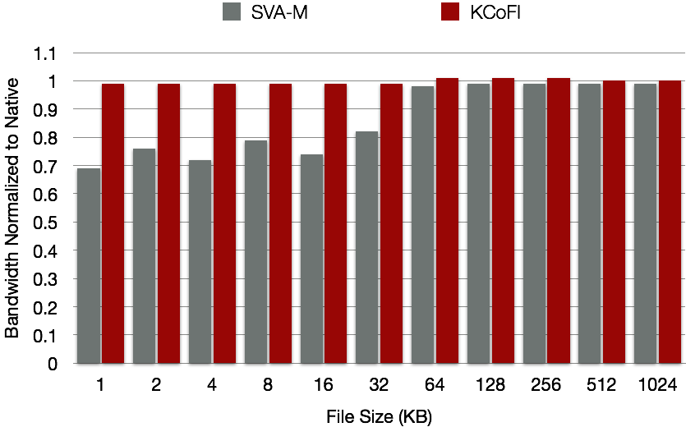
SVA-M and KCoFI: Web Server Performance
Strong security guarantees at the cost of 0-40% application overhead
Weaker but useful protection for < 10% overhead
81

Slide 82
Application Cannot Protect Itself from OS
Public Data
Public Code
Operating System
Operating System Can Access Anything and Everything!
Data
Code
Control Flow
82

Slide 83
But Perhaps That’s Not a Good Idea…
Vulnerability | Examples
Buffer Overflows | BugTraq ID 12911, 13589, 13207, 13225, 12295
Integer Overflows | BugTraq ID 10179, 63707
Information Leaks | BugTraq ID 8831, 64677, 64746, 64742, 62405
Kernel-level Malware | Adore rootkit
83

Slide 84
Virtual Ghost = Secure Computation Using SVA
Ghost Memory:
Inaccessible to OS
Application:
Private data in ghost memory
Encrypts private data for I/O
Virtual Ghost (VG) API
SVA-OS + App. Requests
OS Kernel:
Performs all OS services
Application
Public Data
Ghost Memory
Private Data
OS Kernel
Private Key
Private Code
Virtual Ghost (SVA)
Processor
Notes:
Virtual Ghost Runtime is SVA-OS Runtime with new run-time checks.

Slide 85
Securing Ghost Memory
User-Space Memory
Software Fault Isolation for OS
Protects ghost memory
Protects Virtual Ghost VM memory
Control-Flow Integrity for OS
Prevents instrumentation bypass
Also improves kernel security
Ghost Memory
Virtual Ghost VM Memory
Kernel Memory
User process address space

Slide 86
Secure Application Control Flow
Program state in VM Memory
OS cannot modify directly
SVA-OS vets/performs changes
Kernel
SVA-OS
Virtual Ghost
Saved Program State
86

Slide 87
Secure Application Control Flow: Initial State
Kernel requests code setup
Virtual Ghost
Sets up code segment
Adjusts PC to main()
Kernel returns from interrupt
Kernel
App Executable
Virtual Ghost
Saved Program State
PC
main()
App Code Segment
87

Slide 88
Secure Appl Control Flow: Signal Handlers
Application registers sighandlers
Application is interrupted
Kernel asks to deliver signal via
sva.ipush.function(f(), arg1, …)
Virtual Ghost …
… checks authorized sighandler list
… adjusts PC to handler, f(), if found
Kernel returns from interrupt
Kernel
Virtual Ghost
Saved Program State
PC
sigh1
Authorized PCs
sigh1
sigh2
88

Slide 89
Implementation
Implemented SVA-OS and Virtual Ghost on x86_64
Ported FreeBSD 9.0 to Virtual Ghost
FreeBSD compiles with LLVM out of the box
Modified OpenSSH applications to use ghosting
ssh client
ssh-keygen utility
ssh-agent key-chain server
89

Slide 90
Summary of Experiments
Security: Virtual Ghost thwarts OS attacks:
Simple: Read data directly from ssh-agent application memory
Advanced: Call malicious code in application via fake signal handler
Performance:
ApacheBench: ~0% overheads
OpenSSH: 23% average reduction in bandwidth
Primitive OS operations: VG is 1.5x-14x faster than InkTag (a hypervisor-based solution)

Slide 91
Experiments (1): Security
Added a malware device driver into the kernel
Prototype attacks
Simple: Read data directly from ssh-agent application memory
Advanced: Call malicious code in application via fake signal handler
Virtual Ghost thwarted both attacks
Simple: SFI harmlessly redirects OS read
Advanced: VG only accepts signal handlers “registered” by the application; rejects fake handler
91

Slide 92
Kernel Malware Attack
Read data directly
Kernel
ssh-agent
Traditional Memory
Malware Driver
ssh-agent
Ghost Memory
X
Malicious Data Flow
92

Slide 93
Kernel Malware Attack
Trick Application into Putting Data into the Clear
Install signal handler to malicious code in application
Malicious code copies data to traditional memory
X
memcpy (g, t);
write(fd, t, 10);
Malicious Data Flow
Kernel
ssh-agent
Traditional Memory
Malware Driver
ssh-agent
Ghost Memory
93

Slide 94
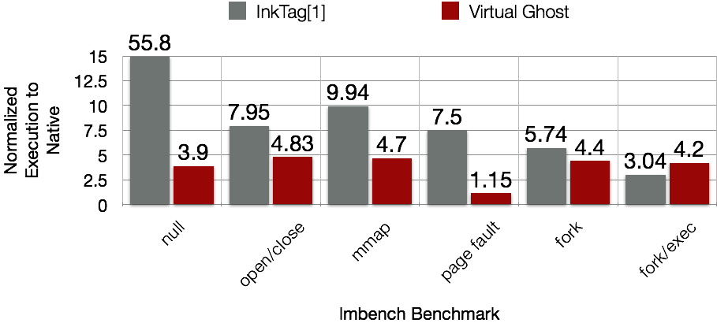
LMBench Execution Time Normalized to Native
[1] InkTag: Secure Applications on an Untrusted Operating System, ASPLOS 2013
94

Slide 95
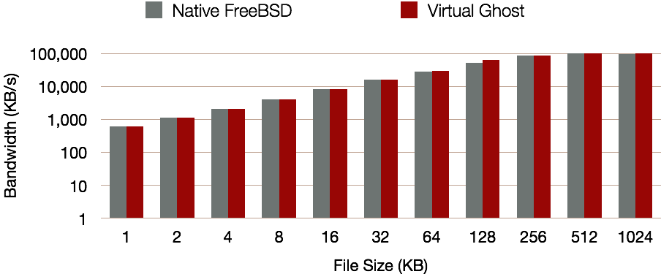
Web Server Performance for thttpd
ApacheBench: 100 clients, 100,00 requests
Performance overhead negligible
95

Slide 96
Unmodified SSH Server Performance
23% reduction of bandwidth on average
45% reduction in worst case
96

Slide 97
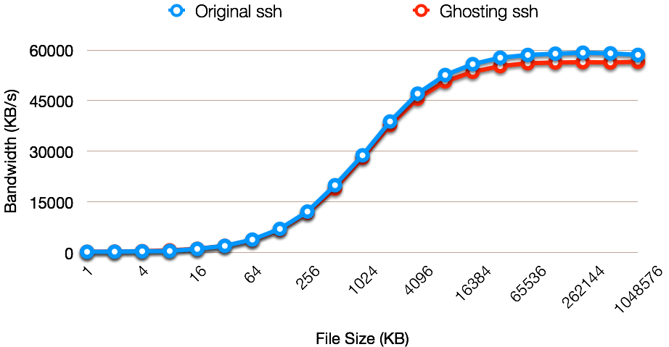
Ghosting SSH Client Performance
5% reduction in worst case
97

Slide 98
VISC for OS Security: Summary
VISC is key to the novel capabilities of SVA
Virtual ISA enables range of compiler techniques for kernel code
SVA-OS API has two benefits:
Higher level of abstraction for primitive hardware interactions
Monitoring library for mediating low-level OS behaviors
Applications, libraries, languages
OS services
OS kernel
Virtual instruction set
Code gen
Instrumentation
SVA-OS lib
Processor
Native instruction set

