Slide 1
A Case for Shipping ALL Software Using Virtual Instruction Sets: The ALLVM Project
Vikram Adve
with Will Dietz, Sean Bartell, Joshua Cranmer, Tom Chen, Sandeep Dasgupta, Theodoros Kasampalis, Maria Kotsifakou, Hashim Sharif, Prakalp Srivastava
University of Illinois at Urbana-Champaign
Supported by: NR, NSF, SRC, DARPA, DOE

Slide 2
Compilation Model for Static Languages
C, C++
Compiler 1
bin / IR
Linker +
IP Optimizer
Fortran
Static
Code Gen
OCAML
• • •
bin / IR
Ada
Rust
Compiler N
bin / IR
bin
Developer site
User site
FORTRAN 1, COBOL
FORTRAN 77
ALGOL, PL/1
Fortran 90
Simula 67
Objective C
Pascal
C++, Ada
C
D
Go
Rust
1955
1965
1975
1985
1995
2005
2015

Slide 3
Virtual Instruction Set Computing
C, C++
Compiler 1
Developer
site
IR
Linker +
IP Optimizer
Fortran
Java, C#
• • •
User
site
Javascript
IR
OpenCL, CUDA, …
Idle-time
Reoptimizer
Compiler N
Virtual
ISA
JIT
Code-gen
End-user
profiles
bin
Runtime
Optimizer
End-user
profiles
bin
Key: Virtual ISA can enable
far richer analyses, transforms
than native ISA
Static
Code-gen

Slide 4
Virtual Instruction Set Computing
C, C++
Compiler 1
Developer
site
IR
Linker +
IP Optimizer
Fortran
Java, C#
• • •
User
site
Javascript
IR
OpenCL, CUDA, …
Idle-time
Reoptimizer
Compiler N
Virtual
ISA
JIT
Code-gen
End-user
profiles
bin
Informal Definition:
VISC == Software ISA differs from Target Machine ISA
Runtime
Optimizer
End-user
profiles
bin
Key: Virtual ISA can enable
far richer analyses, transforms
than native ISA
Static
Code-gen

Slide 5
Popular VISC Systems
(Early systems: Lisp; IBM Systems: S/38, AS400, iSeries)
Managed run-times, e.g., JVM, .NET
VISC enables portability across OSs and architectures, type safety, language interoperability, JIT optimization
Scripting languages, e.g., Javascript, Python, PHP, Lua, …
VISC enables portability across OSs and architectures, flexibility, fast prototyping
GPU compute environments, e.g., PTX, HSA, SPIR, RS
VISC enables portability across some GPUs with high performance

Slide 6
Historical VISC Systems: IBM Mid-range Line
PL/1
Developer
site
RPG III
Compiler 1
User
site
COBOL
• • •
Basic
1979-present
IBM System 38, AS 400,
iSeries, Power Systems
Enabled virtual object code programs to be ported automatically to several hardware ISA families.
But … Virtual ISA deeply integrated with
proprietary OS + RDBMS
PL/1
C, C++
Compiler N
MI (System 38)
TIMI (AS 400 onwards)
S38, AS400,
Power/PowerPC, x86
Install-time
Code-gen

Slide 7
Historical VISC Systems: Transmeta
PL/1
Developer
site
Compiler 1
User
site
• • •
2000-2009
Transmeta x86-compatible processors
Compiler N
JIT
Code-gen
Co-designed
VLIW processor
x86 ISA
Runtime
Optimizer
End-user
profiles

Slide 8
Historical VISC Systems: Summary
VISC standard for (a) managed languages, (b) GPU compute
Successes:
Portability: Most or all
High performance: GPU compute
Failures:
Transparent hardware emulation (of x86): Transmeta
Unexplored:
Security and operating systems
Modern software architectures: “native” libraries, user extensions
Modern hardware architectures: vectors, SoCs

Slide 9
Popular VISC Systems: Managed Run-times
PL/1
Developer
site
Java
Compiler 1
User
site
C#
F#
• • •
VB.Net
C++/CLI
1995-present
Managed Run-times: JVM, .NET
Visual
COBOL
Compiler N
JIT
Code-gen
bin
JVM bytecode
CIL bytecode
Runtime
Optimizer
End-user
profiles

Slide 10
Popular VISC Systems: GPU Compute
PL/1
Developer
site
CUDA
Compiler 1
User
site
OpenCL
• • •
Render-script
C++ AMP
2006-present
GPU Compute Environments
Enable virtual object code to be ported between different GPUs
OpenMP
Compiler N
JIT
Code-gen
PTX (CUDA)
SPIR (OpenCL)
LLVM (Renderscript)
HSAIL
Various GPUs
Install-time
Code-gen

Slide 11
Popular Systems that use Native Code
“VISC” == Ship code as Virtual ISA (e.g,. JVM, PTX)

Slide 12
Popular Systems that use Native Code
“VISC” == Ship code as Virtual ISA (e.g,. JVM, PTX)
Native code is pervasive for two broad classes of software
High performance software is largely shipped as native code | System software is almost exclusively shipped as native code
HPC applications | Operating systems
Media, Gaming, Finance, CAD, … | Hypervisors
Web browsers | Compilers
Database systems | Managed language runtimes
Libraries galore | Communication / crypto libraries
 | Loaders, linkers, GUI frameworks

Slide 13
But the World is Changing
Modern software architectures
User-installed extensions, dynamically loaded libraries, layering
Modern hardware architectures
Diverse vector hardware, GPUs, accelerators in mobile SoCs
Modern security challenges due to untrusted code
Browser extensions, mobile app markets, BYOD
Need rich analyses and transformations on end-user systems

Slide 14
Problem: Modern Hardware Architectures
Native machine code is no longer a good match
for modern hardware diversity
Varying memory hierarchies
Varying vector instruction sets
Varying GPU capabilities
Varying heterogeneous mobile processors (SoCs)
Need to adapt software to individual end-user’s hardware

Slide 15
Problem: Modern Software Architectures
Native machine code is no longer a good match
for modern software engineering practices
Deep software stacks
Large numbers of dynamic libraries
User-installed software extensions
Debugging: reproducing in-field software failures
Need to analyze / optimize software on end-users’ systems

Slide 16


Problem: Modern Security Challenges
Untrusted code is becoming increasingly common
Browser extensions
Web pages with executable code, e.g., Javascript
Mobile application markets
BYOD: “Bring Your Own Device”
Secure applications on (insecure) commodity OS
Need security checking and instrumentation in end-user systems

Slide 17
Proposal
All future software should “ship” using Virtual ISAs.
NOTE: Different systems can use different Virtual ISAs.
The security benefits are strong
There are no inherent performance penalties (and novel performance benefits are possible)
It is technically feasible and commercially acceptable

Slide 18
Outline
VISC Motivation
Background: LLVM as a Virtual ISA
ALLVM: VISC from top to bottom and end-to-end
Early results

Slide 19
Why LLVM IR?
Fully executable virtual ISA
Language-neutral; hardware-neutral; and a rich IR
Extensive production-quality infrastructure and tools
Emerging adoption as a VISC format
Google, OpenCL community, Apple
“For iOS™ apps, bitcode is the default, but optional.
For watchOS™ and tvOS™ apps, bitcode is required.”
-- iOS App Distribution Guide, Apple

Slide 20
Why LLVM IR? (1 of 2)
LLVM IR: Fully executable virtual ISA
“Mid-level” IR : Language-neutral and hardware-neutral
Sophisticated, Scalable link-time optimizer: ThinLTO
Numerous front-ends: C, C++, (Fortran), .NET, Swift, Python, Ruby, Haskell, …
Several table-driven “back-ends”
X86, x86-64, ARM, MIPS, Sparc, Power, Hexagon, PTX, …

Slide 21
LLVM Virtual Instruction Set and IR
/* C Source Code */
int SumArray(int A[], int Num)
{
int i, sum = 0;
for (i = 0; i < Num; ++i)
sum += A[i];
return sum;
}
;; LLVM Code
int %SumArray(int* %A, int %Num)
{
bb1:
%cond = icmp sgt i32 %Num, 0
br i1 %cond, label %bb2, label %bb3
bb2:
%sum0 = phi i32 [%t10, %bb2], [0, %bb1]
%iv = phi i64 [%inc, %bb2], [0, %bb1]
%t2 = getelementptr inbounds i32* %A, i64 %t7
%t3 = load i32* %t2, align 4
%t4 = add nsw i32 %t3, %sum0
%inc = add nuw i64 %iv, 1
%t5 = trunc i64 %iv to i32
%exitcond = icmp eq i32 %inc, %Num
br i1 %exitcond, label %bb3, label %bb2
bb3:
%sum1 = phi i32 [0, %bb1], [%t4, %bb2]
ret int %sum1
}
Simple, 3-address IR
Architecture-neutral
Language-neutral
Explicit CFG
Always in SSA form
Typed memory, regs
LLVM enables sophisticated program analyses and transformations

Slide 22
Why LLVM IR? (2 of 2)
Emerging adoption as a VISC format
 | Compile- time | Link-time | Install-time | Load/Run-time | Idle-time
Apple, Sony, Intel, QCOM, … | ✔ | ✔
(Apple) tvOS, watchOS, iOS | ✔ |  | ✔
MacOS OpenGL | ✔ |  |  | ✔
OpenCL SPIR | ✔ | ? | ? | ✔
Renderscript | ✔ | ? | ? | ✔
(Google) PNaCl | ✔ | ? |  | ✔
Static
compilers
“For iOS™ apps, bitcode is the default, but optional.
For watchOS™ and tvOS™ apps, bitcode is required.”
-- iOS App Distribution Guide, Apple
VISC
systems
SHIP

Slide 23
LLVM: Limitations as a Virtual ISA
Not fully self-contained
Lacks some details that determine program execution semantics
Lacks good abstractions for parallel hardware
Vectors; GPUs; FPGAs; …
Insufficient research on benefits of Virtual ISA
For static languages in particular (C, C++, Fortran, OpenMP, ...)
Uses to date are limited, ad hoc, and haphazard

Slide 24
The LLVM Compiler Infrastructure
C, C++
Compiler 1
LLVM
Linker +
IP Optimizer
Fortran
Static
Code Gen
OCAML
• • •
LLVM
OpenCL
LLVM
Render-script
Compiler N
Developer site
User site
JIT
Code-gen
LLVM
bin
bin
LLVM
Runtime
Optimizer
Profile
info
JVM
Simple JIT
CIL
Simple JIT
LLVM
bin
Install-time
Code-gen
Available at: llvm.org
First release: October 2003

Slide 25
Outline
VISC Motivation
Background: LLVM as a Virtual ISA
ALLVM: VISC from top to bottom and end-to-end
Early Results:
HPVM: VISC for Heterogeneous Parallel Systems
Autotuning
Dynamic autovectorization
Kernel specialization and debloating
Ongoing research

Slide 26
ALLVM Overview
Represent “all” software components as Virtual ISA
Applications
Applications
Virtual ISA
Native ISA
Dynamic
libs
Static
libs
Dynamic
libs
Static
libs
libc
libc
OS
OS
Device
drivers
Boot loader
Userspace only
OS and Userspace

Slide 27
ALLVM Toolchain
Self-hosting: all tools (except allready)
ship in .allexe format
allready
bin
.bc
Linker +
IP Optimizer
.bc
bc2allvm
alltogether
C, C++
Clang
• • •
.bc
.allexe
.bc
.allexe
C, C++
Clang
Developer site
User site
bin
allout
AOT opt + code gen
.allexe
Native object
code cache
bin
alley
Execution YEngine

Slide 28
ALLVM: Statement of Principles
Universal: OS in which all code is represented as LLVM IR
Full-system: Enable full-system analysis and transformation
Single external interface: “libnone” (essentially libc+libpthreads)
AOT translation: essential for performance (but transparent)
JIT optional: dynamic opt. is opportunity, not necessity
Self-contained format: DLL paths; linker semantics; target info
Useful and real: Linux (NixOS); FreeBSD port underway

Slide 29
.allexe: ALLVM File Format
Zip archive of bitcode components + metadata
Based on LLVM IR (bitcode)
main.bc: Default entry point (optional)
All libraries included or indirectly referenced
Fully self-contained ❡: specifies everything needed to run
Target parameter info, ABI choices, etc.
Explicit dependencies only: no “DLL hell”
No unspecified build system choices❡ or linker semantics
❡ Subtleties to be ironed out

Slide 30
The ALLVM Toolchain
All except libnone represented in .allexe format!
Front-end, libs: clang, libc++, libc++abi, libunwind
bc2allvm: wrap bitcode file(s) into .allexe format
alltogether: linker to resolve external name references
libnone: musl libc for simplicity and analyzability
allout: AOT optimizer and code generator
alley: execution engine with optional JIT
Native code cache: transparently used by allout, alley

Slide 31
Making ALLVM Usable: Key Issues
Users: How to “use” ALLVM?
Install the OS
Install/update software
Issue requests for analysis/transformation
Developers/Distributors: How does software get into ALLVM?
How to represent software (that wasn’t written with ALLVM in mind)
How to build software into this format
Handling build systems reasonably
Automatic transparent building of “most” software
Researchers: How to write analysis and transforms for ALLVM?
Without solving these, ALLVM is just a toy

Slide 32
“libnone”: Defining the system platform
Sole external interface for all userspace software
Everything else is in IR!
Essentially libc + libpthreads
Enables complete whole-program
analysis: no boundaries
Portable interface across operating systems
Multiple implementations
Linux: Musl libc
FreeBSD: Evaluating native libc
Applications
Dynamic
libs
Static
libs
"libnone"
OS

Slide 33
ALLVM: Core System Status
Self-bootstrap: Clang (C++) : bash + cmake → make + clang → bc2allvm → alltogether → allout / cache → alley
Substantial userspace software, tools work in ALLVM:
xterm, libX11, vim, spidermonkey
openssl, openssh
(apache) httpd, nginx, redis, memcached, postgresql
subversion, git
binutils, coreutils, bash, zsh, tcsh
lua, perl, python, ocaml (the C-based bits anyway)
Substantial capabilities for userspace:
Runs on top of existing Linux OS, or in Docker
Binary cache: Local and remote (trusted)
Nix package manager: Atomic software upgrades
Adding more packages is “easy” if build system is somewhat sane

Slide 34
ALLVM Core: Near-Future Plans
“Alpha” release: for community involvement
allready: Binary-to-LLVM translator
FreeBSD: userspace port
.allexe format: Further refinements
Research platform: Internal and external

Slide 35
What Could YOU Do with ALLVM?
Better portability for heterogeneous parallel systems!
Ship libraries as .allexe; optimize applications?
Autotuning at install-time?
Dynamic optimization?
Extensive application+OS specialization / debloating?
Automated in-field failure diagnosis?
Automated in-field performance diagnosis?

Slide 36
ALLVM: Research Goals
HPVM: Heterogeneous parallel systems
Autotuning: install-time heuristic search
Autovectorization: install-time and dynamic
allready: Binary-to-LLVM (with Ed Schwartz, CMU)
Kernel specialization and debloating
OPTIC: Compiler techniques for distributed systems
Verified back end: Increasing trust in VISC

Slide 37
What About Machine Code Analysis?
Analysis
results
Analysis
results
Not even close!
ISA semantics is complex (e.g,. X86, ARM)
Memory model is extremely low-level
Difficult to transform or instrument reliably
E.g., advanced tools like PIN resort to dynamic analysis & instrumentation
E.g., “reverse engineering” uses extensive manual analysis of names, strings
Analysis
Budget
“Compiler
IR”
Machine
code
Compiler
IR
Some binary analysis will be unavoidable: proprietary libraries, legacy code

Slide 38
ALLVM for Heterogeneous Parallel Systems:
Heterogeneous Parallel Virtual Machine (HPVM)
Led by: Maria Kotsifakou and Prakalp Srivastava

Slide 39
A Modern Mobile SoC
Incompatible memory systems
≥ 6 different hardware ISAs
Modem
CPU
CPU
GPU
Vector
Vector
A/V Hardware Accelerators
GPS
L1 Cache
L1 Cache
DSP
DSP
DSP
Multi-media
L2 Cache
Interconnect
≥ 7 different parallelism models
Main Memory
And different SoCs have different combinations of such hardware!
Key to Programmability:
Common abstractions for heterogeneous parallel hardware

Slide 40
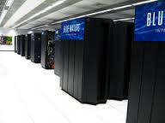
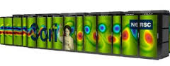

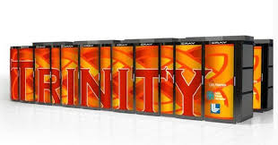
Modern Supercomputers
NWChem, NAMD, TensorFlow, OpenCV, ScalaPack, TBB, …
Sunway Taihu Light @
NSC-Wuxi
Blue Waters @ NCSA
AMD Interlagos
+ NVIDIA GK1100
+ Gemini network
40,960 x
Sunway
256 cores/chip
Customized
OpenACC 2.0
CORI @ NERSC
Trinity @ LANL
Haswell
+ Knights Landing
+ Aries network
Haswell
+ Knights Landing
+ Aries network
Diverse parallel hardware, vector ISAs, GPUs, FPGAs, caches, networks
Key: Common abstractions for heterogeneous parallel hardware

Slide 41
Virtual ISA – Abstraction of Parallel Computation
Focus on broad classes of programmable hardware
CPUs, Vector extensions, GPUs, DSPs, semi-custom accelerators …
Vector
Hierarchical
Dataflow Graph with side effects
V_{A} = load <L4 x float>* A
V_{B} = load <L4 x float>* B
…
V_{C} = fmul <L4 x float> V_{A}, V_{B}
Intuitive
Captures task, data, vector parallelism
Captures shared memory
Captures streams, pipelines
Captures semi-custom hw
or
only two parallelism models!
N different parallelism models
Very small extension to LLVM instruction set

Slide 42
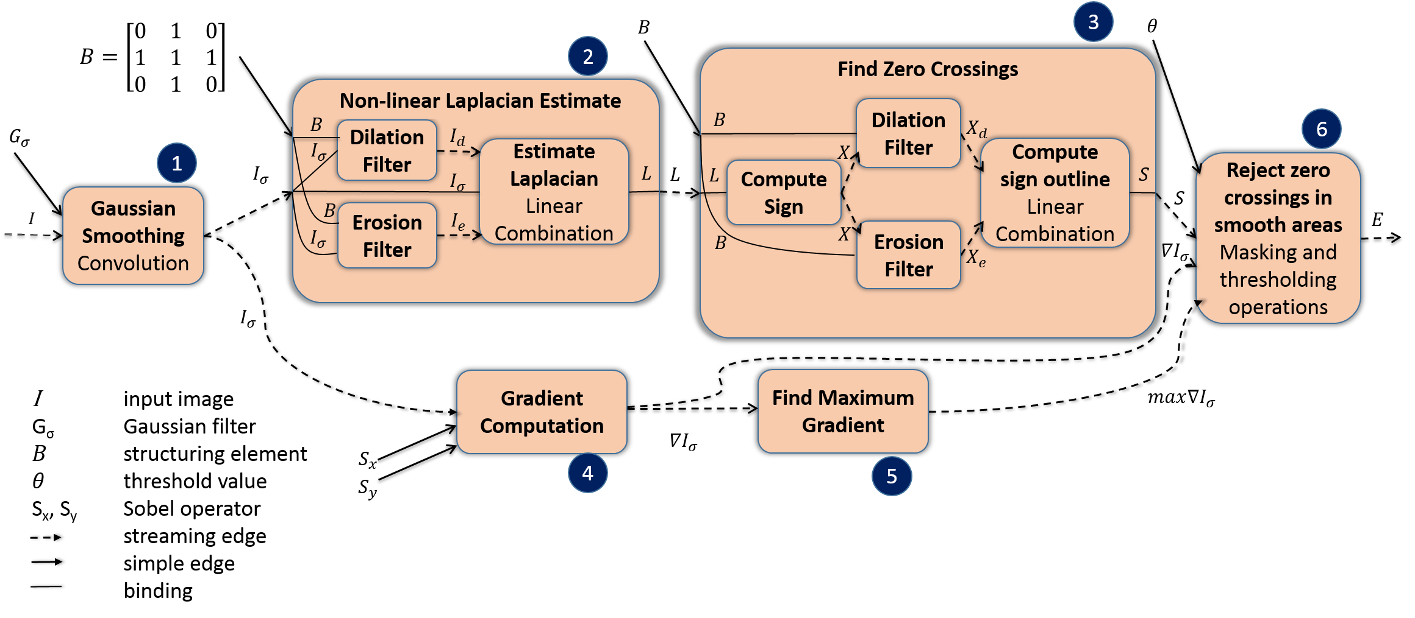
E.g. Edge Detection in Images
Pipelined (task) parallelism with streaming input images
Medium-grain data parallelism within pipeline stages
Fine-grain data parallelism in most stages
Pipelining fairly difficult to express in PTX, HSAIL, SPIR

Slide 43
Compilation Strategy
C +
HPVM
Modified
Clang
.hpvm
Developer site
User site
HPVM graph optimizer + partitioner
HPVM-to-
SPIR-to-AVX
HPVM-to-
pthreads
HPVM-to-
PTX
Host code x86 binary
SPIR binary
Host code x86 binary
Host code x86 binary
PTX binary
Intel OpenCL runtime
P-threads
nVidia OpenCL runtime
Intel Xeon E5 core i7 +AVX
Intel Xeon E5 core i7
+Pthreads
nVidia GeForce
GTX 680 GPU

Slide 44
Evaluation
Comparisons with separate hand-tuned codes
OpenCL (Parboil): SPMV, sgemm, stencil, lbm, bfs, tpacf, cutcp
Hand-tuned for GPU: opencl_nvidia (5), opencl_base (2)
Hand-tuned for AVX: Same as GPU, except bfs
Pipelined streaming experiment
Edge detection in grayscale images
6-stage pipeline DAG
Each stage: 3 targets
Intel Xeon E5 core i7
nVidia GeForce GTX 680 GPU card with 2GB

Slide 45
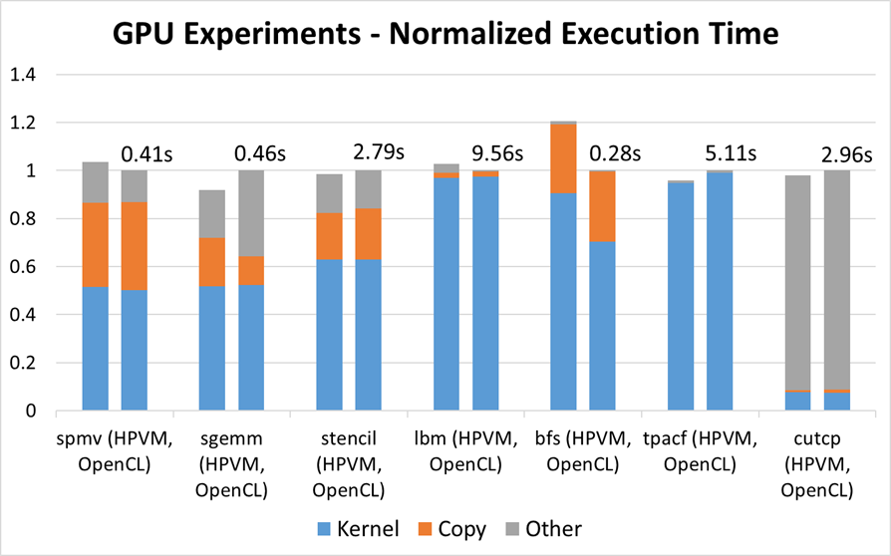
HPVM vs Hand-tuned on GPU
Within 20% of hand-tuned in all cases
Within 3% in all except BFS

Slide 46
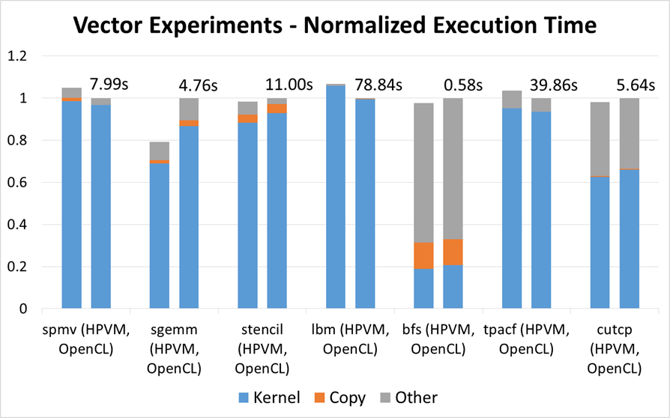
HPVM vs Hand-tuned on AVX
Within 7% of hand-tuned in all cases

Slide 47
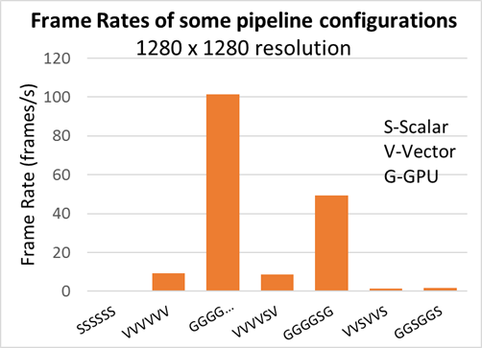
Pipelined Streaming Performance with HPVM
3⁶ = 729 configs from
single HPVM code!
101
49.3
9.37
8.79
1.53
1.54
0.37
Flexible offline (or online?) scheduling across hardware
Single performance-portable code representation
Expressive: several kinds of parallelism

Slide 48
HPVM – Summary and Ongoing Work
Promising parallel abstraction for hetero parallel systems
Ongoing Work:
Parametric vector ISA: for better vector portability
Parallel compiler IR: highly retargetable opts + code-gen
Autotuning: DFG and vector ISA should be helpful

Slide 49
Install-time Autotuning Framework
Led by: Tom Chen

Slide 50
Autotuning Framework
Goal: Framework for Autotuning at Different Levels
Compiler pass sequences
Loop “schedules”
HPVM dataflow graph schedules
Instruction sequences (“superoptimization”)
Code and data layouts
Others?

Slide 51
Profile-Guided Loop-level Framework (1 of 2)
Focus on hot top-level loops + observed callee functions
Loop Profile data
Extracted Bitcode 1
Input
Program Bitcode
Extract hot loops + observed “callees”
Autotune modules individually¹ + link
Extracted Bitcode 2
Optimized Bitcode
...
¹Can be sped up with a replay server
“Main” Bitcode

Slide 52
Profile-Guided Loop-level Framework (2 of 2)
Replay server: Repeatedly execute only the subject loop with the same input state
Tuning Driver
New version of hot loop
Result (e.g.
time)
Input program
Fork replay server
Replay Server
fork
Checkpoint
Load and run new version of hot loop
Hot loop
Replay server runs different versions of a hot loop with the same input state (heap, stack, and global data) repeatedly

Slide 53
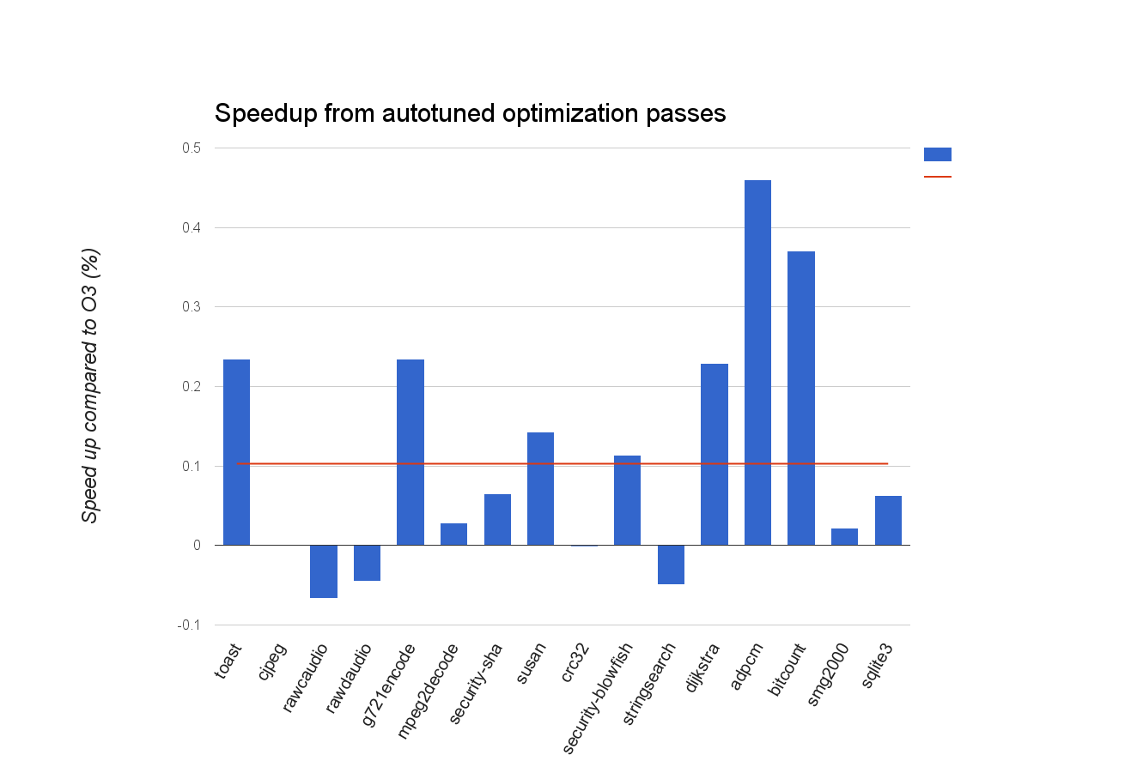
Autotuning Optimization Pass Sequences
1.4
1.3
1.2
Speedup vs. Clang –O3
1.1
1.0
0.9
Largest speedup: 1.46x (adpcm)
Average speedup: 1.102x

Slide 54
Other Ongoing Research
Install-time and dynamic autovectorization
Can we overcome the limitations of static autovectorization?
Kernel optimization and debloating
Can we reduce the kernel footprint for a given application context?
OPTIC: Optimizing Interprocess Communication
Can we apply compiler techniques across distributed components?
Translation Validation for LLVM back-ends
Can we increase confidence in code translated after shipping?

Slide 55
Summary
Proposal
All future “shipped” software should use virtual ISAs
Allvm enables lifelong + system-wide compilation
Lifelong: Link-time, install-time, run-time, idle-time
System-wide: App/DLL; App/OS; Process/Process
Research platform for compiler research
Questions?

Slide 56
Questions?

Slide 57
Install-time and Dynamic Autovectorization
Led by: Joshua Cranmer

Slide 58
Why vectorize after shipping?
Proliferation of vector instruction sets
Uptick in language/library support for vector code
This support is limited to intersection of features
Autovectorization has underperformed
Data dependence
Complex control flow
Cost-benefit prediction
More information available at runtime

Slide 59
Example Run-time Opportunities
Or, why might run-time autovectorization help?
Focus on hot paths to avoid conditional branches
Seemingly aliased pointers might be disambiguated
Unknown loop trip counts get resolved
Unknown data alignments get resolved

Slide 60
Hot path extraction
IF-statements require inefficient vector masks
Some vector lanes may be idle
Deeply nested conditionals may exacerbate this problem
Extracting hot paths eliminates need for masks
Extended loop vectorizer to handle new loop structure
C1
C1&C2
C1
S1
S2
S1
S2
S1’
C2
C2

Slide 61
Preliminary Speedups with hot path extraction
Speedup range: 0.81x – 1.56x
Geom. mean Speedup: 1.05x

Slide 62
Kernel Specialization and Debloating
Led by: Hashim Sharif

Slide 63
Kernel Specialization: Motivation
Large kernel memory footprints
Most applications only use a subset of functionality
Inter-procedural optimizations
Propagating constants from user space applications though the libc interface into the kernel system call handlers
Provides opportunity for code debloating
Improved runtime performance

Slide 64
Progress
Building the FreeBSD kernel
Used 'wllvm’ to build the kernel into a single bitcode file
Drivers statically linked into the bitcode
Specializing kernel for target applications
System wide constant propagation through the system call interface
Partially evaluating the kernel using Occam [Malecha et al., SAC’15]
Limitations:
Incomplete callgraph information due to indirect calls
Inline assembly fragments with side effects

Slide 65
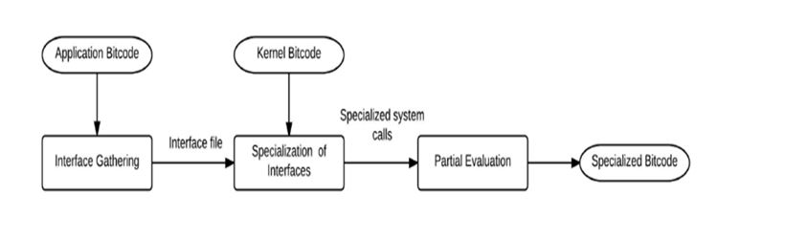
Operational Workflow
Workflow comprises of
Building applications and kernel into llvm bitcode
Gathering system call interfaces in applications/libc
Partial evaluation of system call handlers⌘
⌘ Occam: Malecha, Gehani and Shankar, SAC 2015

Slide 66
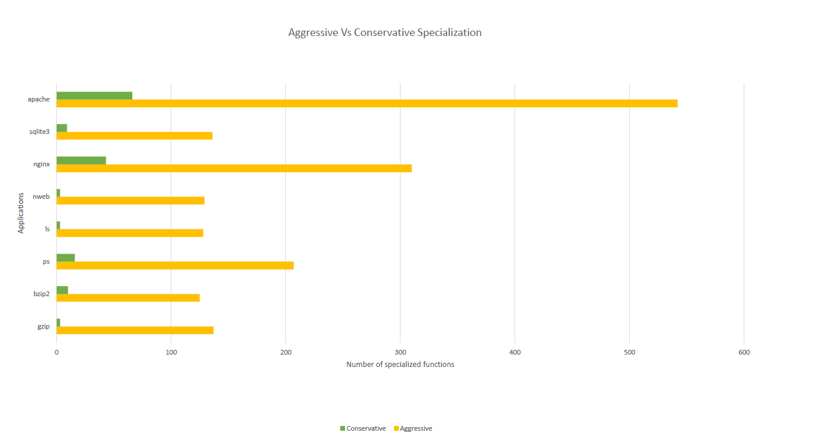
Preliminary Experimental Results
Conservative: Worst-case for any functions containing assembly
Aggressive: Ignores inline assembly
(Longer is better)
Applications
0
100
200
300
400
500
600
Number of specialized functions

Slide 67
References
[1] https://github.com/travitch/whole-program-llvm
[2] Malecha, Gregory, Ashish Gehani, and Natarajan Shankar. "Automated software winnowing." Proceedings of the 30th Annual ACM Symposium on Applied Computing. ACM, 2015.

Slide 68
Binary to LLVM Translation
Led by: Sandeep Dasgupta
with Joshua Cranmer and Ed Schwartz (CMU)

Slide 69
Binary-to-LLVM
allready
bin
.bc
Linker +
IP Optimizer
.bc
bc2allvm
alltogether
C, C++
Clang
• • •
.bc
.allexe
.bc
.allexe
C, C++
Clang
Developer site
User site
bin
allout
AOT opt + code gen
.allexe
Native object
code cache
bin
alley
Execution engine

Slide 70
allready: Binary-to-LLVM
Preference: Only a few components will be binary
Motivation
Some software components will only be in binary format
Existing tools inadequate: McSema, BAP, SecondWrite, Qemu
Goal
Extract “rich” LLVM IR from binary code
Enable full set of ALLVM optimizations on partial-binary programs
Needs variable info, type info, per-procedure stack frames

Slide 71
Current Status
Binary
IDAPro
CFG
LLVM
Stack
Recovery
LLVM
Variable
Recovery
LLVM
Type
Inference
LLVM
McSema
Commercial
External
Completed
Ongoing Work
Ongoing Work
IR extracted by McSema is executable but very “low-level”
Models runtime process stack as unified flat array
Machine registers mapped in flat memory, not SSA virtual registers
No information about variables, types, call graph, exceptions, etc.
Added stack deconstruction
Recovers individual stack frames per function
Distinguishes current vs. parent frame pointers
Tested using McSema test suite; custom test cases

Slide 72
Stack Deconstruction
High
High
%rbp + 16
arg2
%rbp + 8
arg2
%rbp + 24
Parent Stack
arg1
Parent Stack
arg1
%rbp + 16
ret addr
%parent_stack_end
ret addr
old %rbp
%rbp
old %rbp
Current Stack
%rbp
(Function Foo)
Current Stack
(Function Foo)
Low
Low
foo:
push %rbp
mov %rsp, %rbp
mov 16(%rbp), %rax
mov 24(%rbp), %r10
foo:
push %rbp
mov %rsp, %rbp
mov 8(%parent_stack_end), %rax
mov 16(%parent_stack_end), %r10

Slide 73
Ongoing Work
Identify variables and promote them as symbols
Represent every symbol in the IR with a meaningful type instead of the generic types provided by McSema
unsigned int foo(char* buf) {
unsigned alligned_len = 0; unsigned int c = strlen(buf);
if(c%8 == 0 ) {
return c;
} alligned_len = 8* (c/8) + 8; return allign_len;
}
Variable Names | C Type
1) buf | char*
2) c | unsigned int
3) alligned_len | unsigned int
1) and 2) inferred using strlen prototype
3) inferred using arithmetic operation

Slide 74
Technically Feasible, Commercially Acceptable
But … will system designers ever agree on a virtual ISA?
No agreement is needed: each vendor / OS can adopt different one!
But … isn’t JIT compilation inherently weaker?
JIT compilation (optimization) is an opportunity, not a requirement!
But … doesn’t this enable reverse engineering?
Yes, but binary code is not a sufficient defense either!
Better to use encryption keys or code obfuscation, as for Java, C# e.g., obfuscation tools like ProGuard, DexGuard
But … can I trust back-end without end-to-end testing?
Test against a few back-ends (Research: Translation Validation)

Slide 75
Summary
Proposal
All future “shipped” software should use virtual ISAs
Allvm enables lifelong + system-wide compilation
Lifelong: Link-time, install-time, run-time, idle-time
System-wide: App/DLL; App/OS; Process/Process
Research platform for compiler research
Questions?

Slide 76
Questions?

Slide 77
Compiler Techniques for
Distributed Systems
Led by: Will Dietz

Slide 78
Analyzing Distributed Applications
Software often composed of many programs working together
Examples: Microservices pattern, Web Server+Database
Goal: Analyze, optimize distributed applications as single unit
Challenges:
Complex boundaries between programs
Components are unknown until run-time
Solution: ALLVM + OPTIC: Compile all communicating components together at run-time
Fundamentally requires
run-time compilation

Slide 79
OPTIC Overview
Unified Representation
Extended Compiler IR representing communicating programs
Static and Dynamic Analysis
Hybrid analysis overcomes scaling challenges and improves precision
Optimizing Transforms
Improve program performance using novel compiler-based techniques

Slide 80
Example Optimizations w/OPTIC
Constant Propagation
Dead Store Elimination
Protocol Specialization
Code Movement

Slide 81
Status
Published:
Slipstream: Automatic Interprocess Communication Optimization
Dietz, Cranmer, Dautenhahn & Adve, Usenix 2015.
Current:
OPTIC-Trace: “How does software communicate in practice?”
Debugging/research tool for identifying optimization opportunities
Data-structure: dynamic behavior projected onto unified IR

Slide 82
Outline
VISC Motivation
Background: LLVM as a Virtual ISA
ALLVM: VISC from top to bottom and end-to-end
Why could this be a bad idea? What can we do about it?
Reverse engineering?
Weaker testing guarantees?

Slide 83
Verified Code Generation
Led by: Theodoros Kasampalis

Slide 84
Verified Back-end
Goal: High level of trust in VISC code generator
formally certifiable native code generation in VISC back-end (LLVM IR to x86-64)
Motivation: We want to ship code as LLVM bitcode but users do not trust the back-end
Benefits of VISC
Portability
Performance
Security guarantees through sophisticated analyses
Why not trust the back ends?
Back-end bugs
Undefined and implementation-defined behaviors in applications

Slide 85
Undefined Behaviors and Security
Undefined behaviors expose unexpected vulnerabilities because of compiler choices
Google NaCl/x86: Integer overflow
→ alignment enforcement compiles to no op
Linux kernel: Null pointer dereference
→ null check gets removed by compiler
Fundamental problem: Compilers may produce
arbitrary (different) output for undefined source code

Slide 86
Proposed Solution: Translation Validation
Translation Validation❡ (TV) for code generator
Each translation result verified to correctly implement the input
Alternative to full formal verification of the back end
Applied to existing production-quality compilers (LLVM)
No need to re-write a code generator: treat as a black box
TV system and code generator maintained separately by experts
Use K Framework to define input and output semantics
Executable semantics with symbolic execution support
❡Pnueli, Siegel, and Singerman. 1998. Translation Validation. TACAS '98.

Slide 87
State of the Art
Today: TV assumes common language for input, output
e.g. Necula, Tate's equality saturation, LLVM-MD
Not sufficient for code gen, e.g,. LLVM to x86-64
Formally verified compilers (e.g. CompCert)
Developed from scratch along with extensive proof assistance
No guarantees in presence of undefined behaviors
Testing-focused approaches, e.g. CSmith, Orion
do not guarantee absence of bugs

Slide 88
Google NaCl/x86 Issue 245 (1/13/2010)
Ret addresses from untrusted code must be enforced to be 32-byte aligned
Orginal correct code (nap->align_boundary is 32):
Bug after change to (forgot to change nap->align_boundary to 5):
gcc compiles 1 << 32 to 1 hence the whole expr becomes a no-op
aligned_tramp_ret = tramp_ret & ~(nap->align_boundary - 1);
return addr & ~(uintptr_t)((1 << nap->align_boundary) - 1);

Slide 89
Linux Kernel 2.6.30 exploit (7/13/2009)
Pointer dereference before check for NULL
Check condition either false or function undefined
Hence check is removed by compiler
Attacker that can make page zero accessible can now exploit the rest of this code
struct tun_struct *tun = ...;
struct sock *sk = tun->sk;
if (!tun)
return POLLERR;
/* write to address based on tun */

Slide 90
Our Approach
LLVM Back-end
LLVM Bitcode
x86-64
Proof Hints
Translation Validation System
LLVM Semantics (in K)
x86-64 Semantics (in K)
Correctness Proof

Slide 91
Our Approach
First Step
LLVM Back-end
LLVM Bitcode
Instruction Selection
Virtual
x86-64
SSA
Optimizations
Virtual x86-64:
x86-64
+ SSA registers
+ abstract stack
x86-64
post-SSA
Optimizations
Prologue/Epilogue Insertion
Register Allocation
Sync Points
Sync Point Generator
Translation Validation System
Correctness Proof
LLVM Semantics (in K)
x86-64 Semantics (in K)

Slide 92
Open Research Problems
Translation validation between different languages
Today: TV assumes common language for input, output
E.g. Necula, Tate's equality saturation, LLVM-MD
Not sufficient for code gen, e.g,. LLVM to x86-64
Our approach: Use “full program equivalence” proof system [1]
How to deal with undefined behaviors in VISC?
Input K semantic definition captures undefined behaviors
TV enforces a specific treatment
Undefined behavior checker on input: catches 82% of errors [2]
Ciobâcă, Lucanu, Rusu, and Roşu. A Language-Independent Proof System for Mutual Program Equivalence. In ICFEM’14.
Hathhorn, Ellison, and Roşu. 2015. Defining the undefinedness of C. PLDI 2015

Slide 93
Current Status and Future Goals
1. Definition of LLVM IR semantics in K | Mostly comprehensive definition available
2. Definition of x86-64 semantics in K | In progress – currently small x86 subset defined; runs small programs
3. TV of Instruction Selection phase (LLVM IR to x86-64) | In progress – open question of TV between different languages
4. Handling undefined behaviors | Future work
5. TV of phases other than Instrn Selection | Future work
6. TV of concurrent shared memory pgms | Future work

Slide 94
Security Benefits of VISC:
Google’s Portable Native Client (PNaCl)
Secure Virtual Architecture (SVA)
John Criswell’s PhD on SVA won an
Hon. Mention for 2014 ACM Doctoral Dissertation Award

Slide 95
Google Portable Native Client (PNaCl)
Web
application
components
C/C++
Front End
Restricted
C, C++
Developer site
User site
LLVM
Chrome
Browser
Static
code-gen
PNaCl
Verifier
Sandboxing for Chrome browser extensions
Shipped as LLVM bitcode; translated & verified on load
Ensures extensions are portable to x86, x86-64, ARM

Slide 96
Secure Virtual Architecture: OS on VISC
Works with commodity kernels, e.g., Linux, FreeBSD
Applications, libraries, languages
OS services
OS kernel
Virtual instruction set
Code gen
Instrumentation
SVA-OS lib
Processor
Native instruction set
Virtual ISA = LLVM + SVA-OS
Translate at install-time, boot-time, and/or run-time

Slide 97
SVA-OS API
Hardware Control
Syscall, interrupt, trap handlers
sva.register.intr (int intnum,
int *handler(…))
Page table manipulation
sva.update.l1.mapping(void *ptp,
unsigned trans)
I/O operations
sva.io.read(void *ioaddress)
State Manipulation
Context-switching
sva.swap (int newid, int *oldid)
Signal delivery
sva.ipush.function(int *f(…), …)
Manipulate interrupted program state
sva.icontext.load(void)

Slide 98
Porting an OS to SVA
E.g., This is how we ported Linux 2.4.22, FreeBSD 9.0
Clang
C/C++ compiler
Existing
OS in
C/C++
OS in LLVM
bitcode
Port kernel to SVA-OS API
Like porting to a new (virtual) architecture

Slide 99
Porting Linux 2.4.22
Component | Total Lines | Lines Modified
Architecture-Independent | 603,232 | 288
Architecture-Dependent | 29,237 | 4,778
Total | 632,469 | 5,066
Total changes: 0.80%
Notes:
Virtual Ghost SVA is about 5,400 source lines of codes (excluding white space and comments).

Slide 100
What is SVA Good For?
SVA provides a unique combination:
Rich compiler capabilities (like JVM, .NET)
+ OS supervision (like a VMM)
… which can enable powerful, new security solutions
SVA-M: memory safety for a commodity OS [SOSP ’07]
KCoFI: control-flow integrity (CFI) for commodity OS [IEEE S&P ’14]
Virtual Ghost: protect applications from hostile OS using fast compiler techniques [ASPLOS ’14]
Each of these is the first-ever system to do so.

Slide 101
SVA-M: Memory Safety with SVA
Provides safety close to a type-safe language
even for a large commodity kernel like Linux
Prevents many common attacks like buffer overflows, heap corruption, code reuse attacks, etc.
Safe pointer arithmetic (no buffer overflows)
Loads & stores access correct subset of objects
Control-flow and code segment integrity
Type-safety for a subset of memory objects
Dangling pointers made harmless; no garbage collection
SOSP 2007, Audience Choice Paper Award

Slide 102
KCoFI: Control-Flow Integrity with SVA
Control-flow cannot be hijacked arbitrarily
even for a large commodity kernel like FreeBSD
Code segment integrity
Indirect calls, branches follow compiler-predicted paths
Context switching, interrupt/trap handling
MMU management
Formal proof of key control-flow integrity theorems, including tricky kernel-specific issues
IEEE S&P 2014

Slide 103
Virtual Ghost = Secure Computation Using SVA
Ghost Memory:
Inaccessible to OS
Application:
Private data in ghost memory
Encrypts private data for I/O
Virtual Ghost (VG) API
SVA-OS + App. Requests
OS Kernel:
Performs all OS services
Application
Public Data
Ghost Memory
Private Data
OS Kernel
Private Key
Private Code
Virtual Ghost (SVA)
Processor
Notes:
Virtual Ghost Runtime is SVA-OS Runtime with new run-time checks.

Slide 104
Virtual Ghost
Secure application can preserve confidentiality, integrity
even if the underlying OS is compromised
Application is given ghost memory for securing data
Application is given secure key for encrypting I/O
OS cannot read/write ghost memory or VG memory
Software Fault Isolation protects Ghost memory, VG memory: more efficient than using MMU
Extends KCoFI to prevent control flow hijacks of application by OS
ASPLOS 2014

Slide 105
Compiler Techniques Used For Security
Difficult to do on
machine code
Call graph analysis
Points-to analysis
Type inference
Escape analysis
Identifying low-level OS operations
Restrictions on native code
Can be effective with machine code but incurs higher overhead
Software fault isolation
Control flow enforcement

Slide 106
VISC for Security: Summary
VISC enables strong security benefits that
would be very difficult with machine code
Strong memory safety for Linux
Control-flow integrity for FreeBSD 9.0
Application confidentiality, integrity on a hostile operating system (using fast compiler techniques)

