Slide 1
Defining x86-64 Semantics in K
Sandeep Dasgupta
University of Illinois Urbana Champaign
December 17, 2017

Slide 2
Implemented
X86-64 syntax & configuration
Instruction Load Semantics
Instruction fetch and execute semantics
Instruction Semantics
51 Base instructions (~3900 variants) and 11 pseuso-instructions (~316 variants).
Includes AVX2 instruction support.
Floating point arithmetic support.

Slide 3
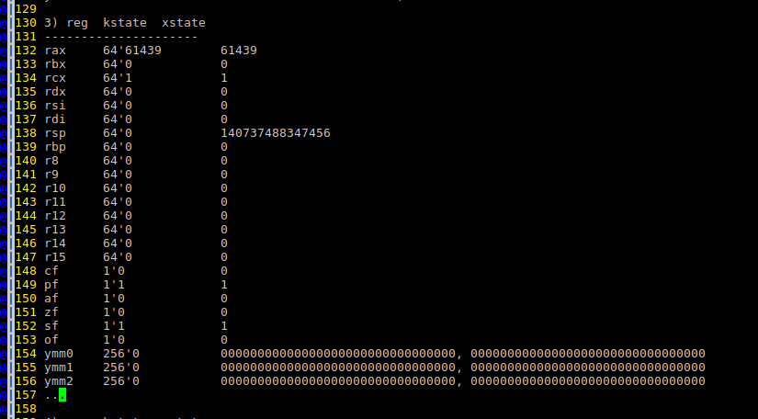
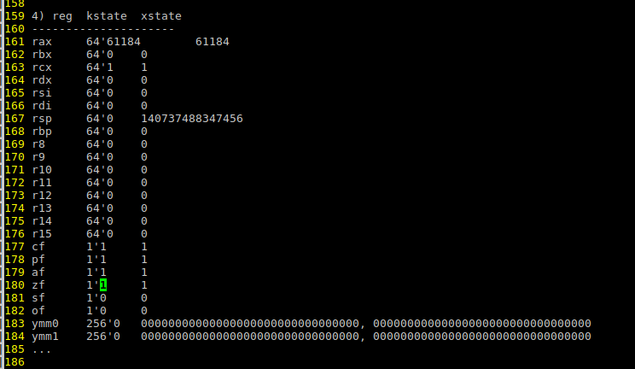
Testing – Using GDB
.section .text
.globl _start
_start:
addq $61438, %rax
inforegisters
addq $1, %rcx
inforegisters
adcb %cl,%al
inforegisters
adcb %cl,%al
inforegisters
nop
0₄₈ 11101111 11111110
0₄₈ 00000000 00000001
0₄₈ 11101111 11111111
sf:1 pf:1
0₄₈ 11101111 00000000
cf:1 af:1 zf:1 pf:1

Slide 4
Stratified Synthesis of “decb %bl”
decb %bl
movq $0xffffffffffffffff, %r9 # Storing -1 in %r9b
xorq %rcx, %rcx # carry flag cleared
adcb %r9b, %bl # %bl <- %bl – 1 + 0
The synthesized program agrees with the target instruction only on the target’s write set.
Example: %r9 is used as scratch pad registers.
Can preserve the semantics by saving all the registers before executing the instructions and restoring only those not in the target’s write set.
Stratified synthesis is not optimized for defining execution semantics.
We can use the formula generated by strata to generate the semantics.
%rbx : %rbx[63:8] ∘ (0xff₉ + 0x0₁ ∘ %rbx[7:0]) [7:0]
%af : (0xf₅ + 0x0₁ ∘ %rbx[3:0])[4:4] = 0x1₁
%zf : (0xff₉ + 0x0₁ ∘ %rbx[7:0])[7:0] = 0x0₈
%sf : (0xff₉ + 0x0₁ ∘ %rbx[7:0])[7:7] = 0x1₁
%of : (true ↔ %rbx[7:7] = 0x1₁) ∧ !(true ↔ (0xff₉ + 0x0₁ ∘ %rbx[7:0])[7:7] = 0x1₁)
…

Slide 5
To be implemented
Instruction semantics using Strata (WIP)
Register and Immediate Variant.
Semantics of memory instructions.
Call instruction semantics.
Library function support.

Slide 6
Related Work
X86 modelling in Coq.
Coq: The world’s best macro assembler?, PPDP '13
Non-FP, Non-SIMD subset of 32-X86, Total: 40/663 opcodes
Modular Development of Certified Program Verifiers with a Proof Assistant, ICFP '06
A subset of real X86-32.
RockSalt
No Floating Point, SIMD, no I-64 Total: 219/663
CompCert
Partial formal semantics of X86-32 in an RTL intermediate language.

Slide 7
Related Work
ACL2 Developed by group led by Warren A. Hunt, Jr. in UT Austin
Supports ~300/663 opcodes.
Also can execute the semantics. Used for validating the model by co-simulation against actual X86 execution.
Lifting Assembly to Intermediate Representation : A Novel Approach Leveraging Compilers, ASPLOS '16

Slide 8
Few Questions
ACL2 vs K.
With more rule, the kompile and krun are getting slower. Why krun!!

