Slide 1
HAPPIEST HEALTH SUMMIT 2026, BENGALURU · DIGITAL TWIN CHALLENGE: TYPE 2 DIABETES
GlucoTwin
A personal digital twin that sees the next two hours of glucose
Record + CGM + sleep and activity → a 2-hour forecast → early warnings with reasons → 7 plans on her own twin.
18.3%
12%
105 min
lower 2-hour error than persistence, on 45 real adults
lower 1-hour error once the health record sets the prior
median warning before a spike; 109 of 254 warned 60+ min ahead
Nikhil Chawla · Team leader, BCA (AI & Data Science), RIMT University
Research prototype, not a medical device.
All patient data is synthetic or open.
Phase 1 · prototype & code submission · October 2026
Notes:
GlucoTwin is a digital twin for Type 2 diabetes. It fuses a patient's health record with their CGM and wearable stream, forecasts the next two hours of glucose, warns before spikes with reasons, and lets a doctor test lifestyle plans on that patient's own fitted twin. Three numbers to remember: 18.3% lower two-hour error than persistence on 45 real adults, 12% lower one-hour error once the health record sets the starting point, and a median 105-minute warning before a spike, with 109 of 254 spikes warned an hour or more ahead.

Slide 2
1 · THE PROBLEM, AS A DOCTOR MEETS IT
Doctors see glucose after the fact. Nothing lets them look ahead.
A diabetologist's clinic, between two visits
THREE GAPS IN TODAY'S CARE
Ananya Rao, 54, has Type 2 diabetes: HbA1c 8.1%, BMI 29.4, on metformin. She is seen every three months.
Her CGM writes 288 readings a day. The doctor gets a 14-day PDF, a separate lab report, and a few minutes.
“Which meal is doing this? Would an earlier dinner help her, or hurt her?” The data cannot answer.
By the time HbA1c moves, the spikes have already happened. Advice stays generic: “cut rice, walk more”.
Record and sensor data never meet
Reports look back; nothing looks ahead
No way to test a plan on this patient
36.3% reach the glycaemic target
Only 7.7% of people with diabetes in India reach HbA1c, blood pressure and LDL targets together.
The missing piece is foresight, not more data.
THE STAKES,
NATIONALLY
101M adults with diabetes, plus 136M with prediabetes (ICMR-INDIAB)
156.7M adults with diabetes by 2050, up 75% from 2024 (IDF)
43% of Indian adults with diabetes are undiagnosed (IDF 2025)
Sources: ICMR-INDIAB-17 (Lancet Diabetes Endocrinol 2023); ICMR-INDIAB-13 (Lancet Diabetes Endocrinol 2022); IDF Diabetes Atlas 11th ed. (2025), India. Patient is simulated (GlucoTwin ward, GT-07); the clinic scene is illustrative.
1
Notes:
The problem as a doctor meets it. Ananya Rao is a simulated patient from our ward: 54, HbA1c 8.1%, on metformin. Her CGM writes 288 readings a day, but the clinic sees a PDF and a lab report a few times a year. Three gaps: the record and the sensor never meet, every report looks backward, and there is no way to try a plan on this specific patient before advising it. Nationally only 36.3% of people with diabetes reach the glycaemic target and 7.7% reach all three targets. 101 million adults have diabetes, 43% are undiagnosed, and IDF projects 156.7 million by 2050.

Slide 3
2 · SOLUTION OVERVIEW
GlucoTwin turns data into the next two hours, for one patient
1 FUSE
record + CGM → one twin
Doctors already get data. What is missing is what happens next.
1 FUSE
−12%
1-hour error, day 0
The FHIR R4 record (labs, BMI, medicines, genetic marker) sets day-0 knobs; CGM, sleep, HRV and walks move the live state.
2 FORECAST
−18.3%
2-hour error
4 COMPARE
plans on her own twin
The patient's
twin
updates every 5 min
2 FORECAST
next 2 hours + band
Physiology curve from meals, walks, dawn rise, sleep and HRV, with a 10–90% band fitted on the twin's own past errors.
3 ALERT
105 min
median warning
Spike risk includes her habitual next meal; thresholds are chosen on validation days. Only Urgent interrupts; every alert lists reasons.
3 ALERT
urgent vs watch, with reasons
4 COMPARE
+3.6 pts
time in range
Seven lifestyle plans, incl. a weekly fasting day, on her highest-risk meal. Never a dose; “Simulation, not advice”.
Sources: GlucoTwin results. Error figures on CGMacros (PhysioNet, 45 adults); alert figures on the simulated stress test (generator differs from the twin); plan figure on the simulated ward, days 10–16.
2
Notes:
The solution is a loop around one patient's twin. Fuse: the FHIR record gives starting knobs on day zero, which alone cuts one-hour error by 12% on real data. Forecast: a physiology curve with an honest uncertainty band, 18.3% more accurate than persistence at two hours. Alert: spike and low warnings with reasons, a median 105 minutes early because spike risk includes the habitual next meal. Compare: seven lifestyle plans ranked on the patient's own twin, the best adding up to 3.6 points of time in range for the patient it suits. No plan touches medicine.

Slide 4
3 · CHALLENGE FIT
Every line of the brief, met and measured
The brief asks for | GlucoTwin delivers | Evidence
A chronic condition prevalent in India | Type 2 diabetes and prediabetes, with Indian subgroups and IFCT 2017 foods | 89.8M Indian adults (IDF 2025)
Static record: demographics, diagnoses, labs, genetic markers | FHIR R4 bundle: age, sex, HbA1c trail, fasting glucose, HOMA-IR, BMI, medicines, simulated TCF7L2 marker | Record cuts 1-hour error 12%
Dynamic wearable / IoT time series | CGM every 5 min, meals, walks, heart rate, sleep and HRV (they shift insulin sensitivity), steps | 45 real adults + 11 simulated
A model that predicts an adverse event ahead of time | Glucose at 30, 60 and 120 min with a 10–90% band; spike and low alerts with reasons | Median 105-min warning; 109 of 254 ≥ 1 h
A conceptual doctor dashboard | Working dashboard, 7 screens, per-stream consent gate and a printable pre-visit summary | Runs live in any browser
Synthetic, open or anonymised data only | Synthetic ward (seed 42) + open CGMacros (PhysioNet); no real identities anywhere | DPDP / HIPAA sandbox rules met
Two streams fused · an adverse event predicted · a doctor's dashboard · open and synthetic data only
Brief: Happiest Health Digital Twin Challenge 2026. Evidence figures come from the result pages that follow (CGMacros, PhysioNet; simulated stress test; IDF Diabetes Atlas 2025).
3
Notes:
This page maps the brief line by line, with the evidence for each. The evidence column is backed by the result pages that follow.

Slide 5
4 · REAL PROTOTYPE OUTPUT
What the twin already produces
REAL PROTOTYPE OUTPUT · SIMULATED WARD (11 PATIENTS) + REAL CGMACROS DATA (45 ADULTS)
Patient | Fact from the twin | What the doctor gets
Ananya Rao (GT-07), simulated | After a 67 g carb lunch, the 2-hour forecast rises past 180 mg/dL; spike risk crosses 60% | Urgent alert with reasons: the meal, glucose vs her fasting baseline, time of day
Split lunch, 8 Type 2 patients | Vikram +3.6 and Kavita +2.9 points of time in range; Leela −5.4, Fatima −4.1, Suresh −2.9 | A personal plan table, not a one-size rule
All 8 Type 2 patients, simulated | Personal 60-min error below the group prior for every one (gain 0.5–3.7 mg/dL) | A twin fitted to each person in 5 days
3 real CGMacros adults, held out | LightGBM residual cuts their 2-hour error from 46.5 to 40.8 mg/dL | Offline today; candidate for the live curve
$ cat real_eval.json
participants 45
forecasts/horizon 11,101
rmse_120 twin 31.8
rmse_120 persist 38.9
clarke_AB_30 0.998
band_cover_60 0.794
$ node --test # model+data
tests 118 pass 118 fail 0
BUILT · habitual-meal anticipation
Spike risk includes her usual next meal: 109 of 254 spikes warned 60+ min ahead (was 7 of 244), 33 a full 2 hours ahead.
Then: the LightGBM residual joins the live curve once the pilot review signs it off.
Honest check: on real CGMacros data, spike alerts caught 38.9% of spikes at 63.8% precision (median lead 35 min) and 7 of 17 lows at 39% precision. The habit prior is not yet on the real-data path; Indian pilot data is the fix.
Sources: GlucoTwin outputs — reports/sim_eval.json (simulated ward, seed 42); src/lib/glucotwin/real/real_eval.json (CGMacros, doi:10.13026/3z8q-x658); model and data test run, 17 Oct 2026.
4
Notes:
This is real output from the prototype, not a mock-up. Ananya's twin forecasts a spike after a 67 gram lunch and raises an Urgent alert with its reasons. The same split lunch helps four Type 2 patients and hurts four, which is why the plan must be tested on each twin. Every Type 2 patient's personal fit beats the group prior. On three held-out real participants, the offline LightGBM residual cuts two-hour error from 46.5 to 40.8. We also show the weaker number: on real data, spike recall is 39% at 64% precision; the habit prior that lifted simulated warnings is the next step there.

Slide 6
5 · IMPACT ON REAL DATA
On 45 real adults, the twin beats the baseline where it matters
FORECAST ERROR, RMSE IN MG/DL (LOWER IS BETTER)
1-HOUR ERROR BY WHAT THE TWIN KNOWS AT START
18.3%
12%
99.8%
8–10%
lower 2-hour error than persistence (31.8 vs 38.9 mg/dL)
lower 1-hour error when the record sets the prior (30.4 → 26.8)
of 30-minute forecasts in Clarke error-grid zones A and B
lower 1-hour error in every group: Type 2, prediabetes, healthy
CGMacros (PhysioNet, CC BY-NC-SA 4.0): 45 adults (15 healthy, 16 prediabetes, 14 Type 2). Knobs fit on days 1–4, band on days 5–6, test from day 7; ~11,100 forecasts per horizon. Ablation: leave-one-out ridge prior, 11,192 forecasts per arm.
5
Notes:
Impact measured on real people. CGMacros is an open PhysioNet dataset of 45 adults with CGM, meals and activity. At 30 minutes the twin beats persistence (18.5 vs 19.6); at one hour it is 9.3% better and at two hours 18.3% better, which is when a meal's effect has not shown up yet. On the right is the fusion proof: same twin, same test days, only the starting knobs change. Labs, BMI, age and sex alone cut one-hour error from 30.4 to 26.8. The gain holds in every group, 8 to 10 percent at one hour, and 99.8% of 30-minute forecasts fall in the clinically acceptable Clarke zones.

Slide 7
6 · IMPACT FOR PATIENT AND DOCTOR
Warnings arrive early, and plans are personal
SPIKE ALERTS ON THE STRESS TEST
SAME PLAN, DIFFERENT TWINS: SPLIT LUNCH, CHANGE IN TIME IN RANGE (PTS)
61.0%
66.9%
of spikes warned (95% CI 54.9–66.8%)
of spike alerts were right (95% CI 61.4–72.0%)
105 min
0.75
median warning before the spike (IQR 50–115)
false alerts per patient-day
It helps 4 of 8 Type 2 twins and hurts the other 4: a one-size rule would be wrong for half. Lifestyle plans only, never a dose.
Only Urgent alerts interrupt, and 83.5% of them were right. A Watch is upgraded to Urgent if the curve gets worse.
WHY IT
MATTERS
+5 pts
of time in range is clinically meaningful (international consensus, 2019)
10 pts
of time in range track about 0.8% of HbA1c (Vigersky & McMahon, 2019)
105 min
of warning leaves time to change the meal itself, not only walk after it
Alert figures: simulated stress test (generator differs from the twin), 11 patients, 254 spikes, Wilson 95% CIs. Plan figures: simulated ward, days 10–16, time in range 70–180 mg/dL. Battelino et al., Diabetes Care 2019; Vigersky & McMahon, Diabetes Technol Ther 2019.
6
Notes:
Impact for the patient and the doctor. On the stress test, whose generator deliberately differs from the twin, 61.0% of spikes were warned, 66.9% of alerts were right, the median warning came 105 minutes before the spike, and there were 0.75 false alerts per patient-day. Only Urgent alerts interrupt and 83.5% of those were right. On the right, the same split lunch adds 3.6 and 2.9 points of time in range for Vikram and Kavita but costs Leela and Fatima 5.4 and 4.1 points. The international consensus treats every 5 points of time in range as clinically meaningful, and 10 points track about 0.8% of HbA1c. These plan figures are simulated; the pilot measures them on real patients.

Slide 8
7 · PROOF: ALERTS VS SIMPLE ALARMS
Level with the best simple alarm on F1, with a third of its false alarms
SAME 254 SPIKES, SAME ALERT RULES, SAME SCORER
Method | Uses | Catches | Right | False / day | Median warning
GlucoTwin (risk ≥ 0.8) | Record + CGM + meals + sleep | 61.0% | 66.9% | 0.75 | 105 min
Rise-rate alarm | CGM only | 24.8% | 78.8% | 0.13 | 5 min
Trend projection, 60 min | CGM only | 89.4% | 49.5% | 2.11 | 25 min
Trend projection, 120 min | CGM only | 81.5% | 34.5% | 3.86 | 45 min
Big-meal rule, ≥ 40 g carbs | Meal log only | 56.7% | 58.5% | 0.77 | 30 min
0.638
F1, level with the 60-min trend projection (0.637), which raises 2.8× the false alerts
3–5×
fewer false alerts than CGM trend projections (0.75 vs 2.1–3.9 a day)
2.5×
the spikes a CGM rise-rate alarm catches, and 100 min earlier
Catches = share of spikes warned in the 2 hours before. Right = share of alerts followed by a spike.
Warning time: median 105 min. 109 of 254 spikes were warned 60+ min ahead and 33 a full 2 hours, because spike risk includes the habitual next meal. CGM trend projections warn at most 45 min ahead, with 3–5× the false alarms.
Risk numbers: when the twin showed a spike risk of 95% or more, a spike followed 95.6% of the time (2,544 steps). Brier skill 0.61.
Simulated stress test (mismatched generator, seed 42): 11 patients × 12 scored days, 254 spikes. Every method uses the same events, the same alert hygiene and the same scorer. scripts/alert-proof.ts → docs/ALERT_PROOF.md. CGMacros comparison not yet run.
7
Notes:
This page is the proof judges ask for: is the twin better than a simple alarm? Every method is scored on the same 254 spikes from the stress test, with the same alert rules and the same scorer. A CGM rise-rate alarm catches only 24.8% of spikes, 5 minutes ahead. Straight-line trend projections catch more, but raise 2.1 to 3.9 false alerts a day, about 3 to 5 times the twin, and warn at most 45 minutes ahead. A simple 'warn after a big meal' rule is right only 59% of the time. The twin is level on F1 with the 60-minute trend projection, 0.638 against 0.637, with a third of its false alarms: it catches 61.0%, is right 66.9% of the time, and warns a median 105 minutes ahead, 109 of 254 spikes an hour or more, because it anticipates the habitual next meal. When the twin shows 95% or more, a spike followed 96% of the time.

Slide 9
8 · USERS & CONTEXT
Built around the doctor who reviews the patient
PRIMARY
SECONDARY
DATA OWNER
Diabetologist / physician
Diabetes educator / care team
The patient
Reviews CGM and labs between visits
Wants: who to look at now, why, and what to try
Works at a desktop; sees reasons, not black-box scores
Decides; the twin never doses
Explains the chosen plan to the patient
Follows up Urgent alerts and plan adherence
Needs plain reasons and simple plan tables
Wears a CGM; logs meals and walks
Consents per stream (DPDP-style, live in the dashboard)
Gets advice from the doctor, never from the twin
CONTEXT THAT SHAPES THE DESIGN
62.3%
4
93 crore
288
of daily energy in India comes from carbohydrate → a meal model built on IFCT 2017 Indian foods
Indian Type 2 subgroups (SIDD, IROD, CIRDD, MARD) → an approximate cold-start prior
ABHA accounts with 104 crore linked records → the record arrives via ABDM
CGM readings a day per patient → the doctor needs triage, not more charts
Sources: Anjana et al., Nature Medicine 2025 (62.3% carbohydrate energy); docs/CLUSTERS.md (approximate subgroup rule, not INSPIRED); PIB ABDM fact sheet, 6 Jul 2026; CGM cadence of one reading per 5 minutes.
8
Notes:
The doctor is the primary user: the dashboard is a review tool, not a patient treatment app. The care team follows up, and the patient owns the data and consents per stream. Four facts shape the design: Indian diets are 62% carbohydrate, so the meal model uses IFCT foods; Indian Type 2 diabetes has distinct subgroups, used as a cold-start prior; ABDM already links over 100 crore health records; and a CGM writes 288 readings a day, so the doctor needs triage.

Slide 10
9 · USER JOURNEY MAP
The doctor's quarter: before and after
Doctor's
quarter
Data arrives
Prepare review
Spot risk
Choose a plan
Between visits
Next visit
BEFORE
(today)
14-day CGM PDF and a separate lab report
Reads charts by hand; no link to the record
Spikes seen days after they happened
Generic advice: cut rice, walk more
No signal until the next visit
HbA1c moved or not; cause unknown
WITH
GLUCOTWIN
Record + CGM fused into one twin from day 0
Cohort ranked by urgency on one screen
Alert a median 105 min before a spike, with reasons
Seven plans compared on her own twin
Drift check flags when the twin stops fitting
One-click pre-visit summary for her chart
Biggest shift: from reading the past to testing the next two hours, on this patient, before advising her.
'Before' is an illustrative clinic workflow. 'After' lists features running in the prototype today. Time saved per review will be measured in the pilot, not claimed here.
9
Notes:
The doctor's quarter, before and after. Today data arrives as a PDF and a lab report, the review is manual, spikes are seen after the fact and advice is generic. With GlucoTwin the record and stream are fused from day zero, the cohort is ranked by urgency, alerts arrive a median 105 minutes early with reasons, plans are compared on the patient's own twin, and a drift check says when the twin stops fitting. The time saved per review is something the pilot will measure.

Slide 11
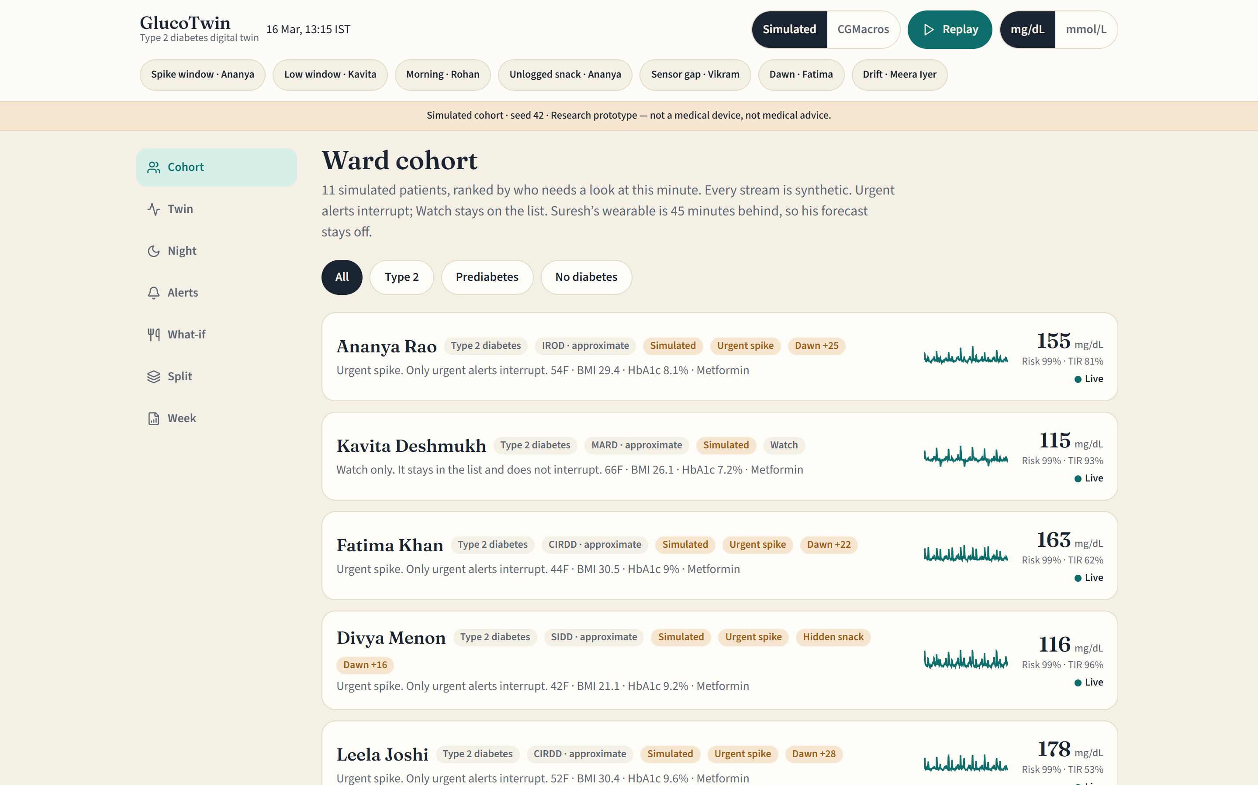
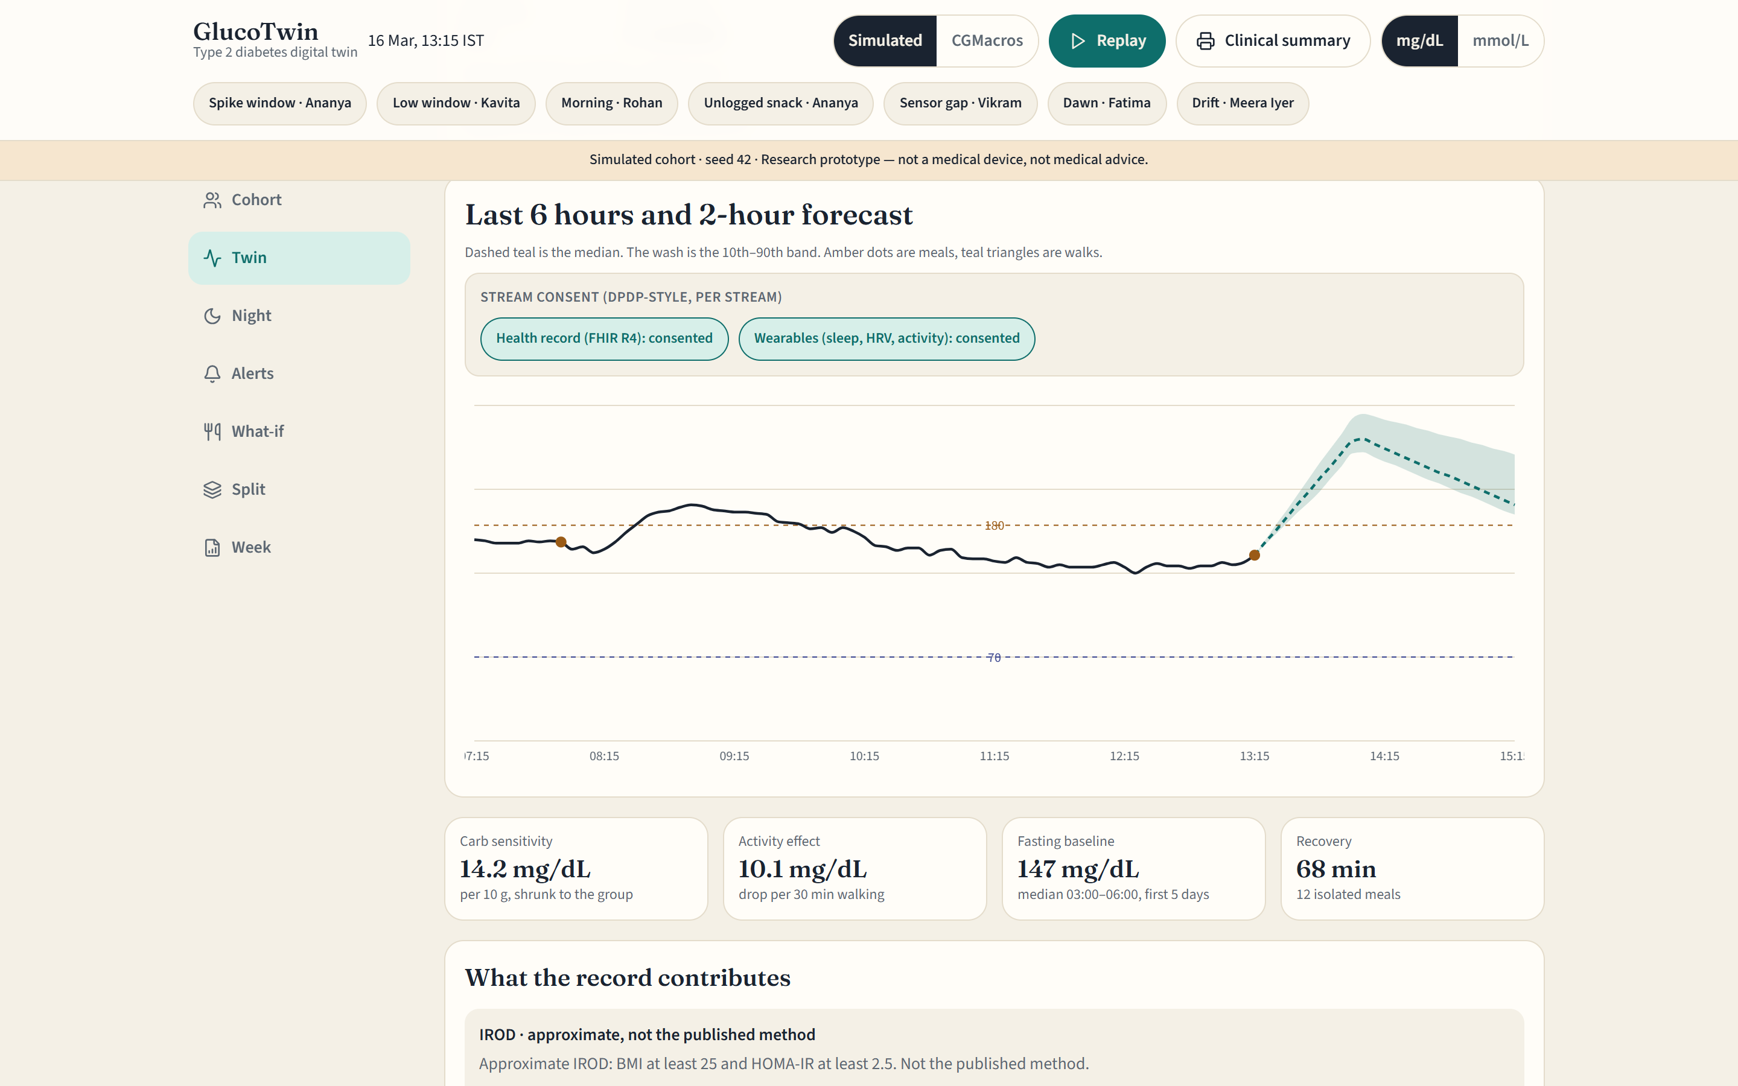
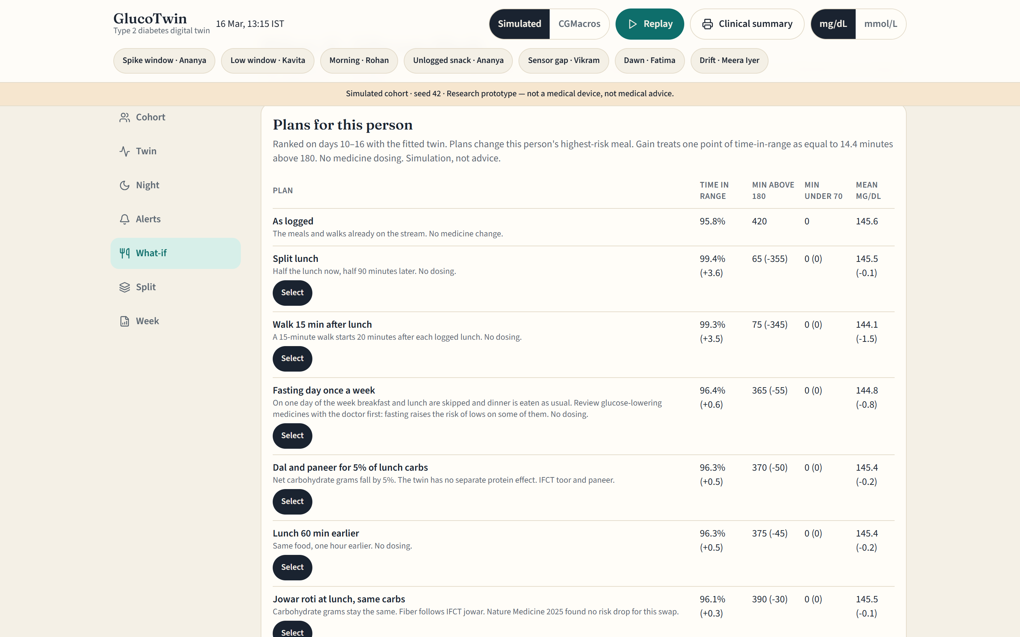
10 · THE DOCTOR DASHBOARD, LIVE
Three screens a doctor uses between visits
COHORT TRIAGE
TWIN FORECAST
7-PLAN WHAT-IF
Patients ranked by urgency. Only Urgent interrupts; Watch stays on the list.
2-hour forecast with a 10–90% conformal band and per-stream consent toggles.
Seven lifestyle plans on her own twin, with deltas. Never a dose.
ONE CLICK: PRE-VISIT CLINICAL SUMMARY
A printable sheet for the patient's chart: twin parameters, 7-day time in range, the chosen lifestyle plan and recent Urgent alerts.
Withdraw the record and the twin drops its prior and medicines but keeps its CGM fit; withdraw wearables and sleep and walks drop out. The band widens on screen.
Screenshots of the running prototype (simulated ward, seed 42), 16 Oct 2026 (docs/presentation/screens). The pre-visit summary prints from the Clinical summary button on any patient screen.
10
Notes:
These are live screens from the running prototype. The cohort view ranks the ward by who needs a look now; only Urgent alerts interrupt. The twin view shows the next two hours with a conformal band and the per-stream consent toggles: withdrawing the record drops the record prior and medicines but keeps the personal CGM fit, withdrawing wearables drops sleep, HRV and walks, and either way the band widens. The what-if view ranks seven lifestyle plans on this patient's own twin. One click prints a pre-visit clinical summary for the chart.

Slide 12
11 · INNOVATION VS EXISTING TOOLS
Others report the past. GlucoTwin tests the next two hours.
 | Fuses record + CGM | Looks ahead | Personal fitted model | What-if plans | Indian foods & subgroups | Shows uncertainty
CGM vendor reports (AGP) | ○ sensor only | ◐ short low alarms, some devices | ○ | ○ | ○ not described | ○
Diabetes logging & coaching apps | ◐ manual entry | ○ not described | ◐ varies | ◐ tips, not simulated | ◐ some | ○
Hospital EHR / HMIS | ◐ record, rarely CGM | ○ | ○ | ○ | ○ | ○
GlucoTwin | ● FHIR R4 + CGM | ● 30 / 60 / 120 min | ● 5-day fit | ● 7 plans | ● IFCT + 4 subgroups | ● 10–90% band
● does it ◐ partly / manual ○ not described publicly
NEW: PLAN-ON-TWIN
Every lifestyle plan is tested on this patient's fitted twin before it is advised.
Split lunch helped 4 Type 2 patients and hurt 4. A report of the past cannot show that.
Explainable: every forecast splits into meal, walk, dawn rise and residual.
Honest: shows a 10–90% band and its real coverage (0.79 at one hour against a 0.80 target).
Indian by design: IFCT foods and subgroup priors, not Western food tables.
Category-level summary from public product descriptions as of Oct 2026; individual products vary. “Not described” ≠ absent. Band coverage from real_eval.json (60-min, CGMacros).
11
Notes:
How GlucoTwin differs, at category level. CGM vendor reports summarise the sensor; some devices add short-horizon low alarms. Logging apps collect data and give tips. Hospital records hold the labs but rarely the CGM. GlucoTwin fuses the record and the stream, forecasts two hours ahead with an uncertainty band, fits a model to each person in five days and tests lifestyle plans on that model before they are advised. Individual products vary, and we only claim what is publicly described.

Slide 13
12 · WHERE THE MODEL IS CENTRAL
Physiology explains the curve; ML learns what it misses
PHYSIOLOGY
MACHINE LEARNING
DOCTOR
TypeScript twin core, live
Python, offline
Reviews and decides
Meal response from carbs, fiber and fat
Walks, dawn rise, sleep + HRV, fading residual
5 personal knobs, kept only if they beat the prior
Conformal 10–90% band from its own errors
Spike and low probability → alerts
Ridge prior: labs, BMI, age, sex → day-0 knobs (−12% error)
LightGBM learns the physiology residual
Subgroup rule sets a cold-start prior
Drift monitor flags when the band stops fitting
Python ↔ TypeScript parity on 300 cases
Works from a cohort ranked by urgency
Picks a lifestyle plan, or none
Acknowledges or marks a false alarm
Sees the data source on every screen
Never sees a dose suggestion
Every curve is explainable
Learns only what physiology misses
Accountability stays with the doctor
Why not a pure black box: open data has only 45 real people with CGM and logged meals. A physiology core fitted to each person in five days generalises, explains itself, and leaves ML to correct what it misses: LightGBM cut held-out 2-hour error from 47.7 to 43.2 mg/dL.
Sources: GlucoTwin design (src/lib/glucotwin/physics.ts, engine.ts; ml/evaluate_cgmacros.py). LightGBM held-out figures from real_eval.json (3 participants held out). Parity checked by ml/parity_test.py.
12
Notes:
The model is a hybrid. The live core is physiology: meals, walks, a dawn rise and a fading residual, with five personal knobs and a conformal band, so every curve can be explained. Machine learning sits offline: a ridge prior turns labs and demographics into day-zero knobs, LightGBM learns the residual, and a drift monitor watches the band. The Python research code and the TypeScript app agree on 160 test cases. The doctor stays in charge and never sees a dose.

Slide 14
13 · ARCHITECTURE & DATA FLOW
How data flows, and where the twin acts
INPUTS
STREAM CHECKS (code)
TWIN CORE (TypeScript)
OUTPUTS
DOCTOR
CGM, every 5 min
Record prior + subgroup → day-0 knobs
5-min grid, gap flags
Alert engine: Urgent / Watch, with reasons
Dashboard: 7 screens + consent gate
Sleep, HRV, steps
Fitted knobs + live state
Compression lows, sensor lag
FHIR R4 health record
Forecast 30/60/120 + band
Plan compare: 7 lifestyle plans
Pre-visit summary; mark false alarm
Unit mix-ups (mg/dL vs mmol/L)
Meals (IFCT) and walks
Drift monitor
OFFLINE (Python): CGMacros → ridge prior + LightGBM residual → results the app reads
STACK
TypeScript · React 19 · TanStack Start · Recharts · Python (numpy, pandas, scikit-learn, LightGBM) · FHIR R4 · Vercel
TODAY (HONEST STATUS): RUNNING END TO END
11 simulated patients + 45 real CGMacros adults. 118/118 model tests; 16.3 µs per reading.
NEXT
ABHA-consented FHIR pull · ABDM consent artefacts · event queue sharded by patient · LightGBM on the live curve after review
Sources: GlucoTwin architecture as built (docs/architecture). Benchmark 17 Oct 2026 on one laptop thread. Items under NEXT are planned, not built. The app deploys as serverless functions (Nitro on Vercel).
13
Notes:
Data flows left to right. Inputs are the CGM, wearable signals, the FHIR record and logged meals and walks. Stream checks put readings on a five-minute grid and flag gaps, compression lows, sensor lag and unit mix-ups. The twin core sets day-zero knobs from the record, keeps the live state, forecasts with a band and watches for drift. Outputs are the alert engine and plan compare, shown to the doctor on the dashboard. Offline, Python fits the record prior and the LightGBM residual on CGMacros and writes results the app reads. Next: consented ABDM import and a sharded event queue.

Slide 15
14 · RISKS, FEASIBILITY, SCALE & COST
Guardrails, scale and cost
Sensor noise & gaps
Alarm fatigue
Over-trust & dosing
Stream checks flag gaps, compression lows and lag before the twin uses a reading
Two tiers, hysteresis, thresholds chosen on validation days; 0.75 false alerts a day
No dose, no diagnosis; plans labelled “Simulation, not advice”
Privacy (DPDP)
Population shift
Rare lows
Synthetic and open data only; per-stream consent gate live in the dashboard
CGMacros is US adults; the pilot refits on Indian patients and meals
Stress test: 6 of 16 lows warned, all correct (blind guard). CGMacros: 7 of 17, 39% precise
SCALE (MEASURED)
16.3 µs per reading on one laptop core: update, 2-hour forecast and spike risk
1.7 KB of state per patient: a million patients fit in 1.7 GB
O(1) update and stateless workers: shard by patient ID
No CGM? Eight fingersticks a day rebuild the curve at 20.3 mg/dL error (simulated)
118/118 model tests; Python ↔ TypeScript parity on 300 cases
MODEL COMPUTE PER PATIENT (MEASURED)
≈ 0.14 CPU-seconds / month
288 readings × 30 days × 16.3 µs. One cloud vCPU covers the model for millions of patients, so the sensor, storage and hosting, not the twin, set the cost.
At 1 million patients: ≈ 39 CPU-hours of model compute a month, 3,300 readings a second, 1.7 GB of twin state.
Hosting and sensor prices are not yet costed.
Benchmark 17 Oct 2026: 3,000 synthetic patients × 288 readings, Node 22, Intel i5-11400H, one thread, compute only (no network or database I/O). Fingerstick figure: interpolation error on the simulated ward. Lows: 6 of 16 on the stress test (blind drug guard), 7 of 17 on CGMacros.
14
Notes:
Guardrails first: stream checks for noisy sensors, two alert tiers with hysteresis against alarm fatigue, no dosing or diagnosis, synthetic and open data only, an honest note that CGMacros is US data, and that lows are rare so low alerts are weak. Scale is measured: 16.3 microseconds per reading on one laptop core and 1.7 kilobytes of state per patient. That is about 0.14 CPU-seconds per patient per month, so the twin itself is almost free to run; the sensor and hosting set the cost. For patients without a CGM, eight fingersticks a day rebuild the curve with about 20 mg/dL error in simulation.

Slide 16
15 · FROM PROTOTYPE TO ONE CLINIC TO A CITY
Pilot plan, impact metrics and roadmap
NOW → DEC 2026
NEXT
THEN
Prototype
One-clinic pilot
City rollout
Twin running: 11 simulated + 45 real adults
Built: habit-aware alerts, consent gate, pre-visit summary
30 adults with Type 2 diabetes on CGM, 12 weeks
Indian meals via IFCT; doctor reviews forecasts
More clinics via ABDM, with ABHA consent
Hypertension twin on the same core
HOW WE'LL KNOW IT WORKS (lead metric: time in range)
Time in range
Spikes warned early
False alerts
Review time
points gained vs the pilot's baseline weeks; +5 is clinically meaningful
% warned ≥60 min ahead (stress test today: 42.9%, median 105 min)
per patient-day; today 0.75, keep below 1
minutes per patient review, before vs after
ADOPTION & SUSTAINABILITY
Plugs in: ABDM exchanges records as FHIR R4, the format the twin already reads; 93 crore ABHA accounts and 104 crore linked records exist today. Regulation: clinician decision support, built for DPDP consent (consent-manager duties from 13 Nov 2026) and the CDSCO software pathway.
The ask: one diabetes clinic, 30 consenting adults with Type 2 diabetes on CGM for 12 weeks, and a doctor willing to review the twin's forecasts.
Pilot design and targets are proposals; outcomes will be reported as associations, not causal proof. ABHA figures: PIB fact sheet, 6 Jul 2026. Regulatory dates: DPDP Rules (notified 13 Nov 2025); CDSCO draft guidance on medical device software (21 Oct 2025).
15
Notes:
The plan: add learned medicine effects for lows and calibrated risk by December; then a 12-week pilot with 30 adults with Type 2 diabetes in one clinic, logging Indian meals with every forecast reviewed by their doctor; then more clinics through ABDM and a hypertension twin on the same core. We will judge it on time in range, the share of spikes warned at least 60 minutes ahead, false alerts per patient-day and review time. The twin already reads FHIR R4, which is how ABDM exchanges records. Our ask is one clinic and one doctor willing to try it.

