Slide 1
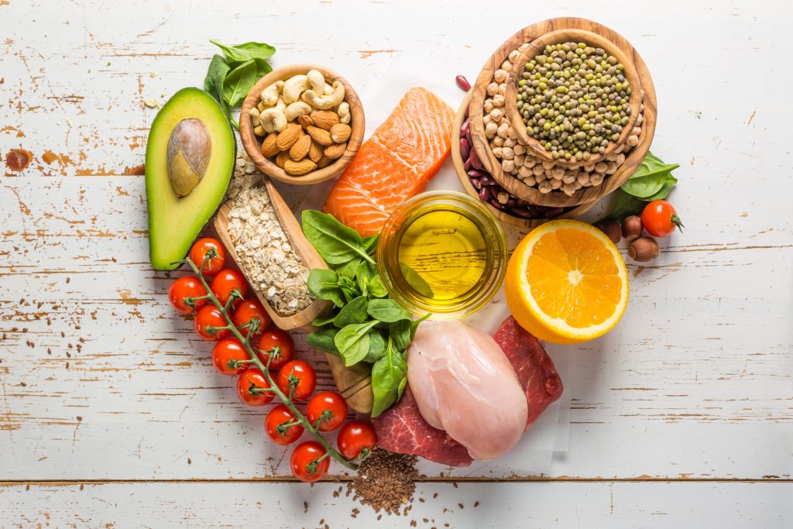
Good Eats
By. Ayanna Burrowes, Patrick Moroney, Abe Rodriguez, Josh Andino, Nikita Ezhov

Slide 2
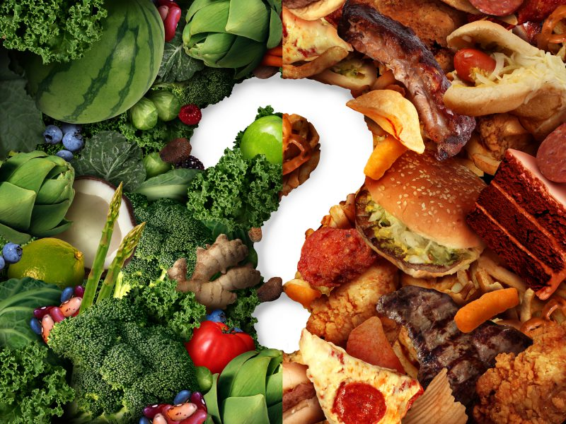
Overall Concept
We wanted to provide a source where people can get delicious recipes, get nutritional facts and location of near by restaurants in their hometown.

Slide 3
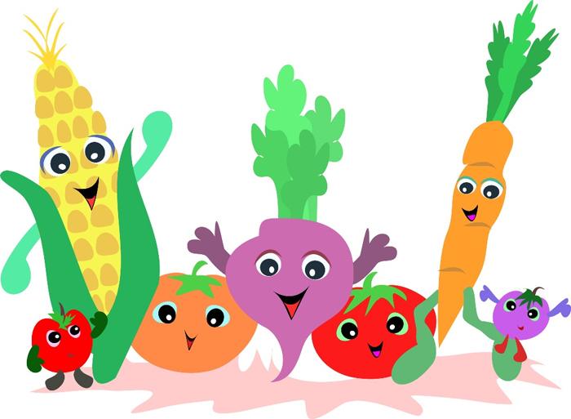
Motivation
One of our major motivations was to promote healthy eating habits. Encouraging others to eat healthier will not only prevent future illnesses but also increase life expectancy

Slide 4
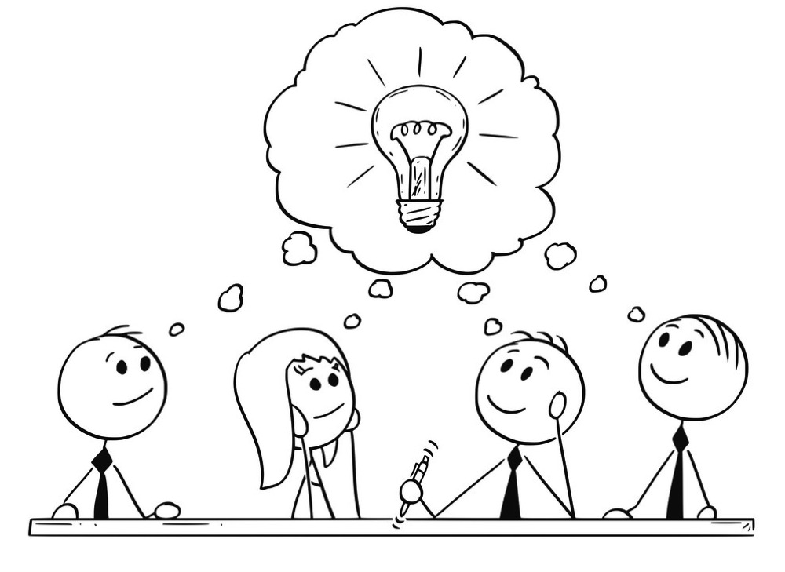
Design Process
Our design process started by getting the idea first. Once we where able to find the idea, we started sketching ideas for the page layout. Once we all agreed on a layout the coding began.

Slide 5
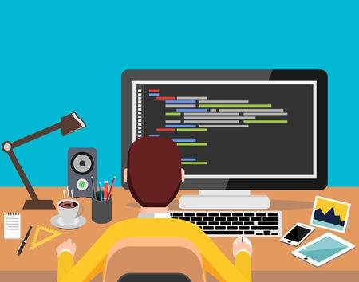
Technologies
Some of the API we use where Zomato and it provided us a restaurant location.
Another API was Edaman and it provided us with the recipe and nutritional facts about the meal
Materialize for the design and layout for the website

Slide 6
Demonstration
Link to Good Eats

Slide 7
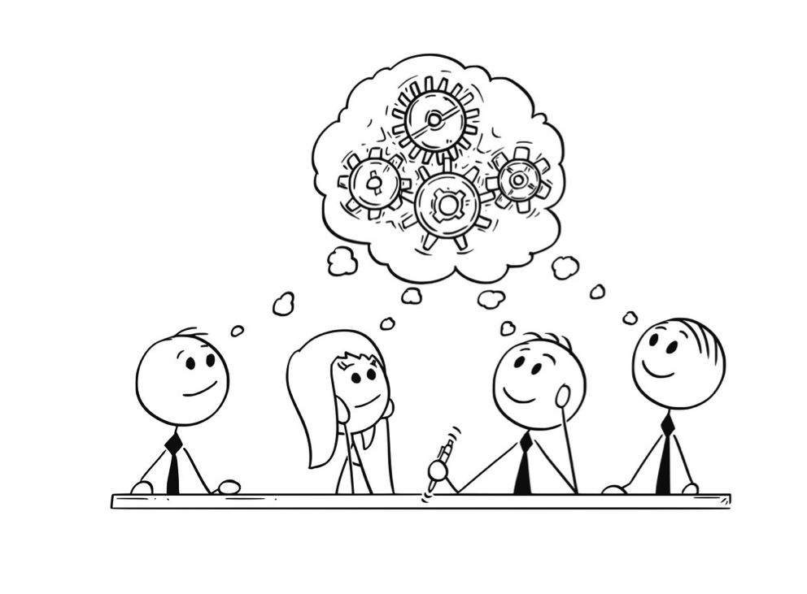
Future Plans
Some of our future plans would be including meal prep plans menu, connect to android, iOS devices, a place where user can blog about their meals and if add their own unique recipes.
Using pictures to bring up locations of restaurants with similar dishes.

Slide 8
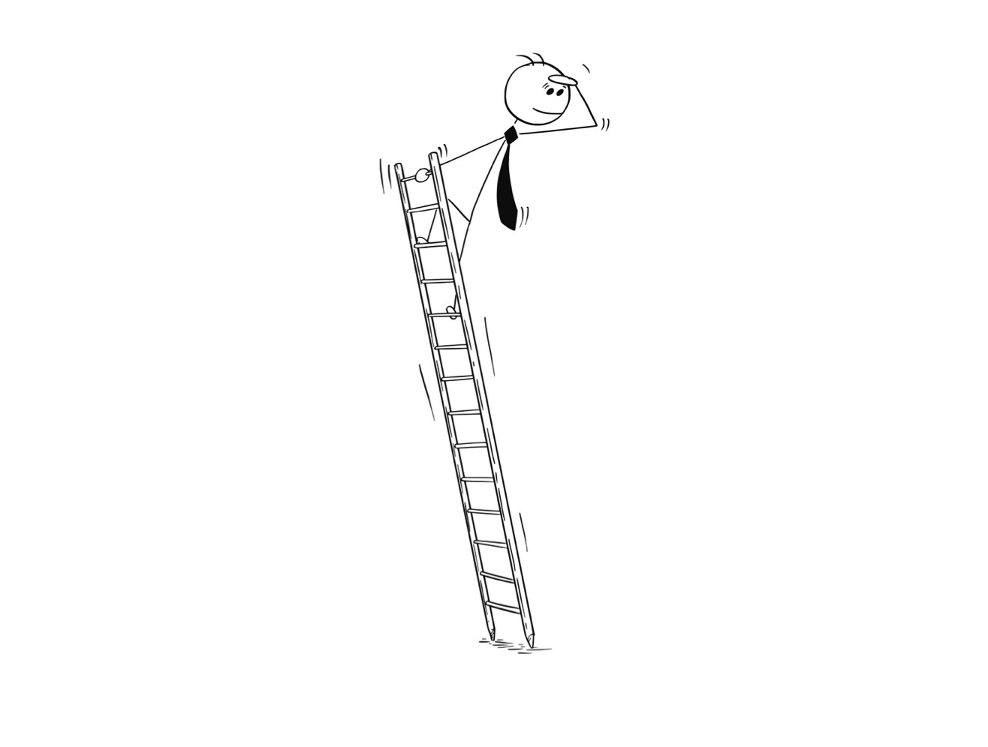
Challenges
Back end – Trying to get the API to correctly for the first time. After researching different outcomes they where able to provide the working code.
Front end – Using both Bootstrap and Materialize in the same HTML
Understanding branching when using Github.

Slide 9
Task
Backend – Nikita and Patrick
Front end – Ayanna, Abe, Josh

