Slide 1
Vulnerability and threat analysis
By: Ananthu Krishna Vadakkeppatt
Group Project – Group 10
Members: 1) Syed Mujahid Hamid Ali
2) Aryan Santosh Saindane
3) Khondoker Ishmum Muhammad
4) Ananthu Krishna Vadakkeppatt

Slide 2
AGENDA
By: Aryan Saindane
Summary​
Network Infrastructure
Risk Assessment Methodology
​Vulnerabilities Found With Scans
​Conclusion

Slide 3
Summary
This presentation evaluates vulnerabilities identified during network scans on home devices from August 8th to 13th, 2023, in Toronto, Canada. Testing encompassed two LAN segments, 192.168.110.0/24 and 192.168.99.0/24, on an operational infrastructure. The report provides a concise overview of findings, assessment details, and technical insights on each risk. Emphasizing critical issues, it urges prompt action through patching to avert security threats. While student scans were limited to local networks, the report underscores the need to address vulnerabilities promptly to safeguard the organization's security and operations. It also highlights the importance of ongoing security reassessment and adaptation.

Slide 4
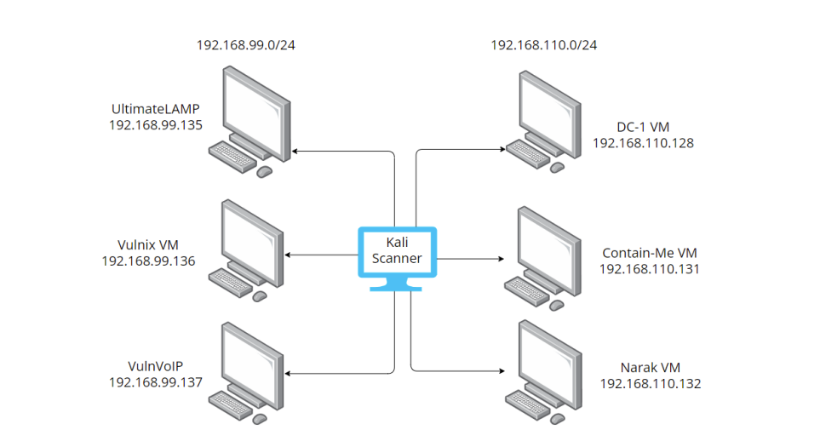
Network infrastructure

Slide 5
Risk assessment methodology
Likelihood | Info | Low | Medium | High | Critical
Critical | Info | Low | Medium | High | Critical
High | Info | Low | Medium | High | Critical
Medium | Info | Low | Medium | Medium | High
Low | Info | Low | Low | Low | Medium
Info | Info | Info | Info | Low | Low

Slide 6
vulnerabilities FOUND WITH SCANS
By: Syed Mujahid Hamid Ali

Slide 7
Machine 1: vulnvoip
By: Syed Mujahid Hamid Ali
Number of vulnerabilities: 2
There were a total of two vulnerabilities found in this machine while doing the scans
One of them was SSH Weak Key Exchange Algorithms Enabled (Low) and the other one was SSH Weak Algorithms Supported (Medium)

Slide 8
Machine 2: vulnix
By: Khondoker Ishmum Muhammad
Number of vulnerabilities: 8
There were a total of eight vulnerabilities found in this machine while doing the scans
The list goes on as follows: SSLv3 PODDLE (Low) SSH Weak Key Exchange Algorithms (Low) SSL Certificate Cannot Be Trusted (Medium) NFS Shares World Readable (High) SSL Medium Strength Cipher Suites Supported (SWEET32) (High) OpenSSL Heartbeat Information Disclosure (High) SSL Version 2 and 3 Protocol Detection (Critical) NFS Exported Share Information Disclosure (Critical)

Slide 9
Machine 3: DC-1
By: Khondoker Ishmum Muhammad
Number of vulnerabilities: 8
There were a total of eight vulnerabilities found in this machine while doing the scans
The list of vulnerabilities: SSH Server CBC Mode Ciphers Enabled (Low) SSH Weak MAC Algorithms Enabled (Low) JQuery 1.2 < 3.5.0 Multiple XSS (Medium) web.config File Information Disclosure (Medium) PHP < 7.3.24 Multiple Vulnerabilities (High) Drupal Database Abstraction API SQLi (High) Unix Operating System Unsupported Version Detection (Critical) PHP Unsupported Version Detection (Critical)

Slide 10
Machine 4: ultimate lamp
By: Khondoker Ishmum Muhammad
Number of vulnerabilities: 2
There were a total of two vulnerabilities found in this machine while doing the scans
One of them was HTTP TRACE / TRACK Methods Allowed (Medium) and the other one was Unix Operating System Unsupported Version Detection (Critical)

Slide 11
Conclusion
By: Ananthu Krishna Vadakkeppatt
In summary, this report has highlighted numerous vulnerabilities identified during scans on home network devices, particularly in the Virtual Machines, spanning from low to critical severity. The existing state of these devices exposes the organization to a range of security hazards. It is imperative for the maintainer to swiftly prioritize the examination and patching of the critical vulnerabilities detailed in the main report.
Underscoring the urgency of these actions is crucial. The maintainer should thoroughly assess the impact of each vulnerability on the devices and the wider network structure to effectively mitigate risks. Immediate planning and implementation of patching measures are essential to minimize the potential for attacks and bolster overall security resilience.
Addressing these concerns promptly will not only fortify the devices' ability to withstand cyber threats but also safeguard the organization's assets and reputation in the process.

Slide 12
THANK YOU
By: Ananthu Krishna Vadakkeppatt
Presentation by: Group 10
1) Syed Mujahid Hamid Ali
2) Aryan Santosh Saindane
3) Khondoker Ishmum Muhammad
4) Ananthu Krishna Vadakkeppatt

