Slide 1
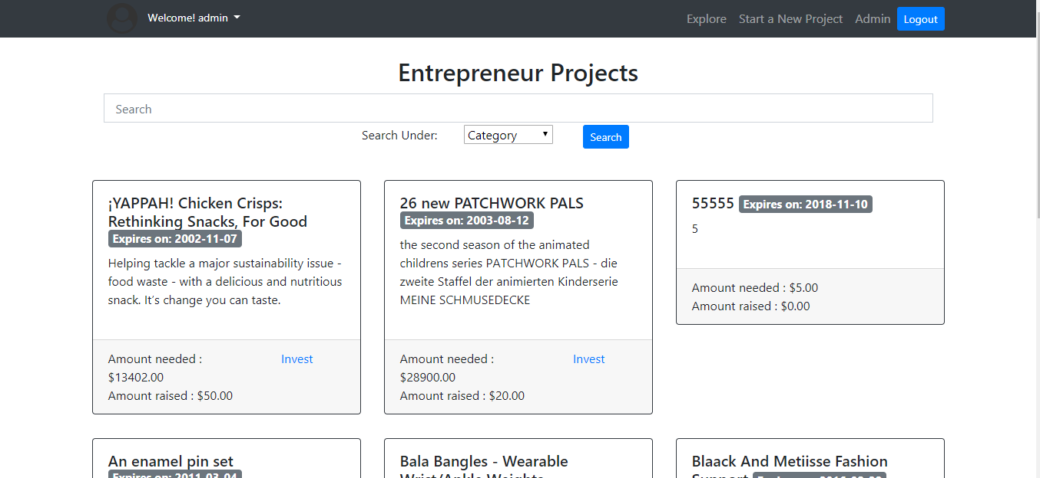
Click to view user profile
Only shown to admin user
Search by project title, description, entrepreneur
Show list of all project on advertisement
A project on advertisement
Filter by project category

Slide 2
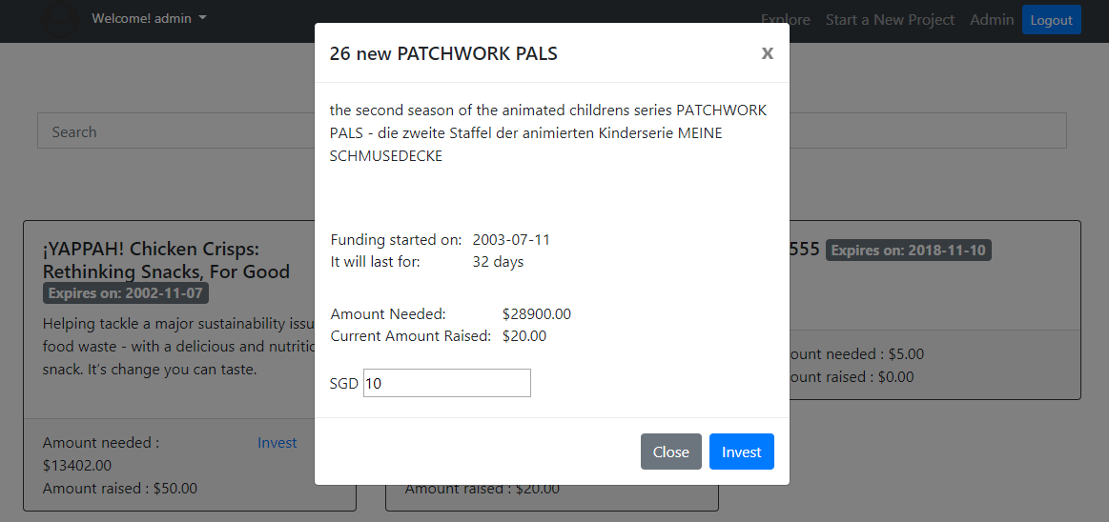
Project Title
Project Description
Click to display investment page

Slide 3
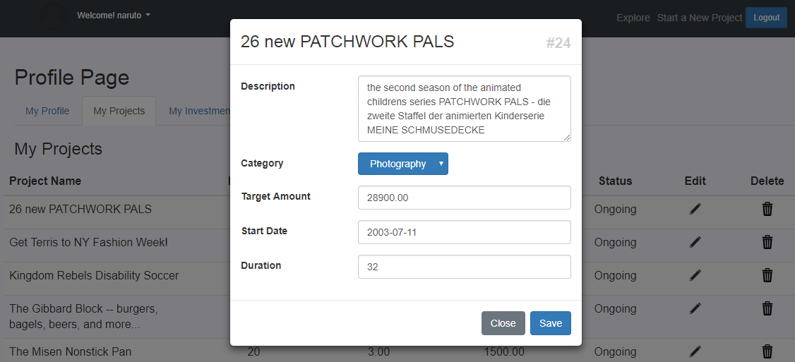
Project Title
Project Id
Click to edit

Slide 4
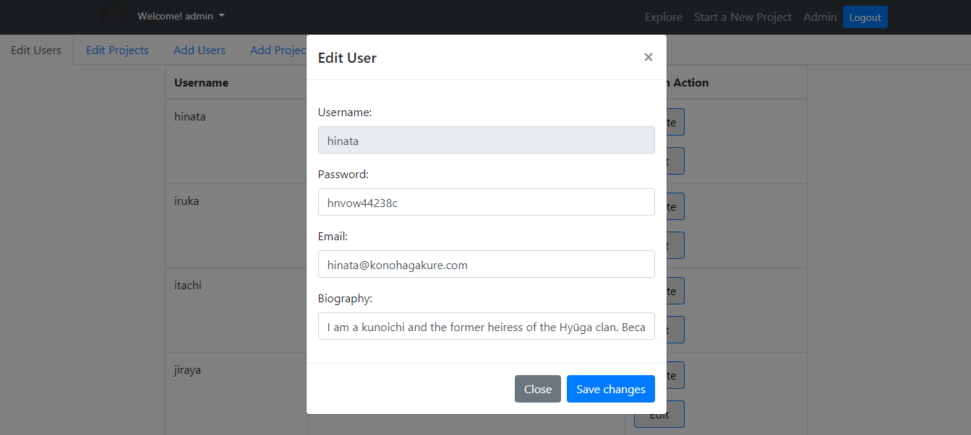
Primary Key in database

Slide 5
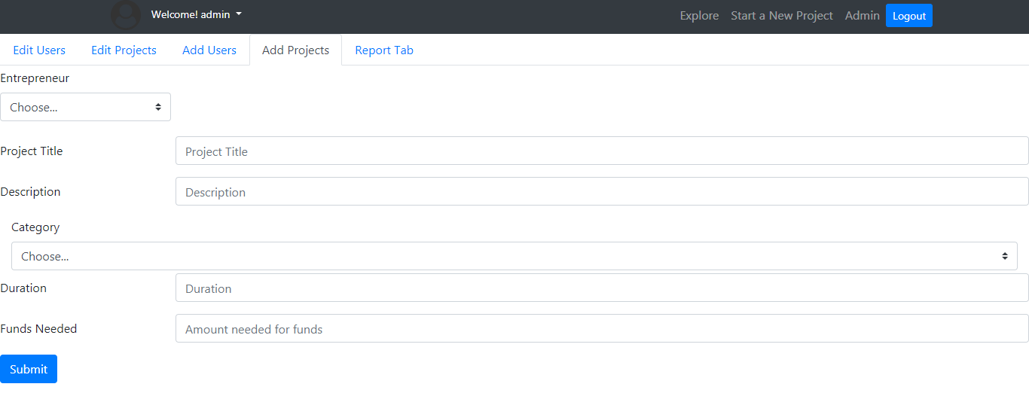
Can only choose from existing users in the database
Can only choose from existing categories in the database

Slide 6
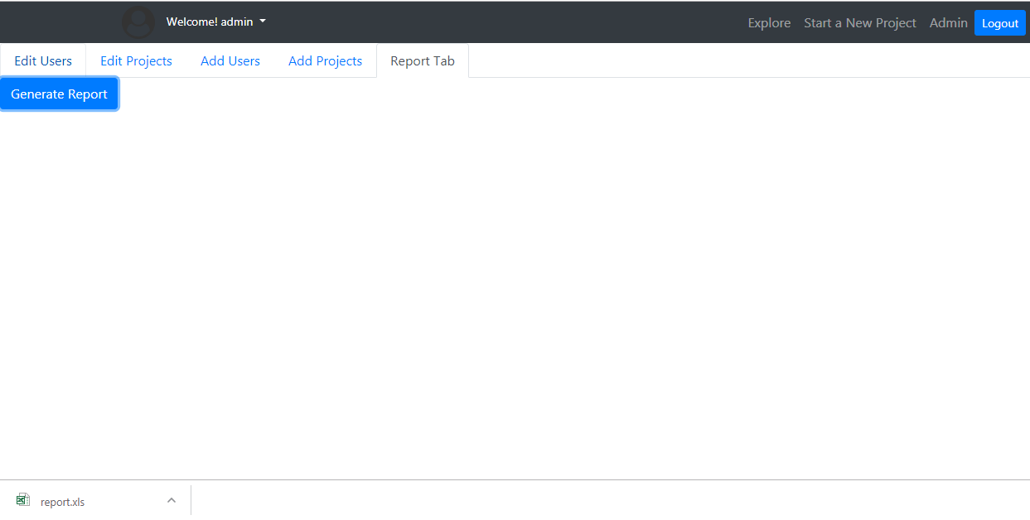
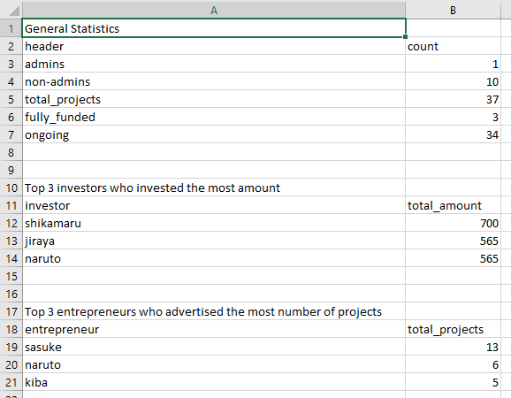
Click to generate a downloadable report
(Excel spreadsheet)

Slide 7
