Slide 1
Update meetings: w/c 07/04/25

Slide 2
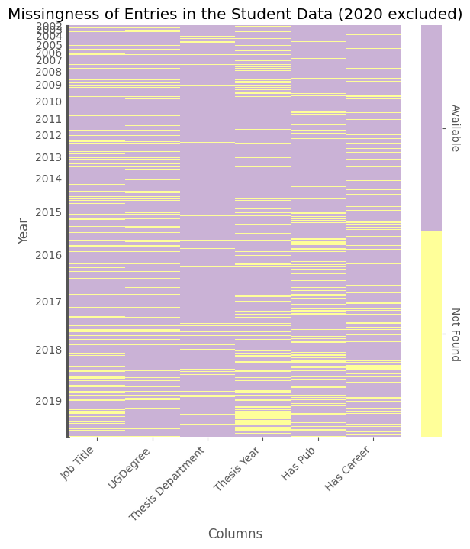

Slide 3
Additions to dataset
Supervisor dataset
Augmented Appendix A using ORA/SOLO
Extend students: end date, thesis title, supervisor
Appendix A records supervisors – at least correct to the time of print
Confirm final titles / supervisors on SOLO
Manual and slow…
Thesis publication date as a proxy for end date

Slide 4
Students
Course, cohort
Study before DTC – location, university, subject, subject category
UG and PG: 61% of students have a PG degree found
Current location & job
Covered later
Thesis titles & supervisors (from Appendix & ORA), submission dates

Slide 5
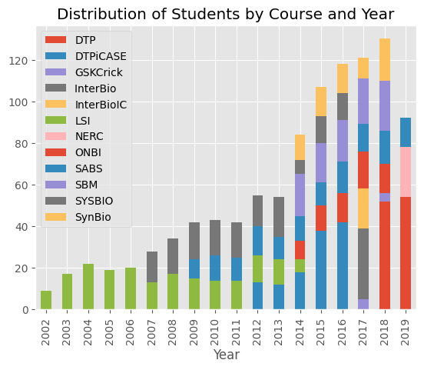

Slide 6
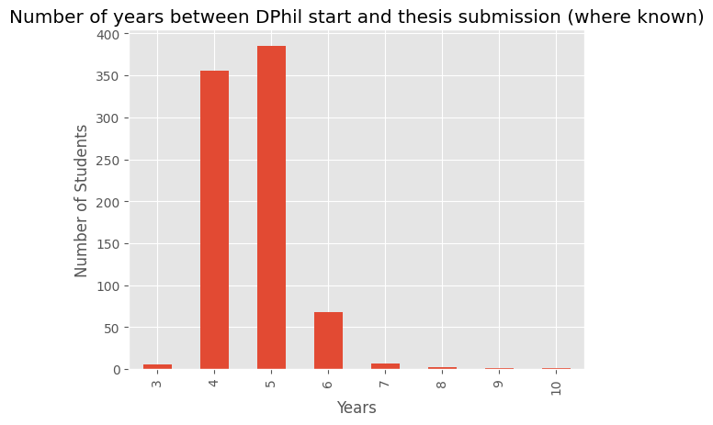

Slide 7
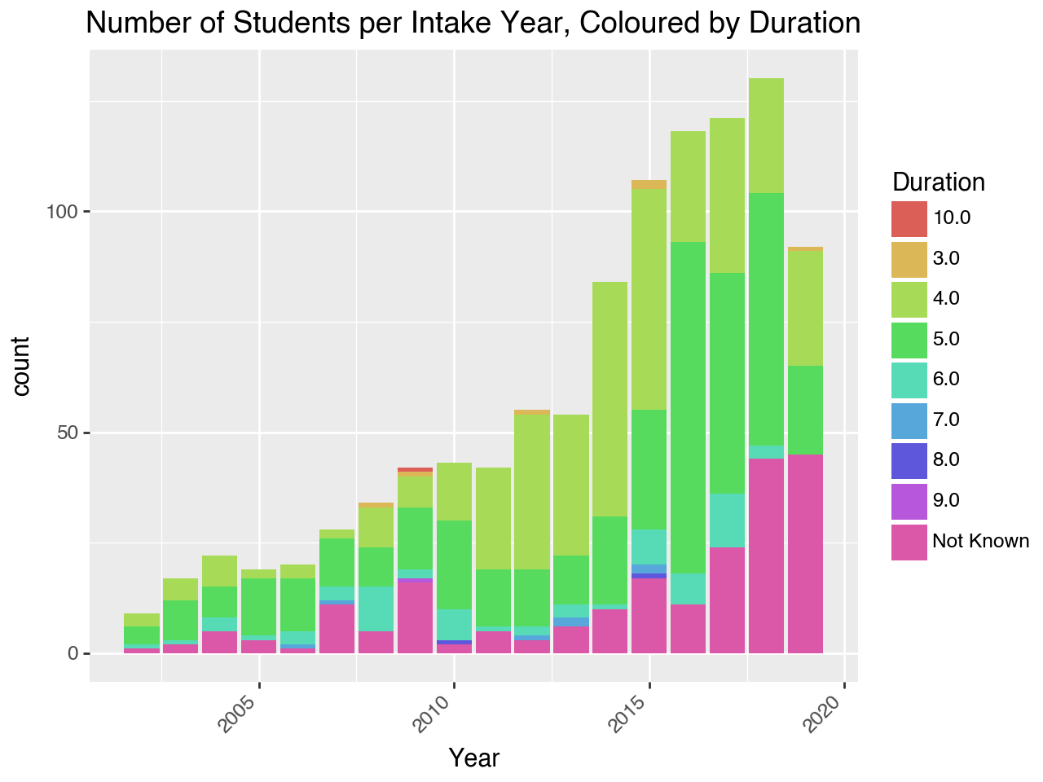
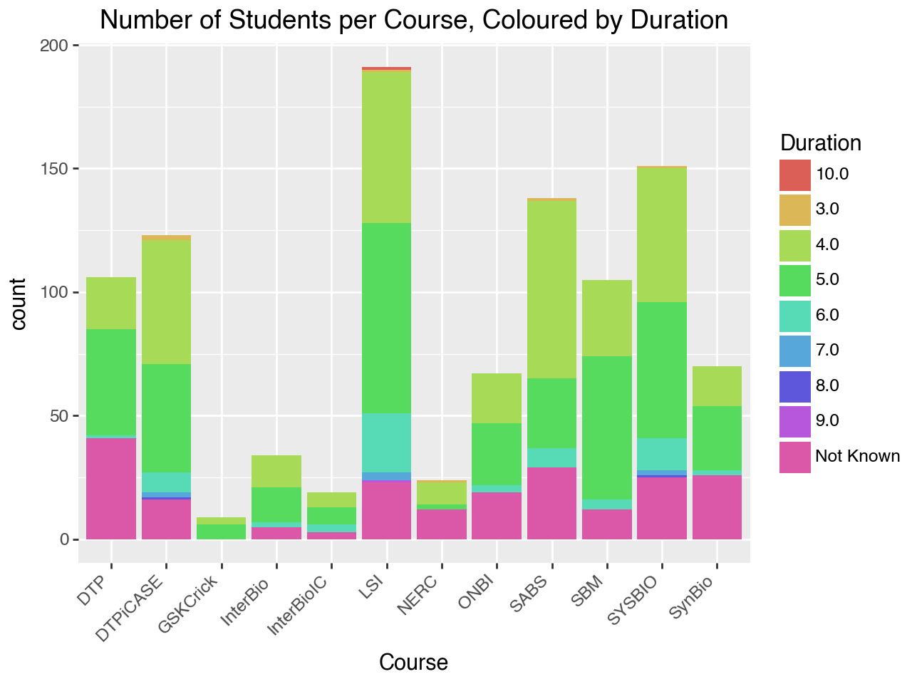

Slide 8
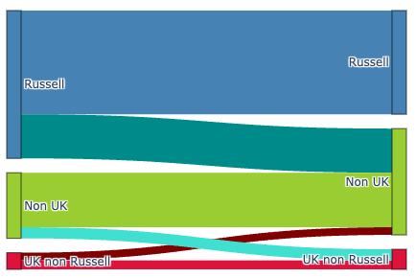
* alternatively… Oxbridge of just Oxford

Slide 9
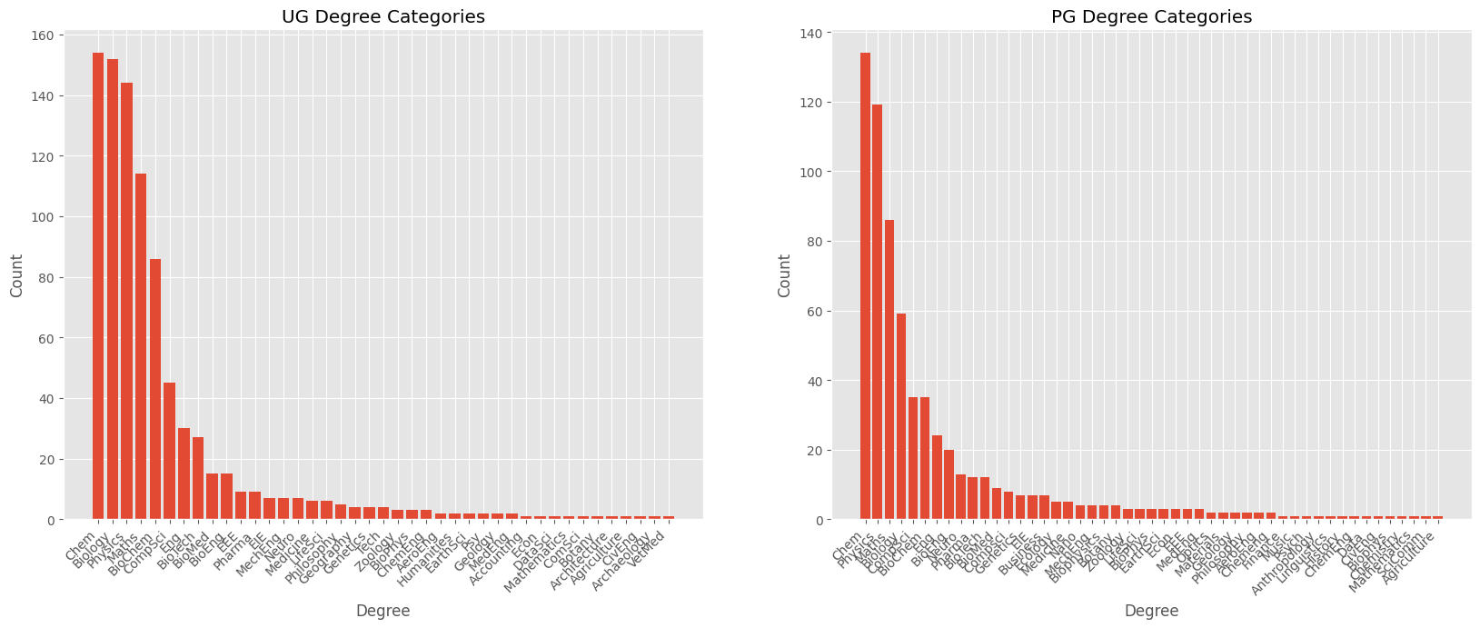

Slide 10
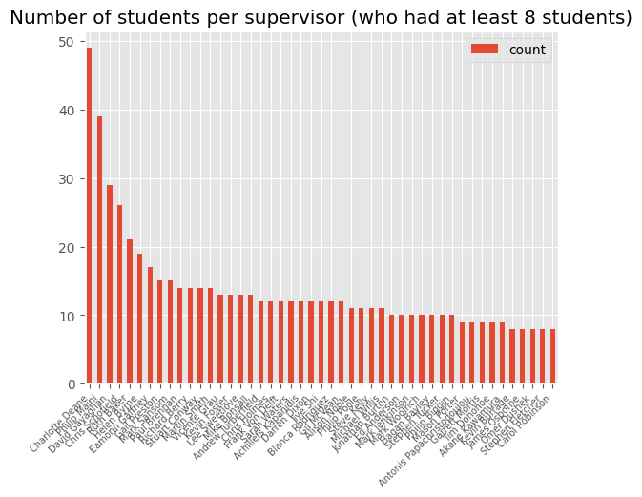

Slide 11
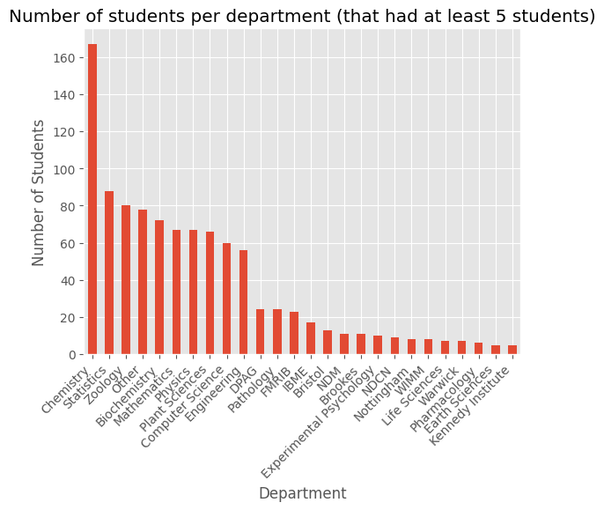

Slide 12
DTC graduates who went on to supervise
Alexander Fletcher
Anthony Bradley
Ben Lambert
Chris Yau
Claire Marks
Daniel Wilson
Gary Mirams
Jack Miller
Jacob Bush
James Anderson
Frederik Lange
James Osborne
Jinwoo Leem
Ken Wang
Kit Yates
Lucy Hutchinson
Martin Bishop
Rafel Bordas
Sara-Jane Dunn
Saulo de Oliveira
Xavier Didelot
That’s 21 out of 1037 students from 2002-2019
They supervised 53 times between them
Notes:
Subject to change given name standardisation

Slide 13
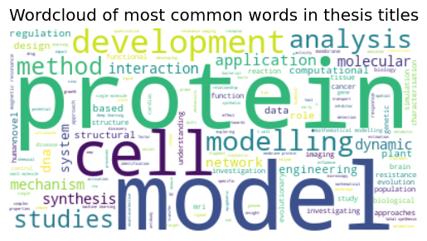

Slide 14
Jobs…
2-part process:
Manual scrape by the boys (2002-mid2017)
Lacks location and sector for each job
Automated scrape by me (mid2017-2019)
Had unstandardized sectors
Job title, company, location, sector, dates
(NB lots more data than what I am about to show (eg location), but trying to keep it interesting)

Slide 15
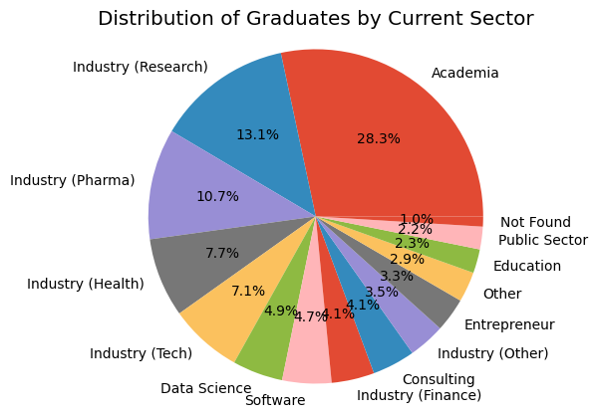
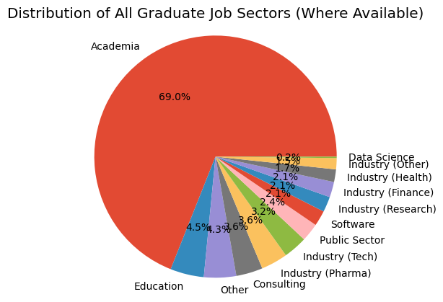
IN
PROGRESS

Slide 16
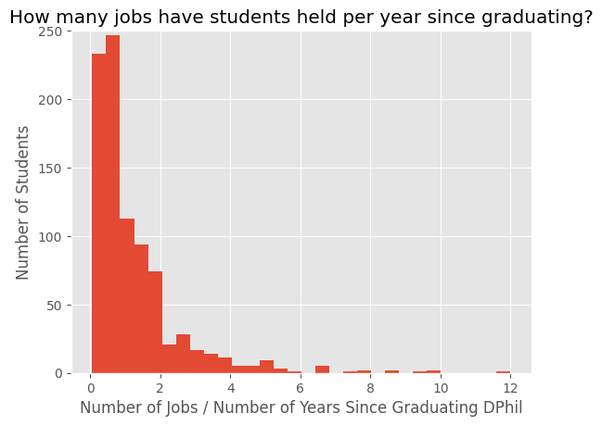

Slide 17
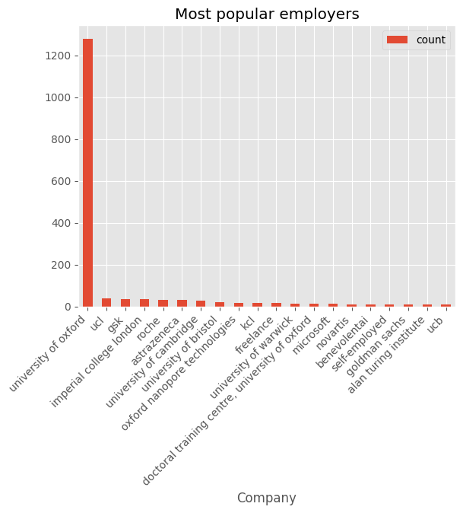
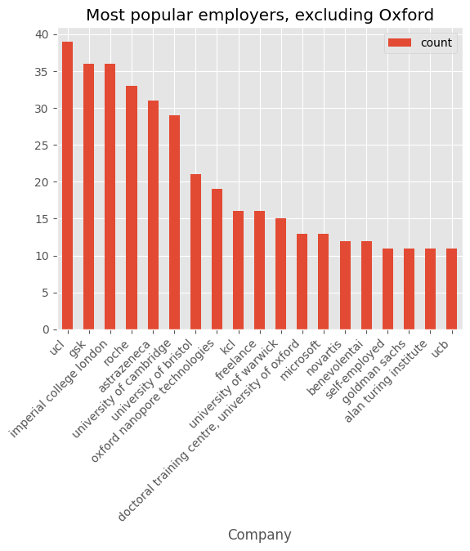

Slide 18
Papers…
2-part process:
Find ORCIDs
Look up that ORCID’s papers
What I’ve done:
Look up everyone’s ORCIDs
Check accuracy of each ORCID – some people I simply can’t find
Look up every paper written by each ORCID
Associated metadata: citations, h-index etc

Slide 19
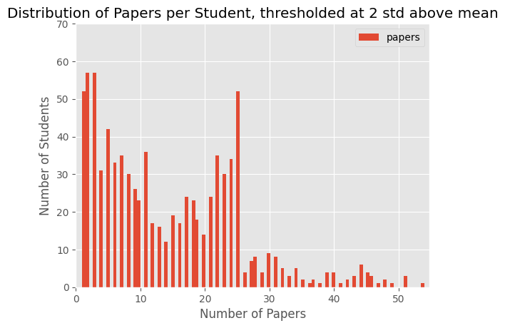

Slide 20
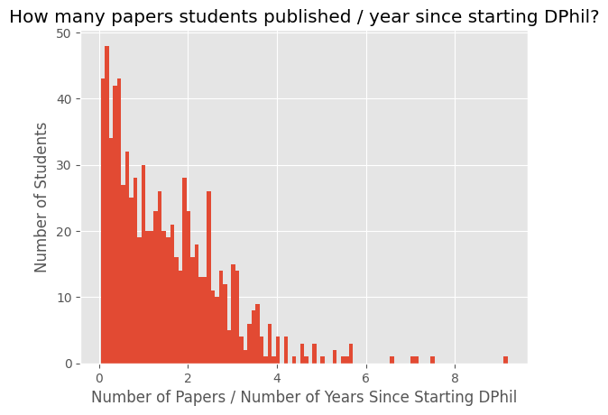

Slide 21
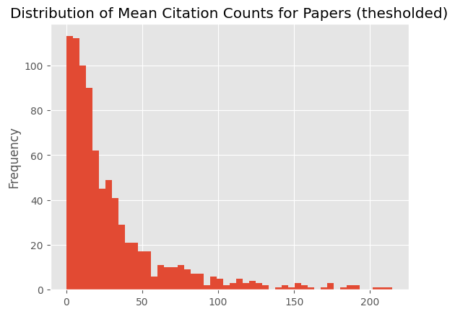

Slide 22
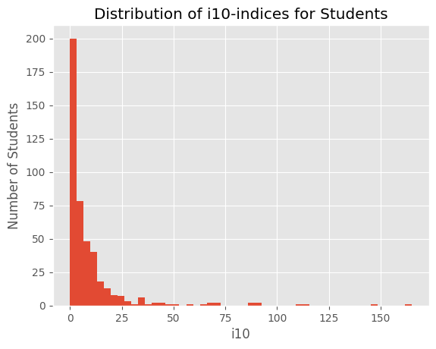
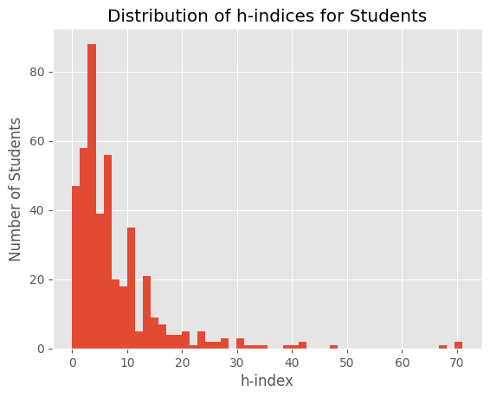
Next: find a dataset to compare these to…

Slide 23
Next…
Control groups/Benchmarking
Google scholar overall metrics
Jobs
Standardise titles to get a sense of progression
Map job sectors in time
Employment rate
Dropout rate
Specific metrics (and confounders?)
Obvious for papers
Employment rate, leadership
Time to reach a certain milestone?
Eg professor – normalized by country!

Slide 24
Next…
Specific metrics (and confounders?)
Obvious for papers
Employment rate, leadership
Time to reach a certain milestone?
Eg professor – normalized by country!
Networks that arise
Shared employers
Coauthorship?
Shared supervisors?
Case studies
Entrepreneurs
Pharma pathways?

Slide 25
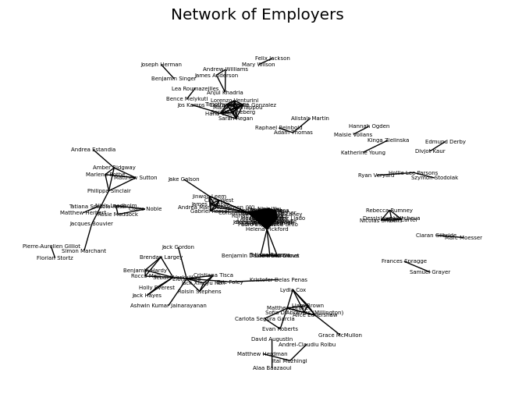

Slide 26
The future: maintaining a publications DB
Ask people for ORCiD on joining
I’m pretty sure some people don’t have one at all
Code is free and quick to run

Slide 27
The future: maintaining a jobs DB (old slide)
Trickier
Ask people for their LinkedIn when they join?
Finding LinkedIns is a timesink
Free automated scripts are very limited
LinkedIn has their own API but (as far as I can tell) you need every user’s permission (they authenticate your access on their account) to look them up
I would also suggest asking students to join the group OR declare they specifically don’t want to
Notes:
Pls stress that data will need to be quickly read by new people!!!!!!!!!!!!!!!!

