Slide 1
27/02 Update Meeting

Slide 2
Agenda
Dataset & progress
Report / Website
The future
Other datasets
LinkedIn
AOB?

Slide 3
Dataset structure
Students set
ID, Name, Career History*, Current Job, Location, UG & PG Study, LinkedIn (and more? See later)
Jobs set
ID, Name, Job Title, Company, Dates, Sector, Location
Papers set**
ID, Name, ORCiD, Title, DOI, Year, Journal, Citation Count
*To be replaced by ‘has career’ as the existing careers are standardized and can be moved
**Currently exists separately

Slide 4
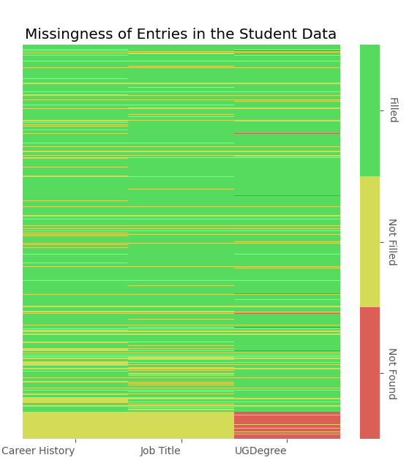
Progress: completeness & work needed
Check
ORDiDs
Two APIs for paper scraping: compare both
Standardize jobs
Filling in blanks

Slide 5
A bit more about jobs…
2-part process:
Manual scrape by the boys (2002-mid2017)
Not standardized… at all
Cleaning: step 1
Lacks location and sector for each job
Cleaning: step 2 (more likely to be automatable)
Automated scrape by me (mid2017-2019)
Has all info
Requires standardization of sectors
All in lowercase for some reason, but I believe we can live with this
How were the sectors decided?

Slide 6
A bit more about papers…
2-part process:
Find ORCIDs
Look up that ORCID’s papers
What I’ve done:
Look up everyone’s ORCIDs
Currently checking the accuracy of this!
Look up every paper written by each ORCID

Slide 7
Report / analysis
[pause to show report]

Slide 8
Website
Proposal: StreamLit
If only DTC, can be hosted on RSE servers
Use TailScale to create a ‘network’
No security issues – doesn’t even leave the building!
Reliant on Abhishek ☺
If want authentication, need to involve FireBase
If cloud based, would involve (deidentified) data on AWS, S3
Potential to do this later during scaleup – it’s a bit more complicated to set up
Requisite repository could be hosted by RSE group GitHub org.
For paid options, maybe £20-30/mo?
Who is this for?
Private for now – public one day … ?
Private to who – us three, the rest of the university?

Slide 9
The future: maintaining a publications DB
Ask people for ORCiD on joining
I’m pretty sure some people don’t have one at all
Code is free and quick to run
However accuracy relies on having a confirmed way to look up THAT SPECIFIC person -- the ORCiD!

Slide 10
The future: maintaining a jobs DB
Trickier
Ask people for their LinkedIn when they join?
Finding LinkedIns is a timesink
Automated script is NOT free (with the method I used)
You can perform 100 person lookups a month with a free account/API key
Paid plans start at $98/mo which seems excessive given there is no need to run any more regularly than 1 time/mo?
No SSO linking so (eg) I am sneakily eligible for 3 free keys due to having 3 Oxford emails
I save every person as a (small) file so once their lookup is performed any info can be mined (86% success rate)
LinkedIn has their own API but (as far as I can tell) you need every user’s permission (they authenticate your access on their account) to look them up
Notes:
Pls stress that data will need to be quickly read by new people!!!!!!!!!!!!!!!!

Slide 11
More datasets
Supervisor dataset
On hold until a clear use case is defined?
Extend students: end date, thesis title, supervisor
Appendix A seems to have titles and supervisors – at least correct to the time of print
Project titles and supervisors
Thesis departments, supervisors and preliminary titles
Final titles can be found on ORA with dates… hopefully not manually!

Slide 12

Can I mass email people if I didn’t ask them if I could do that?
As far as I can tell absolutely not
We probably don’t want to be reported to the ICO ☺
GDPR
https://ico.org.uk/for-organisations/direct-marketing-and-privacy-and-electronic-communications/guide-to-pecr/electronic-and-telephone-marketing/electronic-mail-marketing

Slide 13
Well can we use LinkedIn?
Yes! There are several options.
Linkedin Business Message ads: https://business.linkedin.com/marketing-solutions/message-ads
LinkedIn Developer Sales API: https://learn.microsoft.com/en-us/linkedin/sales/display-services/leads-screenshots#messaging
Messages to connections, InMail to new people
This will likely also pass into email inboxes

