Slide 1
Update meetings: w/c 12/05/25

Slide 2
Next steps from last time
Control groups/Benchmarking
Suggested Google scholar overall metrics
Proving hard to find…
Instead: metric/years since graduating, journal-level metrics
Jobs
Standardised titles to get a sense of progression
Map job sectors in time
Dropout rate
Identified drop-outs on eVision

Slide 3
Next steps from last time
Specific metrics (and confounders?)
Time to reach a certain milestone?
Professor (confounded by age, location)
Time spent in certain roles?
Postdoc
Networks that arise
Done
Shared employers
Shared supervisors
Co-supervision
Pending
Coauthorship

Slide 4
Other updates
Cambridge, Oxford, Russell Group and Other as separate categories
Journal-level statistics for papers
Impact factor is proprietary
2 year mean citations
I10 and H indices
Started writing up

Slide 5
Students…
Graphs (pause for programme switch)
Oxbridge

Slide 6
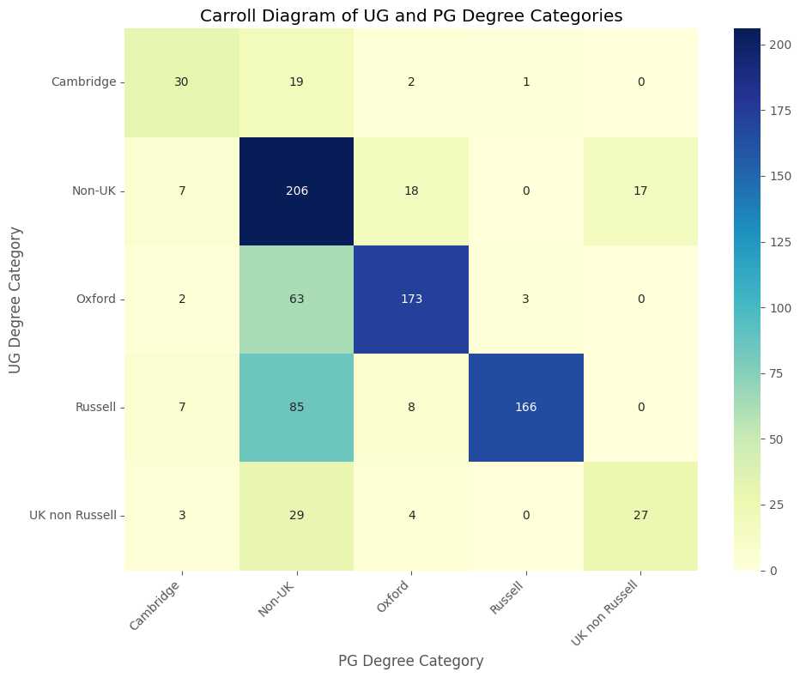

Slide 7
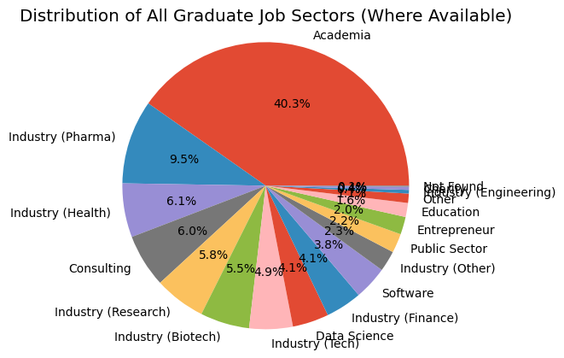
Jobs: titles and progression

Slide 8
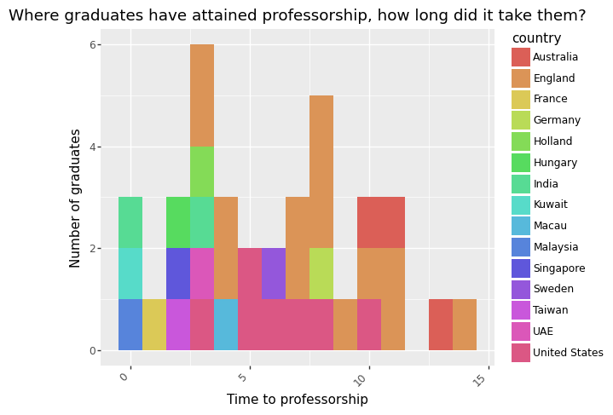

Slide 9
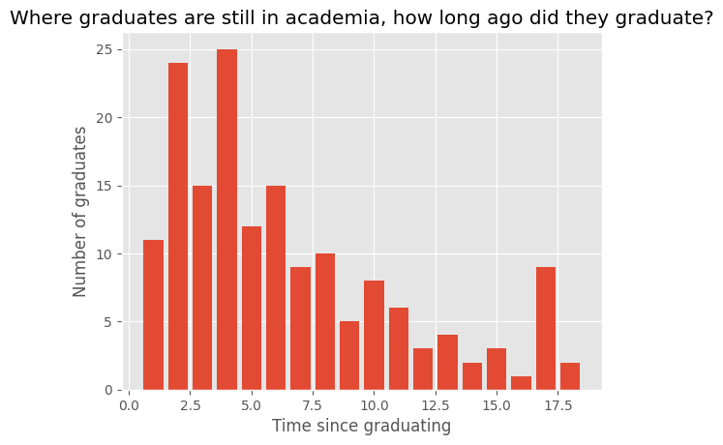

Slide 10
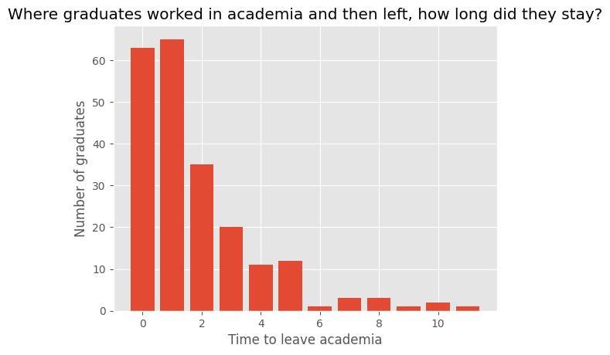

Slide 11
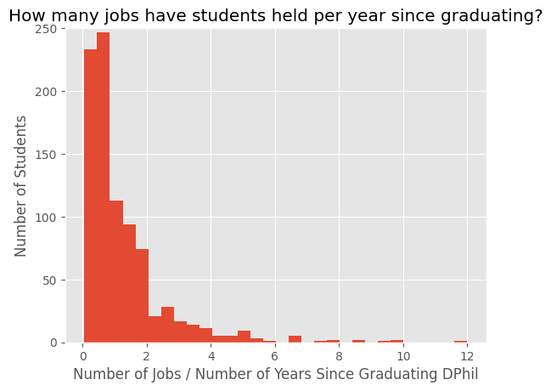

Slide 12
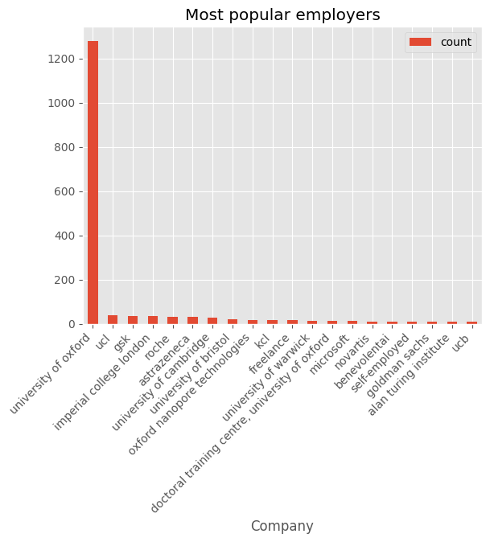
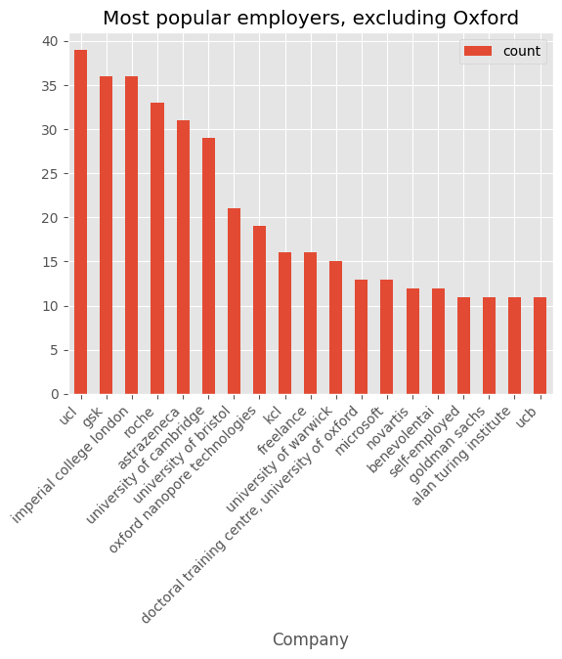

Slide 13
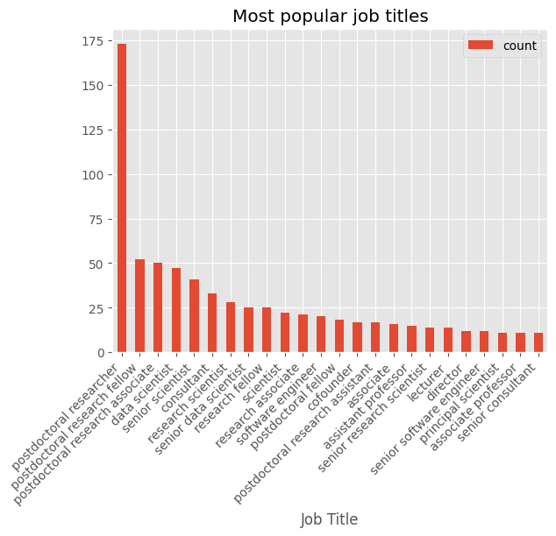

Slide 14
Papers…

Slide 15
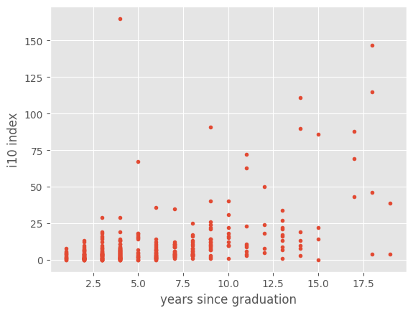

Slide 16
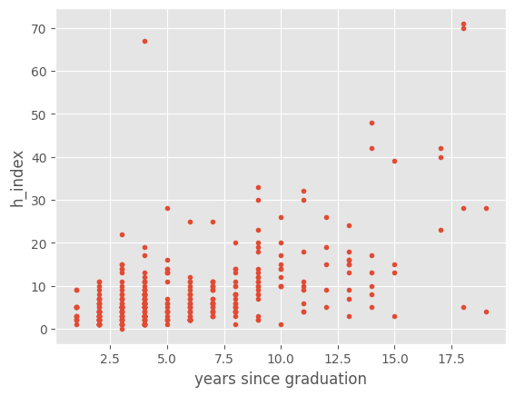

Slide 17
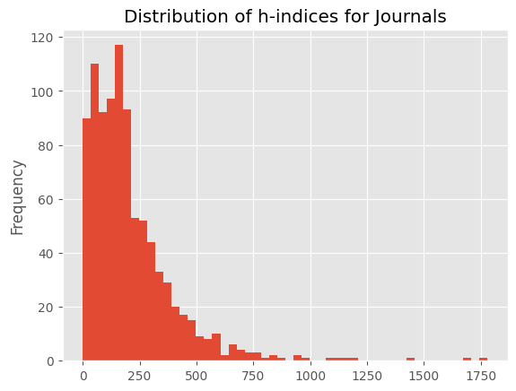

Slide 18
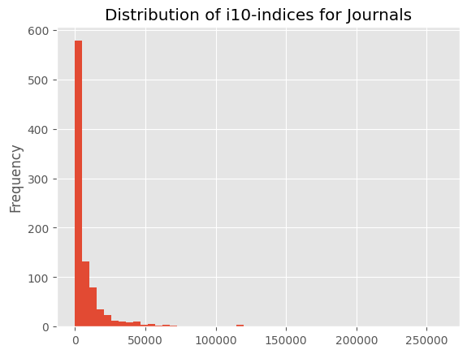

Slide 19
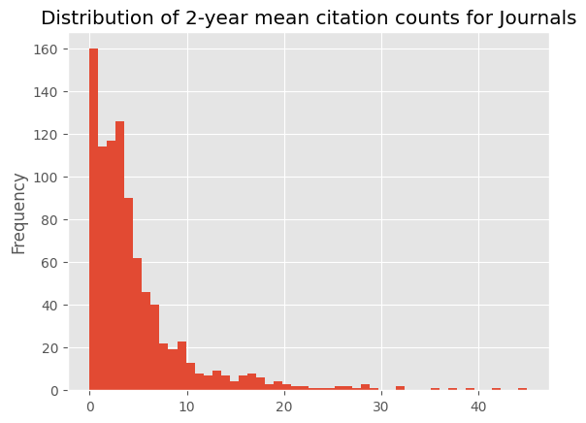

Slide 20
Papers…
Now available as runnable code!
Code is free and quick to run
Code is cleaned and commented: aim is to get it to a stage where someone will just have to press a button
Eoin claims IT form collects ORCID?
Hard to find comparison/benchmark/control datasets

Slide 21
Next
Case studies / Focus groups
Entrepreneurs
Pharma?
Dropouts?
Continue writing
What’s internally / externally relevant
Break down by department?

