Slide 1

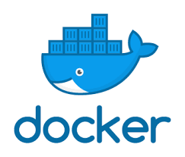


Python Web Development in Docker

Slide 2
Presenter
Moisés Gonçalves
Web Software Engineer
Python Enthusiast (Yes, I’m not python expert)
Docker Enthusiast (I have some docker understanding, but I love it)
Github
https://github.com/moises-pgoncalves
Linked In:
https://www.linkedin.com/in/moises-gon%C3%A7alves-5756342b/

Slide 3
Web Development
Easy to develop
Cross Environment Ready Applications
Easy to Develop

Slide 4
Docker
Docker Desktop is a tool for MacOS and Windows machines for the building and sharing of containerized applications and microservices.

Slide 5
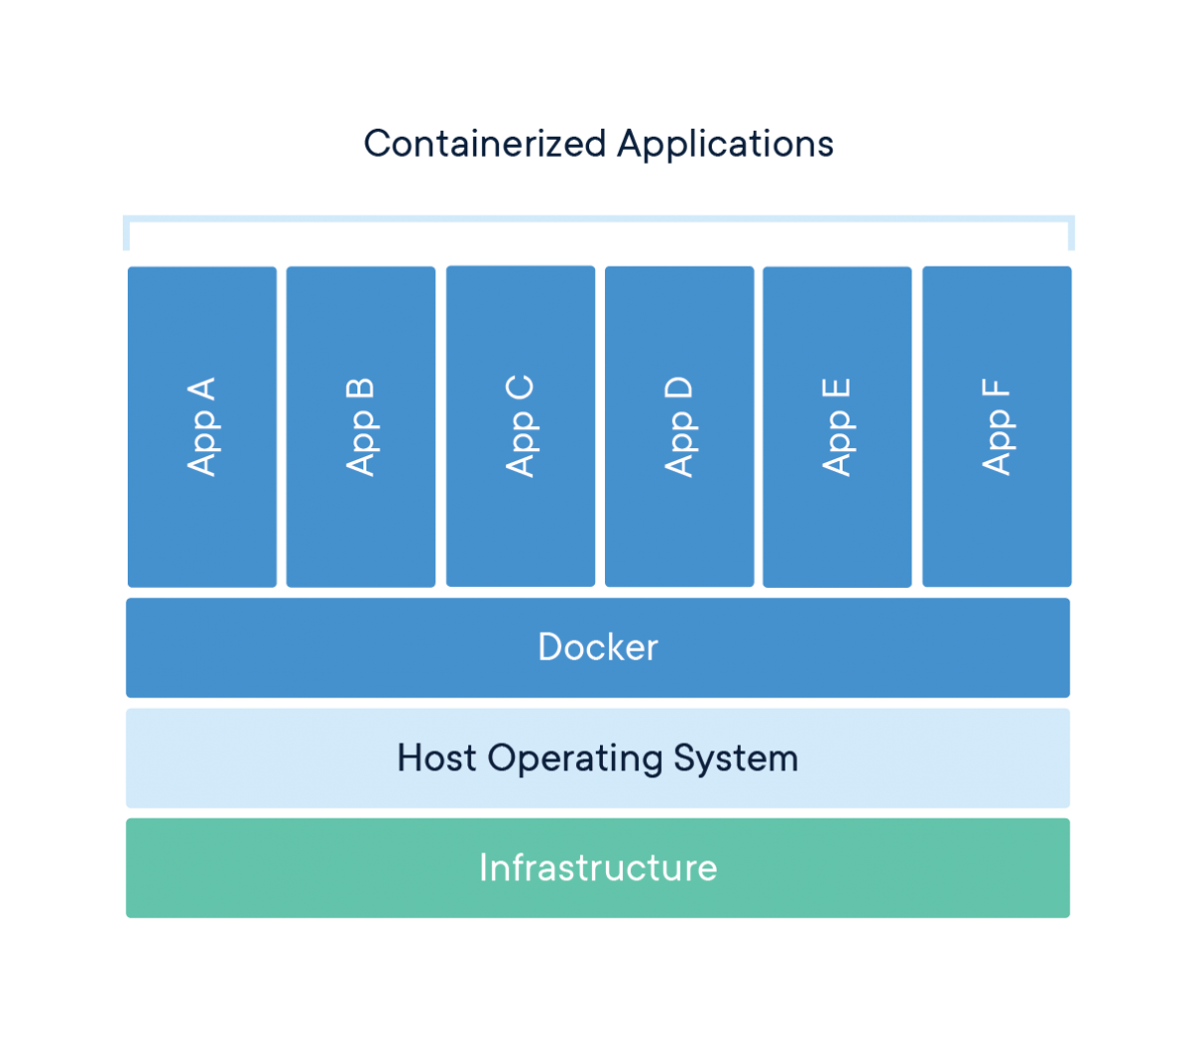
Docker

Slide 6
Docker Advantages
Decoupled Environment
Can run code in any supported platforms:
Windows
Linux
MacOS

Slide 7
Flask
Flask is a lightweight WSGI web application framework. It is designed to make getting started quick and easy, with the ability to scale up to complex applications. It began as a simple wrapper around Werkzeug and Jinja and has become one of the most popular Python web application frameworks.

Slide 8
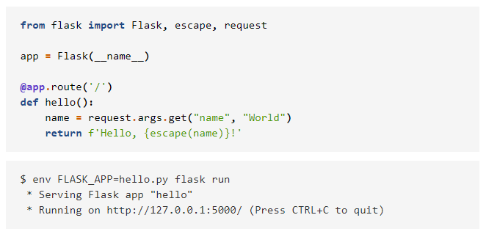
Flask
Easy to Develop

Slide 9
Flask
You can use local environment
We focus on Docker because we want:
Scale up
Share development across environments
Enable multi-environment team work together

Slide 10
Hands in Code
Lets do it…

Slide 11
Fork our repository
Public repository:
https://github.com/moises-pgoncalves/pythonweb
Contribute
Improve

