Slide 1
Optimal Aircraft Design Decisions Under Uncertainty via Robust Signomial Programming
Presented by Berk Ozturk
Joint work with Ali Saab

Slide 2
What to expect
A method that:
turns stochastic design optimization problems into deterministic ones.
solves sparse non-linear problems (1:1 variables/constraints ratio).
solves in <1s for a conceptual design problem with ̴300 variables.
provides probabilistic guarantees of constraint satisfaction.
Insights into:
why conceptual design is key to reducing program risk.
how to reduce design conservativeness when faced with uncertainty.
Notes:
Take a problem with uncert params, and protect against that uncert.
Ratio seen in engineering design
On a highly-laden laptop computer
Conservative Aerospace programs have high risk – large up-front costs and high sensitivity to params
How to make designs less conservative while protecting…

Slide 3
Motivating Conceptual Design under uncertainty
Notes:
Motivate first in aerospace field.

Slide 4
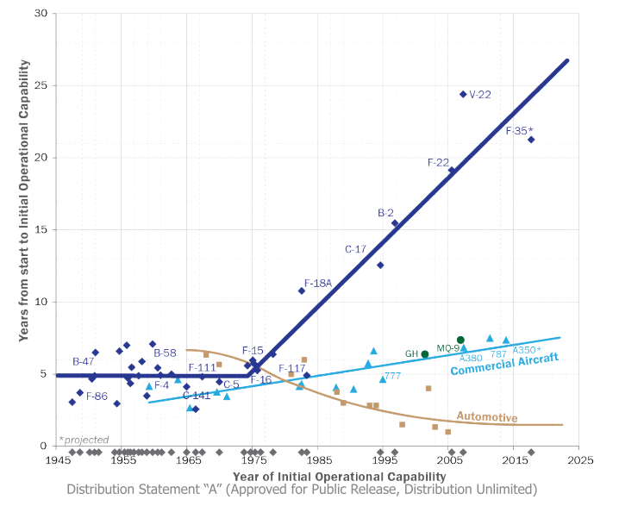
How can we tackle the schedule and cost overruns of aerospace programs?
Notes:
Start with observations and a value proposition.
Strong correlation between schedule and cost
Clearly not a complete picture…

Slide 5
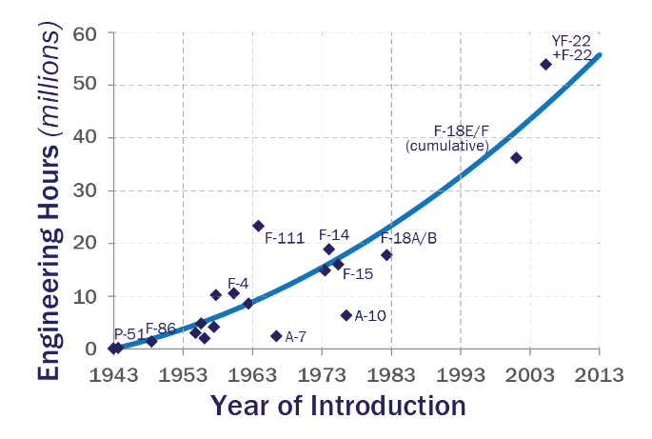
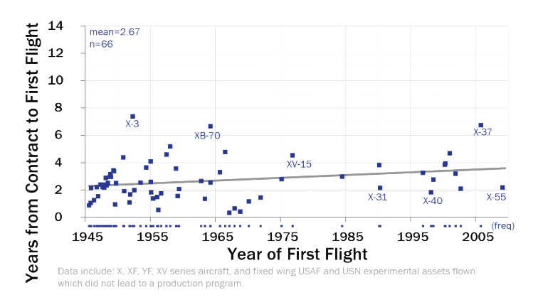

We are approaching the limits of the 2nd law of thermodynamics.
Conflicting evidence?
Notes:
Many arguments that can be made to explain overruns
Demand more capability
Is this conflicting evidence?

Slide 6
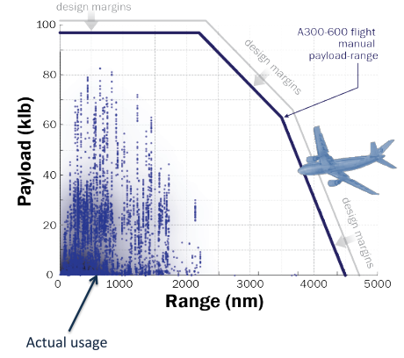
… but we are uncertain about what missions we design aircraft for.
Max zero-fuel weight
How about:
Technological capabilities?
Manufacturing quality?
Regulatory environment?
Max takeoff weight
Max fuel capacity
Notes:
It seems clear that …
Consider paylo-range.
DESIGN PROCESS
Designs are too conservative.
Consider other metrics
Overdesigning when we are uncertain about the environment aircraft are operating in.

Slide 7
Legacy methods are failing to adequately capture the risk/performance tradeoff.
Margins
Multimission design
Off-nominal ‘checking’
Not always intuitive.
No quantitative measures of reliability.
Heavy reliance on experienced engineers.
Too conservative!
There is no such thing as a free lunch!
Notes:
Margins – parameters design is sensitive to
Multimission design – missions under no uncert, finitely adaptive
Checking – post process
Intuitive – wing thickness, + or – margin?
No quantitative… - can’t tell the PoF as part of formulation
Experience – new configurations
Conservative – throw out novel designs because we can’t properly understand effect of uncertainty
Free lunch - economics

Slide 8
Optimization under uncertainty can dampen this trend!
Confidence in analysis tools will increase.
Design cycle time, cost, and risk will be reduced.
System performance will increase while ensuring reliability requirements are met.
Designs will be more robust.
We hope…
Notes:
Studies that show cost and schedule correlated through power law

Slide 9
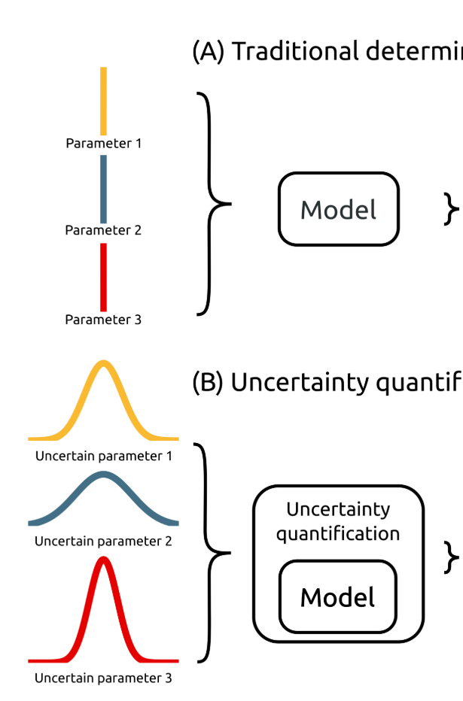
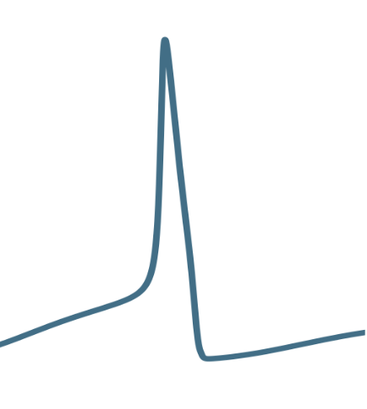
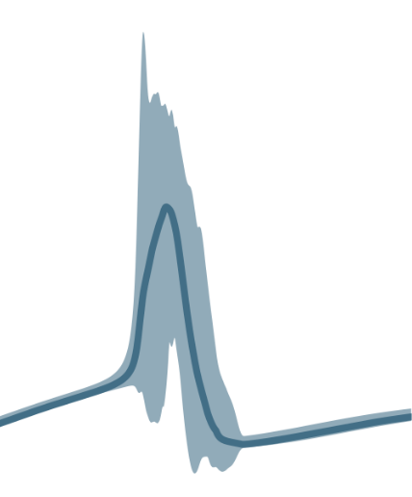
Stochastic optimization operates over PDFs.
The good:
Makes best use of available data.
Extremely general.
The bad:
Not deterministic.
Constraints are soft.
The ugly:
Combinatorics/computational cost of PDF propagation through NLPs.
Optimization ‘under certainty’
Model
Stochastic optimization
Model
*Adapted from: Tennøe, S., Halnes, G., and Einevoll, G. T., “Uncertainpy : A Python toolbox for uncertainty quantification and sensitivity analysis in computational neuroscience .,” 2018, pp. 1–52.
Objective space
Notes:
Two approach, first
Let’s think OUC first. Gradient descent. We sample curve to find local optimum.
Don’t know this performance curve
Propagate
Objective is some characteristic

Slide 10
Robust optimization operates over sets.
The good:
Conservative, with probabilistic guarantees.
Tractable.
The bad:
Doesn’t make full use of distributional information.
Optimizes worst case.
The ugly:
Requires specific formulations (LP, QCQP, SDP, GP, SP).
Optimization ‘under certainty’
Model
u₁
Robust optimization model
u₂
u₃
u ϵ U,
eg. |u| ≤ Γ
Objective space
Notes:
Types of sets (norms, inf, 1, 2, polyhedral)

Slide 11
Mathematical background
Notes:
I will stop boring you.
Principles of robust optimization with methods for nonlinear optimization

Slide 12
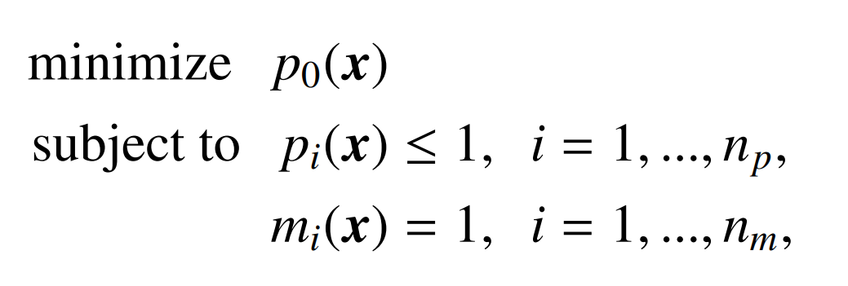
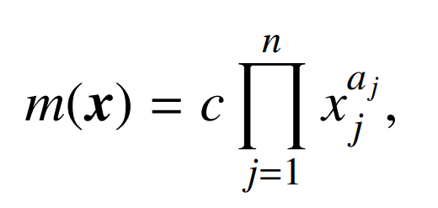
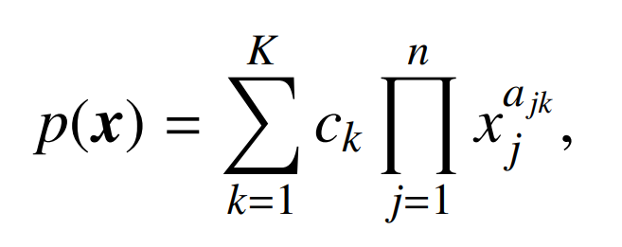
Geometric programming (GP) is accurate and practical to solve general NLPs
Advantages:
Ability to capture real-world complexity
Solution speed
Global optimality
Sensitivities
Disadvantages:
Stringent formulation
Explicit constraints
Notes:
Predecessors have motivated GP
Balance of complexity and efficiency for conceptual design
General optimization formulation with monomials and posynomial
Somewhat restrictive form of optimization to obtain a balance of complexity and efficiency.
Advantages of the formulation are derived from convexity

Slide 13
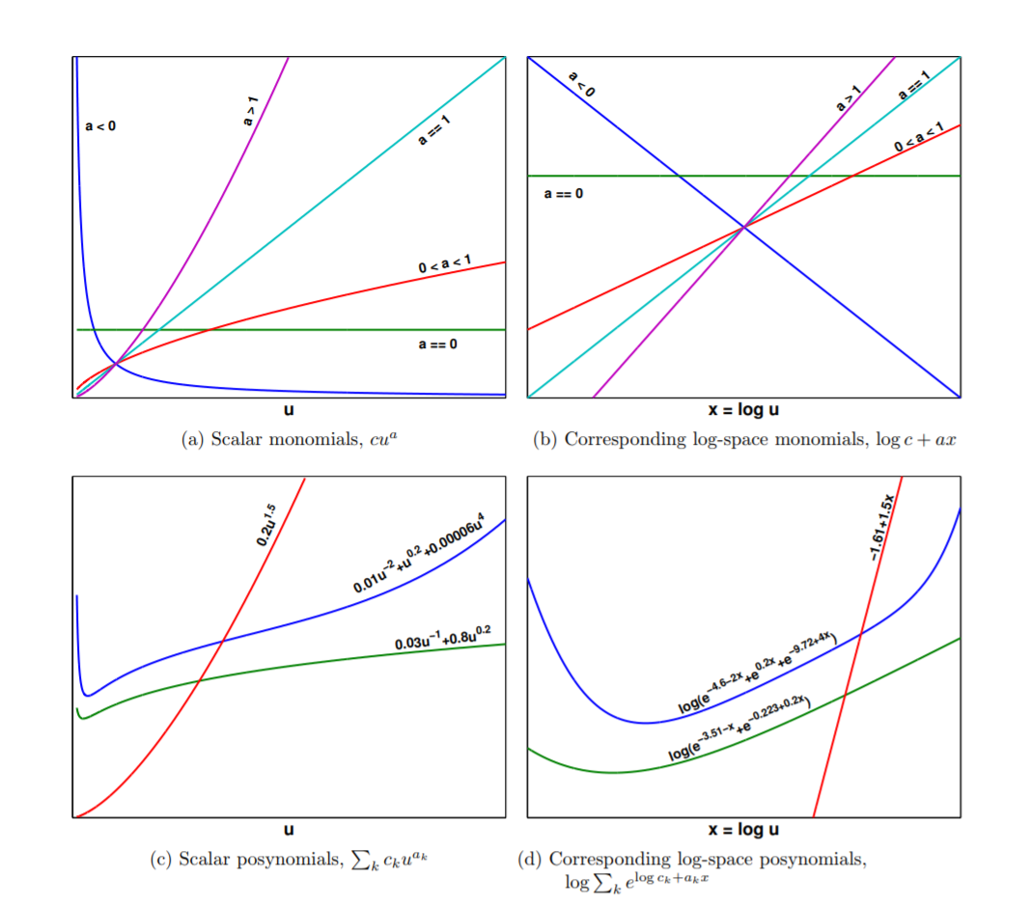
Log-log transformation to turn NLP into convex problem
Primal
form monomial
Exponential form monomial
Primal
form posynomial
Exponential form posynomial
*Hoburg, 2013. Aircraft Design Optimization as a Geometric Program
Notes:
Convexity easily seen. Magic of log-log transformation
We use the principle of duality to transform a non-linear, non-convex problem into a non-linear convex problem, solved efficiently using modern interior-point solvers.
Single variable monomials and posynomials (one decision variable)
Primal clearly nonconvex and non-linear
Log-affine log convex
Epigraph of the graph of posynomials is feasible set
(2min)

Slide 14
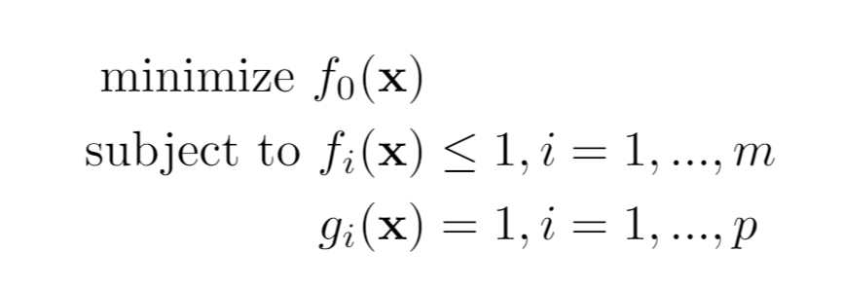
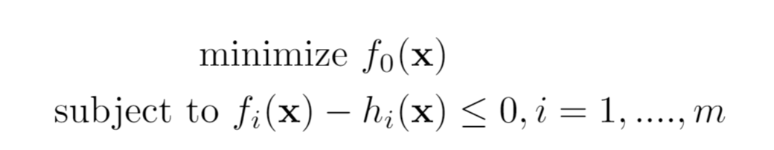

Signomial Programs are more general.
Geometric program (GP):
Log-convex
Globally optimal
No initial guesses
Solved as an exponential cone program.
Signomial program (SP):
Non-log-convex (difference of convex)
Guaranteed to be feasible, but locally optimal
Solves with initial vector of 1’s
Solved as sequential GPs
Formulated in:
Notes:
Exponential cone program: since log-sum-exp f’ns +var transformations
Interior pt. programs scale sublinearly

Slide 15
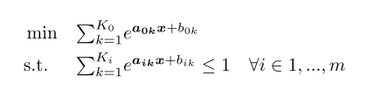
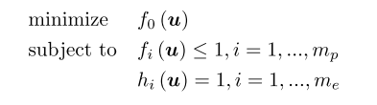





Exponential form of GP
Notes:
Introduce useful nomenclature
Mony and posys
Equalities written as two ineqs
Apply log, and we are convex

Slide 16
The robust counterpart transforms OUU to deterministic optimization problem.
Optimization over:
Infinite number of constraints
Finite number of constraints
A well-defined set
Notes:
Want to merge this framework with…
Number of mathematical moves to convert nominal to RO.
Now that we have found a representation, what is next?
Why is this different than margins?

Slide 17
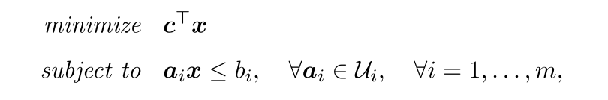
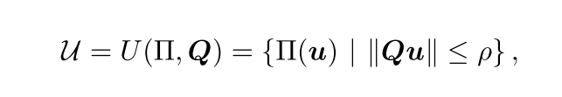
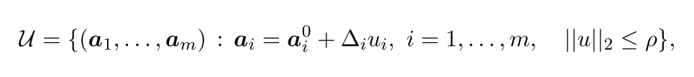
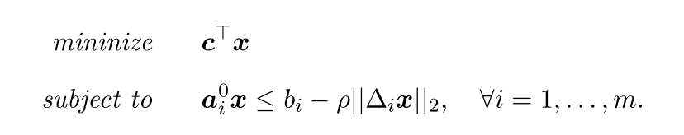
LPs have tractable robust counterparts.
I tip my hat to the editor!
Robust counterpart
An SOCP!
Notes:
As an example. LPs, seminal paper by…
Context: Soyster 1974
Pi(u) is an affine embedding of L uncertain parameters into m constraints
Intuition for SOCP: max over linear ineqs is optimization over QCs.
We are all mortal, even seminal papers can have typos.

Slide 18
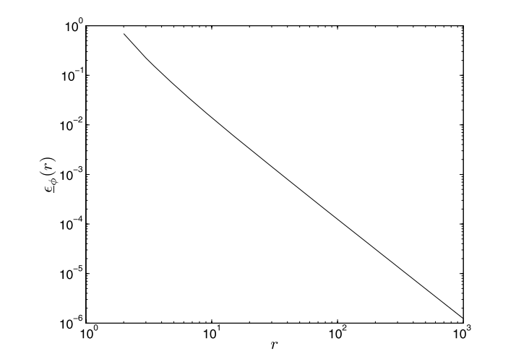
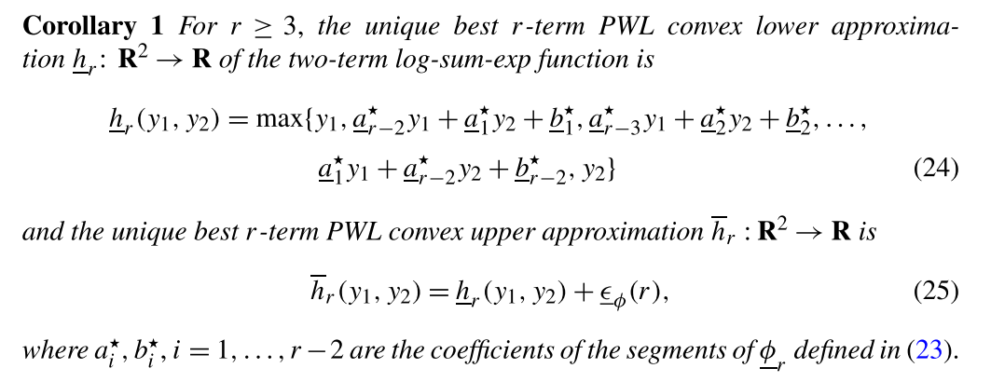
GPs are LP-approximable.
Approximation error vs. degree of PWL approximation r.
Hsiung, K. L., Kim, S. J., and Boyd, S., “Tractable approximate robust geometric programming,” Optimization and Engineering, vol. 9, 2008, pp. 95–118.
Notes:
Use principles from BTandN to form robust approximations of GPs.
Deep mathematics I don’t understand…
Epsilon is max error, phi is the t
Each nonlinear constraint, which is convex in log-space, gets PWL approximation

Slide 19
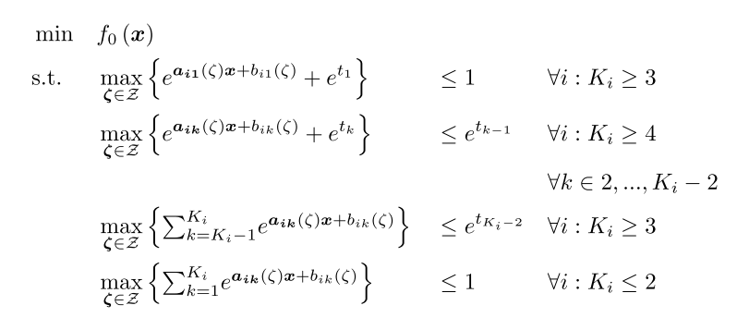
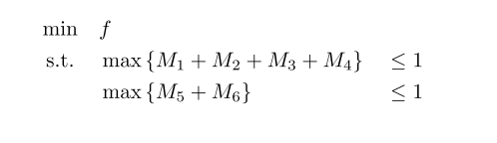
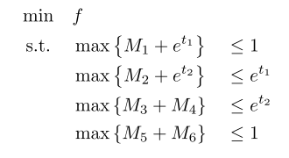
All posynomials must then be LP-approximable.
The recipe:
Simple example:
Saab, A., Burnell, E., and Hoburg, W. W., “Robust Designs Via Geometric Programming.” 2018. ArXiv:1808.07192
Notes:
By the optimal two term approximation, each posynomial must be LP-approx.
Recipe looks complicated, it’s just ‘chaining’ two term posynomials.

Slide 20
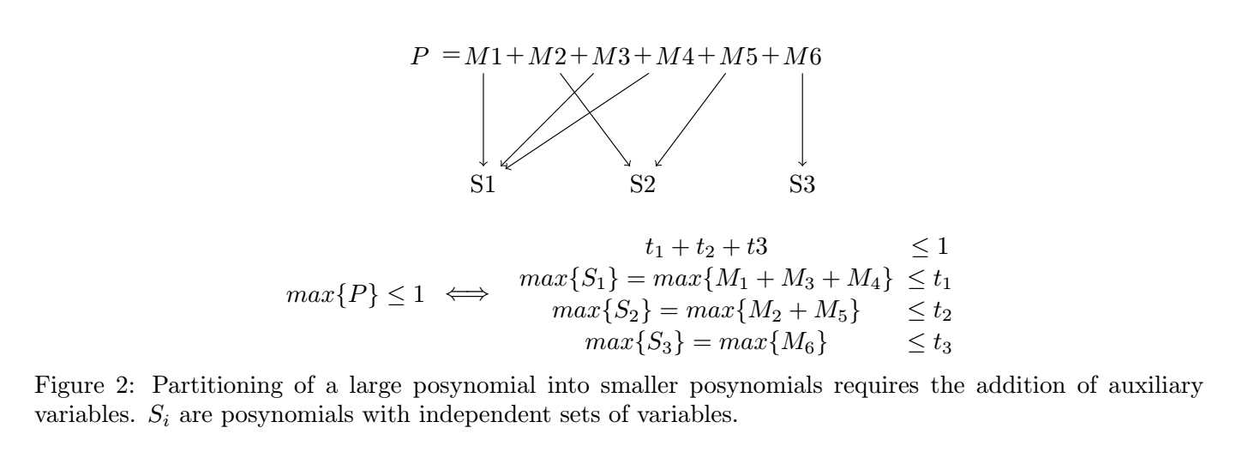
Uncoupled posynomials are robustified separately.
Notes:
Treat uncoupled posynomials separately.
Robustifying s2, s3 easy.
S1 requires previous recipe.

Slide 21
Three approximations exist for RGP.
Simple conservative
Maximizes each monomial term separately
Linearized perturbations
Separates large posynomial into decoupled posynomials
Robustifies smaller posy’s using RLO techniques
Best pairs
Separates large posynomial into decoupled posynomials
Finds least conservative combination of monomial pairs
Uncertain coefficients only
Increasingly
conservative
Uncertain coefficients
and exponents
Saab, A., Burnell, E., and Hoburg, W. W., “Robust Designs Via Geometric Programming.” 2018. ArXiv:1808.07192
Notes:
Best pairs is against some mathematical magic. Please

Slide 22
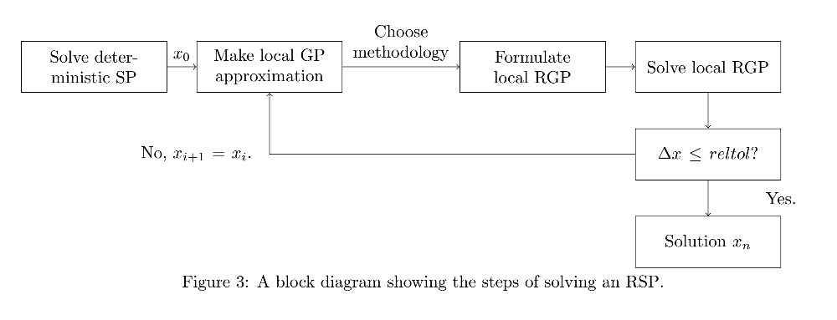
We add a GP robustification block into SP solution heuristic.
Notes:
Solving an robustified GP no different than solving GP with more constraints

Slide 23
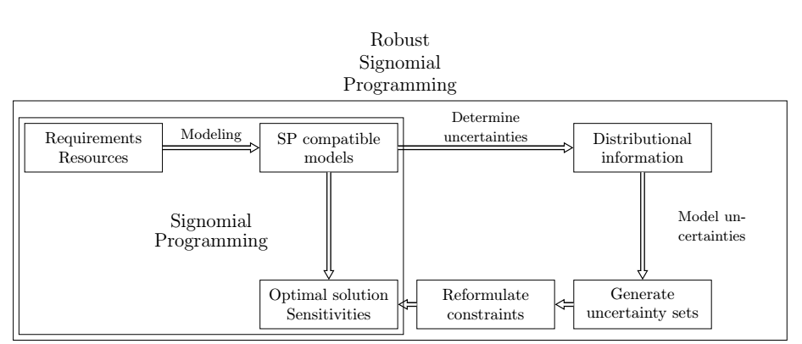
RSP formulations exist for all SP-compatible problems.
Notes:
General

Slide 24
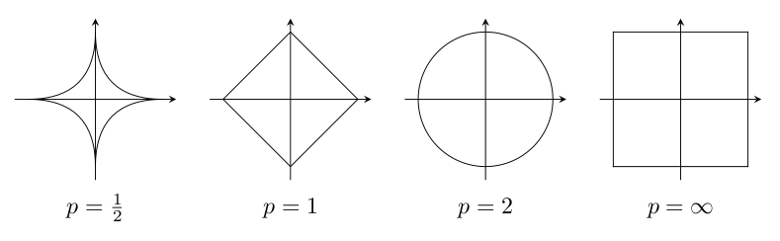
Uncertainty sets considered
Box (L-∞ norm)
Elliptical (L-∞ norm)
Good surrogate for use of margins.
A less conservative candidate!
Margins optimize on a corner of the hypercube!
Other norms also valid.
Notes:
2d-rep
In a way, margins are unintuitive. Should we have positive
or negative margin on wing thickness?
Elliptical makes sense, corners

Slide 25
Applying RO to Conceptual UAV problem

Slide 26
SP model captures important multidisciplinary tradeoffs.
Unmanned, gas-powered aircraft
Without uncertainty: 176 variables and 154 constraints
Monolithic: optimizes aircraft and flight trajectory concurrently through disciplined SP form
Wing
Structure
Fuel volume
Profile drag
Stall constraint
Fuselage
Ellipsoidal
Fuel and payload
Profile drag
Engine
Data-based sizing
Lapse rate
BSFC fits
T/O and TOC constraints

Slide 27
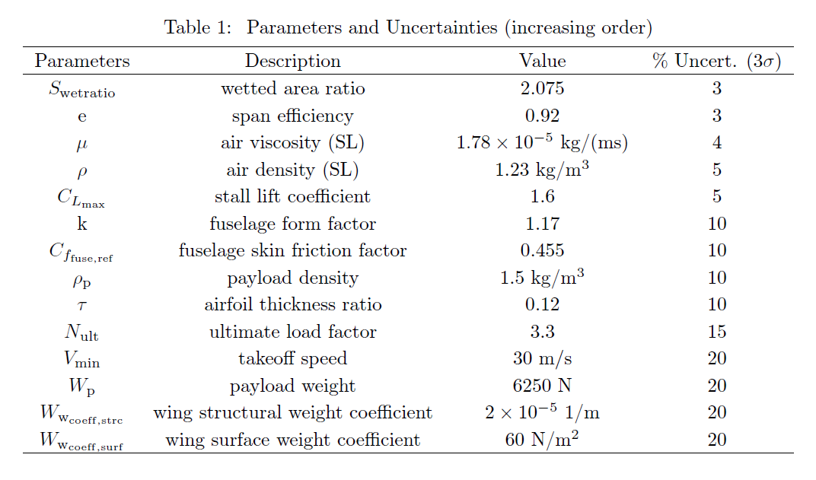
Uncertainties reflect ‘engineering intuition’.
Notes:
3sigma – 3CV
Build quality -> high
Payload weight and density -> medium, developed concurrently
Physical constants -> low
Require testing -> expected variance of empirical studies
NOTE engineering knowledge required.

Slide 28
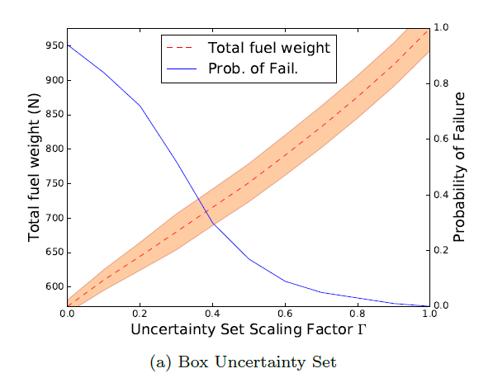
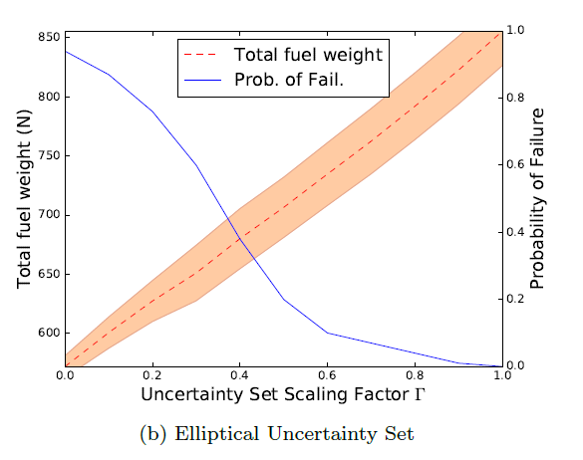
RSP successfully mitigates probability of failure.
For Γ = 1, the elliptical design spends 14% less fuel than the box design (margins), while protecting against the same uncertainty!
Notes:
Prob of failure = constraint violation.
100 samples for MC simulation, truncated 3sigma Gaussaisn
Mean and standard deviation of performance

Slide 29
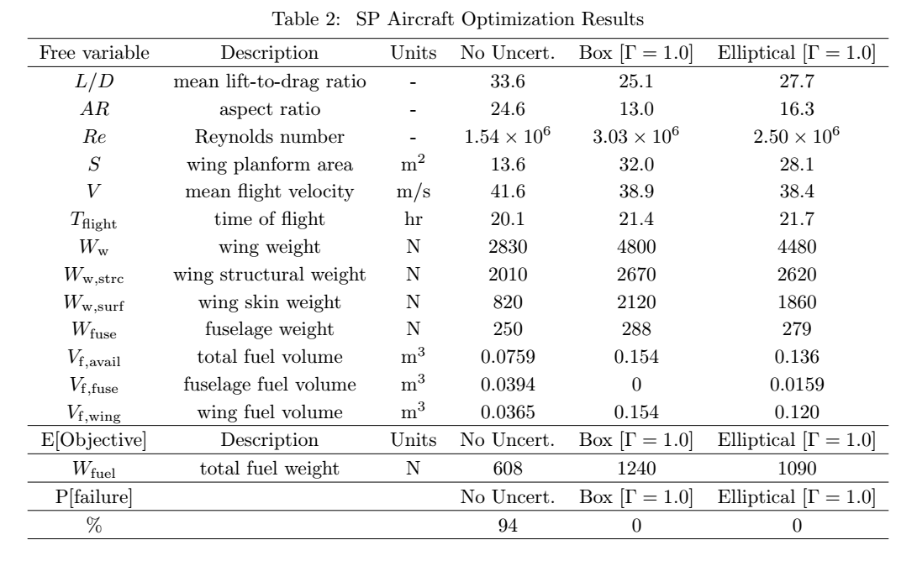
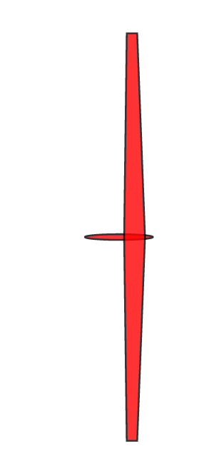
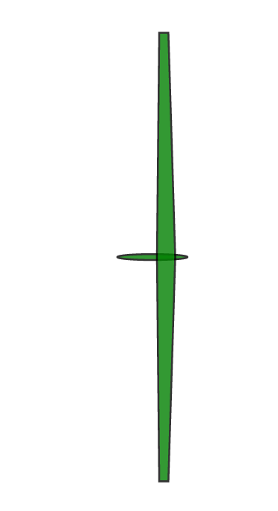
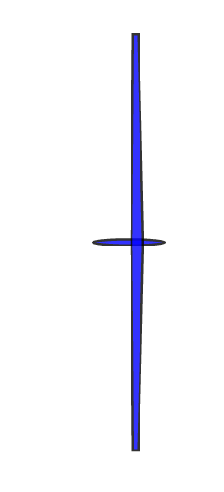

Slide 30
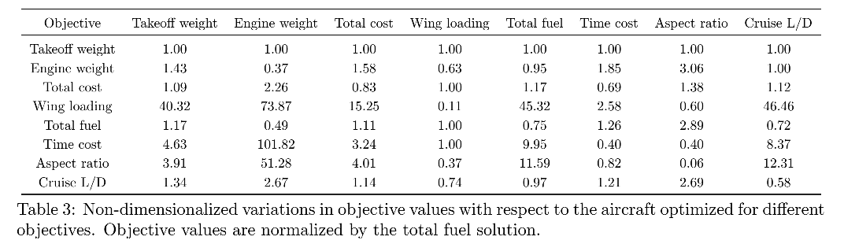
Convex programs allow flexibility in objectives.
Notes:
Highlight importance of considering multiple objectives
Look at two specific things
Aspect ratio (unintuitive)
Fuel and time cost: interesting correlations but also differences
Wing loading are the same. Why does this occur?

Slide 31
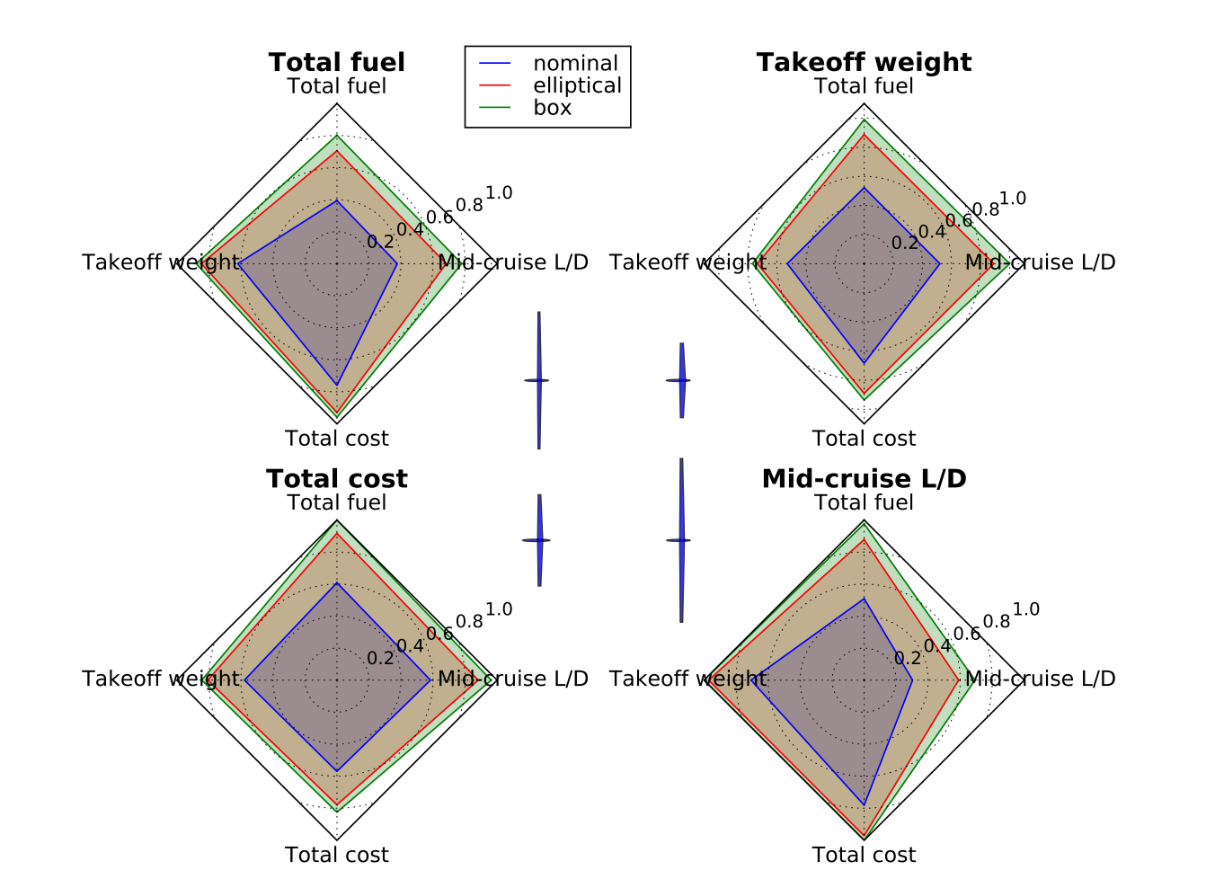
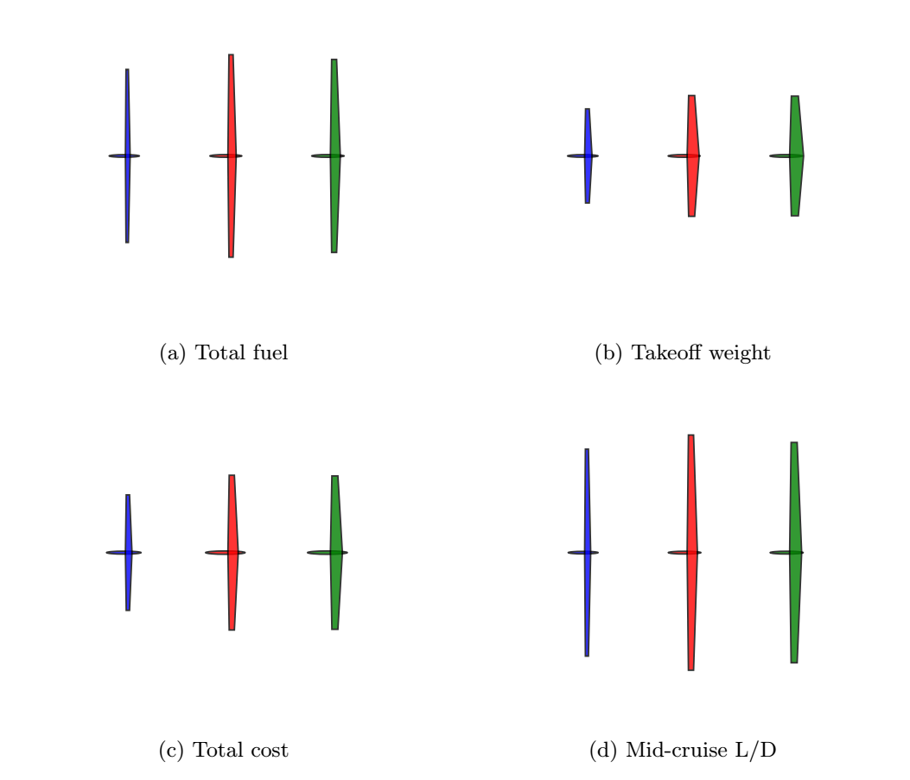
Considering correlated objectives
Notes:
Relative convergence of designs to each other.

Slide 32
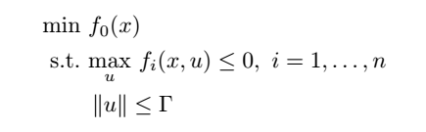
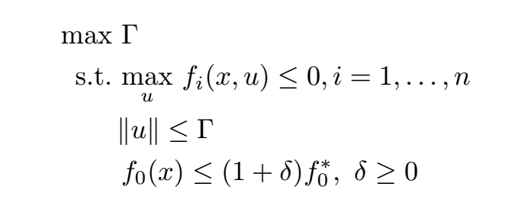
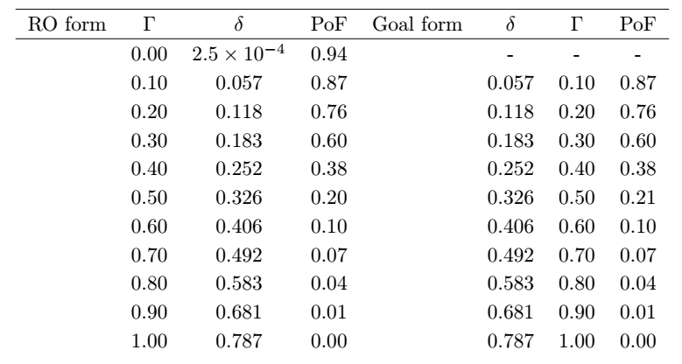
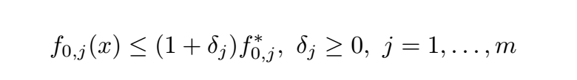
Goal programming: risk is a global design objective.
Standard RO form
Goal programming form
Suggests a good formulation for multi-objective design space exploration:
Notes:
MO makes my skin crawl.
Max gamma worsens objective

Slide 33
Contributions
A tractable RSP formulation for design over uncertain parameters
Demonstration of
Probabilistic guarantees of RSPs
Less conservative designs through RSP than legacy methods
A goal programming formulation for multiobjective optimization
New opportunities in aerospace conceptual design through RO

Slide 34
Future work
How do we use our understanding of the risk of constraint violation?
Not all constraint violation is equal!
How does one restrict the power of nature conservatively?
How does RO change our understanding of the benefits of adaptable designs?
(eg. modular, morphing, adaptively manufactured designs and design families)
How can we gather data about parameters to best reduce uncertainty in feasibility/performance of designs?

Slide 35
Back-up slides

Slide 36
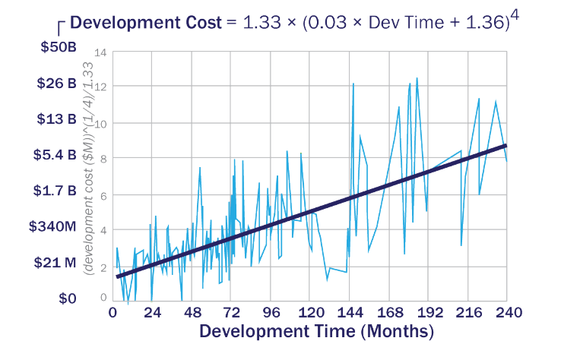
Cost and schedule are highly correlated.

