Slide 1
Optimal Aircraft Design Decisions Under Uncertainty via Robust Signomial Programming
Presented by Berk Ozturk
Joint work with Ali Saab
Notes:
Polling
CFD?
UQ?
Optimization?
Conceptual Design?
This is going to have a different flavor, I hope you like it.
(20s)

Slide 2
What to expect
A method that:
turns stochastic design optimization problems into deterministic ones.
solves sparse non-linear problems (1:1 variables/constraints ratio).
solves in <1s for a conceptual design problem with ̴150 variables.
has sub-linear solution time with number of variables.
provides probabilistic guarantees of constraint satisfaction.
Insights into:
why conceptual design is key to reducing program risk.
how to reduce design conservativeness when faced with uncertainty.
Notes:
Take a problem with uncert params, and protect against that uncert deterministically
Ratio seen in engineering design
On a highly-laden laptop computer
Sublinear – much better than other OUU, polynomial at best
Talk a lot about design as well as math Aerospace programs have high risk – large up-front costs and high sensitivity to params
How to make designs less conservative while protecting…
(90s)

Slide 3
Motivating Conceptual Design under uncertainty
Notes:
Motivate first in aerospace field.
I know a lot of you will say, it is obvious, but I’m going to provide some concrete examples anyways.
(10s)

Slide 4
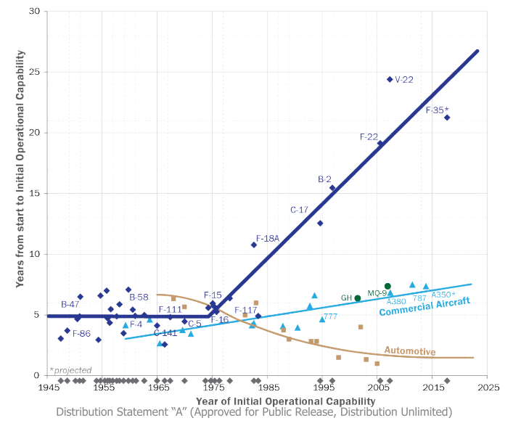

How can we tackle the schedule and cost explosion of aerospace programs?
Notes:
Start with observations and a value proposition.
Describe graph…
Strong power-law correlation between schedule and cost
Why do patterns look different?
Evolutionary design, C and A more commercial pull
Clearly not a complete picture…

Slide 5
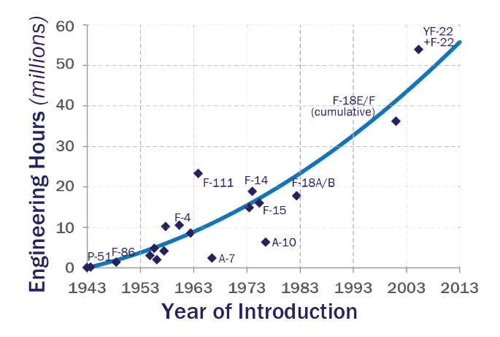
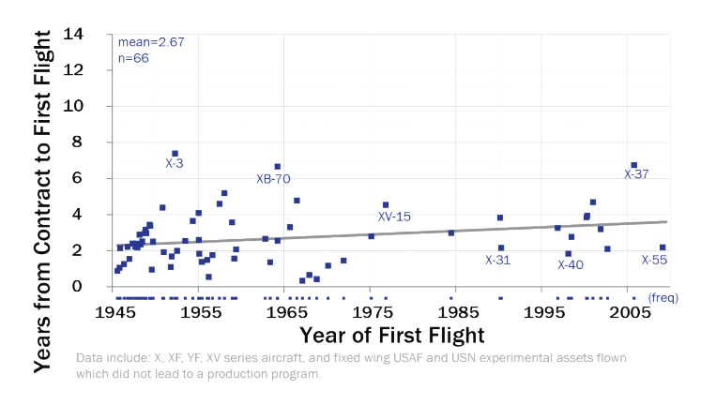
We are approaching the limits of the 2nd law of thermodynamics.
Conflicting evidence?
Notes:
Many arguments that can be made to explain overruns
Let’s look specifically at military aircraft
Naïve view says that the graph on left demonstrates this
Demand more capability
Is this conflicting evidence?
It seems we can get demonstrators out fast, but we are getting choked in a later stage.
And it sure seems like computation is not helping.
Capabilities have gone up, and design time has only increased.

Slide 6
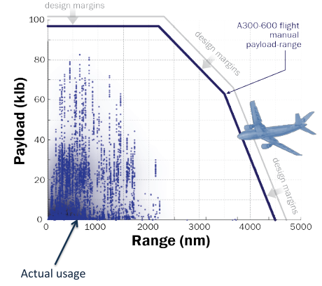
… but we are uncertain about what missions we design aircraft for.
Max zero-fuel weight
How about:
Technological capabilities?
Manufacturing quality?
Regulatory environment?
Max takeoff weight
Max fuel capacity
Notes:
I argue that uncertainty has a key role to play.
Consider paylo-range.
DESIGN PROCESS
Why was the aircraft designed for the envelope?
In presence of uncertainty, we add margins so we are conservative.
Consider other metrics
Overdesigning when we are uncertain about the environment aircraft are operating in.
Primary reason for cost growth is that we chase a moving target when it comes to uncertainty
The more uncertainty, the more overdesign, the longer the time horizon,
the more the uncertainty, the longer the time to design and so on.
We need to break this trend.

Slide 7
Legacy methods are failing to adequately capture the risk/performance tradeoff.
Margins
Multimission design
Off-nominal ‘checking’
Not always intuitive.
No quantitative measures of reliability.
Heavy reliance on experienced engineers.
Too conservative!
There is no such thing as a free lunch!
Notes:
Margins – parameters design is sensitive to
Multimission design – missions under no uncert, finitely adaptive
Checking – post process
Intuitive – wing thickness, + or – margin?
No quantitative… - can’t tell the PoF as part of formulation
Experience – new configurations
Conservative – throw out novel designs because we can’t properly understand effect of uncertainty
Free lunch - economics

Slide 8
Optimization under uncertainty can dampen this trend!
Confidence in analysis tools will increase.
Design cycle time, cost, and risk will be reduced.
System performance will increase while ensuring reliability requirements are met.
Designs will be more robust.
We hope…
Notes:
Confidence… – low update, heavy reliance on legacy. If we know tools can handle uncert better.
Design… - Reducing sensitivitity of designs to uncertain outcoes
System… - Better understanding of tradeoff risk performance. Less conservative designs
Designs… - less sensitive to off-nominal conditions.

Slide 9
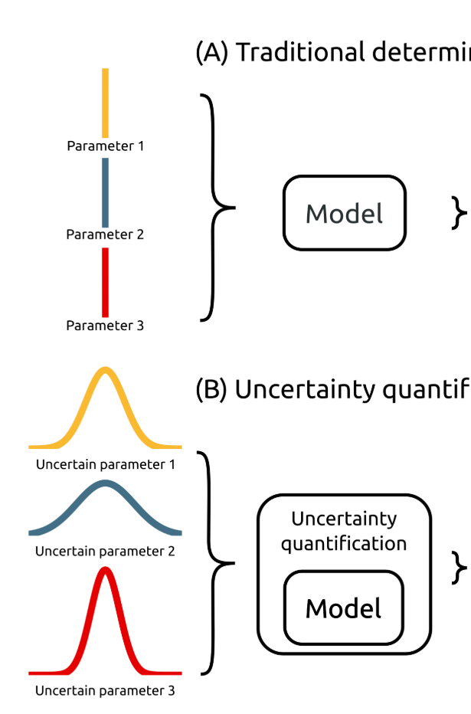
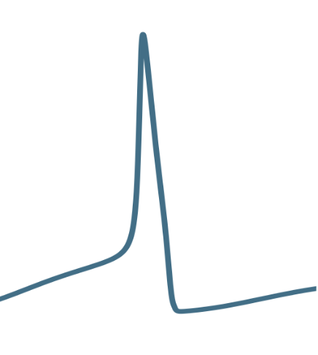
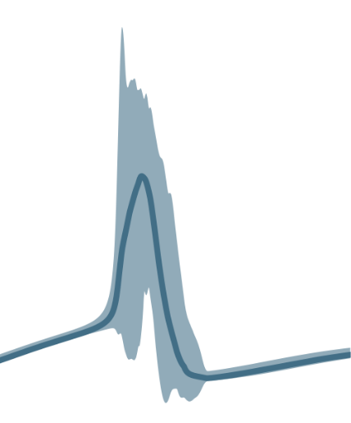
Stochastic optimization operates over PDFs.
The good:
Makes best use of available data.
Extremely general.
The bad:
Not deterministic.
Not conservative.
The ugly:
Combinatorics/computational cost of PDF propagation through NLPs.
Optimization ‘under certainty’
Model
Stochastic optimization
Model
*Adapted from: Tennøe, S., Halnes, G., and Einevoll, G. T., “Uncertainpy : A Python toolbox for uncertainty quantification and sensitivity analysis in computational neuroscience .,” 2018, pp. 1–52.
Objective space
Notes:
Two approach, first
Let’s think OUC first. Gradient descent. We sample curve to find local optimum.
Don’t know this performance curve
Objective is some characteristic
Propagation requires integration of pdfs with potential outcomes
HD quadrature and discretization into scenarios

Slide 10
Robust optimization operates over sets.
The good:
Conservative, with probabilistic guarantees.
Tractable.
The bad:
Doesn’t make full use of distributional information.
Optimizes worst case.
The (beautiful) and ugly:
Requires specific formulations (LP, QCQP, SDP, GP, SP).
Optimization ‘under certainty’
Model
u₁
Robust optimization model
u₂
u₃
u ϵ U,
eg. |u| ≤ Γ
*Adapted from: Tennøe, S., Halnes, G., and Einevoll, G. T., “Uncertainpy : A Python toolbox for uncertainty quantification and sensitivity analysis in computational neuroscience .,” 2018, pp. 1–52.
Objective space
Notes:
Robust optimization (mathematical programming)
Different contexts: optimization over uncertainty sets, worst case
Types of sets (norms, inf, 1, 2, polyhedral)
Bounded support
This is beautiful because many engineering design problems

Slide 11
Mathematical background
Notes:
I will stop boring you.
Principles of robust optimization with methods for nonlinear optimization

Slide 12
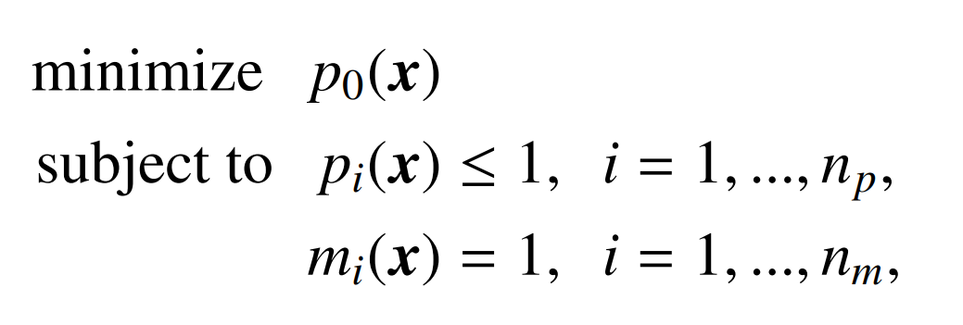
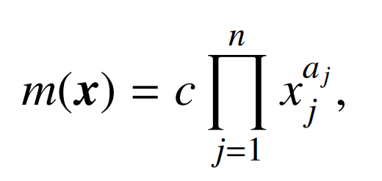
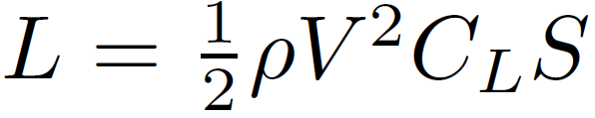
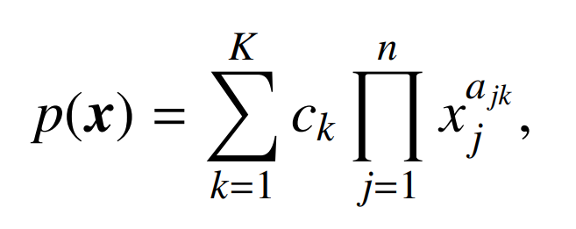

Geometric programming (GP) is accurate and practical to solve general NLPs
Advantages:
Ability to capture real-world complexity
Solution speed
Global optimality
Sensitivities
Disadvantages:
Stringent formulation
Explicit constraints
eg.
Notes:
Predecessors have motivated GP
Balance of complexity and efficiency for conceptual design
General optimization formulation with monomials and posynomial
Somewhat restrictive form of optimization to obtain a balance of complexity and efficiency.
Advantages of the formulation are derived from convexity

Slide 13
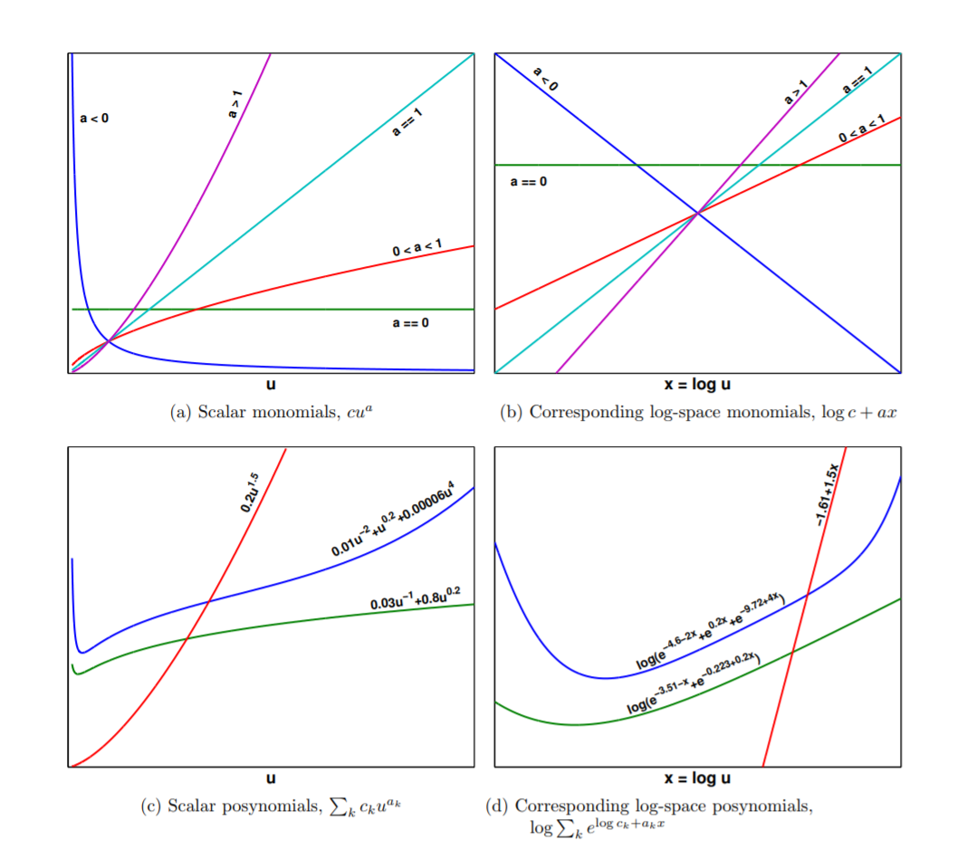
Log-log transformation to turn NLP into convex problem
Primal
form monomial
Exponential form monomial
Primal
form posynomial
Exponential form posynomial
*Hoburg, 2013. Aircraft Design Optimization as a Geometric Program
Notes:
Convexity easily seen. Magic of log-log transformation
We use the principle of duality to transform a non-linear, non-convex problem into a non-linear convex problem, solved efficiently using modern interior-point solvers.
Single variable monomials and posynomials (one decision variable)
Primal clearly nonconvex and non-linear
Log-affine log convex
Epigraph of the graph of posynomials is feasible set
(2min)

Slide 14
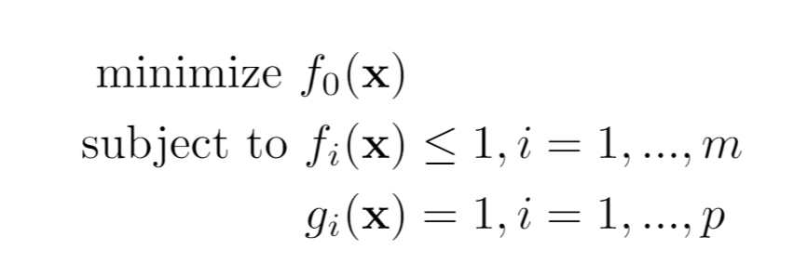
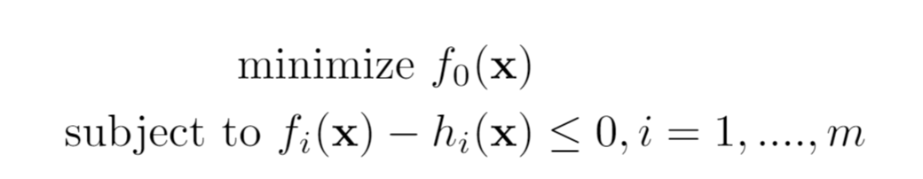

Signomial Programs are more general.
Geometric program (GP):
Log-convex
Globally optimal
No initial guesses
Solved as exponential cone program.
Signomial program (SP):
Non-log-convex (difference of convex)
Solved as sequential GPs
Solves with initial vector of 1’s
Locally optimal
Formulated in:
Notes:
Exponential cone program: since log-sum-exp f’ns +var transformations
Interior pt. programs scale sublinearly

Slide 15
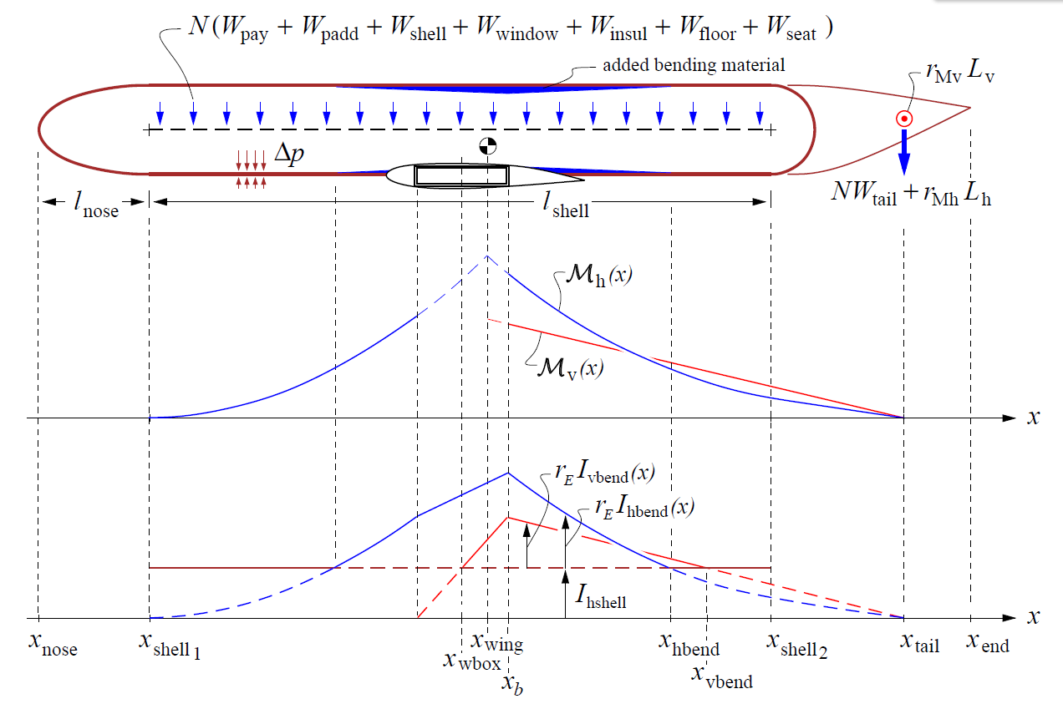
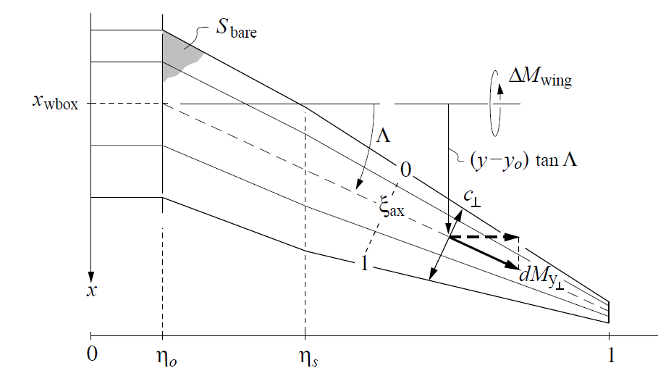
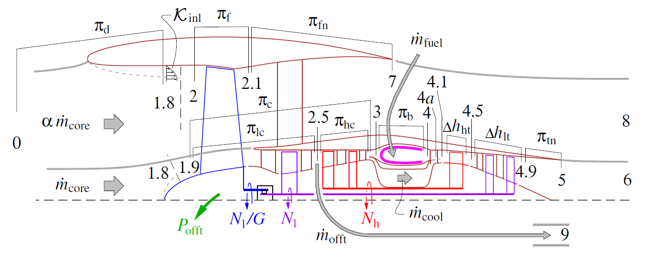
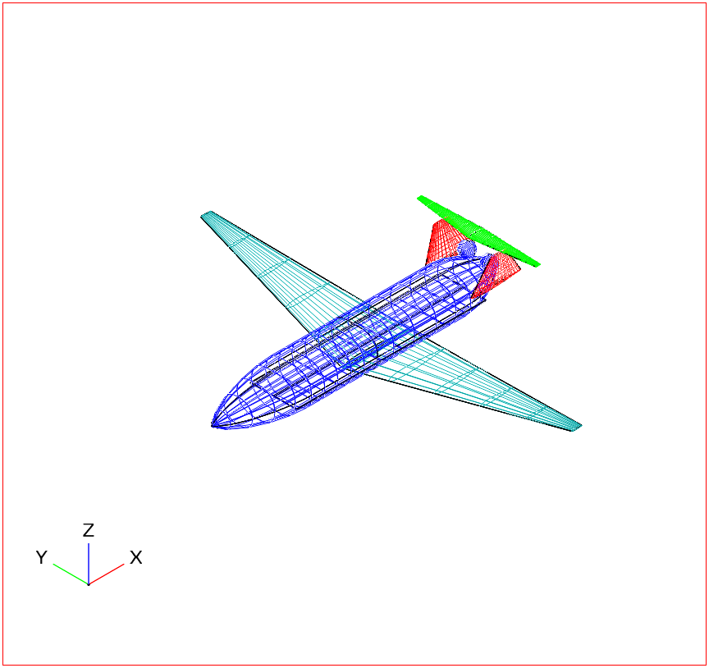
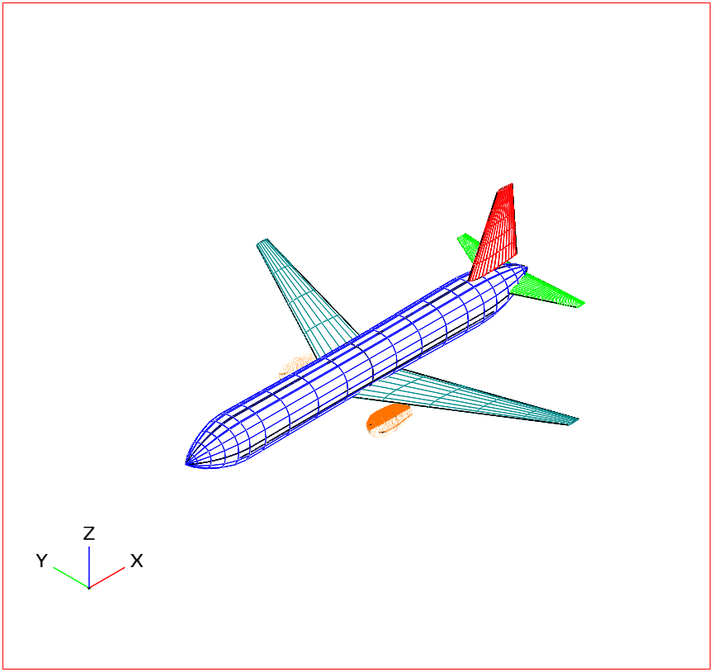
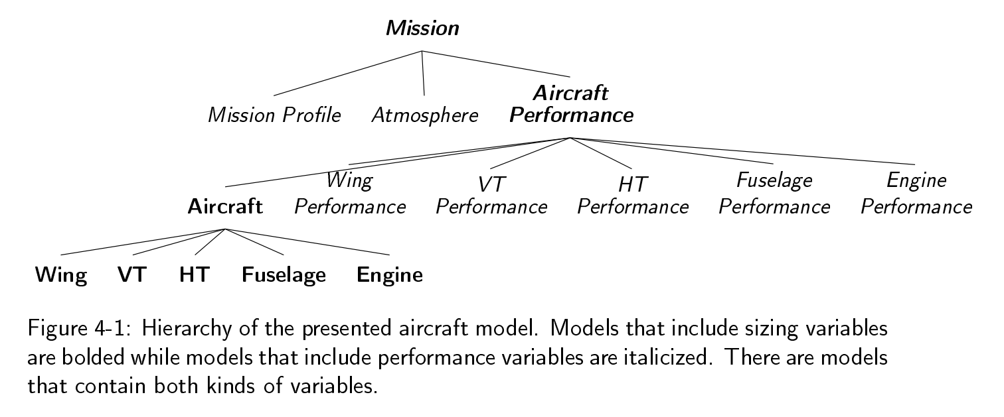
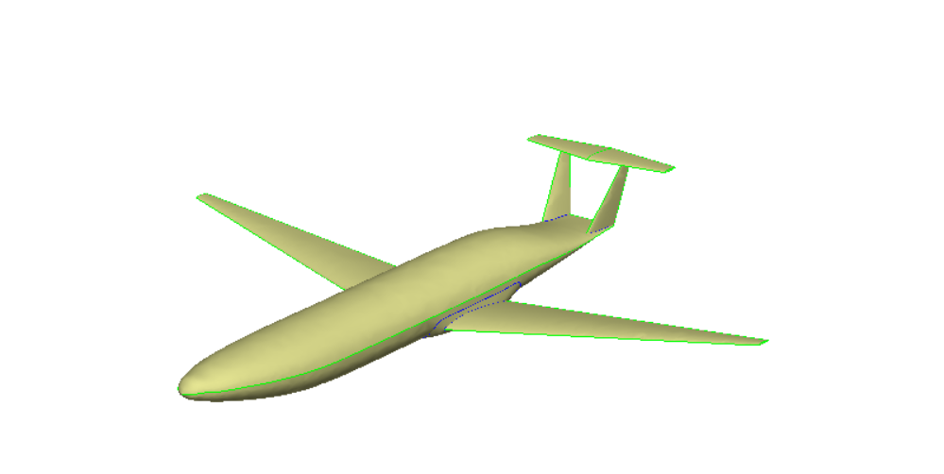
SPs can be extremely complex (TASOPT).
Commercial aircraft model of similar fidelity to TASOPT (5000 variables).
Built on configuration hierarchies
Multi-point design
Visual debugging of constraints
ESP integration for potential HF simulations?
+3x
+
=[ or | Mission + sizing constraints]
Notes:
Bridging the serial nature of software with the integrated nature of design

Slide 16
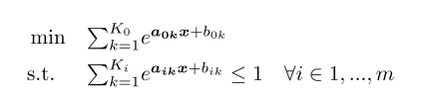
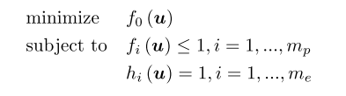





Exponential form of GP
Notes:
Introduce useful nomenclature
Mony and posys
Equalities written as two ineqs
Apply log, and we are convex
WLOG get rid of equalities

Slide 17
The robust counterpart transforms OUU to deterministic optimization problem.
Optimization over:
Infinite number of constraints
Finite number of constraints
A well-defined set
Notes:
Want to merge this framework with…
Number of mathematical moves to convert nominal to RO.
Now that we have found a representation, what is next?

Slide 18
Mathematical moves to obtain RSPs
LPs have tractable robust counterparts.
Two-term posynomials are LP-approximable.
All posynomials are LP-approximable.
GPs have robust formulations.
RSPs can be represented as sequential RGPs.
Notes:
Here are the moves I will describe.

Slide 19
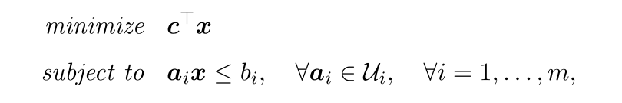
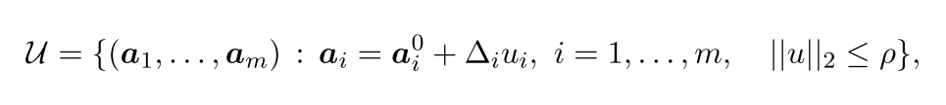
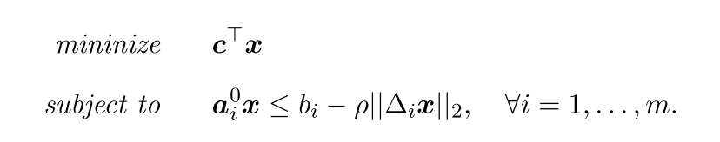
LPs have tractable robust counterparts.
I tip my hat to the editor!
Robust counterpart
A tractable SOCP!
Notes:
As an example. LPs, seminal paper by…
Context: Soyster 1974
Pi(u) is an affine embedding of L uncertain parameters into m constraints
Intuition for SOCP: max over linear ineqs is optimization over QCs.
We are all mortal, even seminal papers can have typos.

Slide 20
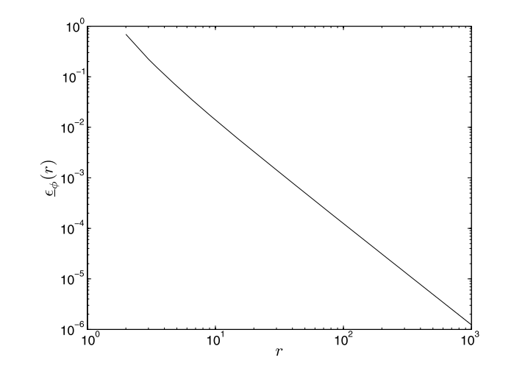
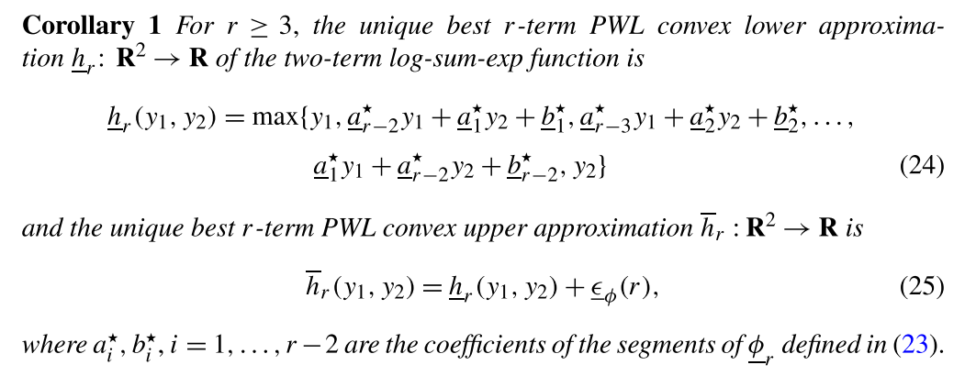
Two-term posynomials are LP-approximable.
Approximation error vs. degree of PWL approximation r.
Hsiung, K. L., Kim, S. J., and Boyd, S., “Tractable approximate robust geometric programming,” Optimization and Engineering, vol. 9, 2008, pp. 95–118.
Notes:
Key to understanding why GPs have robust formulations.
Clearly monomials are LP approximable. (log-log transform)
Use principles from BTandN to form robust approximations of GPs.
Relatively recent paper, 2008.
Deep mathematics… find proof in paper.
Epsilon is max error, phi is the t
Each nonlinear constraint, which is convex in log-space, gets PWL approximation

Slide 21
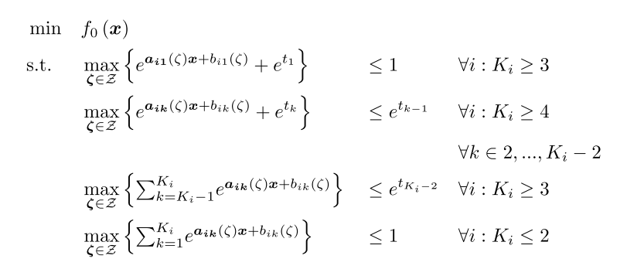
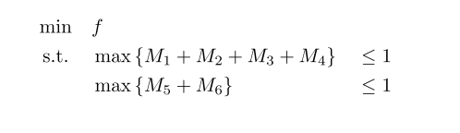
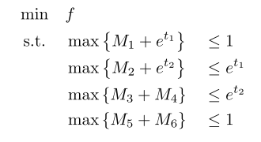
All posynomials must then be LP-approximable.
The recipe:
Simple example:
Saab, A., Burnell, E., and Hoburg, W. W., “Robust Designs Via Geometric Programming.” 2018. ArXiv:1808.07192
Notes:
By the optimal two term approximation, each posynomial must be LP-approx.
Recipe looks complicated, it’s just ‘chaining’ two term posynomials.

Slide 22
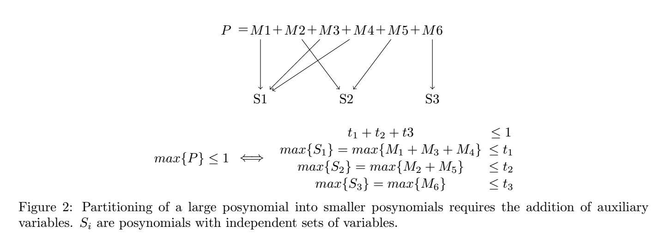
Uncoupled posynomials are robustified separately.
Notes:
Treat uncoupled posynomials separately. Coupling with uncertain variables
Robustifying s2, s3 easy.
S1 requires previous recipe.

Slide 23
Three approximations exist for RGP.
Simple conservative
Maximizes each monomial term separately
Linearized perturbations
Separates large posynomial into decoupled posynomials
Robustifies smaller posy’s using RLO techniques
Best pairs
Separates large posynomial into decoupled posynomials
Finds least conservative combination of monomial pairs
Uncertain coefficients only
Increasingly
conservative
Uncertain coefficients
and exponents
Saab, A., Burnell, E., and Hoburg, W. W., “Robust Designs Via Geometric Programming.” 2018. ArXiv:1808.07192
Notes:
Posys LP approximable, LPs have tractable robust counterparts
RGPs are tractable
Simp Cons – can see why this is conservative. Monomials with inverse correlation to uncertain variable
Best pairs is against some mathematical magic.

Slide 24
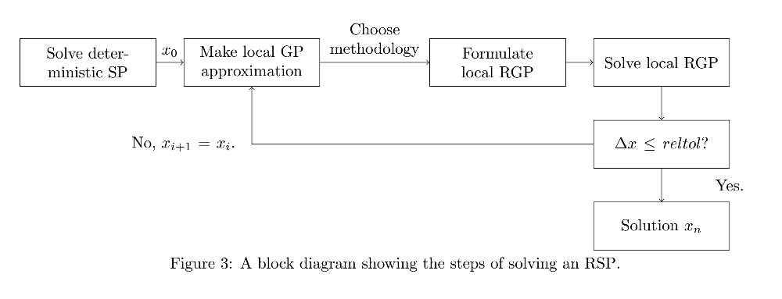
We augment the SP solution heuristic.
Notes:
Describe inner loop of SPs as well.
Solving an robustified SP no different than solving an SP with more constraints

Slide 25
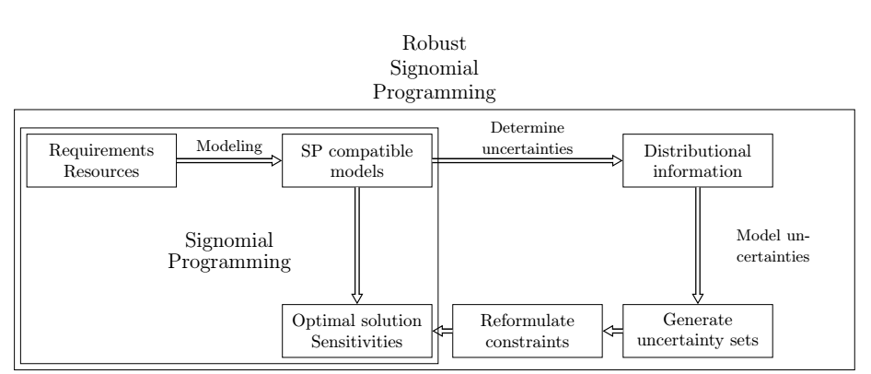
RSP formulations exist for all SP-compatible problems.
Notes:
General

Slide 26
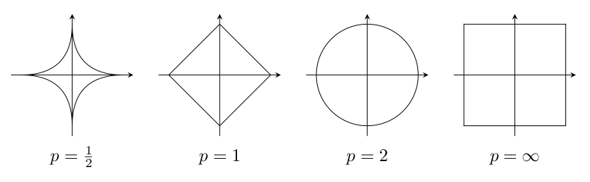
Uncertainty sets considered
Box (L-∞ norm)
Elliptical (L-2 norm)
More conservative than margins.
A less conservative candidate!
Margins optimize on a corner of the hypercube!
Other norms also valid.
Notes:
2d-rep
Statement about margins: The worst-case outcome of uncertainty
Elliptical makes sense, corners

Slide 27
Applying RO to Conceptual UAV problem
Notes:
See whether we have a useful framework

Slide 28
SP model captures important multidisciplinary tradeoffs.
Unmanned, gas-powered aircraft
Without uncertainty: 176 variables and 154 constraints
Monolithic: optimizes aircraft and flight trajectory concurrently through disciplined SP form
Wing
Structure
Fuel volume
Profile drag
Stall constraint
Fuselage
Ellipsoidal
Fuel and payload
Profile drag
Engine
Data-based sizing
Lapse rate
BSFC fits
T/O and TOC constraints
Notes:
Great thing about models
Yes they are simple, but we can easily augment models with data.

Slide 29
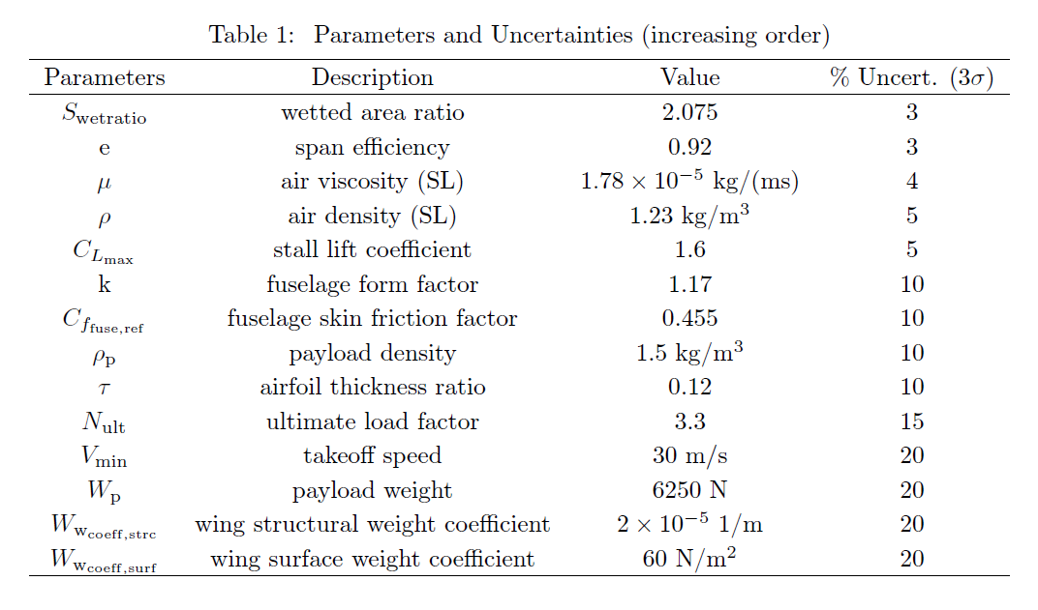
Uncertainties reflect ‘engineering intuition’.
Notes:
3sigma – 3CV
Build quality -> high
Payload weight and density -> medium, developed concurrently
Physical constants -> low
Require testing -> expected variance of empirical studies
NOTE engineering knowledge required.

Slide 30
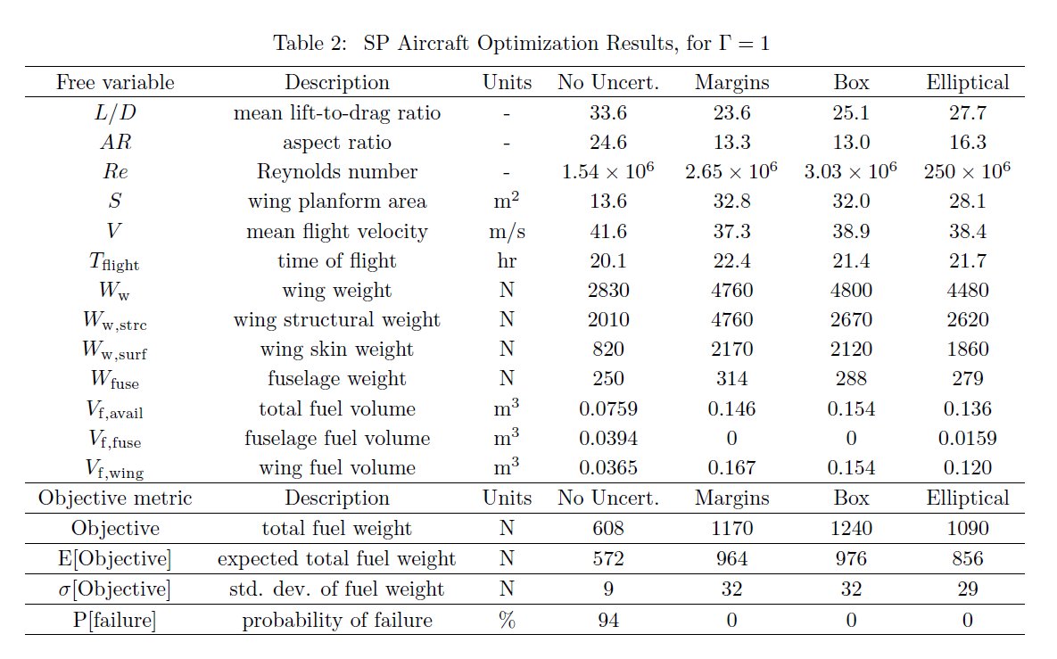
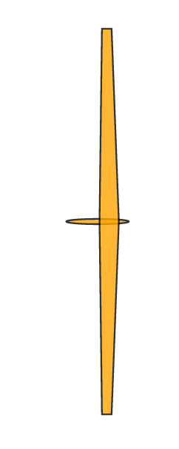
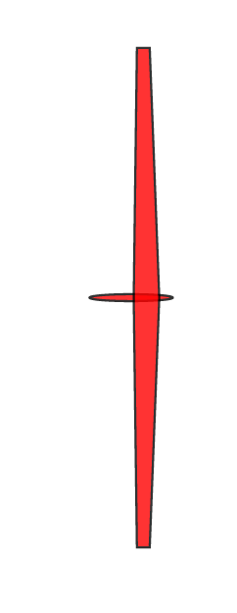
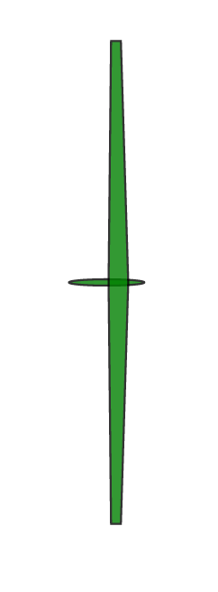
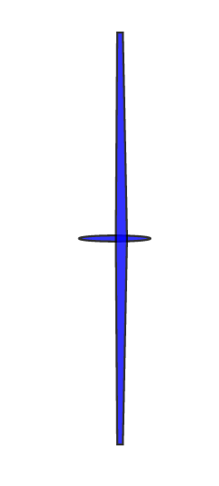
Notes:
Here are results, with corresponding aircraft
Objective is fuel weight, where m,b,e have worst-case
We can compare the designs as we like, but we are interested in statistics of objective
Margins don’t have the level of conservativeness they signal
Firstly, prob of failure. Prob of failure = constraint violation.
Makes sense. Think of hyperplane for LP.
Margin not as conservative as it signals
Use sens of nominal, push to support
Roughly same E and sigma
Elliptical strictly less conservative

Slide 31
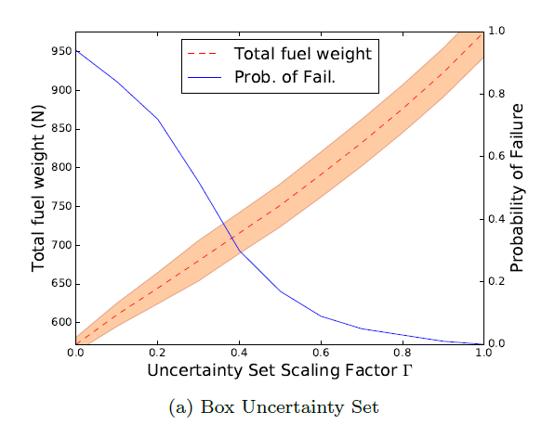
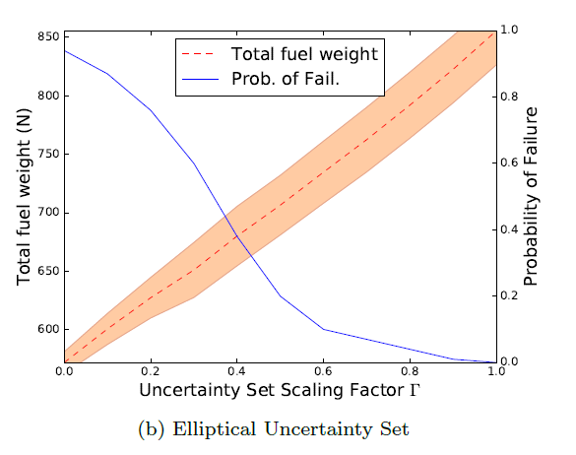
RSP successfully mitigates probability of failure.
For Γ = 1, the elliptical design spends 14% less fuel than the box design, while protecting against the same uncertainty!
Notes:
Don’t present results for margins, look similar to box
100 samples for MC simulation, truncated 3sigma Gaussaisn
Mean and standard deviation of performance
Method significantly less conservative than margins!

Slide 32
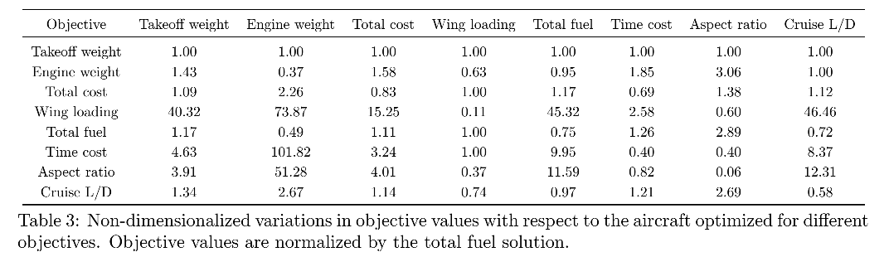
Convex programs allow flexibility in objectives.
Notes:
Highlight importance of considering multiple objectives
Same aircraft, designed under certainty for these objectives. Normalized cost
Look at two specific things
Aspect ratio (unintuitive). Let’s say stubby wings are an objective
Fuel and time cost: Two extreme cases of recurring cost
Can be combined in a total cost metric, compromise aircraft
If we don’t, we can end up with extreme solutions

Slide 33
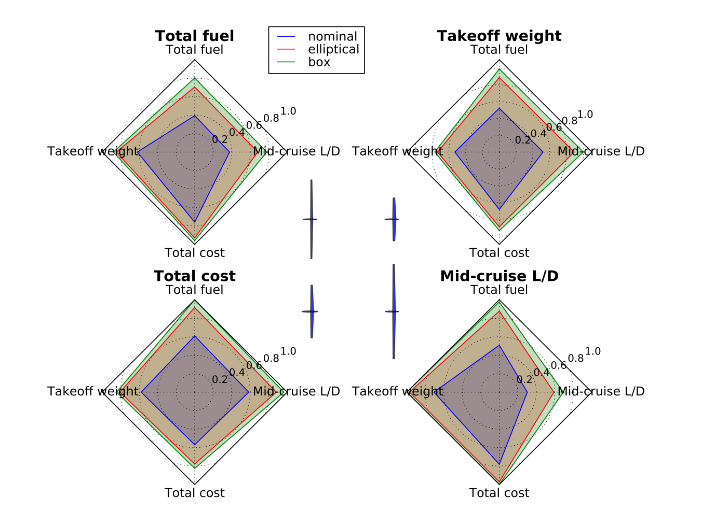
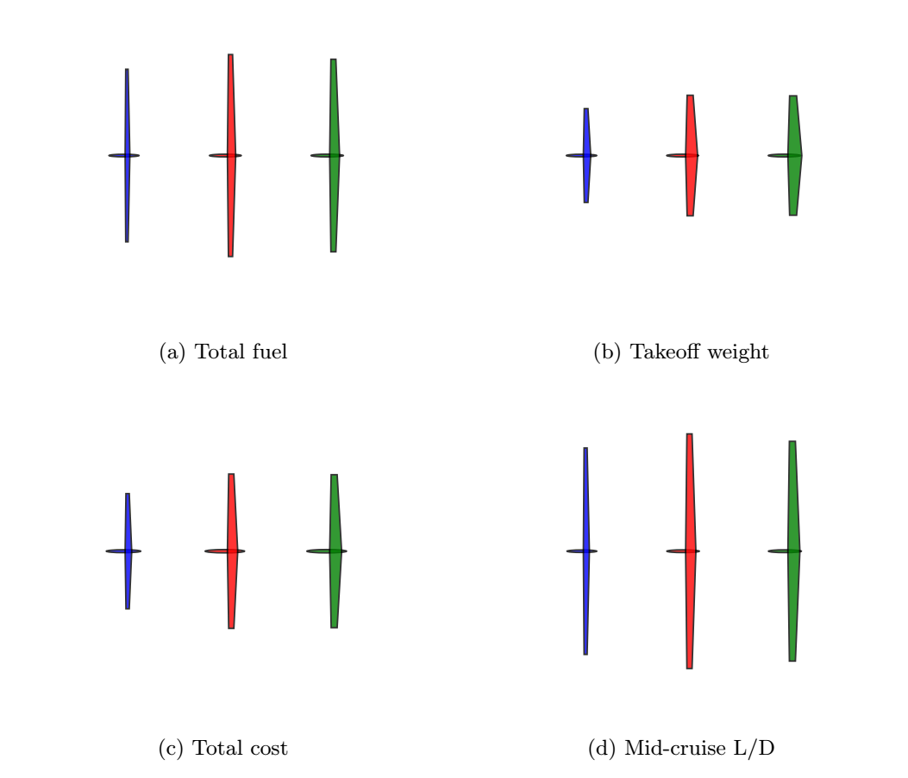
Understanding multiobjective tradeoffs is key to risk mitigation.
Notes:
Take that further, add some good diagrams
Spider plots. 12 aircraft
4 objectives, 3 uncertainty sets. Normalized solutions.
Figure of merit, area inside
Again, confirm conservativity.
Mid/Cruise L/D (traditionally used) is a bad metric for all other objectives.
Relative convergence of designs to each other.
Some examples of studies that we can perform.

Slide 34
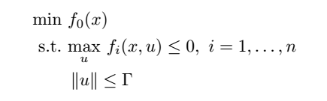
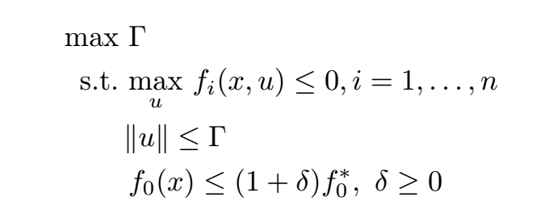
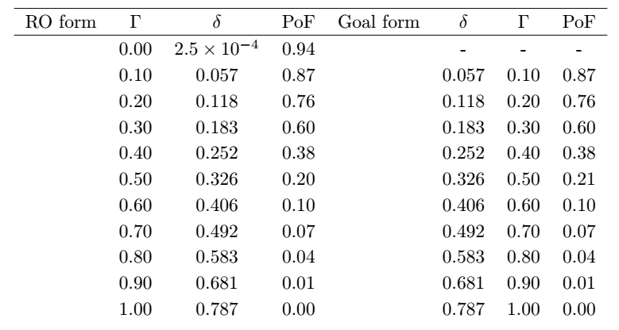
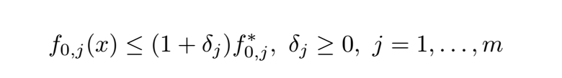
Goal programming: risk is a global design objective.
Standard RO form
Goal programming form
Suggests a good formulation for multi-objective design space exploration:
Notes:
This is a slide that makes me extremely happy.
MO makes my skin crawl, because there is no such thing
Engineers have to make decisions about which objective is the most important.
Or is risk the only real design metric?
No solution on first line, singularity
Formulation is tight!

Slide 35
Contributions
A tractable RSP formulation for design over uncertain parameters
Demonstration of
Probabilistic guarantees of RSPs
Less conservative designs through RSP than legacy methods
A goal programming formulation for multiobjective optimization
New opportunities in aerospace conceptual design through RO
Notes:
Robustness to non-linear, non-log-convex optimization methods

Slide 36
Future work
How do we use our understanding of the risk of constraint violation?
Not all constraint violation is equal!
How does one restrict the power of nature conservatively?
How does RO change our understanding of the benefits of adaptable designs?
(eg. modular, morphing, adaptively manufactured designs and design families)
How can we gather data about parameters to best reduce uncertainty in feasibility/performance of designs?
Notes:
Not all… - structural constraint vs. range
Power of nature – perhaps even less conservative. Constrain number of uncertain vars through L1-norm
Does our ability to better capture uncertainty change value proposition.
We can obtain sensitivities to size of uncertainty set.

Slide 37
Back-up slides

Slide 38

Cost and schedule are highly correlated.

