Slide 1
Optimal Aircraft Design Decisions Under Uncertainty via Robust Signomial Programming
Presented by Berk Ozturk
Joint work with Ali Saab
Notes:
MIT ACDL
Elevator pitch for robust optimization in aerospace design.
Get right into it, because 20 minutes will go quickly.
Questions until end, except for clarifications

Slide 2
What to expect
A method that:
turns stochastic design optimization problems into deterministic ones.
solves sparse non-linear problems (1:1 variables/constraints ratio).
solves in <1s for a conceptual design problem with ̴150 variables.
has sub-linear solution time with number of variables.
provides probabilistic guarantees of constraint satisfaction.
Insights into:
weaknesses of legacy methods of design under uncertainty.
how to reduce design conservativeness when faced with uncertainty.
Notes:
Take a problem with uncert params, and protect against that uncert deterministically
Ratio seen in engineering design
On a highly-laden laptop computer
Sublinear – much better than other OUU, polynomial at best
Talk a lot about design as well as math Aerospace programs have high risk – large up-front costs and high sensitivity to params
How to make designs less conservative while protecting…

Slide 3
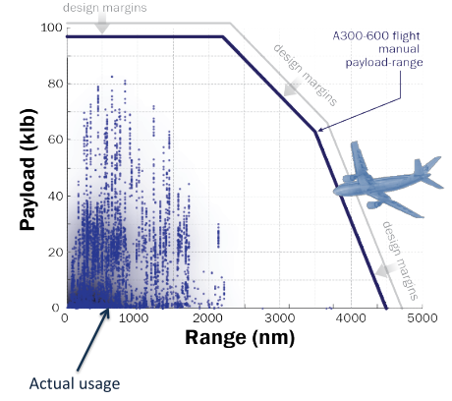

Motivation: understanding how uncertainty influences design decisions.
Max zero-fuel weight
How about:
Technological capabilities?
Manufacturing quality?
Regulatory environment?
Max takeoff weight
Max fuel capacity
Notes:
Motivate talk by showing example
Consider paylo-range.
DESIGN PROCESS
Why was the aircraft designed for the envelope?
In presence of uncertainty, we add margins so we are conservative.
Consider other metrics
Overdesigning when we are uncertain about the environment aircraft are operating in.
Primary reason for cost growth is that we chase a moving target when it comes to uncertainty
The more uncertainty, the more overdesign, the longer the time horizon,
the more the uncertainty, the longer the time to design and so on.
We need to break this trend.

Slide 4
Legacy methods are failing to adequately capture the risk/performance tradeoff.
Margins
Multimission design
Off-nominal ‘checking’
Not always intuitive.
No quantitative measures of reliability.
Heavy reliance on experienced engineers.
Too conservative!
There is no such thing as a free lunch!
Notes:
Legacy methods for OUU
Margins – parameters design is sensitive to
Multimission design – missions under no uncert, finitely adaptive
Checking – post process
Intuitive – wing thickness, + or – margin?
No quantitative… - can’t tell the PoF as part of formulation
Experience – new configurations where there is limited expertise.
Conservative – throw out novel designs because we can’t properly understand effect of uncertainty
Free lunch – economics
Risk adversity is going to come with performance penalties

Slide 5
We need more mathematical rigor in design under uncertainty.
Guarantees of constraint satisfaction.
Reduced sensitivity of designs to uncertain parameters.
Better understanding of tradeoff of risk and performance.
Ultimate goal » Less conservative designs that are robust.
Notes:
A solution to these problems is…
What do we want?
Immunity to certain set of uncertain outcomes
We want to reduce the sensitivity of performance
Know what the performance/risk tradeoffs are.
UR: less performance penalty while protecting against same level of uncertainty as legacy methods.

Slide 6
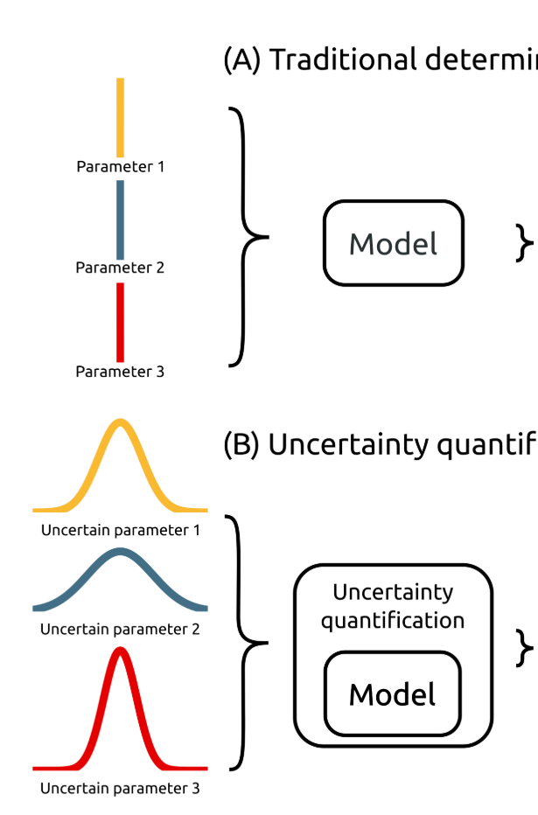
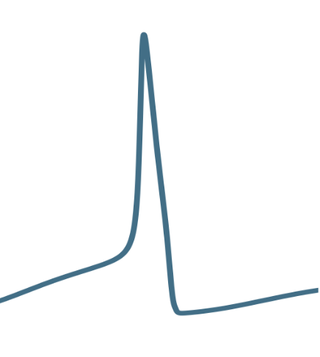
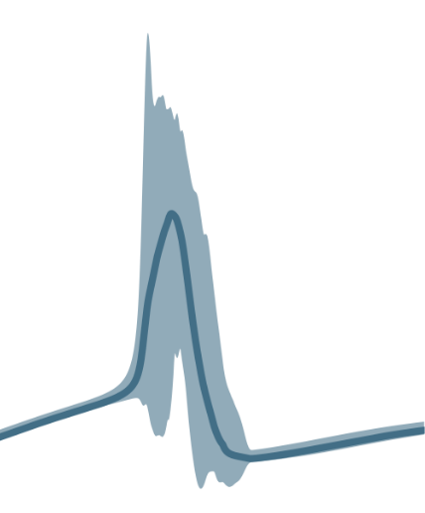
Robust optimization is a tractable method for OUU.
The good:
Monolithic and fast.
Probabilistic guarantees.
Tractable.
The bad:
Doesn’t make full use of distributional information.
Optimizes worst case.
The (beautiful) and ugly:
Requires specific formulations (LP, QCQP, SDP, GP, SP).
Optimization ‘under certainty’
Model
u₁
Robust optimization model
u₂
u₃
u ϵ U,
eg. |u| ≤ Γ
*Adapted from: Tennøe, S., Halnes, G., and Einevoll, G. T., “Uncertainpy : A Python toolbox for uncertainty quantification and sensitivity analysis in computational neuroscience .,” 2018, pp. 1–52.
Objective space
Notes:
But, there is a caveat
General stochastic optimization methods are intractable.
Happy to discuss later, there is simply not enough time here to explain.
Think of gradient descent with f’n evaluations over stochastic inputs.
Let’s think OUC first. Gradient descent.
Don’t know this performance curve. We sample curve to find local optimum.
Robust optimization (mathematical programming)
Different contexts: optimization over uncertainty sets, worst case
This is a monolithic method: no sampling, evaluation and optimization in same loop.
Types of sets (norms, inf, 1, 2, polyhedral)
Bounded support
This is beautiful because many engineering design problems

Slide 7
Mathematical background
Notes:
Explain the magic to you
Principles of robust optimization with methods for nonlinear optimization

Slide 8
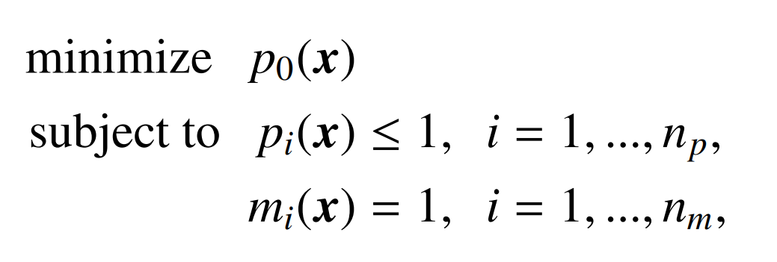
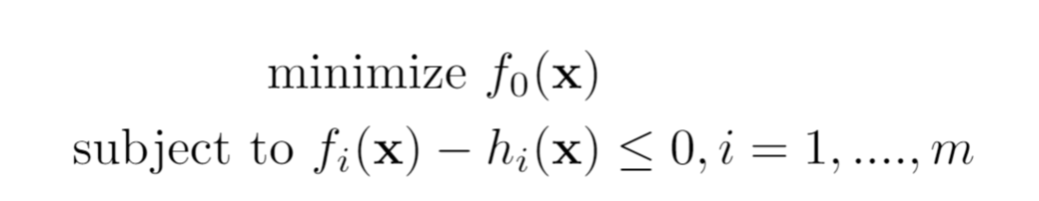
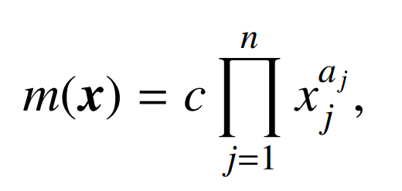
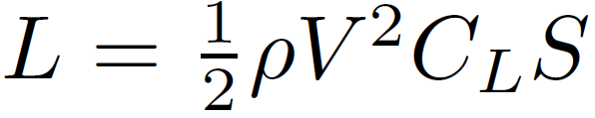
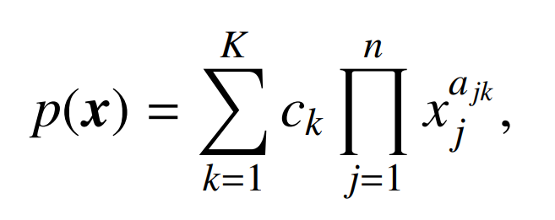


GPs and SPs are practical to solve general NLPs.
Geometric program (GP):
Log-convex
Globally optimal
No initial guesses
Sensitivities through the dual
Signomial program (SP):
Non-log-convex (difference of convex), and thus more general
Solved as sequential GPs
Solves with initial vector of 1’s
Locally optimal
eg.
Formulated in:
Notes:
We are going to exploit mathematical structure.
Practical, and can capture real world complexity.
GPs are log-convex opt problems of the form…
Interior pt. programs scale sublinearly
Signomial problems extend GPs by removing positivity constraint on coeffs
Caveats: explicit constraints, must fit in this form
Python-based object-oriented formulation framework called GPkit
Abstracts away solvers, good abstractions and modularity for eng design.

Slide 9
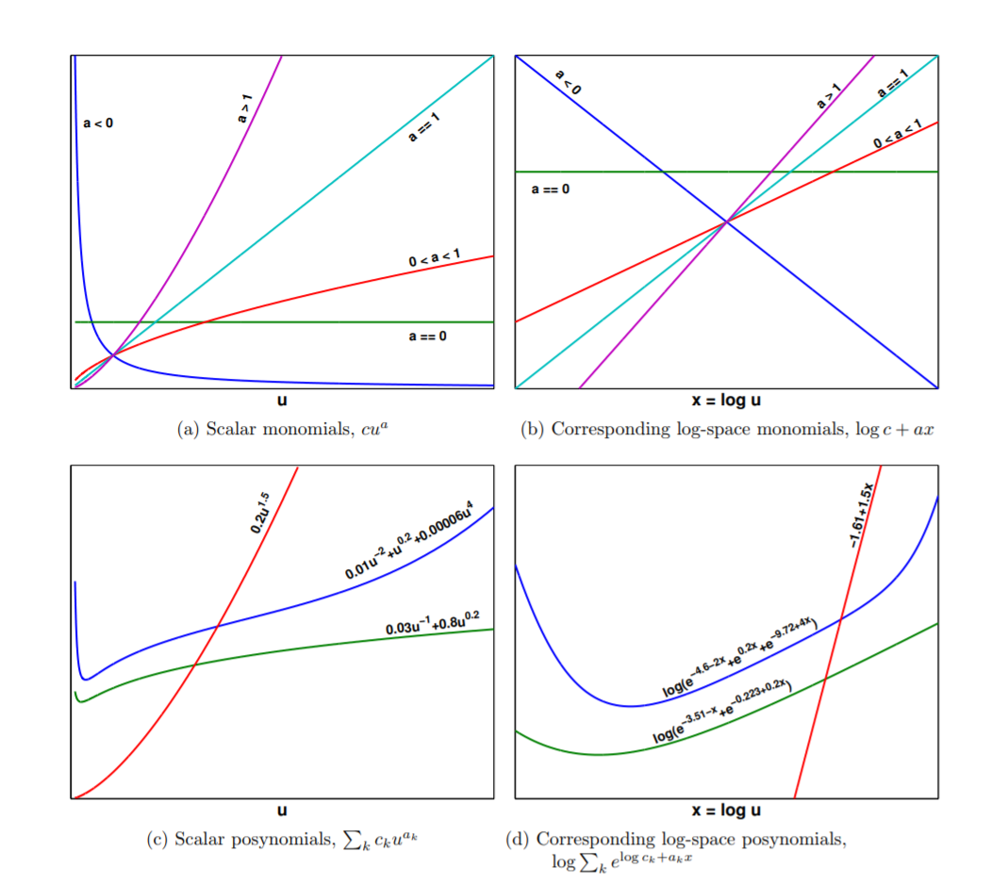
Log-log transformation to turn NLP into convex problem
Primal
form monomial
Exponential form monomial
Primal
form posynomial
Exponential form posynomial
*Hoburg, 2013. Aircraft Design Optimization as a Geometric Program
Notes:
Just to show how a GP is convex
We use the principle of duality to transform a non-linear, non-convex problem into a non-linear convex problem, solved efficiently using modern interior-point solvers.
Single variable monomials and posynomials (one decision variable)
Primal clearly nonconvex and non-linear
Log-affine log convex
Epigraph of the graph of posynomials is feasible set
SPs are about doing a sequence of GP approx. of diff-of-log-convex problems

Slide 10
The robust counterpart transforms OUU to deterministic optimization problem.
Optimization over:
Infinite number of constraints
Finite number of constraints
A well-defined set
Notes:
We want to combine SPs with ideas from RO
Number of mathematical moves to convert nominal to RO.
Well-defined set – tractable robust counterpart

Slide 11
Mathematical moves to obtain RSPs
LPs have tractable robust counterparts.
Two-term posynomials are LP-approximable.
All posynomials are LP-approximable.
GPs have robust formulations.
RSPs can be represented as sequential RGPs.
Notes:
Merging RO framework with SP.
Here are the moves I will describe at a high level.
Too much to cover in this talk, pique the interest of math-savvy folks among you.

Slide 12
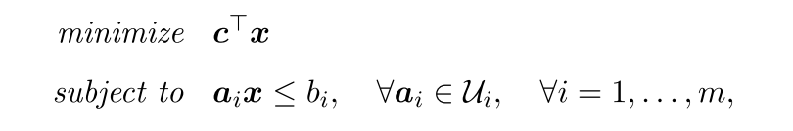
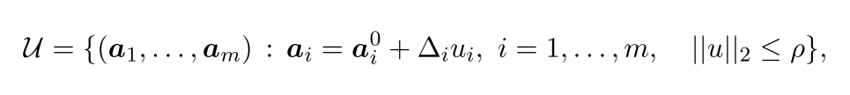
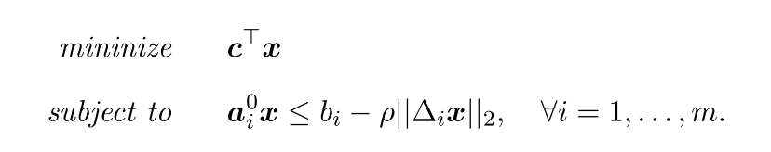
LPs have tractable robust counterparts.
I tip my hat to the editor!
Robust counterpart
A tractable SOCP!
Notes:
Just to show you what a robust counterpart looks like
Context: Soyster 1974
Pi(u) is an affine embedding of L uncertain parameters into m constraints
Intuition for SOCP: max over linear ineqs is optimization over QCs.
We are all mortal, even seminal papers can have typos.

Slide 13
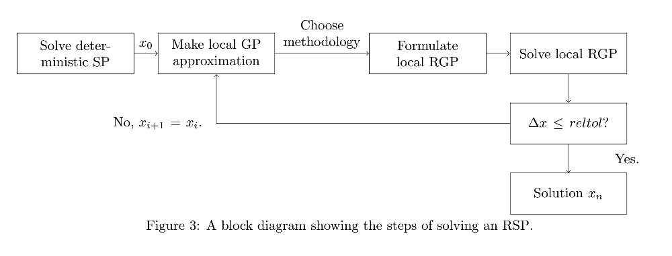
Takeaway: Given that an SP-compatible formulation exists, we can form a tractable robust SP!
Notes:
Describe inner loop of SPs as well.
Solve a second set of GPs based on this method.
Solving an robustified SP no different than
solving original SP, then resolving the SP with additional constraints

Slide 14
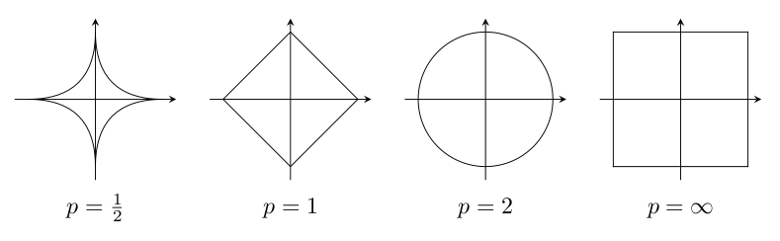
Uncertainty sets considered
Box (L-∞ norm)
Elliptical (L-2 norm)
More conservative than margins.
A less conservative candidate!
Margins optimize on a corner of the hypercube!
Other norm sets also valid.
Notes:
As we apply this framework, we consider two sets
Statement about margins: The worst-case outcome of uncertainty
Elliptical makes sense, exploits the idea that the joint probability of
Multiple params taking values in the corners of hypercube is low.
Hope is, same level of protection, and less conservative.

Slide 15
Applying RO to Conceptual UAV problem
Notes:
See whether we have a useful framework

Slide 16
SP model captures important multidisciplinary tradeoffs.
Unmanned, gas-powered aircraft
Without uncertainty: 176 variables and 154 constraints
Monolithic: optimizes aircraft and flight trajectory concurrently through disciplined SP form
Wing
Structure
Fuel volume
Profile drag
Stall constraint
Fuselage
Ellipsoidal
Fuel and payload
Profile drag
Engine
Data-based sizing
Lapse rate
BSFC fits
T/O and TOC constraints
Notes:
Great thing about models
Yes models are simple, but we do currently have SP models
that can solve commercial-aircraft problems with 3000 variables.

Slide 17
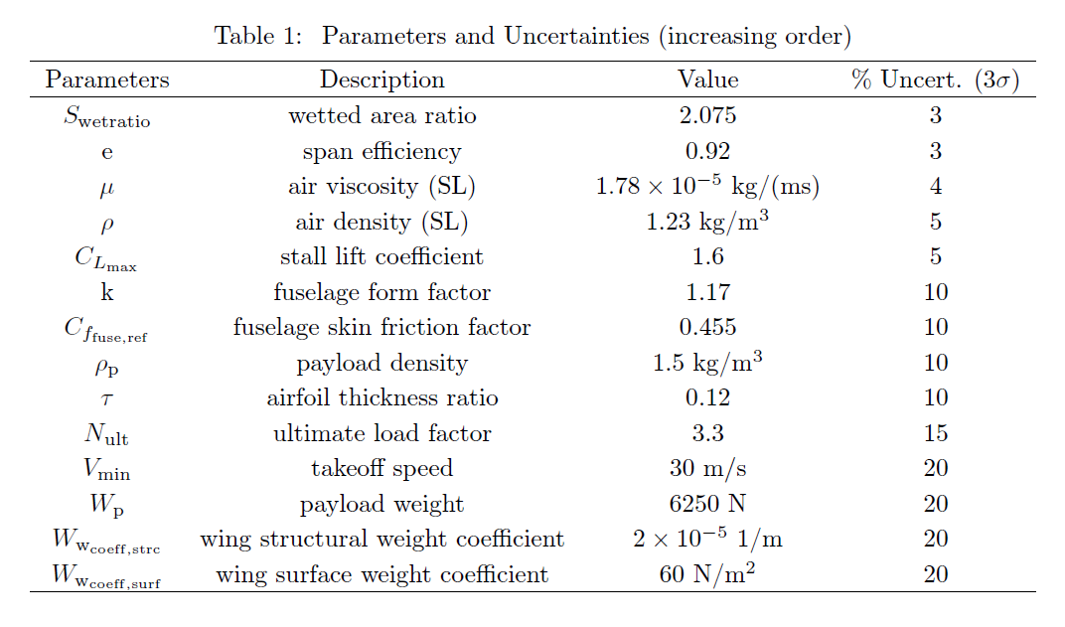
Uncertainties reflect ‘engineering intuition’.
Notes:
And of course, some engineering knowledge is required.
3sigma – 3CV
Build quality -> high
Payload weight and density -> medium, developed concurrently
Physical constants -> low
Require testing -> expected variance of empirical studies

Slide 18
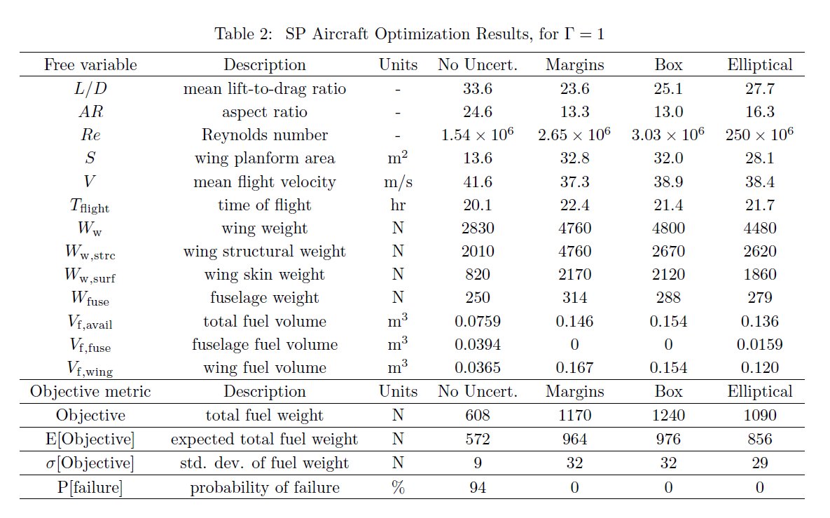
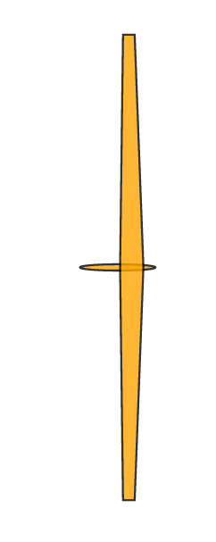
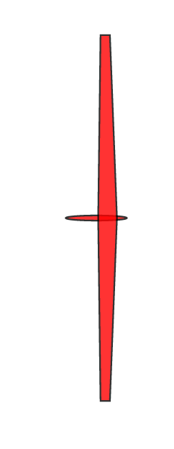
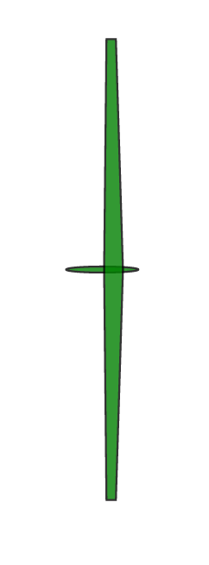
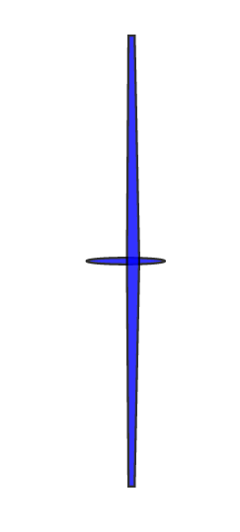
*100 MC simulations over 3σ truncated Gaussians
Notes:
Here are results, with corresponding aircraft
Objective is fuel weight, where m,b,e have worst-case
We can compare the designs as we like, but we are interested in statistics of objective
100 samples for MC simulation, truncated 3sigma Gaussaisn
Firstly, prob of failure. Prob of failure = constraint violation.
Anyone who has designed for nominal are making a mistake.
Makes sense. Think of hyperplane for LP.
Margin not as conservative as it signals
Roughly same E and sigma
Elliptical strictly less conservative

Slide 19
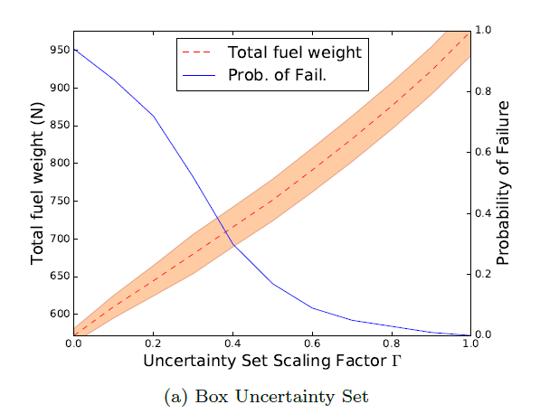
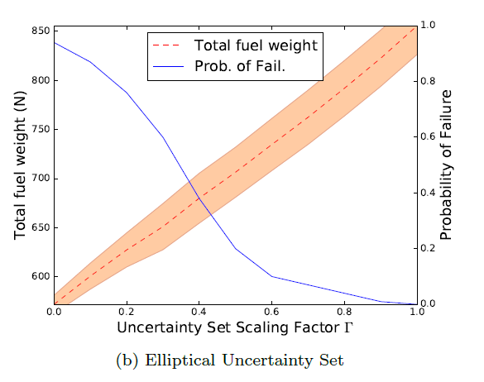
RSP successfully mitigates probability of failure.
For Γ = 1, the elliptical design spends 14% less fuel than the box design, while protecting against the same uncertainty!
Notes:
Don’t present results for margins, look similar to box
Mean and standard deviation of performance
Method significantly less conservative than margins, with little extra computational work!

Slide 20
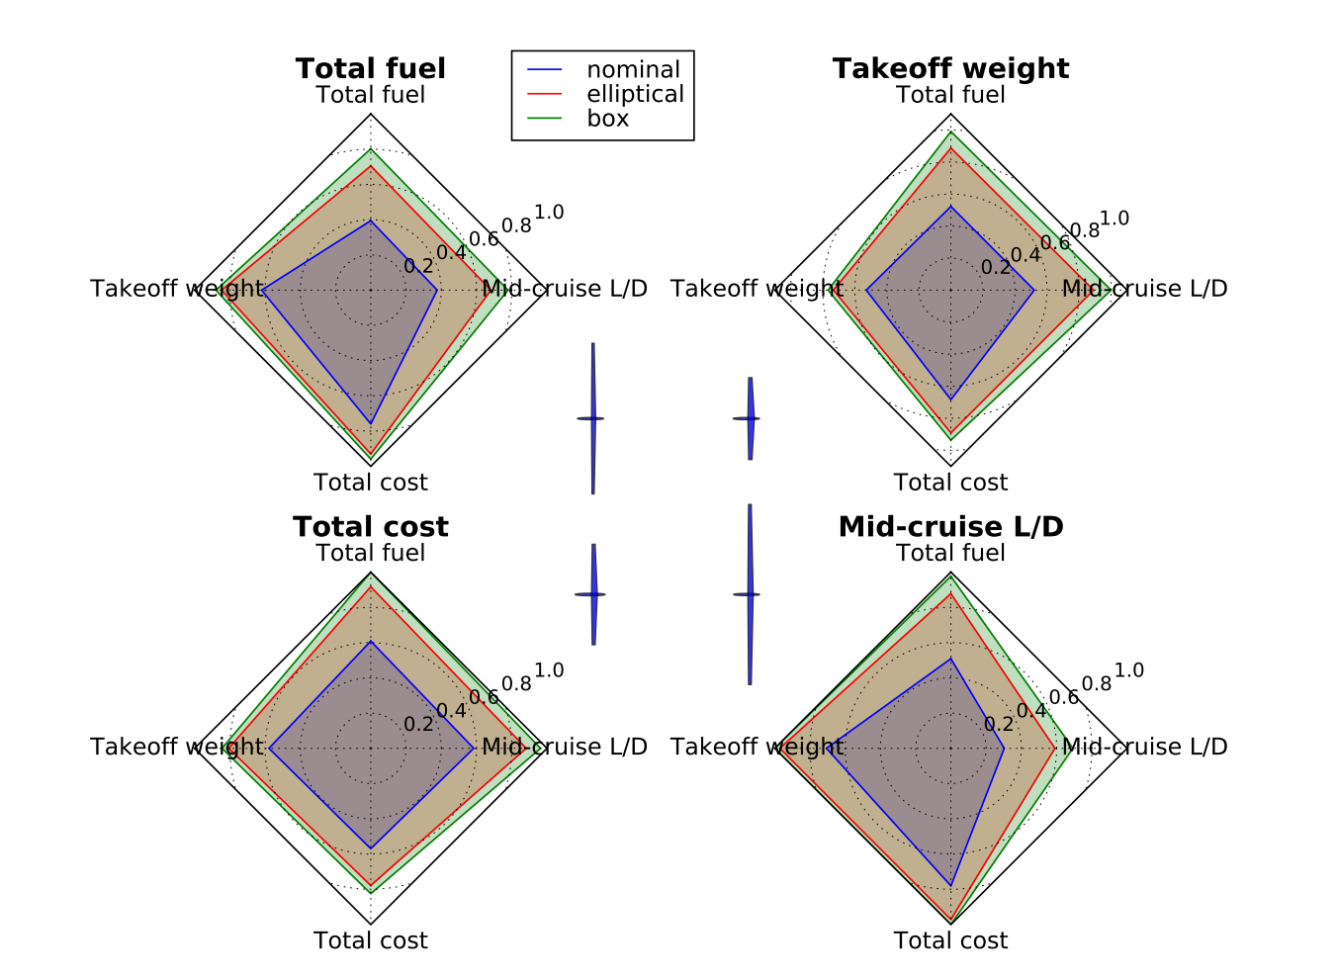
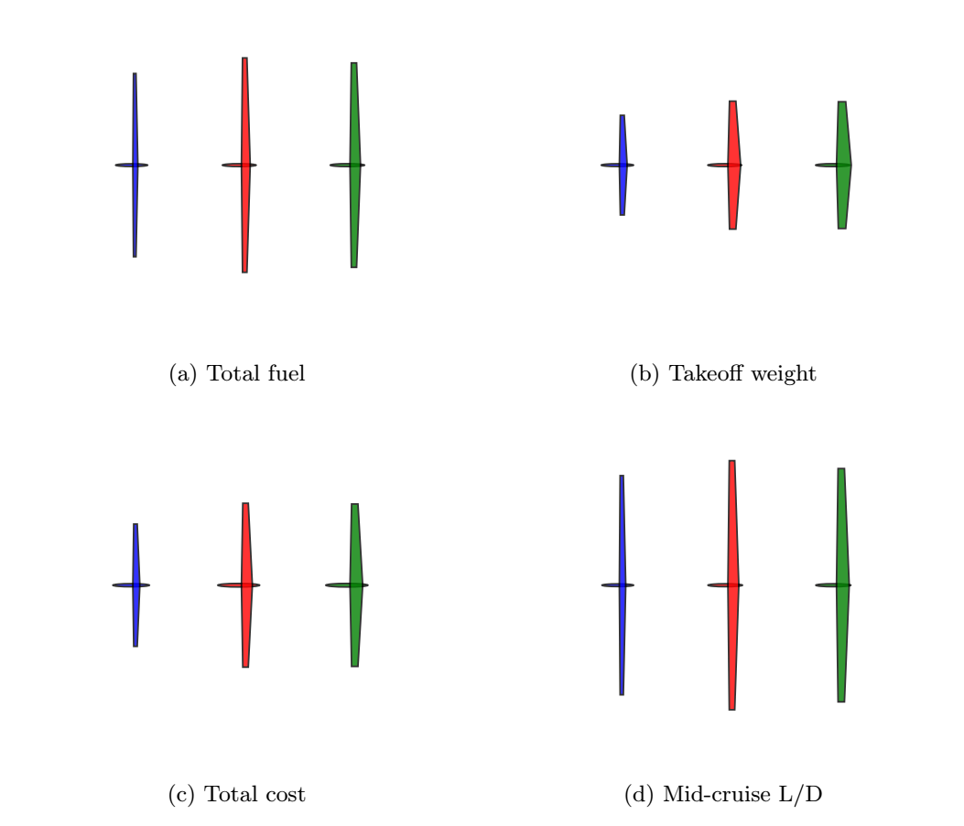
Understanding multiobjective tradeoffs is key to risk mitigation.
Notes:
Highlight importance of considering multiple objectives
We can even optimize for minimum aspect ratio
Take that further, add some good diagrams
Spider plots. 12 aircraft
4 objectives, 3 uncertainty sets. Normalized solutions.
Figure of merit, area inside
See very different aircraft although objectives are supposed to be correlated.
Again, confirm conservativity.
Mid/Cruise L/D (traditionally used) is a bad metric for all other objectives.
Some examples of studies that we can perform in conceptual design to mitigate risk

Slide 21
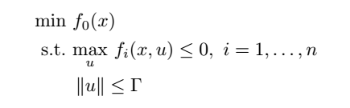
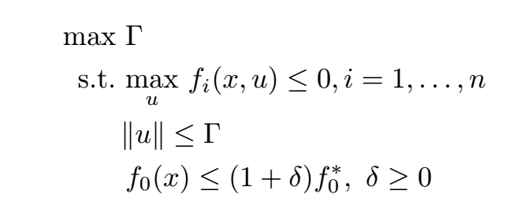
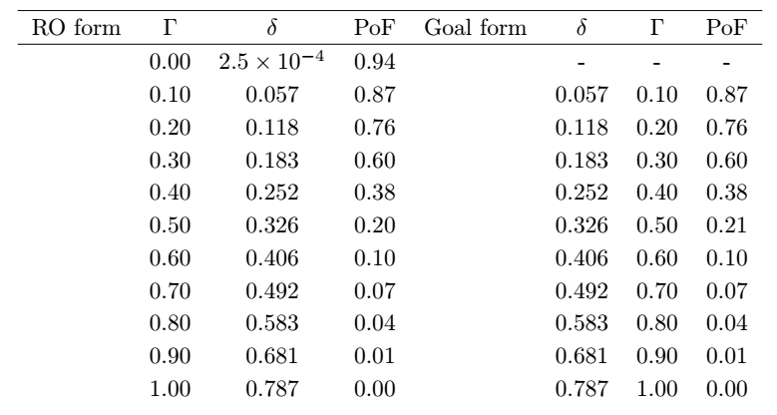
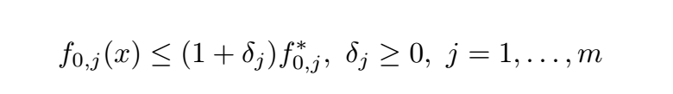
Goal programming: risk is a global design objective.
Standard RO form
Goal programming form
Suggests a good formulation for multi-objective design space exploration:
Notes:
Another exciting aspect of this framework is that we can reformulate
Design problem as risk minimization problem.
Engineers have to make decisions about which objective is the most important.
Or is risk the only real design metric?
No solution on first line, singularity
Formulation is tight!

Slide 22
Contributions
A tractable RSP formulation for design over uncertain parameters
Demonstration of
Probabilistic guarantees of RSPs
Less conservative designs through RSP than legacy methods
A goal programming formulation for multiobjective optimization
Notes:
Robustness to non-linear, non-log-convex optimization methods
RSP protect deterministically against defined uncertainty sets
New opportunities in aerospace conceptual design through RO

Slide 23

Please find our engineering design optimization packages and models at: https://github.com/convexengineering This work is powered by: GPkit: …/gpkit robust: …/robust (in development) Mosek Version 8.1.0.80 Looking forward to your questions!
Convex Engineering
Notes:
Convex engineering group @MIT
Python packages
Mosek powerful interior point solvers

Slide 24
Back-up slides

Slide 25
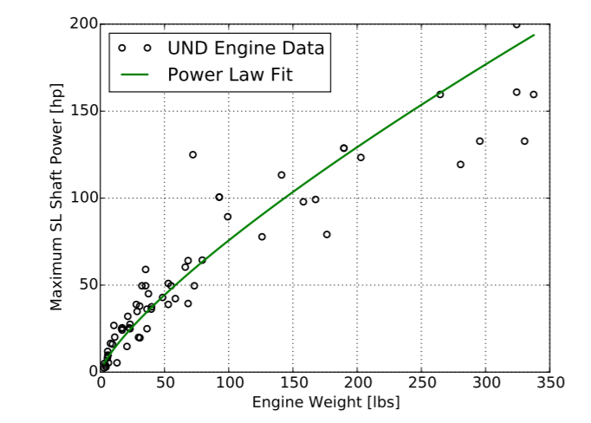
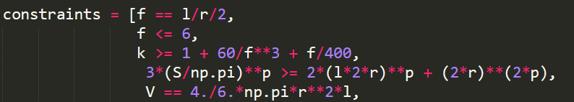
Examples of constraints

Slide 26
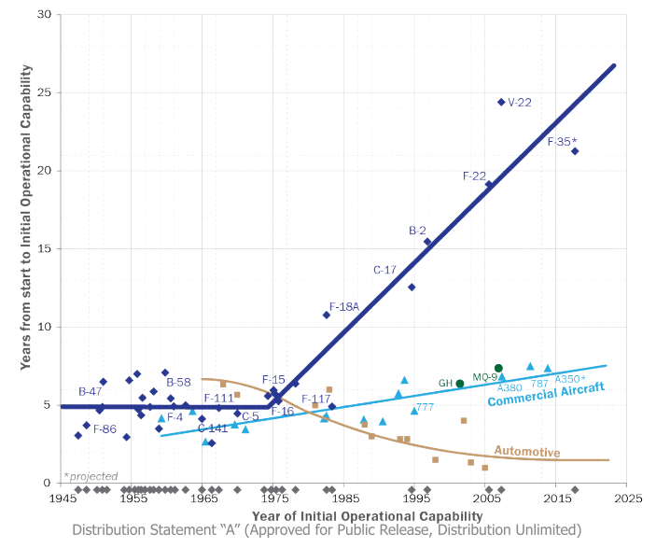
How can we tackle the schedule and cost explosion of aerospace programs?
Notes:
Start with observations and a value proposition.
Describe graph…
Strong power-law correlation between schedule and cost
Why do patterns look different?
Evolutionary design, C and A more commercial pull
Clearly not a complete picture…

Slide 27
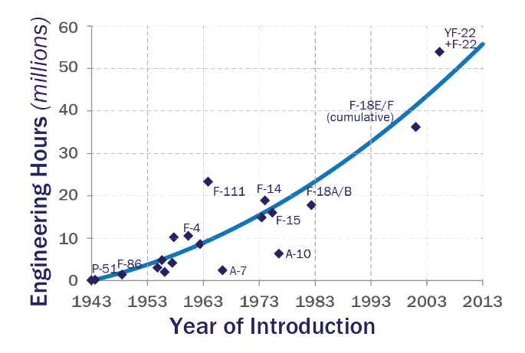
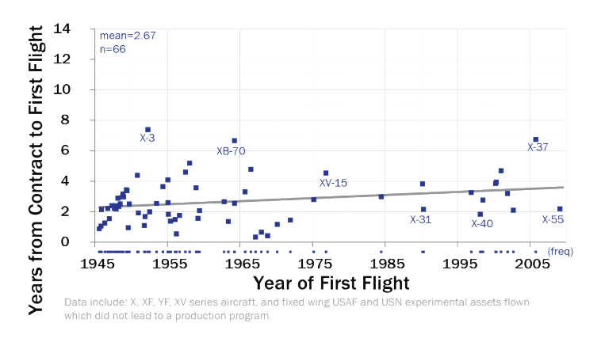
We are approaching the limits of the 2nd law of thermodynamics.
Conflicting evidence?
Notes:
Many arguments that can be made to explain overruns
Let’s look specifically at military aircraft
Naïve view says that the graph on left demonstrates this
Demand more capability
Is this conflicting evidence?
It seems we can get demonstrators out fast, but we are getting choked in a later stage.
And it sure seems like computation is not helping.
Capabilities have gone up, and design time has only increased.

Slide 28
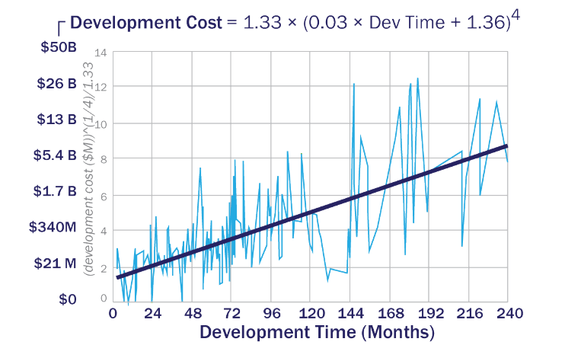
Cost and schedule are highly correlated.

Slide 29
Stochastic optimization operates over PDFs.
The good:
Makes best use of available data.
Extremely general.
The bad:
Not deterministic.
‘Loose’ probabilistic guarantees.
The ugly:
Combinatorics/computational cost of PDF propagation through NLPs.
Optimization ‘under certainty’
Model
Stochastic optimization
Model
*Adapted from: Tennøe, S., Halnes, G., and Einevoll, G. T., “Uncertainpy : A Python toolbox for uncertainty quantification and sensitivity analysis in computational neuroscience .,” 2018, pp. 1–52.
Objective space
Notes:
Two approach, first
Let’s think OUC first. Gradient descent. We sample curve to find local optimum.
Don’t know this performance curve
Objective is some characteristic
Propagation requires integration of pdfs with potential outcomes
HD quadrature and discretization into scenarios

Slide 30
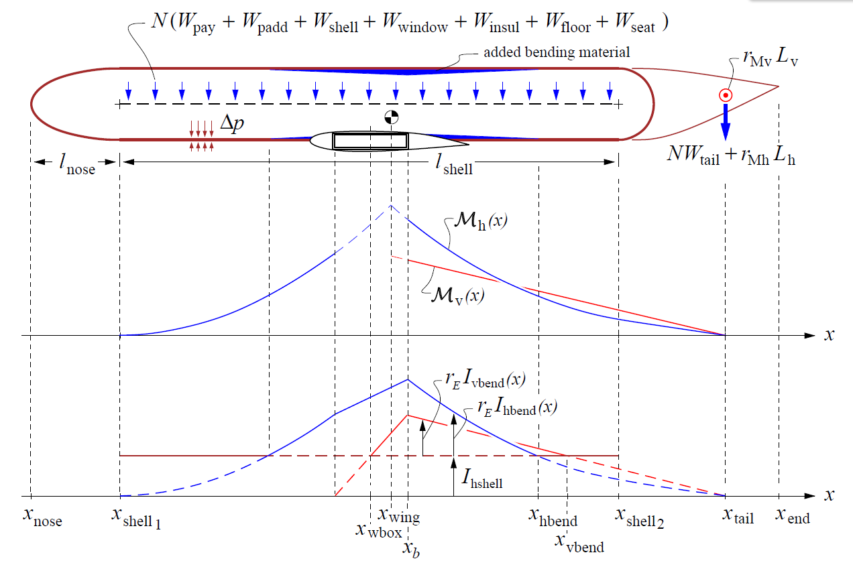
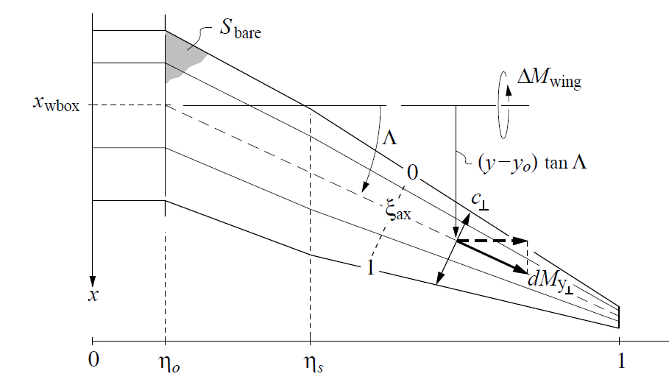
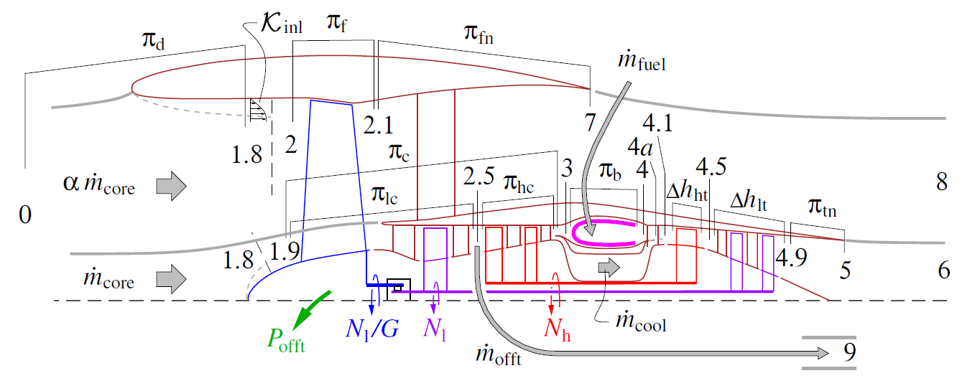
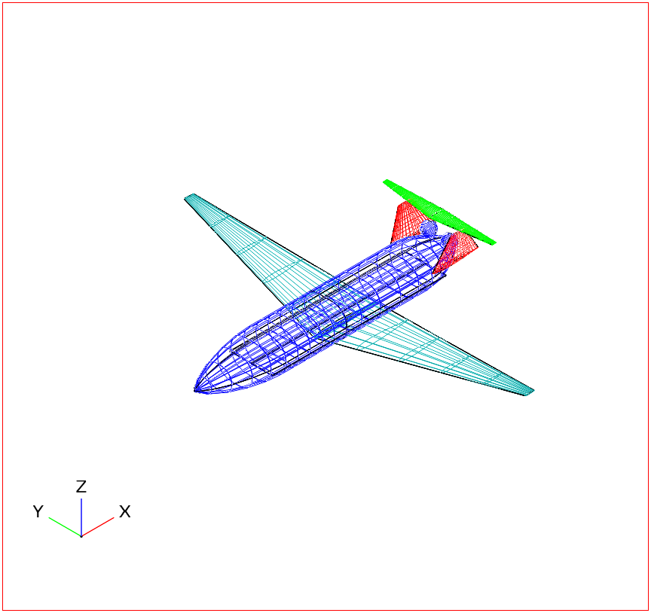
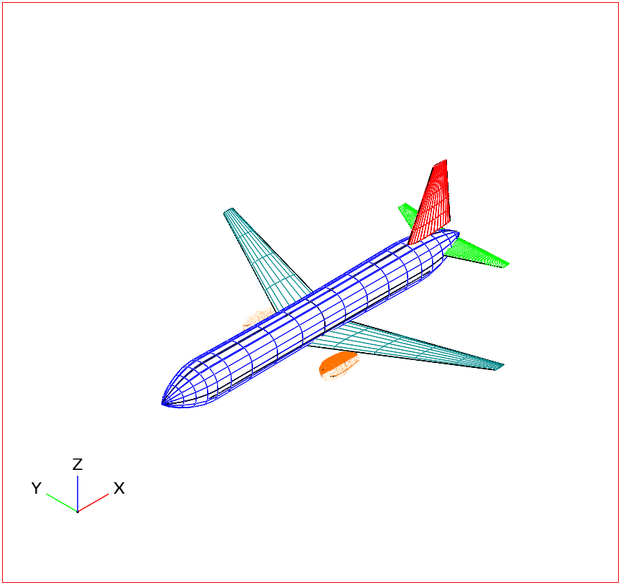
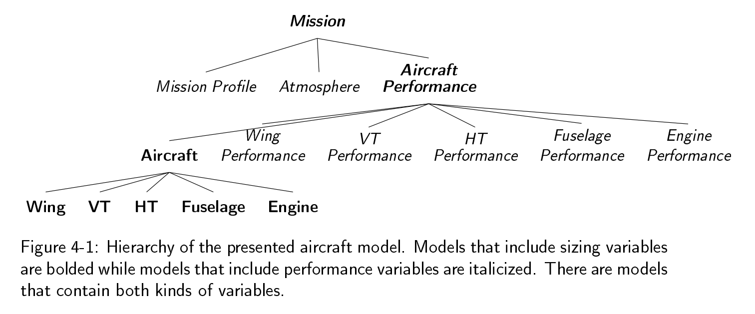
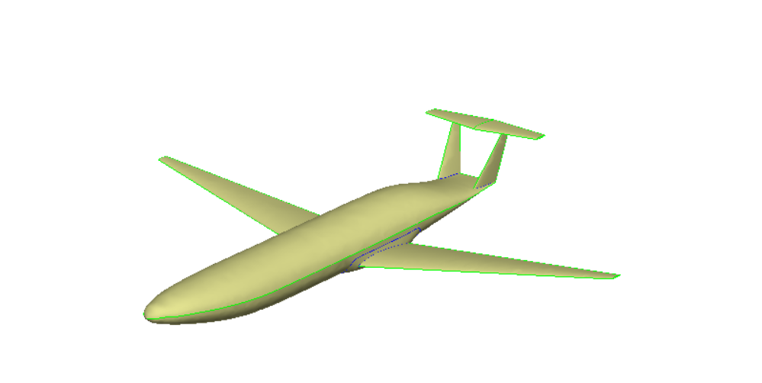
SPs can be extremely complex (TASOPT).
Commercial aircraft model of similar fidelity to TASOPT (5000 variables).
Built on configuration hierarchies
Multi-point design
Visual debugging of constraints
ESP integration for potential HF simulations?
+3x
+
=[ or | Mission + sizing constraints]
Notes:
Bridging the serial nature of software with the integrated nature of design

Slide 31
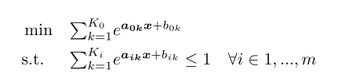
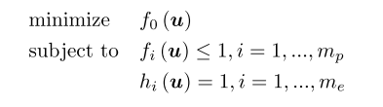





Exponential form of GP
Notes:
Introduce useful nomenclature
Mony and posys
Equalities written as two ineqs
Apply log, and we are convex
WLOG get rid of equalities

Slide 32
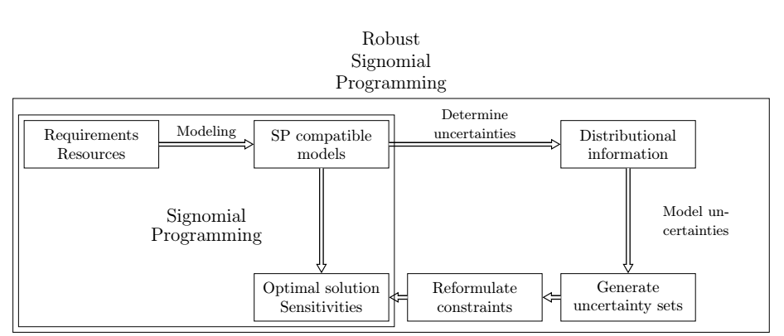
RSP formulations exist for all SP-compatible problems.
Notes:
General

Slide 33
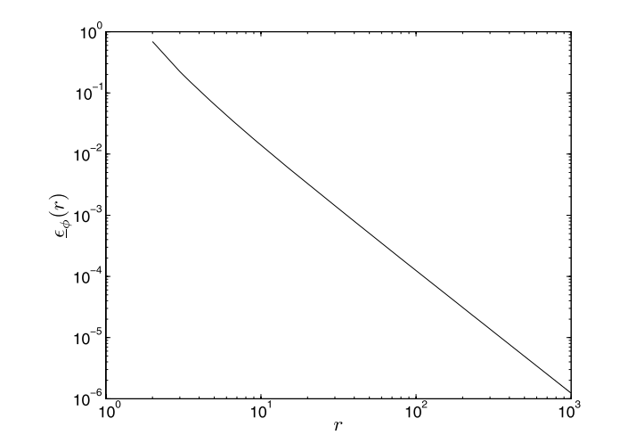
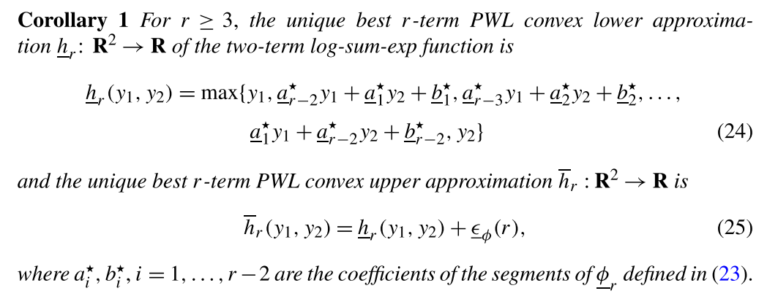
Two-term posynomials are LP-approximable.
Approximation error vs. degree of PWL approximation r.
Hsiung, K. L., Kim, S. J., and Boyd, S., “Tractable approximate robust geometric programming,” Optimization and Engineering, vol. 9, 2008, pp. 95–118.
Notes:
Key to understanding why GPs have robust formulations.
Clearly monomials are LP approximable. (log-log transform)
Use principles from BTandN to form robust approximations of GPs.
Relatively recent paper, 2008.
Deep mathematics… find proof in paper.
Epsilon is max error, phi is the t
Each nonlinear constraint, which is convex in log-space, gets PWL approximation

Slide 34
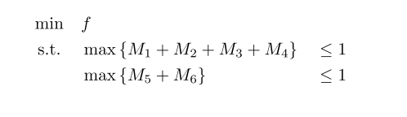
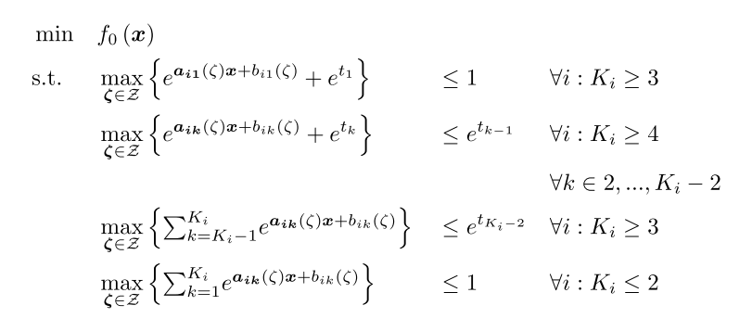
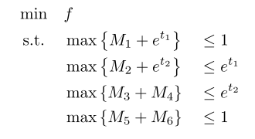
Given two-term posynomials are LP-approximable¹, all posynomials must then be LP-approximable.
The recipe:
Simple example:
1. Hsiung, K. L., Kim, S. J., and Boyd, S., “Tractable approximate robust geometric programming,” Optimization and Engineering, vol. 9, 2008, pp. 95–118.
Saab, A., Burnell, E., and Hoburg, W. W., “Robust Designs Via Geometric Programming.” 2018. ArXiv:1808.07192
Notes:
By the optimal two term approximation, each posynomial must be LP-approx.
Recipe looks complicated, it’s just relaxing large posynomials by ‘chaining’ two term posynomials.

Slide 35

Uncoupled posynomials are robustified separately.
Notes:
Treat uncoupled posynomials separately. Coupling with uncertain variables
Robustifying s2, s3 easy.
S1 requires previous recipe.

Slide 36
Three approximations exist for RGP.
Simple conservative
Maximizes each monomial term separately
Linearized perturbations
Separates large posynomial into decoupled posynomials
Robustifies smaller posy’s using RLO techniques
Best pairs
Separates large posynomial into decoupled posynomials
Finds least conservative combination of monomial pairs
Uncertain coefficients only
Increasingly
conservative
Uncertain coefficients
and exponents
Saab, A., Burnell, E., and Hoburg, W. W., “Robust Designs Via Geometric Programming.” 2018. ArXiv:1808.07192
Notes:
Posys LP approximable, LPs have tractable robust counterparts
RGPs are tractable
Simp Cons – can see why this is conservative. Monomials with inverse correlation to uncertain variable
Best pairs is against some mathematical magic.

Slide 37

Convex programs allow flexibility in objectives.
Notes:
Highlight importance of considering multiple objectives
Same aircraft, designed under certainty for these objectives. Normalized cost
Look at two specific things
Aspect ratio (unintuitive). Let’s say stubby wings are an objective
Fuel and time cost: Two extreme cases of recurring cost
Can be combined in a total cost metric, compromise aircraft
If we don’t, we can end up with extreme solutions

Slide 38
Future work
How do we use our understanding of the risk of constraint violation?
Not all constraint violation is equal!
How does RO change our understanding of the benefits of adaptable designs?
(eg. modular, morphing, adaptively manufactured designs and design families)
How can we gather data about parameters to best reduce uncertainty in feasibility/performance of designs?
Notes:
Not all… - structural constraint vs. range
Does our ability to better capture uncertainty change value proposition.
We can obtain sensitivities to size of uncertainty set.

