Slide 1
MACHINE LEARNING ASSIGNMENT
UE17CS303
To classify stellar objects into spectrometric classes based on photometric data.
BY
PRATHEEK KAMATH PES1201701595
RADHIKA SADANAND PES1201701702
REVANTH YALIPI PES1201700201

Slide 2
APPROACH:
GENETIC ALGORITHM
Basically,we take the help of neural networks to classify an instance whether it belongs to class 0,1 or 2.
But,we implement genetic algorithm to find the optimal weights for the network suited so that it can fairly classify an instance well.
This algorithm proved to be faster for us than other ML algorithms like SVM,KNN etc.
But,we implement genetic algorithm to find the optimal weights for the network suited so that it can fairly classify an instance well.

Slide 3
What is Genetic Algorithm?.
The problem addressed by GA’s is to search a space of candidate sets of weights to identify the optimal set of weights.
In GA’s the best optimal weight set is defined as the one that optimizes a predefined numerical measure for the problem at hand, called the hypothesis fitness.
The algorithm operates by iteratively updating a pool of weight sets,called the population.

Slide 4
On each iteration, all members of the population are evaluated according to the fitness function
A new population is then generated by probabilistically selecting the most fit individuals from the current population.
Some of these selected individuals are carried forward into the next generation population intact. Others are used as the basis for creating new offspring individuals by applying genetic operations such as crossover and mutation.
We have configured 3 neurons for the output layer meant for 3 classes 0,1 and 2

Slide 5
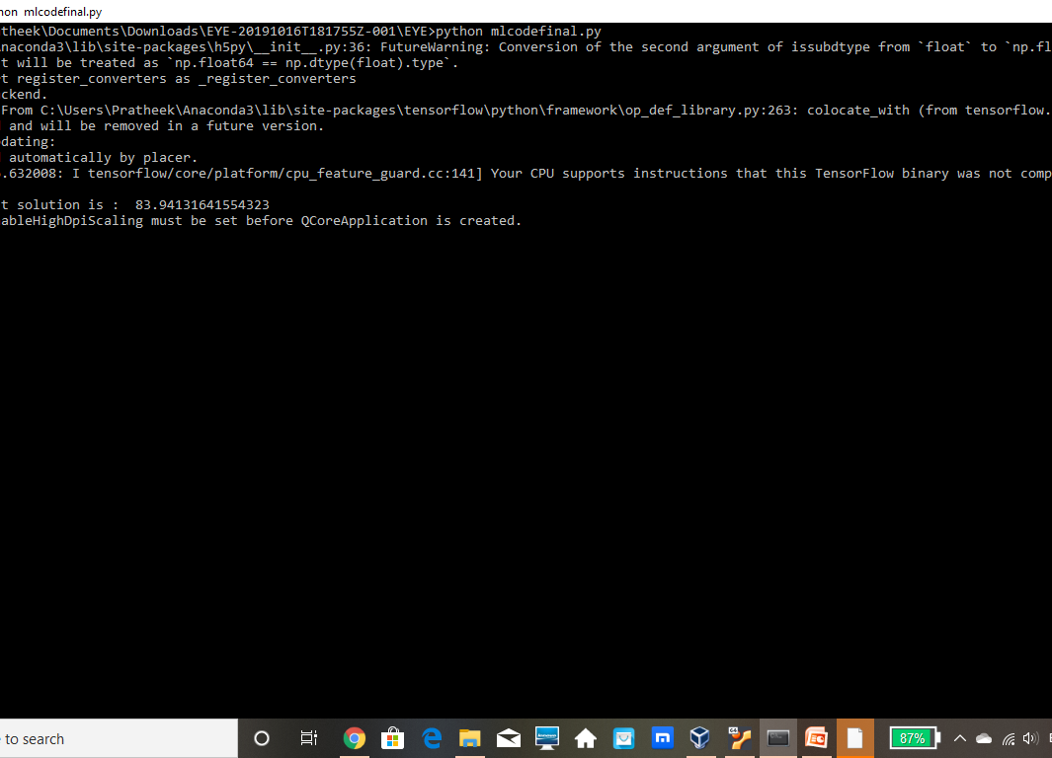
ACCURACY-----> 83.94%~84%

Slide 6
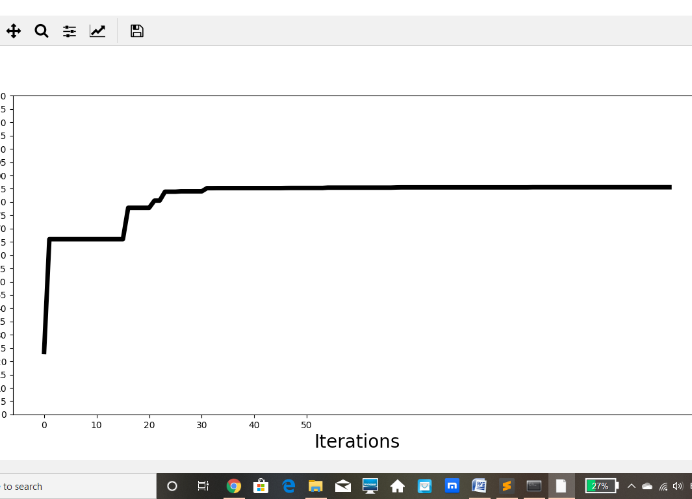
GRAPH

