Slide 1
Advanced Section #4: Methods of Dimensionality Reduction: Principal Component Analysis (PCA)
Marios Mattheakis and Pavlos Protopapas

Slide 2
Outline
Introduction:
Why Dimensionality Reduction?
Linear Algebra (Recap)
Statistics (Recap)
Principal Component Analysis:
Foundation
Assumptions & Limitations
Kernel PCA for nonlinear dimensionality reduction.

Slide 3
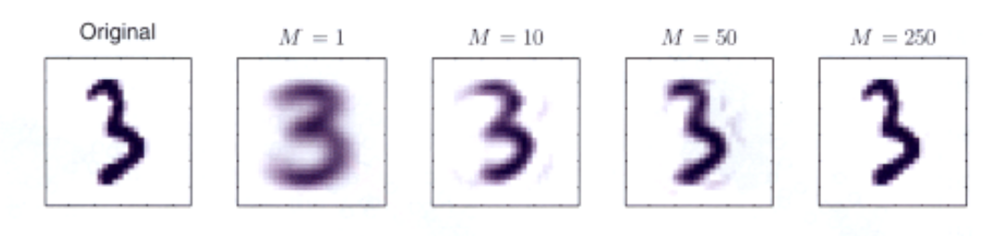

Dimensionality Reduction, why?
A process of reducing the number of predictor variables under consideration.
To find a more meaningful basis to express our data filtering the noise and revealing the hidden structure
C. Bishop, Pattern Recognition and Machine Learning, Springer (2008).

Slide 4
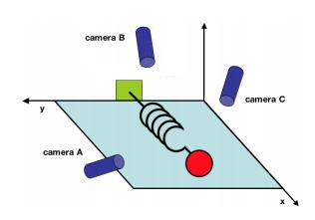
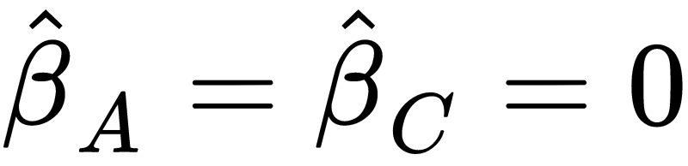
A simple example taken by Physics
Consider an ideal spring-mass system oscillating along x
Seeking for the force Y that spring exerts on the wall.
LASSO regression model:
LASSO variable selection:
J. Shlens, A Tutorial on Principal Component Analysis, (2003).

Slide 5
Principal Component Analysis versus LASSO
LASSO
LASSO simply selects one of the arbitrary directions, scientifically unsatisfactory.
We want to use all the measurements to situate the position of mass.
We want to find a lower-dimensional manifold of predictors that data lie.
X
X
Principal Component Analysis (PCA): A powerful Statistical tool for analyzing data sets and is formulated in the context of Linear Algebra.

Slide 6
Linear Algebra (Recap)

Slide 7





Symmetric matrices
Suppose an arbitrary matrix of real numbers
Then the and are symmetric matrices. Symmetric property:

Slide 8






Eigenvalues and Eigenvectors
Suppose a real, symmetric matrix:
Exists a unique set of real eigenvalues: and the associate linear independent eigenvectors:
such that:
(orthogonal)
(normalized)
Hence, they consist an orthonormal basis.

Slide 9
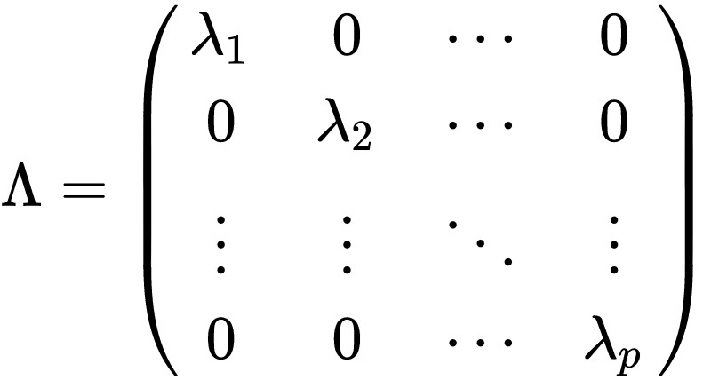
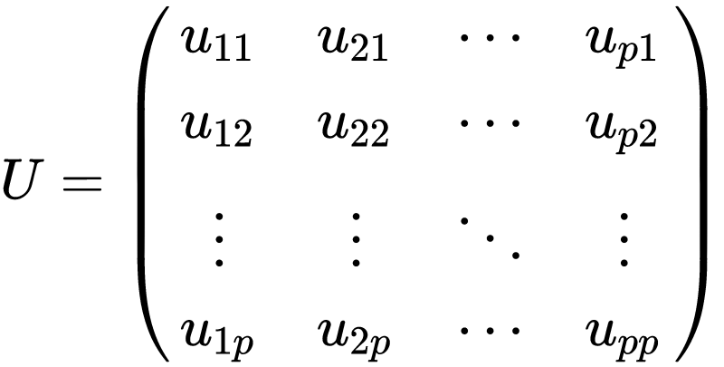

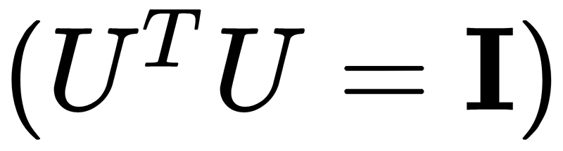

Spectrum and Eigen-decomposition
Spectrum:
Unitary Matrix:
Eigen-decomposition:

Slide 10
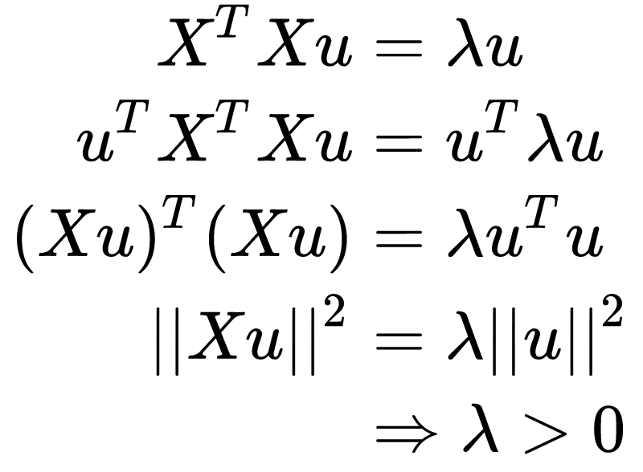
Real & Positive Eigenvalues: Gram Matrix
The eigenvalues of and are positive & real numbers:
Hence, and are Gram matrices.

Slide 11
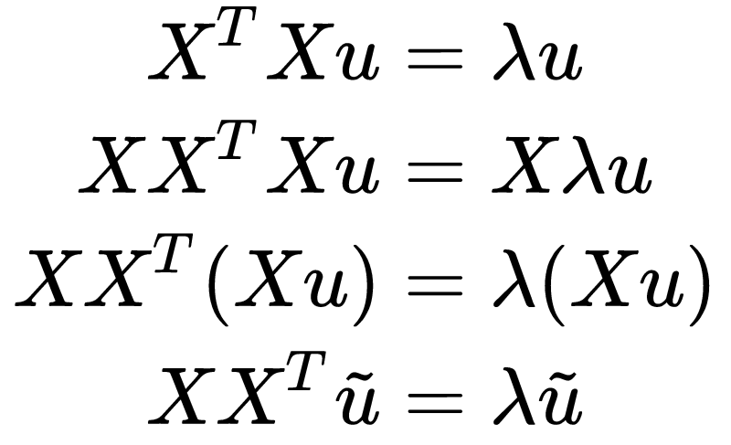


Same eigenvalues
The and share the same eigenvalues
Same eigenvalues:
Modified eigenvectors:

Slide 12
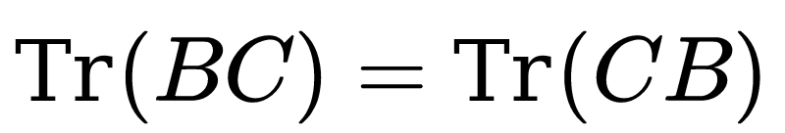
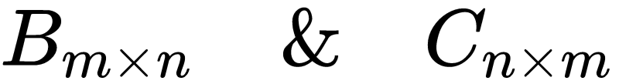
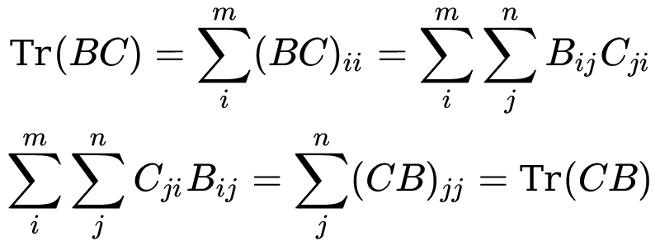
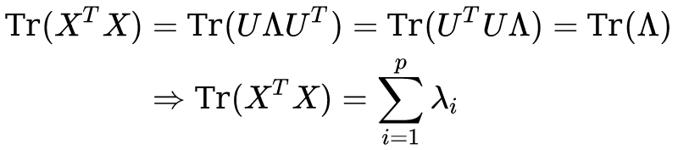
The sum of eigenvalues of is equal to the trace
Cyclic Property of Trace: Suppose the matrices:
The trace of a Gram matrix is the sum of its eigenvalues.

Slide 13
Statistics (Recap)

Slide 14
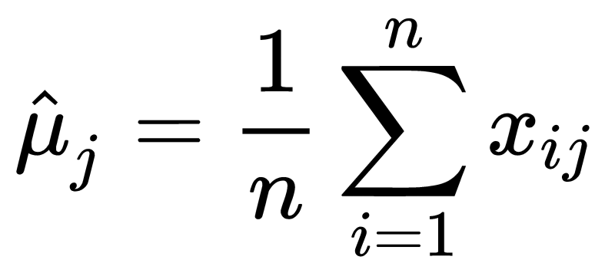

Centered Model Matrix
Suppose the model (data) matrix
We make the predictors centered (each column has zero expectation) by subtracting the sample mean
Centered Model Matrix
Notes:
each of the n rows represents a different repetition of the experiment, and each of the p columns gives a particular kind of feature

Slide 15
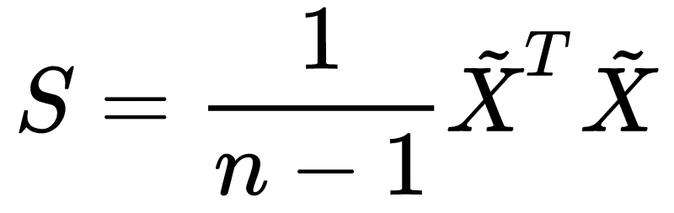
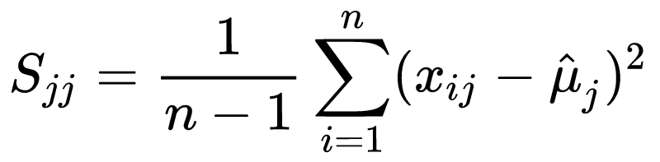
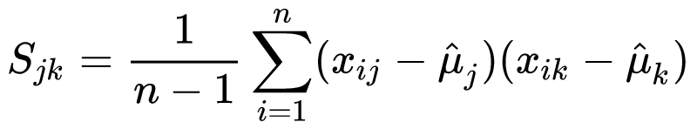
Sample Covariance Matrix
Consider the Covariance matrix
Inspecting the terms:
Th diagonal terms are the sample variances
The non-diagonal terms are the sample covariances

Slide 16
Principal Components Analysis (PCA)
Notes:
With the above preliminaries, the actual methodology of PCA is now quite simple. The idea is to remove as much redundancy in our predictors as possible. The redundancy is defined through the correlation between the predictors.

Slide 17
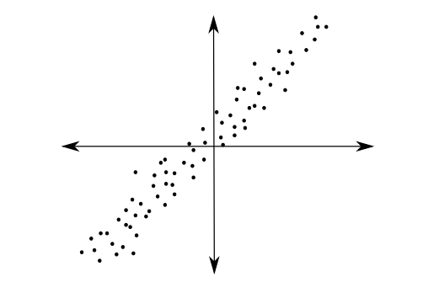
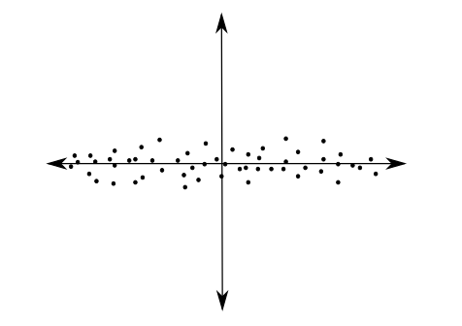
PCA
PCA tries to fit an n-dimensional ellipsoid to the data.
PCA is a linear transformation that transforms data to a new coordinate system.
Now, the data with the greatest variance lie on the first coordinate (first principal component) and so on.
J. Jauregui (2012)
Notes:
Using Linear Algebra

Slide 18



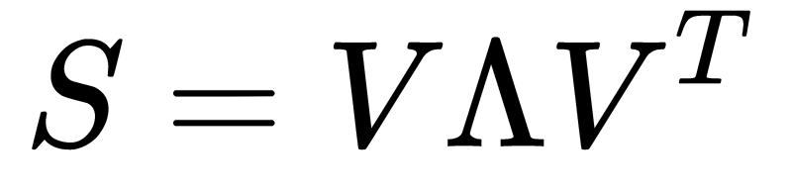



PCA foundation
Since is a Gram matrix, will be a Gram matrix too, hence:
The eigenvalues are sorted in the
The eigenvector is called the i^{th} principal component of
Notes:
Using Linear Algebra

Slide 19
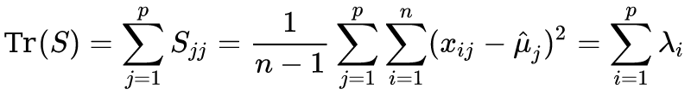
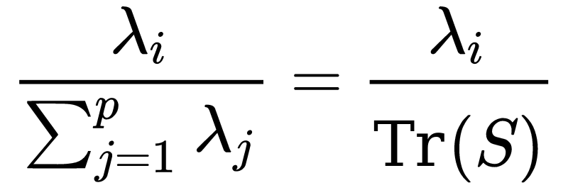

Measure the importance of the principal components
The total sample variance of the predictors:
The fraction of the total sample variance that corresponds to
so, the indicates the “importance” of the i^{th} principal component

Slide 20

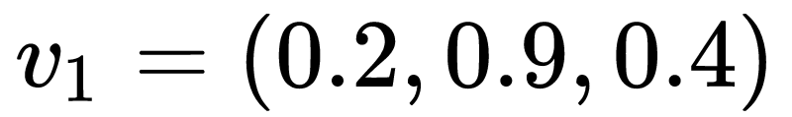
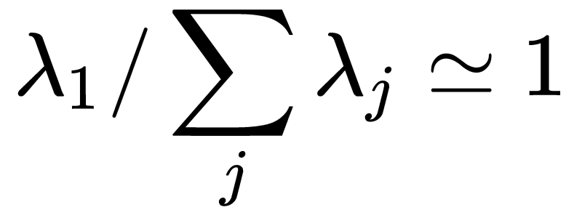
Back to spring-mass example
The principal comp. denote directions in that are “natural” for the data and linear combinations of the original coordinates.
For the spring-mass example:
with
as it represents the x-axis
Hence, PCA indicates that there may be fewer variables, represented by , that are responsible for the variability of the response

Slide 21
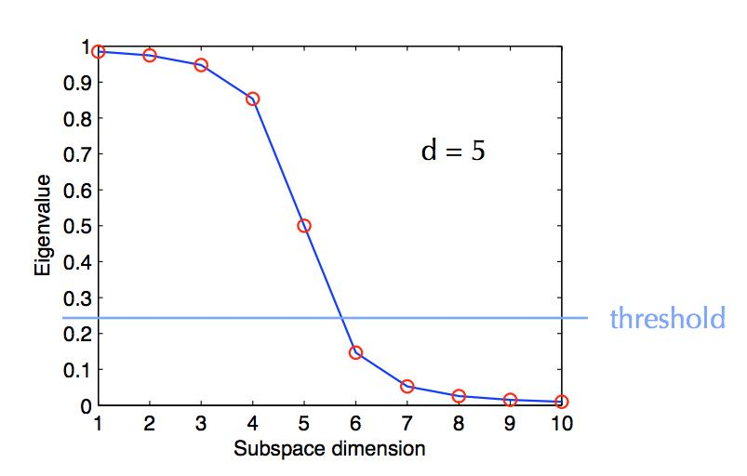
PCA Dimensionality Reduction
The Spectrum represents the dimensionality reduction by PCA
Notes:
Usually the first eigenvalue are orders of magnitude greater than the others because the data may have fewer degrees of freedom than the number of the predictors.

Slide 22
PCA Dimensionality Reduction
There is no rule in how many eigenvalues to keep, but it is generally clear and left in analyst’s discretion
C. Bishop, Pattern Recognition and Machine Learning, Springer (2008).
Notes:
Usually the first eigenvalue are orders of magnitude greater than the others because the data may have fewer degrees of freedom than the number of the predictors.
How many eigenvalues to keep is left in teh

Slide 23
Assumptions of PCA
Although PCA is a powerful tool for dimension reduction, it is based on some strong assumptions.
The assumptions are reasonable, but they must be checked in practice before drawing conclusions from PCA.
When PCA assumptions fail, we need to use other Linear or Nonlinear dimension reduction methods.

Slide 24
Mean/Variance are sufficient
In applying PCA, we assume that means and covariance matrix are sufficient for describing the distributions of the predictors.
This is true only if the predictors are drawn by a multivariable Normal distribution, but approximately works for many situations.
When a predictor is heavily deviate from Normal distribution, an appropriate nonlinear transformation of the predictor may solve this problem.

Slide 25
High Variance indicates importance
The eigenvalue is measures the “importance” of the i^{th} principal component.
This is intuitively reasonable, that lower variability components describe lesse the data, but it is not always true and needs to be checked.

Slide 26
Principal Components are orthogonal
PCA assumes that the intrinsic dimensions are orthogonal allowing us to use linear algebra techniques
When this assumption fails, we need to assume non-orthogonal components which are non compatible with PCA.

Slide 27
Linear Change of Basis
PCA consists of a change of basis from Euclidean basis, where we measure the predictors, to an orthonormal basis of eigenvectors of
When the data lie on a nonlinear manifold in the predictor space, then linear methods are doomed to fail.

Slide 28



Kernel PCA for Nonlinear Dimensionality Reduction
Applying a nonlinear map Φ (called feature map) on data yields PCA kernel:
Centered nonlinear representation
Apply PCA to the modified Kernel

Slide 29
Summary
Dimensionality Reduction Methods
A process of reducing the number of predictor variables under consideration.
To find a more meaningful basis to express our data filtering the noise and revealing the hidden structure.
Principal Component Analysis
A powerful Statistical tool for analyzing data sets and is formulated in the context of Linear Algebra.
Spectral decomposition: We reduce the dimension of predictors by reducing the number of principal components and their eigenvalues.
PCA is based on strong assumptions that we need to check.
Kernel PCA for nonlinear dimensionality reduction.

Slide 30
Advanced Section 4: Dimensionality Reduction, PCA
Thank you
Office hours are:
Monday 6:00-7:30 pm
Tuesday 6:30-8:00 pm

