Slide 1
Advanced Section #3: Methods of Regularization and their justifications
Camilo Fosco

Slide 2
Outline
Motivation for regularization
Generalization
Instability
Ridge estimator
Lasso estimator
Elastic Net estimator
Visualizations
Bayesian approach

Slide 3

Regularization: introduce additional information to solve ill-posed problems or avoid overfitting.

Slide 4
Motivation
Why do we regularize?

Slide 5
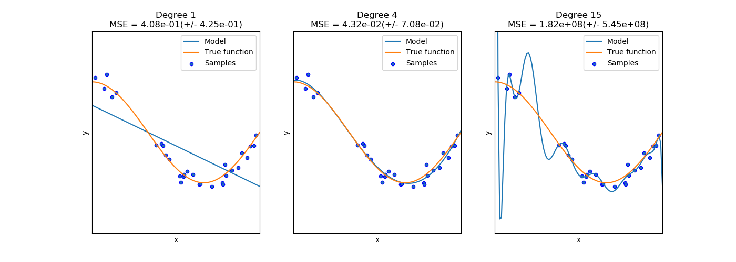
Generalization
Avoid overfitting. Reduce features that have weak predictive power.
Discourage the use of a model that is too complex.
Do not fit the noise!
Notes:
Regularization will, in most cases, add a bias to our coefficients such that they perform worse on train data, but hopefully they perform better on test data. Complex model hard to understand!

Slide 6
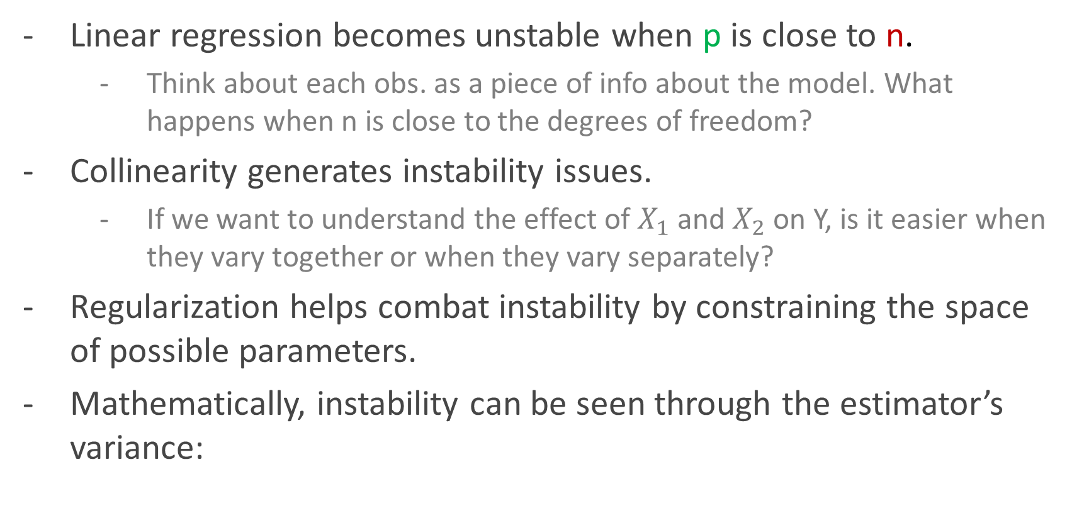

Instability issues
Linear regression becomes unstable when p is close to n.
Think about each obs. as a piece of info about the model. What happens when n is close to the degrees of freedom?
Collinearity generates instability issues.
If we want to understand the effect of $X_{1}$ and $X_{2}$ on Y, is it easier when they vary together or when they vary separately?
Regularization helps combat instability by constraining the space of possible parameters.
Mathematically, instability can be seen through the estimator’s variance:
$$var\left(\hat{β}\right)=σ^{2}{\left(X^{T}X\right)}^{−1}$$
Notes:
Instability = (small change in input generates big change in output)

Slide 7

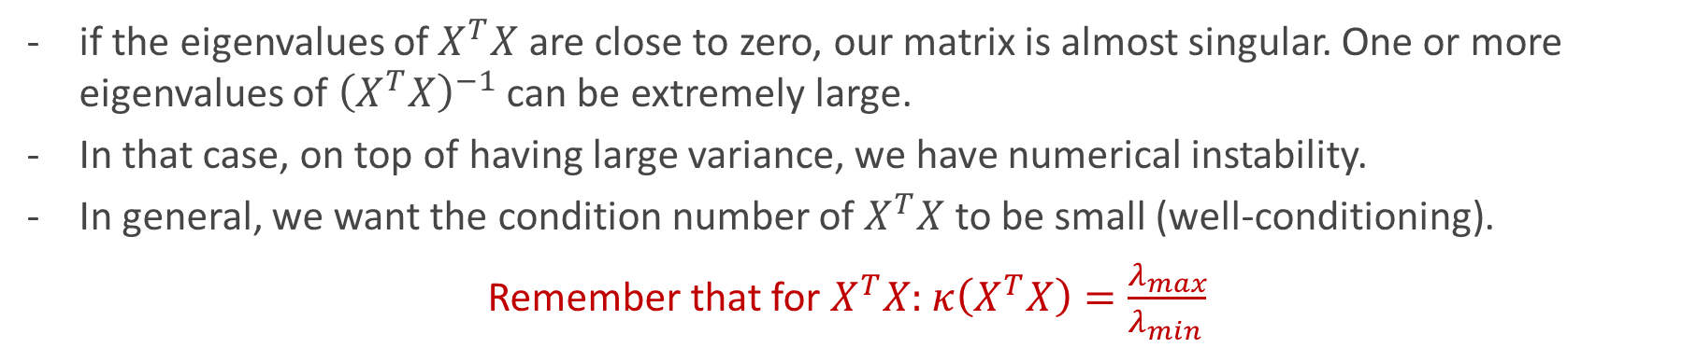
Instability issues
$$var\left(\hat{β}\right)=σ^{2}{\left(X^{T}X\right)}^{−1}$$
var(Y)
Inverse of Gram matrix
The variance of the estimator is affected by the irreducible noise of the model. We have no control over this.
But the variance also depends on the predictors themselves! This is the important part.
if the eigenvalues of $X^{T}X$ are close to zero, our matrix is almost singular. One or more eigenvalues of ${\left(X^{T}X\right)}^{−1}$ can be extremely large.
In that case, on top of having large variance, we have numerical instability.
In general, we want the condition number of $X^{T}X$ to be small (well-conditioning).
Remember that for $X^{T}X:$ $κ\left(X^{T}X\right)=\frac{λ_{max}}{λ_{min }}$
Notes:
Out loud: This is an important formula. The sigma corresponds to the variance of the response, and the second term is the inverse of the Gram matrix. It is clear from here that if XtX is ill-conditioned, the variance of my estimator will be large. Ill-conditioning = condition number large = you are working on scales that differ on complete orders of magnitude. Thinking of our matrix as a transformation, it is like squeezing something really thin in one direction, while stretching it very far in another direction.
In nearly collinear datasets, condition number is large, and small changes in our data can yield large changes in our estimations.

Slide 8
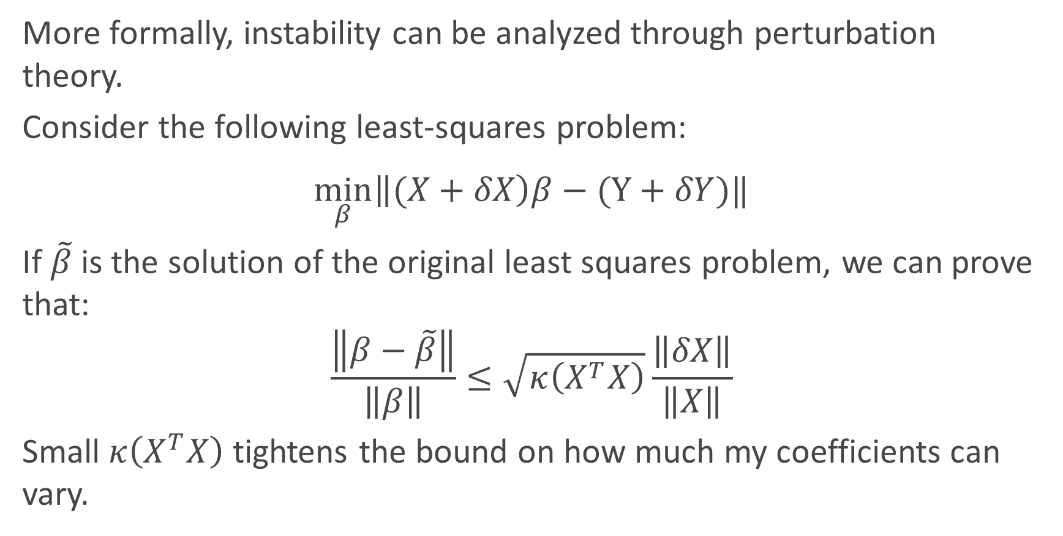

Instability and the condition number
More formally, instability can be analyzed through perturbation theory.
Consider the following least-squares problem:
$$\min_{β}\left\|(X+δX\right)β−(Y+δY)‖$$
If $\tilde{β}$ is the solution of the original least squares problem, we can prove that:
$$\frac{\left\|β−\tilde{β}\right\|}{\left\|β\right\|}≤\sqrt{κ\left(X^{T}X\right)}\frac{\left\|δX\right\|}{\left\|X\right\|}$$
Small $κ\left(X^{T}X\right)$ tightens the bound on how much my coefficients can vary.
Perturbations
Condition number of $X^{T}X$

Slide 9
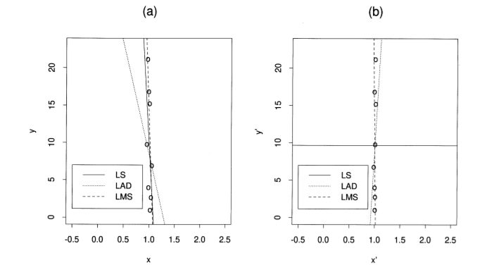
Instability visualized
Instability can be visualized by regressing on nearly colinear data, and observing the changes on the same data, slightly perturbed:
Image from “Instability of Least Squares, Least Absolute Deviation and Least Median of Squares Linear Regression”, Ellis et al. (1998)

Slide 10
Motivation in short
We want less complex models to avoid overfitting and increase interpretability.
We want to be able to solve problems where p = n or p > n, and still generalize reasonably well.
We want to reduce instability (increase min eigenvalue/reduce condition number) in our estimators. We need to be better at estimating betas with colinear predictors.
In a nutshell, we want to avoid ill-posed problems (no solutions / solutions not unique / unstable solutions)

Slide 11
Ridge regression
Instability destroyer

Slide 12
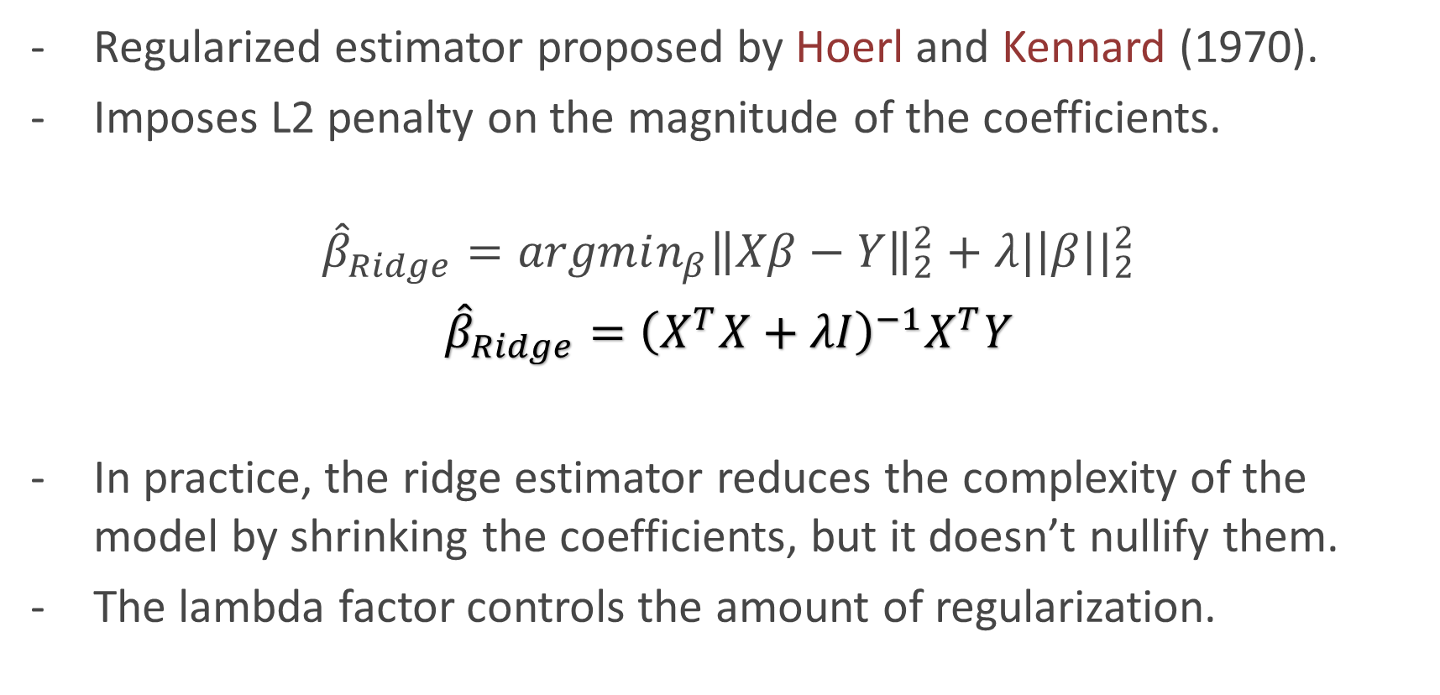
What is the Ridge estimator?
Regularized estimator proposed by Hoerl and Kennard (1970).
Imposes L2 penalty on the magnitude of the coefficients.
$${\hat{β}}_{Ridge}=argmin_{β}{\left\|Xβ−Y\right\|}_{2}^{2}+λ{|\left|β\right||}_{2}^{2}$$
$${\hat{β}}_{Ridge}={\left(X^{T}X+λI\right)}^{−1}X^{T}Y$$
In practice, the ridge estimator reduces the complexity of the model by shrinking the coefficients, but it doesn’t nullify them.
The lambda factor controls the amount of regularization.
Regularization factor
Notes:
Although we learn from this formulation that Ridge helps because it shrinks the parameters (less model complexity translates to better out of sample error, provable with learning theory), This formulation is not the original one. In fact, originally, it was proposed as a way to solve instability in the Gram matrix by adding a constant to the eigenvalues.

Slide 13
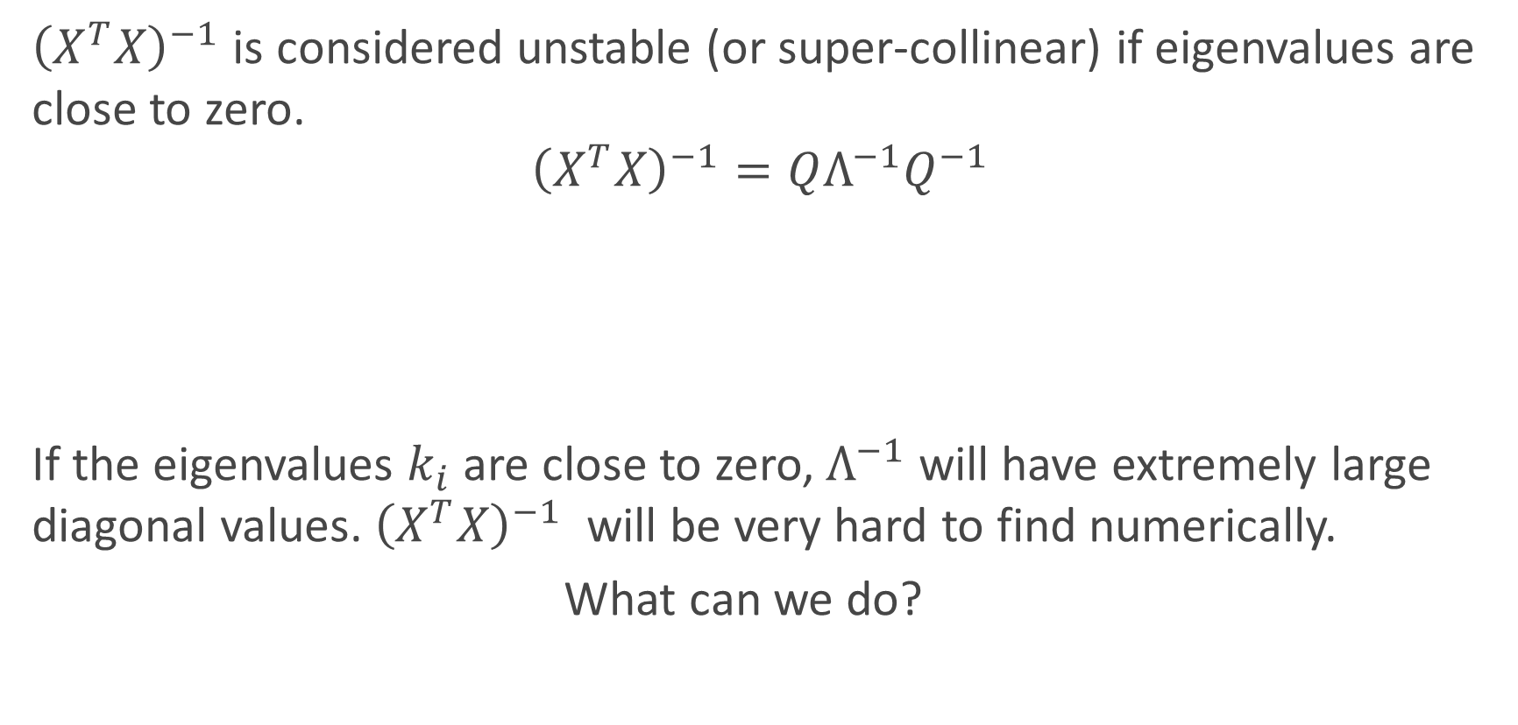

Deriving the Ridge estimator
${\left(X^{T}X\right)}^{−1}$ is considered unstable (or super-collinear) if eigenvalues are close to zero.
$${\left(X^{T}X\right)}^{−1}=QΛ^{−1}Q^{−1}$$
If the eigenvalues $k_{i}$ are close to zero, $Λ^{−1}$ will have extremely large diagonal values.${\left(X^{T}X\right)}^{−1}$ will be very hard to find numerically.
What can we do?
Eigendecompostion
$Λ^{−1}=\left[\begin{matrix}k_{1}^{−1} & 0 & 0 \\ 0 & ⋱ & 0 \\ 0 & 0 & k_{p}^{−1}\end{matrix}\right]$.

Slide 14

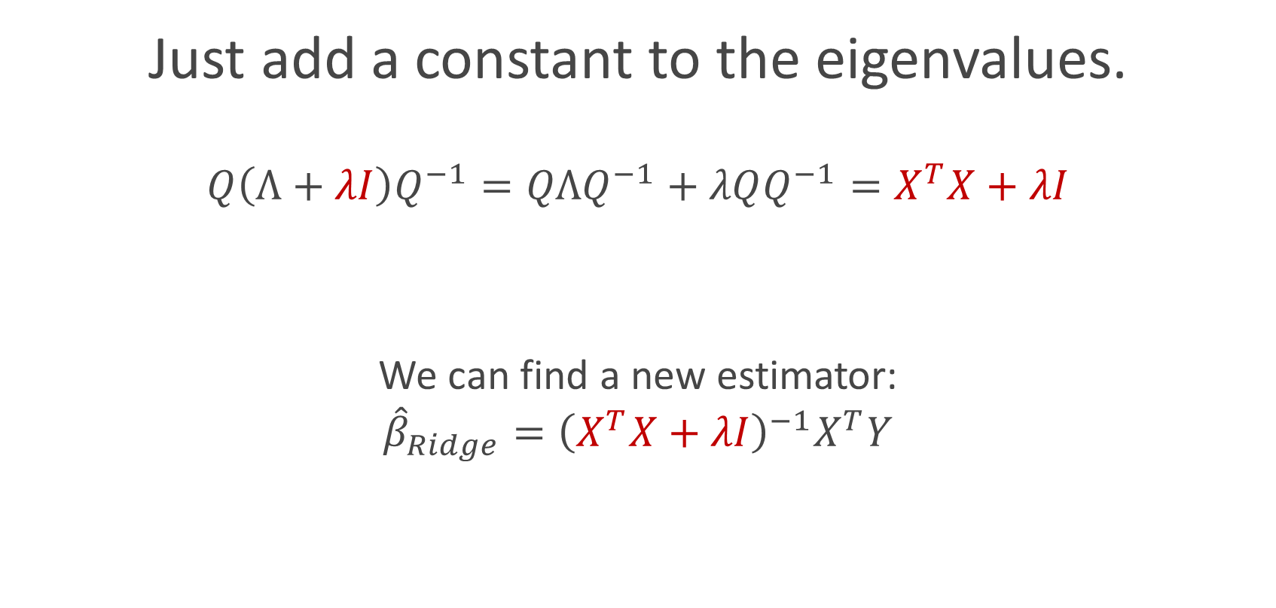
Deriving the Ridge estimator
Just add a constant to the eigenvalues.
$$Q\left(Λ+λI\right)Q^{−1}=QΛQ^{−1}+λQQ^{−1}=X^{T}X+λI$$
We can find a new estimator:
$${\hat{β}}_{Ridge}={\left(X^{T}X+λI\right)}^{−1}X^{T}Y$$
Added constant $λ$

Slide 15
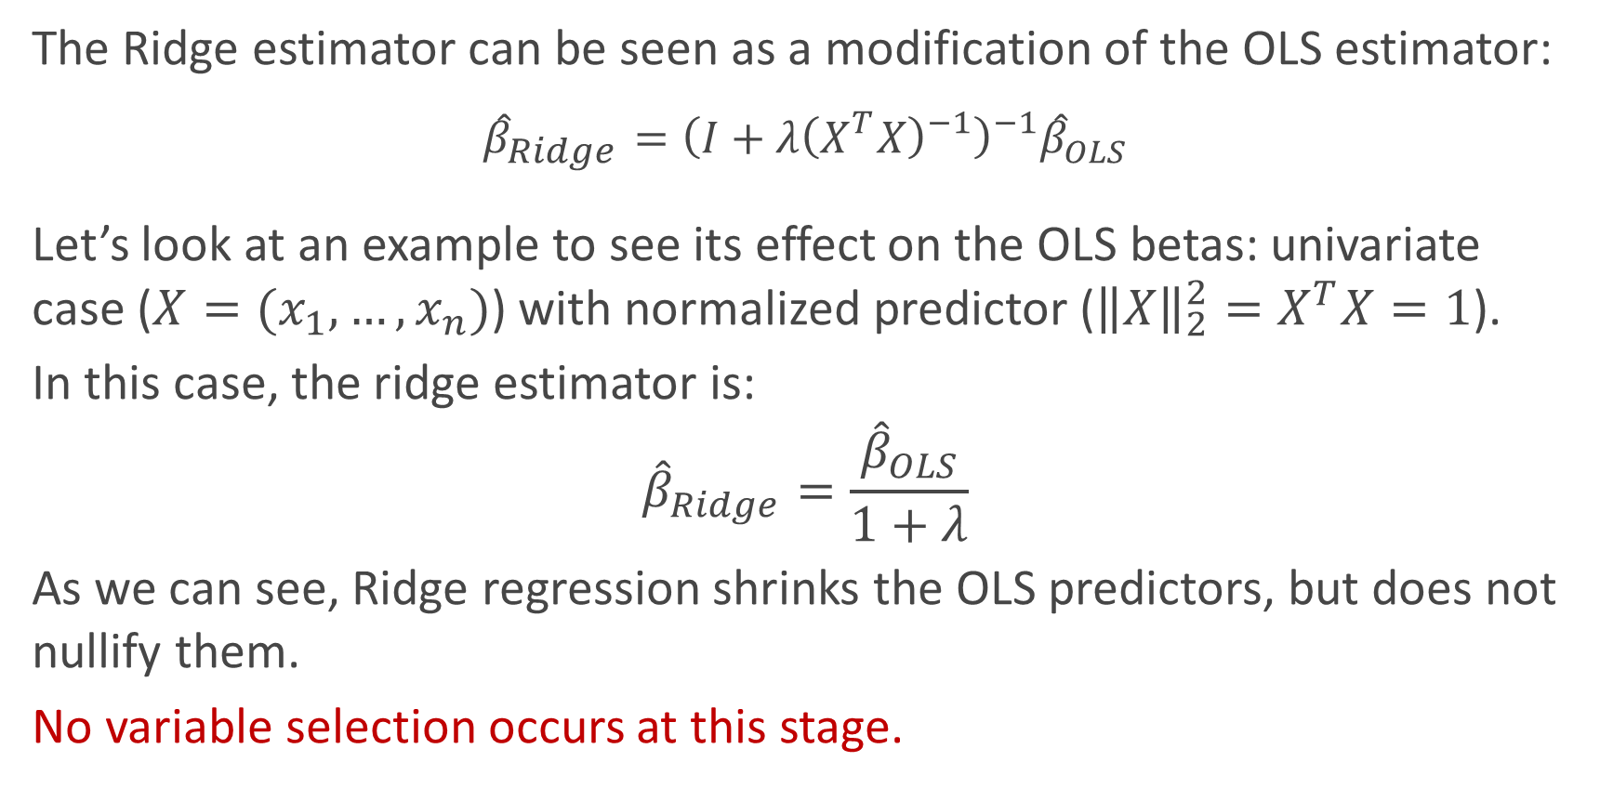
Properties: shrinks the coefficients
The Ridge estimator can be seen as a modification of the OLS estimator:
$${\hat{β}}_{Ridge}={\left(I+λ{\left(X^{T}X\right)}^{−1}\right)}^{−1}{\hat{β}}_{OLS}$$
Let’s look at an example to see its effect on the OLS betas: univariate case ($X=(x_{1},…, x_{n})$) with normalized predictor (${\left\|X\right\|}_{2}^{2}=X^{T}X=1$).
In this case, the ridge estimator is:
$${\hat{β}}_{Ridge}=\frac{{\hat{β}}_{OLS}}{1+λ}$$
As we can see, Ridge regression shrinks the OLS predictors, but does not nullify them.
No variable selection occurs at this stage.

Slide 16
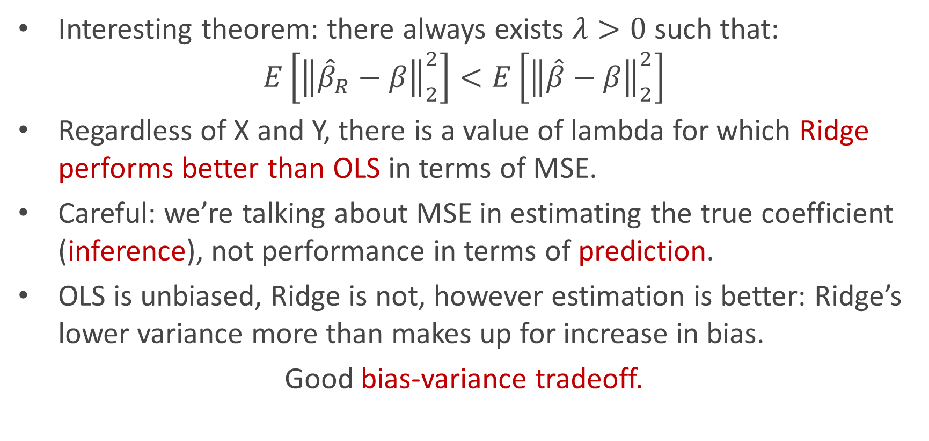
Properties: closer to the real beta
Interesting theorem: there always exists $λ>0$ such that:
$$E\left[{\left\|{\hat{β}}_{R}−β\right\|}_{2}^{2}\right]<E\left[{\left\|\hat{β}−β\right\|}_{2}^{2}\right]$$
Regardless of X and Y, there is a value of lambda for which Ridge performs better than OLS in terms of MSE.
Careful: we’re talking about MSE in estimating the true coefficient (inference), not performance in terms of prediction.
OLS is unbiased, Ridge is not, however estimation is better: Ridge’s lower variance more than makes up for increase in bias.
Good bias-variance tradeoff.

Slide 17
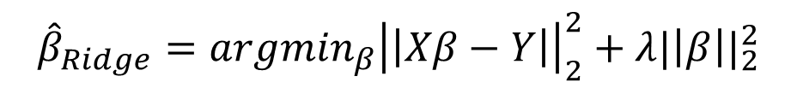
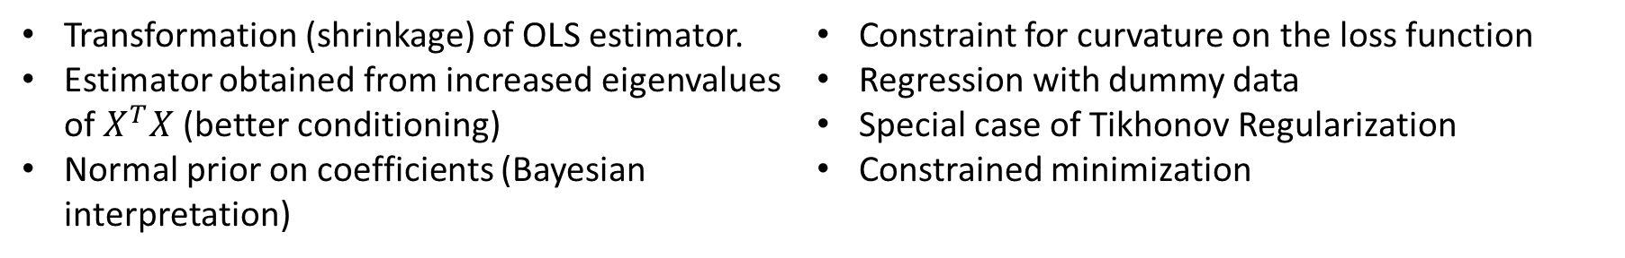
Different perspectives on Ridge
So far, we understand Ridge as a penalty on the optimization objective:
However, there are multiple ways to look at it:
$${\hat{β}}_{Ridge}=argmin_{β}{\left|\left|Xβ−Y\right|\right|}_{2}^{2}+λ{|\left|β\right||}_{2}^{2}$$
Transformation (shrinkage) of OLS estimator.
Estimator obtained from increased eigenvalues of $X^{T}X$ (better conditioning)
Normal prior on coefficients (Bayesian interpretation)
Constraint for curvature on the loss function
Regression with dummy data
Special case of Tikhonov Regularization
Constrained minimization

Slide 18
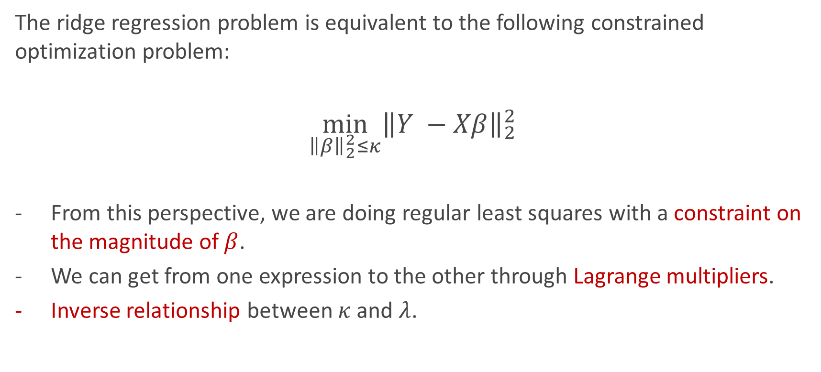
Optimization perspective
The ridge regression problem is equivalent to the following constrained optimization problem:
$$\min_{{\left\|β\right\|}_{2}^{2}≤κ}{{\left\|Y −Xβ\right\|}_{2}^{2}}$$
From this perspective, we are doing regular least squares with a constraint on the magnitude of $β$.
We can get from one expression to the other through Lagrange multipliers.
Inverse relationship between $κ$ and $λ$.

Slide 19

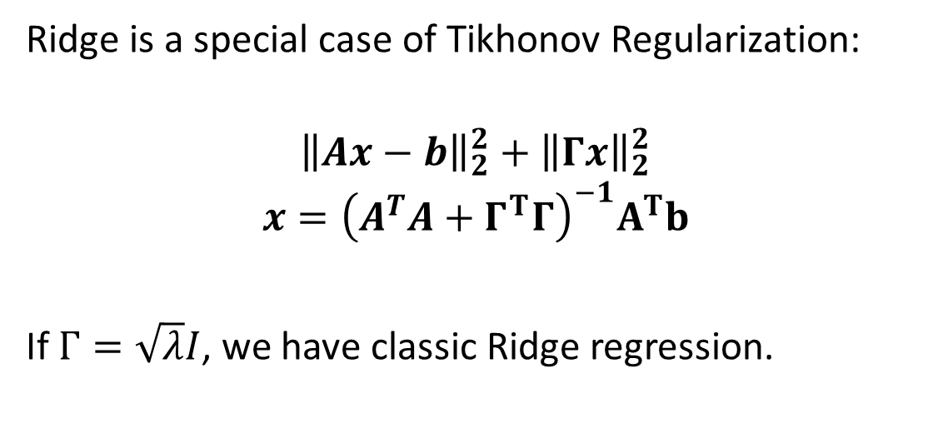
Ridge, formal perspective
Ridge is a special case of Tikhonov Regularization:
$${\left\|Ax−b\right\|}_{2}^{2}+{\left\|Γx\right\|}_{2}^{2}$$
$$x={\left(A^{T}A+Γ^{T}Γ\right)}^{−1}A^{T}b$$
If $Γ=\sqrt{λ}I$, we have classic Ridge regression.
Monsieur Ridge
Tikhonov Matrix
Tikhonov regularization is interesting, as we can use $Γ$ to generate other constraints, such as smoothness in the estimator values.

Slide 20
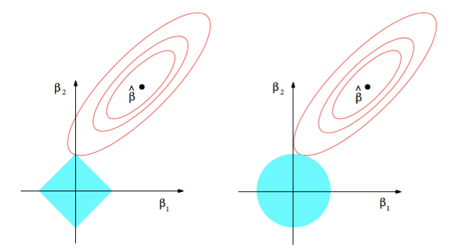
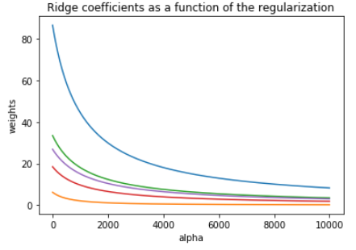
Ridge visualized
Ridge estimator
The ridge estimator is where the constraint and the loss intersect.
The values of the coefficients decrease as lambda increases, but they are not nullified.

Slide 21
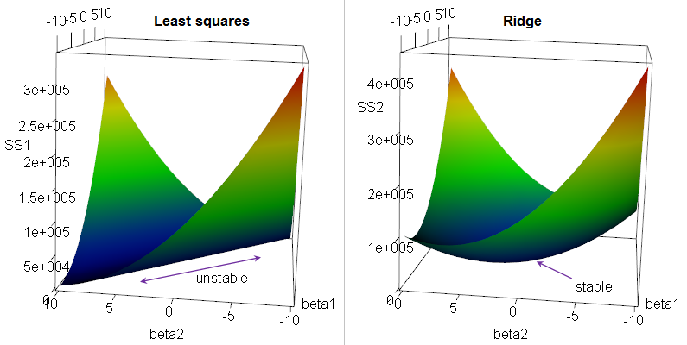
Ridge visualized
Ridge curves the loss function in colinear problems, avoiding instability.
Notes:
If there's multicollinearity, you get a "ridge" in the likelihood function (likelihood is a function of the β's). This in turn yields a long "valley" in the RSS (since RSS=−2logL−2log⁡L).
Ridge regression "fixes" the ridge - it adds a penalty that turns the ridge into a nice peak in likelihood space, equivalently a nice depression in the criterion we're minimizing.

Slide 22
LASSO regression
Yes, LASSO is an acronym

Slide 23
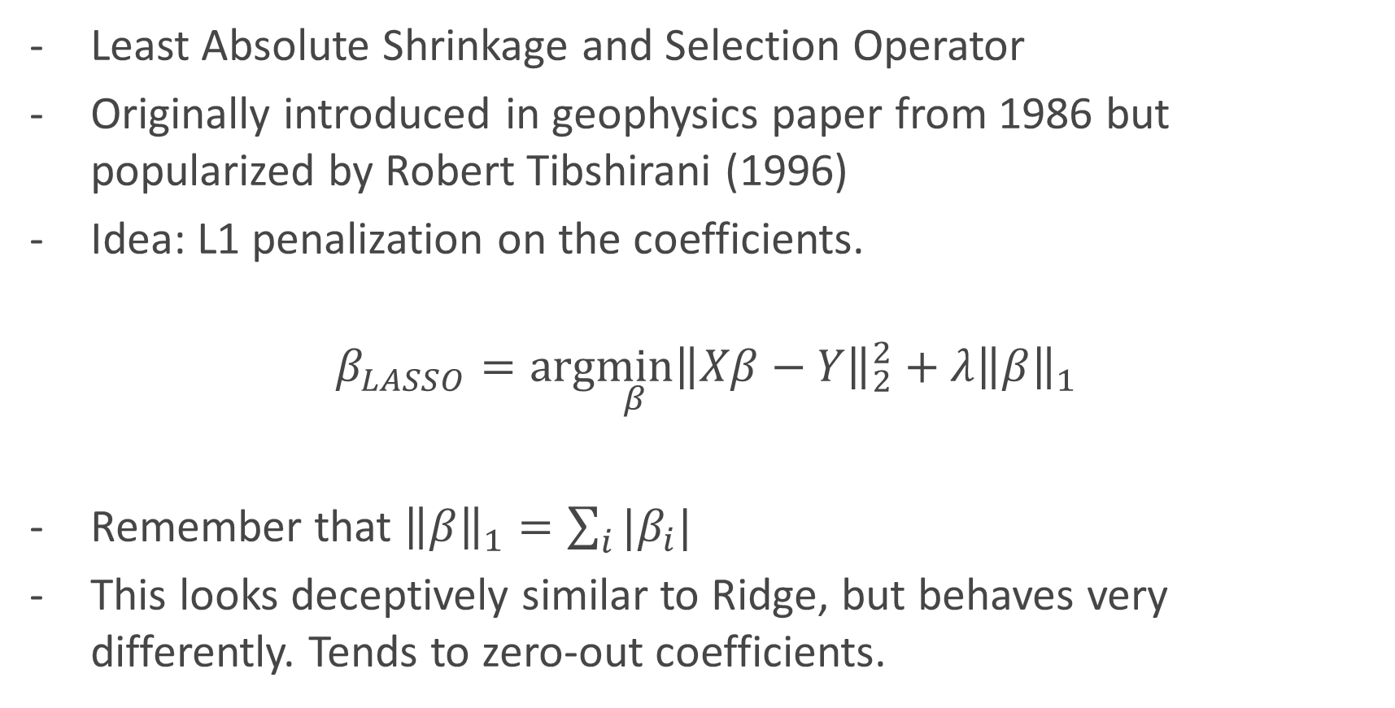
What is LASSO?
Least Absolute Shrinkage and Selection Operator
Originally introduced in geophysics paper from 1986 but popularized by Robert Tibshirani (1996)
Idea: L1 penalization on the coefficients.
$$β_{LASSO}=arg\min_{β}{\left\|Xβ−Y\right\|}_{2}^{2}+λ{\left\|β\right\|}_{1}$$
Remember that ${\left\|β\right\|}_{1}=\sum_{i}{|β_{i}|}$
This looks deceptively similar to Ridge, but behaves very differently. Tends to zero-out coefficients.

Slide 24
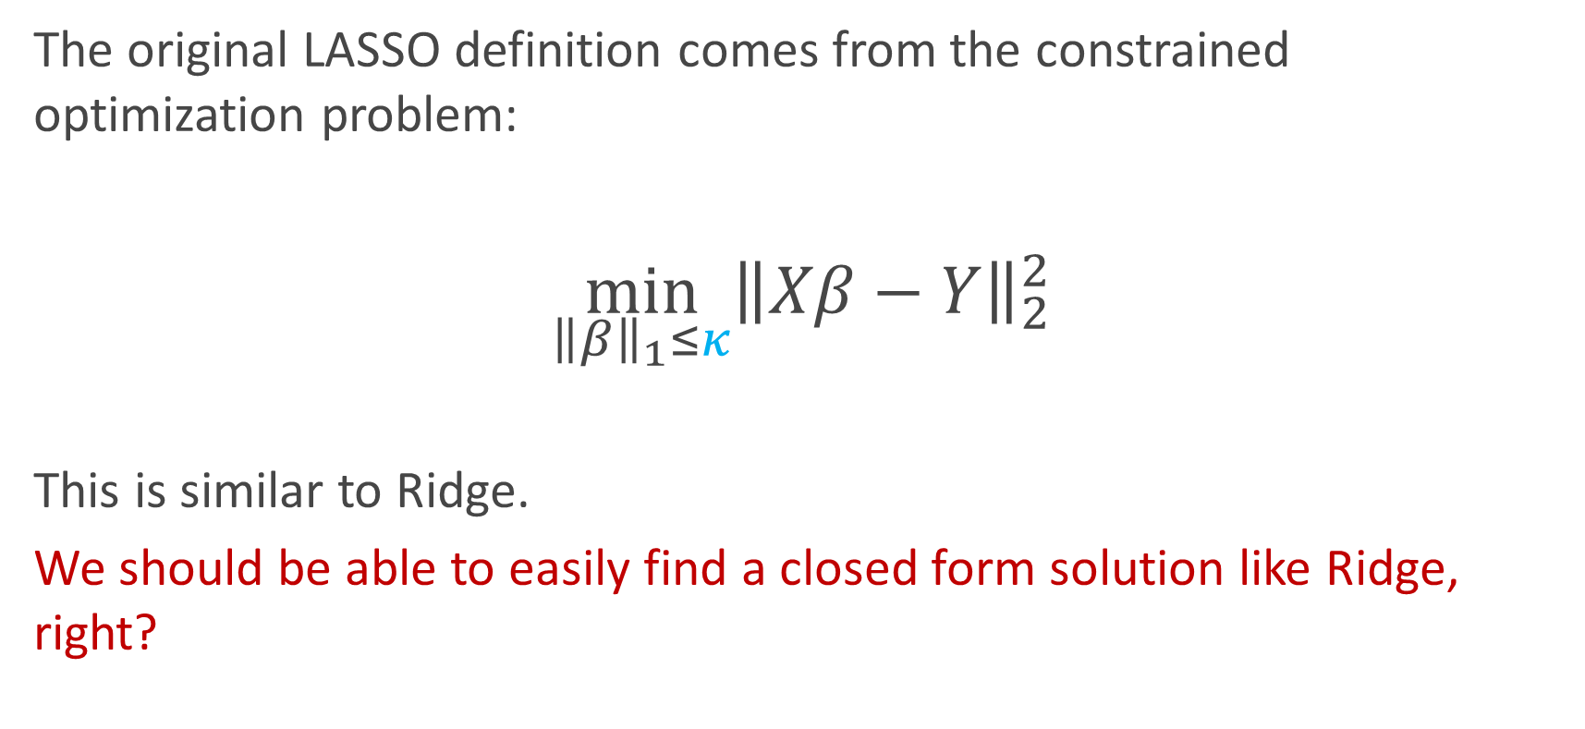
Deriving the LASSO estimator
The original LASSO definition comes from the constrained optimization problem:
$$\min_{{\left\|β\right\|}_{1}≤κ}{\left\|Xβ−Y\right\|}_{2}^{2}$$
This is similar to Ridge.
We should be able to easily find a closed form solution like Ridge, right?

Slide 25
No.

Slide 26
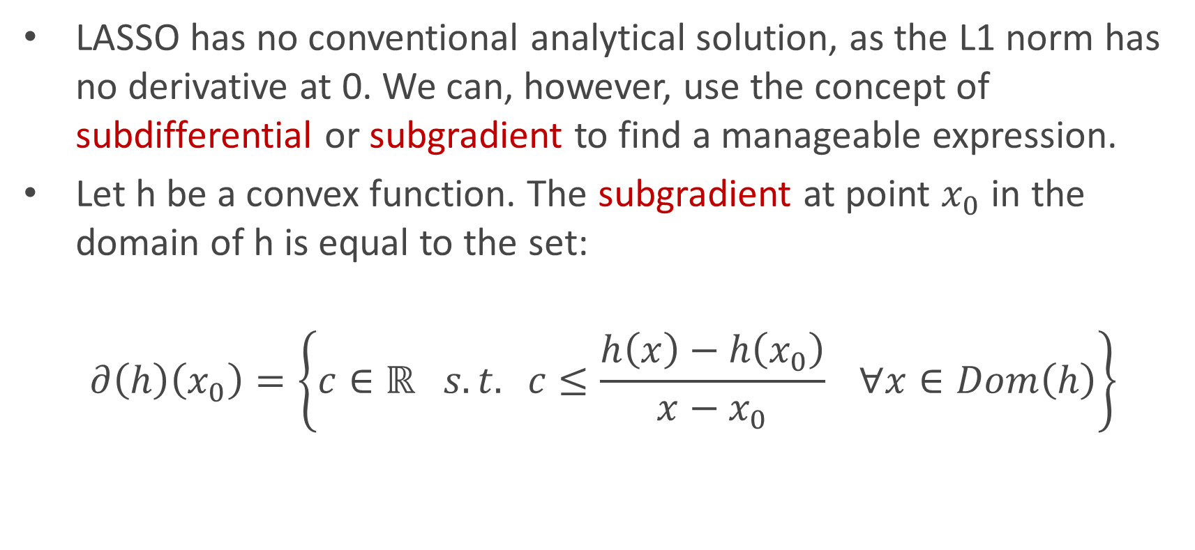
Subgradient to the rescue
LASSO has no conventional analytical solution, as the L1 norm has no derivative at 0. We can, however, use the concept of subdifferential or subgradient to find a manageable expression.
Let h be a convex function. The subgradient at point $x_{0}$ in the domain of h is equal to the set:
$$∂\left(h\right)\left(x_{0}\right)=\left\{c∈ℝ s.t. c≤\frac{h\left(x\right)−h\left(x_{0}\right)}{x−x_{0}} ∀x∈Dom\left(h\right)\right\}$$

Slide 27
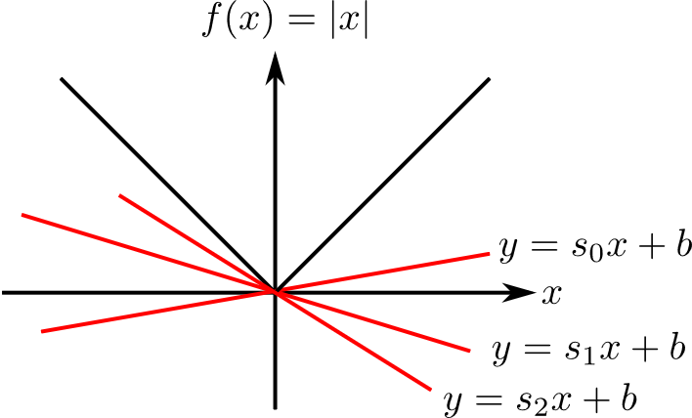
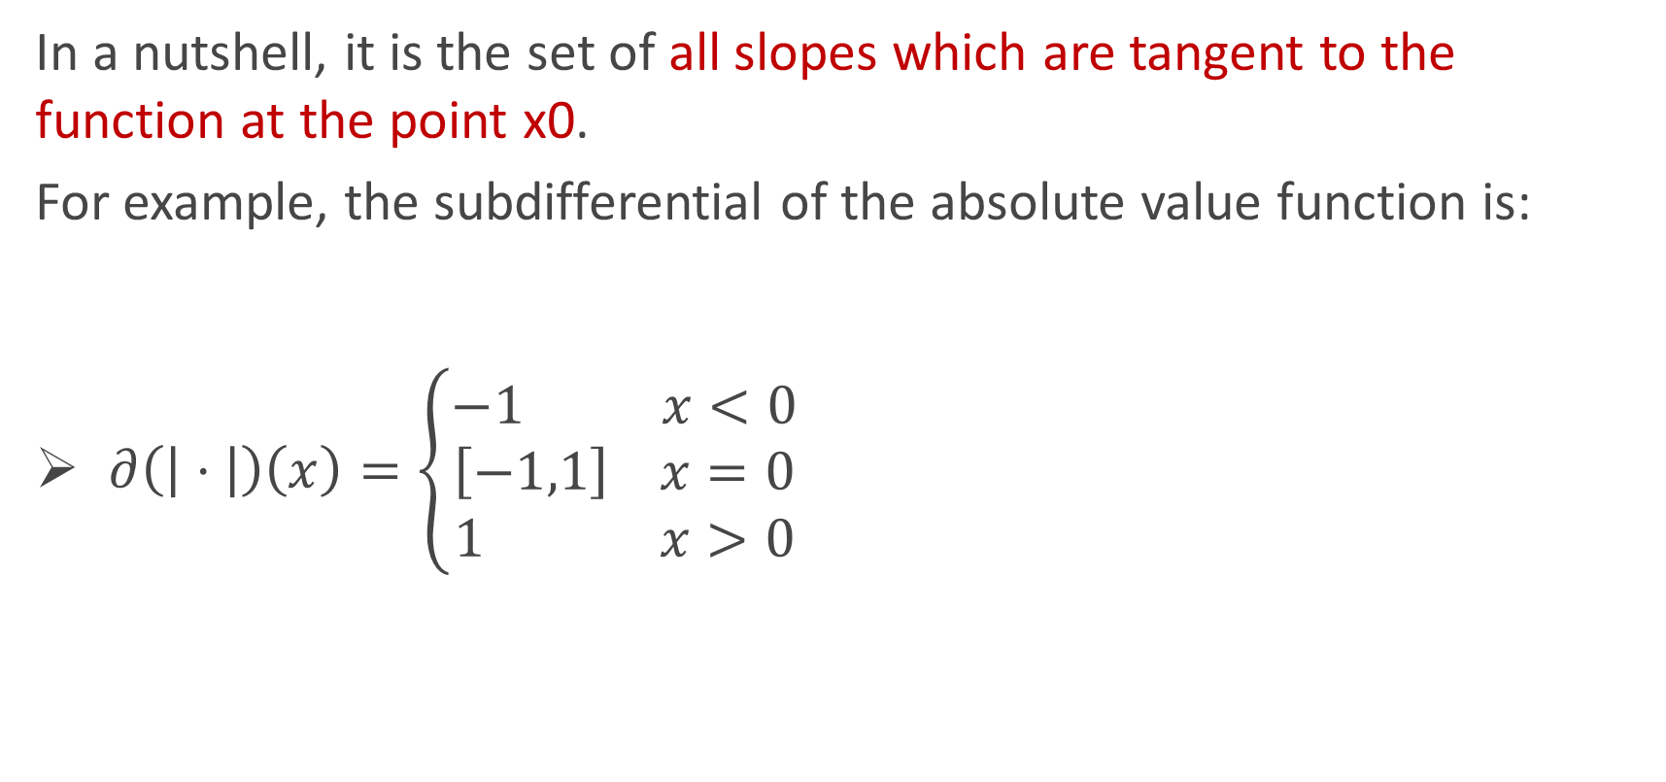
Subgradient to the rescue
In a nutshell, it is the set of all slopes which are tangent to the function at the point x0.
For example, the subdifferential of the absolute value function is:
$∂\left(\left| ⋅ \right|\right)\left(x\right)=\left\{\begin{aligned}−1 x<0 \\ \left[−1,1\right] x=0 \\ 1 x>0\end{aligned}\right.$

Slide 28
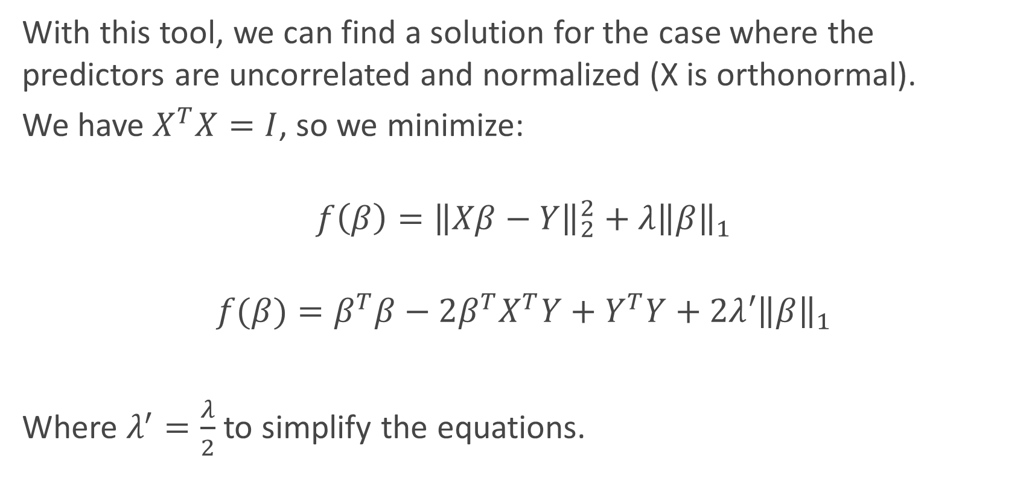
Deriving LASSO
With this tool, we can find a solution for the case where the predictors are uncorrelated and normalized (X is orthonormal).
We have $X^{T}X=I$, so we minimize:
$${f\left(β\right)=\left\|Xβ−Y\right\|}_{2}^{2}+λ{\left\|β\right\|}_{1}$$
$$f(β)=β^{T}β−2β^{T}X^{T}Y+Y^{T}Y+2λ{′\left\|β\right\|}_{1}$$
Where $λ^{′}=\frac{λ}{2}$ to simplify the equations.

Slide 29
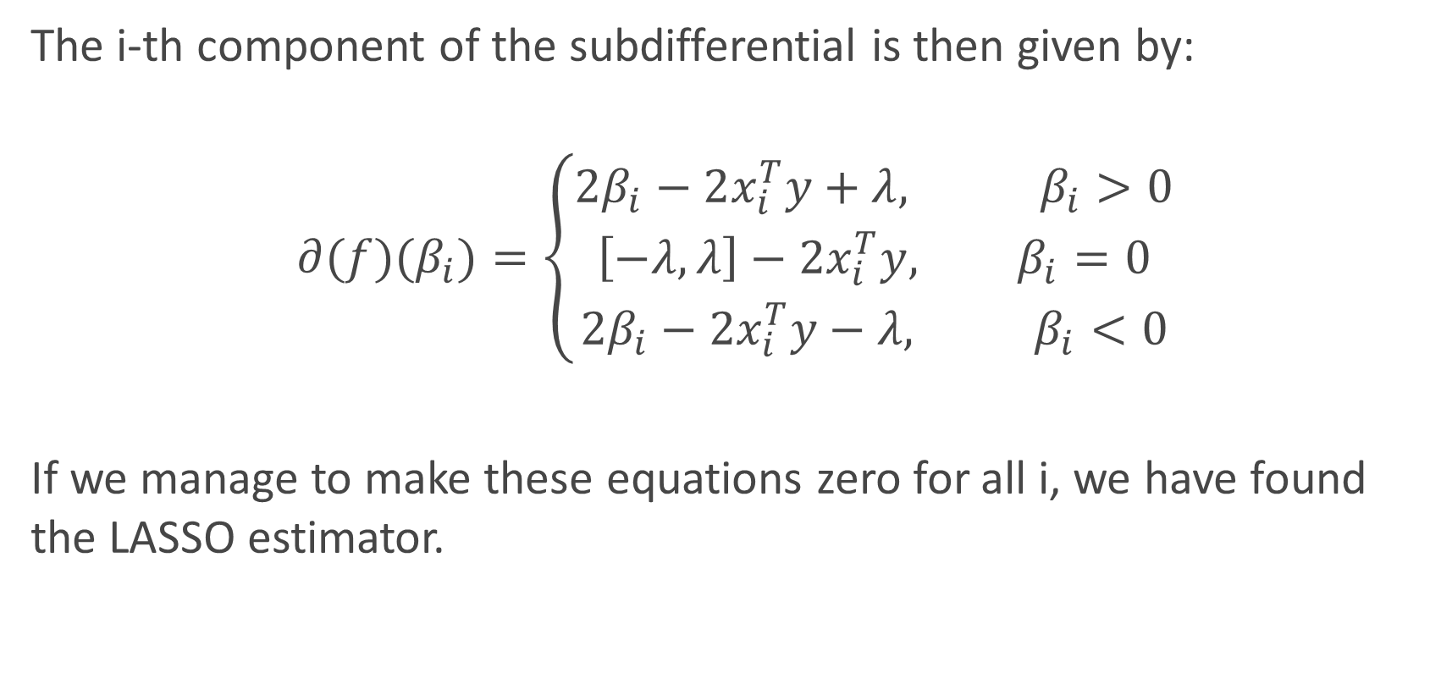
Deriving LASSO
The i-th component of the subdifferential is then given by:
$$∂(f)(β_{i})=\left\{\begin{aligned}2β_{i}−2x_{i}^{T}y+λ, β_{i}>0 \\ \left[−λ,λ\right]−2x_{i}^{T}y, β_{i}=0 \\ 2β_{i}−2x_{i}^{T}y−λ, β_{i}<0\end{aligned}\right.$$
If we manage to make these equations zero for all i, we have found the LASSO estimator.

Slide 30
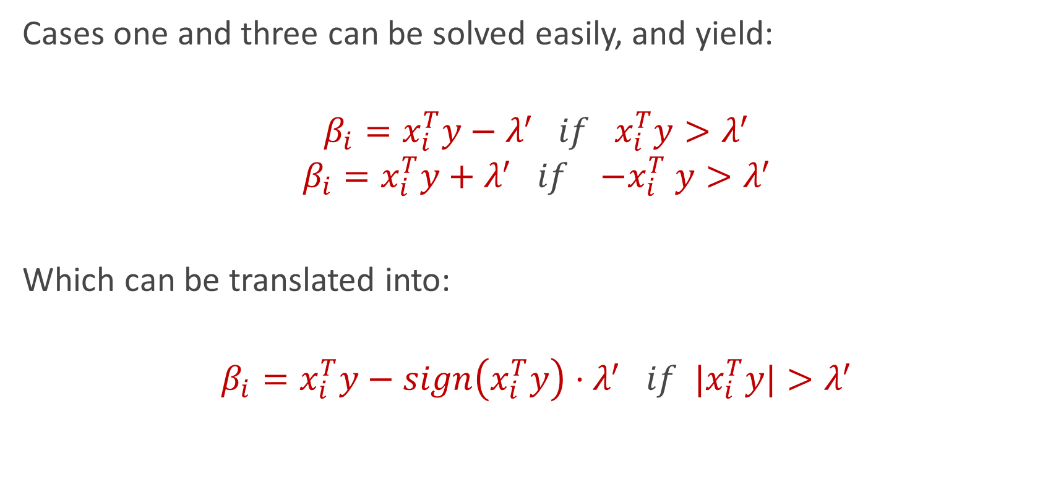
Deriving LASSO
Cases one and three can be solved easily, and yield:
$$β_{i}=x_{i}^{T}y−λ^{′} if x_{i}^{T}y>λ^{′}$$
$$β_{i}=x_{i}^{T}y+λ^{′} if {−x}_{i}^{T}y>λ^{′}$$
Which can be translated into:
$$β_{i}=x_{i}^{T}y−sign\left(x_{i}^{T}y\right)⋅λ^{′} if {|x}_{i}^{T}y|>λ^{′}$$

Slide 31

Deriving LASSO
For the last case ( $β_{i}=0$ ), we need:
$$0∈\left[−2λ′,2λ′\right]−2x_{i}^{T}y$$
Which implies:
$$−2λ′−2x_{i}^{T}y<0 \underset{⇔}{} λ′>−x_{i}^{T}y$$
$$2λ′−2x_{i}^{T}y>0 \underset{⇔}{} λ′>x_{i}^{T}y$$
Notes:
Im putting a cap on how little correlation with the output I want. If xty is smaller than lambda, eliminated!

Slide 32
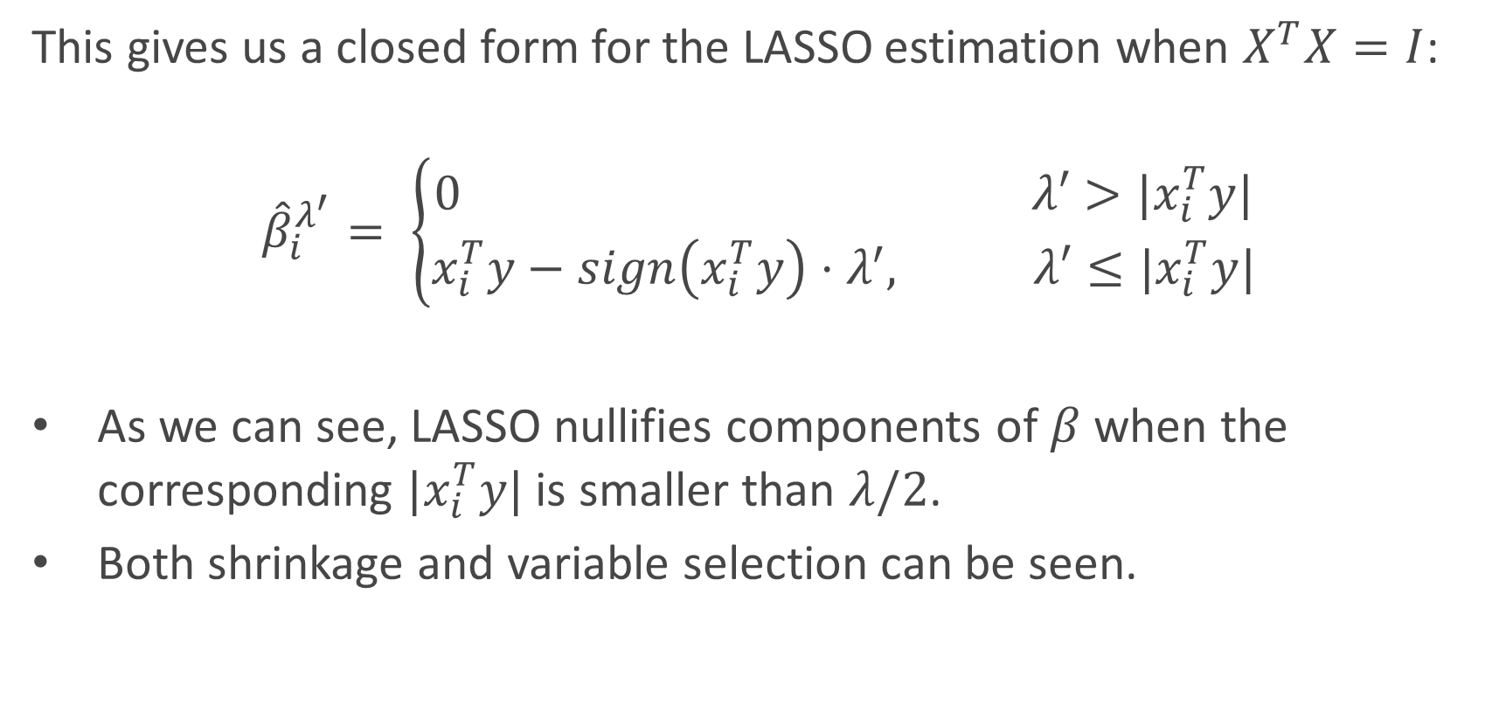
Deriving LASSO
This gives us a closed form for the LASSO estimation when $X^{T}X=I$:
$${\hat{β}}_{i}^{λ^{′}}= \left\{\begin{aligned}0 λ′>|x_{i}^{T}y| \\ x_{i}^{T}y−sign\left(x_{i}^{T}y\right)⋅λ^{′}, λ′≤|x_{i}^{T}y|\end{aligned}\right.$$
As we can see, LASSO nullifies components of $β$ when the corresponding $|x_{i}^{T}y|$ is smaller than $λ/2$.
Both shrinkage and variable selection can be seen.

Slide 33
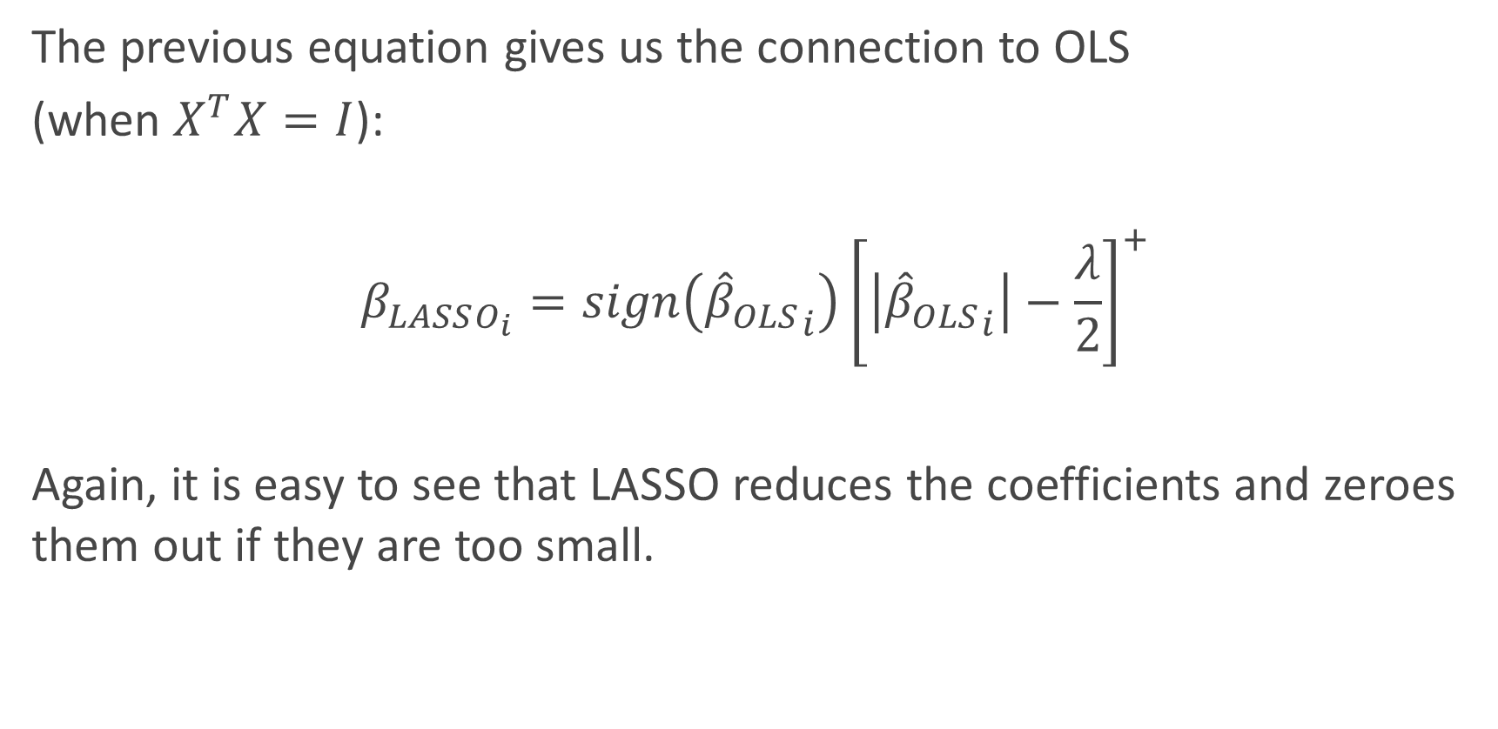
Connections of LASSO with OLS
The previous equation gives us the connection to OLS
(when $X^{T}X=I$):
$$β_{LASSO_{i}}=sign\left({{\hat{β}}_{OLS}}_{i}\right){\left[\left|{{\hat{β}}_{OLS}}_{i}\right|−\frac{λ}{2}\right]}^{+}$$
Again, it is easy to see that LASSO reduces the coefficients and zeroes them out if they are too small.

Slide 34
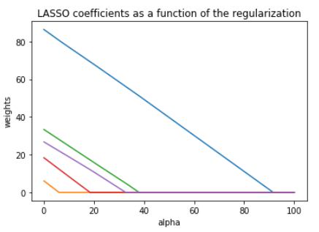
LASSO visualized
Lasso estimator
The Lasso estimator tends to zero out parameters as the OLS loss can easily intersect with the constraint on one of the axis.
The values of the coefficients decrease as lambda increases, and are nullified fast.

Slide 35
Elastic Net ESTIMATOR
Estimators, assemble

Slide 36
Problems with Ridge and LASSO
Ridge does not perform feature selection.
Ridge and Lasso are sensible to outliers.
When p > n, LASSO can choose at most n predictors to use. The rest are nullified.
When there are multiple correlated predictors, LASSO tends to indifferently choose one and discard the rest.
For example, if you run a problem with large number features multiple times, you might have a very different feature set each time.
Notes:
In addition, both empirical evidence and theoretical analysis (Efron et al., 2004) show
that when there are a number of highly-correlated predictors, then the LASSO estimator
indierently selects one among them and discards the rest. This can be highly problematic
in practice; for example, if a group of clustered genes jointly predict for a disease but are
correlated, it would be scientifically invalid to randomly select one of these genes and
ignore the rest.

Slide 37
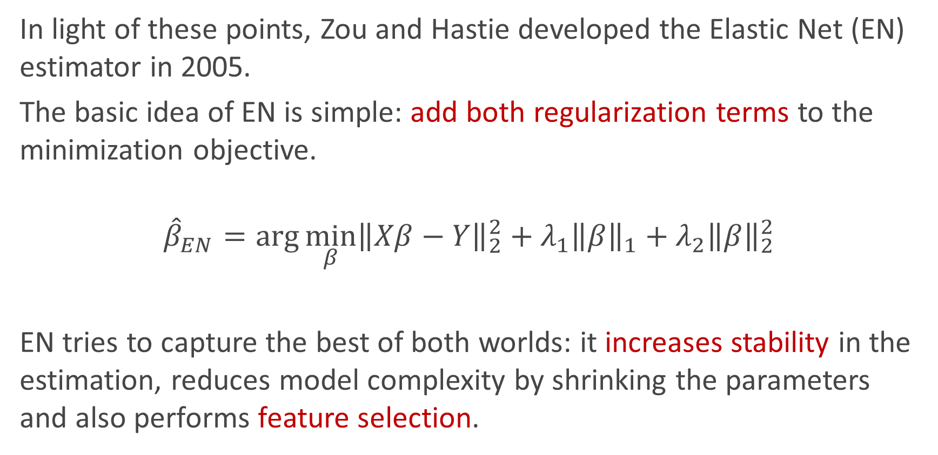
Combine Ridge and LASSO!
In light of these points, Zou and Hastie developed the Elastic Net (EN) estimator in 2005.
The basic idea of EN is simple: add both regularization terms to the minimization objective.
$${\hat{β}}_{EN}=\arg{\min_{β}{{\left\|Xβ−Y\right\|}_{2}^{2}+{λ_{1}{\left\|β\right\|}_{1}+λ}_{2}{\left\|β\right\|}_{2}^{2}}}$$
EN tries to capture the best of both worlds: it increases stability in the estimation, reduces model complexity by shrinking the parameters and also performs feature selection.
LASSO
Ridge

Slide 38
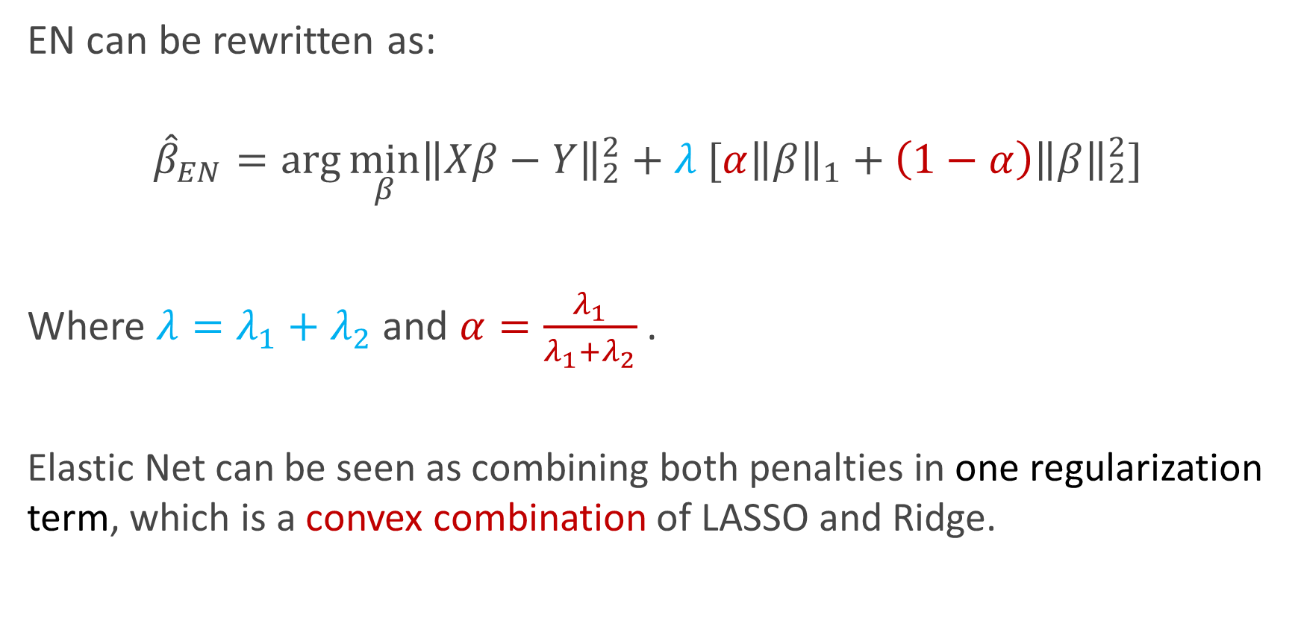
Combine Ridge and LASSO!
EN can be rewritten as:
$${\hat{β}}_{EN}=\arg{\min_{β}{{\left\|Xβ−Y\right\|}_{2}^{2}+λ [α{\left\|β\right\|}_{1}+{\left(1−α\right)\left\|β\right\|}_{2}^{2}]}}$$
Where $λ=λ_{1}+λ_{2}$ and $α=\frac{λ_{1}}{λ_{1}+λ_{2}}$ .
Elastic Net can be seen as combining both penalties in one regularization term, which is a convex combination of LASSO and Ridge.

Slide 39
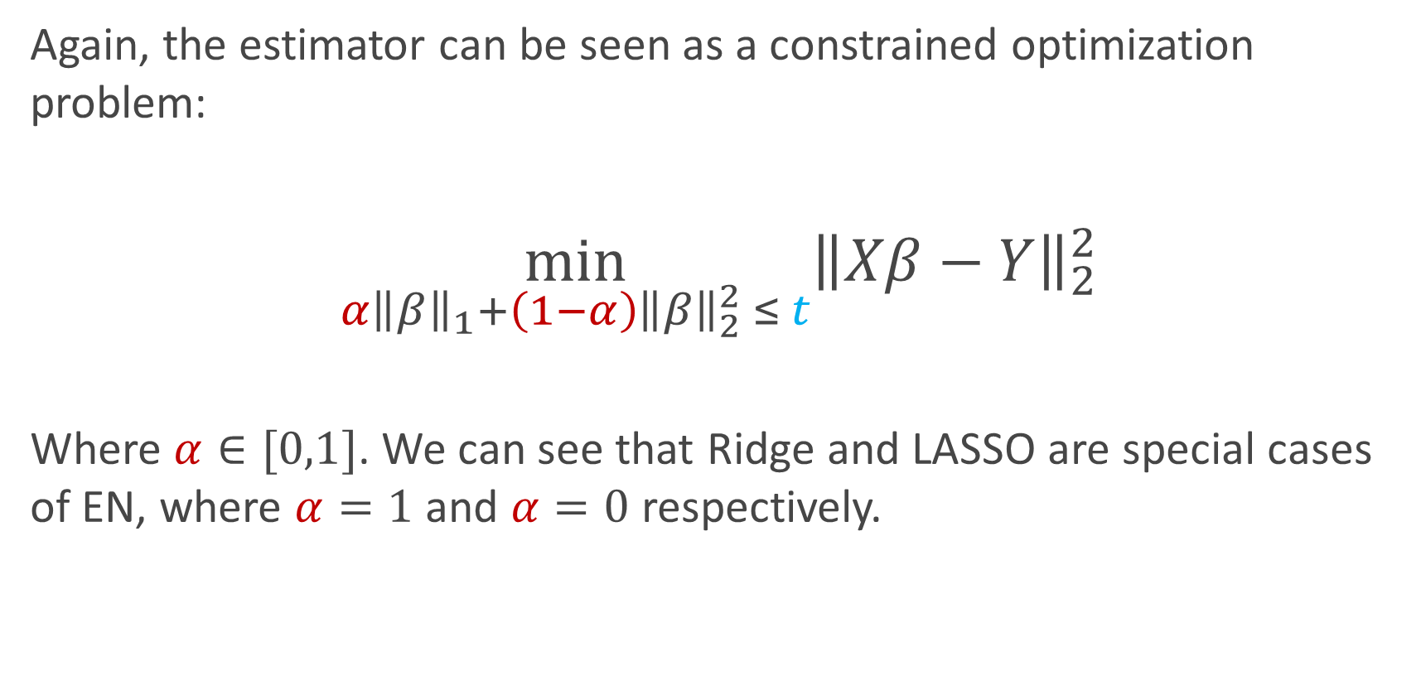
Combine Ridge and LASSO!
Again, the estimator can be seen as a constrained optimization problem:
$$\min_{α{\left\|β\right\|}_{1}+\left(1−α\right){\left\|β\right\|}_{2}^{2} ≤ t}{{\left\|Xβ−Y\right\|}_{2}^{2}}$$
Where $α∈[0,1]$. We can see that Ridge and LASSO are special cases of EN, where $α=1$ and $α=0$ respectively.

Slide 40
Geometry of estimators
Visualization is key

Slide 41
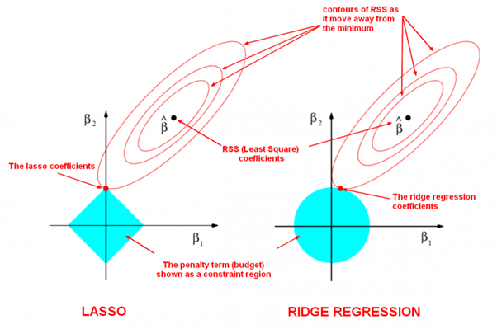

Slide 42
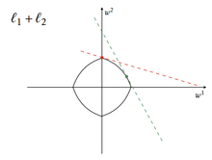
Elastic Net

Slide 43
Let’s see it live!
DEMO TIME

Slide 44
Bayesian Interpretations
“The right way of looking at it” - Kevin Rader, probably

Slide 45
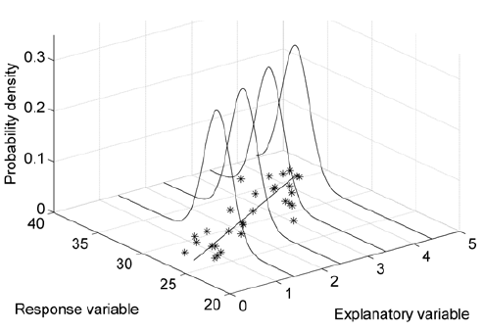
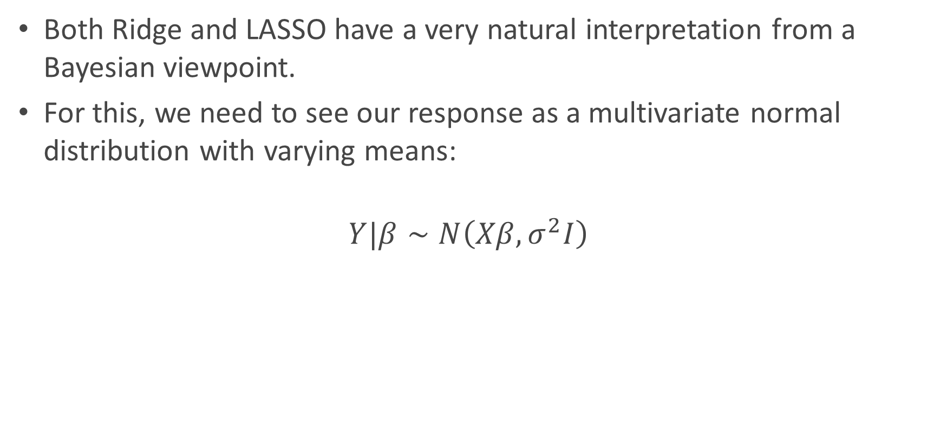
A different but useful perspective
Both Ridge and LASSO have a very natural interpretation from a Bayesian viewpoint.
For this, we need to see our response as a multivariate normal distribution with varying means:
$$Y|β∼N\left(Xβ,σ^{2}I\right)$$

Slide 46

A different but useful perspective
$$Y|β∼N\left(Xβ,σ^{2}I\right)$$

Slide 47
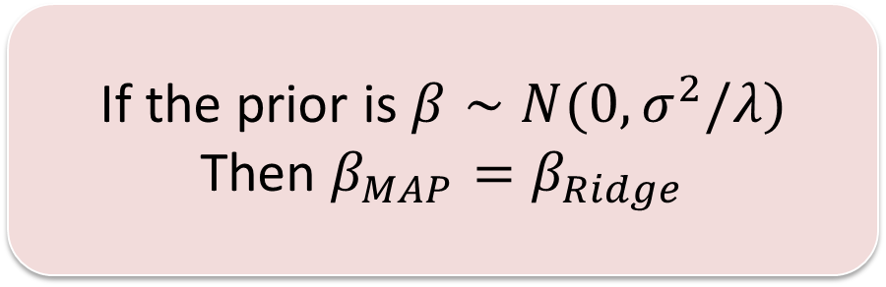

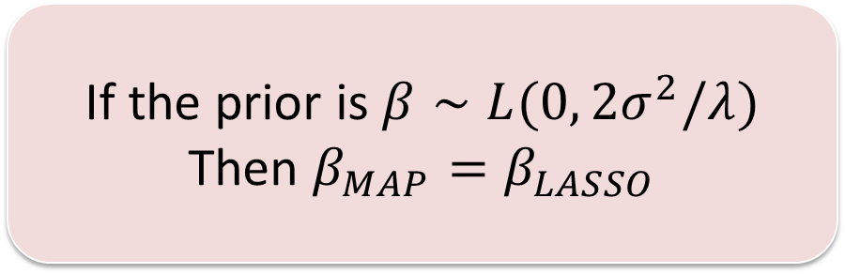
Ridge and LASSO as MAP estimates
Consider $Y|β∼N\left(Xβ,σ^{2}I\right),$ $and the MAP estimator:$
$${\hat{β}}_{MAP}=arg\max_{β} p(β|Y)$$
If the prior is $β∼N(0,σ^{2}/λ)$
Then $β_{MAP}=β_{Ridge}$
If the prior is $β∼L(0, 2σ^{2}/λ)$
Then $β_{MAP}=β_{LASSO}$

Slide 48
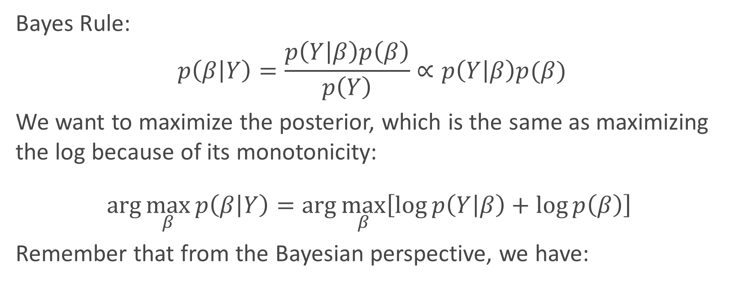



Proof of Bayesian interpretations
Bayes Rule:
$$p\left(β | Y\right)=\frac{p\left(Y | β\right)p\left(β\right)}{p\left(Y\right)}∝p\left(Y | β\right)p(β)$$
We want to maximize the posterior, which is the same as maximizing the log because of its monotonicity:
$$\arg{\max_{β}{p\left(β | Y\right)=\arg{\max_{β}\left[\log{p\left(Y | β\right)}+\log{p\left(β\right)}\right]}}}$$
Remember that from the Bayesian perspective, we have:
$$p\left(Y | β\right)∼N(Xβ, σ^{2}I)$$
$$\log{p\left(Y | β\right)∝−{\left(2σ^{2}\right)}^{−1}{\left\|Xβ−Y\right\|}_{2}^{2}}$$
$$p\left(β\right)∼N(0,τ^{2}I)$$
$$\log{p\left(β\right)∝} −{\left(2τ^{2}\right)}^{−1}{\left\|β\right\|}_{2}^{2}$$

Slide 49
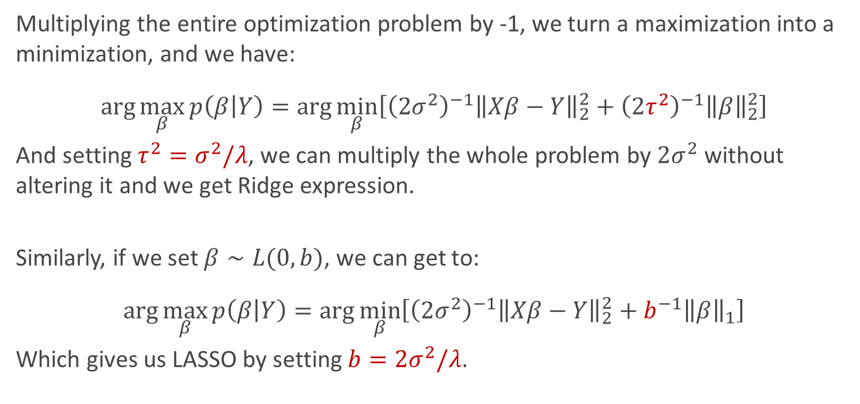
Proof of Bayesian interpretations
Multiplying the entire optimization problem by -1, we turn a maximization into a minimization, and we have:
$$\arg{\max_{β}{p\left(β | Y\right)=\arg{\min_{β}\left[{\left(2σ^{2}\right)}^{−1}{\left\|Xβ−Y\right\|}_{2}^{2}+{\left(2τ^{2}\right)}^{−1}{\left\|β\right\|}_{2}^{2}\right]}}}$$
And setting ${τ^{2}=σ}^{2}/λ$, we can multiply the whole problem by $2σ^{2}$ without altering it and we get Ridge expression.
Similarly, if we set $β∼L(0,b)$, we can get to:
$$\arg{\max_{β}{p\left(β | Y\right)=\arg{\min_{β}\left[{\left(2σ^{2}\right)}^{−1}{\left\|Xβ−Y\right\|}_{2}^{2}+b^{−1}{\left\|β\right\|}_{1}\right]}}}$$
Which gives us LASSO by setting $b=2σ^{2}/λ$.

Slide 50
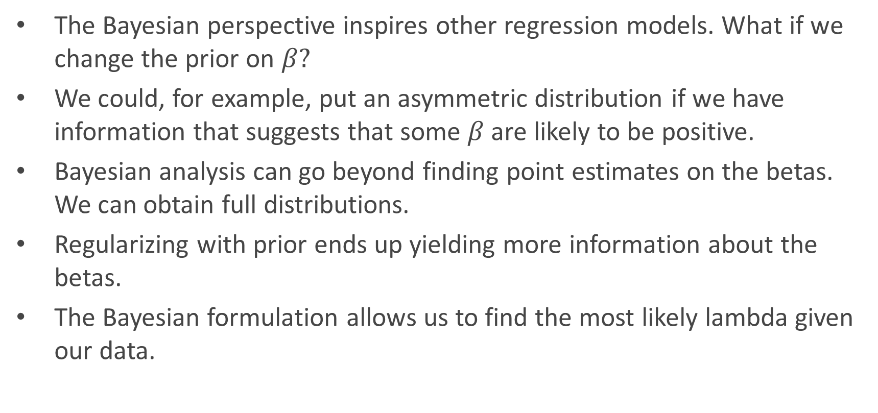
Considerations on Bayesian Linear Regression
The Bayesian perspective inspires other regression models. What if we change the prior on $β?$
We could, for example, put an asymmetric distribution if we have information that suggests that some $β$ are likely to be positive.
Bayesian analysis can go beyond finding point estimates on the betas. We can obtain full distributions.
Regularizing with prior ends up yielding more information about the betas.
The Bayesian formulation allows us to find the most likely lambda given our data.

Slide 51
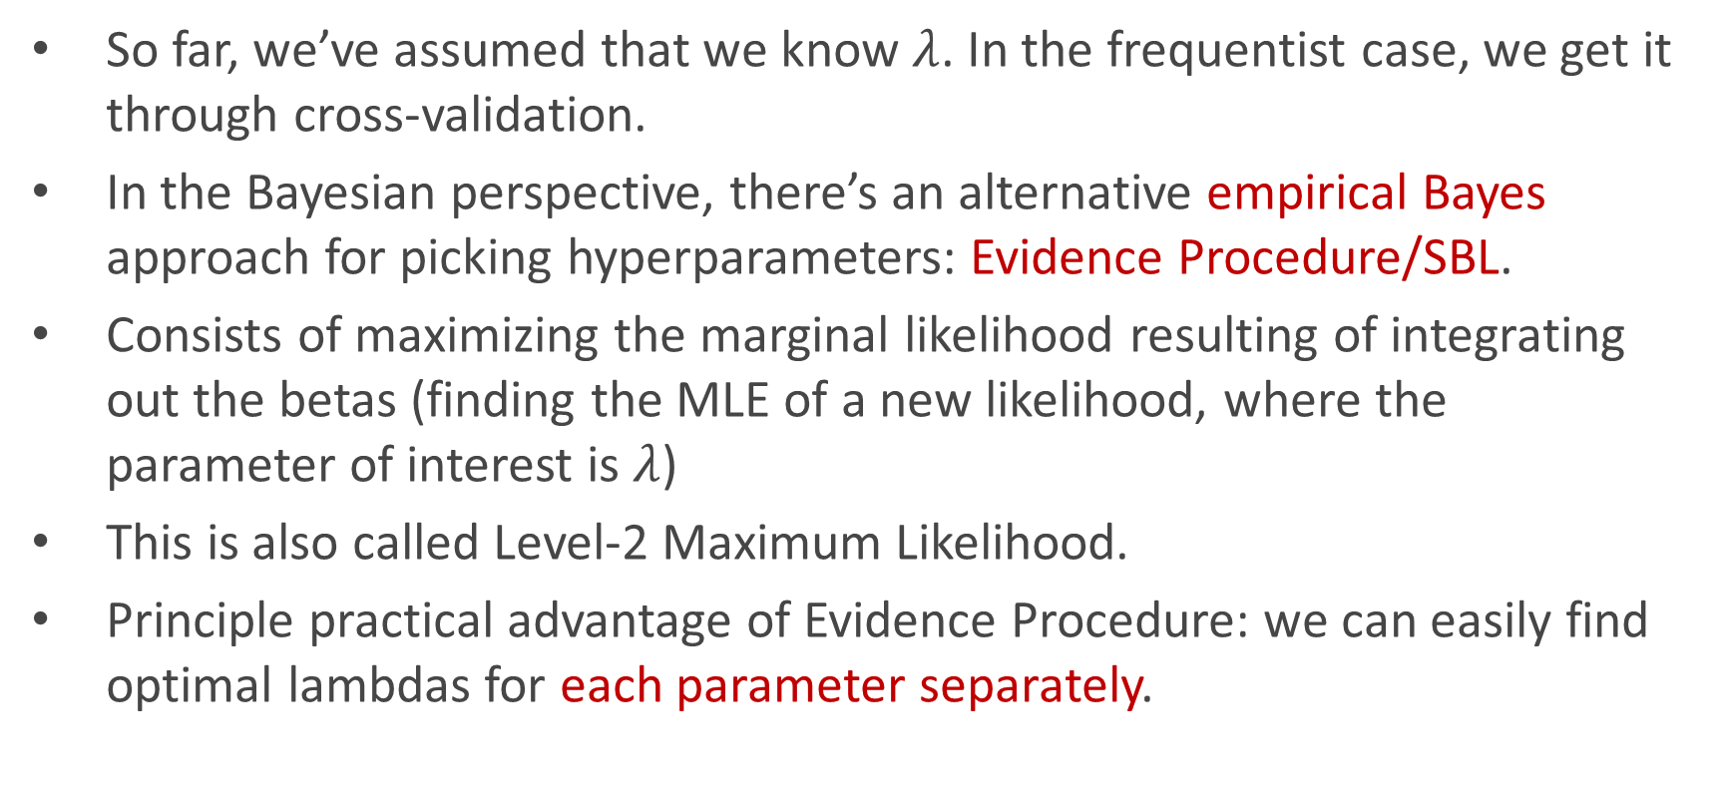
Bayesian priors instead of cross-validation
So far, we’ve assumed that we know $λ$. In the frequentist case, we get it through cross-validation.
In the Bayesian perspective, there’s an alternative empirical Bayes approach for picking hyperparameters: Evidence Procedure/SBL.
Consists of maximizing the marginal likelihood resulting of integrating out the betas (finding the MLE of a new likelihood, where the parameter of interest is $λ$)
This is also called Level-2 Maximum Likelihood.
Principle practical advantage of Evidence Procedure: we can easily find optimal lambdas for each parameter separately.

Slide 52
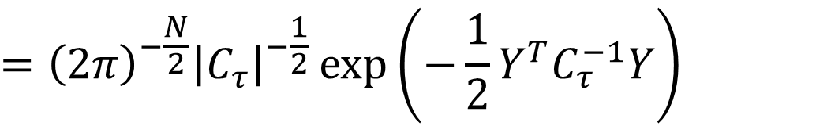


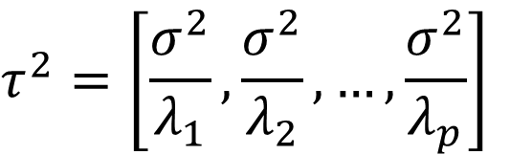

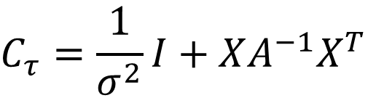
Evidence Procedure: The maths in a nutshell
Assume the following model:
$$p\left(Y | β\right)∼N(Xβ, σ^{2}I)$$
$$τ^{2}=\left[\frac{σ^{2}}{λ_{1}},\frac{σ^{2}}{λ_{2}},…,\frac{σ^{2}}{λ_{p}}\right]$$
$$A^{−1}=τ^{2}I$$
$$p(β)∼N(0, A^{−1})$$
The marginal likelihood can be computed as follows:
$$p\left(Y | τ^{2}\right)=∫N\left(Y;Xβ,σ^{2}I\right)N\left(β;0,A^{−1}\right)dβ$$
$$=N\left(Y;0,σ^{2}I+XA^{−1}X^{T}\right)$$
$$C_{τ}=\frac{1}{σ^{2}}I+XA^{−1}X^{T}$$
$$={\left(2π\right)}^{−\frac{N}{2}}{\left|C_{τ}\right|}^{−\frac{1}{2}}\exp\left(−\frac{1}{2}Y^{T}C_{τ}^{−1}Y\right)$$

Slide 53
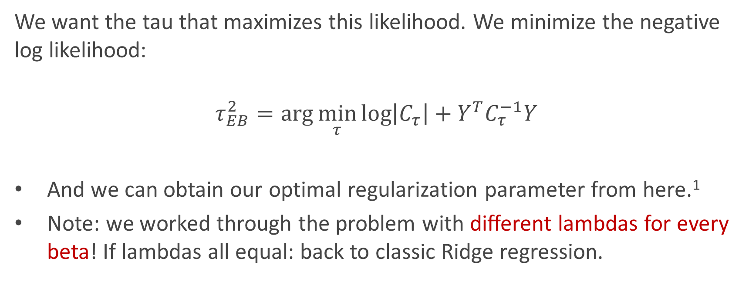
Evidence Procedure: The maths in a nutshell
We want the tau that maximizes this likelihood. We minimize the negative log likelihood:
$$τ_{EB}^{2}=\arg{\min_{τ}{\log\left|C_{τ}\right|+Y^{T}C_{τ}^{−1}Y}}$$
And we can obtain our optimal regularization parameter from here.¹
Note: we worked through the problem with different lambdas for every beta! If lambdas all equal: back to classic Ridge regression.
¹ There is an easy formula to automatically obtain the betas as well, available in chapter 13, p. 464 of Murphy’s “Machine Learning – A Probabilistic Perspective”.

Slide 54
Thank you!

Slide 55
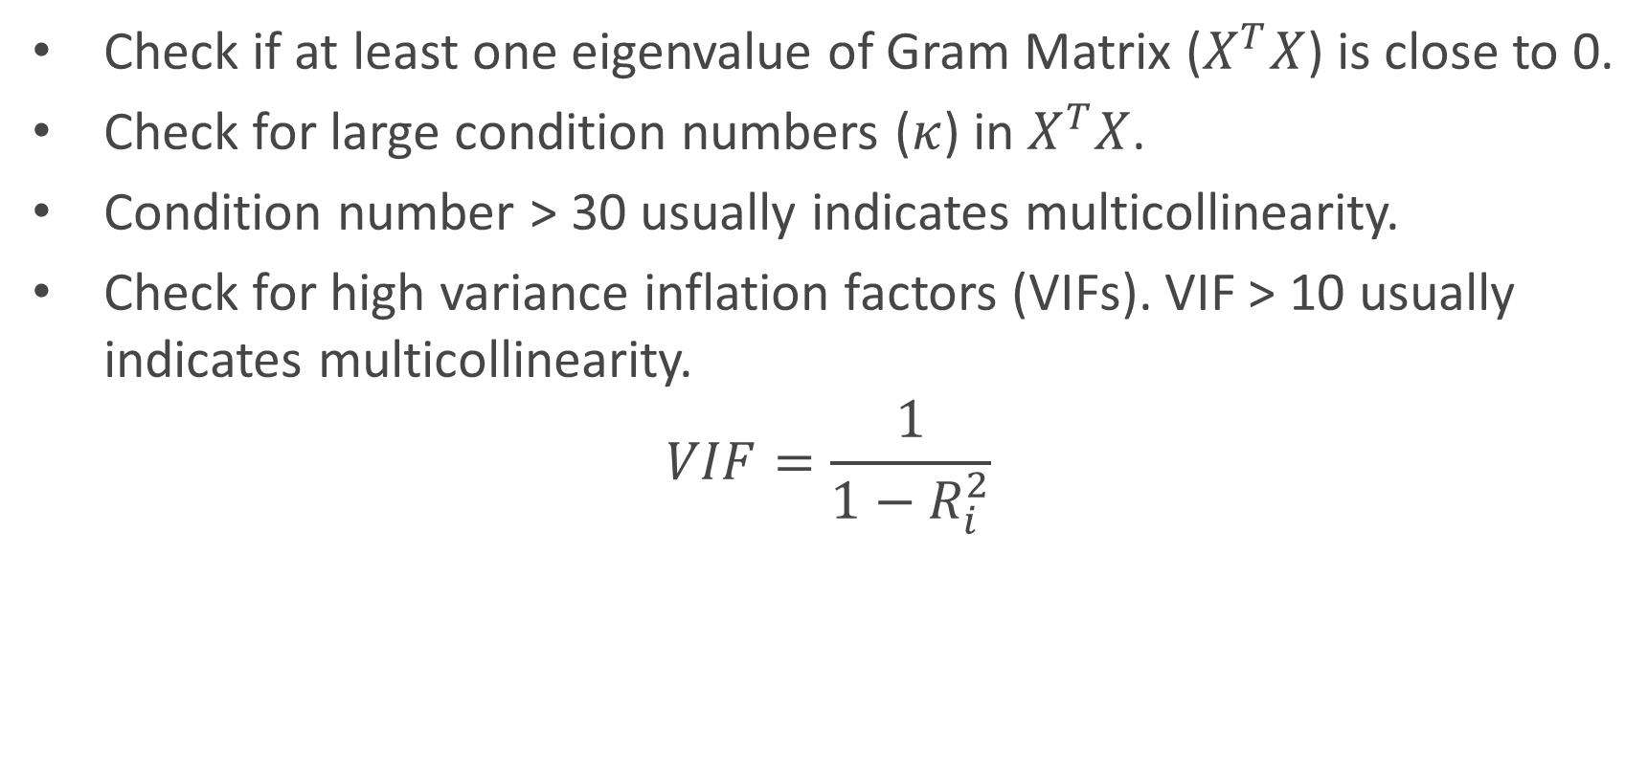
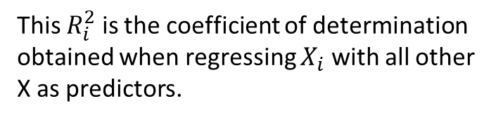
Practical side: how to check for multicollinearity?
Check if at least one eigenvalue of Gram Matrix ($X^{T}X$) is close to 0.
Check for large condition numbers ($κ$) in $X^{T}X$.
Condition number > 30 usually indicates multicollinearity.
Check for high variance inflation factors (VIFs). VIF > 10 usually indicates multicollinearity.
$$VIF=\frac{1}{1−R_{i}^{2}}$$
This $R_{i}^{2}$ is the coefficient of determination obtained when regressing $X_{i}$ with all other X as predictors.
Notes:
where R²_{i} is the coefficient of determination of the regression equation in step one, with {X_{i}} on the left hand side, and all other predictor variables (all the other X variables) on the right hand side.

Slide 56

Augmented problem – Elastic Net
We can actually prove that EN is a generalized LASSO with augmented data. Construct the augmented problem:
$$Y^{∗}=\left({Y \atop 0}\right)∈ ℝ^{n+p}$$
$$X^{∗}={\left(1+λ_{2}\right)}^{−\frac{1}{2}}\left({X \atop \sqrt{λ_{1}}I}\right)∈ℝ^{\left(n+p\right) × p}$$
and define:
$$γ=\frac{λ_{1}}{\sqrt{\left(1+λ_{2}\right)}}$$
$$β^{∗}=\sqrt{\left(1+λ_{2}\right)}β$$

Slide 57

Augmented problem – Elastic Net
Then, the elastic net problem can be written as:
$${\hat{β}}^{∗}=\arg{\min_{β^{∗}∈ℝ^{p}}{{\left\|X^{∗}β^{∗}−Y^{∗}\right\|}_{2}^{2}+γ{\left\|β^{∗}\right\|}_{1}}}$$
Where ${\hat{β}}_{EN}={\left(1+λ_{2}\right)}^{−\frac{1}{2}}{\hat{β}}^{∗}$
As we can see, the EN problem can be reformulated as a LASSO problem on augmented data.
Note that since sample size of X is n + p > p, the elastic net estimator can actually select all p predictors.
${\hat{β}}_{E}$ is a shrunk version of ${\hat{β}}^{∗}$: EN does both variable shrinking and variable selection.
LASSO problem!

