Slide 1

^{t} JAN 24th, 2022
EE312H : Recitation
CLion
Make
aditya Thimmaiah
The University of Texas at Austin
Notes:
1

Slide 2
My Environment Setup
C/C++ compiler : gcc 9.3.0 (Ubuntu 9.3.0-17ubuntu1~20.04)
GNU Make : Make 4.2.1
Linux Arch
5.11.0-43-generic
64 bit (x86_64)
System
Intel® Core™ i7-6560U CPU @ 2.20GHz × 4
16GB RAM

Slide 3
CLion

Slide 4
Make

Slide 5

Motivation : what is ${GNU Make}^{1}$ ?
Make provides an efficient modular method of compiling and linking source files to generate an executable
Compile
&
Link
Debug
Edit/Create
Test
Efficiency in terms of time required to compile and link
Modularity in terms of maintainability, readability and portability of build environment
Fig 1 : Lifecycle of software development
(the ratio of division does not correspond to any specific metric)

Slide 6
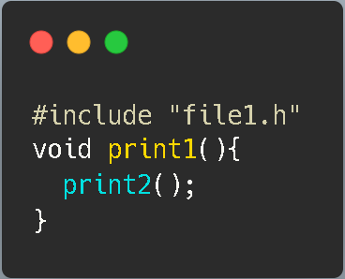
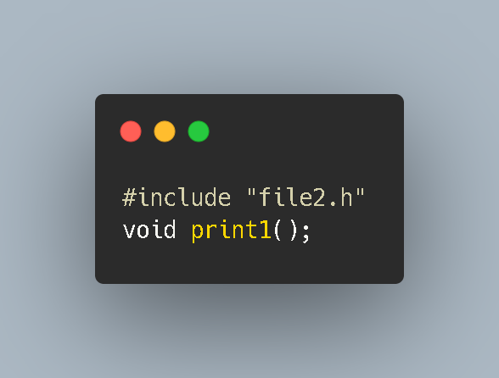


Motivation : what is Make “more” efficient than?
file1.c
file1.h
main.c
file1.c
file1.h
file2.c
file2.h
file2.c
file2.h
Defined in file2.c
fileN.c
fileN.h
Fig 2 : File dependency hierarchy of experimental setup to demonstrate efficiency of Make

Slide 7
Motivation : what is Make “more” efficient than?
Consider 100 source files
Divide into deciles
Edit median file
file1.c
file1.c
file10.c
file5.c
file2.c
file11.c
file20.c
file15.c
file3.c
file100.c
file91.c
file100.c
file95.c
Fig 3 : Experimental setup for demonstrating efficiency of Make

Slide 8
Motivation : Baseline approach
The Baseline approach – Compile and link all source files at once
Completely disregards file dependence hierarchy
Run :
gcc *.c –o main.o
.C
files
.h
files
gcc *.c -o main.o
Invoke GNU C-Compiler
Use –o flag to specify name of generated Object/Executable
Fig 4 : Baseline approach
Wildcard to use all .c files in present directory for compilation

Slide 9
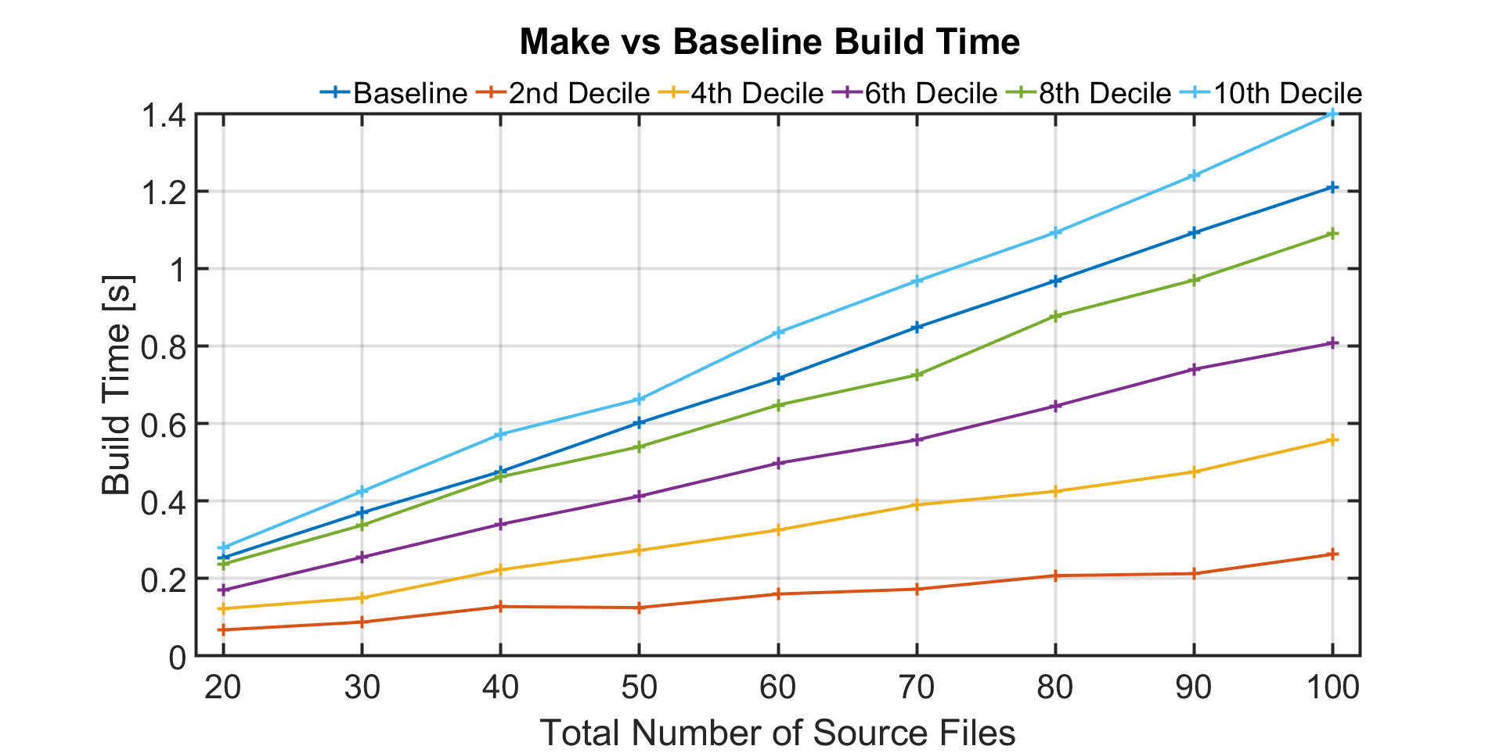
Motivation : Make vs Baseline?
Build time decreased by 75% !!!
In Fig.5, files in lower deciles are shallower in dependency hierarchy (file1.c/.h is shallowest and fileN.c/.h is deepest)
Every datapoint in Fig.5 besides Baseline, corresponds to build time with Make when the median file in the respective decile is edited
Build time with Make is much faster than Baseline approach when the edited file is shallower in the dependency hierarchy (1 in 10 chance of Make performing worse than Baseline)
Fig 5 : Make vs Baseline approach

Slide 10

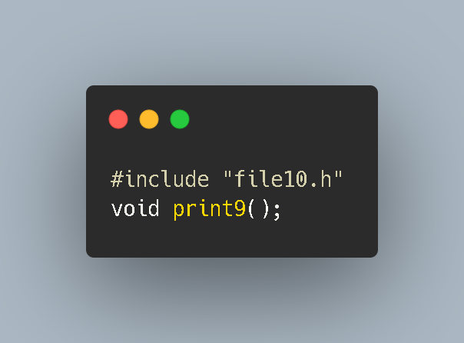
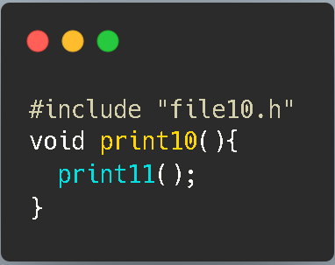
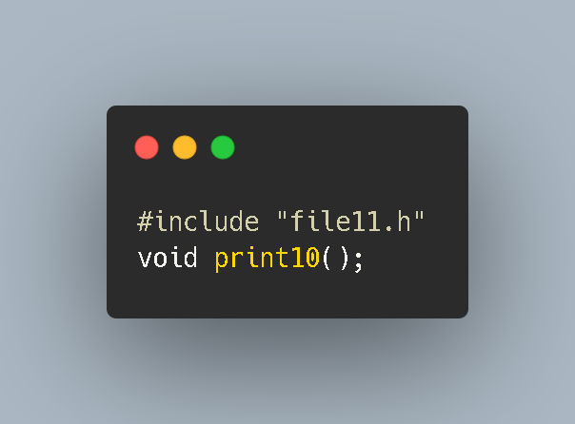
Working : Make Approach
file9.c
file9.c
file9.h
file9.h
To Compile a .c file we need to know the function signature of all functions used inside it (given by the function declaration)
To link .o files generated after the compilation process, we need to know the contents of the function* (given by the function definition)
What if I compile all .c files into respective .o files but link only in the end? Well, then I don’t have to compile file9.c if there are any changes in main.c/.h upto file8.c/.h
gcc –c file9.c –o file9.o
Definition
Declaration
Declaration
file10.c
file10.h
file10.h
file9.o
Fig 6 : Make Approach
Use –c flag to only compile but not link
* Address where the function is defined

Slide 11
Working : Make Approach?
In the Make approach, we compile but not link all source files into intermediary respective .o (OBJ) files
Any change in any source file requires only recompiling all dependent files but all .o files must be linked to generate the executable
In the Baseline approach, we compiled and linked all source files disregarding file dependencies
Any change in any source file required recompiling and linking all files again
main.o
main.c
main.o
main.c
file1.c
file1.h
file1.c
file1.h
file1.o
file2.c
file2.h
file2.c
file2.h
file2.o
fileN.c
fileN.h
Fig 7 : Make approach
Linking
Compiling

Slide 12
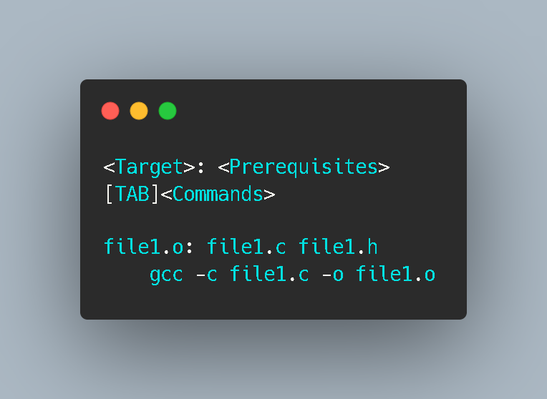
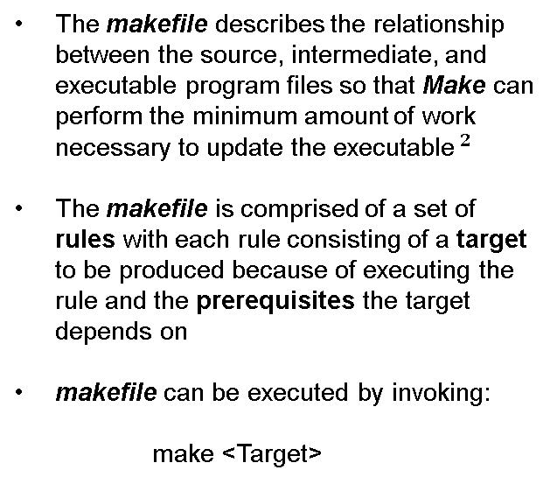
Working : The makefile
The makefile describes the relationship between the source, intermediate, and executable program files so that Make can perform the minimum amount of work necessary to update the executable$^{2}$
The makefile is comprised of a set of rules with each rule consisting of a target to be produced because of executing the rule and the prerequisites the target depends on
makefile can be executed by invoking:
make <Target>
Rule
Fig 8 : Rule to Make file1.o
Invoke GNU Make
Target name. If empty, first rule in makefile is executed

Slide 13
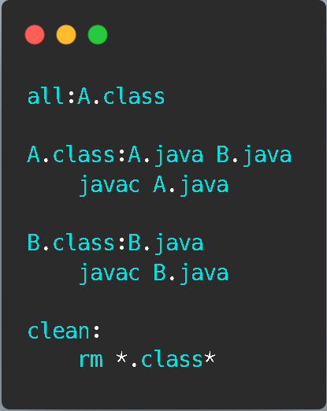
Summary : Make
Make is more efficient on average than the Baseline approach
Compiling into intermediary .o files makes the Make approach modular. In fact, its modularity that drives efficiency !!
Make is language agnostic , can be used to build projects of any language (Fig.9)
All examples used can be found at https://github.com/1sand0s/EE312H
Fig 9 : makefile for Java

Slide 14
References
Paul Smith , GNU Make, Jan 19, 2020 , Accessed on : Jan 19, 2022 Available : https://www.gnu.org/software/make/manual/
Robert Mecklenburg, “Managing Projects with GNU Make”, O'Reilly Media, 2004

