Slide 1

MediCare Empowering Health, Enhancing Lives
Presented By Md Sazzad Hossain & Sadi Mahmud

Slide 2
Slide Overview
Project Overview | In this slide we described our MediCare project
Problem Definition, Purpose and Scope | Here you will know about current problems in healthcare sector and the purpose of our project and the scope.
Plan | Plane for this project are given here using gantt chart
Risk Assessment | The risks we encountered are described here
Project Status | ????
Functional & Non-|Functional Requirement | Functional & Non-Functional Requirement for the MediCare Project

Slide 3


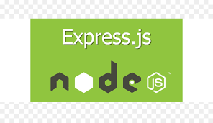

MediCare is a hospital management system designed to streamline operations for Patients, Assistants, Doctors, and Admins.
Front-End
Back-End

Slide 4
Hospitals face challenges in managing patient records, scheduling, billing, and resource allocation efficiently. Manual processes lead to delays, errors, and poor patient experience.
Purpose: To develop an integrated digital system that automates hospital operations, improves data accuracy, enhances patient care, and streamlines administrative tasks.
Scope:
This system covers:
Patient registration & history
Appointment scheduling
Billing & payments
Staff & resource management

Slide 5
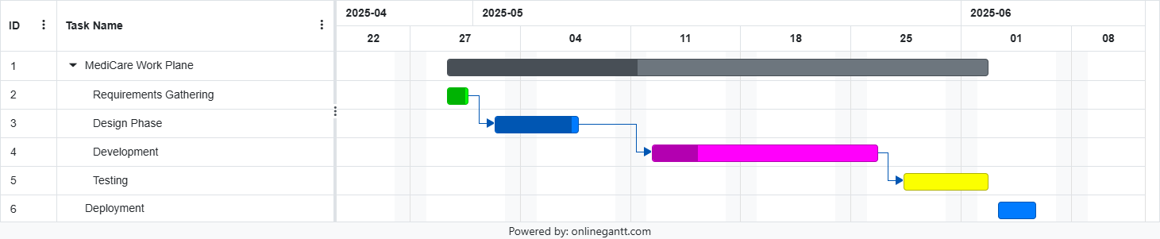

Slide 6
Risks
Technical Issue
Manpower
Power Shortage Problem
For the unstable weather or natural disaster we faced with load shedding issue, as we do not have any power backup so we encountered power shortage issue.
Here we use reactjs for front-end and express js for backend, but the express js which is a framework of Node Js is a unstable framework. Few time we are unable to run the project in local server.
We are two member in our team, here is a problem, if anyone seeks then another one can not handle the pressures properly, as a result the project deadline can be extend.

Slide 7
Status
Requirement Gathering Complete
Design Complete
Development running
Rest will be start soon

Slide 8
Functional & Non-Functional Requirements
Functional
Non-Functional
Secure user authentication and role-based dashboards.
Appointment booking and management with calendar integration.
Patient data updates and admin user management.
Encrypted data and JWT-based security.
Fast response times (<2s APIs, <3s pages) for 1,000 users.
Scalable, reliable (99.9% uptime), and responsive UI.

Slide 9
Resources
Vectors
ReactJs,NodeJs, etc’s documentation
TutorialsPoint, GeeksforGeeks
Grok AI, Cloud Sonet 3.5, ChatGPT
SlidesGo

Slide 10
Thanks!
Do you have any questions?
Please keep this slide for attribution

