Slide 1
🩸 DAMI
The right blood unit, to the right hospital, before it's requested… and by drone when there's no time
Team NEXORA · Jordan Students Pitch Competition

Slide 2
5 p.m. — an accident on the Airport Road
A hospital needs 6 units of O negative now.
Car from the blood bank: 34 minutes in traffic.
Drone: 9 minutes, box steady at 4°C.
In severe bleeding, every minute matters.

Slide 3
The problem: shortage here… waste there
Blood banks face a hard equation: shortages of certain blood types when they are needed, while units expire elsewhere. In major accidents or shortage crises, hospitals need urgent units from the blood bank or another hospital, but vehicles get stuck in traffic or delayed on mountain and remote roads, and in severe bleeding every minute counts.
35–42 days: Shelf life of red blood cells stored at 2–6°C
5–7 days: Shelf life of platelets only, so some are wasted unless distributed smartly
O negative: The type requested first in severe bleeding, before the patient's type is known
Since 2016: Drone blood delivery operates in Rwanda, then Ghana and other countries (Zipline)

Slide 4
The solution: three layers, one platform
🧠 Forecasting & balancing
A model forecasts 14-day demand for each type at each hospital, warns before shortages, and proposes moving units close to expiry to a hospital that will use them.
🫂 Smart donor call-up
Selects eligible donors (last donation 90+ days ago) who are nearby and most likely to respond, and invites them for exactly the type that's short.
🚁 Blood ambulance drone
In emergencies the system picks the nearest source holding the type, compares drone vs car time, and launches a drone with a smart cooling box and live temperature and position tracking.

Slide 5
The drone mission: blood bank to hospital
1. Emergency request
The hospital requests 6 units of O negative in the app with “critical” priority.
2. Source selection
The system checks live stock and picks the blood bank or the nearest hospital holding the type.
3. Launch decision
Comparison: car 34 min at peak vs drone 9 min; the operator approves with one tap.
4. Packing & flight
Units packed in a 2–6°C cooled box, on a safe route that avoids restricted zones.
5. Delivery & restock
Landing on the hospital pad, receipt and flight temperature confirmed, and donors called to restock.
Type: Multirotor drone for the pilot, then fixed-wing VTOL for longer distances
Payload: 2–4 kg: 4–6 blood units with the cooled box
Range & speed: 15–40 km for urban pilots, at 60–90 km/h
Cooling box: Thermal insulation and phase-change material holding 2–6°C, with a temperature logger and live alarm
Connectivity: 4G/5G cellular with backup link, streaming position, temperature and battery every second
Safety: Emergency parachute, automatic return on link loss, and geofencing
Delivery: Landing on a dedicated pad on the hospital roof or a small-parachute drop in a safe zone
Operations: A licensed pilot monitors from the operations center, on pre-approved routes

Slide 6
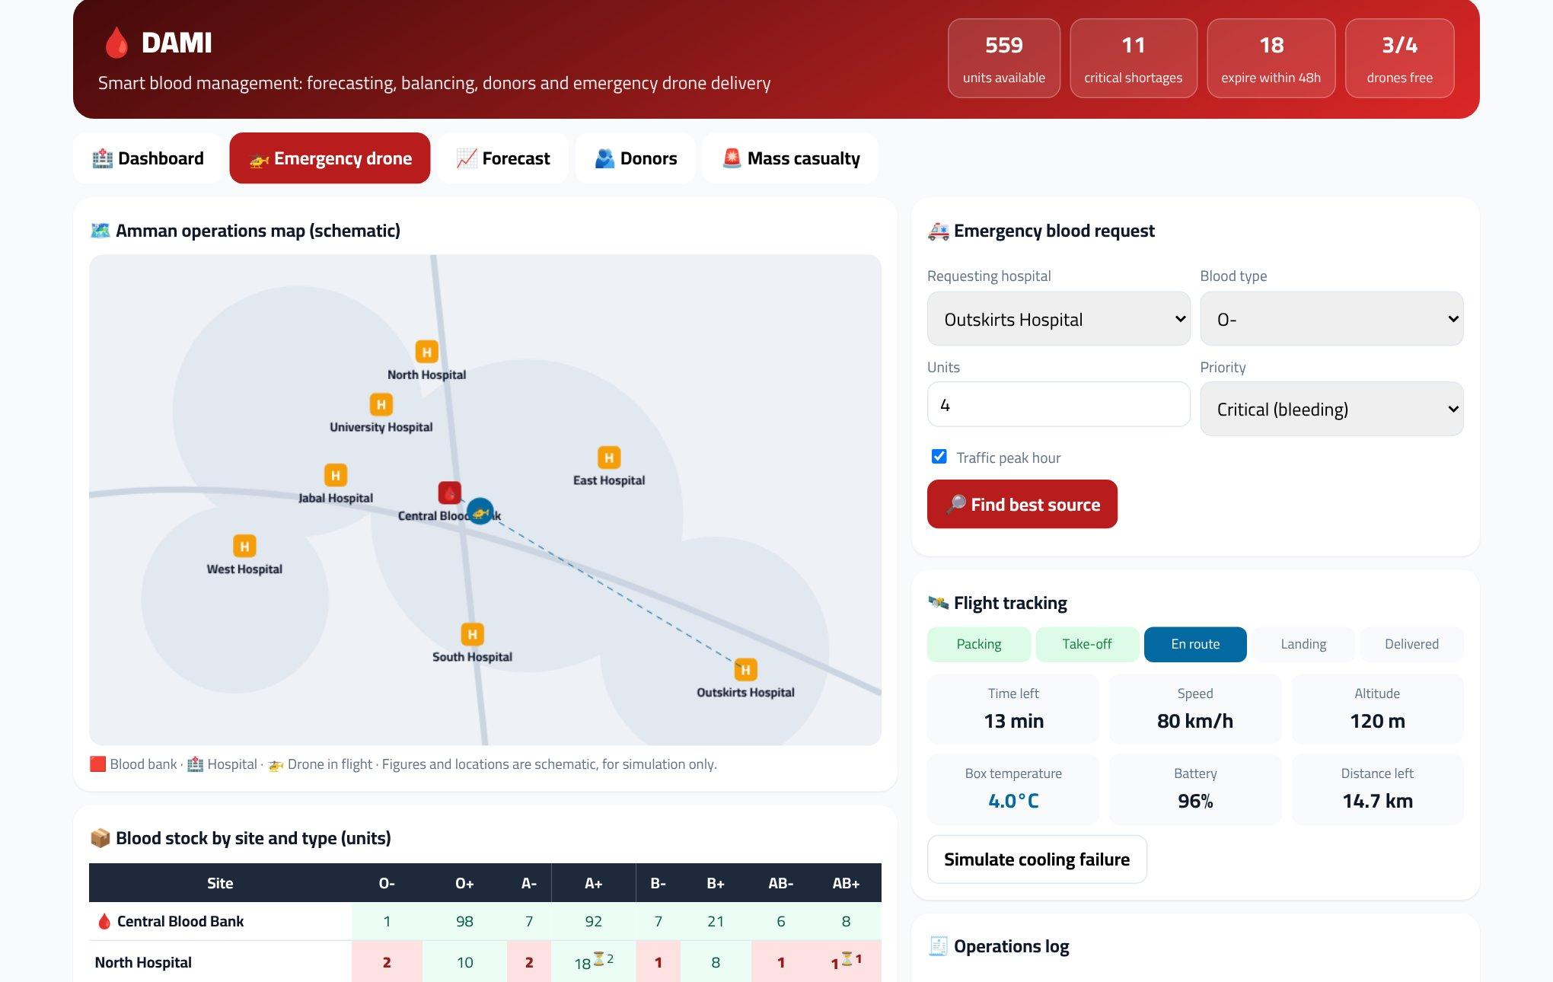
The prototype works: Emergency drone request
Best-source selection, drone vs car time comparison, then launch and tracking: temperature, battery, altitude and distance.

Slide 7
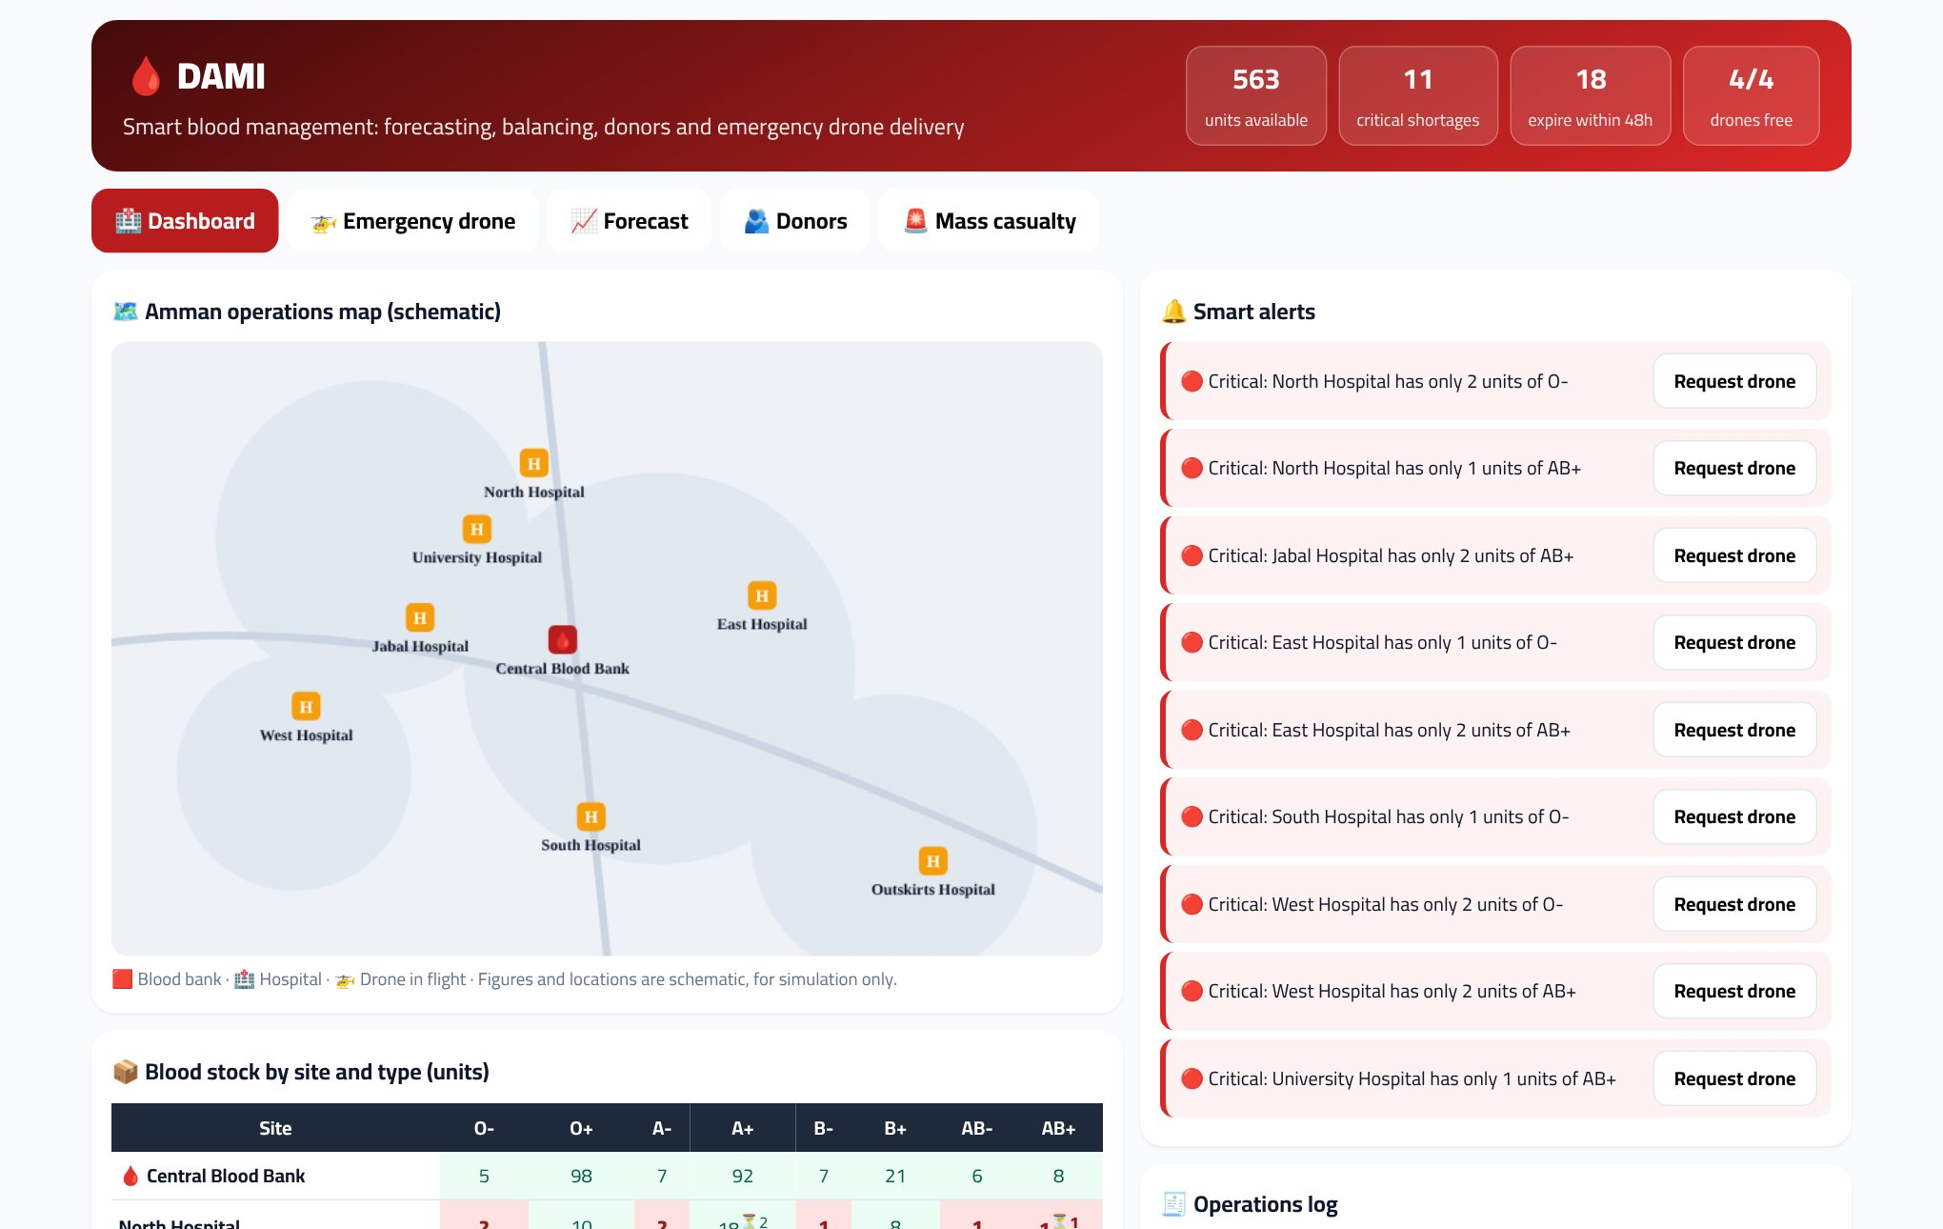
The prototype works: Dashboard
Stock of 8 blood types at the blood bank and 7 hospitals, color-coded shortage and expiry alerts, and one-tap transfer or drone request.

Slide 8
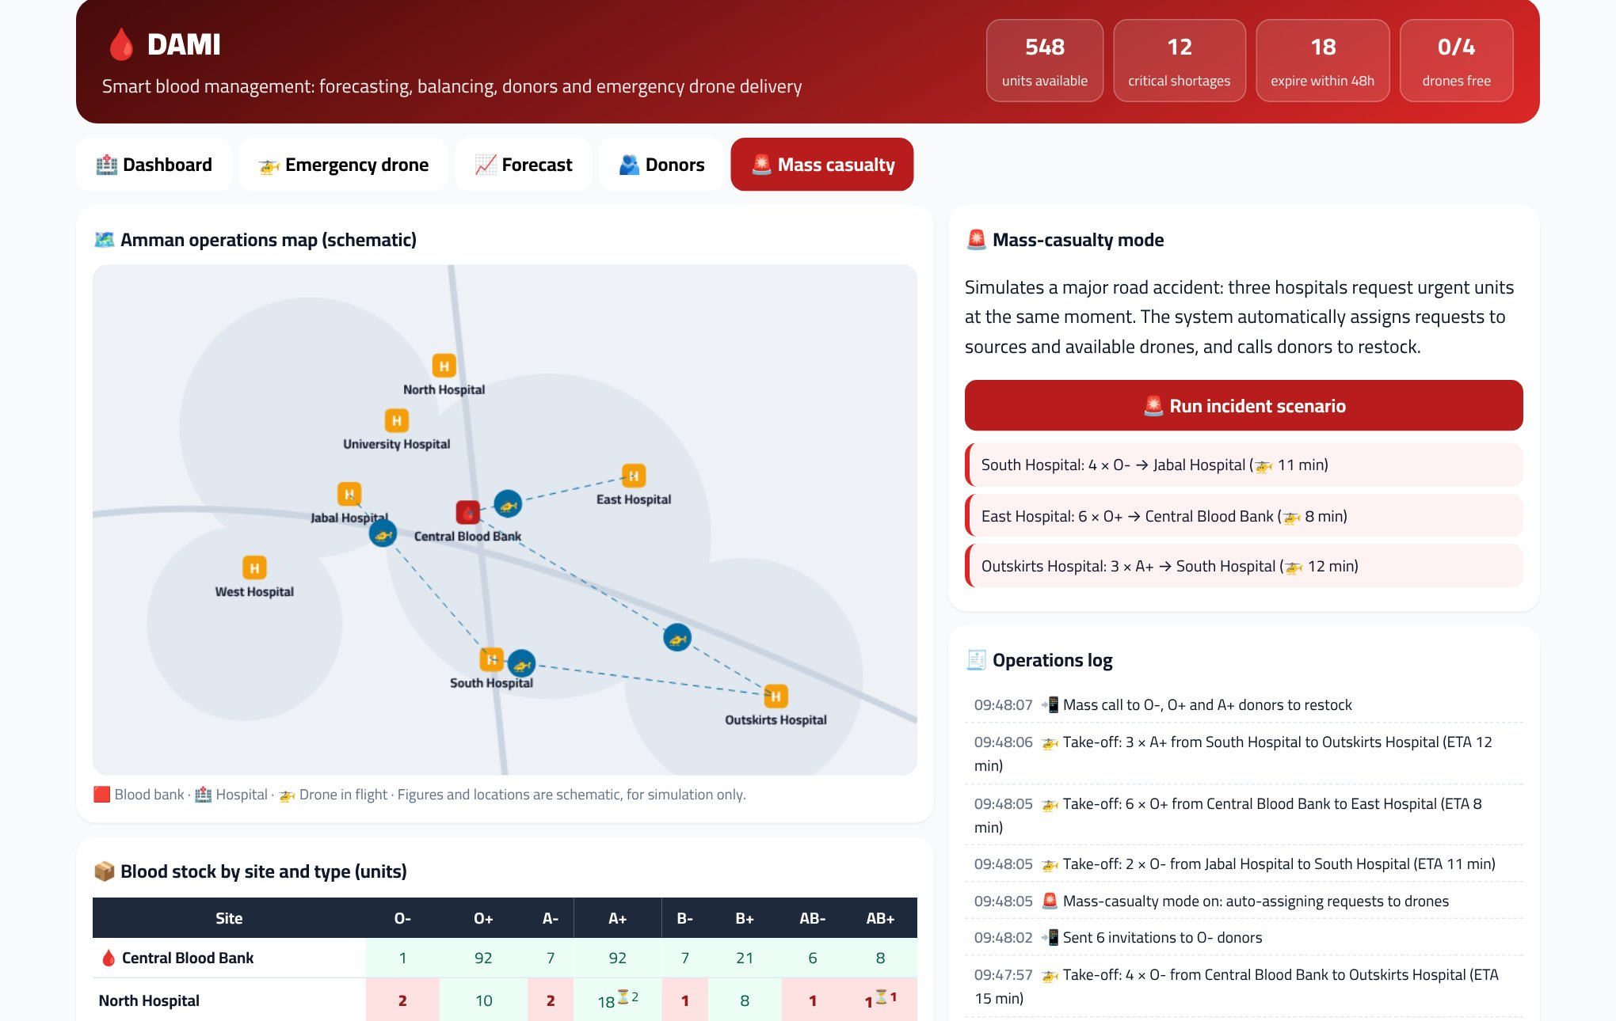
The prototype works: Mass-casualty mode
3 hospitals request blood at the same moment; the system dispatches drones automatically and calls donors.

Slide 9
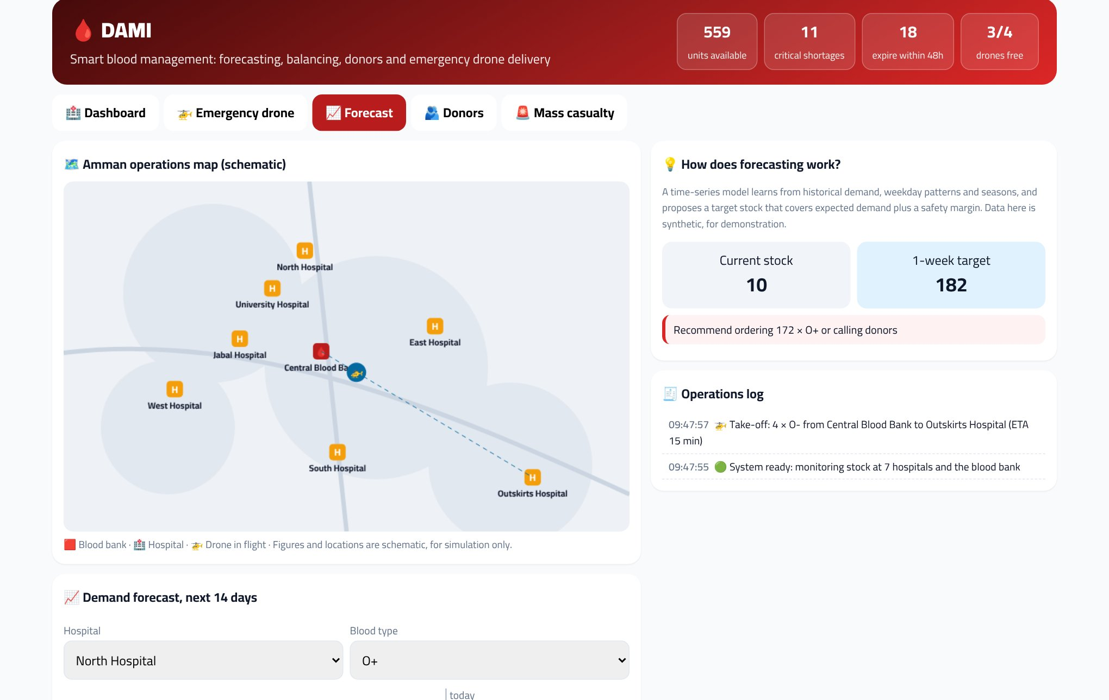
The prototype works: Demand forecast
14-day demand curve per type and hospital with a confidence band, a target stock and a call-up recommendation.

Slide 10
Market and competition
Status quo
Offers: Phone calls between blood banks, transport by car, general donation drives
Falls short: Slow in emergencies, expiry waste, no type targeting
Blood bank management systems
Offers: Stock records inside one hospital
Falls short: No forecasting, no national view, no delivery
Zipline (global)
Offers: Drone delivery in Africa and the US
Falls short: Not present in Jordan per our preliminary research; focused on delivery only
DAMI
Offers: Forecasting + balancing + donors + drone in one platform
Falls short: Built for Jordan; starts with simulation and phases into licensed operations

Slide 11
Business Model Canvas
Key Partnerships
Ministry of Health & National Blood Bank
Private and public hospitals, Royal Medical Services
Medical drone operators and manufacturers
Civil Aviation Regulatory Commission & security authorities
Jordan Red Crescent
Telecom and insurance companies, CSR sponsors
Key Activities
Building forecasting and balancing models
Running the emergency ops center and fleet
Cold-chain and quality management
Running the donor app and call-up campaigns
Building partnerships and obtaining permits
Key Resources
Software platform and AI models
Drone fleet and smart cooling boxes
Consented donor database
Tech team, licensed pilots and a blood bank expert
Permits and agreements
Value Propositions
Hospitals: emergency units in minutes instead of half an hour
Blood banks: less waste by rebalancing before expiry
Ministry: a live national dashboard and mass-casualty readiness
Donors: invited at the right time and see their impact
Patients: blood available when they need it
Customer Relationships
Annual service contract with an account manager
24/7 emergency operations center
Monthly impact reports
Donor community, rewards and badges
Channels
Direct sales to hospital management
Partnership with the Ministry of Health and the blood bank
Health conferences and exhibitions
Media campaigns and universities for donors
Mobile app and web dashboard
Customer Segments
Private hospitals (beachhead)
Ministry of Health hospitals and Royal Medical Services
National Blood Bank
Red Crescent and Civil Defense
Donors (free users)
Cost Structure
Software and AI development
Drones and cooling boxes, purchase and maintenance
Insurance, permits and compliance
Team and pilot salaries
Servers, connectivity and marketing
Revenue Streams
Annual hospital subscription: JOD 6,000
Emergency drone flight fee: JOD 90
National dashboard contract: JOD 40,000/year
Corporate sponsorship of the donor app: JOD 10,000/year

Slide 12
The numbers: how we make money
Hospital subscription: JOD 6,000 per hospital/year — volumes 3 / 10 / 20
Emergency drone delivery: JOD 90 per flight — volumes 0 / 400 / 1,500
National dashboard contract: JOD 40,000 per annual contract — volumes 0 / 0 / 1
Donor-app sponsorship: JOD 10,000 per sponsor/year — volumes 1 / 2 / 3
Initial investment: JOD 58,000
Year-3 revenue: JOD 325,000
Year-3 operating result: JOD 85,250
Year-3 gross margin: 72%
Break-even: after year 3 (base) · month 27 (optimistic)

Slide 13
Plan and risks
Phase 1 · Months 0–6: Prototype and full simulator (ready) + synthetic data + interviews with 10 blood banks and hospitals.
Phase 2 · Months 6–12: Software pilot in 3 private hospitals at a discounted subscription: forecasting, balancing and donors.
Phase 3 · Months 12–24: Pilot drone route between a blood bank and a hospital after flight permits, with paid flights.
Phase 4 · Months 24–36: National dashboard under a government contract, expanding the fleet to remote governorates and mass-casualty response.
Sensitivity of health data: Formal partnership, encryption and consent
Licensing drone flights in Jordanian airspace: Start with simulation, then a pilot route approved by the Civil Aviation Regulatory Commission and security authorities
Maintaining the cold chain: Medically certified boxes with live temperature monitoring and alarms
Slow government contracting: Start with private hospitals and corporate sponsorship

Slide 14
Team and the ask
Project Lead / AI Lead
Technical architecture, forecasting models and coordination
Data Scientist
Stock and demand data, and model evaluation
Systems Engineer / Drones & IoT
Drone, cooling box and sensor integration
App Developer
Dashboard, donor app and live demo
Business & Pitch Lead
Health and regulatory partnerships, business model and pitch
The Ask
Seed funding of about JOD 89,900 covering initial investment and the growth period; the pilot fleet (JOD 30,000) can be split out as a health grant.
A pilot partnership with a blood bank and a private hospital to connect real stock.
Support on the permit path with the Civil Aviation Regulatory Commission and security authorities.
Mentoring in the health sector and entrepreneurship.

Slide 15
Because blood that arrives late… doesn't arrive.
🩸 DAMI · Team NEXORA · Thank you

