Slide 1
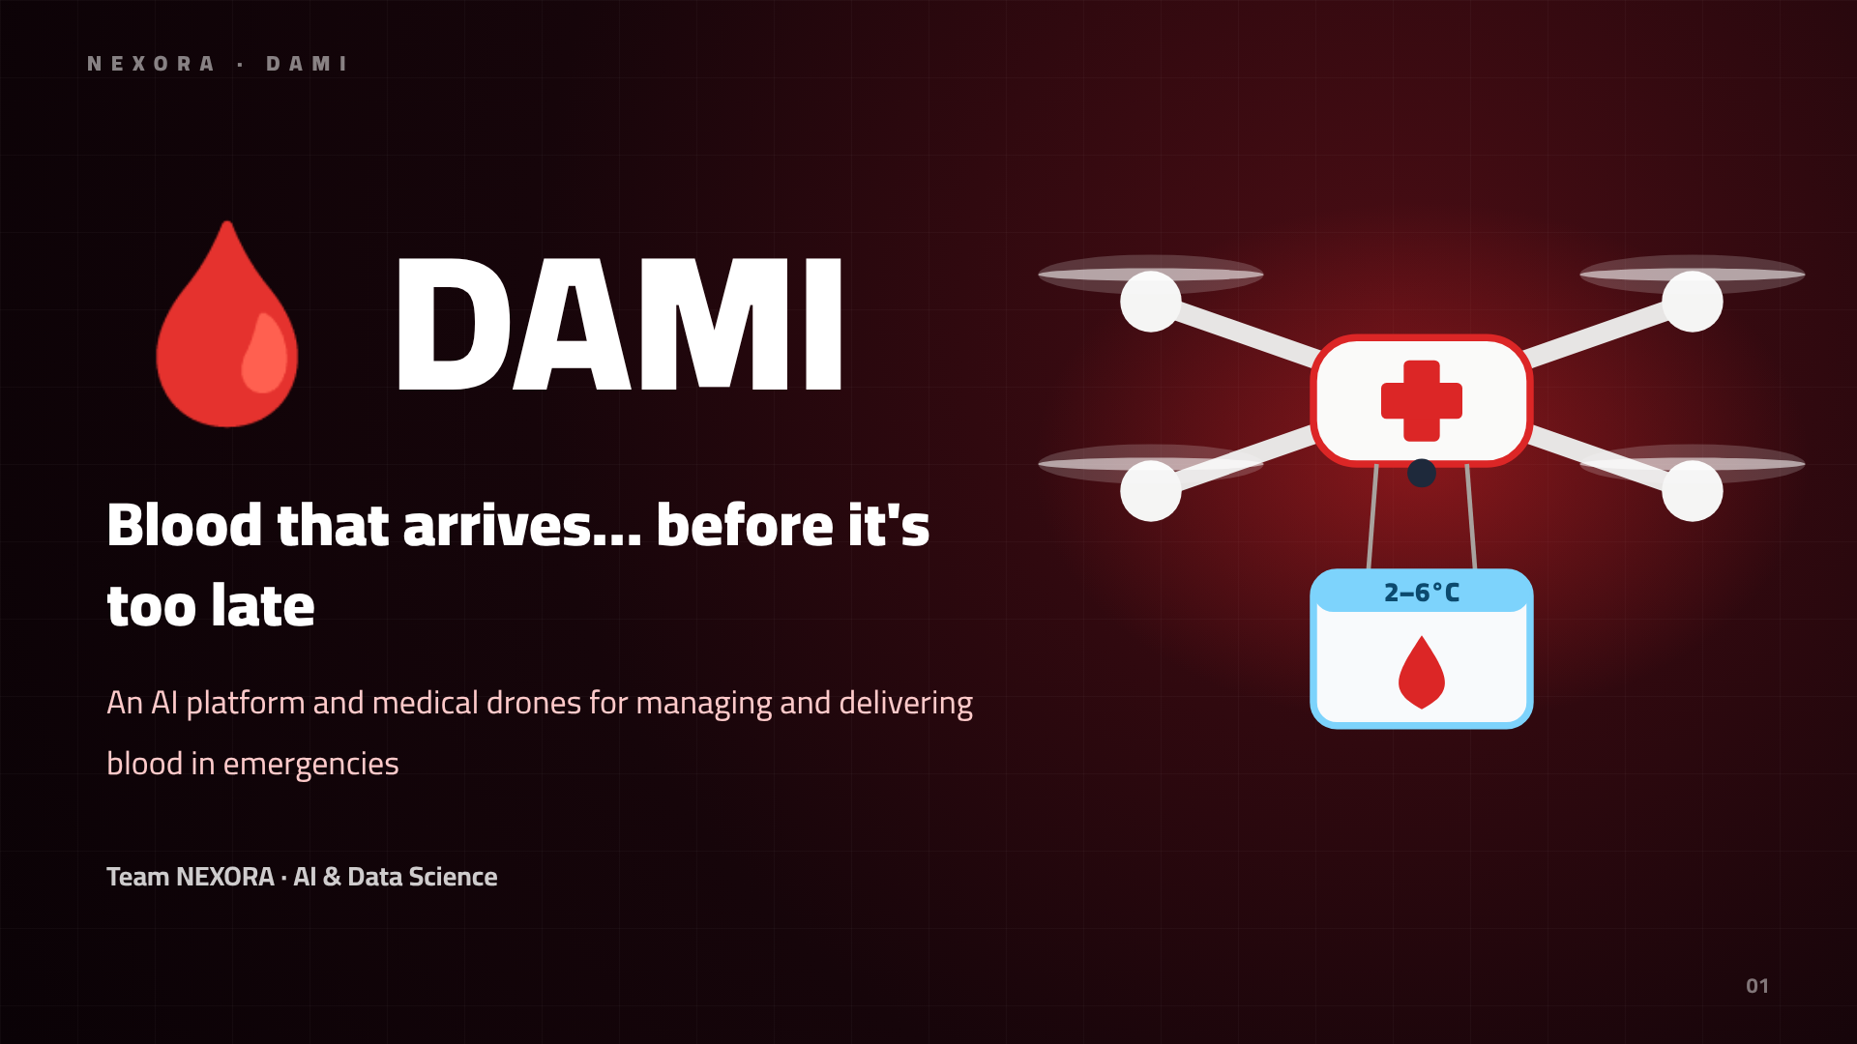
Notes:
DAMI: an AI platform and medical drones that get blood there before it's too late.

Slide 2
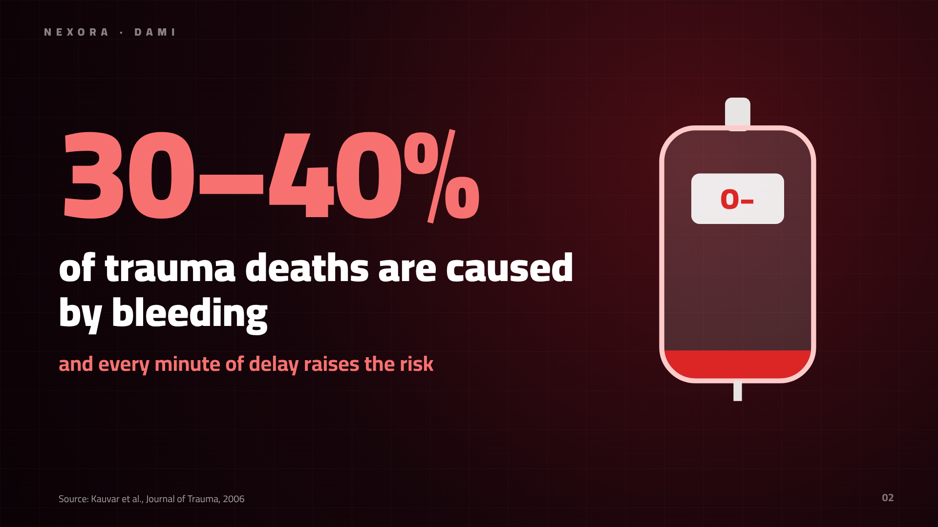
Notes:
Bleeding is a leading cause of trauma death, and every minute of delay matters.

Slide 3
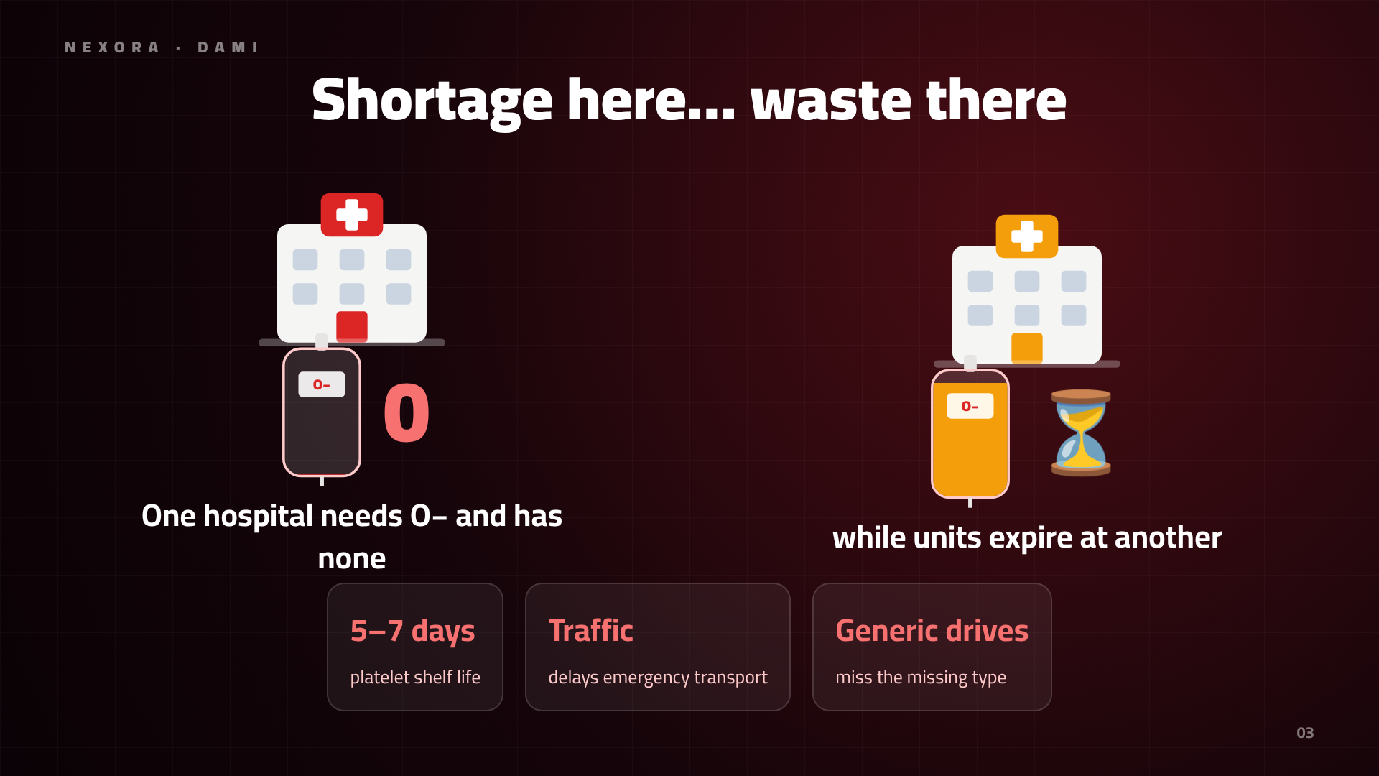
Notes:
The problem is twofold: shortage at one hospital, expiry waste at another.

Slide 4
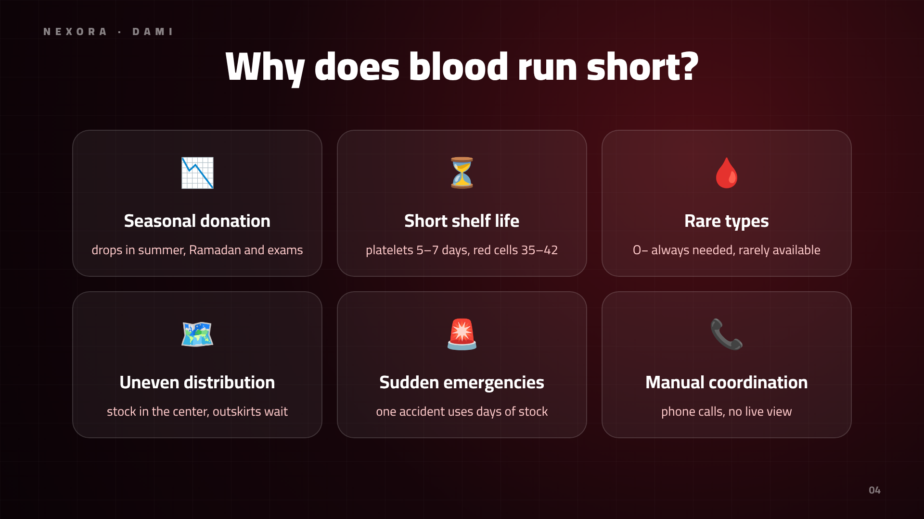
Notes:
Blood runs short for many reasons: seasonal donation, short shelf life, rare types, uneven distribution, sudden emergencies and manual coordination.

Slide 5
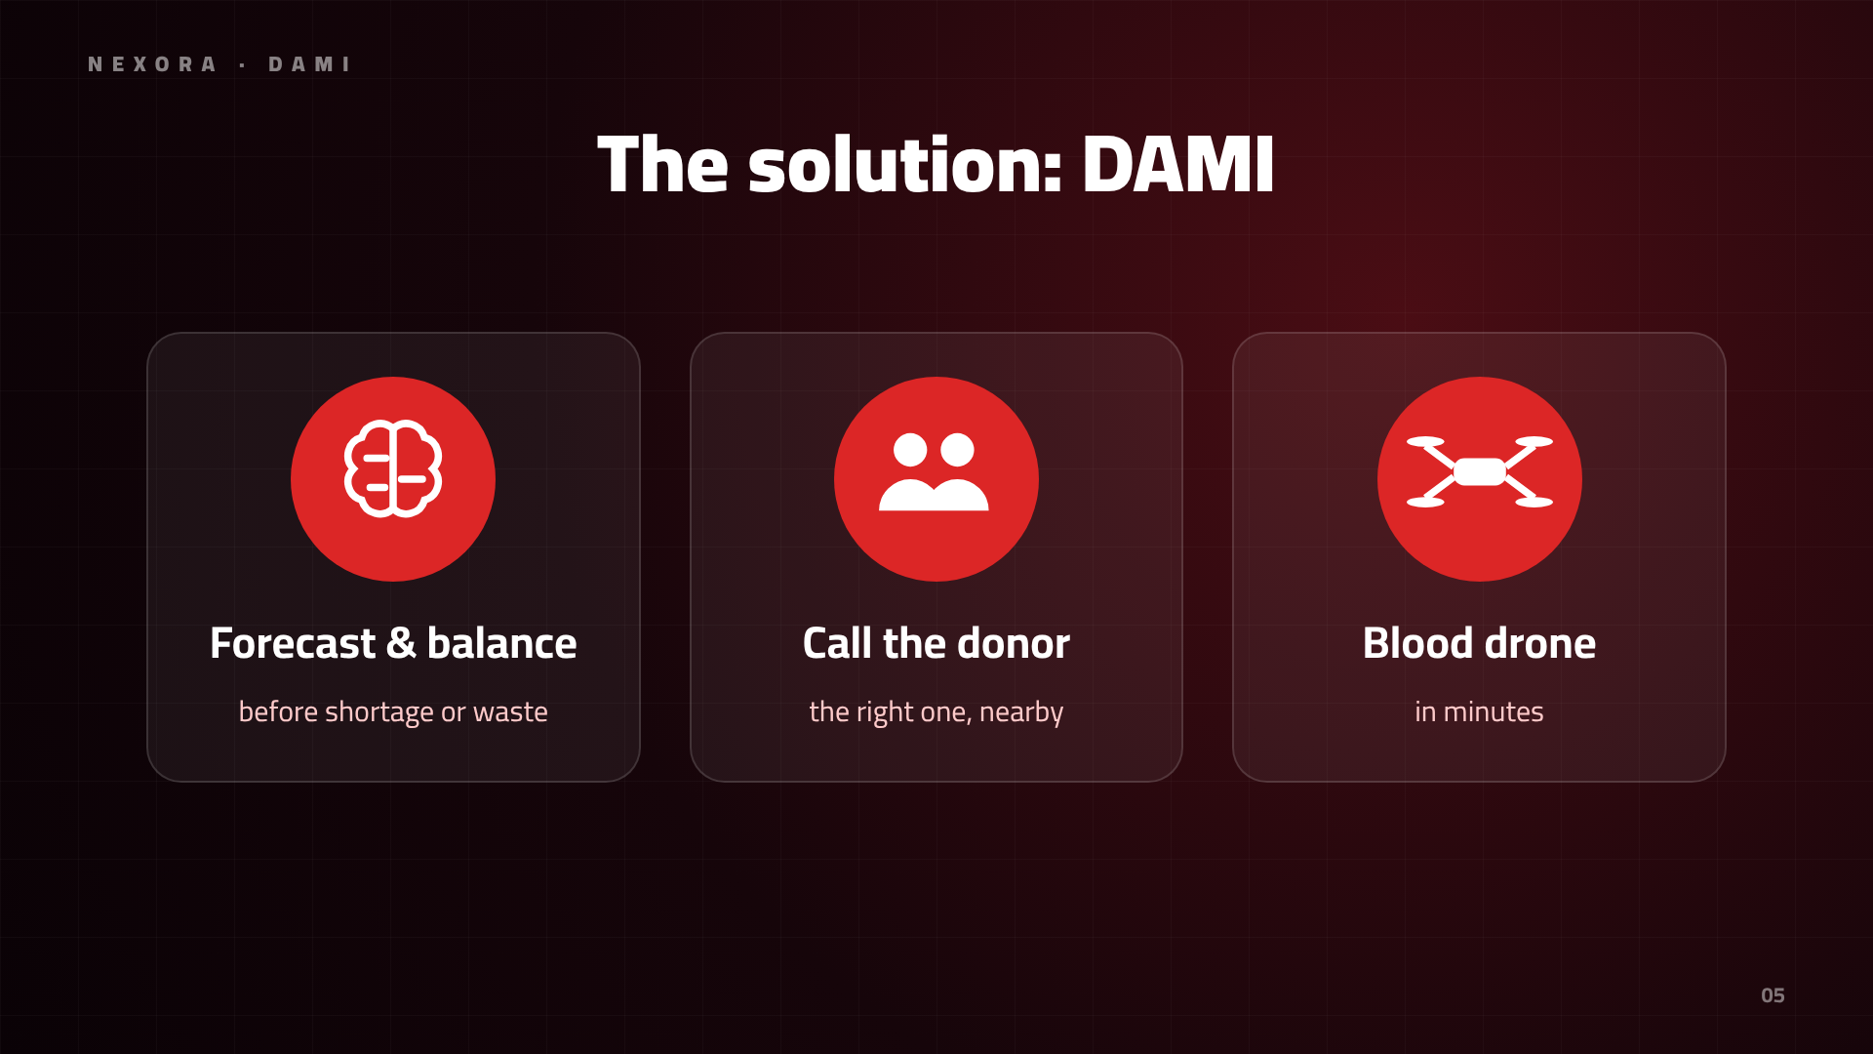
Notes:
Three layers: forecasting and balancing, donor call-up, and a blood ambulance drone.

Slide 6
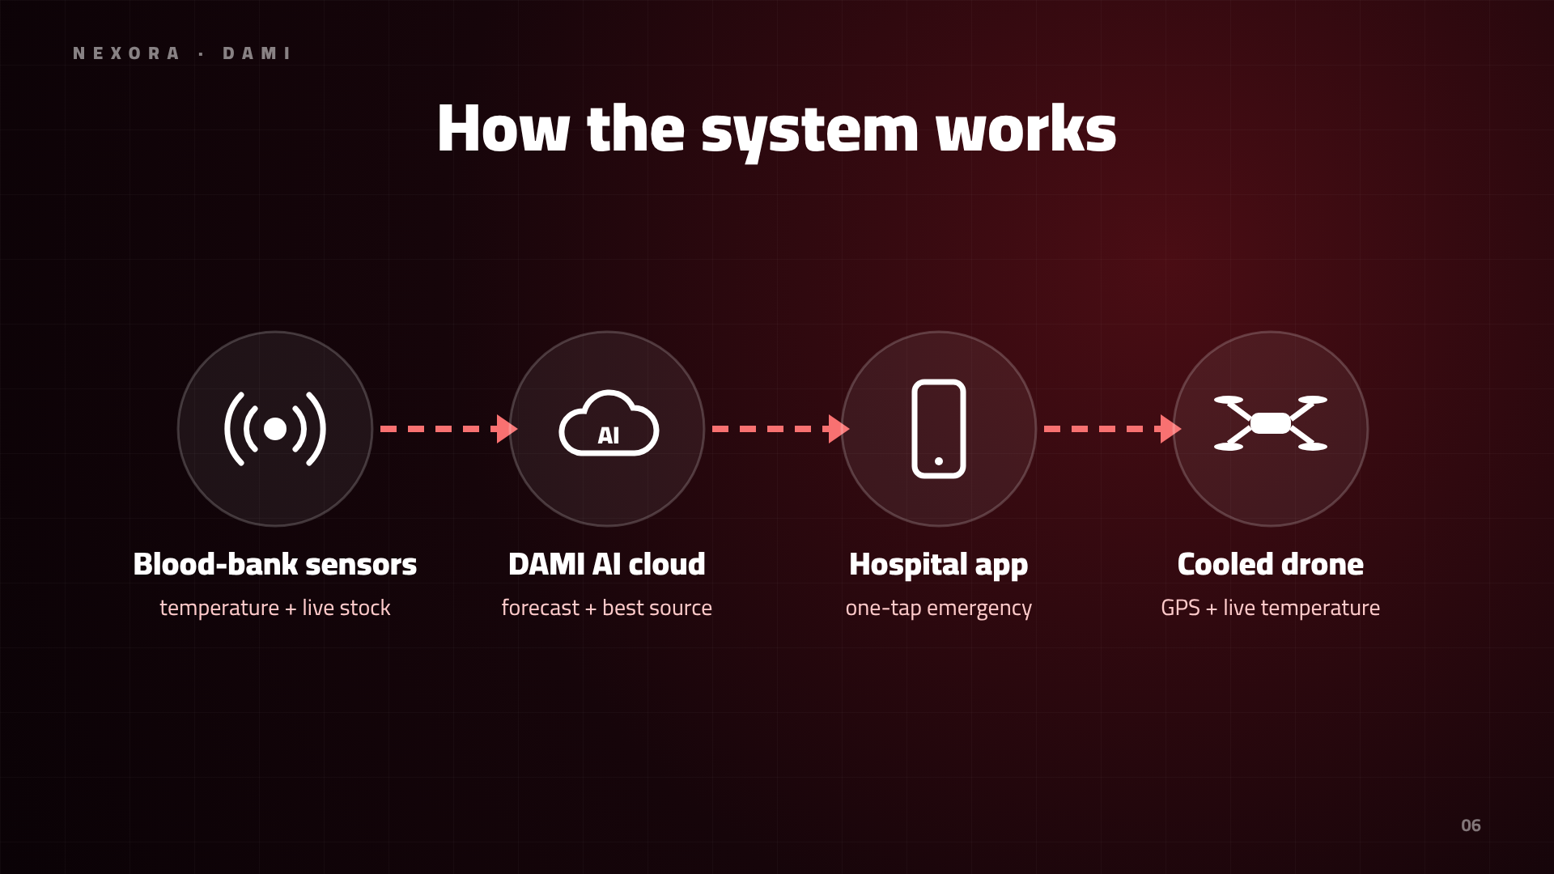
Notes:
Blood-bank sensors stream temperature and stock to the cloud; AI picks the best source; the hospital requests in one tap; the drone flies with a monitored box.

Slide 7
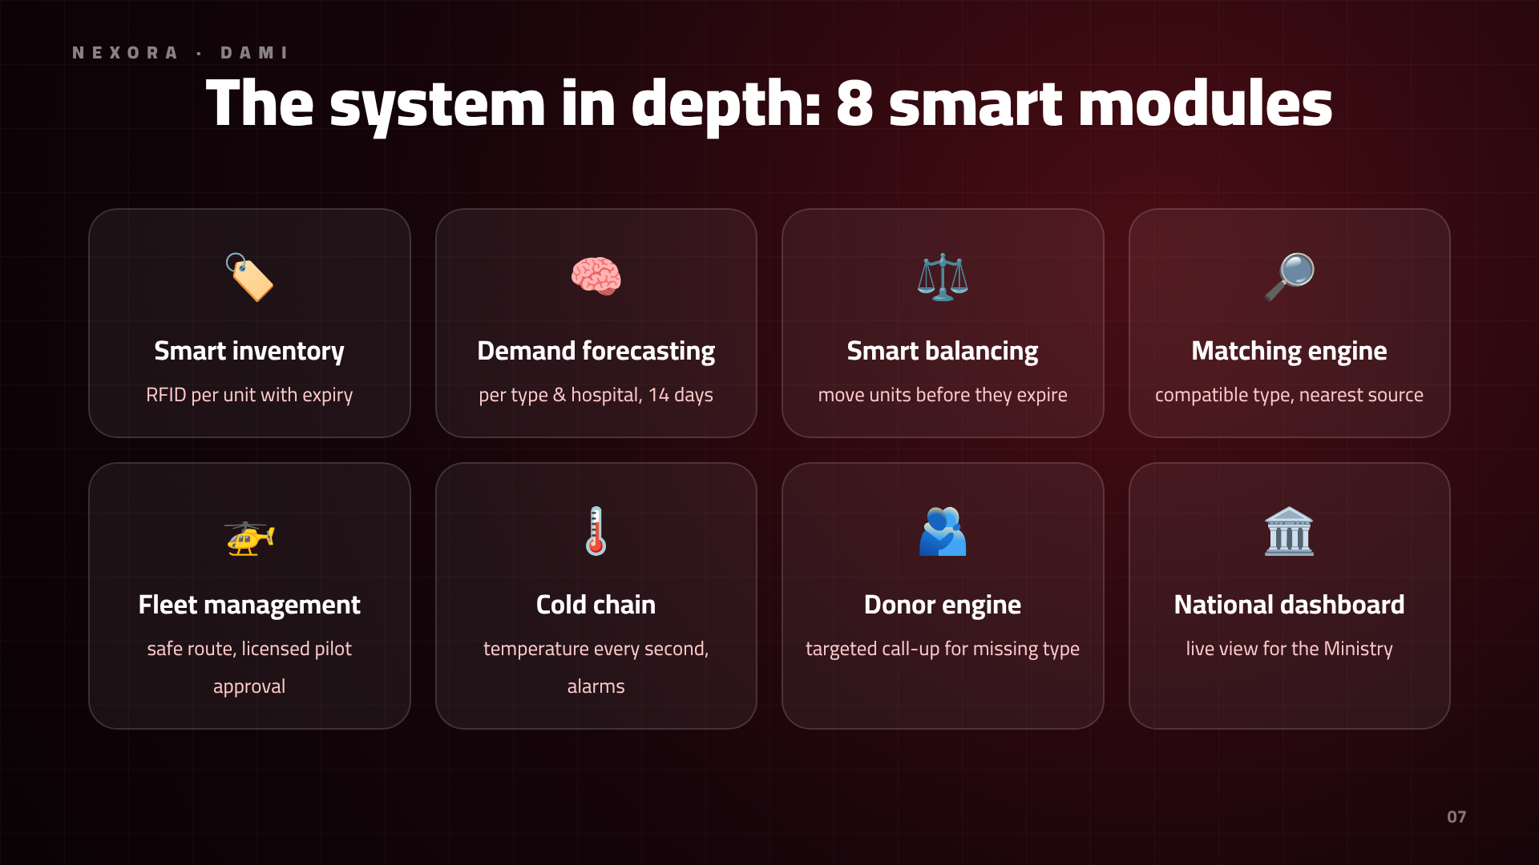
Notes:
It's not just drones: eight modules, from tracking every unit to a national dashboard for the Ministry of Health.

Slide 8
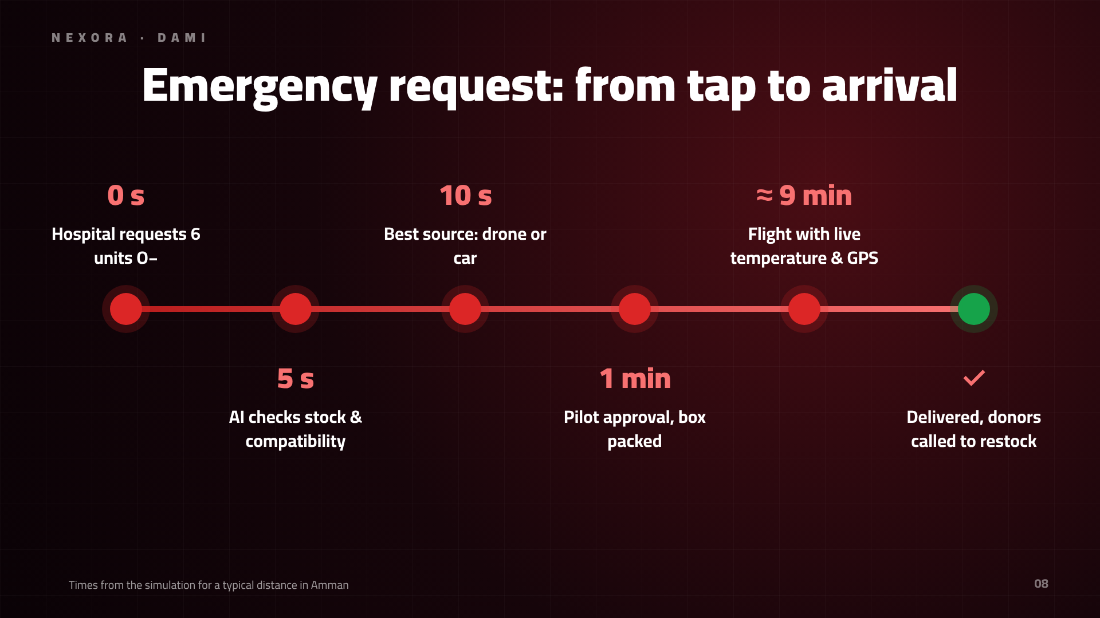
Notes:
From request to arrival: seconds to decide, minutes to deliver.

Slide 9
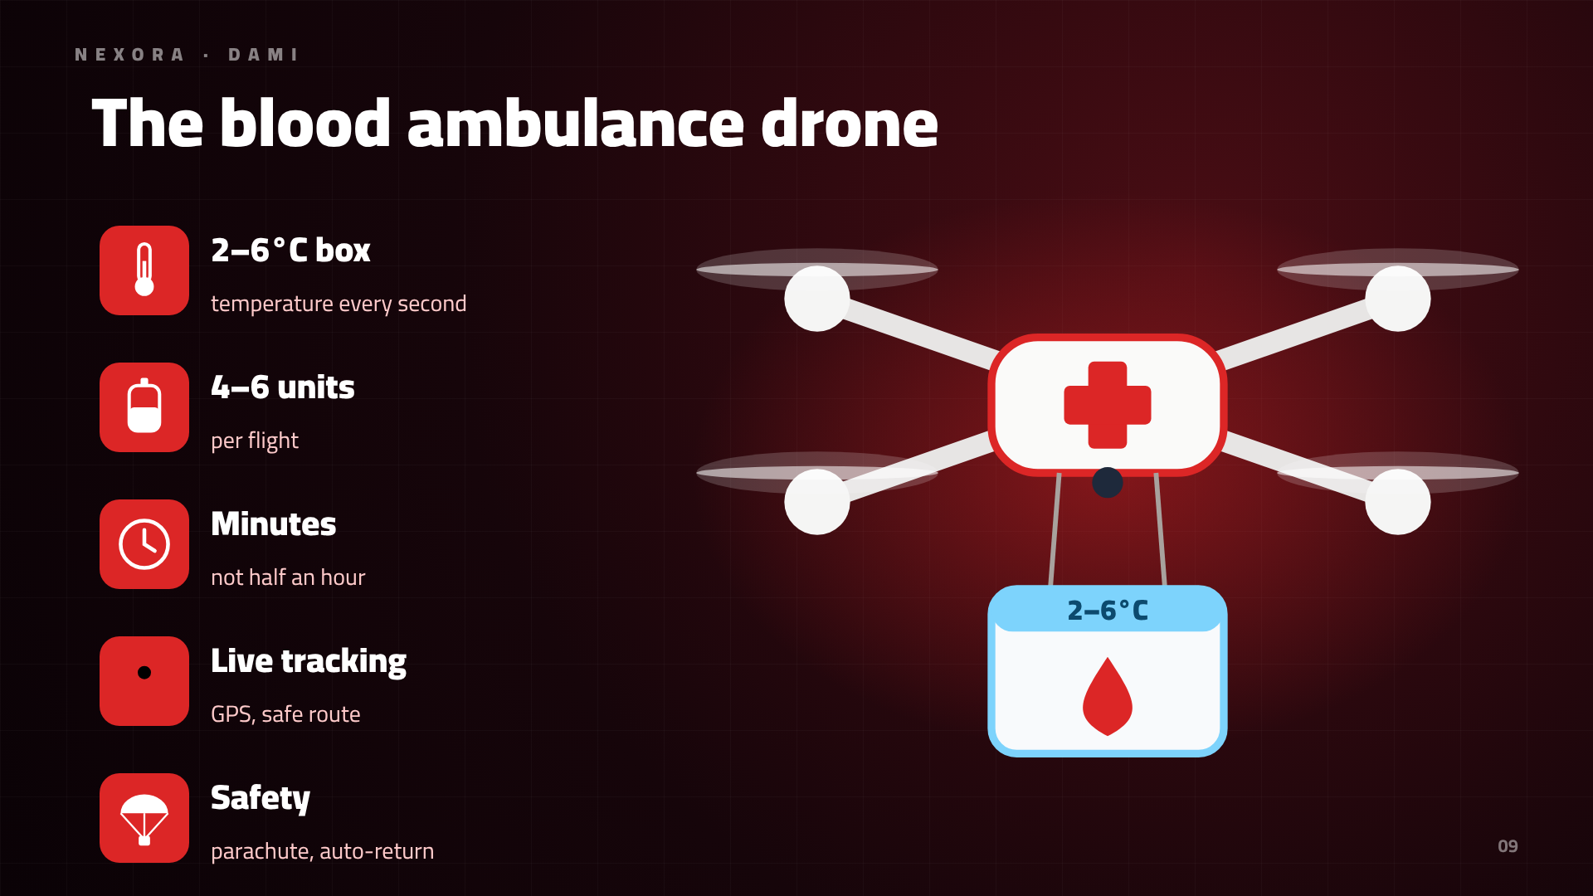
Notes:
The drone carries 4–6 units in a 2–6°C box, with live tracking and a safety parachute.

Slide 10
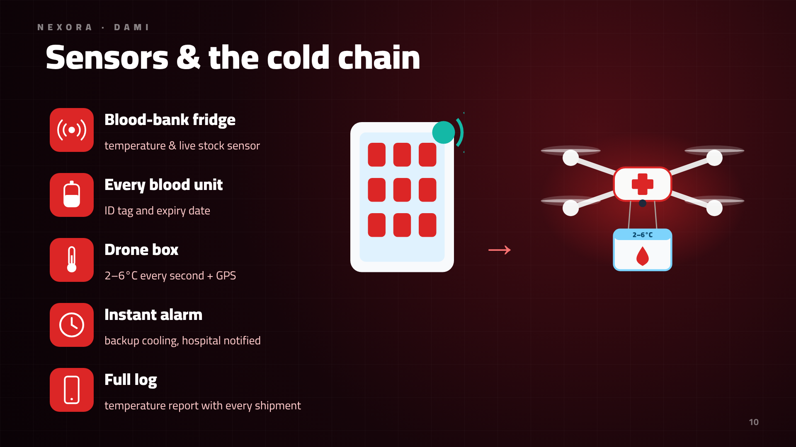
Notes:
Sensors watch temperature in the fridge and the box every second; any fault triggers an instant alarm.

Slide 11
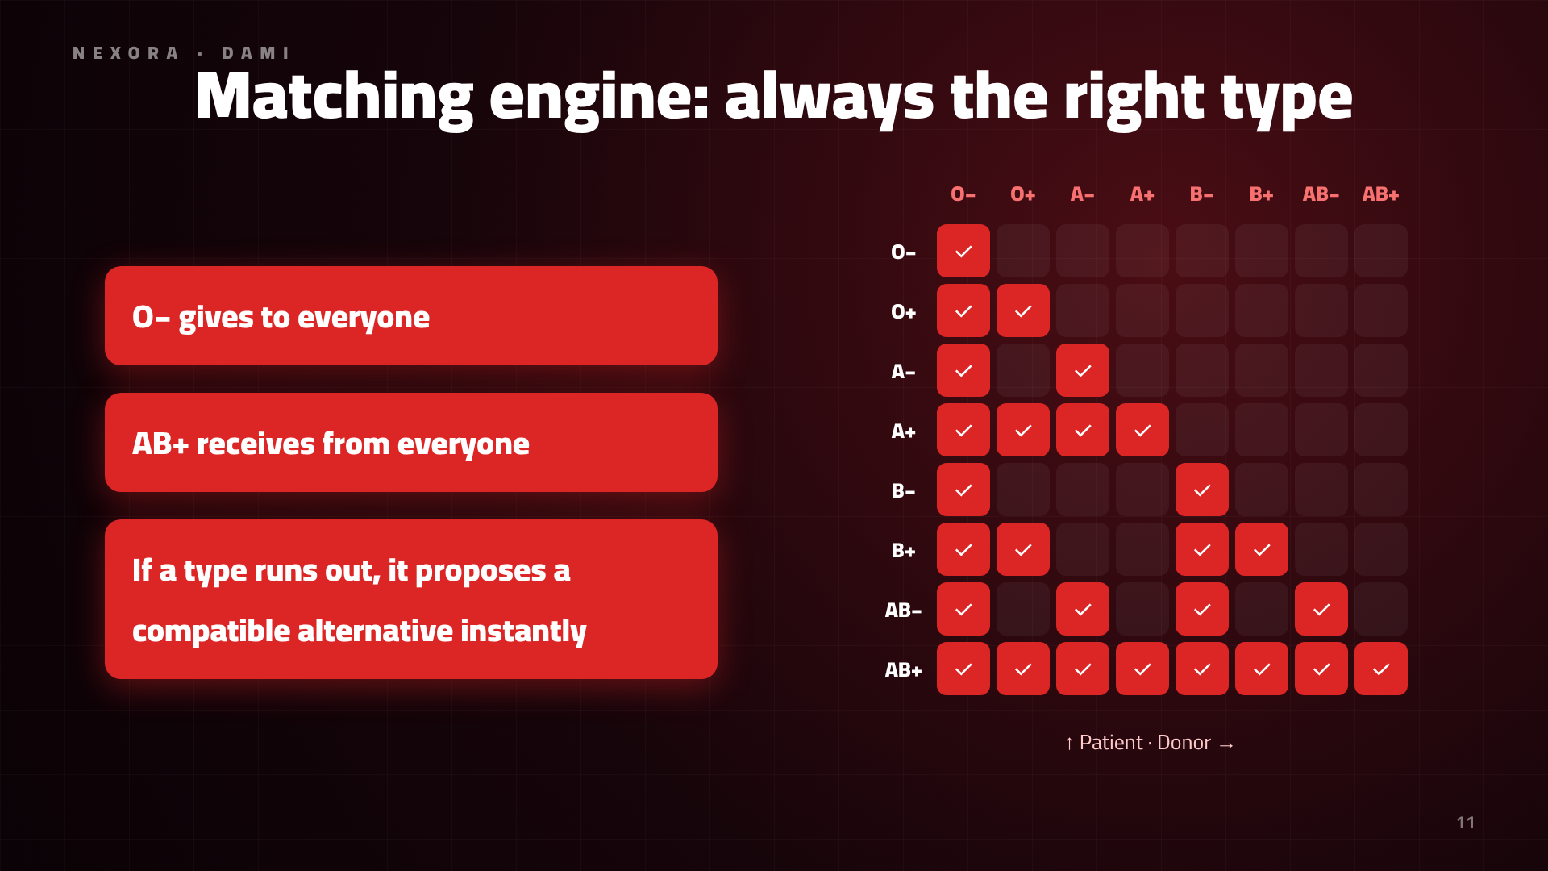
Notes:
The matching engine knows blood compatibility rules and proposes a safe alternative if a type runs out.

Slide 12
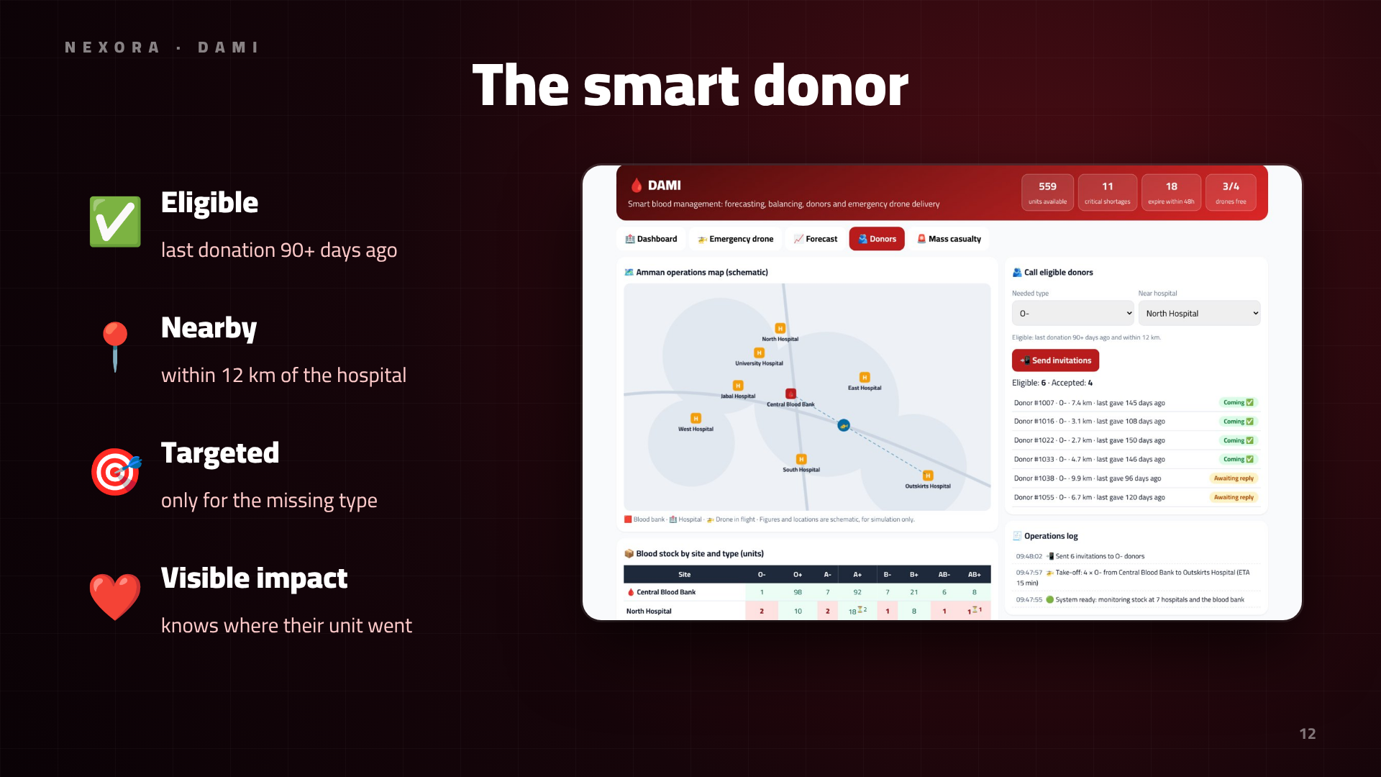
Notes:
Instead of generic drives, we call eligible nearby donors for exactly the missing type.

Slide 13
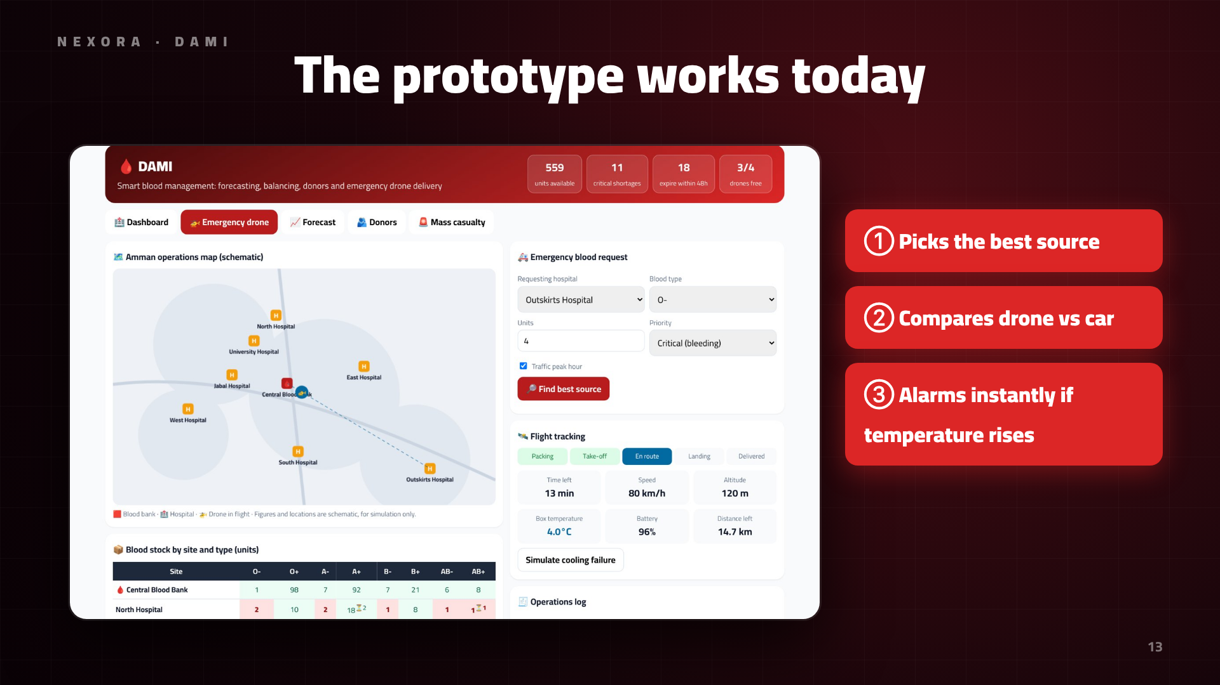
Notes:
This simulator works today: we demo it live to the judges.

Slide 14
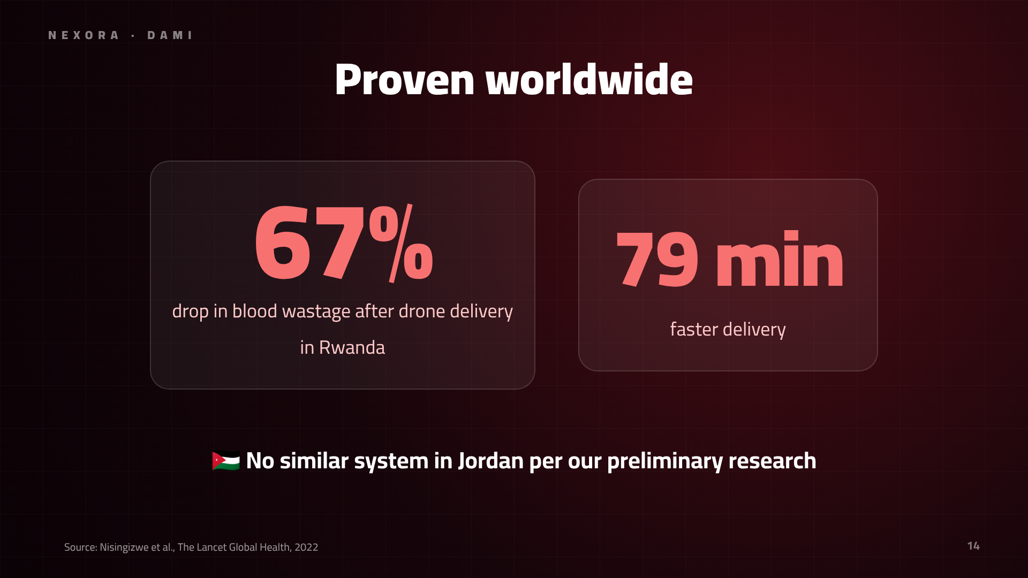
Notes:
It's proven: in Rwanda, wastage fell 67% and delivery got 79 minutes faster.

Slide 15
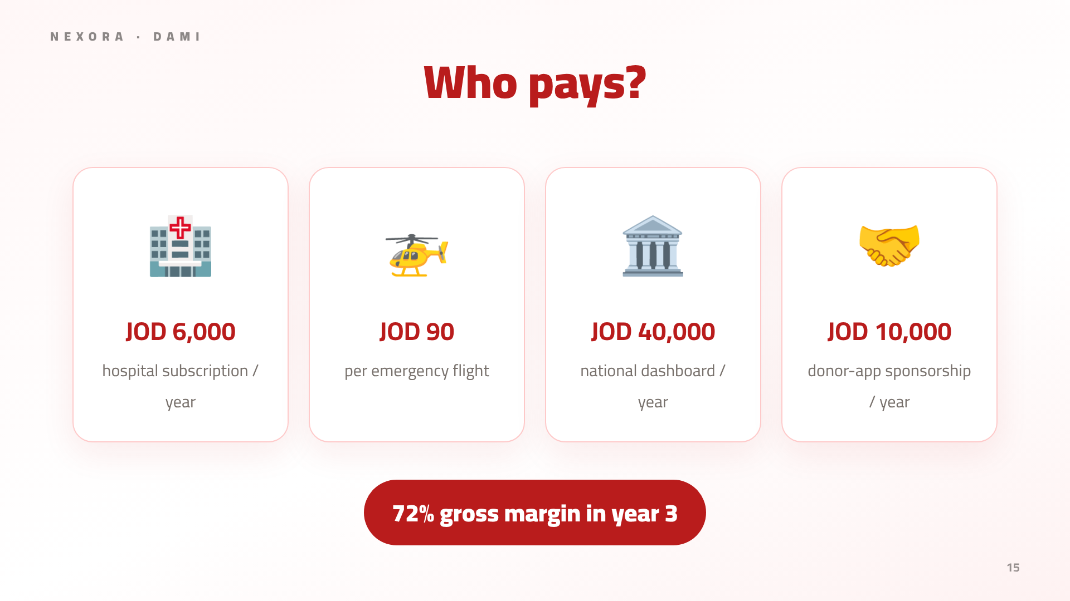
Notes:
Revenue comes from hospital subscriptions, flight fees, a national contract and sponsors.

Slide 16
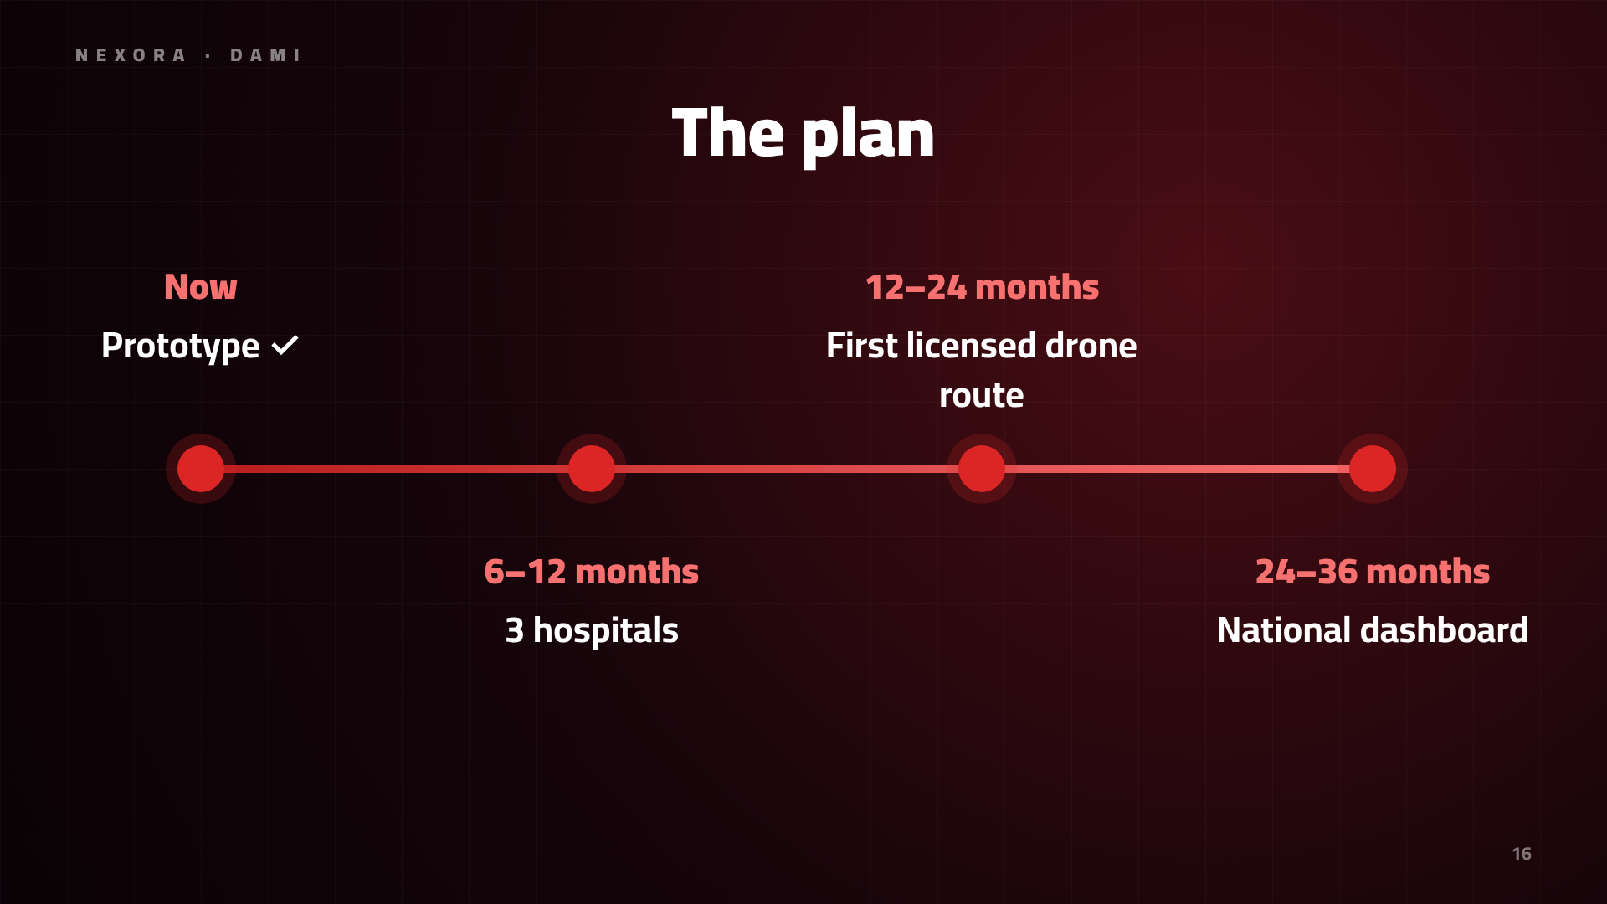
Notes:
Software first, then the first licensed drone route, then a national dashboard.

Slide 17
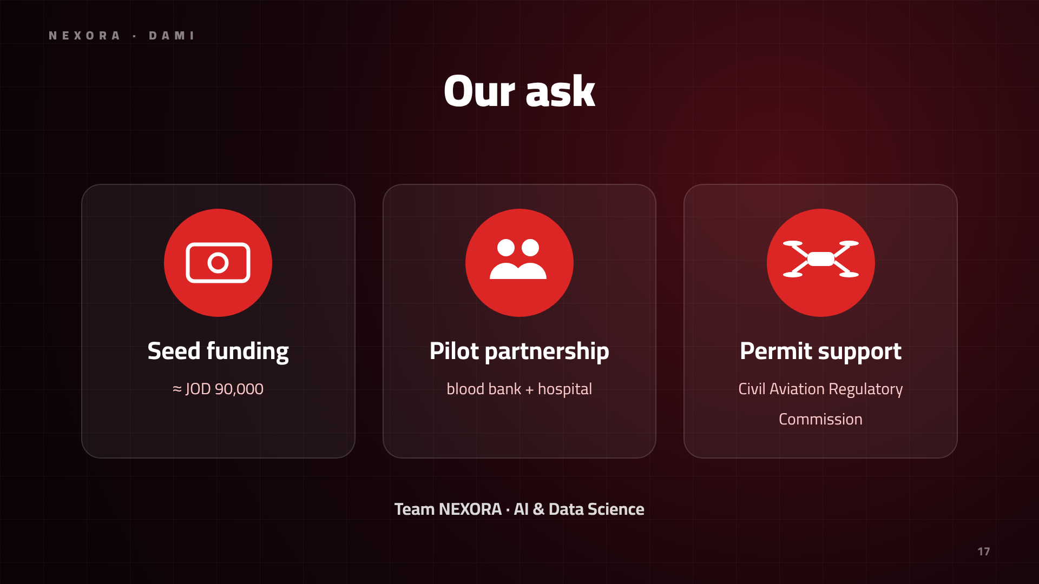
Notes:
We ask for seed funding, a pilot partnership and permit support.

Slide 18
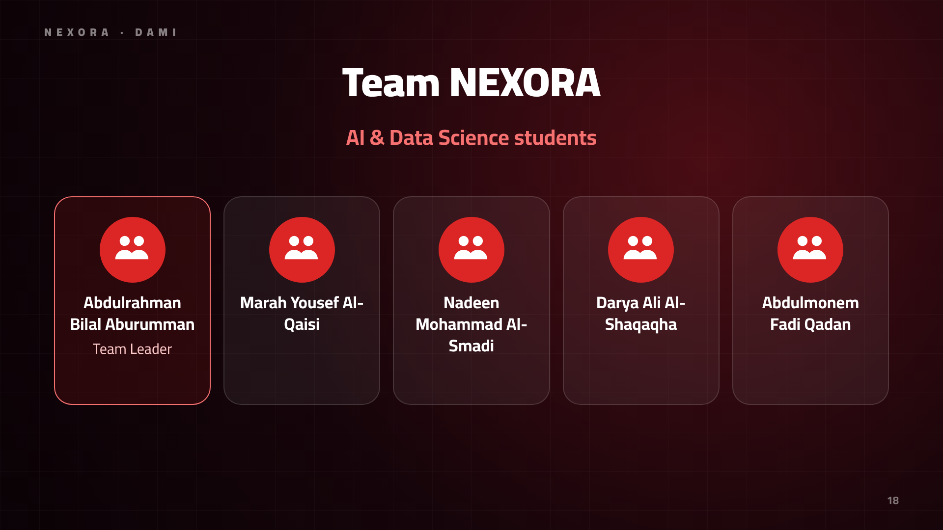
Notes:
We are team NEXORA, AI and Data Science students.

Slide 19
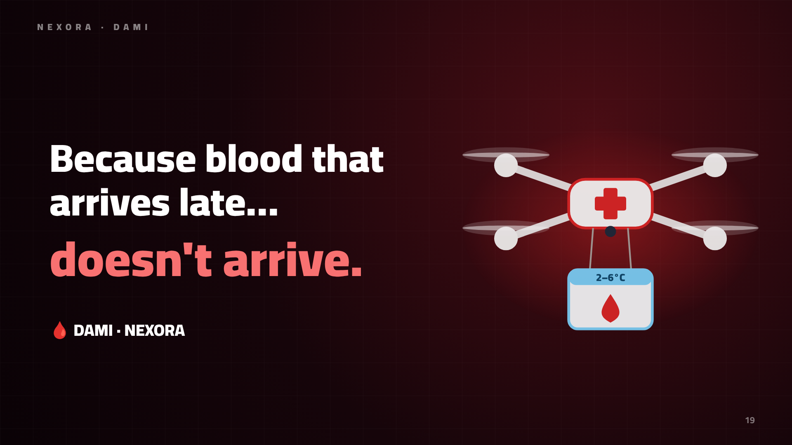
Notes:
Because blood that arrives late doesn't arrive. Thank you.

