Slide 1

INTRODUCTION TO VARIABLES: A variable is “a named space in the memory” that stores values. In other words, it acts a container for values in a program.

Slide 2
RULES FOR NAMING A VARIABLE:
1) Variable name can consist of letter and alphabets. 2) Keywords are not allowed to use as a variable name. 3) Blank spaces are not allowed in variable name. 4) First character of variable should always be alphabet and cannot be digit. 5) Variable name are case sensitive i.e. UPPER and lower case are .) significant. 6) Special characters like #, $ are not allowed except the underscore (_) and the dollar ($) sign.

Slide 3
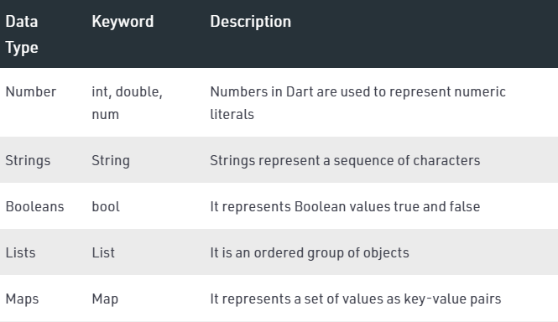
INTRODUCTION TO DATA TYPES:

Slide 4
NUMBERS (INT, DOUBLE, NUM): int age = 18; double temperature = 16.5; num age = 19; num temperature = 18.5;

Slide 5
Strings (Represents a sequence of character): String name = “ALI”; String name = “Street No 123 abc karachi ”; String date = “28-March-2021”; String email = “bilalrehman080808@gmail.com”

Slide 6
Booleans (true, false) bool status = true; OR bool status = false; bool calculation; calculation = 12>5; print(calculation);

Slide 7
OPERATORS: 1) Arithmetic Operators 2) Equality and Relational Operators 3) Logical Operators

Slide 8
ARITHMETIC OPERATORS:
Sr.No | Operators & Meaning
1 | +Add
2 | −Subtract
3 | *Multiply
4 | /Divide
5 | ~/Divide, returning an integer result
6 | %Get the remainder of an integer division (modulo)
7 | ++Increment
8 | --Decrement

Slide 9
EQUALITY & RELATIONAL OPERATORS:
Operator | Description | Example
> | Greater than | (A > B) is False
< | Lesser than | (A < B) is True
>= | Greater than or equal to | (A >= B) is False
<= | Lesser than or equal to | (A <= B) is True
== | Equality | (A==B) is False
!= | Not equal | (A!=B) is True

Slide 10
LOGICAL OPERATORS:
Operator | Description | Example
&& | And − The operator returns true only if all the expressions specified return true | (A > 10 && B > 10) is False.
|| | OR − The operator returns true if at least one of the expressions specified return true | (A > 10 || B > 10) is True.
! | NOT − The operator returns the inverse of the expression’s result. For E.g.: !(7>5) returns false | !(A > 10) is True.

Slide 11
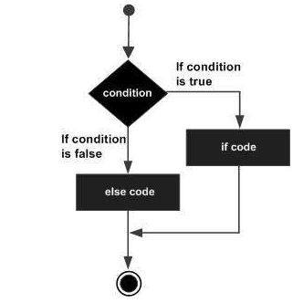
CONDITIONAL STATEMENTS (IF, ELSE): If statement allows a block of code to be executed only when a specified condition is true. An if statement evaluates a Boolean expression followed by one or more statements. The given Boolean expression results in a Boolean value that can only be either true or false.

Slide 12
SYNTAX (IF, ELSE)
if(condition1) { // statement(s) } else if(condition2){ // statement(s) } . . else if(conditionN){ // statement(s) } else { // statement(s) } OUTPUT: A and b are equal

Slide 13
EXAMPLE #1 (IF, ELSE):
var a = 10;
var b = 10;
if(a > b){
print("a is greater than b");
}
else if(a == b){
print("a and b are equal");
}
else {
print("b is greater than a");
}
OUTPUT:
A and b are equal

Slide 14
EXAMPLE #2 (IF, ELSE): var marks = 74; if(marks > 85) { print("Excellent"); } else if(marks>75) { print("Very Good"); } else if(marks>65) { print("Good"); } else { print("Average"); } OUTPUT: Good

Slide 15
Lists List is similar to an array, which is the ordered collection of the objects. The array is the most popular and commonly used collection in any other programming language. Syntax: var list1 = [10, 15, 20,25,25] list is defined by storing all elements inside the square bracket ([]) and separated by commas (,).

Slide 16
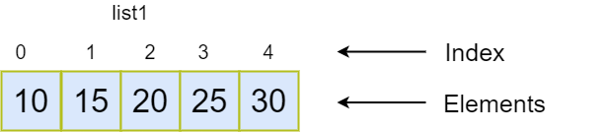
Graphical Representation:
List1:
It is the list variable that refers to the list object.
Index:
Each element has its index number that tells the element position in the list. The index number is used to access the particular element from the list, such as list name[index]. The list indexing starts from 0 to length-1 where length denotes the numbers of the element present in the list.
For example:
The length of the above list is 5.
Elements:
The List elements refers to the actual value stored in the given list.

