Slide 2
Narrowing
In TypeScript, narrowing is the process of refining the type of a variable or expression based on additional information that is available to the compiler at a certain point in the program. This can be done using various constructs such as type guards, type assertions, and control flow analysis.
Type guards are functions or expressions that return a boolean value, which is used by the TypeScript compiler to narrow the type of a variable. For example, the typeof operator can be used as a type guard to narrow the type of a variable based on its type at runtime

Slide 3
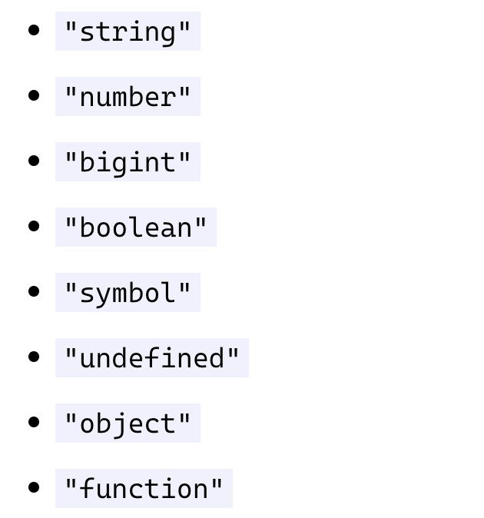
Narrowing types options

Slide 4
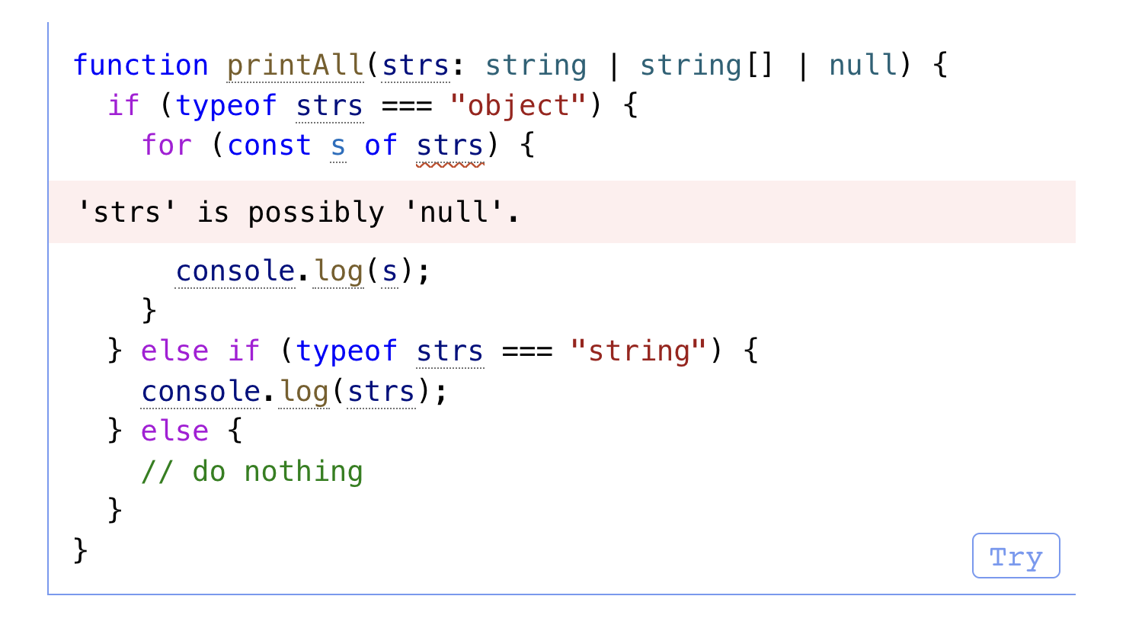
Wait what with null and undefiend

